Slide 1

Concept “Safety: haven”
Jesper, Asher, joey, Thomas, ramon

Slide 2
indeling
Het idee
Concept
Style
Taakverdeling

Slide 3
Het idee
Safe haven
Objecten
Raadsels
asylum

Slide 4
COncept
Fpsshap Game
Slums
7 gebieden
Malcolm
city

Slide 5
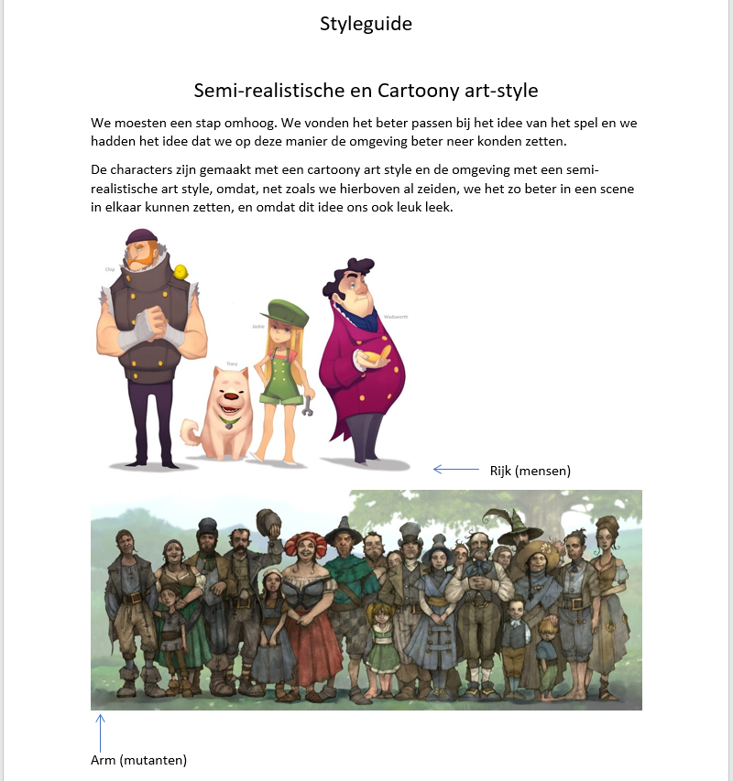
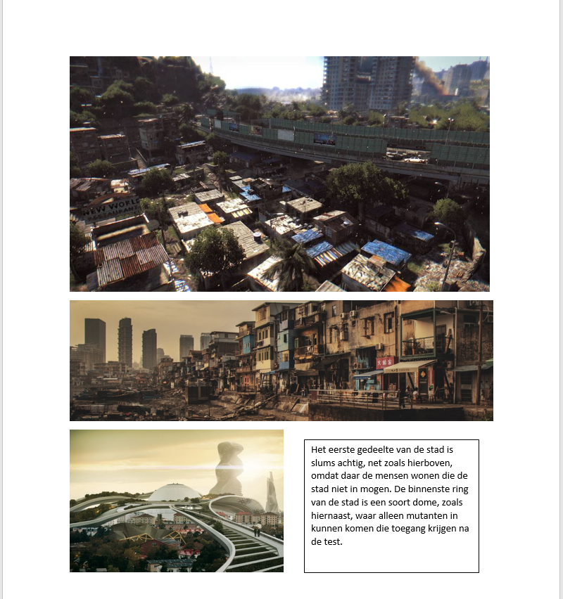
style

Slide 6
taakverdeling
Producer: jesper
Lead Art: Ramon
Lead dev: asher
Level design: joey
2d artist: Thomas
Artist: jesper, ramon, joey, Thomas
Dev: Asher, joey, Jesper

Slide 7
Fuck you! that’s it

