Slide 1
Global Registry of Fossil Fuels
Technical Briefing to EU, June 21, 2021

Slide 2
The Registry’s technical offering for launch
Data
Full country level reserves, historic and future production estimates
Project-level: 20-25,000 projects, covering 55% global fossil fuels
Processed (June 2021): 7,000 assets, 350,000 records.
Insight
Decline Curve Analysis
Carbon Pricing
Cost Curve Analysis
Relative Carbon Intensity
Geospatial
“Slice and Dice”
Downloadable comparable data
Downloadable carbon models
API: real-time feed into public or private platforms
Honest Broker
Public service
Open source

Slide 3
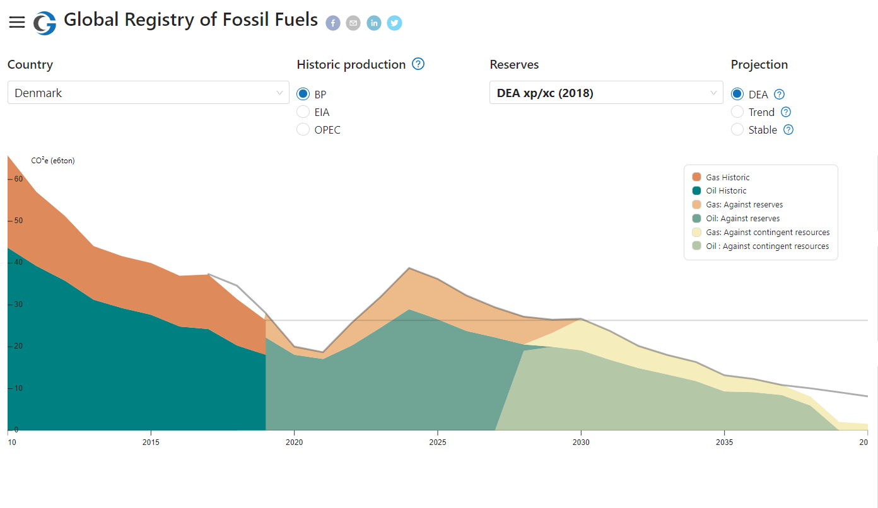
General Demo: Country Level Information

Slide 4
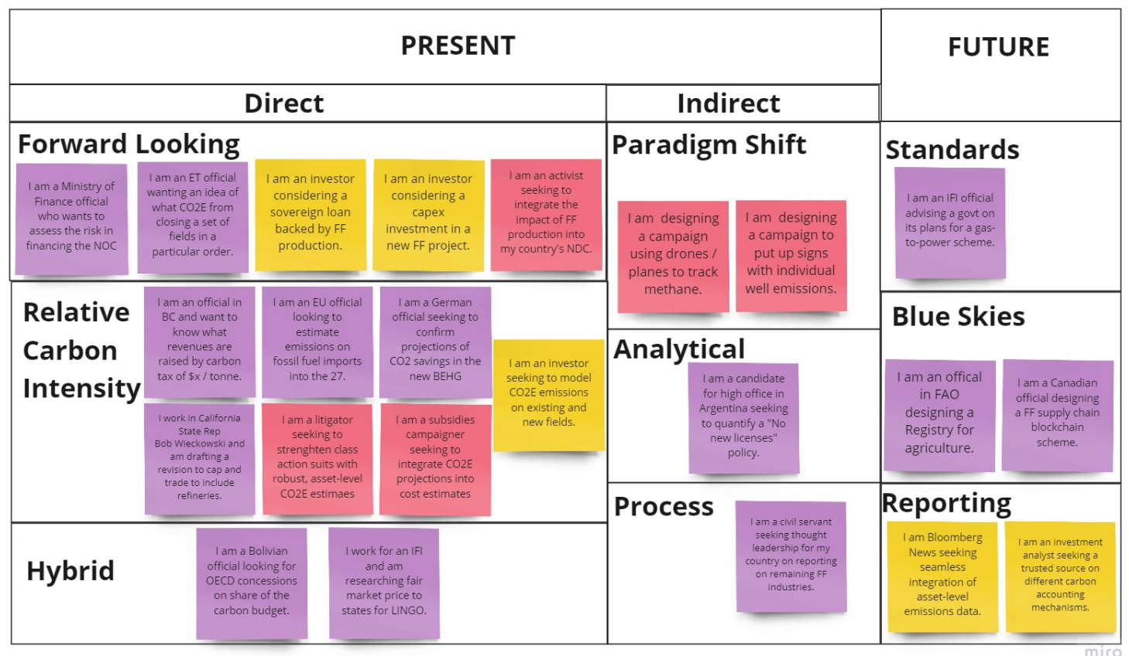

Slide 5
Which Policy World Are We In?
Business As Usual
2021
Low carbon price and coverage
Low measurement
Pressure largely moral
Carbon Price $50 per tonne CO2E in most markets
2023-5
Global Alignment
????
Social Cost of Carbon everywhere
Trading blocks aligned on decline
Legal force

Slide 6


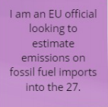


Map Use Cases against the “Three Worlds”
Global Alignment
Registry
Launch
Registry
Max
2021 BAU

Slide 7
CI: whose emissions methodology? Part 1

Slide 8
CI: whose emissions methodology? Part 2

Slide 9
How material are these different estimates?
Woodmac-Opgee Emissions / Carbon Price Divergence
 | Mln Tons CO2E | $50/ton Carbon ($bln)
USA | 235 | 11.76
Saudi Arabia | 38 | 1.88
Brazil | 39 | 1.95
Russia | 136 | 6.81
Mexico | 22 | 1.09
Colombia | 2 | 0.09
Canada | 117 | 5.86
Nigeria | 10 | 0.50
Iraq | 34 | 1.71
Venezuela | 17 | 0.83
Total | 650 | 32.49

Slide 10
Carbon Intensity of Crude Oil Imports to EU
Emissions (e6tonsco2e) | Low | High | Opgee-Mid | Volume (e6bbls) | Price (bln)
Russian Federation | 398 | 641 | 489 | 970 | 24.45
Norway | 162 | 262 | 193 | 396 | 9.66
Iraq | 137 | 220 | 168 | 334 | 8.41
Nigeria | 127 | 204 | 153 | 309 | 7.66
Kazakhstan | 120 | 193 | 140 | 292 | 7.00
Saudi Arabia | 118 | 190 | 129 | 288 | 6.47
United States | 118 | 190 | 140 | 288 | 7.02
Libya | 101 | 163 | 120 | 247 | 6.00
Azerbaijan | 67 | 108 | 75 | 164 | 3.76
Algeria | 56 | 90 | 74 | 136 | 3.68
Mexico | 28 | 46 | 33 | 69 | 1.67
Angola | 21 | 35 | 24 | 52 | 1.22
Specified Others | 59 | 95 | 71 | 143 | 3.54
Unspecified Others | 28 | 45 | 32 | 68 | 1.61
Total | 1,540 | 2,481 | 1,843 | 3,756 | 92.15

Slide 11
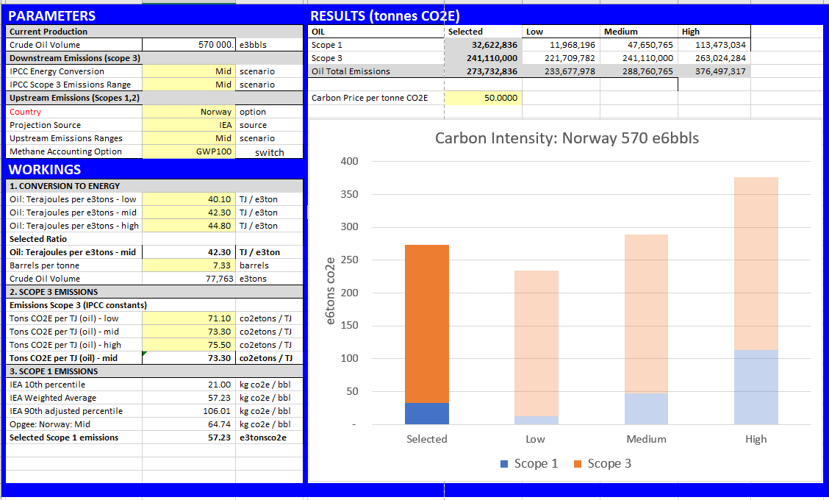
Carbon emissions estimates: base mode

Slide 12
Thanks for your attention
Johnny West jwest@carbontracker.org

