Slide 1

Final Project
By Jesus Martinez

Slide 2
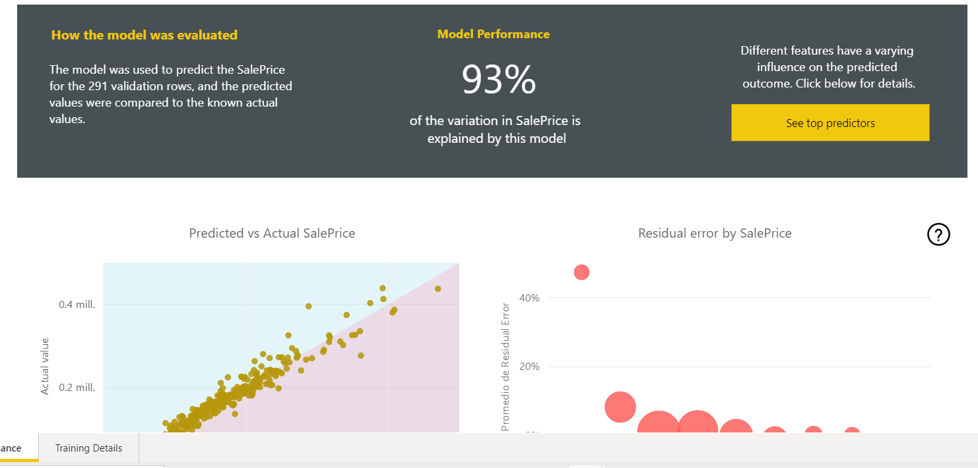
1. What did you build and how does it work?
To Project data houses prices

Slide 3
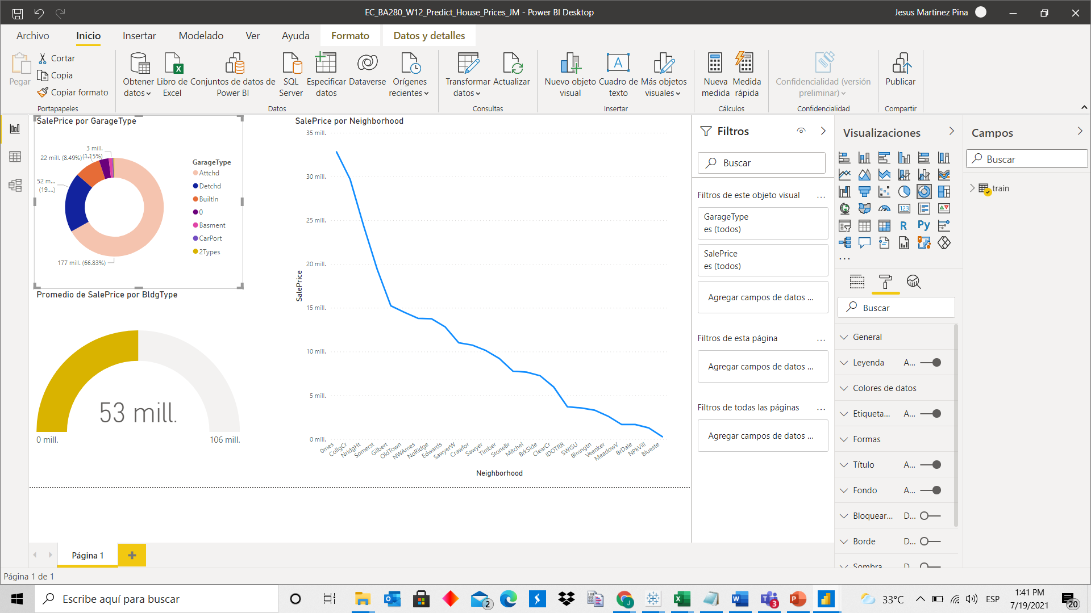

Slide 4
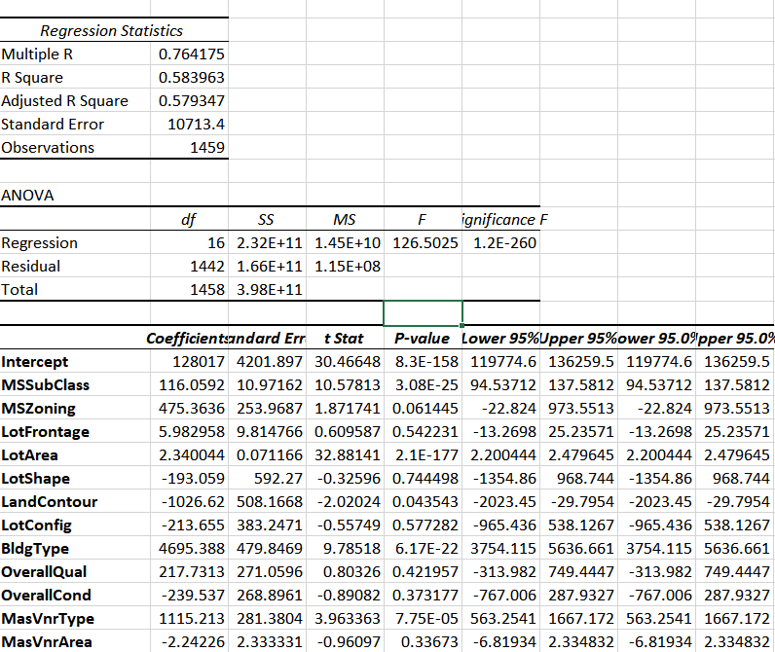

Slide 5
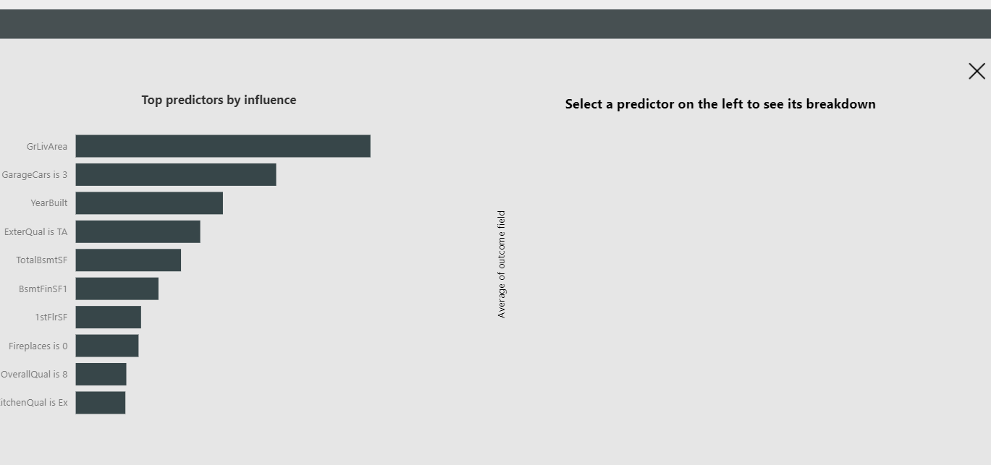
2. What is the purpose and objective of your dashboard?
To see what characrteristics affects the house prices.

Slide 6
What does this your solution teach us about predicting house prices?
You could learn in this kind of models which characteristics a person is lookig when he or she is buying a house.

Slide 7
Y Como dijo mi “ex”, esto aquí se acabo
The end

