Slide 1
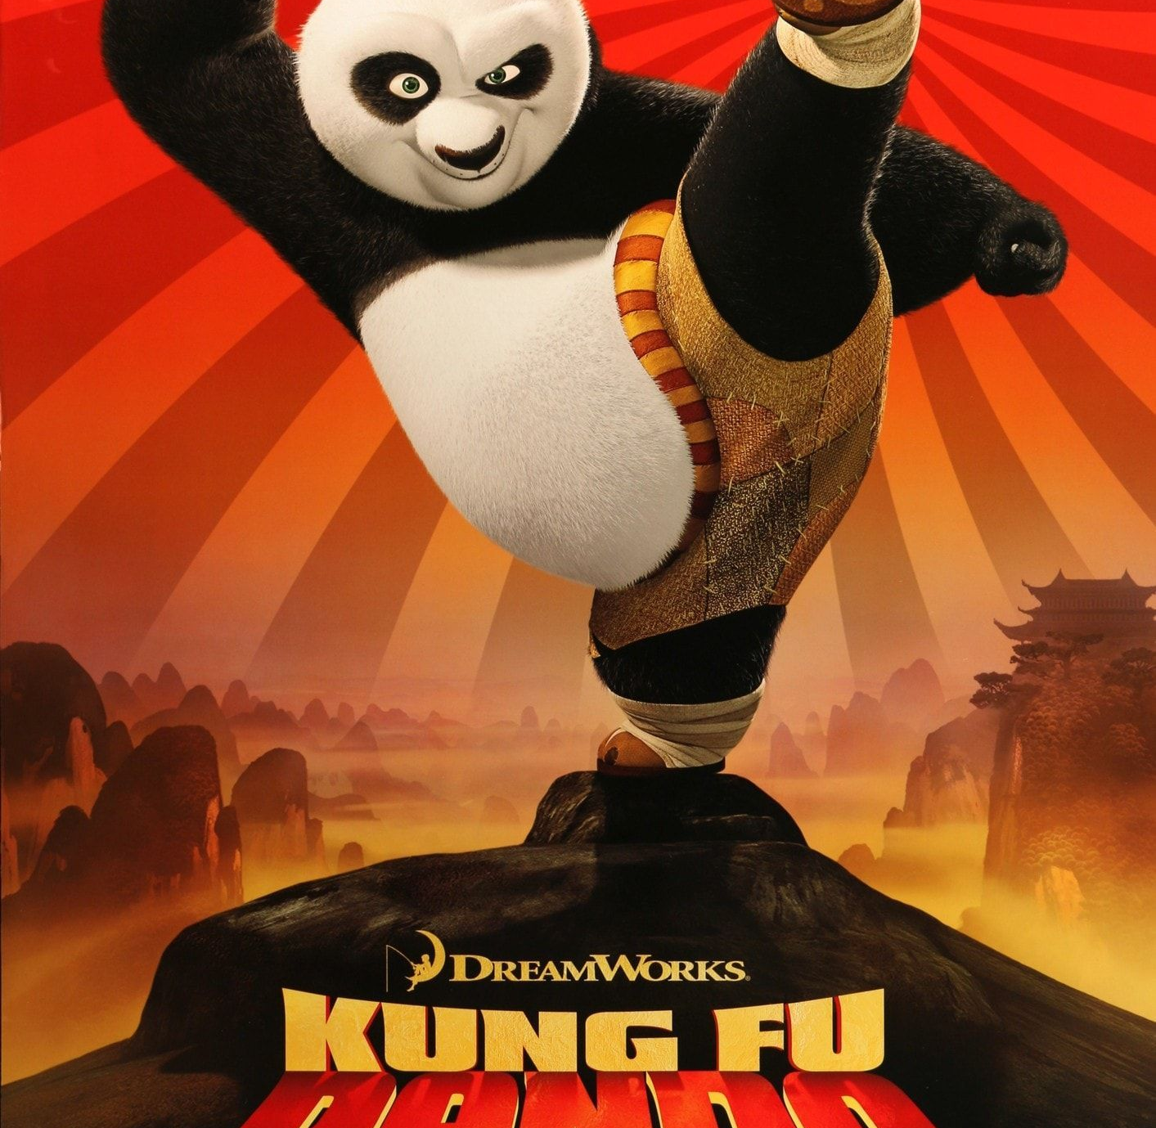
Kung fu panda
Word Cloud

Slide 2
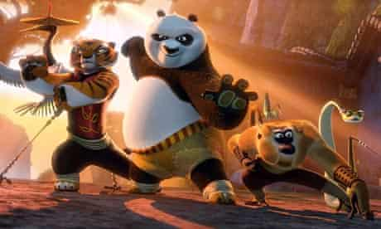
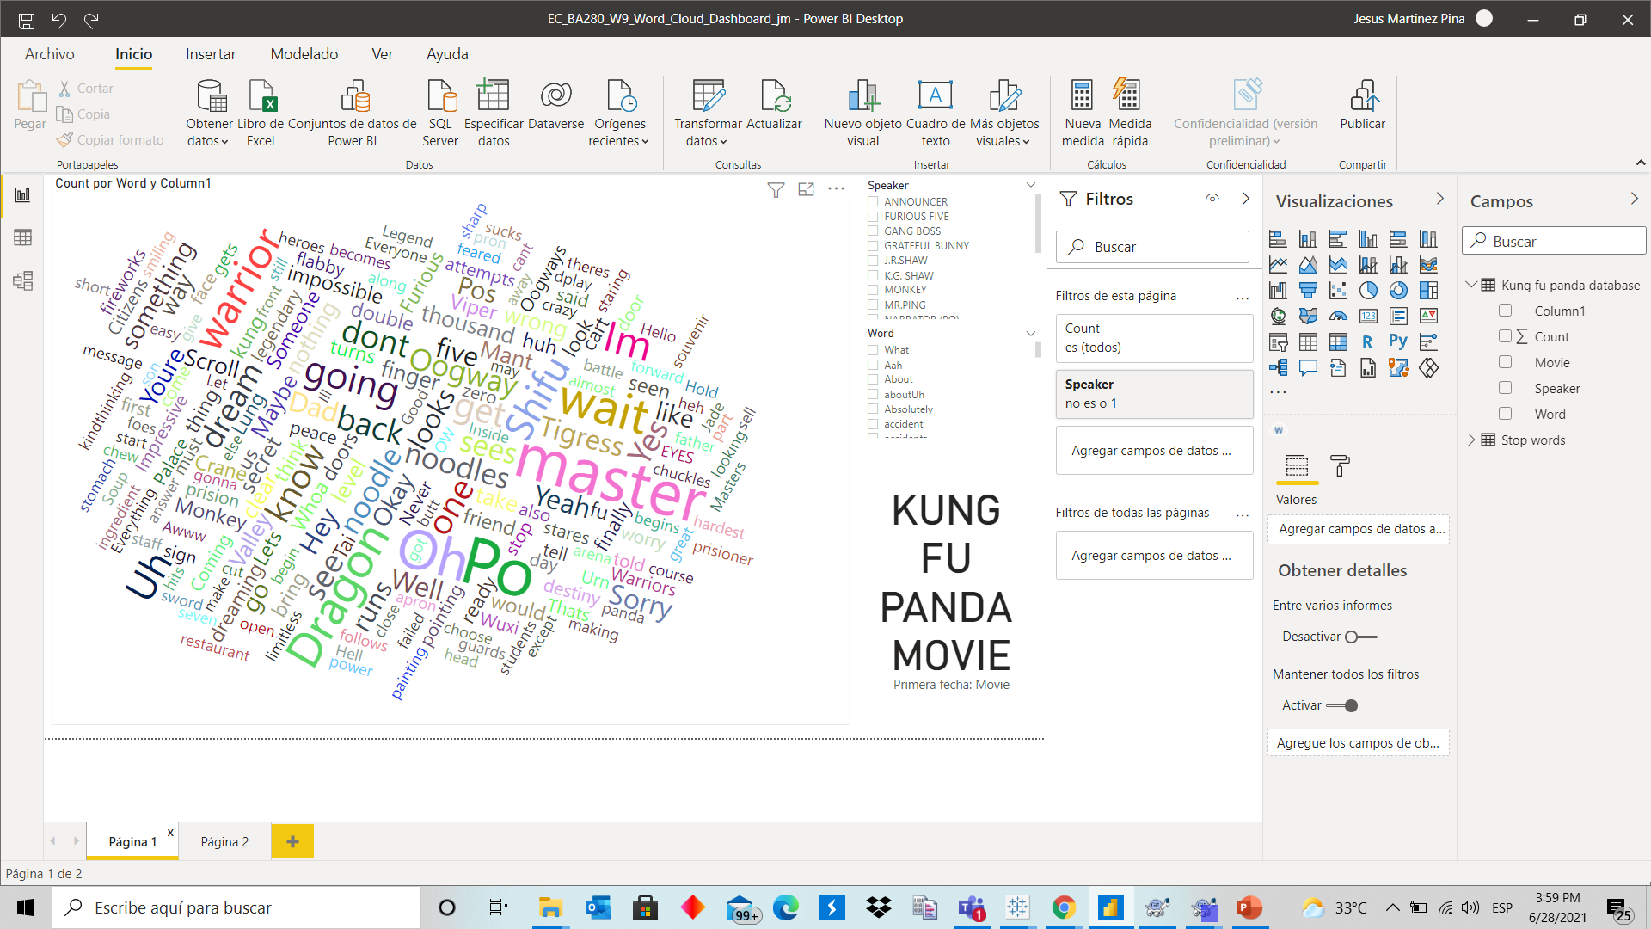
What did you build and how does it work?

Slide 3
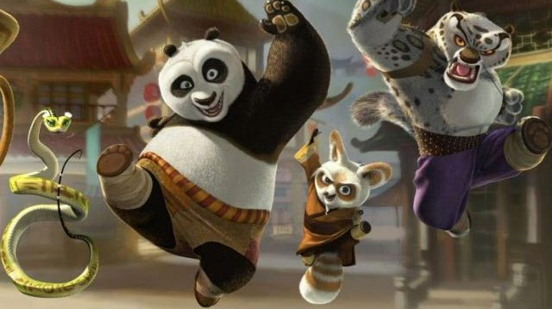
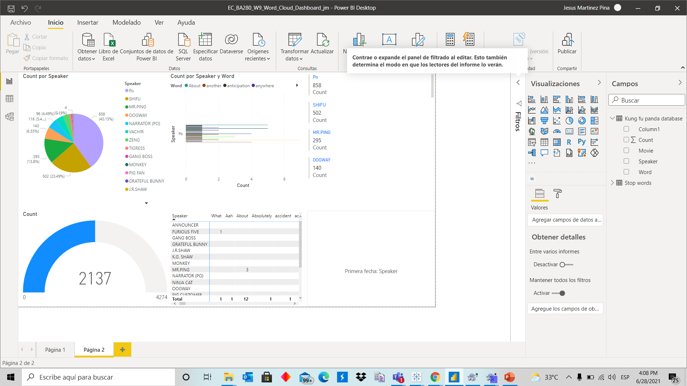

Slide 4
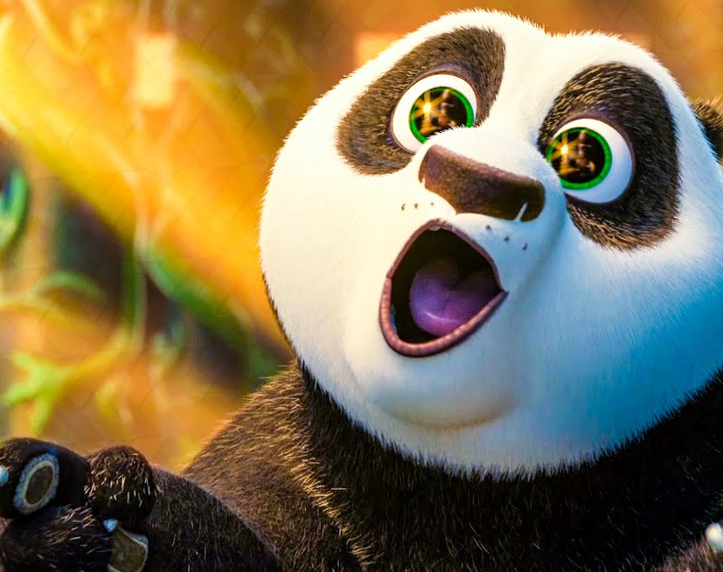
2. What is the purpose and objective of your dashboard?
To show what words are more used for the personajes of the movie.

Slide 5
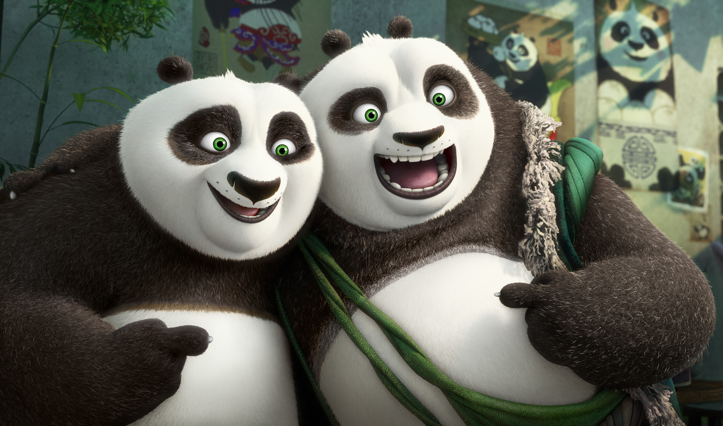
3. What does this dashboard teach us about your data source ?
It is to tricky to define which words are stop words.

