Slide 1
COLLABORATIVE
EXO ARM PROJECT
EduExo Pro + Unity
Assist-as-Needed Control and Transparent Interaction using EduExo Pro and Unity Brick Breaker
✓
ACTIVE TRANSPARENT
CONTROL
◎
Jessica Dichakdjian
♙
Previous group work: original team
▱
Course: Collaborative Exo Arm
Notes:
“The project uses the EduExo Pro as a physical interface to control a Unity Brick Breaker paddle. The user moves their arm, Arduino reads the exoskeleton angle, and Unity moves the paddle accordingly. The new focus is improving transparent interaction and adding feedback based on how far the user is from the target.”

Slide 2
✦
OUTLINE
01.
☷
02.
◎
03.
▣
PREVIOUS
GROUP WORK
UPDATED
OBJECTIVES
TRANSPARENT
CONTROL
04.
◉
05.
⚖
06.
⚑
VISUAL
FEEDBACK
EVALUATION &
RESIDUAL TORQUE
CONCLUSIONS
Notes:
The presentation is divided into a short recap of last semester’s group work and a longer section on the new individual objectives and implementation.

Slide 3
01.
PREVIOUS
GROUP WORK

Slide 4
01.
PREVIOUS GROUP WORK
Recap of the original rehabilitation game platform
Original goal
• EduExo Pro controls the game paddle
• Unity predicts ball interception point
• Robot assists only when needed
• User remains the primary motion generator
◎
▣
▥
▤
USER
EDUEXO
PRO
ARDUINO
UNITY
BRICK BREAKER
target + assist level
Last semester result
A functional game–exo interaction was implemented:
the user controlled the paddle with elbow motion and received assistance when far from the target.
Notes:
The previous group implementation created the basic rehabilitation game platform. The EduExo Pro acted both as an input device and as an assistive device. The user’s elbow motion controlled the paddle, while Unity predicted where the ball should be intercepted. Assistance was activated only when the user was far from the predicted target, so the user remained the primary motion generator.

Slide 5
01.
INITIAL SYSTEM ARCHITECTURE
✦
Sensors, communication and game-control loop from the group implementation.
⚖
▥
⇄
▤
▔
FORCE
SENSOR
ARDUINO
NANO 33 IoT
WiFi
UDP
UNITY
GAME
PADDLE +
TARGET
∠
ANGLE
SENSOR
target angle + assistance level
• Arduino measured elbow angle + interaction force
• Unity returned target information and assistance commands
Notes:
The Arduino measured the elbow angle and the interaction force. The angle was used by Unity to move the paddle, while the force sensor was used for the admittance-based assistance. Unity then sent back the target angle and assistance level to Arduino.

Slide 6
01.
ORIGINAL ASSIST-AS-NEEDED LOGIC
Distance to target controlled the assistance region and admittance gain.
Three assistance regions
Original admittance controller
⚖
×
Δθ
⚙
FAR FROM TARGET
High assistance
FORCE
SENSOR
ADMITTANCE
GAIN
POSITION
INCREMENT
SERVO
COMMAND
MEDIUM DISTANCE
Low assistance
θ_des(i+1) = θ_des(i) + G_adm · F_user
CLOSE TO TARGET
No assistance
Identified limitation:
“Close to target / no assistance” was treated like motor off or detach.
This is not true transparent control.
Notes:
The original assist-as-needed logic used three assistance regions. When the user was far from the target, the admittance gain was higher, so the measured force produced a larger position increment. When the user was closer, the gain decreased. The issue was not the idea of assistance regions itself. The issue was that the close-to-target condition was treated as no assistance or motor detachment, while the professor requested transparent mode by control.
Formula-
The exact sign depends on the motor and sensor convention, but conceptually the measured user force was converted into an incremental desired position.

Slide 7
02.
UPDATED
OBJECTIVES

Slide 8
02.
UPDATED PROJECT OBJECTIVES
New focus: transparency, compliance, feedback and quantitative evaluation.
Transparent mode by control
Visual feedback
1
2
Ball Color feedback based on tracking error.
Motor remains active; controller sends neutral/high-compliance behavior.
Residual torque evaluation
4
Comparison plots over 3 games
3
Estimate remaining interaction force from the force sensor.
Slider trajectory, target/ball position, feedback state, torque.
5
User performance evaluation
Mean error, score, and time inside transparent region.
Notes:
After the project objectives were updated, the focus shifted from only providing assistance to ensuring transparent interaction, feedback, and quantitative evaluation. The most important correction is that transparent mode must be implemented by control, not by detaching the motor. Therefore, the new work focuses on fixing transparent mode, adding visual feedback, and logging data over three games to evaluate residual torque and trajectory tracking.

Slide 9
03.
TRANSPARENT
CONTROL

Slide 10
03.
WHY DETACHING THE MOTOR WAS WRONG
Transparent control is not the same as switching the actuator off.
Previous approach
New approach
✕
Motor detached
No active motor command, but also no controllability
No smooth transition back to assistance
✓
Motor active
High-compliance transparent control
Low residual interaction force
Controllability preserved
Smooth transition back to assistance
Notes:
This was the most important correction. In the previous implementation, transparency was approximated by detaching or disabling the motor. But that removes active control, so the system cannot smoothly transition between transparent behavior and assistance. In the new approach, the motor remains active, but the controller sends a neutral or high-compliance command to minimize residual interaction force.

Slide 11
03.
FINAL CONTROL ARCHITECTURE
Core mode: transparent interaction; optional branch: low/high assistance.
⚖
Control Summary
FORCE
SENSOR
▥
⚙
▣
• Base behaviour: transparent control
• Motor remains active
• Optional assist branch modifies the command when user is far from target
• Force sensor used to estimate residual interaction force
• Goal: high compliance without motor detachment
TRANSPARENT
CONTROLLER
SERVO / MOTOR
COMMAND
EDUEXO
PRO
∠
ANGLE
SENSOR
◎
☰
TARGET
ERROR
OPTIONAL
LOW / HIGH
ASSISTANCE
Notes:
The final architecture prioritizes transparent interaction. The force and angle sensors feed the transparent controller. The original assistance logic is retained as an optional extension, but it is no longer the main behaviour.

Slide 12
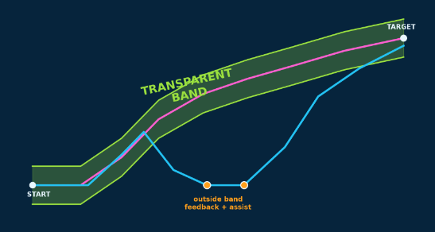
03.
TRANSPARENT REGION LOGIC
The user remains in transparent mode inside a tolerance corridor around the target trajectory.
TARGET
1. DEFINE target reference
Target/ball position used as the desired paddle reference.
TRANSPARENCY BAND
2. SET TRANSPARENCY BAND
Tolerance corridor around the ideal path.
3. APPLY LOGIC
Inside: assistance = 0, transparent control
Outside: feedback active + optional assistance
START
Notes:
The transparent region is a tolerance band around the target reference. If the actual paddle trajectory remains inside the band, Unity sends assist level zero and the Arduino keeps the motor in transparent control. If the paddle exits the band, the game activates visual feedback, and optionally sends low or high assistance depending on the error.

Slide 13
04.
VISUAL
FEEDBACK

Slide 14
04.
VISUAL FEEDBACK SYSTEM
Colour-coded feedback based on tracking error
Feedback meaning
GREEN
Safe / inside band
ORANGE
Moderate tracking error
RED
Large tracking error
Live game response
Ball color changes according to tracking error
Notes:
The visual feedback communicates the tracking error continuously. When the paddle is inside the transparent region, the ball is green. When the user moves outside the region, the ball changes to orange or red depending on the error magnitude. This gives the user immediate information and encourages self-correction before physical assistance is needed.

Slide 15
05.
2 participants
60-second rehab sessions
4 assistance settings
EVALUATION &
RESIDUAL TORQUE
Notes:
The previous group work created the basic system. The exoskeleton acted as both an input device and an assistive device. Elbow motion moved the paddle, Unity predicted the interception point, and assistance was provided when the user could not reach the target.

Slide 16
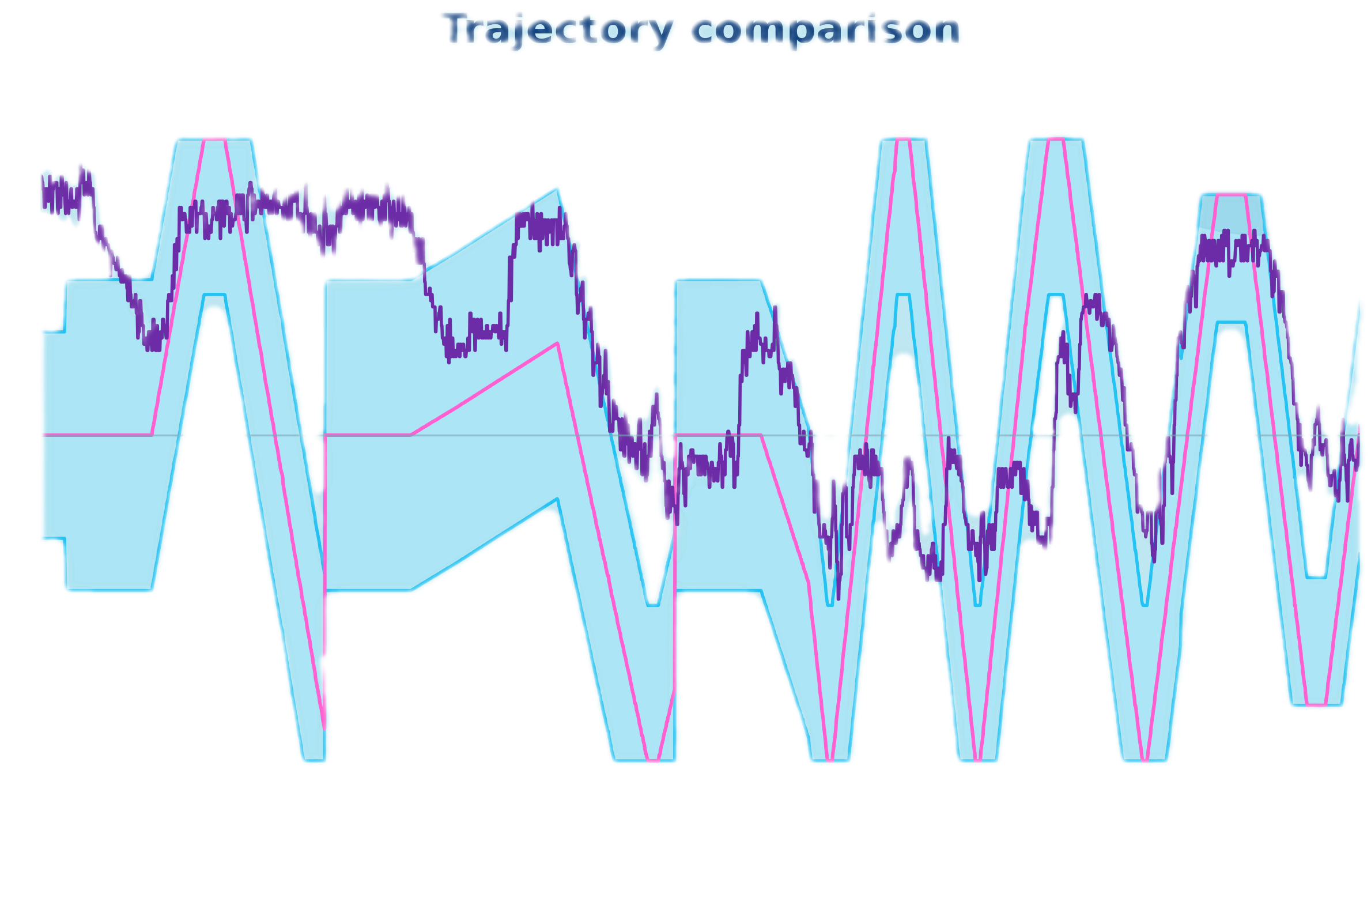
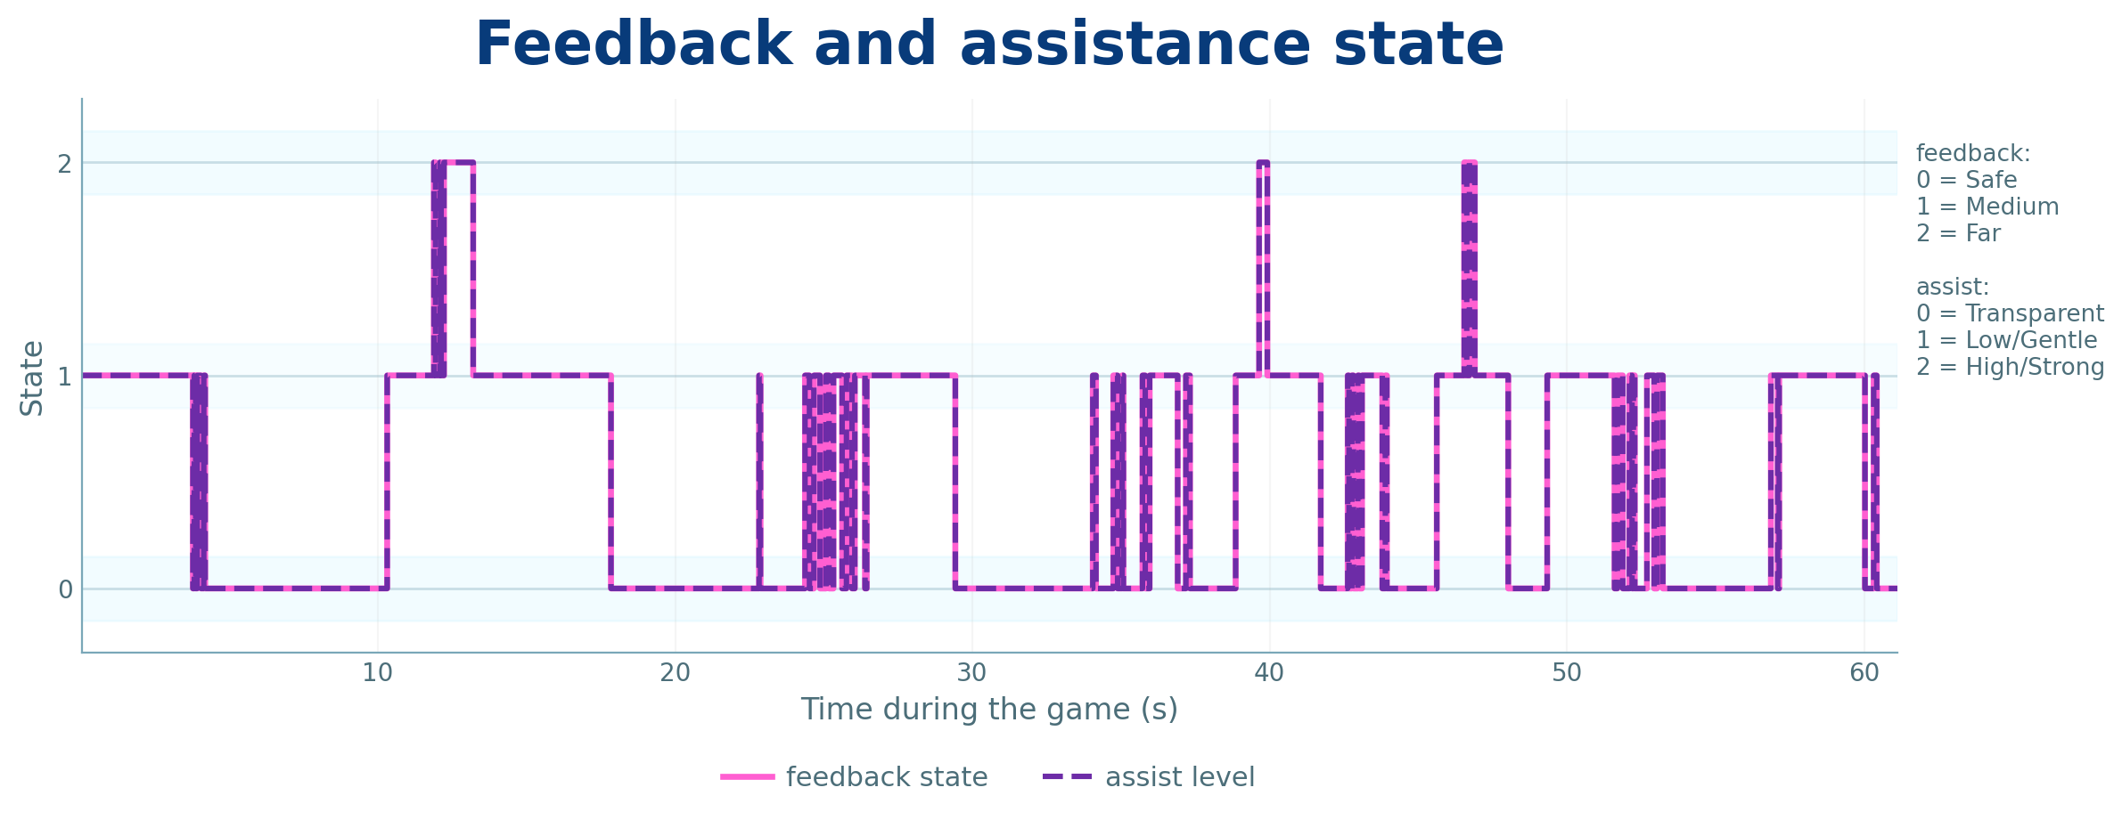
Trajectory comparison and Shown Feedback
transparency range
Feedback
0 = Safe
1 = Medium
2 = Fart
Assist:
0 = Transparent
1 = Low/Gentle
2 = High/Strong
Notes:
As assistance intensity increased, the time spent in transparent mode decreased. This confirms that higher assistance settings caused the system to intervene earlier, reducing independent movement but increasing guidance.

Slide 17
Actual limit of transparency
Notes:
0 / Off:
Physical assist off
Feedback only
Low:
Transparent until 50%
Gentle until 75%
Strong after 75%
Medium:
Transparent until 25%
Gentle until 60%
Strong after 60%
High:
Transparent until 10%
Gentle until 35%
Strong after 35%

Slide 18
Performance metrics across assistance intensity
Notes:
This slide summarizes the performance metrics across the four assistance intensity settings.
The tracking accuracy and mean tracking error show that the effect of assistance is not perfectly linear. For example, one participant improved with low and high assistance, while the other participant stayed more consistent across the settings. This suggests that the best assistance level depends on the user and on how they interact with the device.
The clearest trend is shown in the independent movement time. When assistance is off or low, the user spends more time in the transparent region, meaning they are moving more independently. As assistance intensity increases, the system intervenes earlier, so the transparent time decreases.
For rehabilitation, this is the main trade-off: higher assistance gives more guidance, but lower assistance encourages more autonomous movement. Therefore, the assistance level should be adapted to the user’s performance instead of always using the strongest assistance.
“These graphs are secondary performance metrics. The main observation is that accuracy does not simply improve when assistance is increased. However, independent movement time clearly decreases as assistance increases. This shows the rehabilitation trade-off: more assistance gives more guidance, but less assistance encourages user autonomy.”

Slide 19

Example session: paddle tracking target
P1 — Low assistance
Notes:
This graph shows one 60-second session. The blue line is the predicted target position, and the orange/red line is the user-controlled paddle position. When the two lines are close, the user is tracking well. When the distance increases, the system detects higher tracking error and activates feedback or assistance depending on the selected assistance intensity
or
This representative session shows the user-controlled paddle following the predicted target trajectory under low assistance. The remaining offset between the two curves reflects human response delay and movement limitations, while closer overlap indicates better tracking performance.

Slide 20
Residual torque during transparent mode
Notes:
Residual torque was evaluated during transparent mode only. Mean residual torque remained low across all three representative games, indicating generally good transparency, while the maximum residual torque highlights short peaks of resistance during interaction.

Slide 21
Performance Summary Across Assistance Settings
Game ID | Assistance setting | % time in transparent region | Mean tracking error % | Max tracking error % | Mean residual torque % | Max residual torque % | Assistance activations
Game 1 | Off | 100.0 | 28.8 | 93.0 | 4.2 | 46.2 | 0
Game 2 | Low | 91.8 | 18.9 | 72.0 | 3.7 | 16.6 | 9
Game 3 | Medium | 51.7 | 25.5 | 85.9 | 3.4 | 18.2 | 48
Game 4 | High | 29.2 | 19.7 | 58.0 | 3.8 | 20.8 | 64
Notes:
Although the original requirement asked for three games, we extended the comparison to four assistance settings to evaluate the full assistance-intensity slider. As expected, higher assistance reduced the time spent in transparent mode and increased assistance activations, while mean residual torque during transparent control remained low.

Slide 22
05.
ADAPTIVE HELP BASED ON USER PERFORMANCE
Performance indicators can be used to encourage more autonomous movement.
▥
PERFORMANCE
INDICATORS
Score
Catch success rate
Average tracking error
Time spent in transparent region
✓
□
↓
◎
↻
GOOD
PERFORMANCE
WIDER
TRANSPARENCY
BAND
LESS
ASSISTANCE
MORE
AUTONOMY
NEXT
GAME
Principle:
if the user performs well, reduce help and make the task more transparent.
Notes:
After each game, the system evaluates mean error and time spent inside the transparent region. If the user performs well, the transparency band can be increased, meaning the system becomes less assistive and encourages more autonomous movement

Slide 23
06.
CONCLUSIONS
Notes:
The previous group work created the basic system. The exoskeleton acted as both an input device and an assistive device. Elbow motion moved the paddle, Unity predicted the interception point, and assistance was provided when the user could not reach the target.

Slide 24
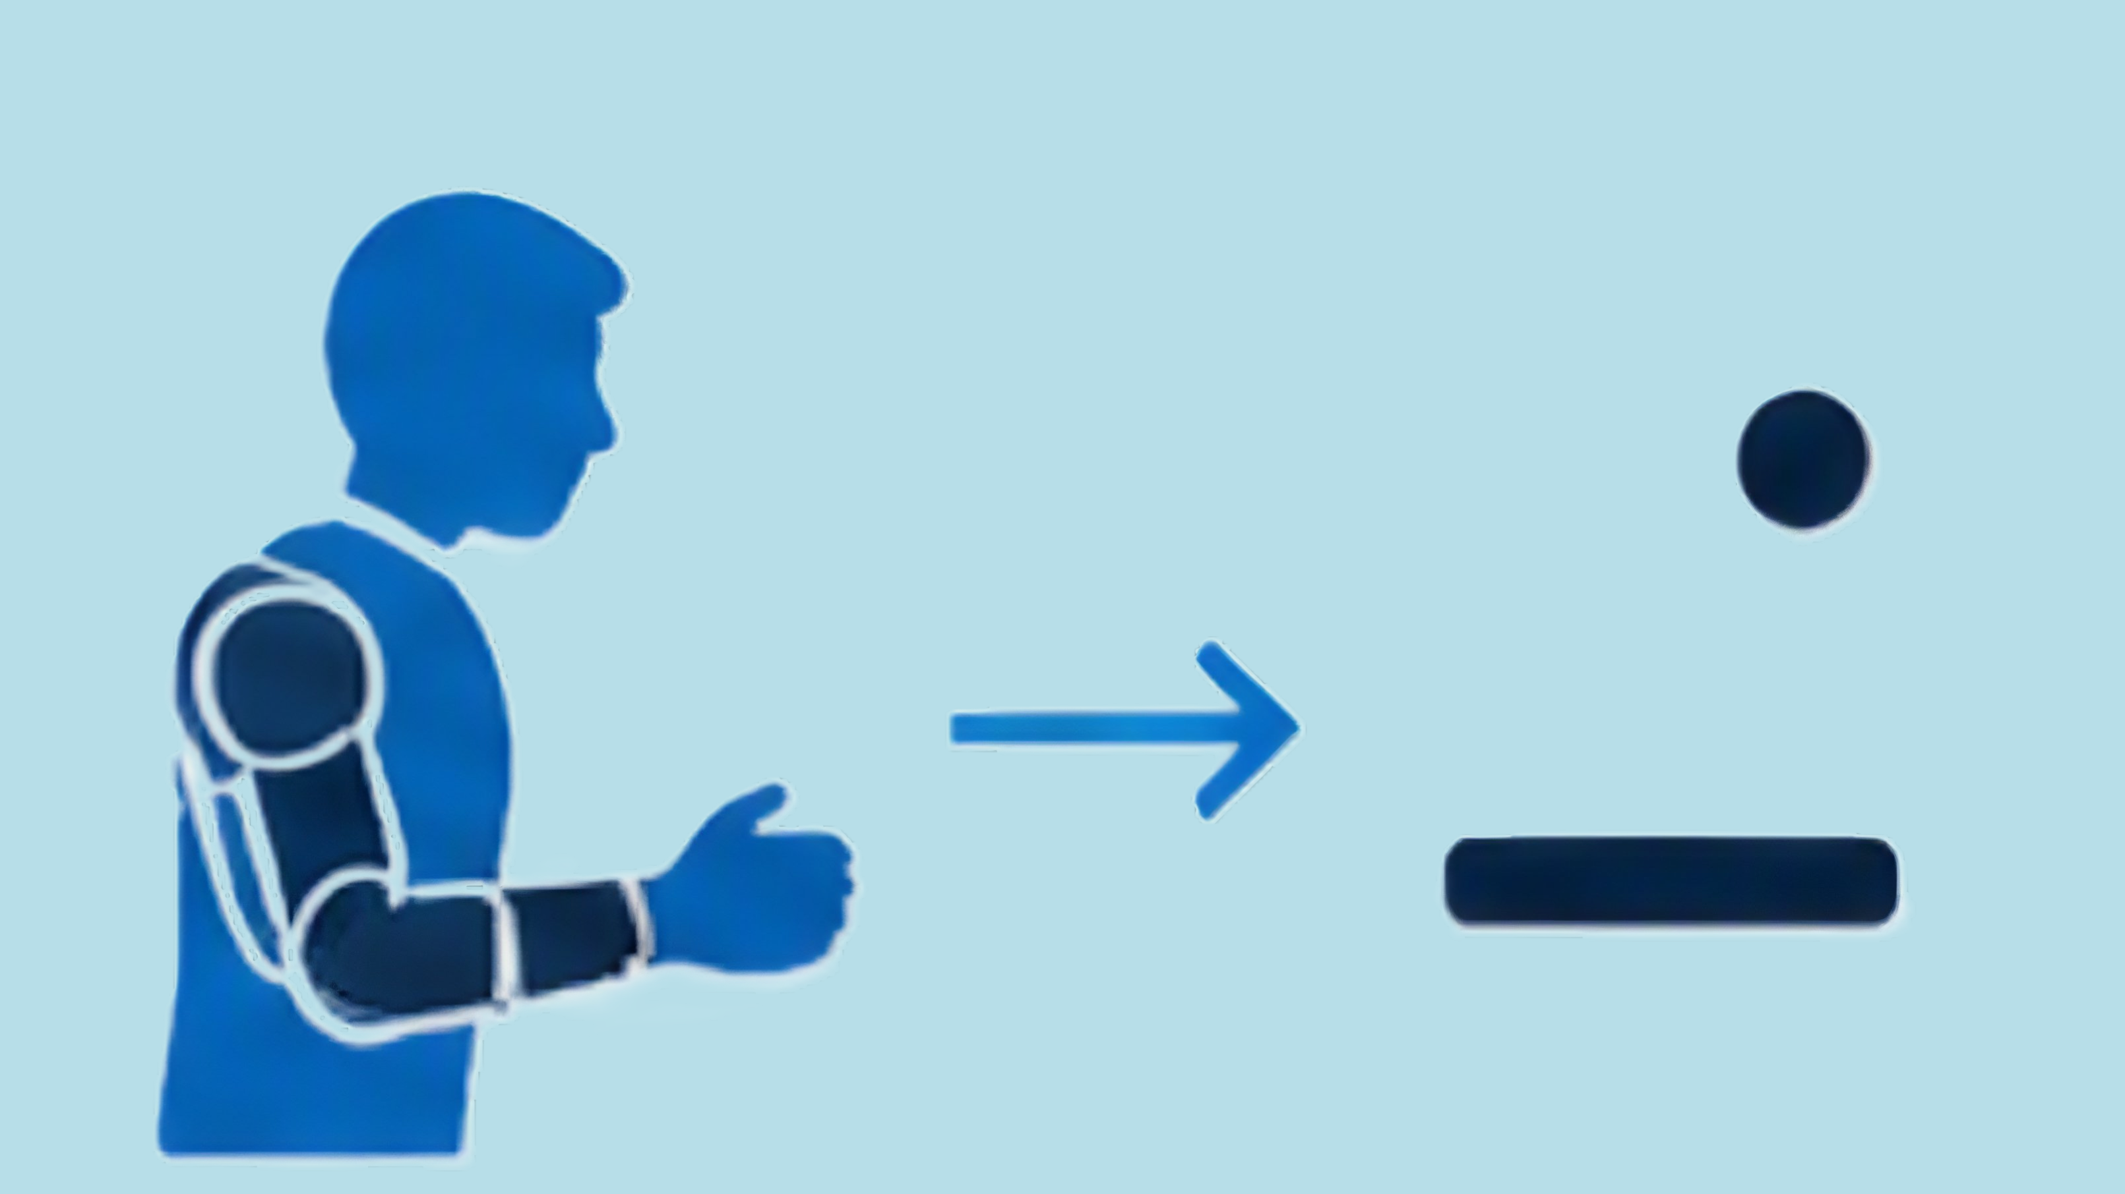

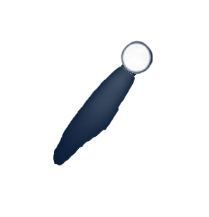


06.
DEMONSTRATION & LOGGING
Live proof that transparent control, feedback, assistance, and data logging work together
1.
2.
◷ ▥
3.
CSV
USER INTERACTION
REAL-TIME RESPONSE
LOGGED OUTPUT
→
→
•
60-second rehab session
•
Ball color feedback
•
CSV log file
•
EduExo arm controls paddle
•
Assistance outside the band
•
Summary table
•
Transparent mode
inside the band
•
Performance shown
at session end
•
Trajectory and feedback plots
•
Residual torque evaluation
✓
What this proves:
the system is not only playable — it is measurable.
Notes:
In the demo, I will show first that the EduExo angle controls the paddle. Then I will show the transparent region: when the paddle is close to the target, the system stays in assist level zero and gives green feedback. When the paddle moves outside the band, the ball changes to orange or red, and optional assistance can be activated. At the end of the game, Unity automatically saves the CSV and summary files used for the required plots.

Slide 25
06.
CONCLUSIONS
The second chance presentation is centred on the new control requirements.
Achievements
Improvement possibilities
• Transparent control without motor detachment
• Visual feedback based on tracking error
• Residual torque evaluation
• Trajectory and assistance analysis
• Performance-based assistance recommendation
• Tune compliance gains
• Improve force to torque estimation
• Patient-specific adaptation
• Validate with impaired users
• Test with more users and longer sessions
Main message: The previous platform provided the base;the new work makes interaction transparent, measurable, and feedback-driven.
Notes:
The main achievement is that the second-chance work directly addresses the new control requirements. The transparent mode is no longer based on detaching the motor. The system now gives visual feedback, logs residual interaction force, and produces the trajectory and feedback plots needed for evaluation. The remaining limitation is tuning: the neutral command, compliance gains, and force estimation still need refinement before testing with impaired users.

Slide 26
Thank you !
Notes:
The previous group work created the basic system. The exoskeleton acted as both an input device and an assistive device. Elbow motion moved the paddle, Unity predicted the interception point, and assistance was provided when the user could not reach the target.

