Slide 1
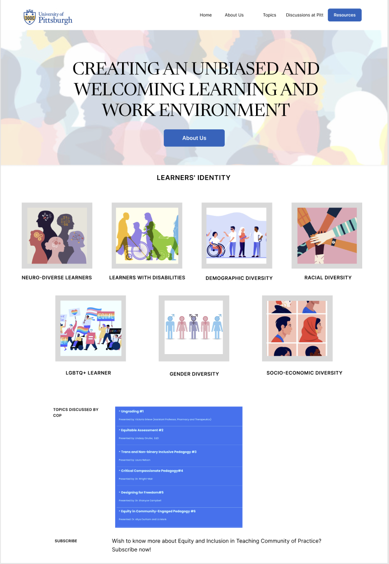

Slide 2
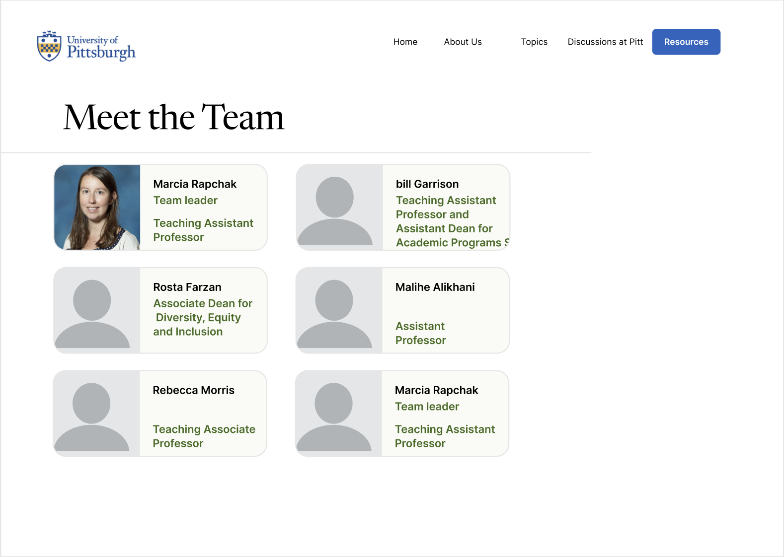

Slide 3
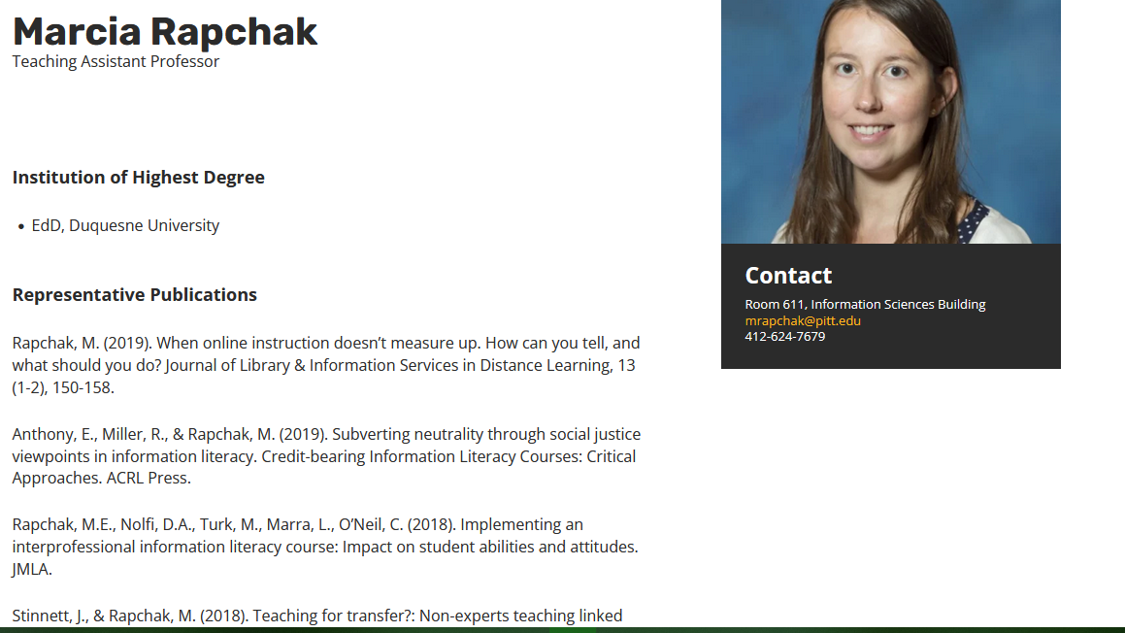
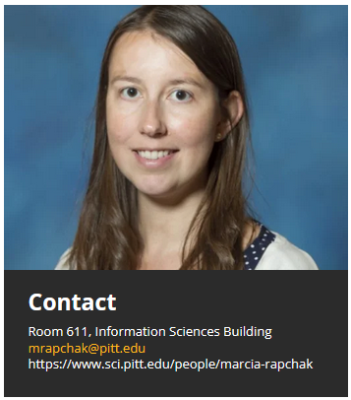

Slide 4
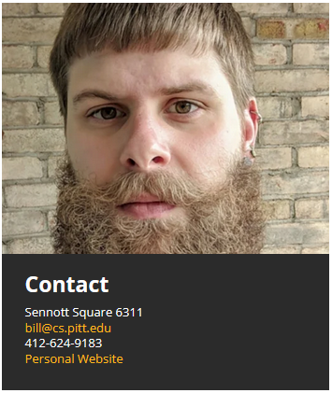
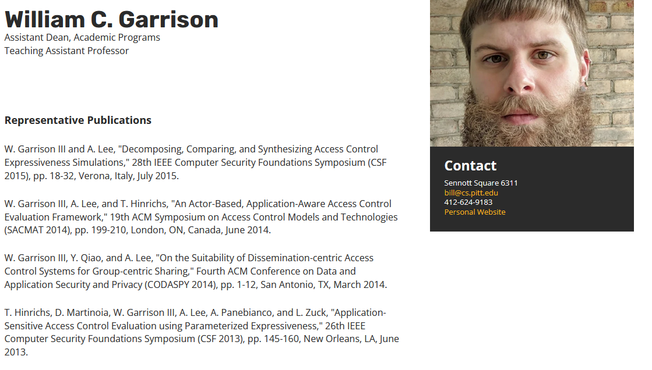

Slide 5
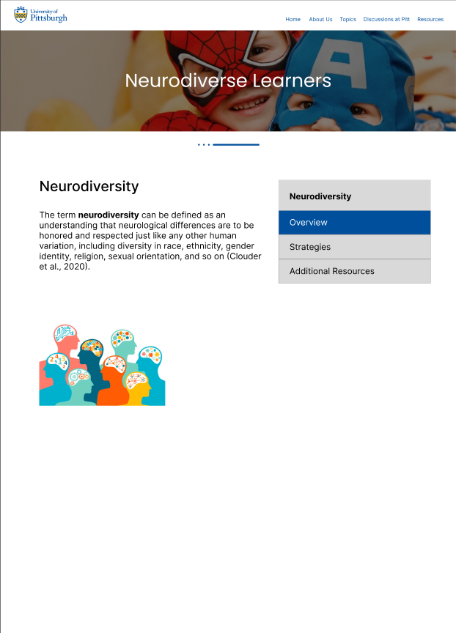

Neurodiversity
Overview
Strategies
Additional Resources

Slide 6
Strategies
Neurodiversity
The following part offers a set of adaptable
strategies that faculty can use to familiarize
neurodiverse learners with the many aspects
of the university system:
Overview
Strategies
Additional Resources
A one-page supplemental guide to the syllabus
One strategy for ensuring that neurodiverse learners understand the syllabus is to supplement it with a one-page
"syllabus breakdown", which includes key deadlines, guidelines, and requirements, and perhaps some assessment
details (Welby, 2015).
It is important to place this supplemental content on one side of the page. The one-page syllabus breakdown is
helpful for all students and promotes accessibility for all types of learners. Students can refer to this one-page
supplemental guide on their desks, in their agenda book, or in their dorms for quick information (Welby, 2015).
A published agenda
Neurodiverse learners could benefit from a posted class agenda. A published schedule creates
predictability, which reduces anxiety and avoids distractions (Skelling, 2020).
Students feel comfortable knowing what to expect next, which encourages mindful learning with less worry.
Instructors can introduce the agenda through a PowerPoint presentation at the beginning of the course (Skelling,
2020).
Nevertheless, whether presented this way or written on a blackboard or whiteboard in front of the students ‘eyes,
hanging such an agenda for the class can improve retention and predictability while curbing students’ stress (Mirfin-
Veitch et al., 2020).
Clearly defined daily learning objectives
Posting clear daily learning goals can improve neurodiverse learners’ ability to determine whether they understand
the content knowledge taught that day (Mirfin-Veitch et al., 2020).
When students realize they have successfully learned a learning objective, they often have an aha moment and the
information becomes easier to remember. It can also assist them self-assess their understanding and take
responsibility for their own learning (Welby, 2015).
It can also enable the instructors to focus on the most important things they want to teach and deliver.
Daily formative reflection or exit cards
Posting clear daily learning goals can improve neurodiverse learners’ ability to determine whether they understand
the content knowledge taught that day (Mirfin-Veitch et al., 2020).
When students realize they have successfully learned a learning objective, they often have an aha moment and the
information becomes easier to remember. It can also assist them self-assess their understanding and take
responsibility for their own learning (Welby, 2015).
It can also enable the instructors to focus on the most important things they want to teach and deliver.

Slide 7
Resources
Neurodiversity
The following are references that were used to
Inform the information in this section:
Clouder, L., Karakus, M., Cinotti, A., Ferreyra, M. V., Fierros, G. A., & Rojo, P. (2020).
Neurodiversity in higher education: A narrative synthesis.
Higher Education, 80(4), 757–778. https://doi.org/10.1007/s10734-020-00513-6
Welby, K. (2022, June 15). Teaching Neurodiverse Students. Inside Higher Ed.
Retrieved November 18, 2022, from
https://www.insidehighered.com/advice/2022/06/15/advice-teaching-neurodiverse-students-opinion.
Skelling, J. (2020, October 19). Neurodiversity: A strengths-based approach to teaching diverse learners.
The Education Hub. Retrieved November 18, 2022, from
https://theeducationhub.org.nz/neurodiversity-a-strengths-based-approach-to-teaching-diverse-learners/.
Mirfin-Veitch, B., Jalota, N., & Schmidt, L. (2020). Responding to neurodiversity in the education context:
An integrative literature review.
Nachman, B. R. (2020). Enhancing Transition Programming for College Students with Autism: A Systematic Literature Review.
Journal of Postsecondary Education and Disability, 33(1), 81–95.
Cox, B. E., Edelstein, J., Brogdon, B., & Roy, A. (2021). Navigating Challenges to Facilitate Success for College Students with Autism.
The Journal of Higher Education, 92(2), 252–278. https://doi.org/10.1080/00221546.2020.1798203
Nuske, A., Rillotta, F., Bellon, M., & Richdale, A. (2019). Transition to higher education for students with autism:
A systematic literature review. Journal of Diversity in Higher Education, 12(3), 280–295. https://doi.org/10.1037/dhe0000108
Overview
Strategies
Additional Resources

Slide 8

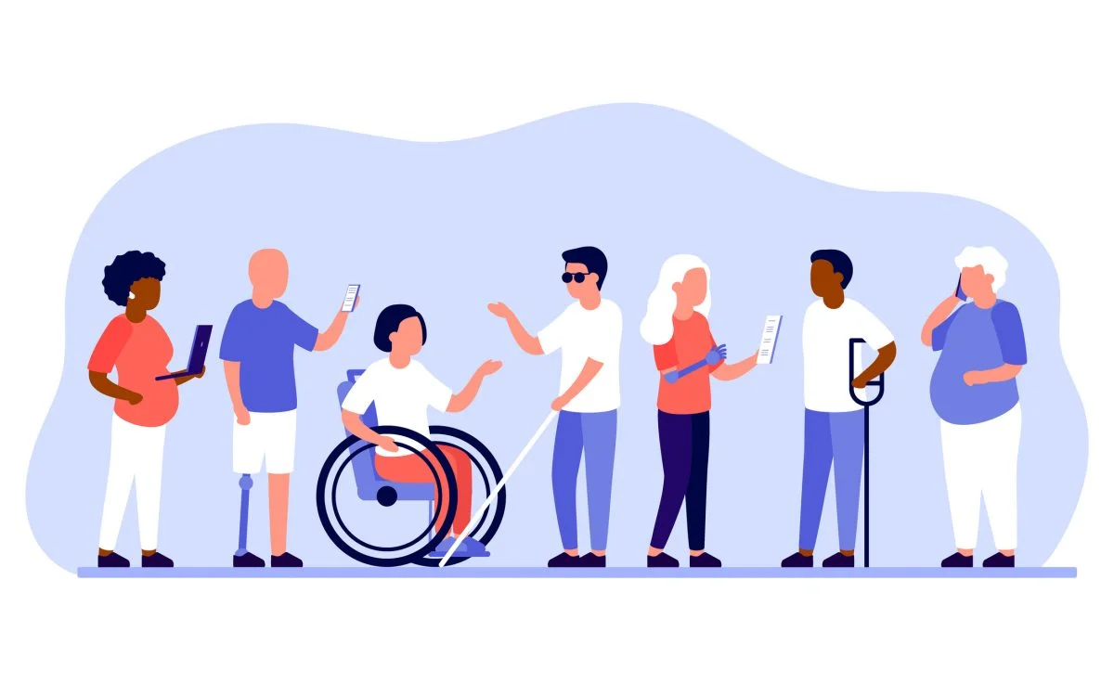
Learners with Disabilities
Disabilities
Disabilities
A disability is any condition of the body or mind
that makes it more difficult for the person with
the condition to do certain activities (activity
limitation) and interact with the world around
them (participation restrictions).
There are many types of disabilities.
Overview
Strategies
Additional Resources

Slide 9
Learners with Disabilities
Strategies
Neurodiversity
The following part offers a set of adaptable
strategies that faculty can use to familiarize
disabled learners with the many aspects
of the university system:
Overview
Strategies
Additional Resources
Design as an Inclusive Pedagogical Approach:
Universal Design constitutes an approach in developing course materials, content, and pedagogy that aims to cater
to the diverse needs of learners (Jetter & Jetter, 2021). Rather than modifying or retrofitting a course to
accommodate a particular audience, this methodology prioritizes the creation of accessible learning environments,
irrespective of individual capabilities. By incorporating these design principles during syllabus construction and the
development of instructional materials, educators may discover that their courses inherently facilitate the inclusion
of all students (Hodge & Preston-Sabin, 2020).
Strategies to accommodate students with learners with disabilities:
Instructors are recommended to adopt the following approaches to facilitate success for students with disabilities
in higher education:
Meet with the Student in Private:
Instructors should hold private meetings with students seeking accommodations to agree on their effective implementation. Document the outcome for record-keeping (Allarakhia, 2022).
Textbook Accessibility:
Instructors should provide early textbook information to the bookstore to facilitate the timely acquisition of electronic copies for students with visual or reading disabilities. Utilize “Bookshare” as a resource: https://www.bookshare.org/cms (Marriott, 2020)
Accessible Format for Course Materials:
Use accessible Word documents for handouts and online materials. Avoid PDFs (Beck, 2021).
Flexibility in the Classroom Environment:
Allow short breaks in class when possible (Khouri et al., 2019)
Flexible attendance policy (Marriot, 2020).
Learning through Technology Tools (Lawler & King, 2000, Maehl, 2000)
Use Vocaroo for audio recording and review prior to printing QR Codes (Charles & Dickens, 2012). https://vocaroo.com
Use Padlet for collaborative editing of videos, images, and documents (Dunbar, 2017) https://padlet.com.
Use Plickers for formative assessments and individual data gathering (Tolbert, 2017). https://get.plickers.com

Slide 10
Learners with Disabilities
Resources
Neurodiversity
The following are references that were used to
Inform the information in this section:
Hodge, B. M., & Preston-Sabin, J. (2020). Accommodations–or just good teaching?: Strategies for teaching college students with disabilities. Westport, Conn: Praeger.
Jetter, K. P., & Jetter, K. P. (2021). Accommodations – Or Just Good Teaching? Strategies for Teaching College Students with Disabilities [Review of Accommodations-Or Just Good Teaching? Strategies for Teaching College Students with Disabilities, by B. M. Hodge & J. Preston-Sabin]. Research and Teaching in Developmental Education, 15(1), 105–107.
Khouri, M., Lipka, O., & Shecter-Lerner, M. (2019). University faculty perceptions about accommodations for students with learning disabilities. International Journal of Inclusive Education, 26(4), 365–377.https://doi.org/10.1080/13603116.2019.1658812
Kilpatrick, S., Johns, S., Barnes, R., Fischer, S., McLennan, D., & Magnussen, K. (2016). Exploring the retention and success of students with disability in Australian Higher Education. International Journal of Inclusive Education, 21(7), 747–762. https://doi.org/10.1080/13603116.2016.1251980
Marriot, D. (2020, July). Accommodations for students in Higher Education with Learning Disabilities: First Year Transition. Ashleys Pressbook. Retrieved December 7, 2022, from https://open.library.okstate.edu/ashley/chapter/accommodations-for-students-in-higher-education-with-learning-disabilities-first-year-transition/
Tolbert, J. B. (2017). Foreign language assessment: Instructional considerations for students with specific learning disabilities. Journal of Language Teaching and Research, 8(3), 441. https://doi.org/10.17507/jltr.0803.01
Yssel, N., Pak, N., & Beilke, J. (2016). A door must be opened: Perceptions of students with disabilities in higher education. International Journal of Disability, Development and Education, 63(3), 384–394. https://doi.org/10.1080/1034912x.2015.1123232
Overview
Strategies
Additional Resources

Slide 11
References
Clouder, L., Karakus, M., Cinotti, A., Ferreyra, M. V., Fierros, G. A., & Rojo, P. (2020).
Neurodiversity in higher education: A narrative synthesis.
Higher Education, 80(4), 757–778. https://doi.org/10.1007/s10734-020-00513-6
Welby, K. (2022, June 15). Teaching Neurodiverse Students. Inside Higher Ed.
Retrieved November 18, 2022, from
https://www.insidehighered.com/advice/2022/06/15/advice-teaching-neurodiverse-students-opinion.
Skelling, J. (2020, October 19). Neurodiversity: A strengths-based approach to teaching diverse learners.
The Education Hub. Retrieved November 18, 2022, from
https://theeducationhub.org.nz/neurodiversity-a-strengths-based-approach-to-teaching-diverse-learners/.
Mirfin-Veitch, B., Jalota, N., & Schmidt, L. (2020). Responding to neurodiversity in the education context:
An integrative literature review.
Nachman, B. R. (2020). Enhancing Transition Programming for College Students with Autism: A Systematic Literature Review.
Journal of Postsecondary Education and Disability, 33(1), 81–95.
Cox, B. E., Edelstein, J., Brogdon, B., & Roy, A. (2021). Navigating Challenges to Facilitate Success for College Students with Autism.
The Journal of Higher Education, 92(2), 252–278. https://doi.org/10.1080/00221546.2020.1798203
Nuske, A., Rillotta, F., Bellon, M., & Richdale, A. (2019). Transition to higher education for students with autism:
A systematic literature review. Journal of Diversity in Higher Education, 12(3), 280–295. https://doi.org/10.1037/dhe0000108
Allarakhia, H. (2022, October 31). Strategies for accommodating students with disabilities in higher education : Faculty focus. Faculty Focus | Higher Ed Teaching & Learning. Retrieved December 4, 2022, from https://www.facultyfocus.com/articles/equality-inclusion-and-diversity/strategies-for-accommodating-students-with-disabilities-in-higher-education/
Beck, D. (2021). Successful Strategies for Teaching Students with Learning Disabilities. Learning Disabilities Association of America. Retrieved December 8, 2022, from https://ldaamerica.org/info/successful-strategies-for-teaching-students-with-learning-disabilities/

