Slide 1
Electric Outage Duration Prediction - Final Report
A Comprehensive Overview of Model Development and Evaluation

Slide 2
1. Introduction
This report provides a comprehensive overview of the electric outage duration prediction project. The objective was to develop a predictive model capable of estimating the duration of electric outages based on various features such as the event description, year, and respondent information. Multiple machine learning models were evaluated to determine the best-performing model.

Slide 3
2. Data Preprocessing
The dataset contained features such as 'Event Description,' 'Year,' and 'Respondent.' Categorical variables were encoded using label encoding, and rows with missing values in the target variable 'Duration (Hours)' were removed.

Slide 4
3. Model Training and Evaluation
Several machine learning models were trained and evaluated, including Linear Regression, Decision Tree Regressor, Support Vector Regressor, K-Neighbors Regressor, Gradient Boosting Regressor, Neural Network Regressor, and XGBoost Regressor. The final evaluation focused on three models due to computational constraints. The RMSE values for the models were:
- Linear Regression: RMSE = 95.65
- Decision Tree Regressor: RMSE = 90.3
- K-Neighbors Regressor: RMSE = 99.63

Slide 5
4. Final Model
The Decision Tree Regressor was selected as the final model due to its superior performance. Key parameters included:
- Criterion: 'squared_error'
- Splitter: 'best'
- Maximum Depth: None
- Minimum Samples Split: 2
- Minimum Samples Leaf: 1
The final RMSE of the Decision Tree Regressor was 90.3.

Slide 6
5. Conclusions and Recommendations
The Decision Tree Regressor provided the most accurate predictions. Future improvements could involve hyperparameter tuning, experimenting with ensemble methods, or incorporating additional features to enhance performance.

Slide 7
Exploratory Data Analysis (EDA)
Key findings from the Exploratory Data Analysis include:
- Most electric outages are relatively short in duration.
- Severe weather is the most common cause of outages.
- Longer outages tend to impact a larger number of customers.

Slide 8
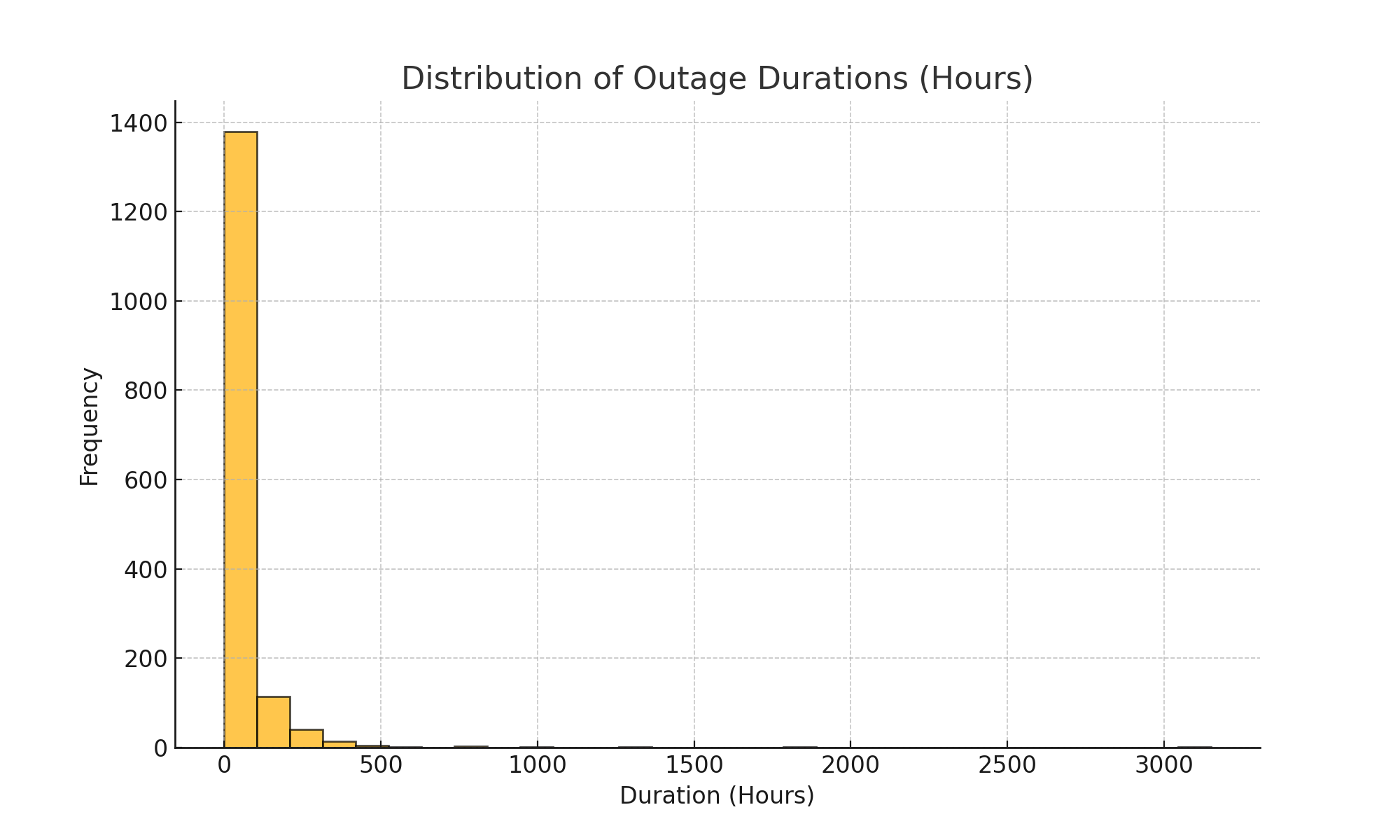
Distribution of Outage Durations (Hours)

Slide 9
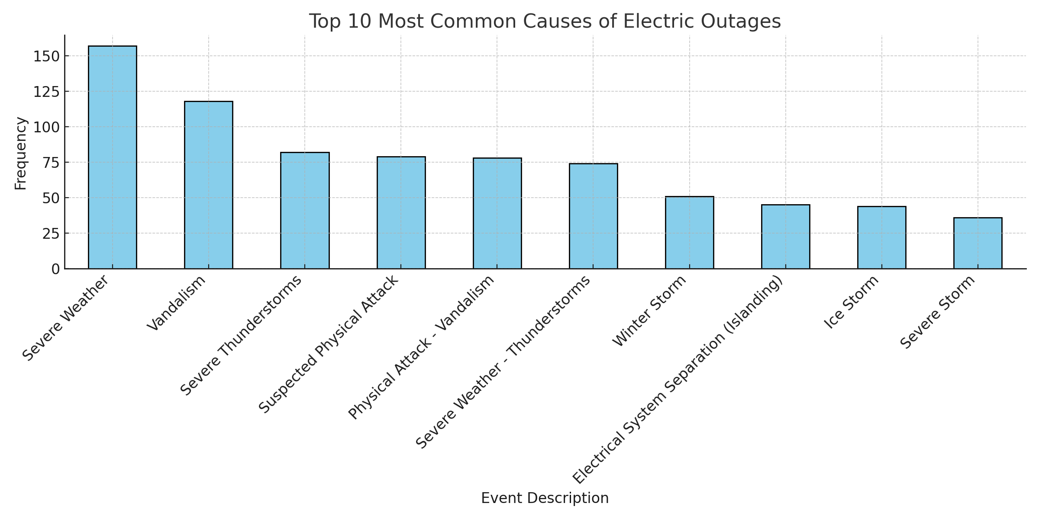
Top 10 Most Common Causes of Electric Outages

Slide 10
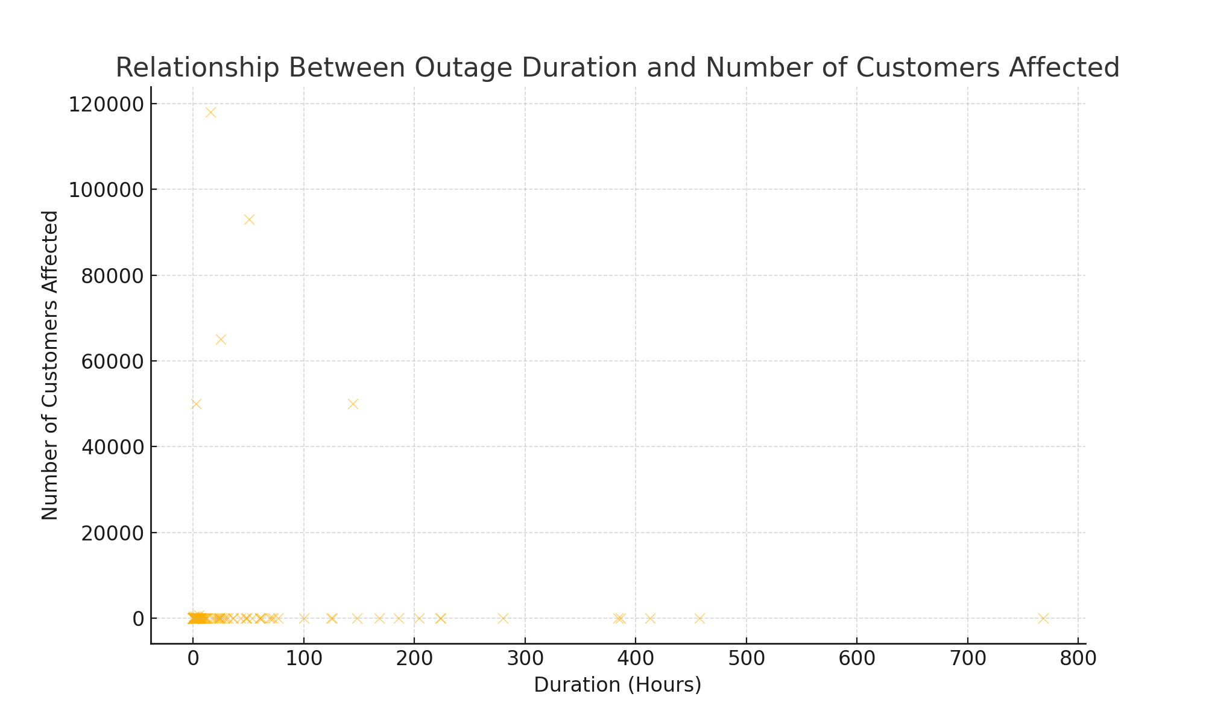
Impact of Outages on Customers

