Slide 1
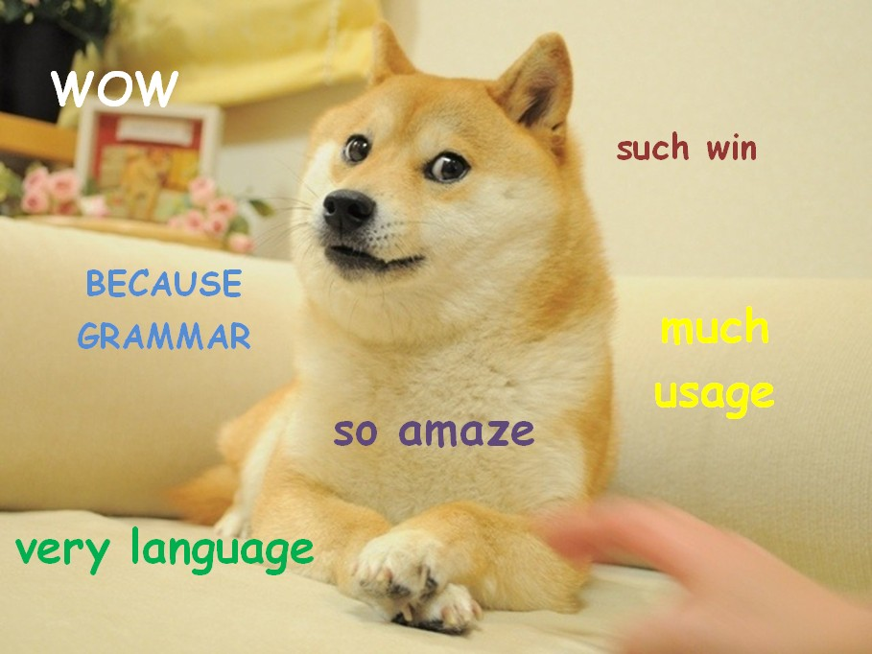
Dogebot:
Part of Speech Tagging using the hidden Model

Slide 2
Objective
Part of Speech tagging
Input sentences into a program, whereupon each word in the sentences is assigned a part of speech
The cow jumped over the moon.
art
noun
verb
prep
art
noun

Slide 3
Markov Model
Start
0.6
0.4
0.7
0.8
Sun
Rain
0.3
0.2

Slide 4
Hidden Markov Model (HMM)
Markov Process
X₁
X₂
X₃
X₄
X₅
X₆
A₁
A₂
A₃
A₄
A₅
O₁
O₂
O₃
O₄
O₅
O₆
Observations

Slide 5
Hidden Markov Model (HMM)
Observations are words inputted by the user
Each observation(O_{1,} O₂…) is assumed to be dependent on a state (X_{1,} X₂…).
We cannot see the state (thus it is hidden)
Can guess the states based on the observed words
After each observed word, the state can change (A_{1,} A₂…)
Probabilities of changing states depends ONLY on current state

Slide 6
Part of Speech Tagging and HMM
Words are observations
Parts of speech are states
Probability of states changing are stored in a dictionary
Some combinations such as “article-noun” and “noun-verb” are perhaps more likely to occur than “article-prep” and “prep-adjective”
Calculate probabilities of possible part of speech sequences
Highest probability = part of speech sequence

Slide 7
Implementation
Brown Corpus Processing: Importing information from the Brown Corpus and creating a dictionary with part of speech combinations and states
Tokenization: Separating out words so that we can have a series of “observations”
Iteration: Given series of words, create

Slide 8
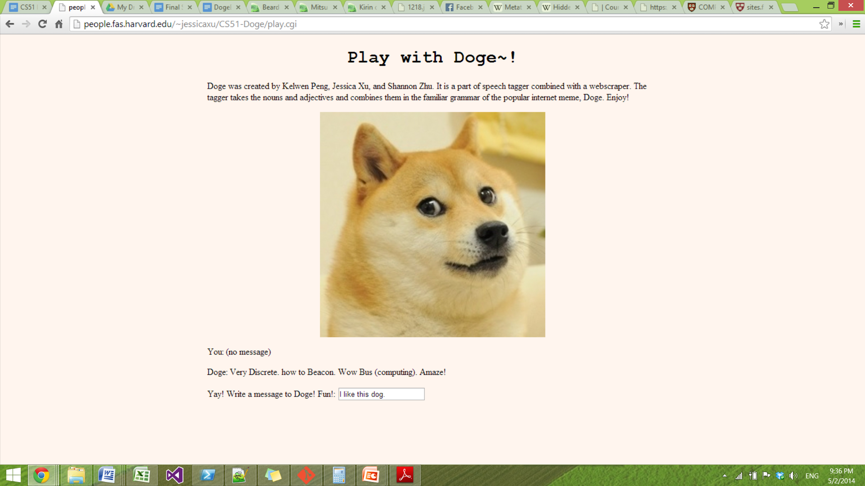
Welcome to NerdDoge!

Slide 9
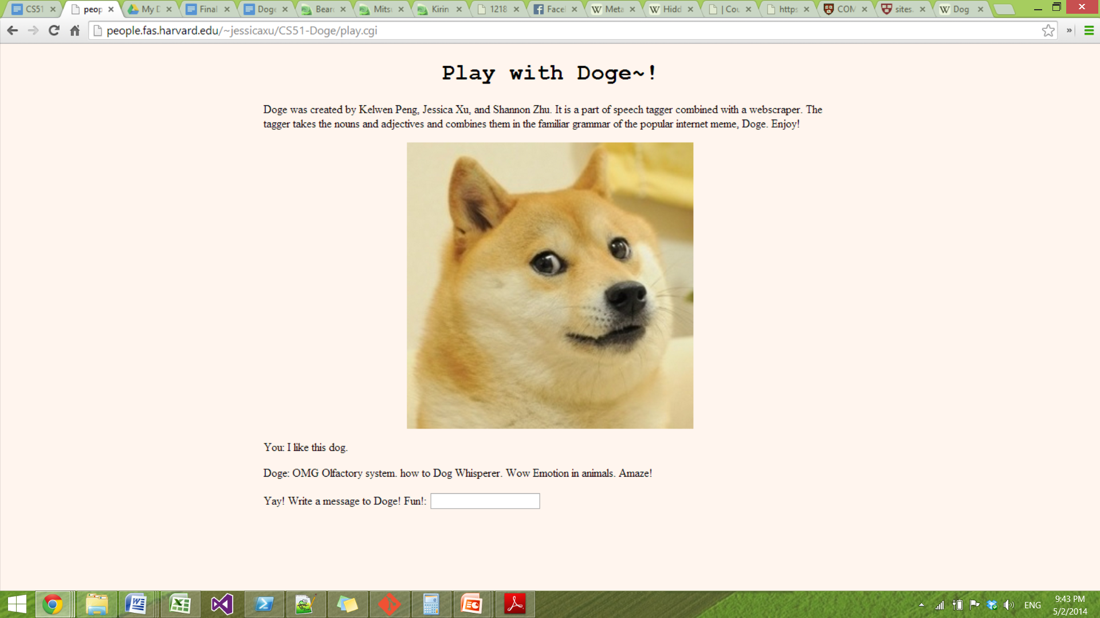
The NerdDoge speaks!

