Slide 1
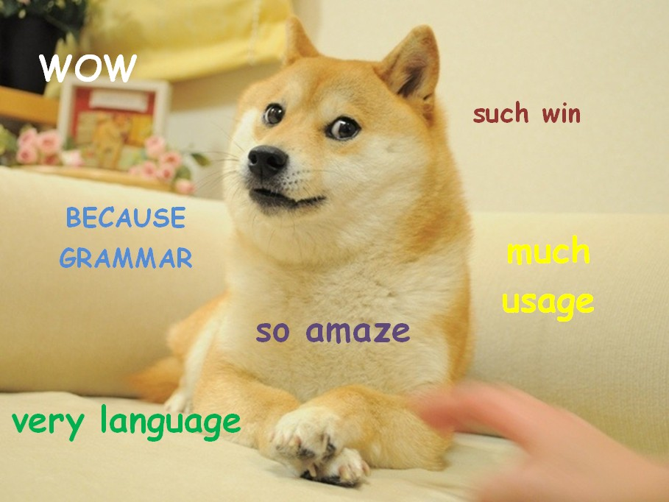
Dogebot:
Part of Speech Tagging using the hidden Model

