Slide 1
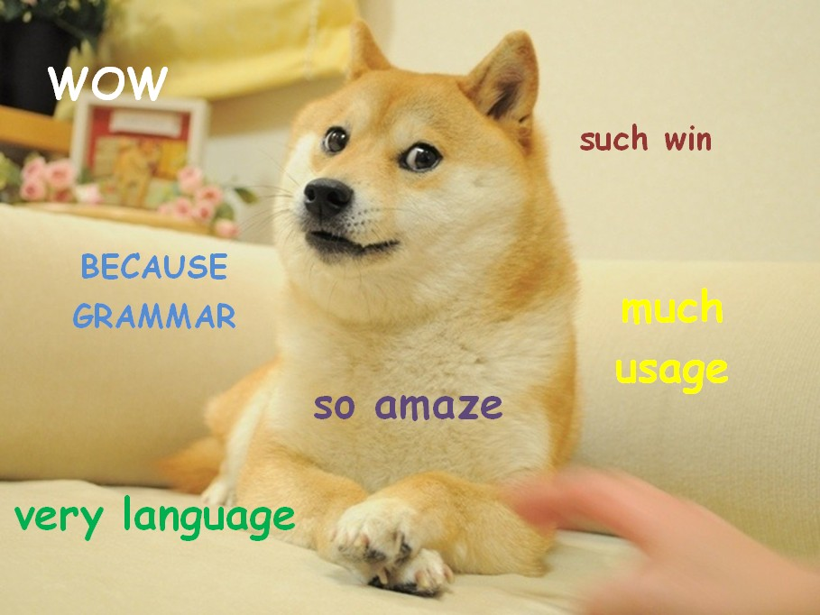
Dogebot:
Part of Speech Tagging using the hidden Model

Slide 2
Objective
Part of Speech tagging
Input sentences into a program, whereupon each word in the sentences is assigned a part of speech
The cow jumped over the moon.
art
noun
verb
prep
art
noun

Slide 3
Markov Model
Start
0.6
0.4
0.7
0.8
Sun
Rain
0.3
0.2

Slide 4
Hidden Markov Model (HMM)
Markov Process
X₁
X₂
X₃
X₄
X₅
X₆
A₁
A₂
A₃
A₄
A₅
O₁
O₂
O₃
O₄
O₅
O₆
Observations

Slide 5
Hidden Markov Model (HMM)
Observations are words inputted by the user
Each observation(O_{1,} O₂…) is assumed to be dependent on a state (X_{1,} X₂…).
We cannot see the state (thus it is hidden)
Can guess the states based on the observed words
After each observed word, the state can change (A_{1,} A₂…)
Probabilities of changing states depends ONLY on current state

Slide 6
Part of Speech Tagging and HMM
Words are observations
Parts of speech are states
Probability of states changing are stored in a dictionary
Some combinations such as “article-noun” and “noun-verb” are perhaps more likely to occur than “article-prep” and “prep-adjective”
Calculate probabilities of possible part of speech sequences
Highest probability = part of speech sequence

Slide 7
Implementation
Brown Corpus Processing: Importing information from the Brown Corpus and creating a dictionary with part of speech combinations and states – in other words, calculating probabilities for part of speech chains across the entire corpus, in addition to part of speech probabilities for each word.
Tokenization: Separating out words so that we can have a series of “observations”. This systematically strips punctuation from input and splits into word arrays.

Slide 8
Implementation
Iteration: Given series of words, create an array of all possible combinations of parts of speech. This is anchored on the words that have only one possible part of speech based on the corpus – words such as “banner,” “action,” “a.”
Collapse: Given an array of possible combinations, this function calculates the probabilities for each word’s part of speech both based on the dictionary of word-word relationships and based on the dictionary of word-part of speech probabilities. This returns the highest probability combination.

Slide 9
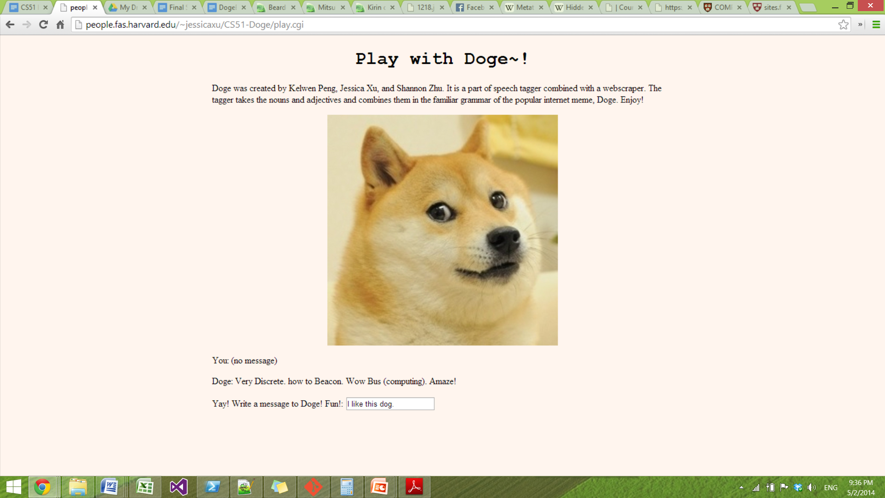
Welcome to NerdDoge!

Slide 10
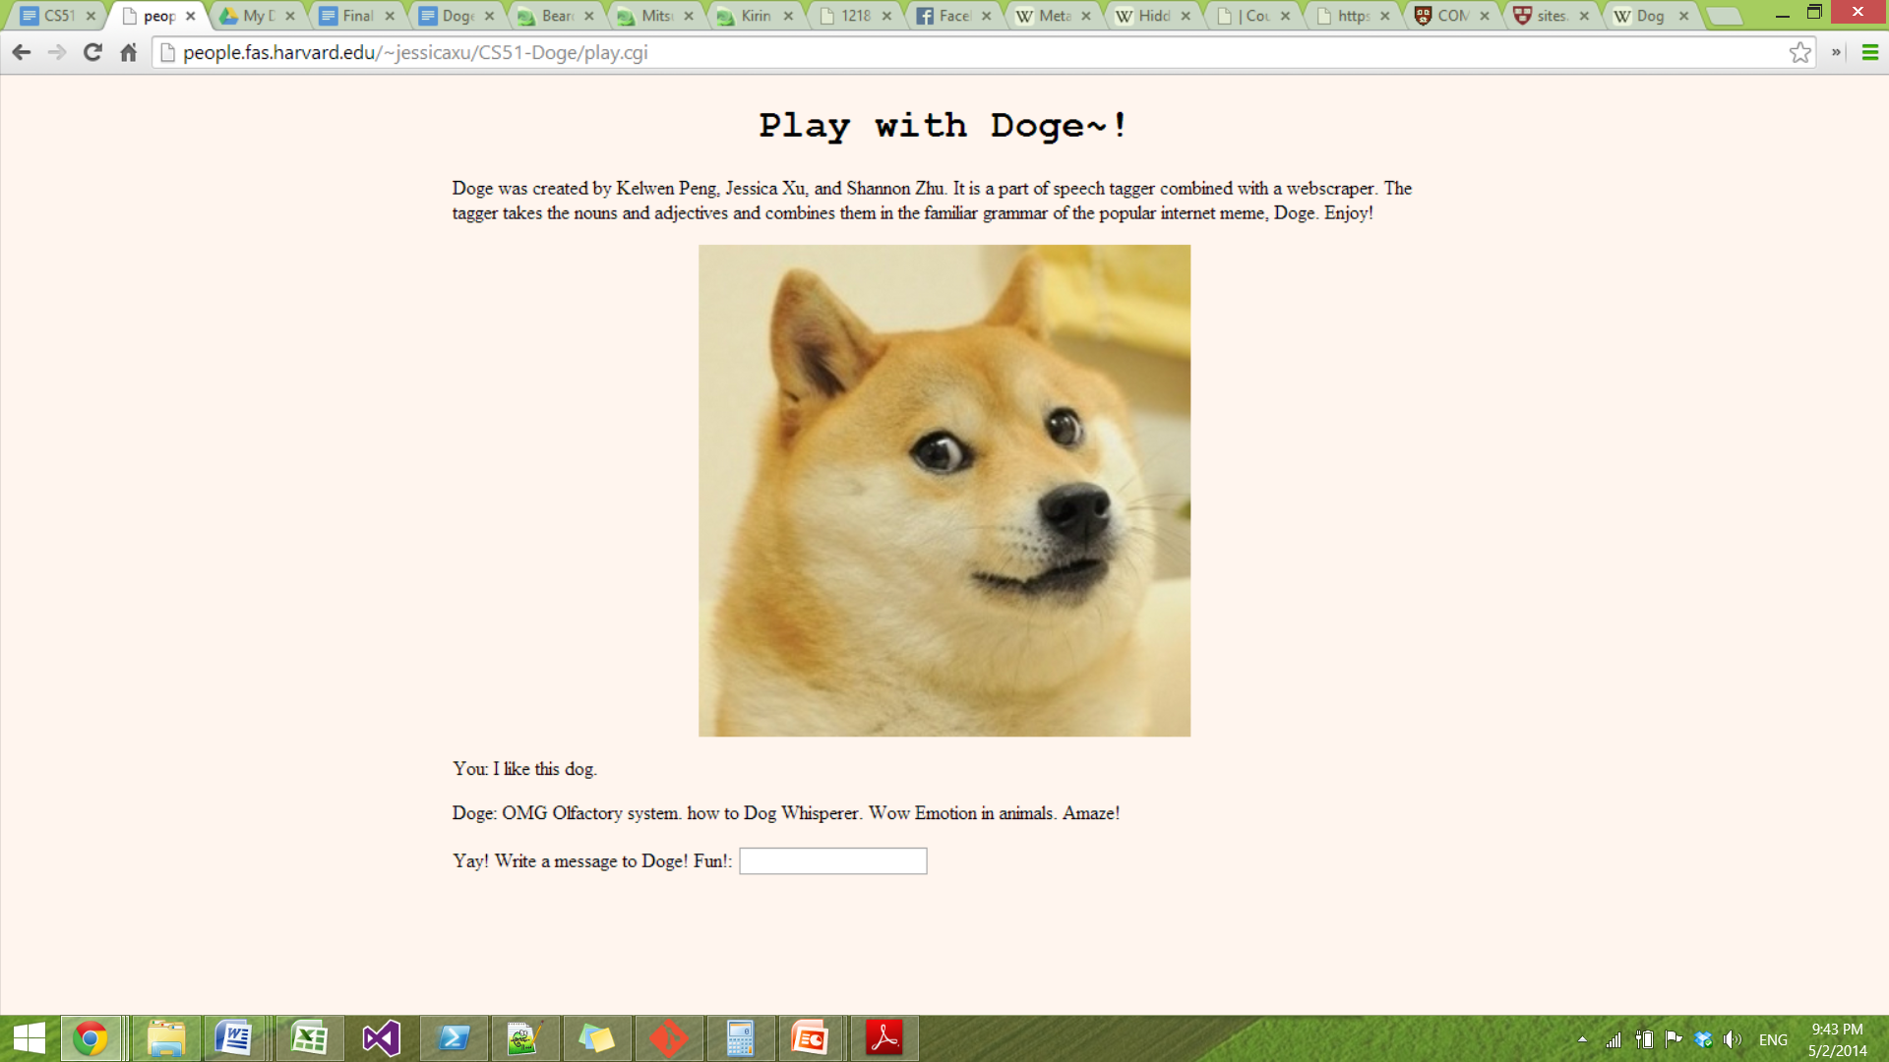
The NerdDoge speaks!

Slide 11
Reflections
We learned a very significant amount about how to understand the Hidden Markov Model, and why it is powerful when there is no direct source to find hidden information.
Overall, we believe that we were fairly successful in implementing this project. We were able to get the Hidden Markov Model up and running, and it seems to effectively tag most of the parts of speech. While there are some uncertainty when it comes to words not in the dictionary, some of our decisions do help.

