Slide 1
PROJECT 4: DATA VISUALIZATION
Turning Raw Data Into Boardroom-Ready Insights
Jesse Trevor Koch | DecodeLabs Industrial Training

Slide 2
Business Operated Stable Through 2023 - $552,643 Revenue, 510 Orders
$552,643.24
2023 Revenue
510
2023 Orders
$1,083.61
Avg Order Value
1,200
Total Orders
Source: orders table (1,200 rows, 14 columns), 2.5 years of data (Jan 2023 – Jun 2025)

Slide 3
Revenue Declined 13.1% in 2024 - Q4 Dropped 22.2%
↓ 13.1%
2024 Revenue Decline
↓ 22.2%
Q4 2024 vs Q4 2023
↓ 4%
AOV Erosion per Year
So what: The decline is systemic, not seasonal — 3 of 4 quarters declined

Slide 4
Three Actions to Reverse the Decline by Q4 2025
01
Rebuild Q4 Strategy
02
Lift AOV Through Bundling
03
Convert One-Time Buyers
Each action targets a specific driver of the decline

Slide 5
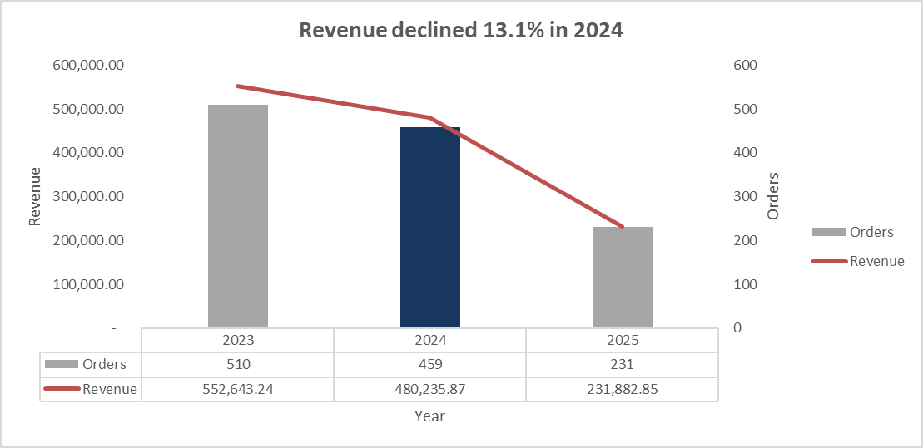
Revenue Declined 13.1% in 2024 - Q4 Recovery Is Critical
[
So what: Q4 2025 recovery determines whether the full-year decline reverses or compounds

Slide 6
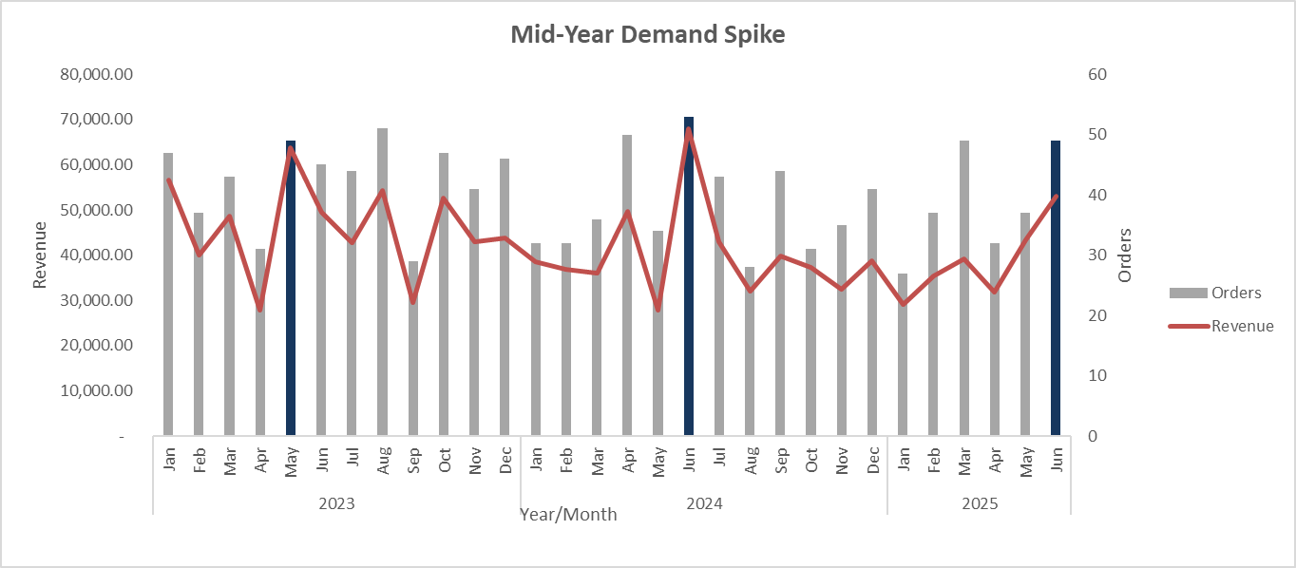
Mid-Year Demand Spike
So what: Inventory and staffing should scale up ahead of May/June each year

Slide 7
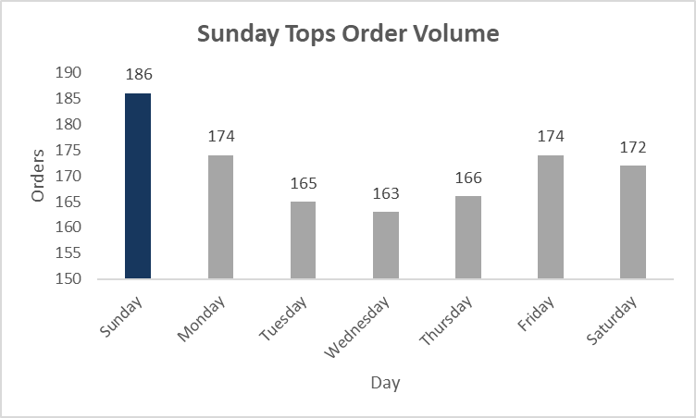
Sunday Tops Order Volume at 186 Orders
So what: Shift customer service to cover Sunday peaks

Slide 8
Pricing Drives Order Value
So what: Bundling higher-priced items is the fastest lever to lift AOV

Slide 9
Next Steps - Stop the Decline by Q4 2025
Key Insights
Revenue declined 13.1% in 2024, with Q4 falling 22.2% year-over-year
3 of 4 quarters were down, not just seasonal
Pricing correlates strongly with order value (r = 0.72), supporting a bundling strategy
Action | Owner
Rebuild Q4 Strategy | Sales
Lift AOV Through Bundling | Merchandising
Convert One-Time Buyers | Marketing

