Slide 1
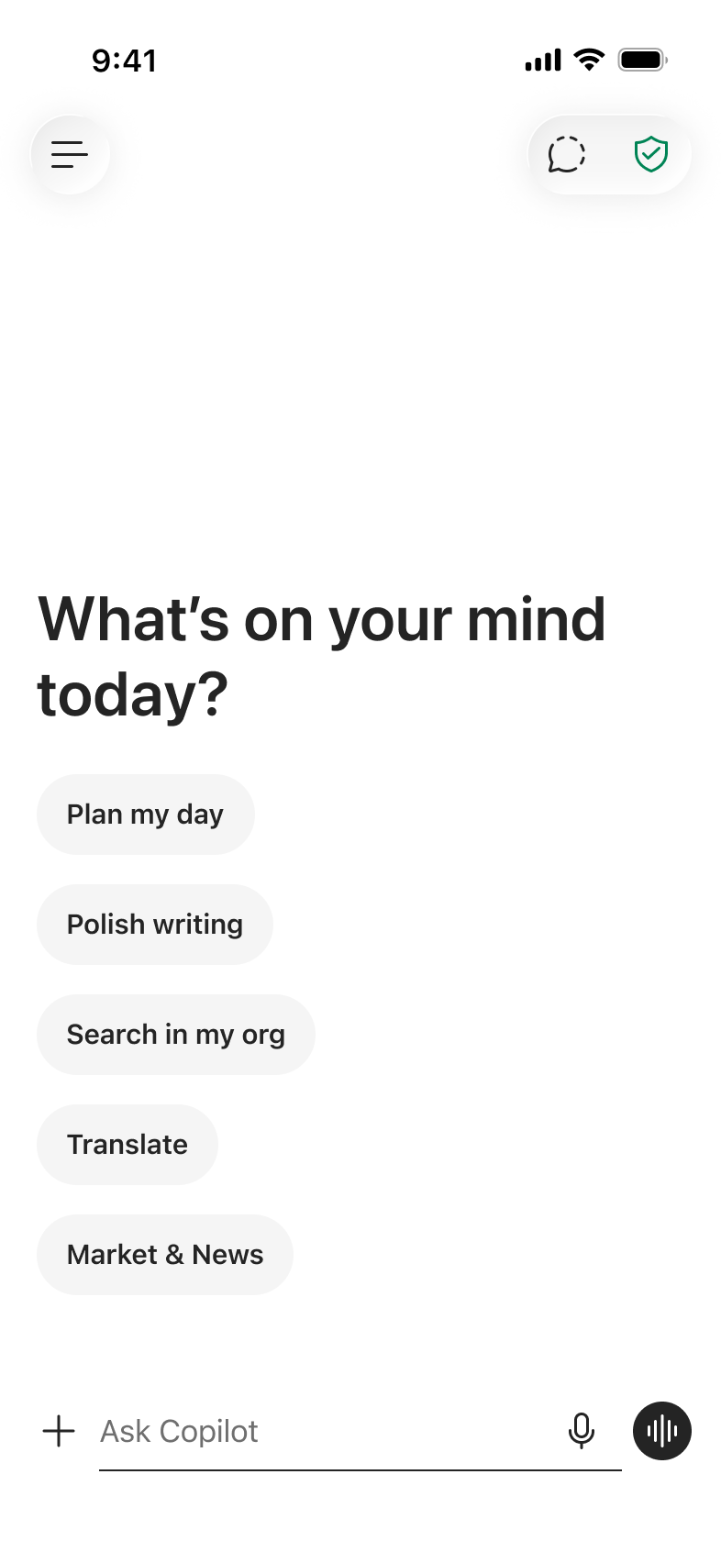
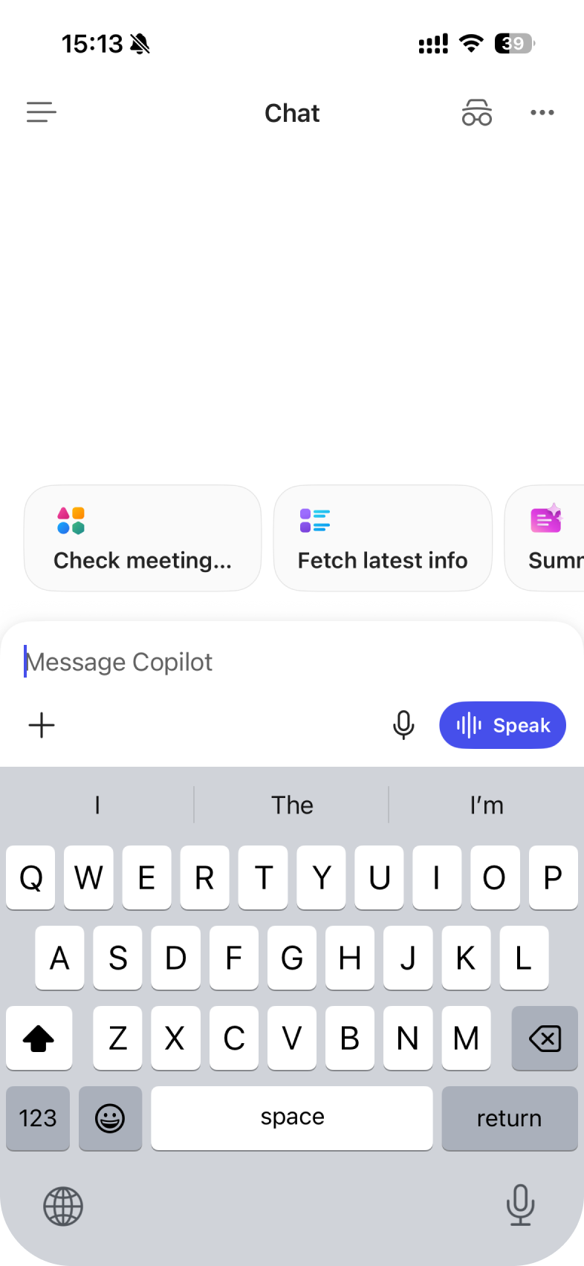
Bebop 5% WW
Scorecard
Analysis
Recommendation: Hold at 5%. Do not expand.
PR179825216(T) vs PR1798252C15(C) | Mar 31 – Apr 12, 2026 | ~89K vs ~87K users
1

Slide 2
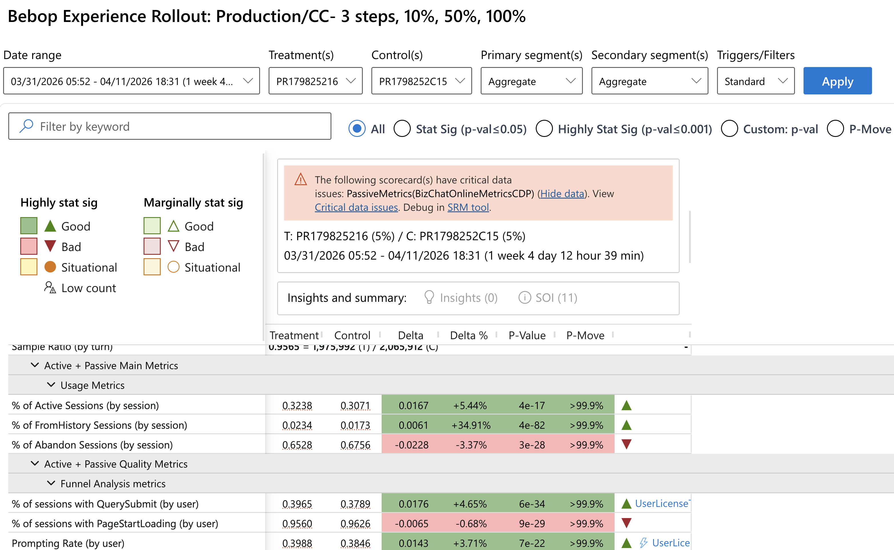
Two stories in one flight
Bebop succeeds at getting users in — but fails at keeping them satisfied
Activation
Quality
ZQ engagement
6.27%
vs 2.33%
+169%
Stop Generating
1.79%
vs 1.30%
+38.2%
Active sessions
32.38%
vs 30.71%
+5.44%
Message DAU
18.18%
vs 18.65%
-2.52%
Query submission
39.65%
vs 37.89%
+4.65%
Sessions / UU
3.563
vs 3.691
-3.45%
Prompt rate (by users)
42%
vs 2.33%
+3.71%
Thumbs up/down is flat — users don't rate bad responses, they just leave.
Behavioral signals are the true read.
New convo starts
1.25%
vs 1.09%
+15.0%
2

Slide 3
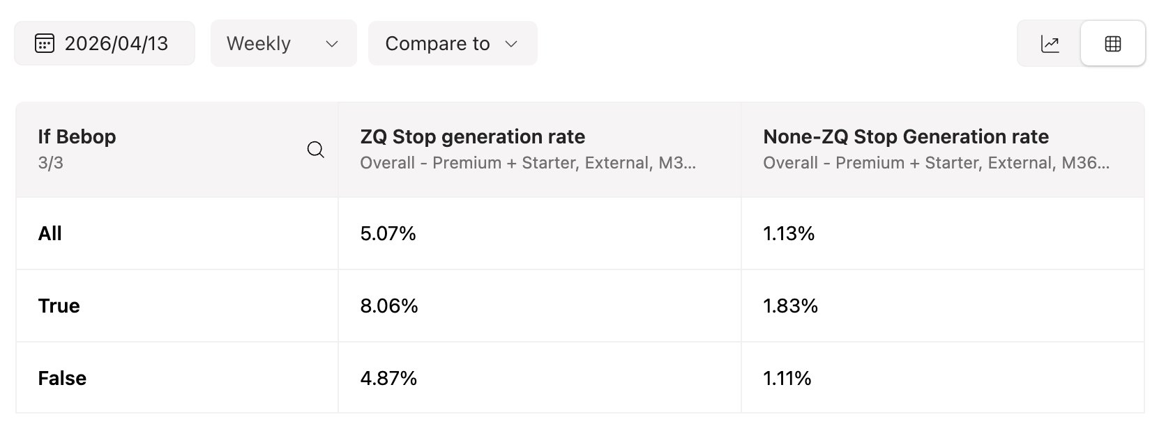
Hypotheses - Why stop generation is high
User would try ZQ as test and quit since ZQ is not personalized and latency is high
Responds is slow
Async capability is not enabled
Web/Work tab is removed and user cannot switch between work and web

Slide 4
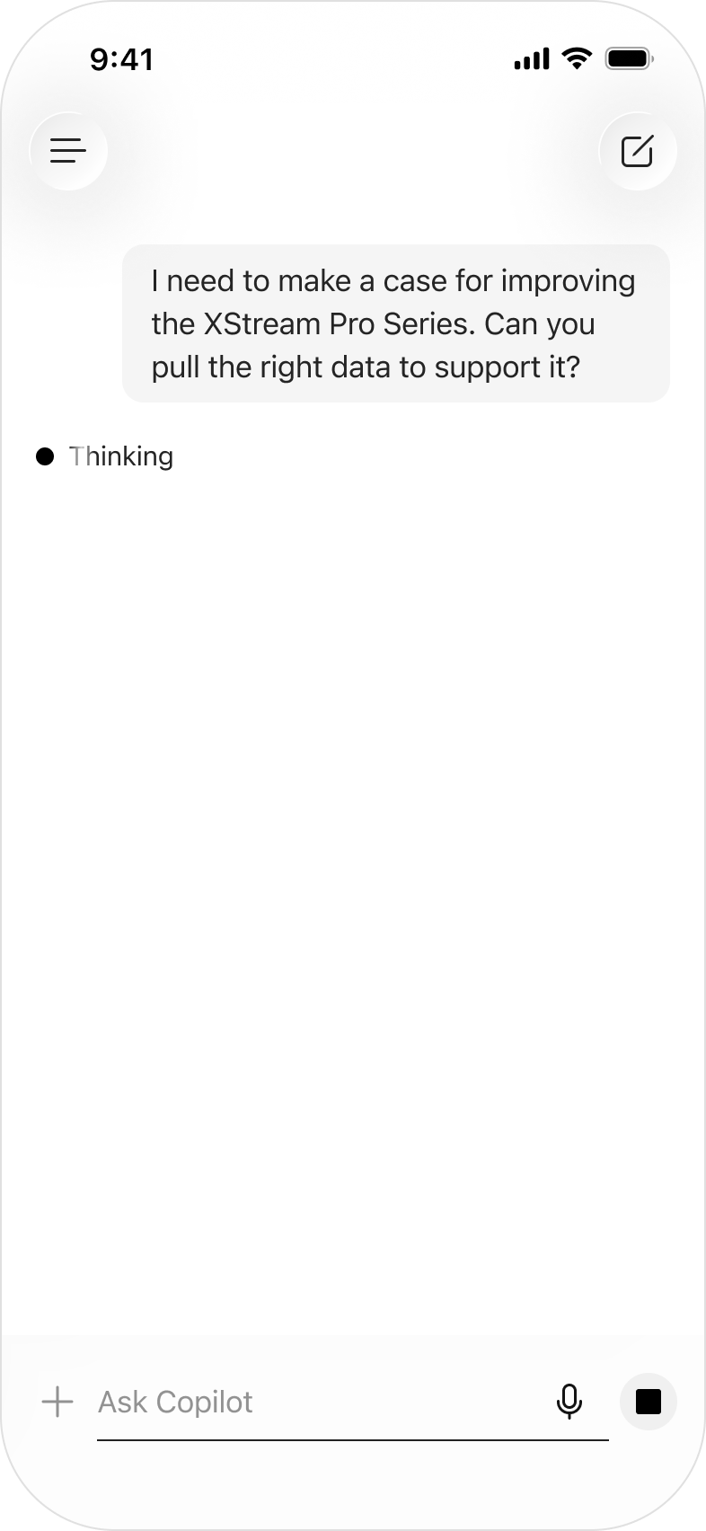
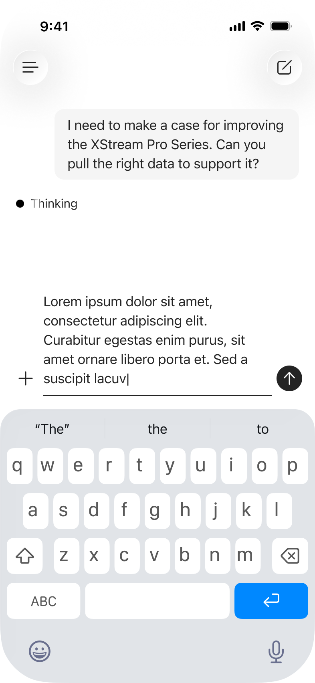

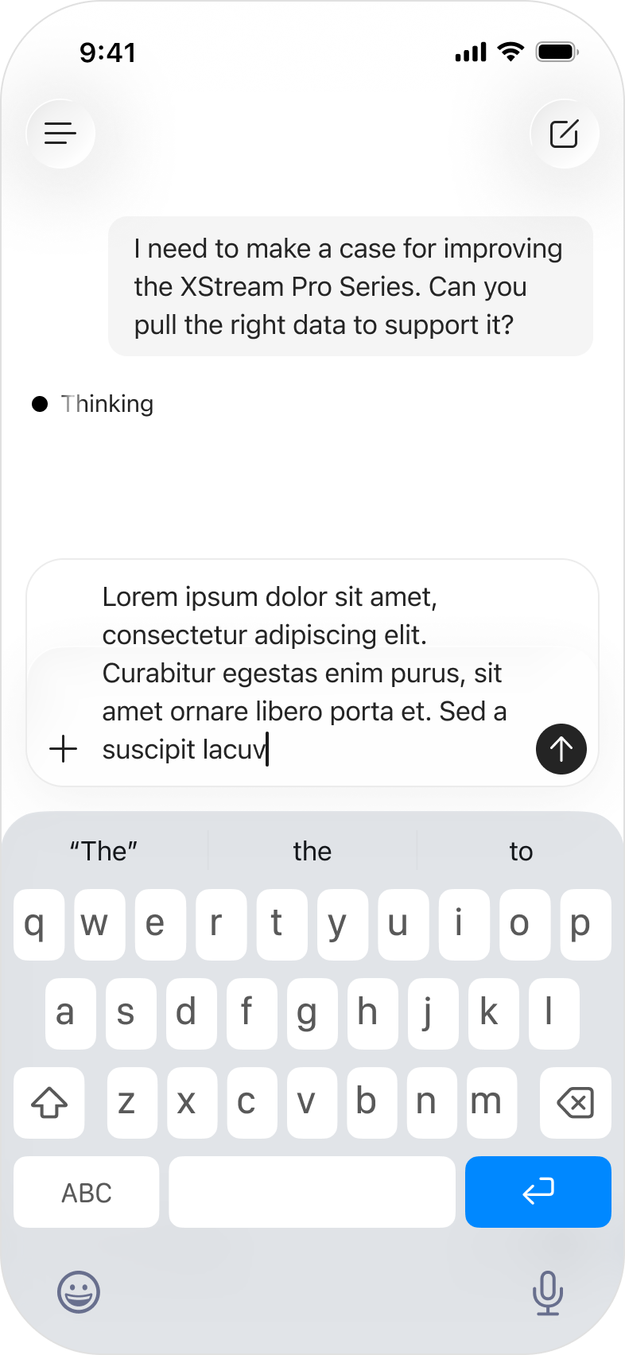
Next steps – Experiments
Experiment with different ZQ
Add animation for Thinking status
Queued- prompt

Slide 5
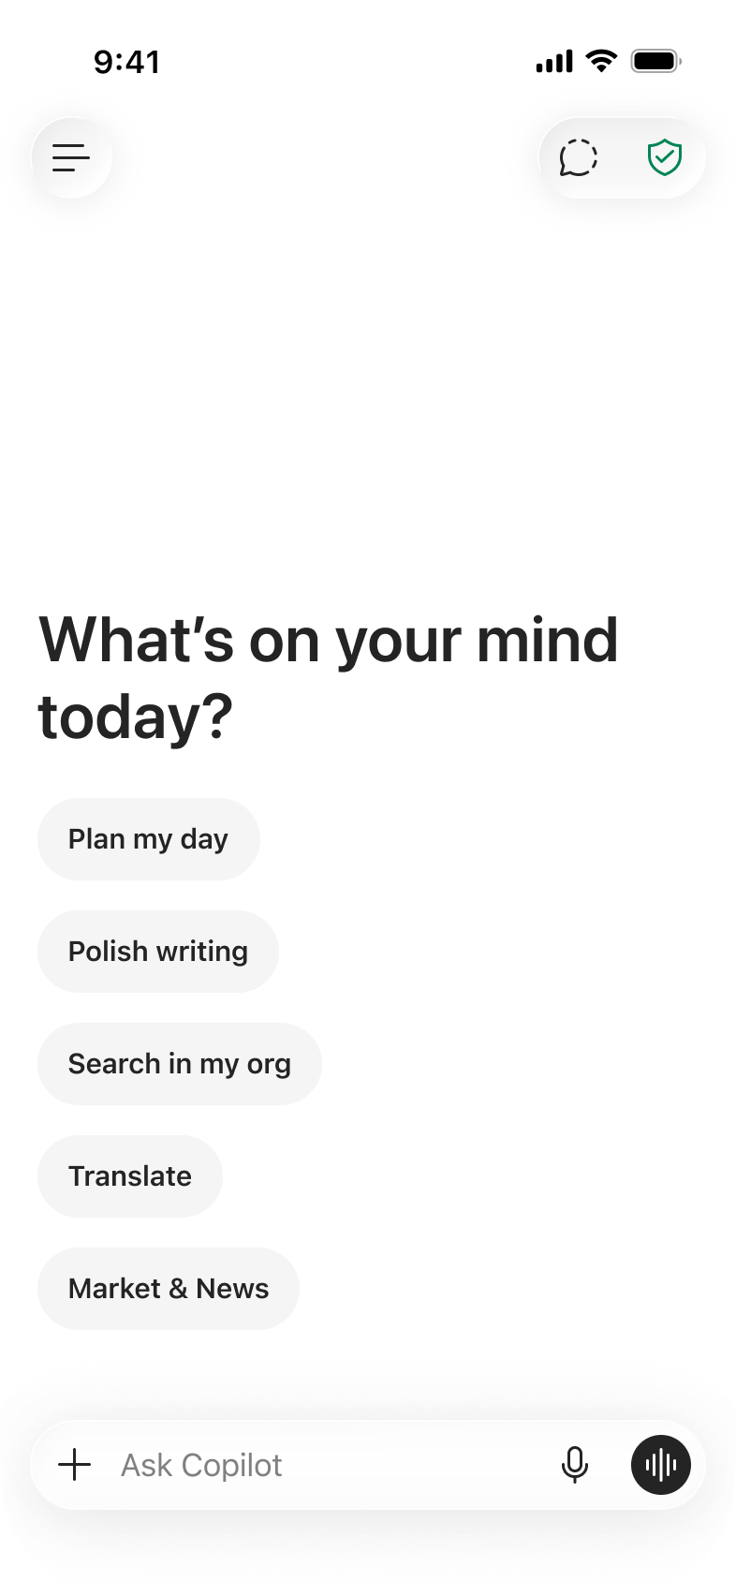
Current - Prompt line
Experiment B - Liquid Glass prompt box
Next steps – Experiments

