Slide 1
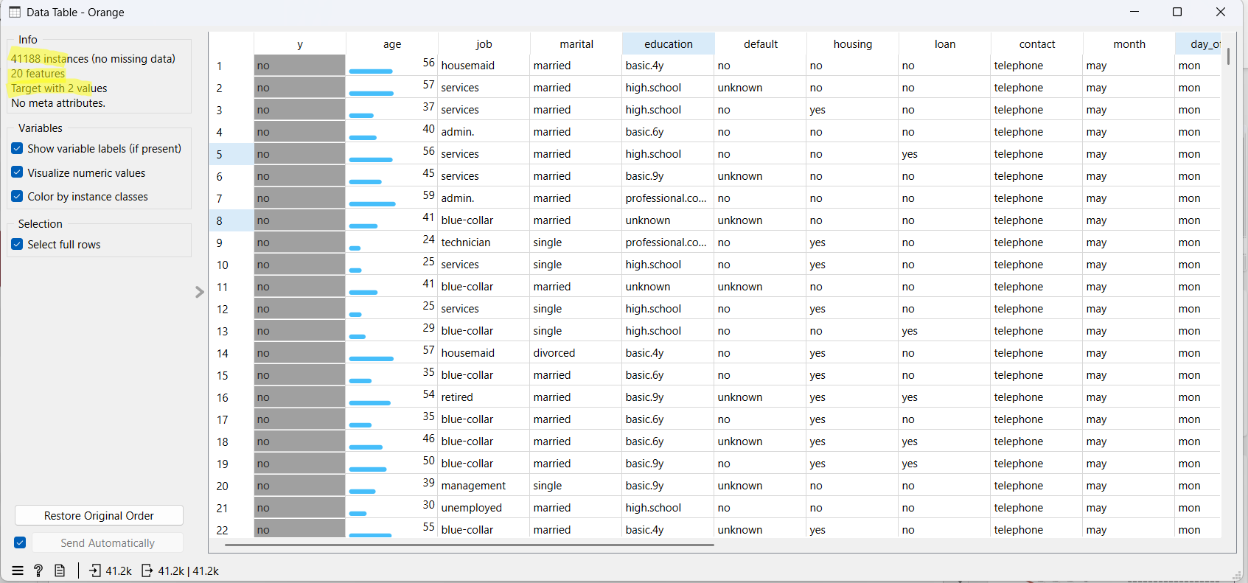
Data Input (41,188, 20 features, 2 target values)

Slide 2
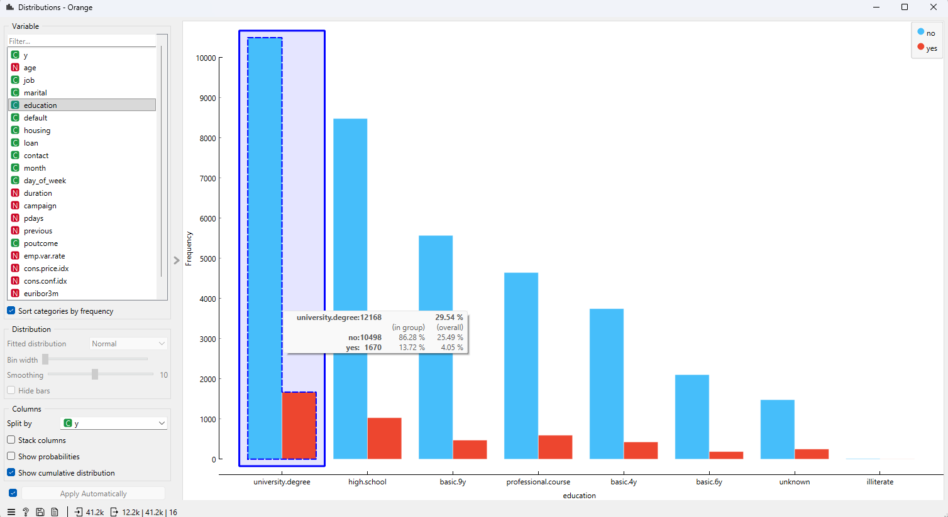
distribution by education and yes/no classification

Slide 3
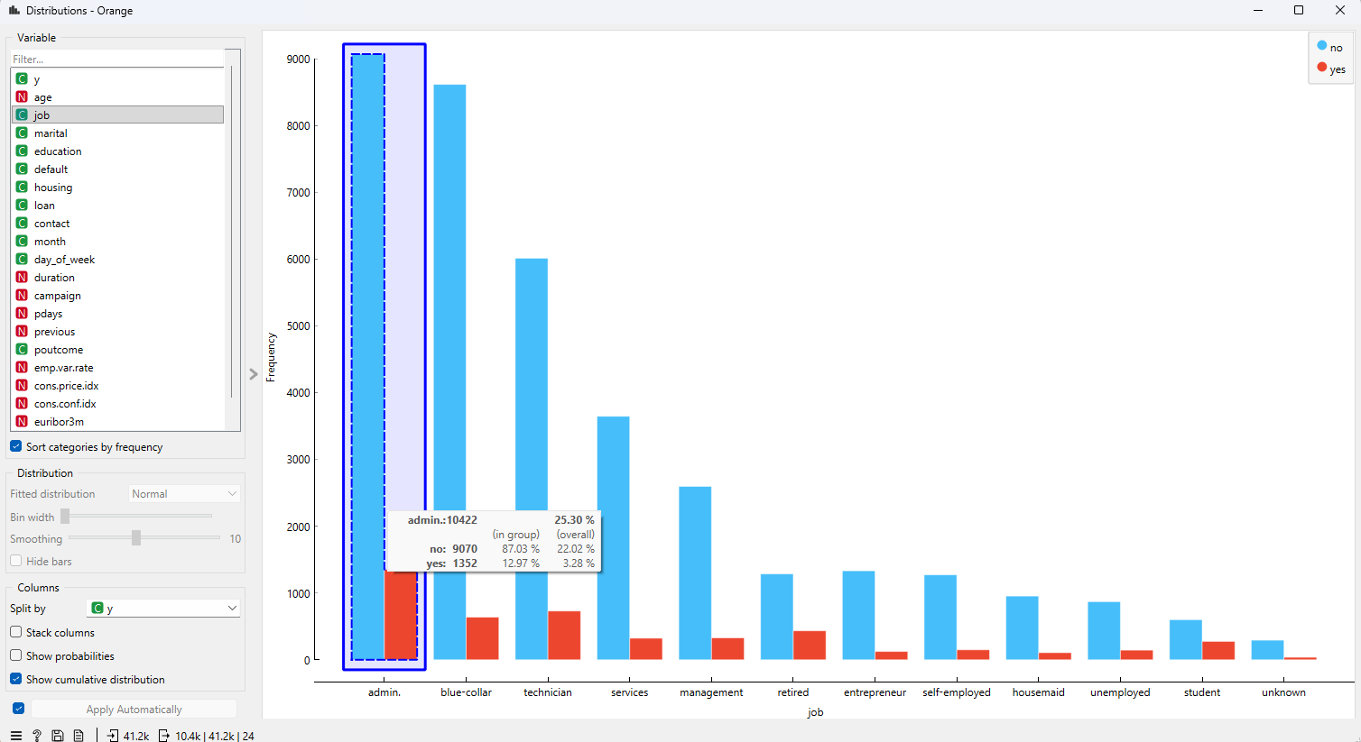
distribution by job and yes/no classification

Slide 4
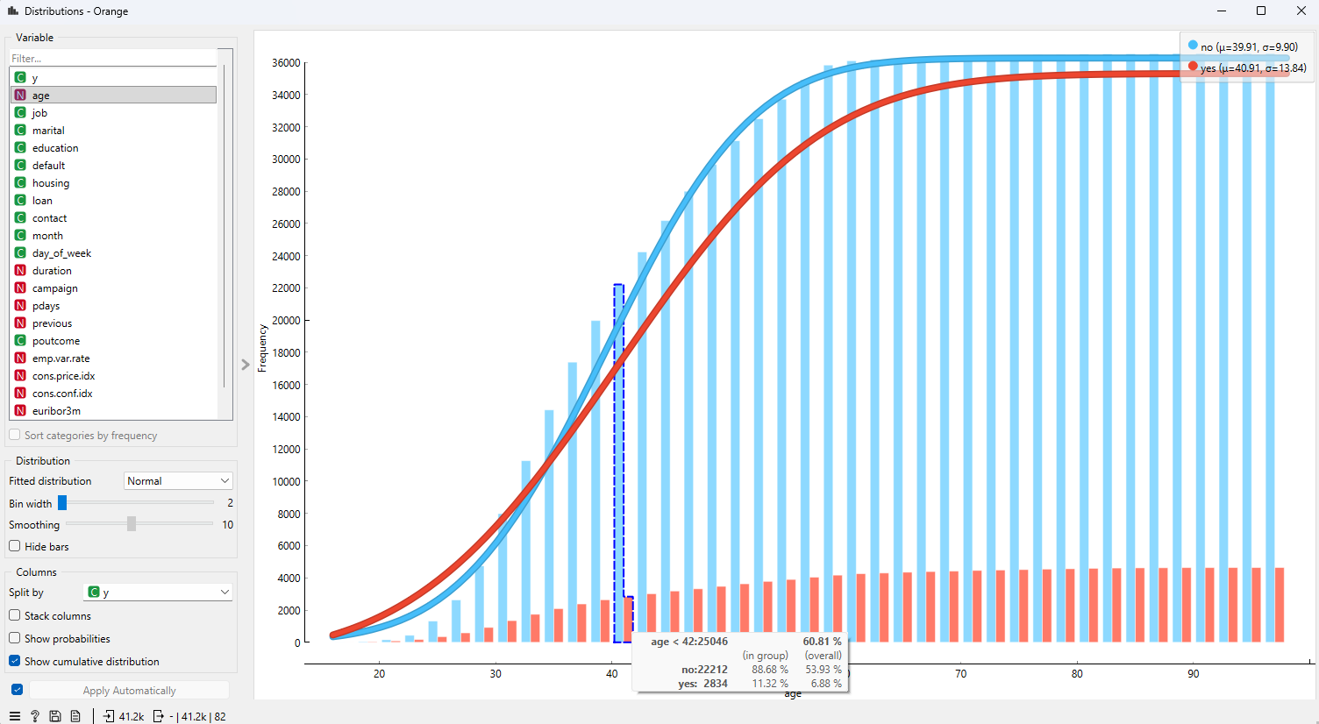
distribution by age and yes/no classification

Slide 5
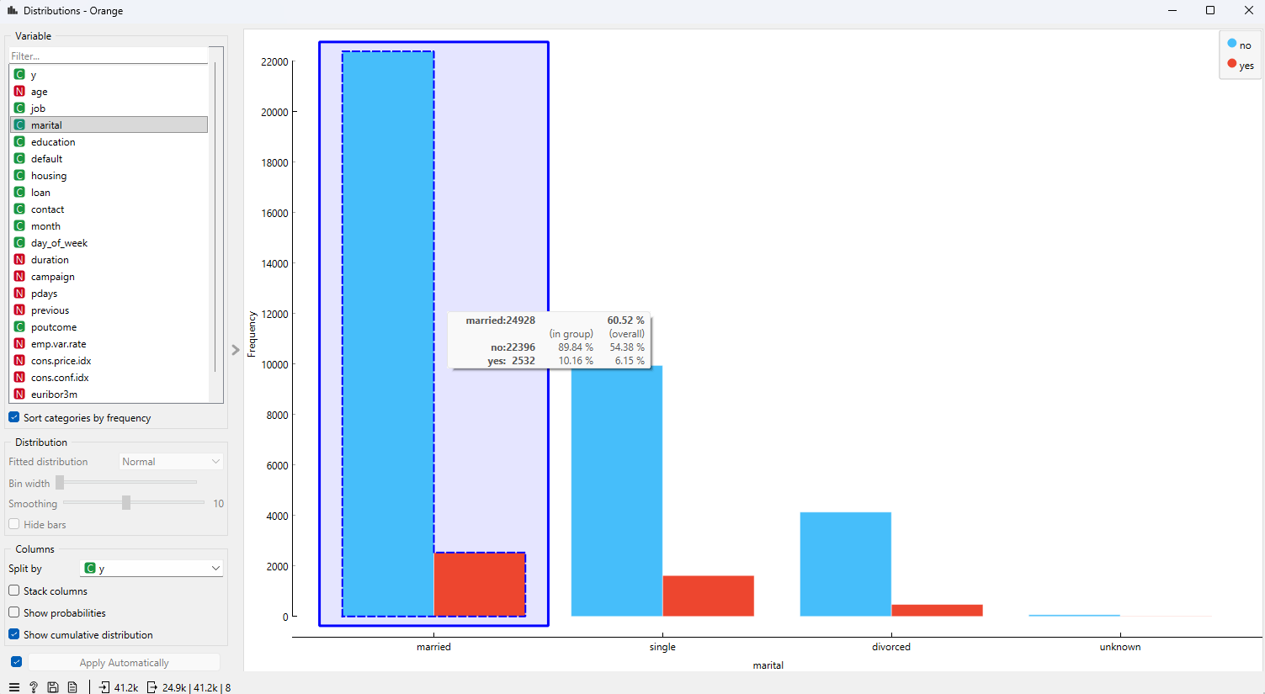
distribution by marital and yes/no classification

Slide 6
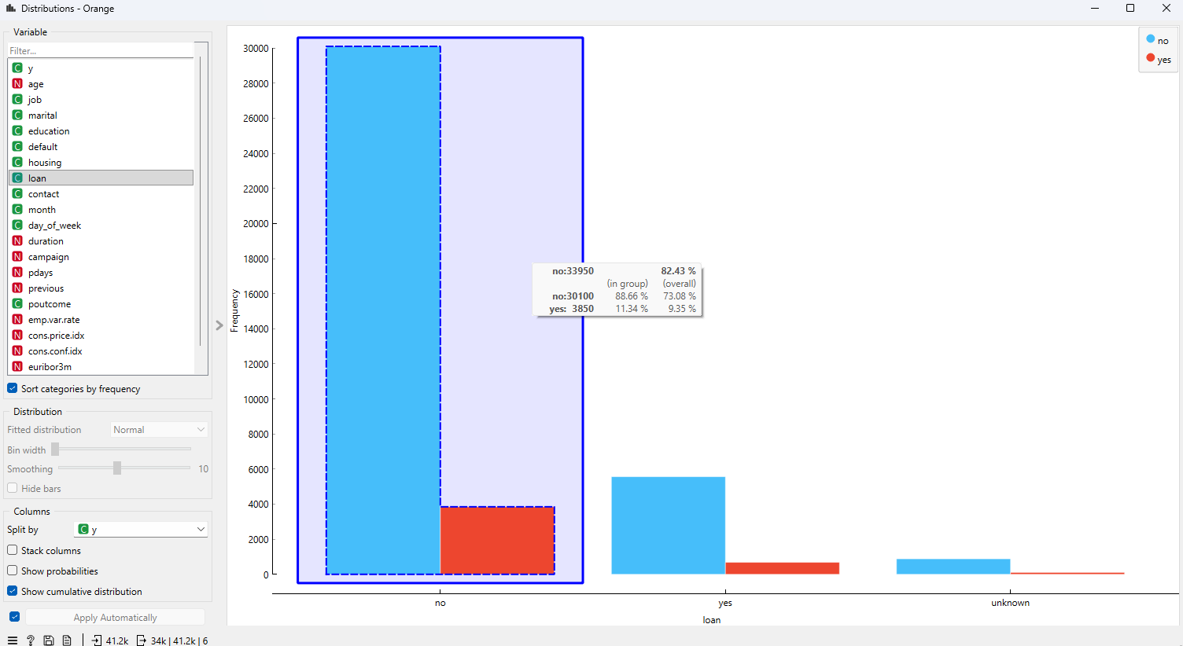
distribution by loan status and yes/no classification

Slide 7
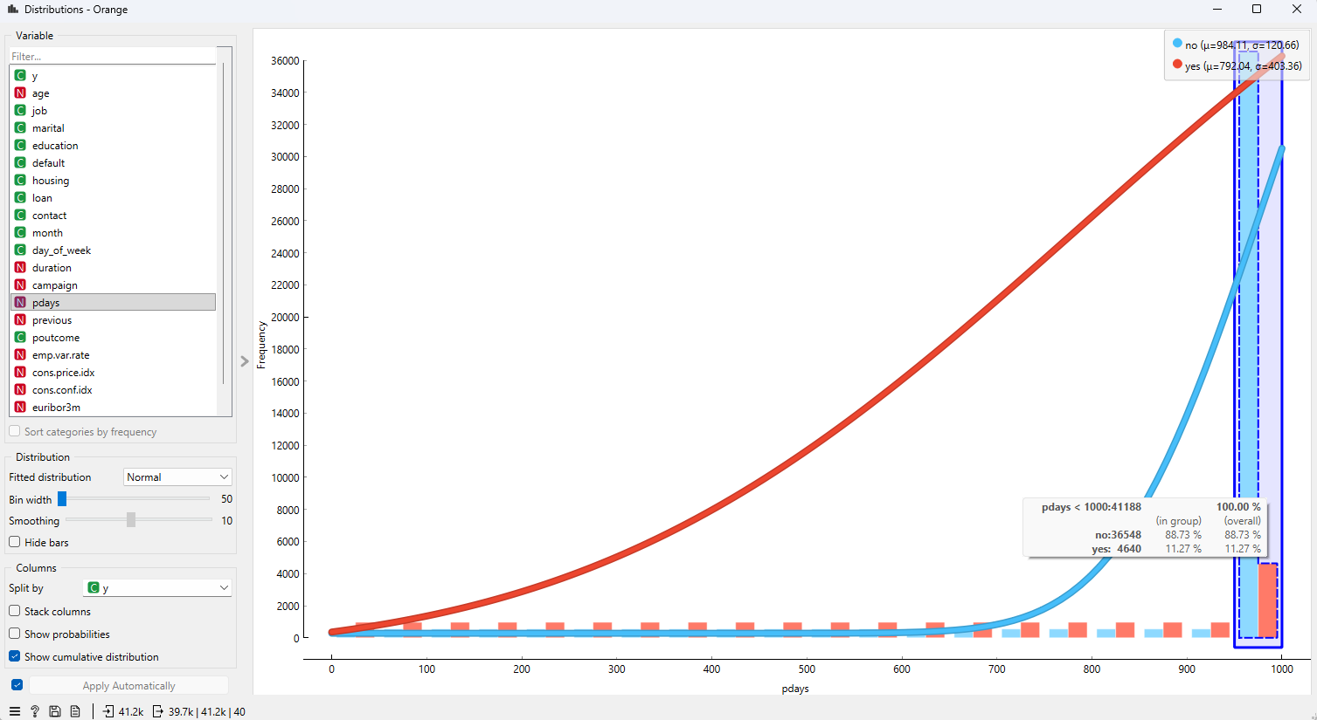
distribution by pdays and yes/no classification 13 - pdays: number of days that passed by after the client was last contacted from a previous campaign (numeric; 999 means client was not previously contacted)
No significant trend on the days count after the last contact

Slide 8
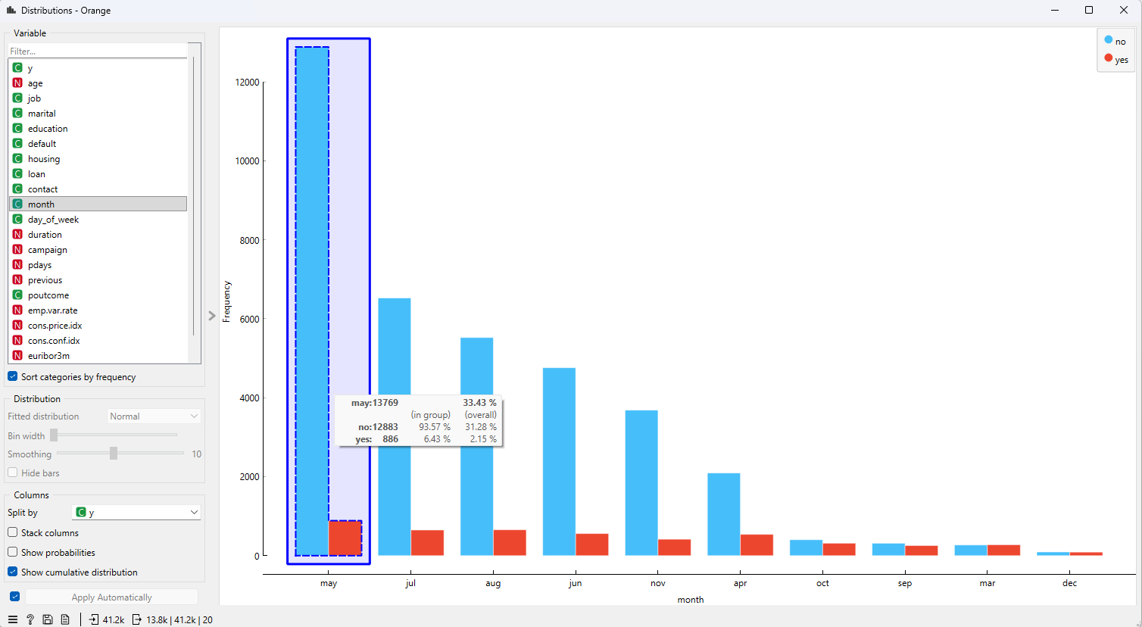
distribution by month and yes/no classification
Not so much change in the yes count, significant low count in December possibly due to lower work days and people are in vacation mode?
May has significant No count

Slide 9
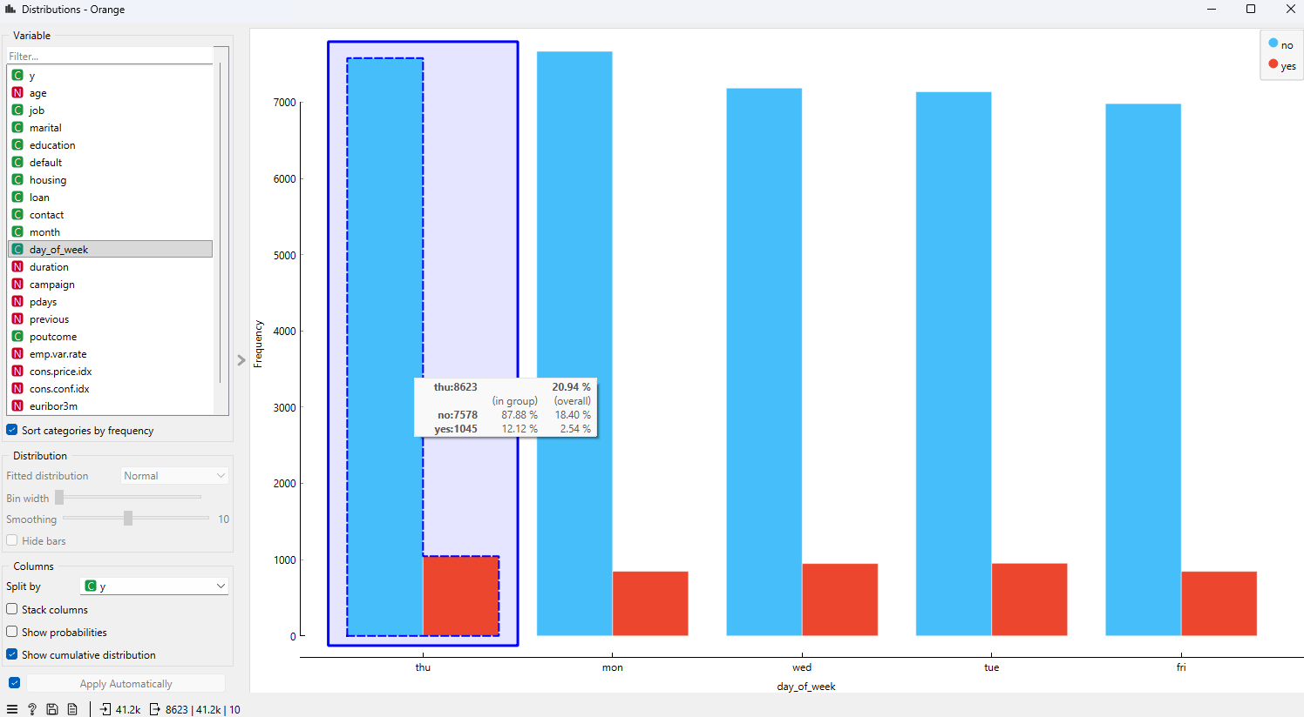
distribution by days of the week and yes/no classification
Appears to have no significant impact on the outcome, yes range is similar

Slide 10
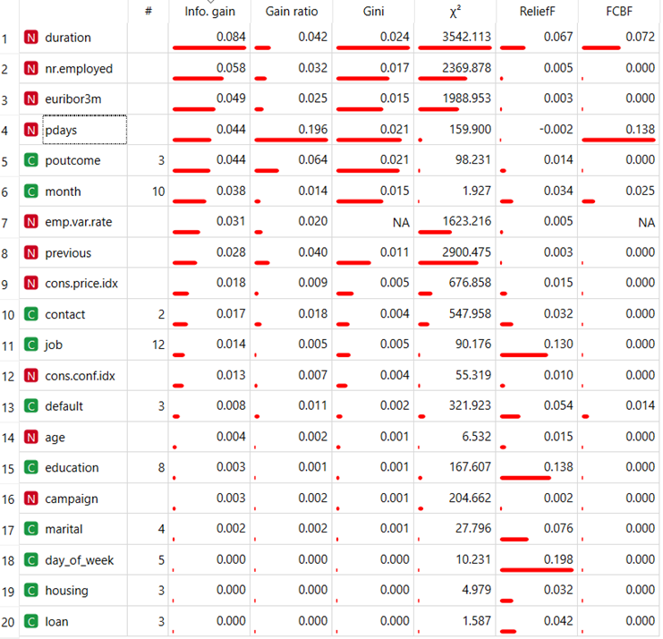
Rank all features
Rank using all features

Slide 11
Rank all 20 features
Rank using all features

Slide 12
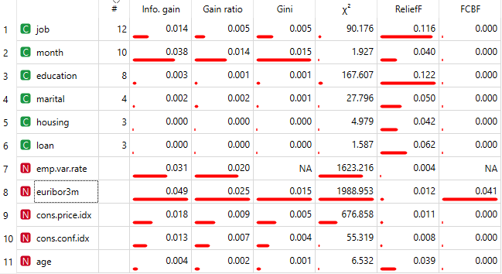
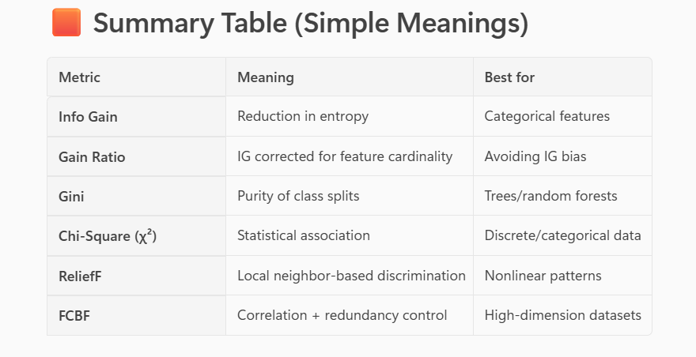
Rank using reduced (11) features
Summary of simple meanings from copilot

