Slide 1
Data Source
Citation Request:
This dataset is publicly available for research. The details are described in [Moro et al., 2014].
Please include this citation if you plan to use this database:
[Moro et al., 2014] S. Moro, P. Cortez and P. Rita. A Data-Driven Approach to Predict the Success of Bank Telemarketing. Decision Support Systems, In press, http://dx.doi.org/10.1016/j.dss.2014.03.001
Available at: [pdf] http://dx.doi.org/10.1016/j.dss.2014.03.001
[bib] http://www3.dsi.uminho.pt/pcortez/bib/2014-dss.txt

Slide 2
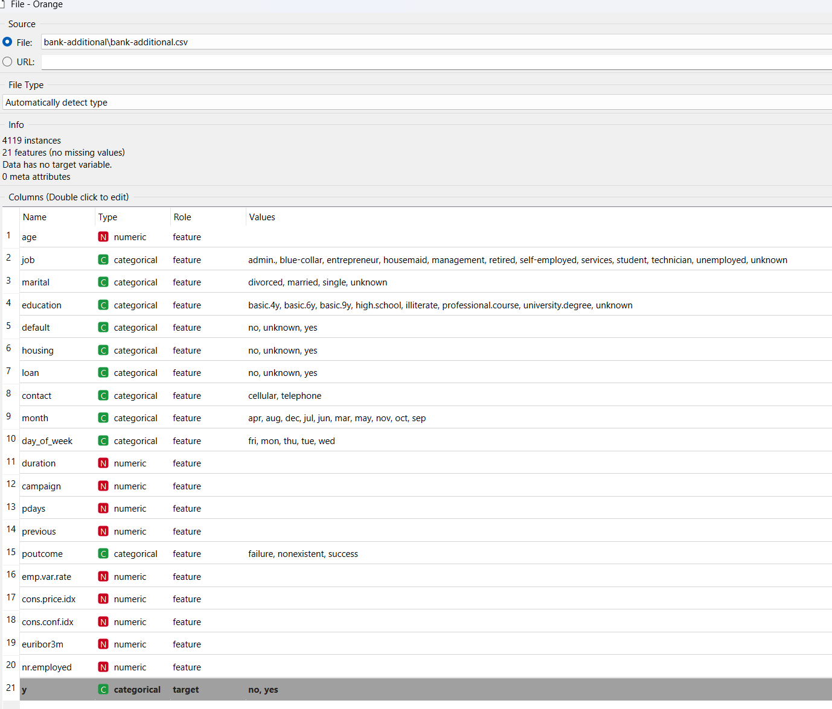
Data Input

Slide 3
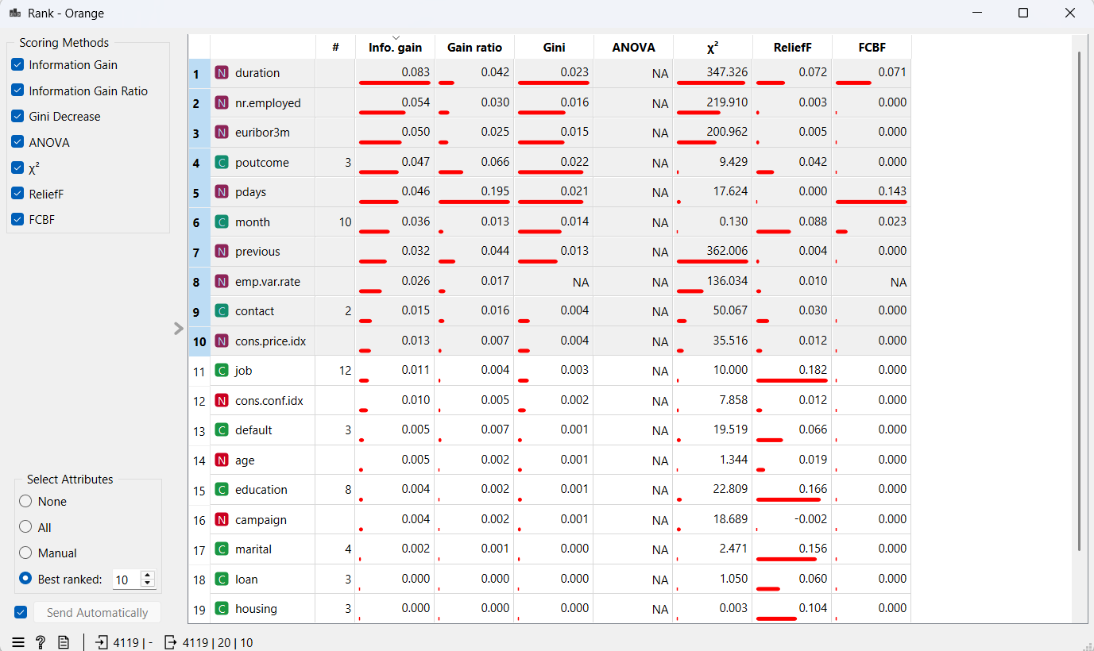
Rank all data

Slide 4
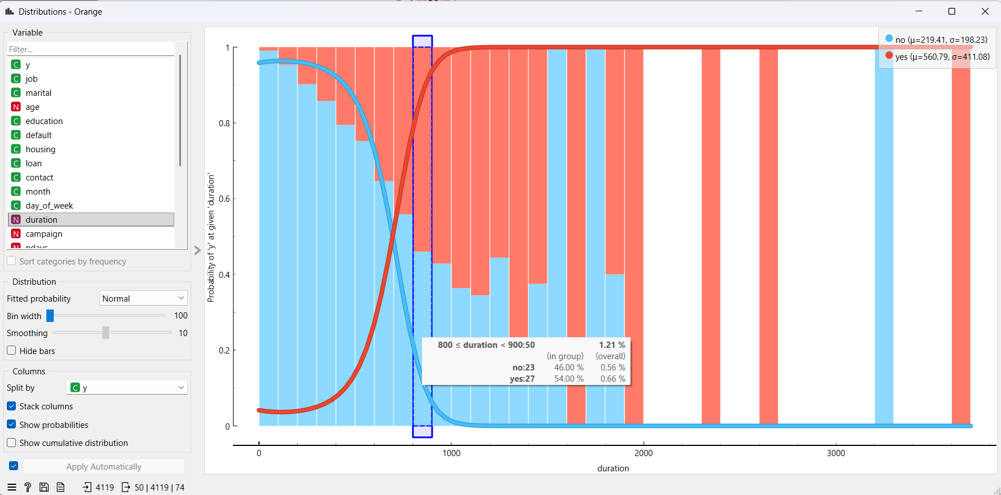
11 - duration: last contact duration, in seconds (numeric). Important note: this attribute highly affects the output target (e.g., if duration=0 then y="no"). Yet, the duration is not known before a call is performed. Also, after the end of the call y is obviously known. Thus, this input should only be included for benchmark purposes and should be discarded if the intention is to have a realistic predictive model. Comments: last call duration ≤800 seconds is 54% (27/50) yes and appears to be increasing the longer the calls; all blue bars of longer calls thereafter are statistically low client count (e.g. 0/2, 0/1 and 0/1)

Slide 5
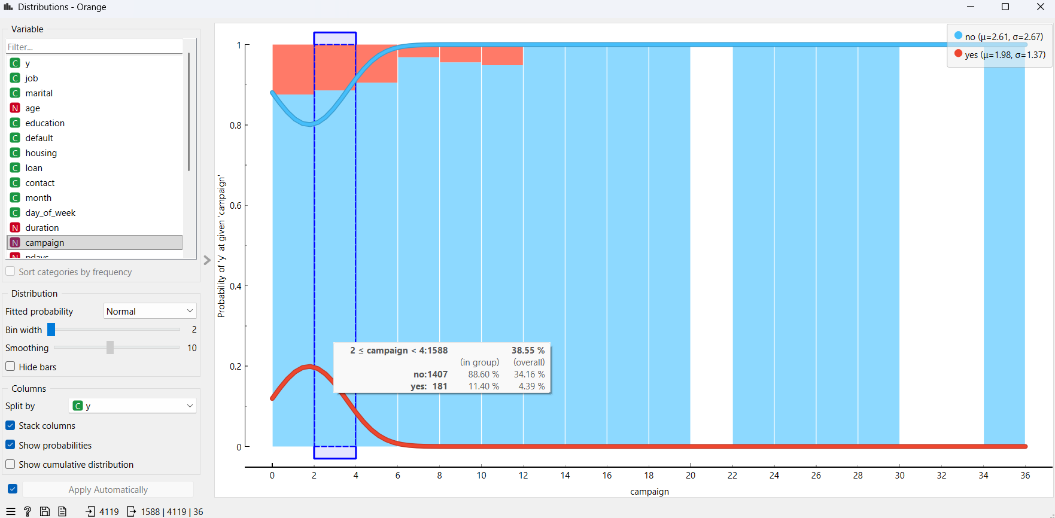
12 - campaign: number of contacts performed during this campaign and for this client (numeric, includes last contact) Comments: call attempts 2-4 is at 11.4% yes and decreasing after with no “yes” after 12 attempts

Slide 6
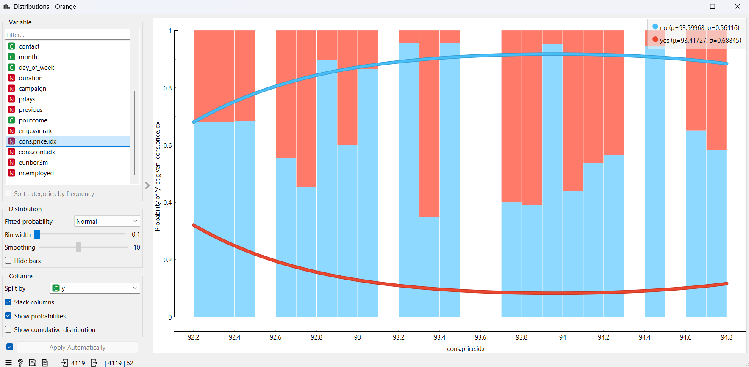
17 - cons.price.idx: consumer price index - monthly indicator (numeric) Comments: some localized anomaly with very low “yes’ percentage

Slide 7
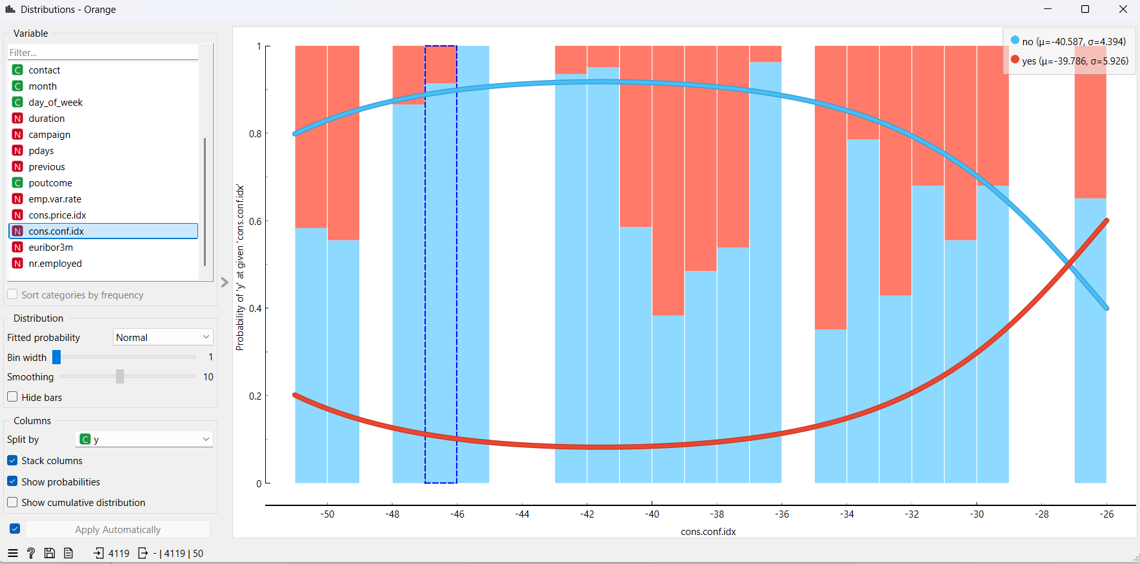
18 - cons.conf.idx: consumer confidence index - monthly indicator (numeric) Comments: some localized anomaly with very low “yes’ percentage

Slide 8
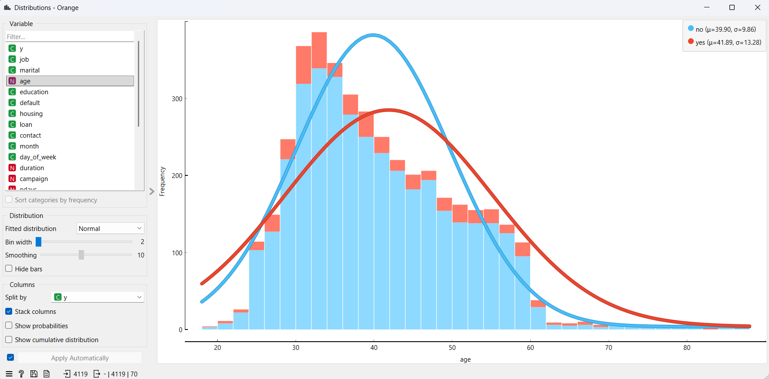
distribution by age and yes/no classification

Slide 9
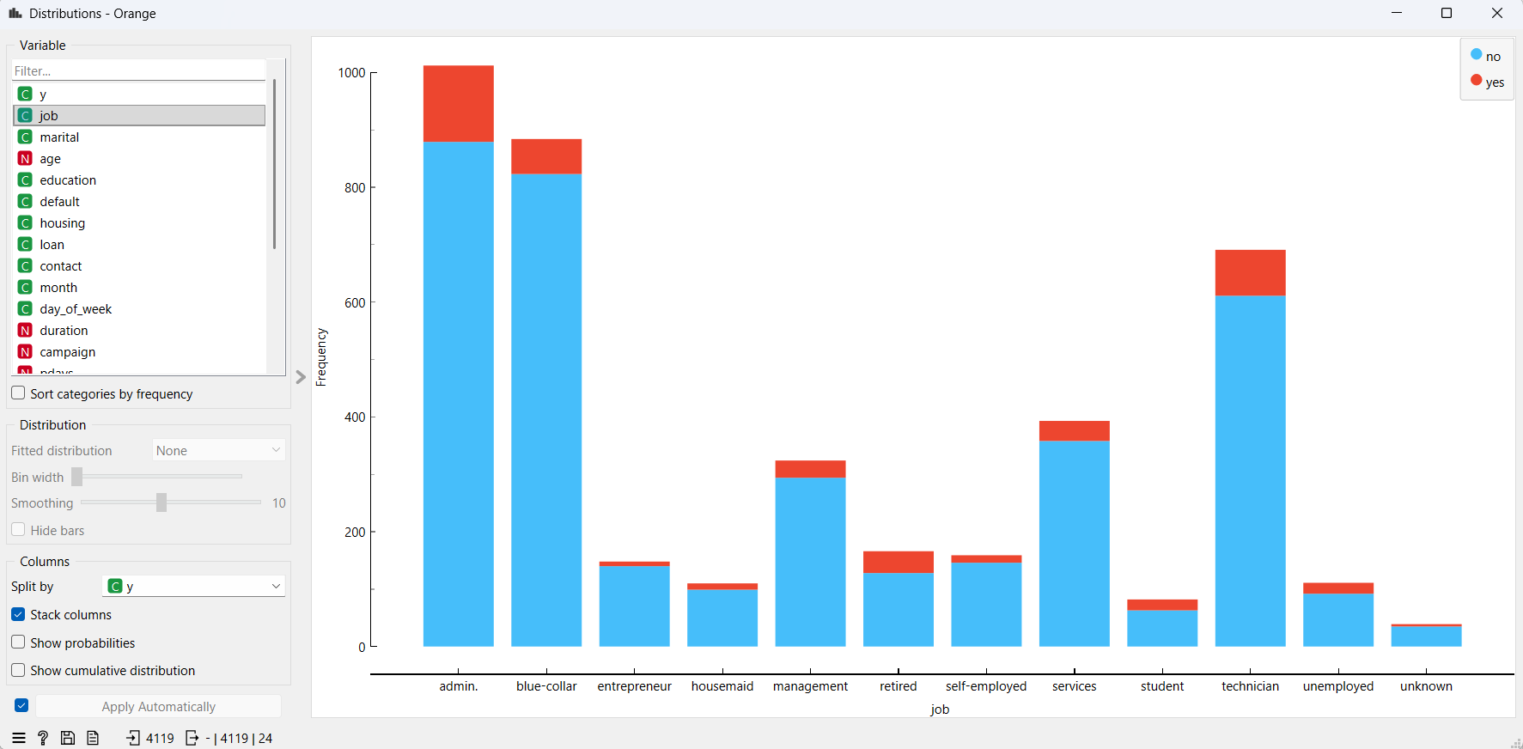
distribution by job and yes/no classification

Slide 10
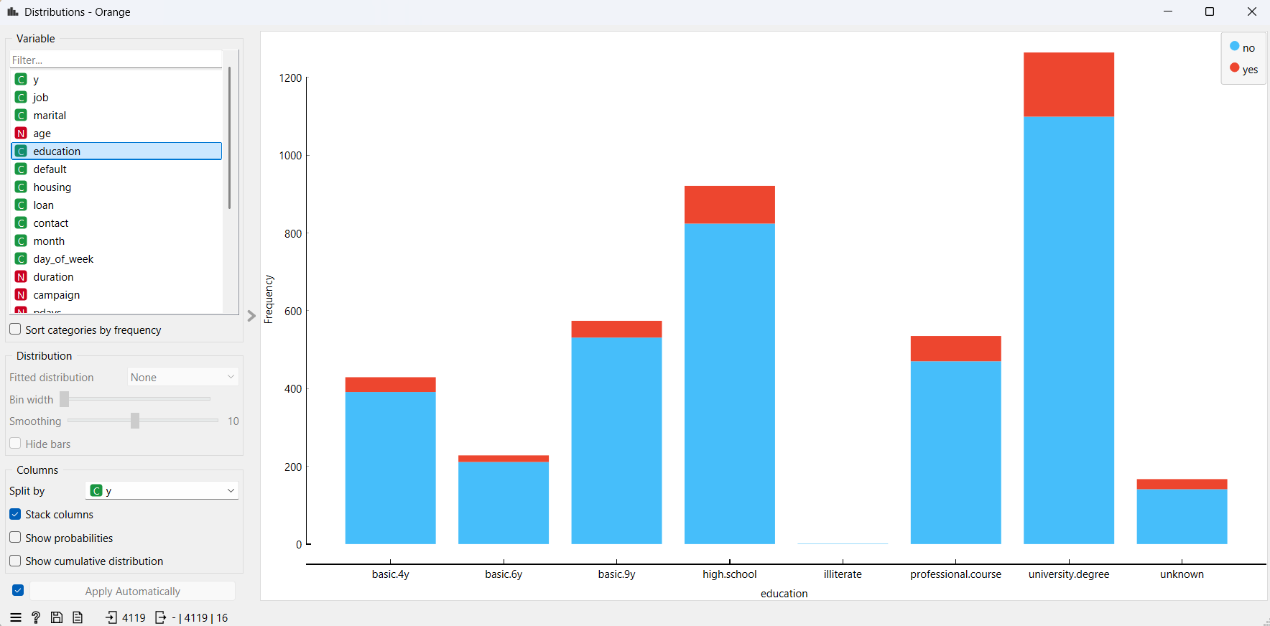
distribution by education and yes/no classification

Slide 11
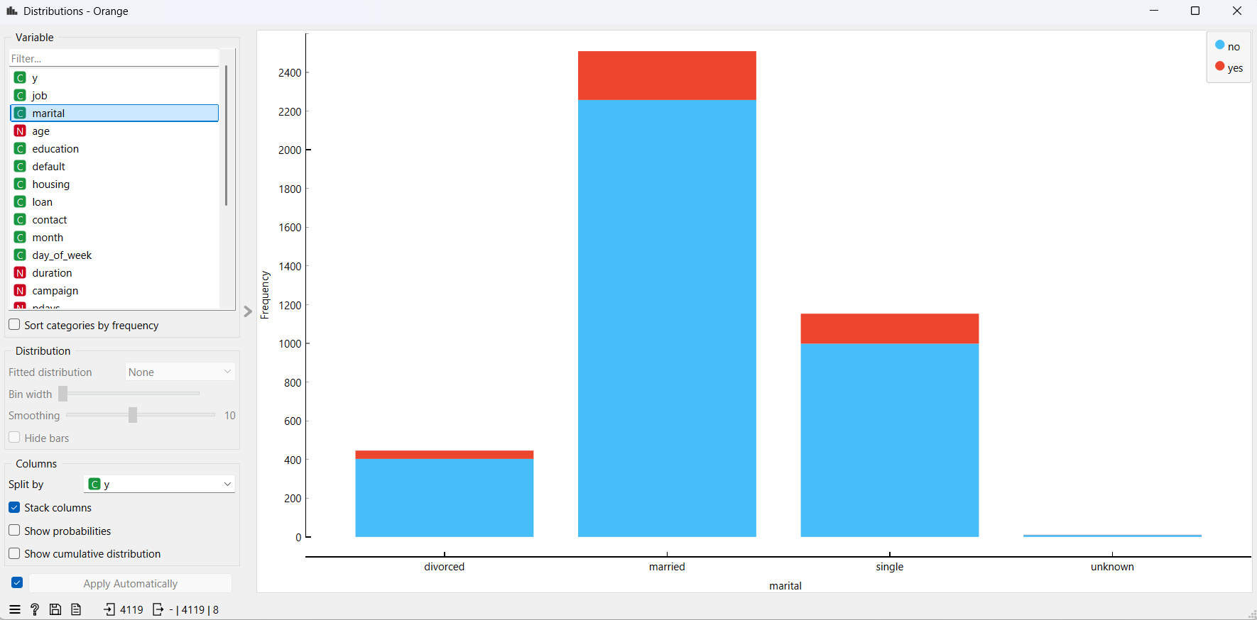
distribution by marital status and yes/no classification

Slide 12
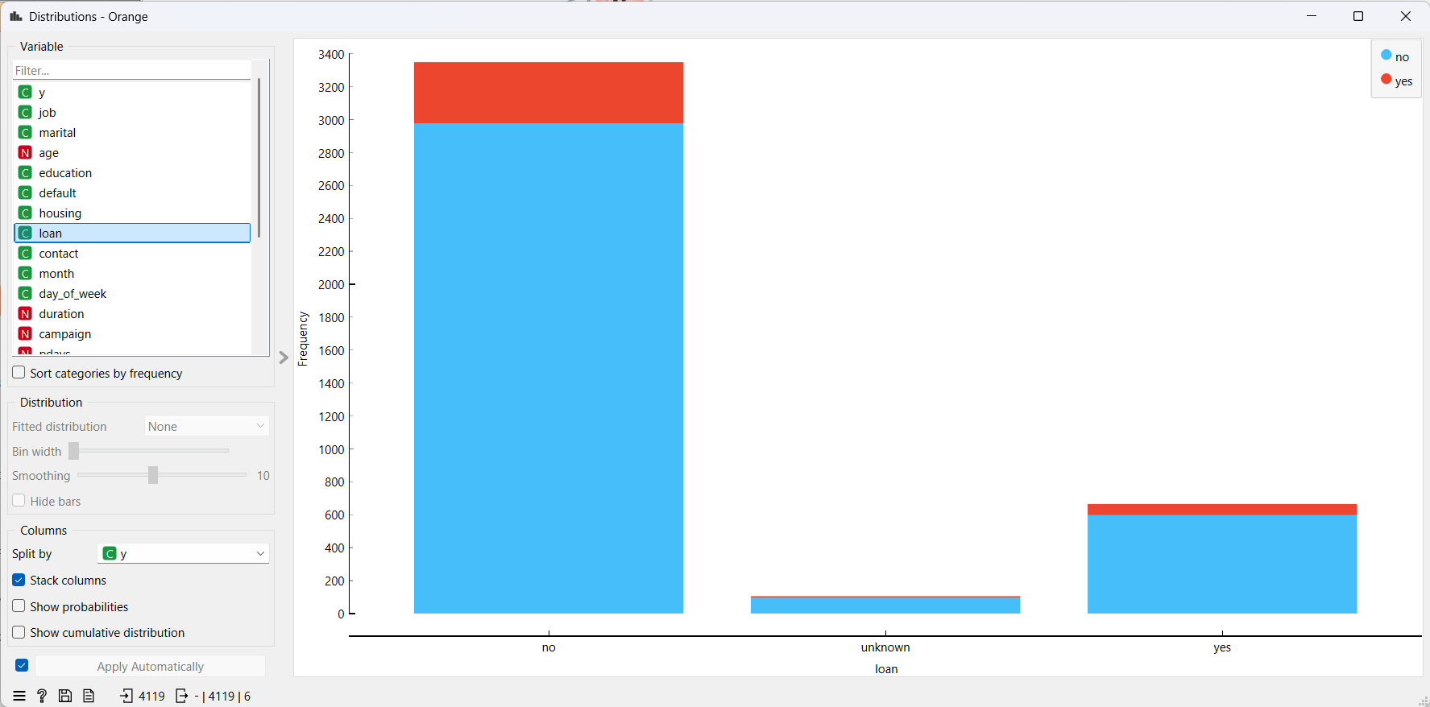
distribution by loan and yes/no classification

Slide 13
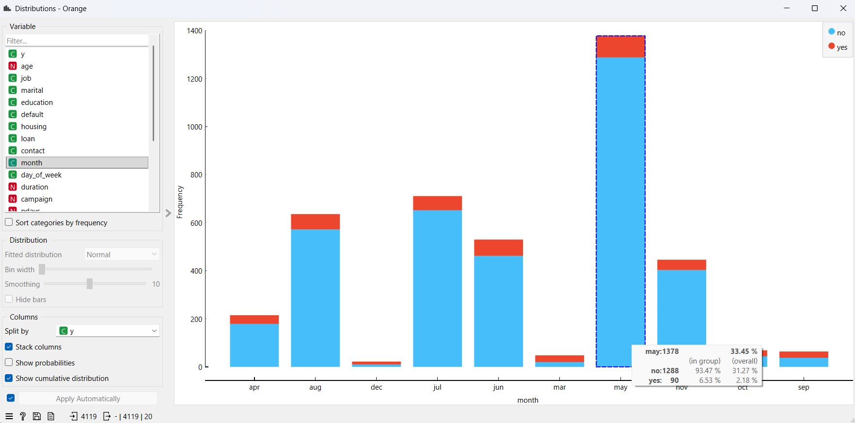



distribution by month and yes/no classification

Slide 14
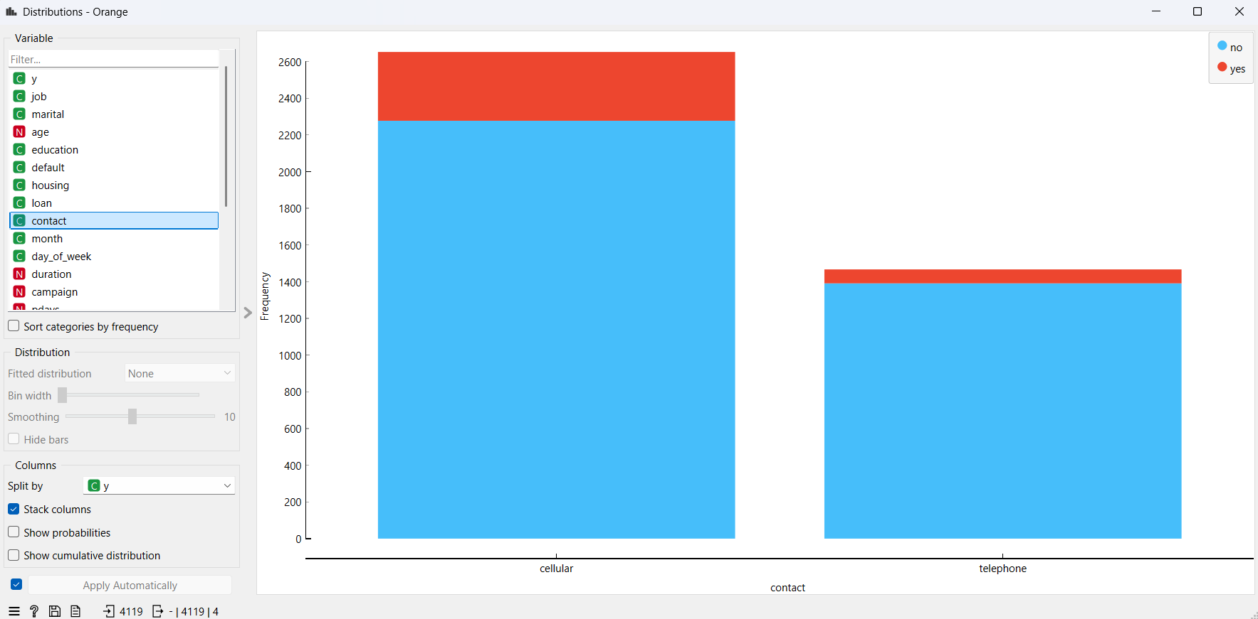
distribution by contact and yes/no classification

Slide 15
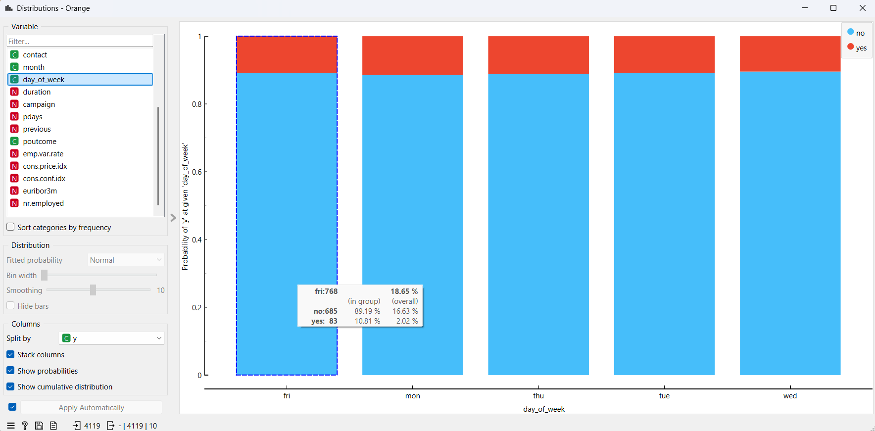
distribution by day_of_week and yes/no classification

