Slide 1
PROGRESS REPORT · SESSION 2
A Similarity Index for
Cellular Automata
Measuring behavioral similarity between CA rules, from exact classification to a continuous, quantitative index
Indian Summer School on Cellular Automata 2026
August 16, 2026

Slide 2
MOTIVATION
Why "similarity" between rules?
Conway's Game of Life has a large family of “life-like” rules — different birth/survival sets that produce visually similar behavior.
From random initial configurations these rules often look indistinguishable: it is only specific small patterns (gliders, oscillators, still lifes) that reveal a difference.
This raises the core question of the project:
SCOPE
• Primarily 1-dimensional CA rules (elementary CA and generalizations)
• Extended this session to a 2-dimensional case: Conway's Game of Life and life-like variants
• Two complementary questions: are two rules exactly the same? and if not, how different are they?
How similar are two CA rules, based on their behavior — and can that
similarity be measured, not just judged by eye?
CA Similarity Index — Progress Report
2

Slide 3
APPROACH
Three methods, one question
01
02
03
Exact / inheritance relations
Evolution graph
Spectral moments
Binary test: do two rules show exactly the same behavior? Built from state permutation, state/neighbor addition-removal.
Continuous measure: canonical form of the transition graph via adjacency-matrix eigenvalues, compared by cosine distance.
Fixed-length cycle-length signature per rule — solves the eigenvalue method's variable-vector-length limitation.
Each method was also stress-tested on the 2D case: Conway's Game of Life and life-like variants.
CA Similarity Index — Progress Report
3

Slide 4
METHOD 1 › INHERITANCE RELATIONS
Four filters for exact equivalence
Rule 0 and the highest rule are always trivially the same, regardless of neighbors, states or dimensionality. Beyond that trivial case, we found 4 transformations that preserve a rule's exact behavior:
State permutation
Mirror / inverse rules
A bijection between two rules' state sets that preserves every transition. Example: swapping {0,1}→{a,b} identifies rule 01,10 and 31,13 as the same rule wearing different labels.
Reversing the order of the neighbor positions (a left-right spatial reflection) maps a rule onto an equivalent one — a spatial symmetry of the same behavior.
Neighbor deletion
State deletion
If the output never actually depends on one neighbor position, that position can be dropped — reducing the neighborhood size without changing behavior.
If the top state's only transition is to state 0, it can be removed, moving the rule to a smaller state space. The reverse (state addition) also holds.
CA Similarity Index — Progress Report
4

Slide 5
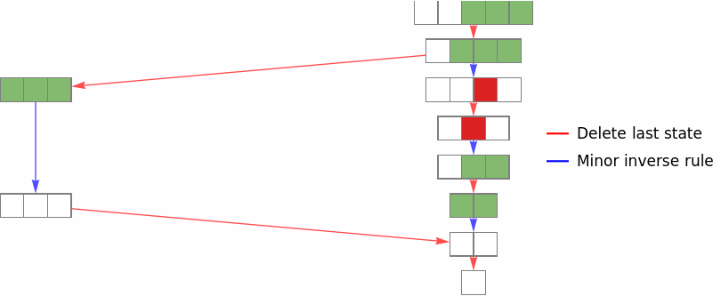
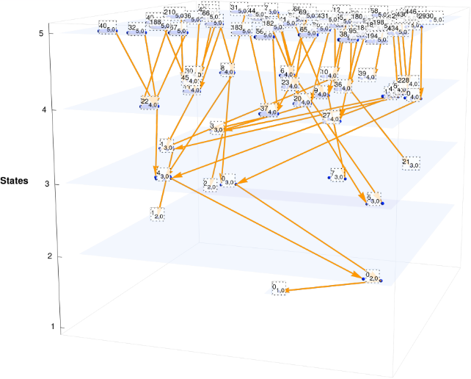
METHOD 1 › INHERITANCE RELATIONS
Moving across rule spaces
• A second relation: adding a state that transitions to 0 moves a rule from an n-state space to an (n+1)-state space without changing its behavior.
• The reverse (removing a state) only works when 2 structural conditions hold — when it fails, the target rule can still often be reached via the state-permutation graph instead.
• Chaining both relation types over all tested small spaces produces a connection graph: most paths converge toward the trivial rule, as expected for dimensionless CA.
Delete-last-state and minor-inverse-rule relations chained together
CA Similarity Index — Progress Report
5

Slide 6
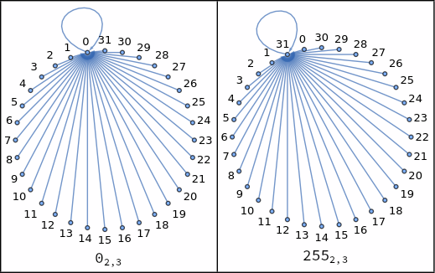
METHOD 2 › EVOLUTION GRAPH
From binary match to continuous distance
• Evolve a rule over every possible finite configuration of a space: each configuration is a node, each transition an edge — this is the rule's evolution (transition) graph.
• Two graphs that are isomorphic (same shape, different labels) mean the rules are behaviorally equivalent, generalizing method 1.
• To go beyond yes/no: take the eigenvalues of each graph's adjacency matrix as a canonical, label-free feature vector, and compare rules with cosine distance between eigenvalue vectors.
• Distance 0 ⇒ equivalent rules; small distance ⇒ similar dynamics (e.g. rule 8 behaves like rule 0, just slower).
Rule 0 and rule 255 (5-cell space): isomorphic transition graphs
CA Similarity Index — Progress Report
7

Slide 7
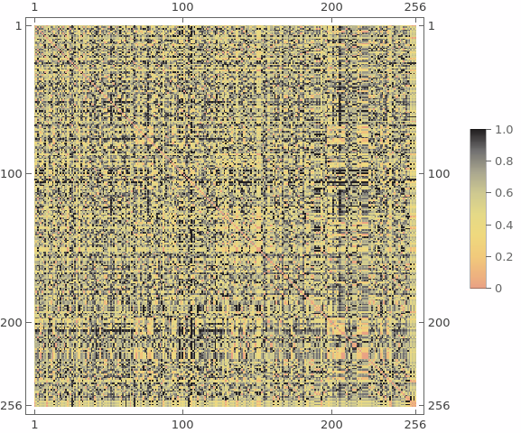
METHOD 2 › EVOLUTION GRAPH
Similarity across all 256 elementary CA
TWO OPEN PROBLEMS
• Vector length problem: the eigenvalue vector's length equals the graph's node count, so rules can only be compared directly within the same space size.
• Space-size problem: larger spaces reveal more unique behaviors, but with diminishing returns — what size is “enough” is not obvious.
→ Addressed next by rotation-class graphs and spectral moments.
CA Similarity Index — Progress Report
8

Slide 8
METHOD 2 › ROTATION-CLASS GRAPH
A cleaner canonical form — and a debunked artifact
• Alternative construction: quotient the graph by cyclic rotations of each configuration (e.g. 0001, 0010, 0100, 1000 collapse to one node). Well-defined because the rule is homogeneous and the boundary is cyclic.
• Node count now depends only on space size, not on the rule — a step toward comparable vector lengths.
FINDING: rules 15, 85, 170, 240 (+ 30 as control)
• Raw graph (MakeGraph): all 4 rules merge together — but only at even space sizes (2,4,6,8); at odd sizes only 15~85 and 170~240 merge.
• Rotation-class graph (MakeGraphRot): the even/odd split disappears — at every tested size, only 15~85 and 170~240 merge, never all 4.
• Conclusion: the full 4-rule merge was an artifact of parity in the raw construction, not a real property of the rules.
CA Similarity Index — Progress Report
9

Slide 9
METHOD 3 › SPECTRAL MOMENTS
A fixed-length behavioral signature
• Definition: evolve a rule j steps from every possible configuration, and let m_j be the fraction of configurations that returned to their starting configuration after exactly j steps.
• The result is a vector (m_1, m_2, …, m_j) of fixed length kmax — independent of the rule and of how many nodes its graph has.
• This directly resolves the eigenvalue method's vector-length problem, letting rules from different spaces (state counts, neighborhoods, even dimensions) be compared on equal footing.
• Rule similarity is again cosine distance, now between spectral-moment vectors instead of eigenvalue vectors.
CA Similarity Index — Progress Report
10

Slide 10
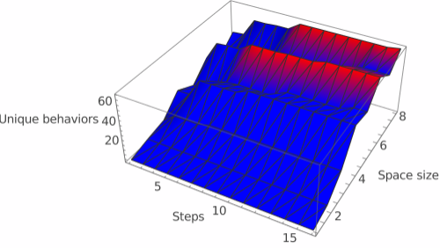
METHOD 3 › SPECTRAL MOMENTS
How many steps and how much space are enough?
• Repeating the similarity-matrix experiment while varying step count (2–16) shows how many distinct behaviors the method can tell apart.
• Sweeping space size at the same time locates the region (in red) where more than 60 unique behaviors are resolved — i.e. where the method has “enough resolution” to be useful.
Unique behaviors found, as a function of step count and space size (ECA)
CA Similarity Index — Progress Report
11

Slide 11
2D EXTENSION › GAME OF LIFE
Does the method generalize to 2 dimensions?
• Same two constructions (functional-graph quotient, spectral moments) applied to Conway's Life on a toroidal grid with a Moore (8-cell) neighborhood.
• Symmetry quotient generalizes naturally: instead of cyclic rotations (1D), we quotient by toroidal translations in x and y.
• Implementation validated against known Life patterns first: a block (still life) stays fixed, and a horizontal blinker correctly rotates to vertical.
• Test bed: 4x4 toroidal grid (2^16 = 65,536 configurations — the same scale already validated at 1D size 16), comparing standard Life (B3/S23) against two variants: Life+S8 (B3/S238) and Life+B8 (B38/S23).
CA Similarity Index — Progress Report
12

Slide 12
2D EXTENSION › GAME OF LIFE
Life, Life+S8, Life+B8: cosine distance
Rule A | Rule B | Distance
Life (B3/S23) | Life+S8 (B3/S238) | 0.000516
Life (B3/S23) | Life+B8 (B38/S23) | 0.000000
Life+S8 (B3/S238) | Life+B8 (B38/S23) | 0.000516
KEY FINDING
Life and Life+B8 are indistinguishable at this grid size (distance 0): reviving a cell only when all 8 neighbors are alive never changes the graph's cycle structure once quotiented. The survival-side change (Life+S8) has a small but non-zero effect — suggesting survival rules matter more structurally than birth rules here, on a 4x4 toroidal grid.
CA Similarity Index — Progress Report
13

Slide 13
2D EXTENSION › 6X6 PROBABILISTIC SAMPLING
Scaling up: when exact enumeration breaks
• At 6x6 (36 cells), exact enumeration is infeasible: 2^36 ≈ 68.7 billion raw states, and even the translation-quotiented graph has ≈ 1.9 billion nodes — neither fits in memory.
• Solution: Monte Carlo estimation. Sample random configurations, run a transient so each settles onto its attractor, then measure recurrence time — the fraction of samples recurring within j steps estimates m_j directly.
• Sampling parameters: 3,000 samples per rule, 200-step transient, 150-step cap to detect a period (unresolved beyond that).
• Tested 5 rules: 3 Moore-neighborhood, life-like rules (same family as Life) and 2 Von Neumann-neighborhood rules (4 neighbors — outside the life-like family by definition), across both graph constructions (raw and translation-quotiented).
CA Similarity Index — Progress Report
14

Slide 14
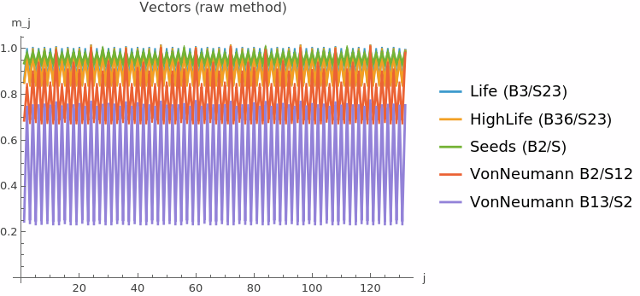
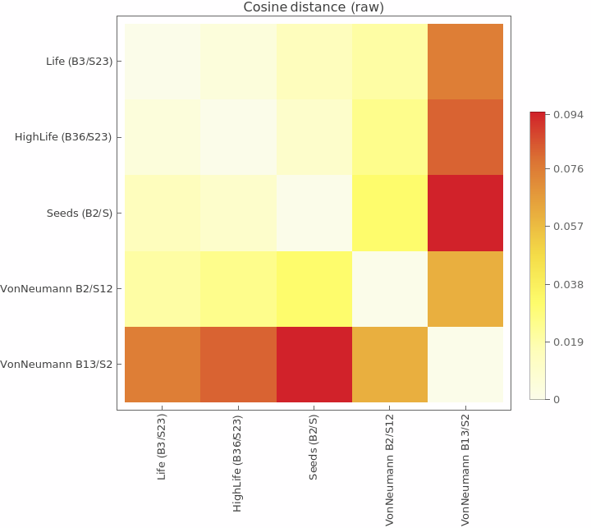
2D EXTENSION › 6X6 PROBABILISTIC SAMPLING
Neighborhood type, not the B/S set, drives similarity
The 3 Moore-neighborhood (life-like) rules cluster tightly (cosine distance ≈ 0.0001–0.0065), while both Von Neumann rules sit far away (≈ 0.05–0.09). Both graph constructions agree closely except for VonNeumann B13/S2 — also the only rule with ~24% of samples unresolved within the step cap, hinting at long-period or chaotic dynamics.
CA Similarity Index — Progress Report
15

Slide 15
SUMMARY
Where the project stands
• Built a full pipeline from exact behavioral equivalence (state permutation, state/neighbor relations) to a continuous similarity measure (eigenvalue vectors, then spectral moments).
• Spectral moments solve the eigenvalue method's key limitation — fixed vector length — enabling comparison across spaces of different size, state count, and even dimensionality.
• Rotation/translation-class graphs give a cleaner canonical form and correctly identified a parity artifact in an earlier finding (the {15,85,170,240} “full merge”), replacing it with the real result: only 15~85 and 170~240 merge.
• Extended and validated the whole approach in 2D, up to a 6x6 grid via Monte Carlo sampling
CA Similarity Index — Progress Report
16

Slide 16
NEXT STEPS
Toward the research paper
• Consolidate the three methods and their findings into a single manuscript, strengthening the theoretical grounding behind each (formal definitions, proofs of well-definedness for the quotient constructions, error bounds for Monte Carlo sampling).
• Push the spectral-moments comparison to larger, systematic sweeps (more rules, more space sizes) now that step/space resolution has been characterized.
• Extend the 2D Monte Carlo study beyond 5 rules to a broader life-like/non-life-like sample, to test how robust the neighborhood-dominates-similarity finding is.
CA Similarity Index — Progress Report
17

