Slide 1
DESIGN AND IMPLEMENTATION OF A WEB-BASED RADIO AUDIENCE MEASUREMENT SYSTEM
By Jesse Ayegba
16ck020793

Slide 2
OUTLINE
01
PROBLEM STATEMENT
07
RECOMMENDATIONS AND CONCLUSION
02
AIMS AND OBJECTIVES
03
SIGNIFICANCE OF PROJECT
04
DESIGN AND ANALYSIS
05
RESULTS
06
CHALLENGES
Notes:
© Copyright Showeet.com – Creative & Free PowerPoint Templates

Slide 3

INTRODUCTION
Audience measurement refers to the determination of the number of people that are in an audience within a given market.
Radio audience measurement specifically relates to radio listenership.
It measures how many people are tuned to and listening to a radio broadcast over a period of time.

Slide 4
PROBLEM STATEMENT
01
Very few web-based audience measurement technologies a currently in use.
Currently, the methods used in carrying out radio audience measurement require a lot of human input.
More accurate data relating to audience listenership needs to be readily available.

Slide 5
AIM AND OBJECTIVES
02
To design an audience measurement system for FM radio.
To implement the design using a mobile and web application.
To evaluate the performance of the system.
Notes:
© Copyright Showeet.com – Creative & Free PowerPoint Templates

Slide 6
SIGNIFICANCE OF PROJECT
03
This project will be useful to advertisers because they are always in need of audience data
This project is also in line with the sustainable develop goal (SDG) 9.
To build resilient infrastructure, promote inclusive and sustainable industrilization and foster innovation.
Notes:
© Copyright Showeet.com – Creative & Free PowerPoint Templates

Slide 7
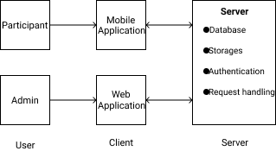
DESIGN AND ANALYSIS
04
Client-Server architectural pattern.
Two access points, a mobile application and a web application.
Mobile application for participants.
Web application for administrators.
Client-Server Architecture
Notes:
© Copyright Showeet.com – Creative & Free PowerPoint Templates

Slide 8
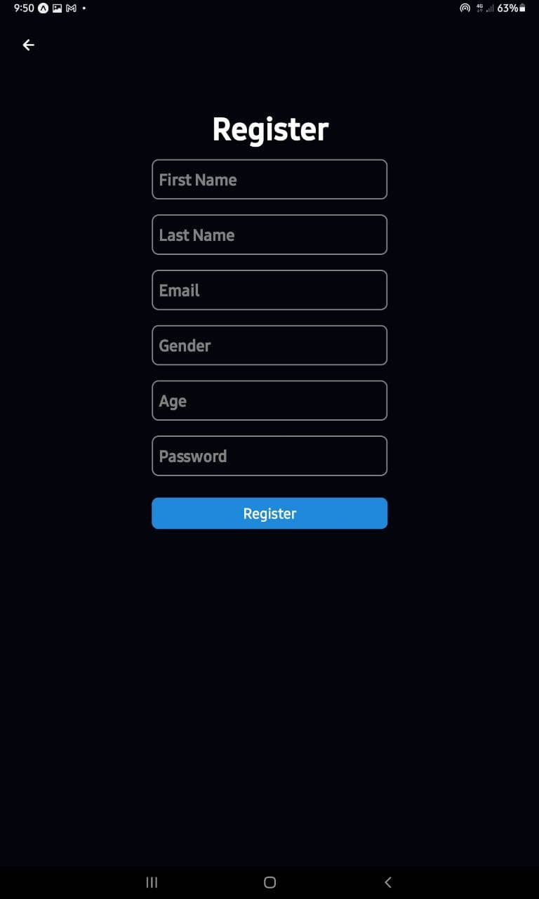
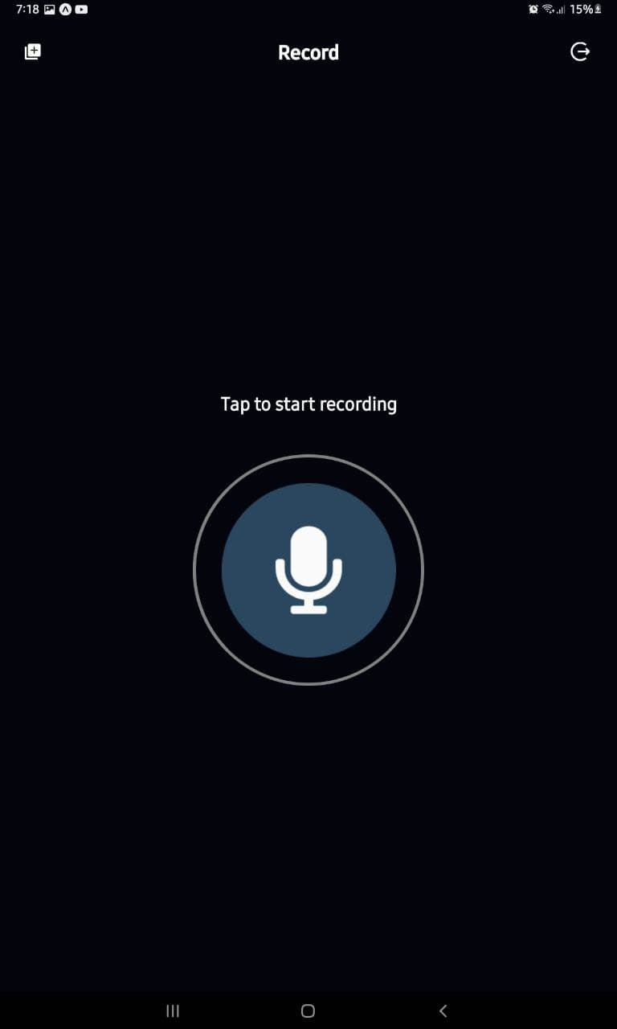
RESULTS
05
Technology
React Native
Register Screen
Record Screen
Notes:
© Copyright Showeet.com – Creative & Free PowerPoint Templates

Slide 9
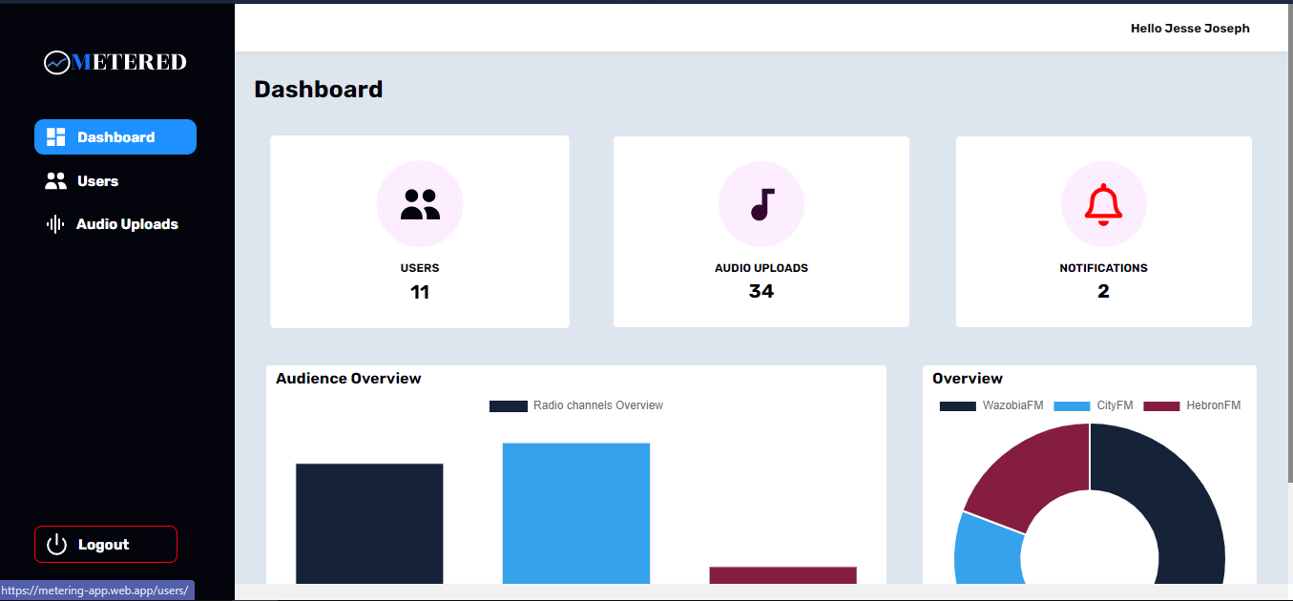
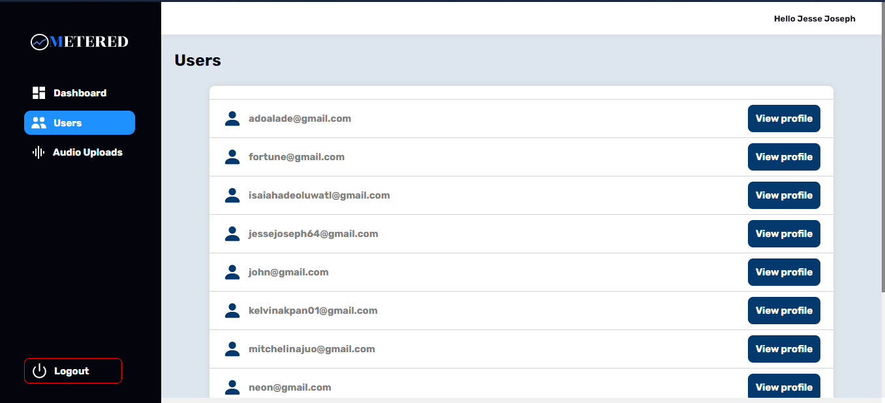
RESULTS
ADMIN PLATFORM https://metering-app.web.app
TECHNOLOGIES
Client Side: React JS
Server Side: Firebase
Database: Cloud Firestore
Deployment Server: Firebase
Notes:
© Copyright Showeet.com – Creative & Free PowerPoint Templates

Slide 10
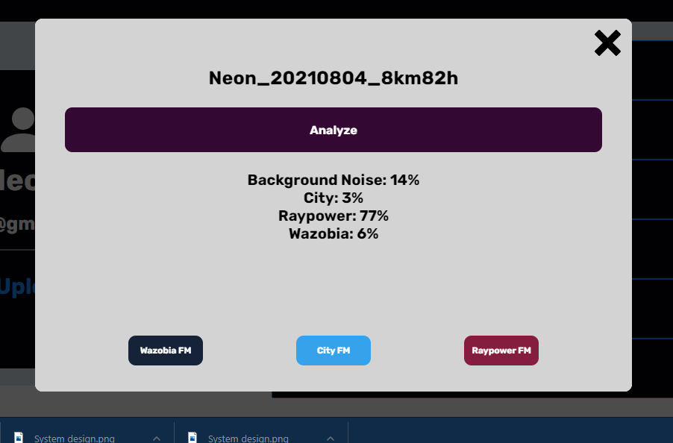
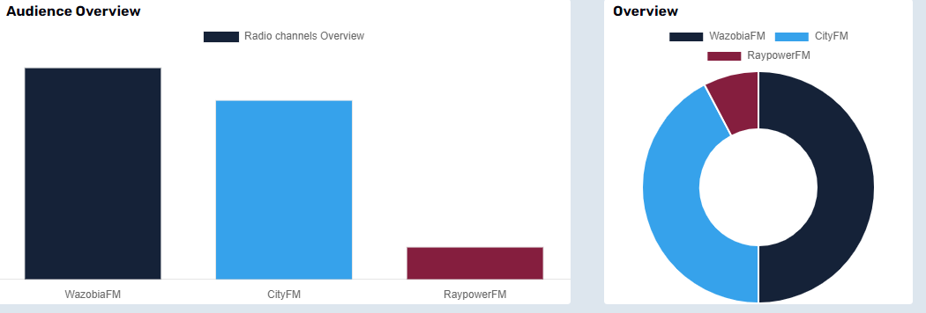
RESULTS
Analysis Modal
Listenership charts
Notes:
© Copyright Showeet.com – Creative & Free PowerPoint Templates

Slide 11
CHALLENGES
06
Eliminating background noise.
Getting the web application to make real-time updates on the client.
Firebase security.
Testing the mobile application on a real-time device.
Working with a NoSQL database.

Slide 12
RECOMMENDATIONS
07
This project can modified to include extra functionality to enhance radio audience measurement.
More readily available datasets for Nigerian radio stations should be made available.

Slide 13
CONCLUSION
07
This project has provided a software-based solution to the problem of radio audience measurement. Also, the audio data gathered from this project could be made open-source to serve other applications that may need the data-set of Nigerian radio stations.

Slide 14
Thank you
Notes:
© Copyright Showeet.com – Creative & Free PowerPoint Templates

Slide 15
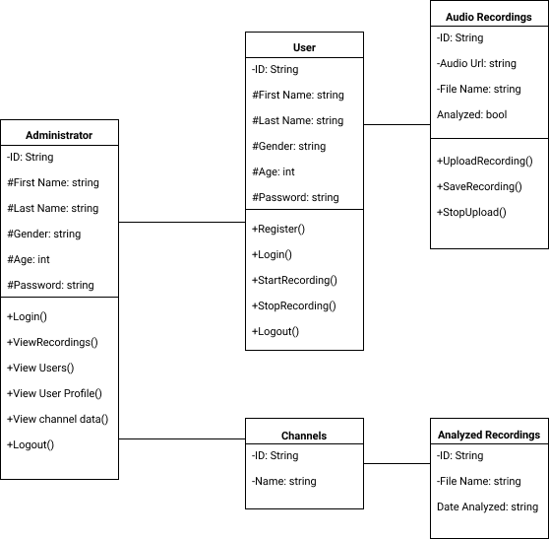
APPENDIX
System’s Class Diagram
Notes:
© Copyright Showeet.com – Creative & Free PowerPoint Templates

