Slide 1
Cropped Input Capsule Networks – MNIST & Leaf Dataset
CSCE 629 – Fall 2018
Jesse Broussard

Slide 2
Background
Initial implementation mirrors the capsule network architecture as described in Sabour et. al. “Dynamic Routing Between Capsules”.
Capsule networks are a relatively new type of neural network, theorized in part by Geoffrey Hinton.
The implementation from which this project’s code was derived is part of the Hanson-ML series available on the Hanson-ML github. (just google hanson-ml github)

Slide 3
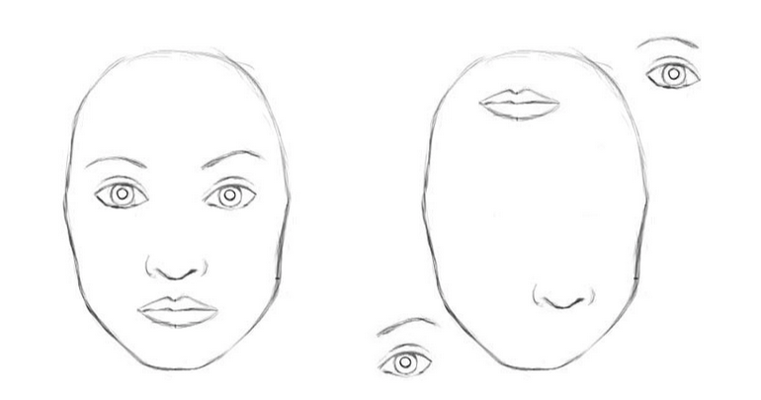
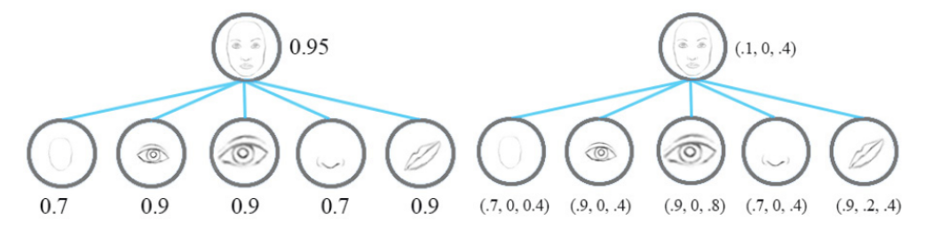
What are capsule networks?
Witchcraft, but not really –
A convolutional capsule network such as the one proposed in the paper “CapsNet” has a few important features that are worth noting
“Inverse Graphics” – the idea of reverse rendering taking an image of something rendered and obtaining pose information.
Loss of pose information in traditional networks, while capsule networks atleast in theory preserve this information.
Pooling layers lose information
https://towardsdatascience.com/a-simple-and-intuitive-explanation-of-hintons-capsule-networks-b59792ad46b1

Slide 4
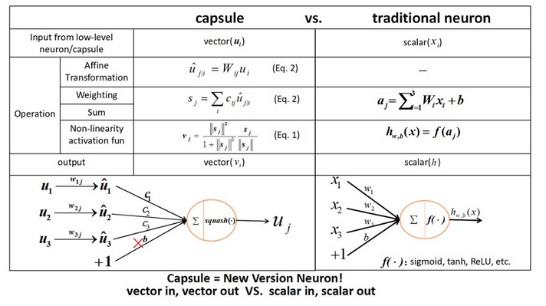
https://towardsdatascience.com/a-simple-and-intuitive-explanation-of-hintons-capsule-networks-b59792ad46b1

Slide 5
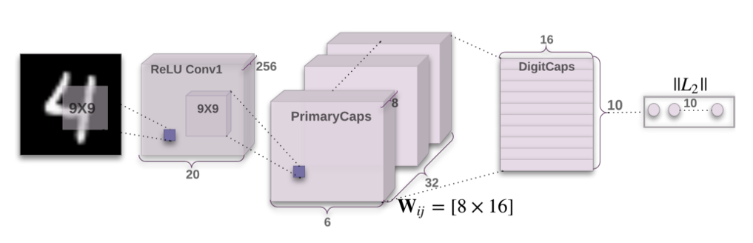
“CapsNet”
Primary Capsules
6x6x256 from conv2
Reshape 6x6x32x8
32 filters containing 8 activation vectors
Secondary DigitCaps
16 - wide representing characteristics of digits
10 - dimensions representing classes
Treat as conv1
256 filters
9x9 kernels
Stride 1
Treat as conv2
256 filters
9x9 kernels
Stride 2
Loss function:
Made in part from reconstruction loss and

Slide 6
Initial plan / Contribution goal
Discover how well capsule networks learn on partial and incomplete data. This in theory will be useful for applying learning to larger images without needing to resort to pooling layers, and other methods leading to data loss.
Start with cropping from MNIST : also get more comfortable with the CapsNet architecture, its layers, and hyperparameters
Leaf Dataset – due to its masked nature, and odd shaped imagery, seems like an interesting second dataset to apply the cropped MNIST model to

Slide 7
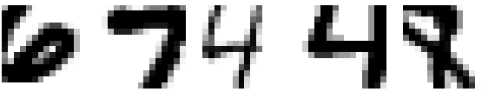
Starting with MNIST
Take MNIST from 28x28 to 14x14 – applying constraints to make sure images are always containing digits.
Adjust the architecture, and hyperparameters to achieve best performance
Use results as indicator before moving on to leaf dataset

Slide 8
List of things tried to improve network:
Primary capsule maps, and activation vector depth
Digit Capsule layer depth increase/decrease
Decoder reconstruction dense layer depth/size
Changes in convolutional filter depth/size/structure
Changes in weight initializations
Changes to optimizer hyperparameters
Number of routing passes between capsules

Slide 9
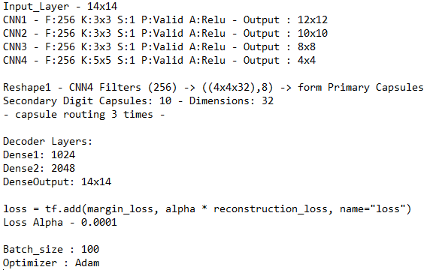
Cropped MNIST – Capsule Network -Results
Best validation results:
Accuracy : 96.90%
Best test results:
Accuracy: 96.35%
Traditional Network:
Validation : 96.15%
Test: 95.86% 7 million total parameters
8 million total parameters
Using ReLu/Dropout layers

Slide 10
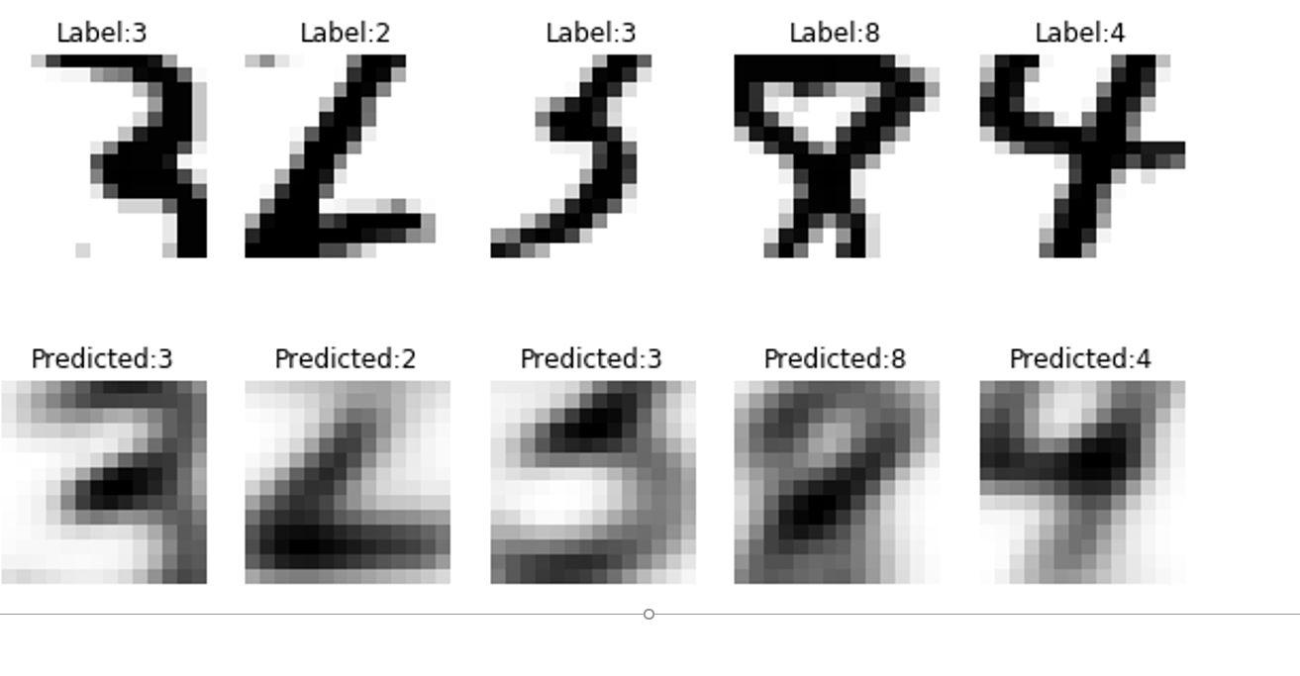
Recreated image – MNIST Cropped

Slide 11
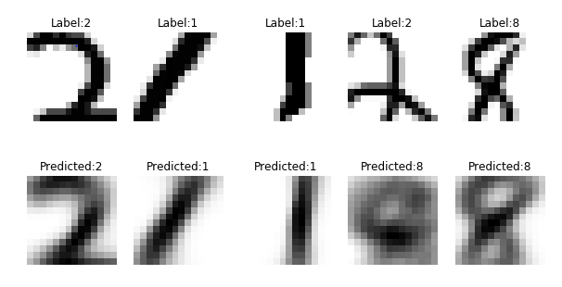
Causes of error

Slide 12
What if cropping shrinks/expands?
18x18 – highest validation accuracy :97.66% - test – 97.43%
16x16 – highest validation accuracy : 97.14% - test - 96.7%
14x14 – highest validation accuracy : 96.90% - test – 96.35%
12x12 – highest validation accuracy : 93.56% - test - 91.69%
10x10 – highest validation accuracy : 87.52% - test - 86.57%
8x8 – highest validation accuracy : 74.56% - test – 73.36%
6x6 – highest validation accuracy :71.38% - test – 70.06%

Slide 14
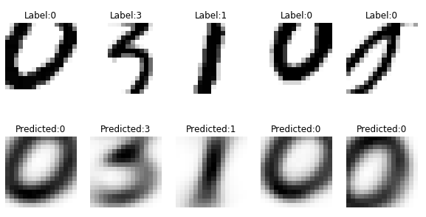
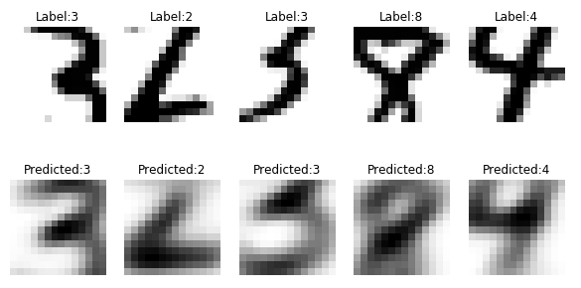
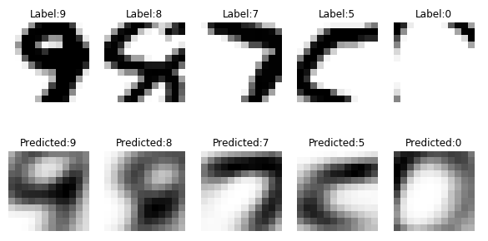
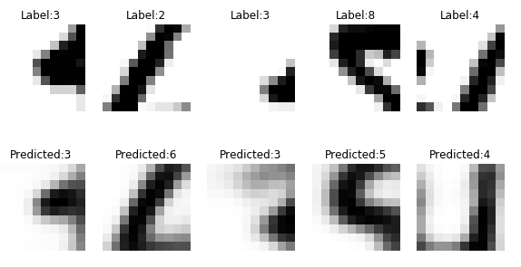
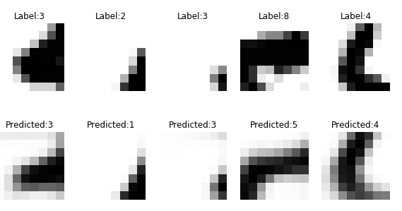
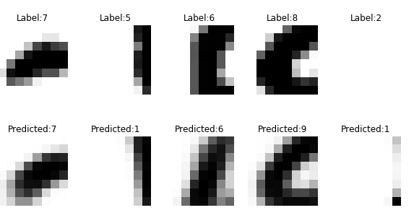
Reconstructions
16x16
14x14
12x12
10x10
8x8
6x6

Slide 15
Achievements of cropped MNIST experiment
Out performs baseline convolutional network with similar parameters using dropout, and RELU activation functions.
Shows good performance with one quarter of the original image size, and using incomplete digits (missing pieces).
At least points in the direction that learning using pieces of imagery instead of full images is possible using capsule networks.

Slide 16
Kaggle Leaf Dataset
Goal and reasoning:
The leaf images in the data set are large, with odd dimensions
Take pieces of these images, feed it to a capsule network to train
Be able to correctly classify the leaves using the cropped capsule network.

Slide 17
Leaf Dataset – the good
Large and odd shaped images creates a challenge when determining where to crop sections.
Hopes are that the cropping acts as a form of data augmentation, enough so that the small size of this dataset is not a big deal.
Selection method would ensure leaf will be in picture, but the randomness of where crops are taken would generate “new” data being presented to the network.

Slide 18
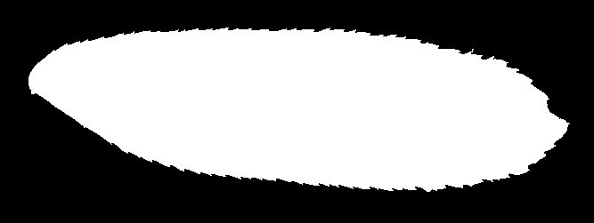
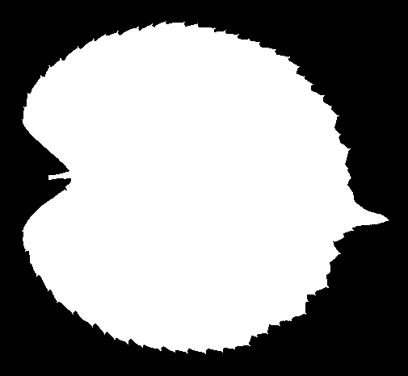
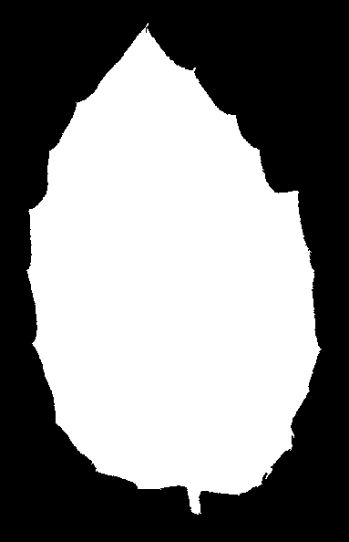
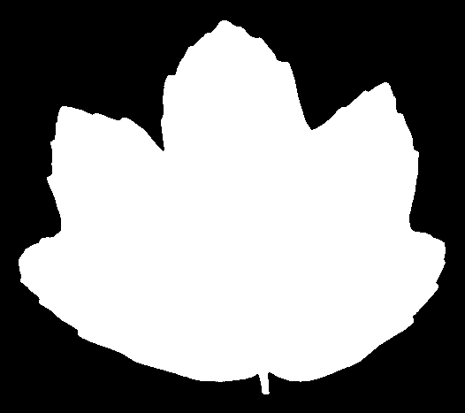
Leaf Dataset

Slide 19
Ways of choosing where to crop:
Process 1:
1. Pick random integer bounded by width or length (lets say length)
2. Traverse along width until a non-zero pixel is found
3. Use that pixel as the center of the cropped region
Process 2:
1. Pick two random integers bounded by width and length.
2. Check pixel value, if non zero check (crop_size//4) pizels in each direction.
3. If any of those pixels are 0 then you’re near an edge, use as crop centroid.

Slide 20
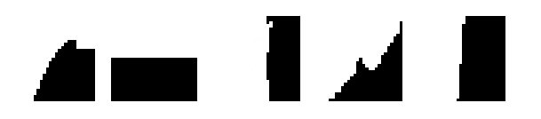
Cropping – Leaf Dataset – 28x28
First observations while implementing:
99 classes is very large for capsule network
28x28 too small? Dataset too small?

Slide 21
Issues with the dataset: ☹
In the capsule routing portions of the network:
Secondary capsules consist of (# of classes) by (# character vectors)
This unfortunately makes a very large network when there are 99 different types of leaves.
Large networks also train slower, and require more data to train correctly.
Leads to really dense network upwards of 41 million parameters.
Really wish that the dataset was larger.

Slide 22
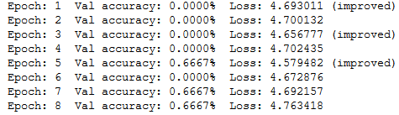
Results – Leaf Dataset
Network parameter size is crazy.
Total dataset – 1584 images, 16 images per class.

Slide 23
Future work
Find a better dataset that’s more complicated than MNIST but not as small as the leaf dataset.
Apply the works discussed in the presentation to the new dataset (which should be fairly easy to do).
Do MNIST training runs for 20x20, 22x22, 24x24, and 26x26 to add to graph
Anyone have any ideas for datasets that have black and white outline masks of objects?

