Slide 1
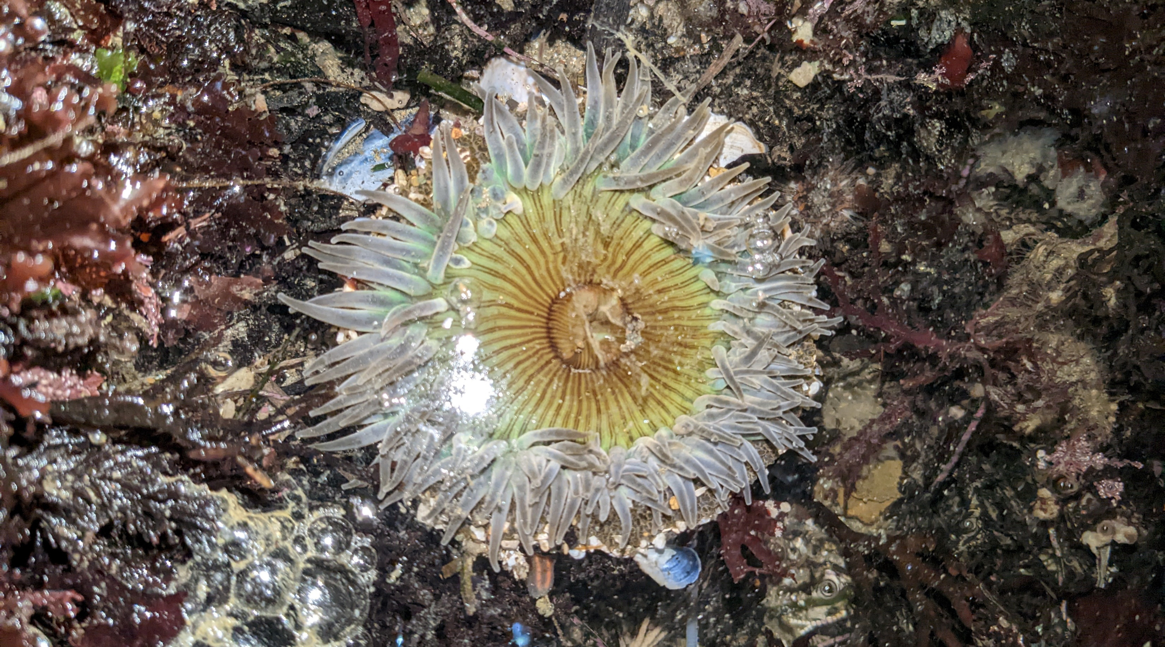
Tentacles
Oral Disc

Slide 2
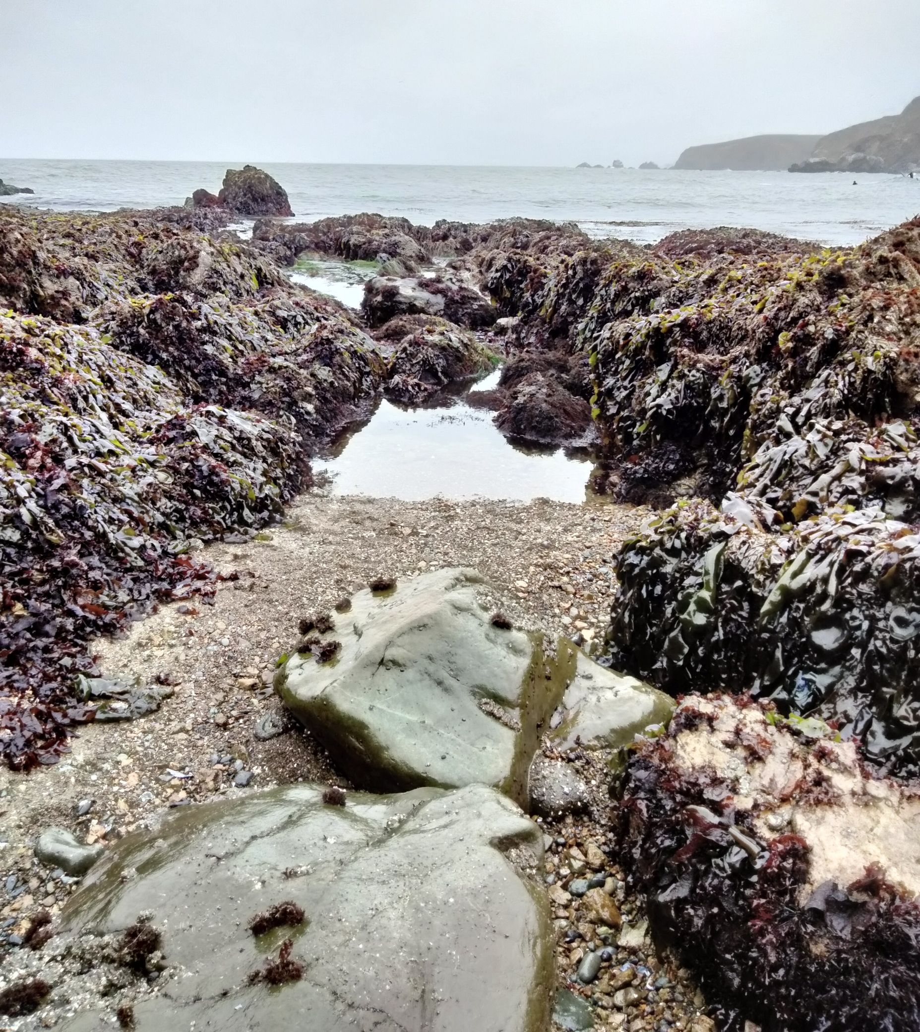


Slide 3
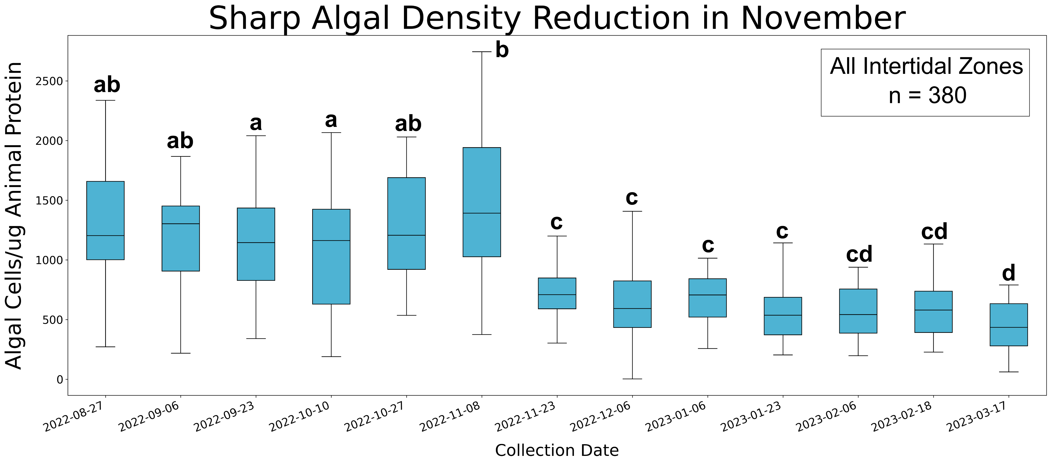

Slide 4
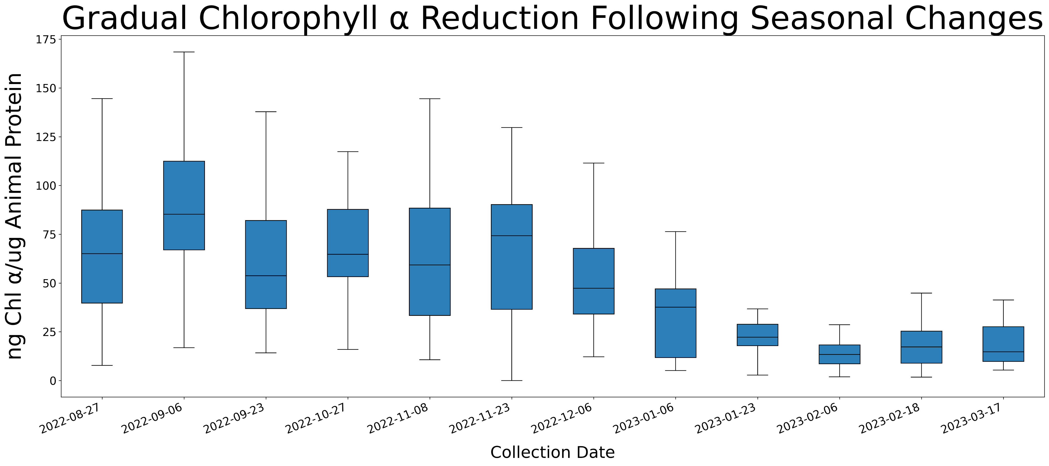
b
ac
ac
Algal Cell Drop (see figures 5 & 6)
a
ab
a
c
d
d
e
e
e

Slide 5
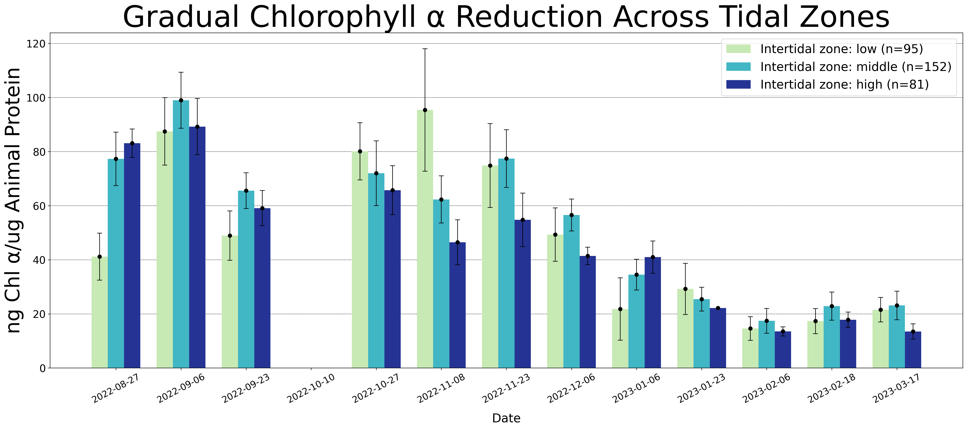
Algal Cell Drop (see figures 5 & 6)

Slide 6
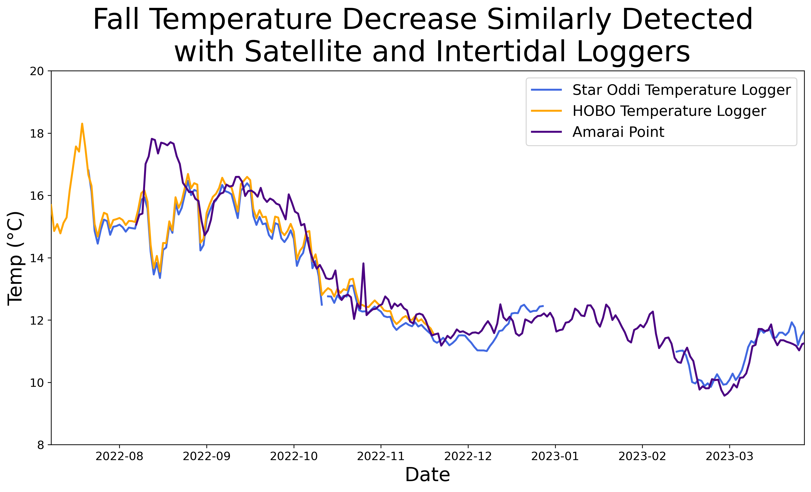
Algal Cell Drop

Slide 7
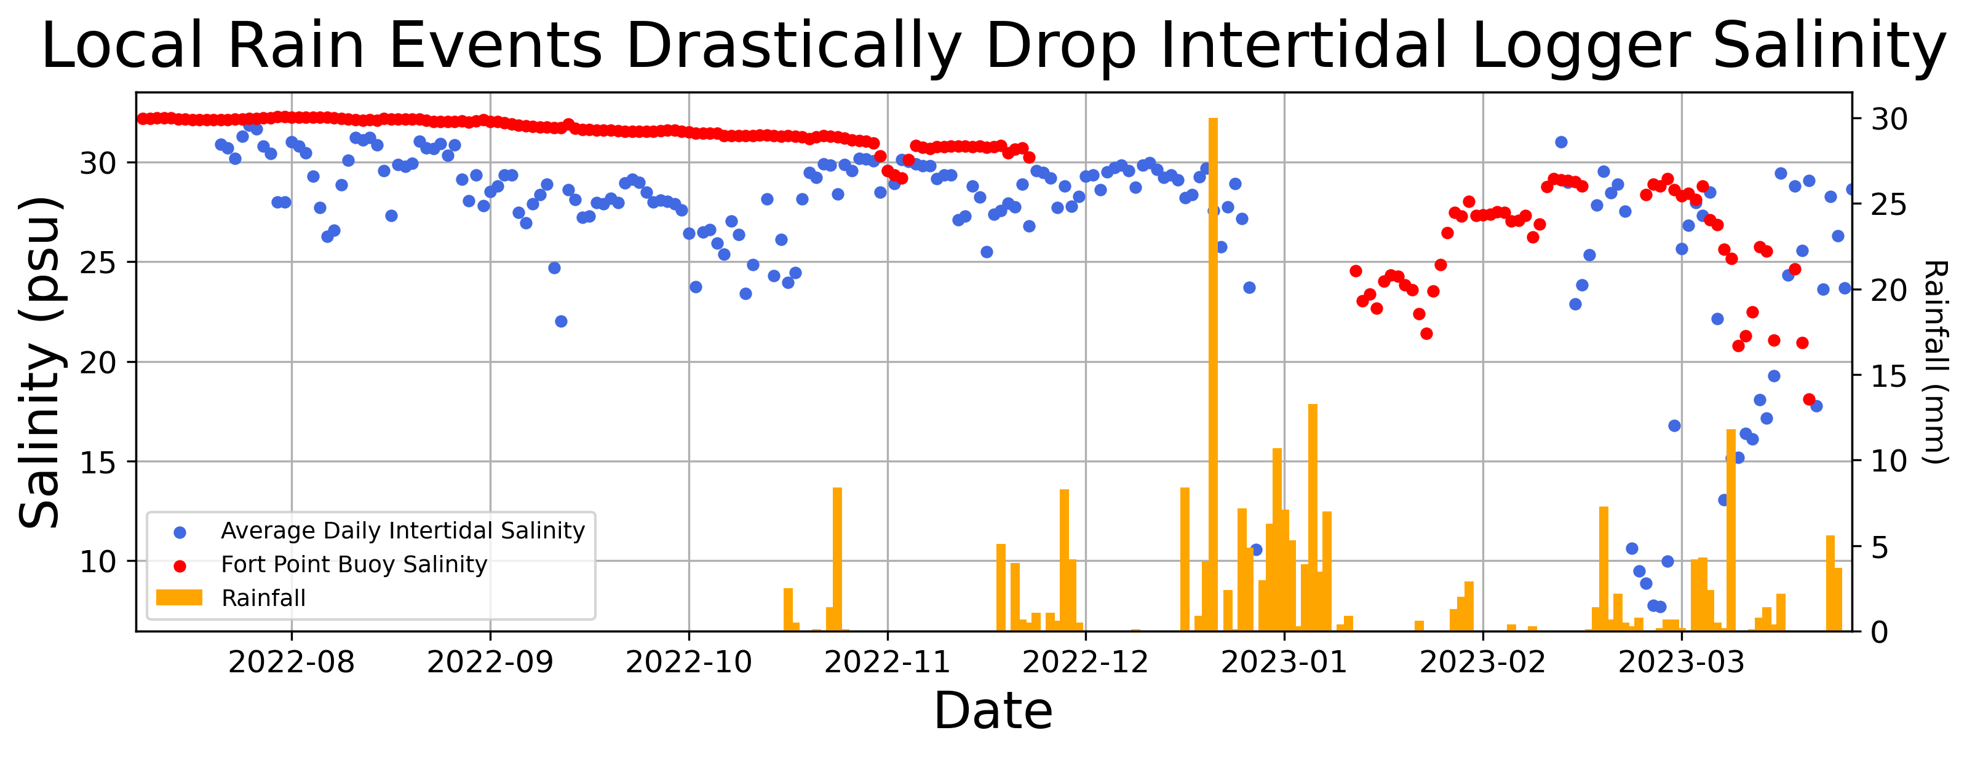
Algal Cell
Drop

Slide 8
