Slide 1
Berkley lectures 1-6 + CLIP Model

Slide 2
What I learned
I am focusing on learning as much as possible from each lecture video.
I also am learning symbology for the sake of writing future papers.
Back propagation, linear modeling, activation functions, I understand the basics given for most of the 5 lectures I watched.
However there are certain things, details, which I never heard.
The history of different neural operations, datasets, the exact terminology of different parts of neural networks. I learned…
What is representation learning?
Deeper reasons for using CNNs
Concept of low to high feature abstraction as we go through the model.
Methods for unsupervised learning (I knew little about this before CLIP)
History of BERT and why it was so important

Slide 3
CNN Filtering + Receptive Fields
1 | 0 | 1
0 | 1 | 0
1 | 0 | 1
I got a review of filtering and how convolutions throughout the model increase receptive fields.
I am currently getting into pooling and its use cases in reducing parameters while increasing the fields.
Weight Filter

Slide 4
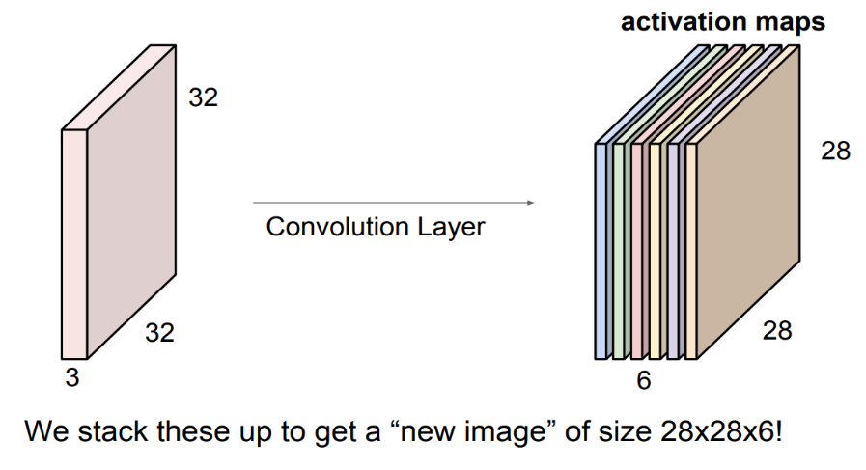
3D Convolutions
I know how to use CNNs in PyTorch but was in sore need of theoretical knowledge.
I never saw a clear explanation of 3D Convolutions.
In addition I see we can stack filters and convolutions into a new tensor of activation maps, then convolve even that tensor.
Really really cool!

Slide 5
Model details
We trained CLIP with the same repository. I trained a CLIP model on MS-COCO from 2017 at 118k images for 5 epochs.
I then tested it on some test-COCO images for zero shot text retrieval.
My findings were
#1 given COCO is so small, compared to the 400M image, text pairs from the original experiment, the checkpoints are mostly good at specific types of images.
To get those SOTA results we would need to train on vastly more data and more epochs.
#2, CLIP would benefit from 30-40 epochs given MS-COCO, but variety would be better.

Slide 6
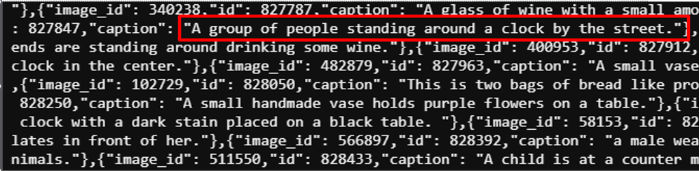
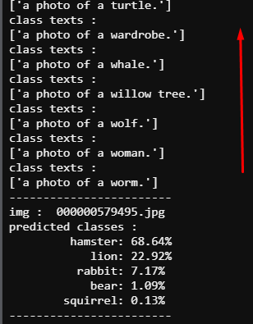
Coco annotations were unique…
This model was trained on unique labels as caption annotations.
Then as a zero shot the image embeddings were compared to ‘a photo of a {item}’.
If CLIP could identify which image was most like that text then it would return that class.

Slide 7
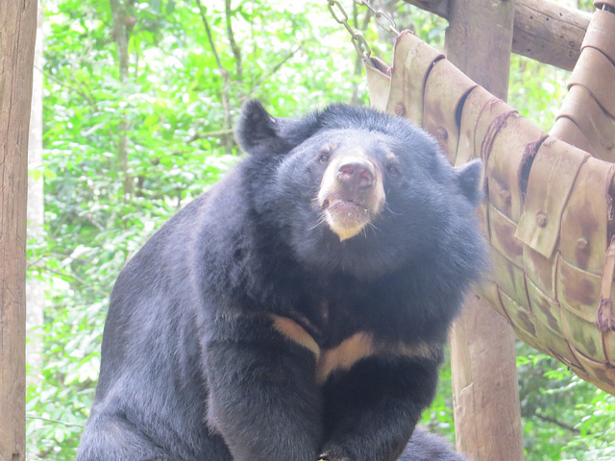
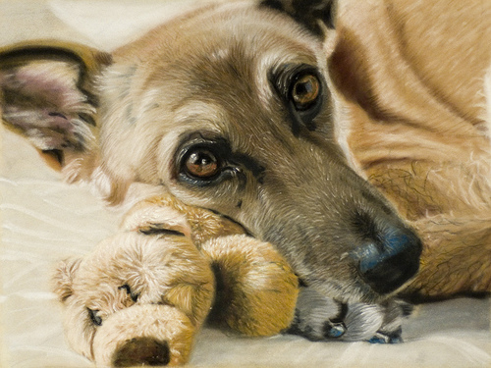
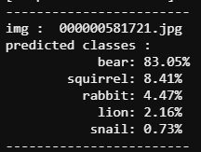
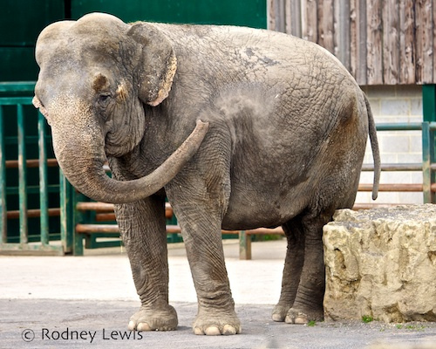
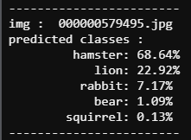
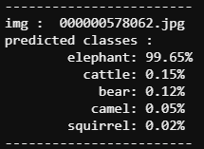
Zero shot Clip Model
The CLIP model fit on specific classes like the two on the left.
The one on the right is outside the image set
This shows CLIP would benefit from more epochs, then more variety/datasets as there may be some imbalance in the dataset.
Unique annotations on large datasets like imagenet would be warranted or other large image data.

Slide 8
End

