Slide 1
Learning Transferable Visual Models From Natural Language Supervision

Slide 2
Notes
I am thinking of following the rubric Dr. Rad gave us. The content structure follows that.
After creating your powerpoint, not before, you can try pasting your slides to ChatGPT and asking, “Which parts of this presentation are not factual?”. I did this and thankfully didn’t have to do any edits as ChatGPT said it looks good.
But, yea sometimes when we read something I don’t understand it 100% correctly. ChatGPT knows all these papers and the relationships between them. So that helps me.

Slide 3
Content
Prior Art
Gap analysis
Core contributions
Methodology
Experiments
Reproduction

Slide 4
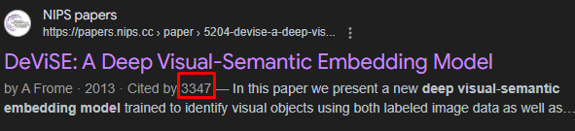
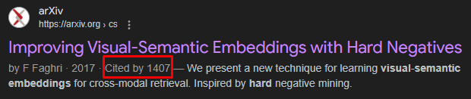
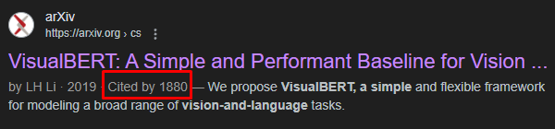
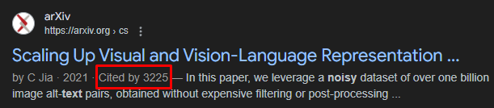
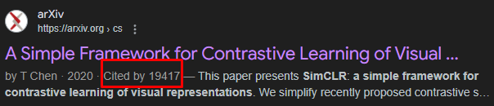
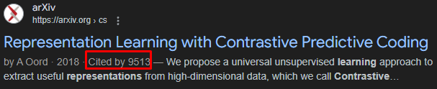
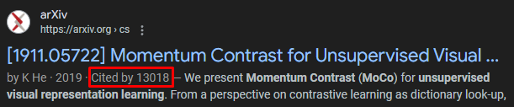
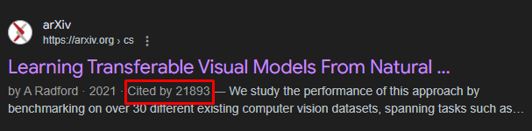
Prior Art
The multimodal SOTA of 2021 had a difficult time with zero-shot tasks and general image-text relationships. VisualBert and ViT were considered pivotal for image and text congruence.
Contrastive learning was a hot topic going far back as 2013 with the DeViSE paper. Papers on contrastive learning were a high citation topic. Many had over 1000 citations, even going above 5,000. At the time OpenAI had a massive opportunity gap to fill with contrastive learning.
Since Attention is All You Need, methods for using transformers with Contrastive learning have popped up as these famous papers. But none were done on the scale of CLIP.

Slide 5
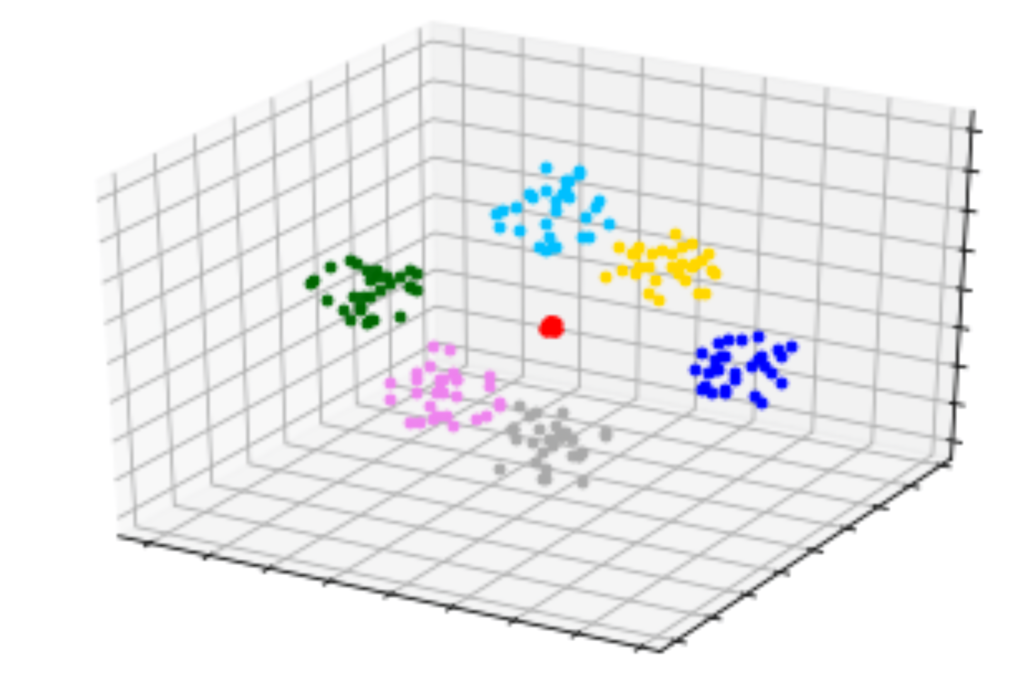
Gap Analysis
The unique gap OpenAI filled with CLIP was the scale of training, use and comparison of transformers and CNN. For image-text congruence there was a massive need for learning how to use shared embedding.
Shared embedding had already existed for years, as well as contrastive learning. However it was never refined as a methodology so well as OpenAI had done it.
They established a new SOTA methodology by teaching the world how to use the latest research better than anyone else. Contrastive learning was a gold rush topic and OpenAI won the gold.
Image/Text had similar embedding results

Slide 6
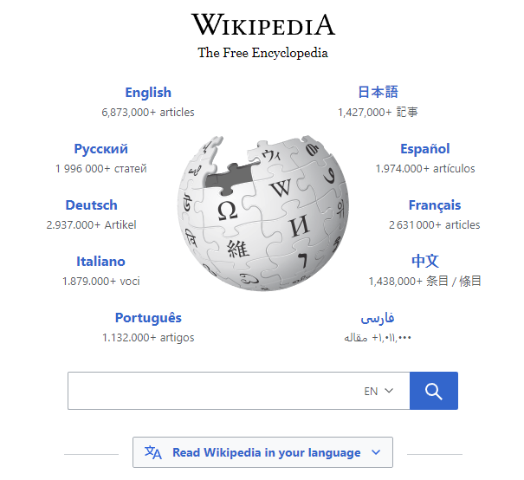

Core Contributions
Shared embedding is now part of foundational Machine Learning techniques. They are a requirement for pre-training models up to SOTA. OpenAI, Google and Meta were all trying to contribute to this topic.
The way OpenAI implemented contrastive learning allows for large scale internet data to teach a ViT image encoder. This is major. The key missing factor of image-text congruence was always a lack of data. And now we have it.
A year later, OpenAI applied CLIP to image-text generative AI, by using the internet to contrastively learn image-text. This allows for human-like thought vectors of text to images and images to text. Just like we humans visualize text or simplify images to text in our minds, CLIP teaches models to do the same. This is a shared embedding space.
OpenAI applied this to DALL·E and there are many papers using CLIP to give visual capability to VLLMs.
Vision-text training
(From internet)

Slide 7
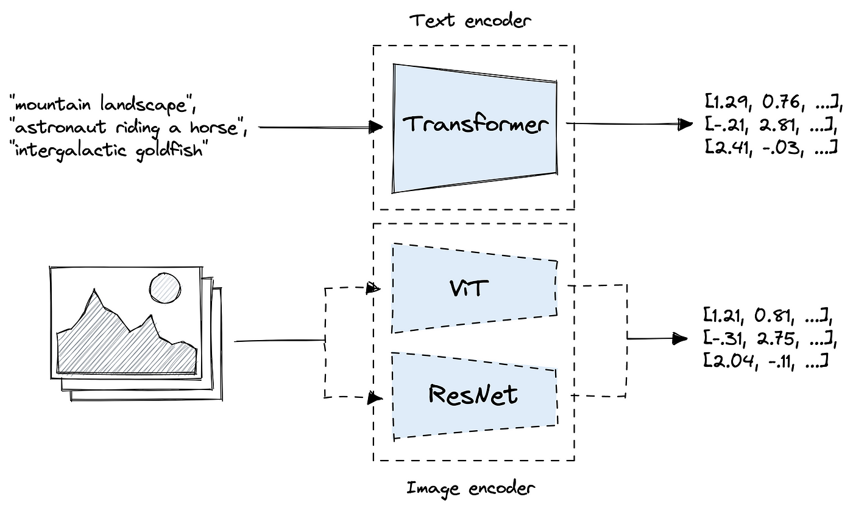
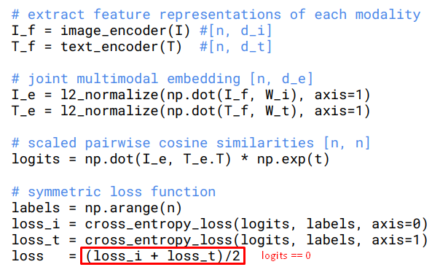
Methodology
CLIP takes two encoders, a text and image encoder.
Then creates two embeddings one from image and the other from text.
The embeddings are then converted to a random loss value.
Then we force them to be 0 by (image_loss - text_loss)/2
That is the most important part. By forcing the loss of image and text to be 0 we make the embedding spaces the same AKA shared as we back propagate.

Slide 8
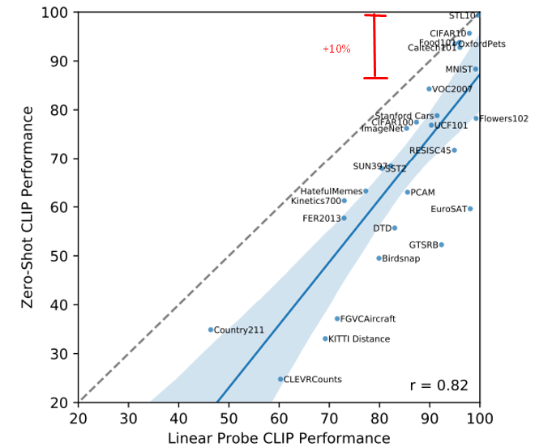
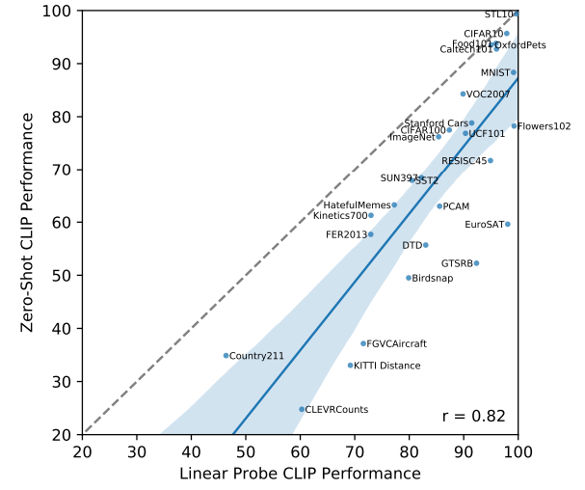
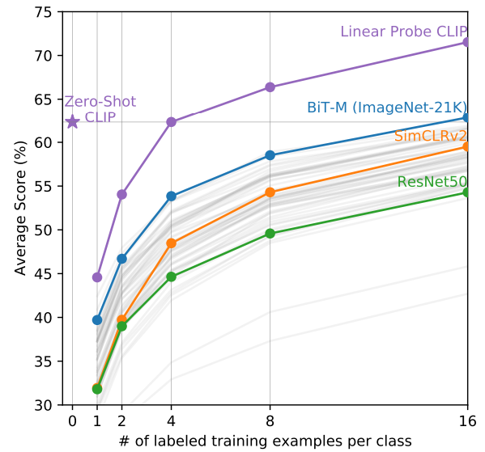
Experiments
Linear
Probe
There were two major experiment types of CLIP. First the linear probe, and second the zero-shot.
Linear Probe means freezing the parameters of the image encoder then training it a final linear layer for classification. For example mapping “dog”, “cat”. The encoders are left the same.
Zero-shot means training a vanilla CLIP model then introducing brand new data as an inference to either the text or image encoder.
Notice the bottom graph and how well zero-shot clip performs versus foreign models. Zero-shot CLIP performs as well as BiT-M with 16 shots, which is a huge accomplishment.
The top graph compares zero-shot to linear prob. Linear probe is minimum 10% more performant at few shot variation compared to zero-shot. This shows the power of transfer learning and refining CLIP. That is both good at zero-shot and beyond.
Zero
Shot

Slide 9

Reproduction
I tried to train and inference CLIP. However I was not able to do it in time as the paper was quite long and I had to make sure I understood it correctly.
However I was able to find a notebook with existing inferences, if you are interested in that.
Image_Search_CLIP - Colab

Slide 10
End

