Slide 1

Pairs Trading Using Cointegration
Jesse Haulk

Slide 2
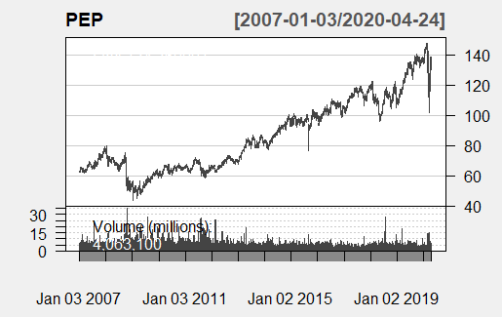
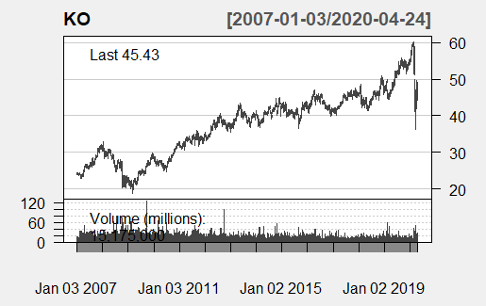
Candle Chart of PEP and KO
These show that the stock prices for PepsiCo (PEP) and Coca-Cola (KO) have similar pattern.
Indicates possible pair for a pairs trading strategy if PEP and KO are cointegrated.

Slide 3
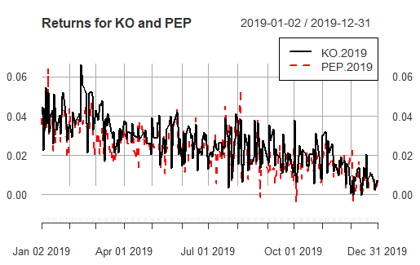
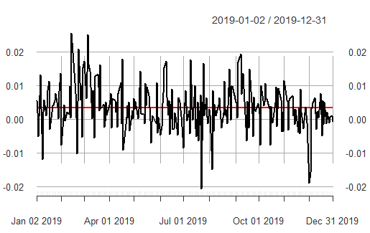
Returns for KO and PEP
In order to compare them on the same scale, the daily returns was plotted against each other.
The daily returns are very similar and importantly, one is never always higher or lower than the other.
Plotting the difference of the returns shows that it’s mean reverting. The difference doesn’t have a long run of being high or low.
This means if the difference of return is large, the next day will be smaller, and vice versa.

Slide 4
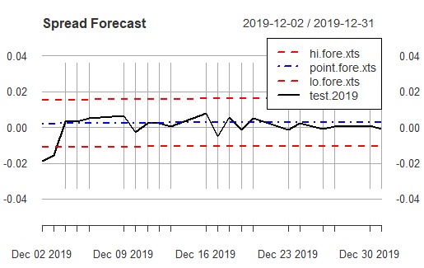
Forecasting the Spread
Training set using the first 11 months of 2019 data was using to develop an ARIMA model.
ARIMA(1,0,1) or ARMA(1,1) was the best model; and used to forecast 2019 December.
Most of the 2019 December data trends closely to the point forecasts; and falls within the 0.95 prediction interval.

Slide 5
Conclusion
It was possible to model the 2019 returns using an ARMA(1,1) model.
However, KO and PEP were not cointegrated.
This means that KO and PEP are likely linked by a confounding variable and not directly linked together.

