Slide 1
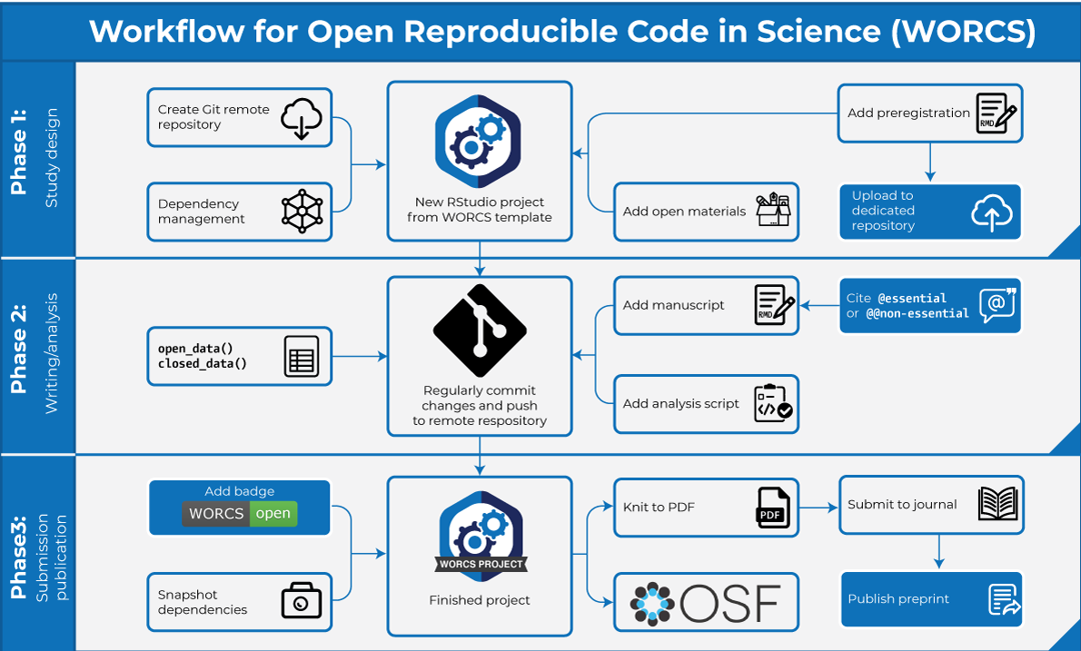
A Workflow
Tutorials and YouTube presentations: http://developmentaldatascience.org/worcs
Paper: https://doi.org/10.3233/DS-210031

