Slide 1
January 13 Meeting with Li-Lin

Slide 2
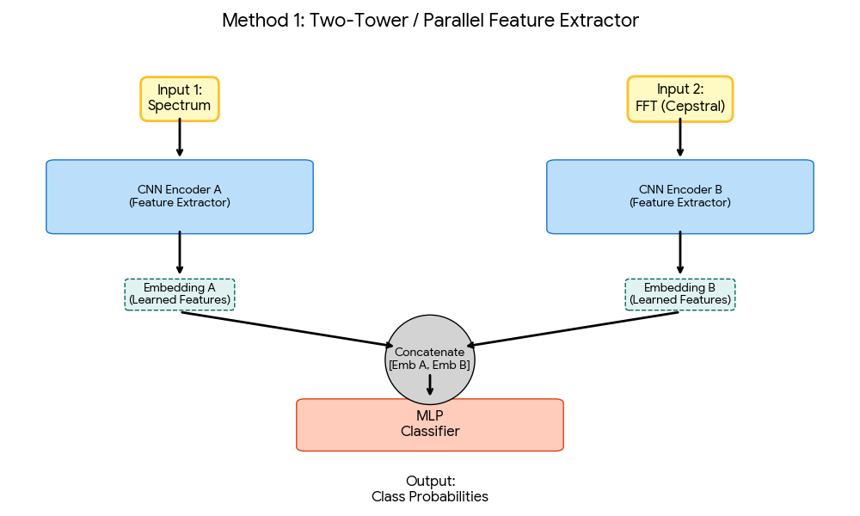
System Architecture
Encoder A: Embeds raw Raman Spectrum
  Shape, Peak Locations
Encoder B: Embeds FT of spectrum
  Periodicity of signal
Multi-Layer-Perceptron

Slide 3
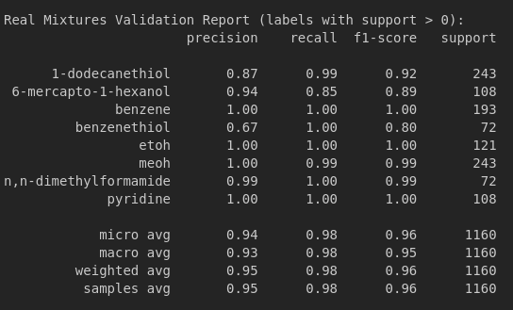
Results

Slide 4
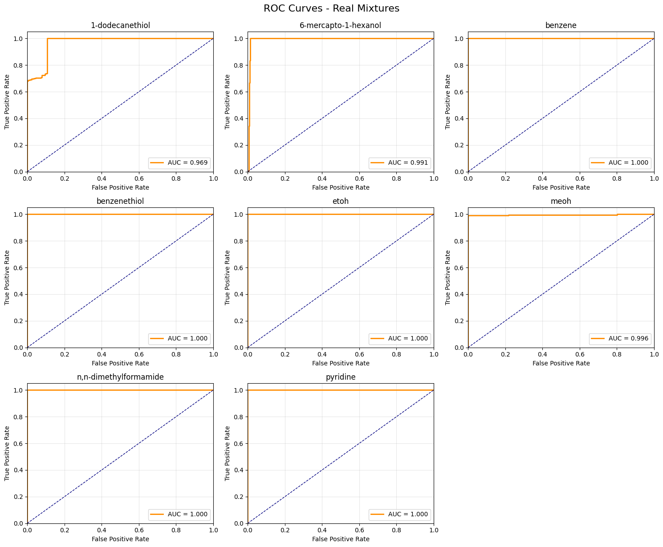
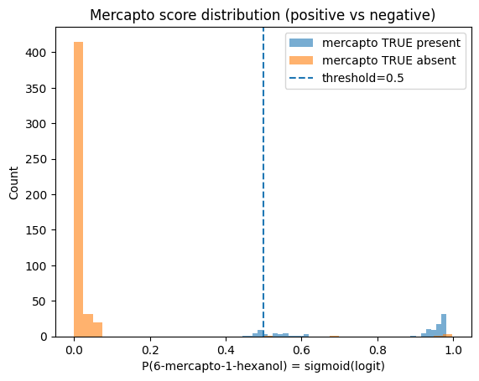
Analysis/Investigation
Calibration Shift (calibration issue)
Current model is underconfident
1-dodecanethiol everytime

Slide 5
Path Forward
Immediate Fix:
  Threshold Calibration with 20% of real mixtures
“Long” Term Fix:
  Increase synthetic data realism + Threshold calibration

