Slide 1

Get Git In 60-90 Minutes
Please do not share.
Jesse Liberty
@jesseliberty
Microsoft MVP

Slide 2
Git Is Really Much Easier Than They Say*
* 99% of the time

Slide 3
So, What is Git?
Version Control – So What Is That?
Ability to go back to a working version
Ability to switch among tasks safely
Ability to share code safely

Slide 4
* Most things happen locally
* You have to work hard to lose your work.

Slide 5
Work Area
Staging
(Index)
Repo on your machine
Stash
Remote Repo

Slide 6
Work Area
The current files in your directory (if you open VS, these are the files you see).

Slide 7
Index /Staging
Holds files you want to commit.

Slide 8
Repository On Your Machine
Holds all the versions of your program. The meaning of life, the universe & everything

Slide 9
Remote Repository
Just like your local repository but in the cloud. Allows you to share code with others, and provides off-site safety

Slide 10
Stash
Holds modifications you don’t want to use now, but don’t want to lose.

Slide 11
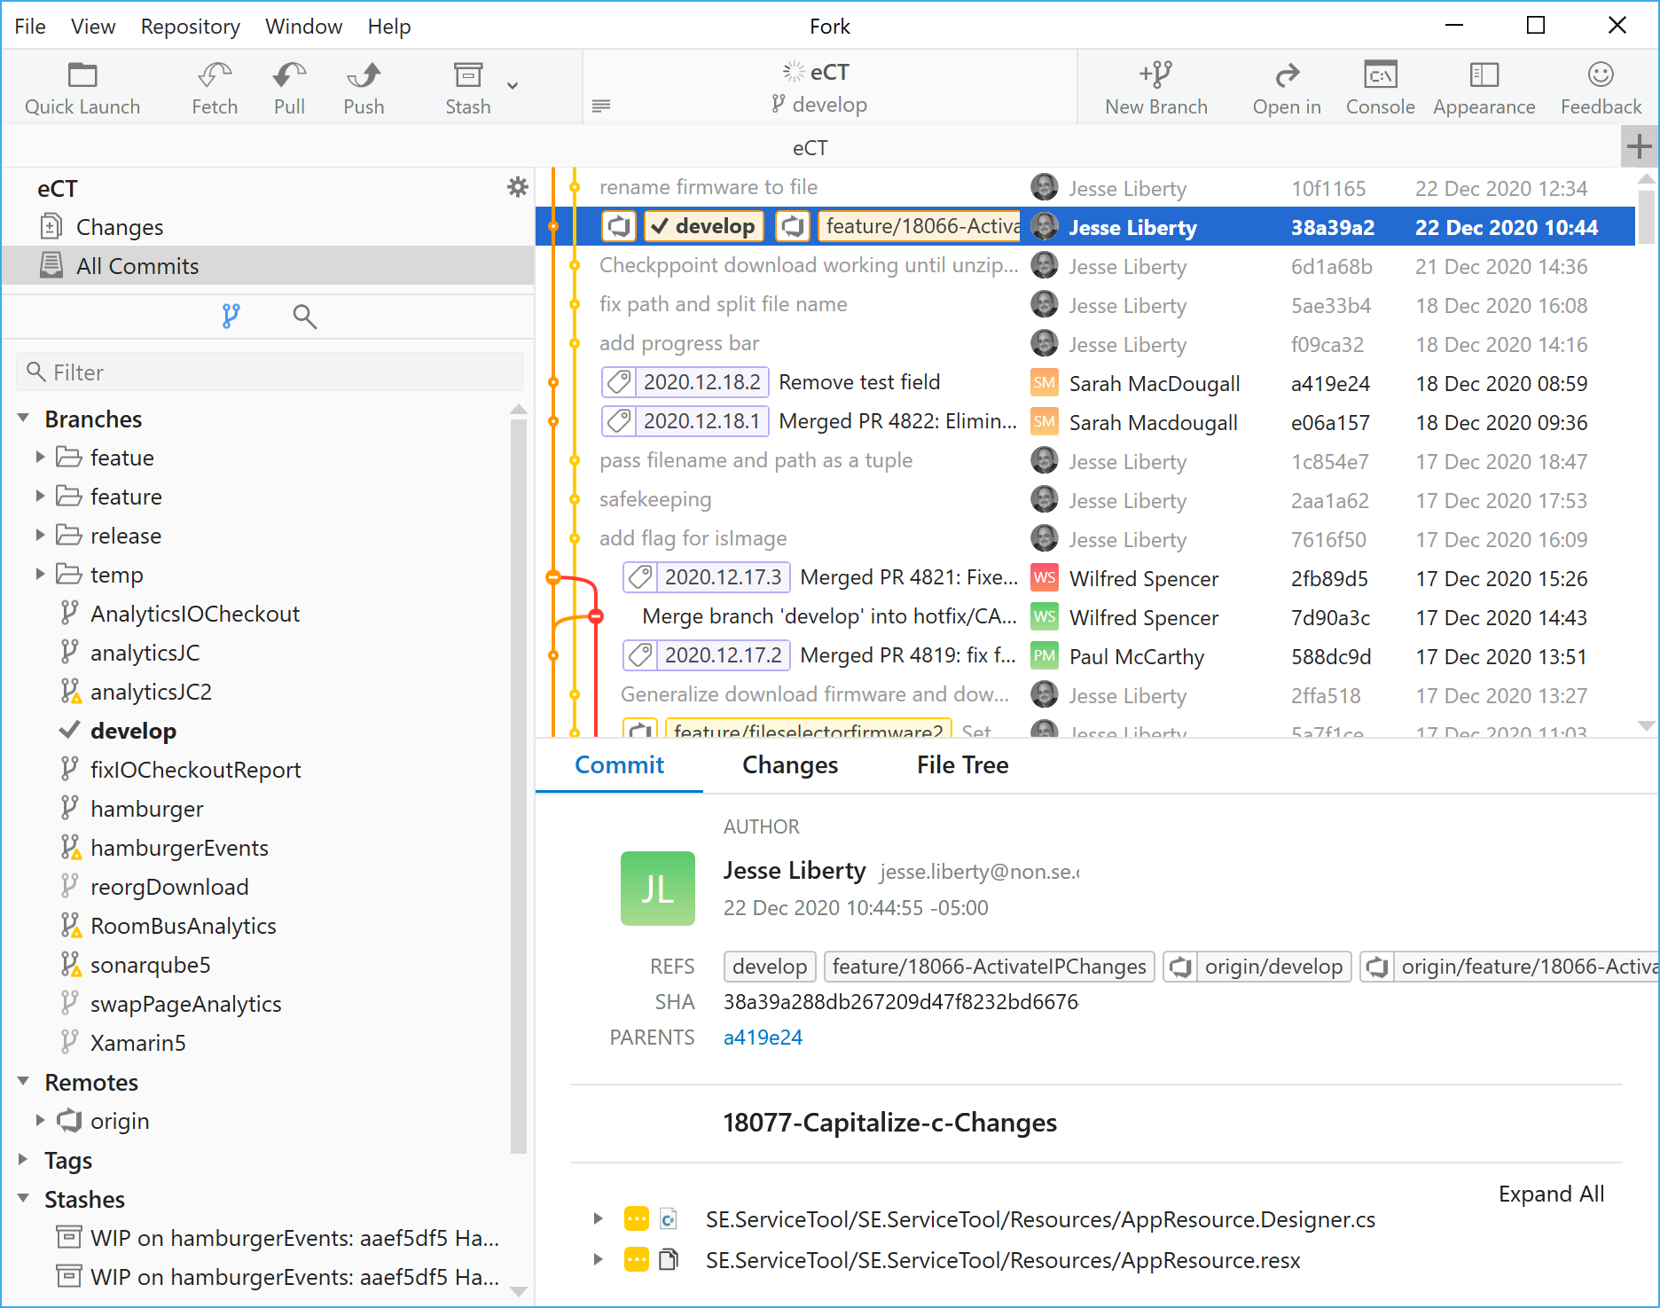
GUI – e.g., Fork

Slide 12
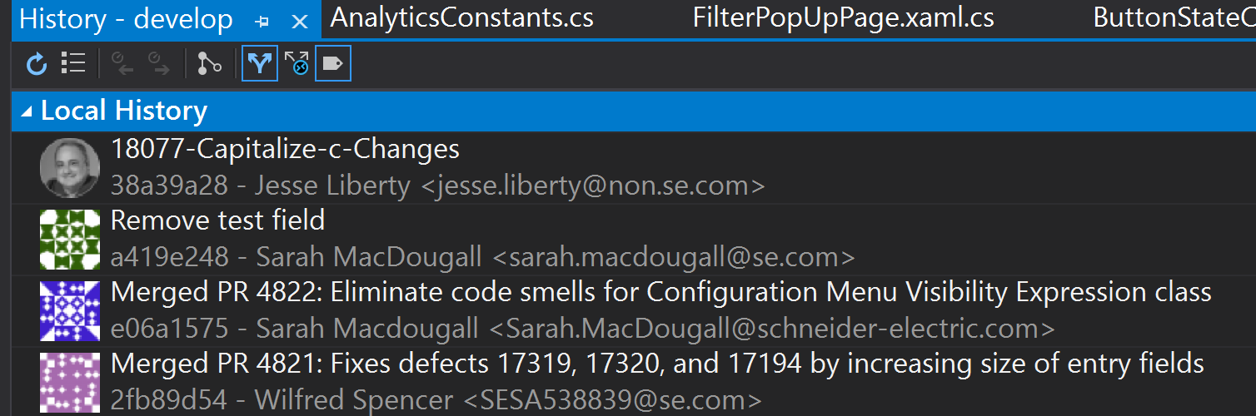
git in Visual Studio 19

Slide 13
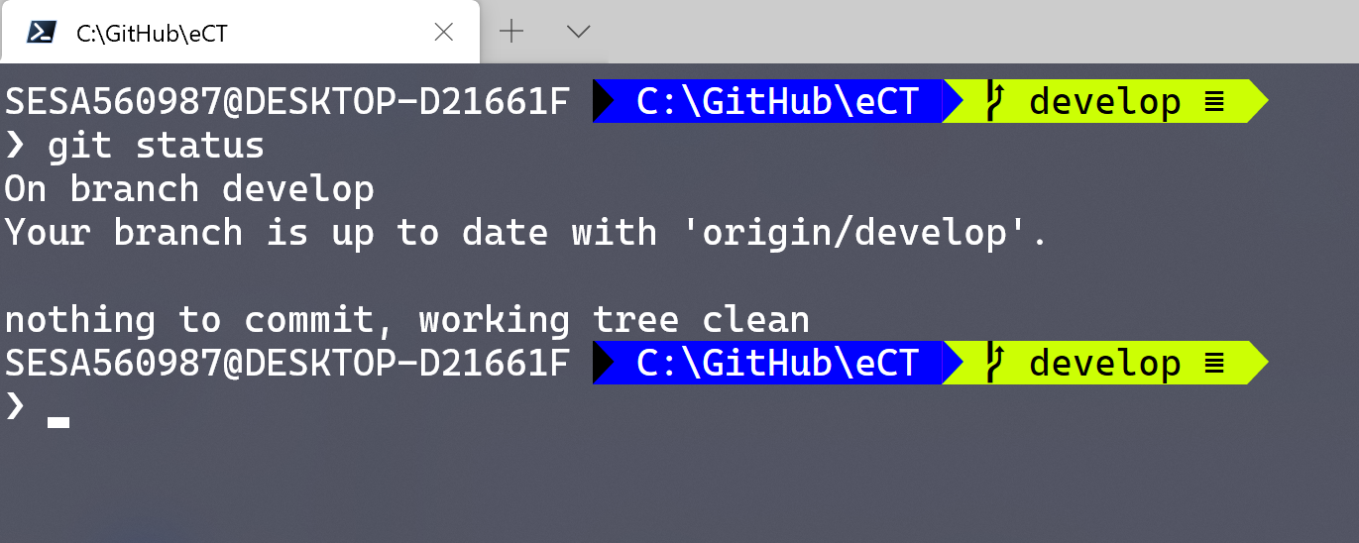
Pretty Git – git command line
Install Powershell
Go to Scott Hanselman’s article: http://jliberty.me/PrettyGit

Slide 14
Creating Your Repository

Slide 15
Work Area
Staging Area
Add

Slide 16
Staging Area
Repo on your machine
Commit

Slide 17
Local Repo
Remote Repo
Push

Slide 18

Good Commit Messages
A meaningful message
Put the message in the imperative
Added some files // bad
Add calculator class // good
You can clean these up with interactive rebase, covered later in this presentation.

Slide 19
Main
Head

Slide 20
Best Practice: All development is done on branches – never on Main.
Feature 1
Head
Main

Slide 21
Main
Feature 1
Head
Main
Feature 1
Main
Feature 1
Main

Slide 22
git checkout Main
git branch Feature2
git checkout Feature2
OR
git checkout –b Feature2
Feature 1
HEAD
Feature 2
Main
Feature 1
Main
Feature 1
Main

Slide 23
git checkout Feature 1
Feature 1
HEAD
Feature 2
Main
Feature 1
Main
Feature 1
Main

Slide 24
git checkout Feature1
git merge Main
Feature 2
Feature 2
Main
Merge
Feature 1
HEAD
Feature 2
Main
Feature 1
Main
Feature 1
Main

Slide 25
Feature 2
Pull Request
Feature 2
Main
Feature 1
HEAD
Feature 2
Main
Feature 1
Main
Feature 1
Main

Slide 26
Repo on your machine
Remote Repository
(origin)
Push
Pull

Slide 27
Work Area
Repo on your machine
Commit
Check out

Slide 28
Feature 1
HEAD
Feature1
Feature 1
Main
Main
Feature 1
Main

Slide 29
Fast Forward
Feature 1 / Main
HEAD
Feature1
Main
Feature 1
Main
Feature 1
Main

Slide 30
Feature 1
Main
Feature 1
Main
Feature 1
Main

Slide 31
True Merge
A
Feature 1
Main
Feature 1
Main
Feature 1
Main

Slide 32
Rebase solves the same problem as true merge
Feature 1
Main
Feature 1
Main
Feature 1
Main

Slide 33
Rebase
git checkout Feature1
git rebase main
Feature 1
Main
Feature 1
Main
Feature 1
Main

Slide 34
Feature 1
Feature 1
Feature 1
Rebase
Main
Main
Main

Slide 35
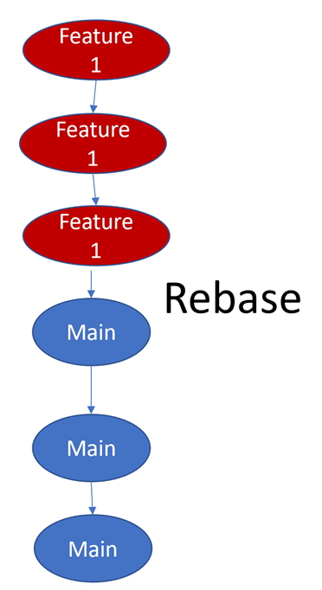
Rebasing
Advantage: much cleaner history
Reduce conflicts: commit and rebase frequently
Never rebase on the server.
Remember: you rebase onto another branch
git checkout Feature1
git rebase main
You want to do this frequently – avoid conflicts building up

Slide 36
Rebasing
After rebasing, do not pull
push --force-with-lease
Force means “I know what I’m doing,
Overwrite what is there with my current
Version.
-- with-lease means don’t overwrite anyone
else’s commits (fails if the push would do so)
Now you are ready to do a Pull Request or merge

Slide 37
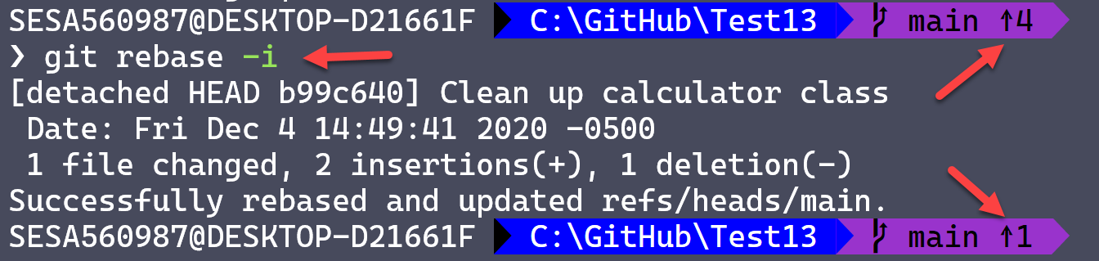
Interactive Rebase A totally different kettle of fish
Allows you to
Squash commits together
Reword messages
Remove commits
Reorder commits
Do this Before You Push

Slide 38
Changing History
Made a mistake on your last commit?
Haven’t pushed it yet. Use
git commit –amend

Slide 39
Order of operations
1 Create a branch
2 Write code
3 Commit (often)
Repeat 2 and 3 until ready to push
Interactive Rebase to clean up commits
Pull main
Rebase onto main - Locally
Repeat above until done Never rebase on shared code
Push --force-with-lease
Pull Request

Slide 40
This ‘n That

Slide 41
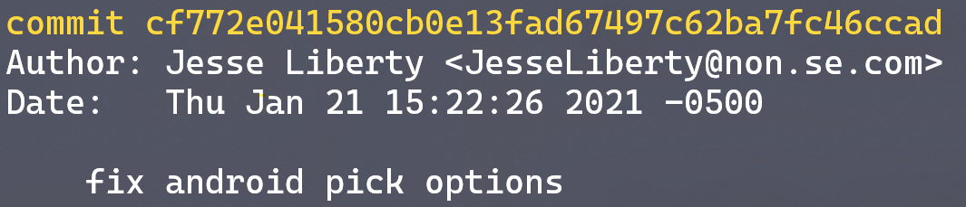
Don’t Work So Hard -- Aliasing
git config --global alias.co checkout
git config --global alias.bc checkout -b
git config --global alias.lg log --pretty=‘ %C(cyan)%h%Creset | %s %C(cyan)[%an]%Creset %C(yellow) (%cr)%Creset` %C(green)%d%Creset'
git config --edit --global

Slide 42
Never forget --with-lease again!
git config --global alias.pushf push --force-with-lease

Slide 43
Log
git log --oneline
git log --name-only // names of files changed in each commit
git log -1 --pretty=fuller // last commit
git log -p // what changed
git log <filename> // what changed in this file over time
git log --Scalculator // find all commits with Calculator
git log --committer=“jesse”
git log --author=“jesse” --since=“1 week”

Slide 44
Other useful commands
git restore --staged <filename>
git restore <filename>
With --staged undo an add (to index)
Without the flag discard changes to a file (careful!)
With –source <short hash> restores to that version
Use wild cards to restore more than one file
Use . To restore all the files in a directory
git show
git show 12345 // show what’s in commit 12345
git blame
git diff // what has changed in modified files (before commit)
git branch --d <branch name> // delete branch (careful!)
git add -- i // interactive add

Slide 45
Even More cool stuff
What changed in a file (History)
git log -p [--follow] [-1] <full path & filename>
--follow to see changes that occurred prior to name change
Committed to wrong branch?
git reset --soft HEAD~ // leaves files in working area
Using Powershell to delete all dead branches
git branch -vv | where {$_ -match '\[origin/.*: gone\]'} | foreach {git branch $deleteSwitch ($_.split(" ", [StringSplitOptions]'RemoveEmptyEntries')[0])}

Slide 46
Finding the broken commit -- Bisect
Start Bisect
Give Bisect a previously known-to-be-good commit
Then give Bisect a known-to-be-bad commit
It will divide the remaining commits in half, you then test
Essentially it is an assisted binary search
It can even work on its own if you have good unit tests
Can also be used to find where a property changed

Slide 47
git bisect start
git bisect bad # current commit is bad
git bisect good 123456 # short sha of a known to be good commit
Bisecting: 920 revisions left to test after this (roughly 12 steps)
# test the version that bisect checked out for you
git bisect bad # the commit bisect chose is bad
Bisecting: 460 revisions left to test after this (roughly 11 steps)
Sooner or later you will run out of commits and refs/bisect/bad will point to the problem. When you are done, enter:
git bisect reset #returns you to the original commit

Slide 48

Find out more…
Git Documentation
Blogs
Podcasts
http://jesseliberty.com

Slide 49


