Slide 1
Ziv-Zakai Lower Bounds on Signal Parameter Estimation
Ning Liu
Nov. 5, 2008

Slide 2
Outline
Problem statement
Motivation of ZZB: A comparison
Development of ZZB
Special cases
Examples
Conclusions

Slide 3
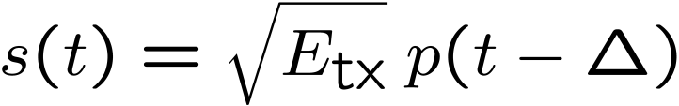


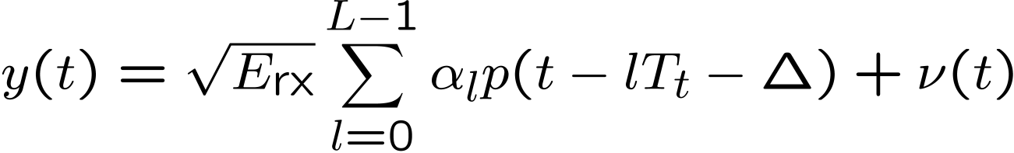


Background: Time delay estimation
Under a multipath channel, the transmitted is
: arbitrary signal pulse with duration
Δ : time delay, possible interval [0, T]
Received
: AWGN noise.
α_{l} : channel gain.
Problem: If estimating Δ, what is the minimum MSE (performance bound)?

Slide 4
Problem Statement
An implementation of random process
t₀ : random unknown to be estimated, uniformly in [0,T]. Time delay, frequency, phase, bearing.
[0,T] : a priori interval
α: stray parameter, unknown, phase, fading, etc.
n(t) : WGN
Usually non-linear parameter estimation

Slide 5
Comparison of Bounds – Local Bounds
Family of deterministic “covariance inequality” bounds
Cramer-Rao bound (CRB), Barankin bound (BB), Bhattacharyya, Hammersley-Chapman-Robbins, Fraser-Guttman, Kiefer, Abel .
Parameter θ is unknown deterministic
Not utilize a priori information. Providing bound on the MSE for any value of θ.
CRB is the easiest, but not accurate outside of asymp. region.
Major drawbacks of local bounds:
Estimators be restricted in some manner. CRB and BB require unbiased estimators.
Do not take account into any a priori information.

Slide 6
Comparison of Bounds – Global Bayesian Bounds
Family of Bayesian bounds: Ziv-Zakai bound (ZZB) and Weiss-Weinstein bound (WWB), etc.
Bayesian bound: assume known a priori distribution. Global MSE averaged over the a priori distribution.
Relate the MSE in the estimation problem to the error probability in a binary detection problem.
No restrictions on the class of estimators.
Incorporate knowledge of the a priori parameter space.
Bayesian bound can be computationally complex.
CRB, BB and WWB applicable to vectors. ZZB only for uniform scalar random variable. Extension exists.

Slide 7
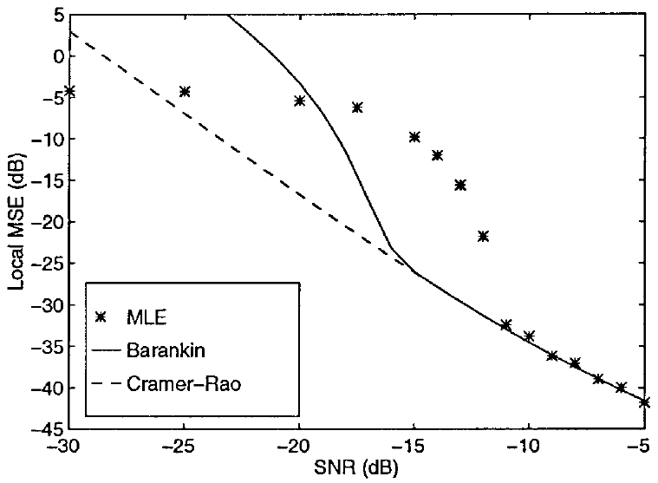
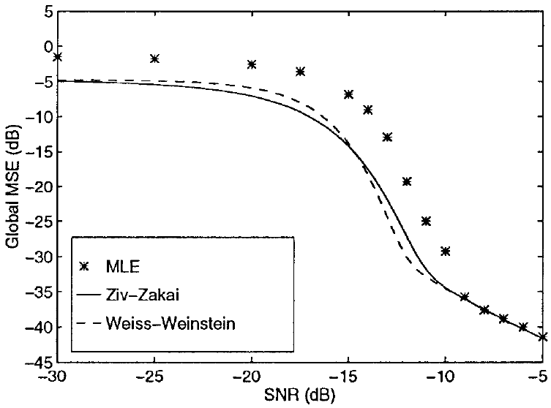
Comparison of Bounds - Plots
Fig. 1 MSE bounds and MLE vs. SNR for bearing estimation. (Bell, Van Trees, 1997)
Notes:
Asymptotic region: closely predict when SNR drops below threshold, MLE sharply increase, and then flatten out as the error limited by a priori. Both bounds exceed the MSE of MLE in the low SNR. Attributed to both two drawbacks.

Slide 8
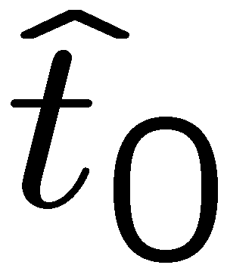
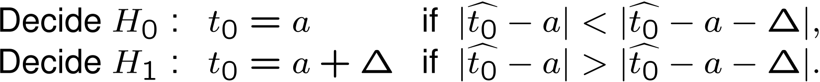
ZZB – Development (1)
A hypothesis testing problem
Two possible received signals transmitted with equal probability:
A sub-optimal estimator produces
Decision error probability:

Slide 9

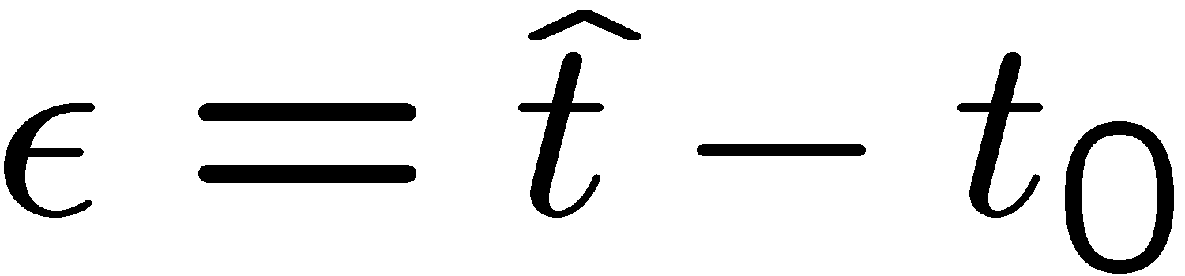

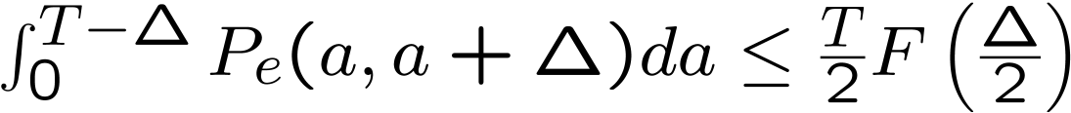

ZZB – Development (2)
The suboptimal decision error probability is bounded by the minimal error probability of the optimal decision scheme:
Integrating :

Slide 10
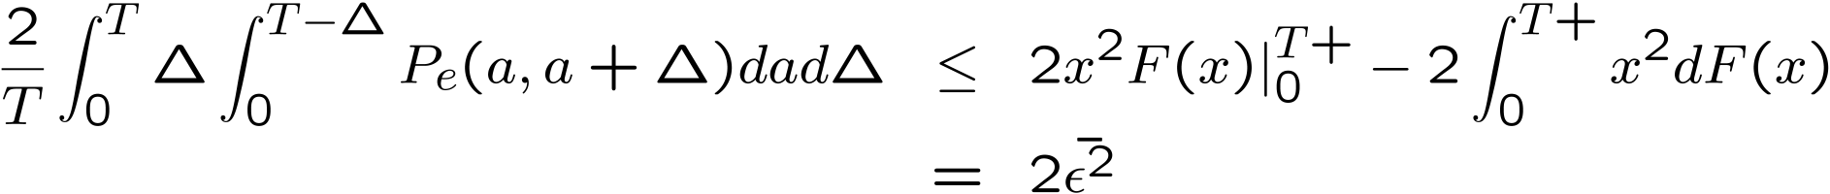
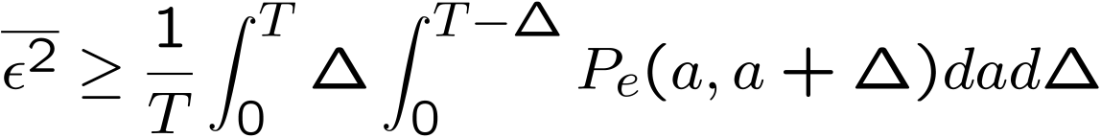
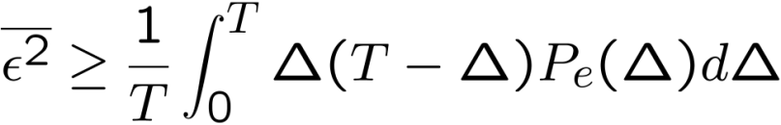
ZZB – Development (3)
Integrating over Δ :
ZZB:
If

Slide 11

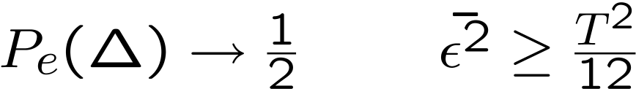



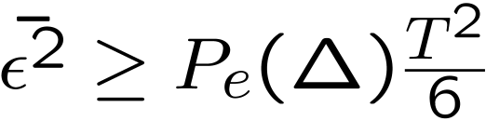
Special Case – Asymptotic Behavior
: error probability for two orthogonal signals.
Not tight.

Slide 12
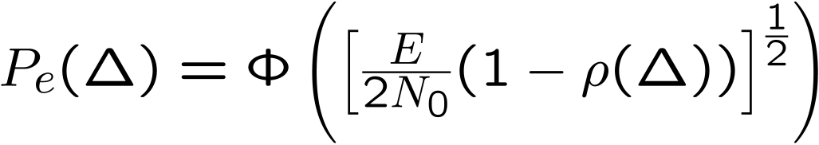

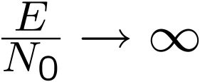
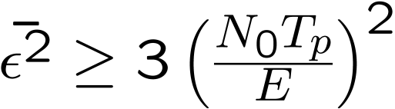
Special Case – Rectangular Pulse w/o Stray Parameters
Signal model:
When

Slide 13
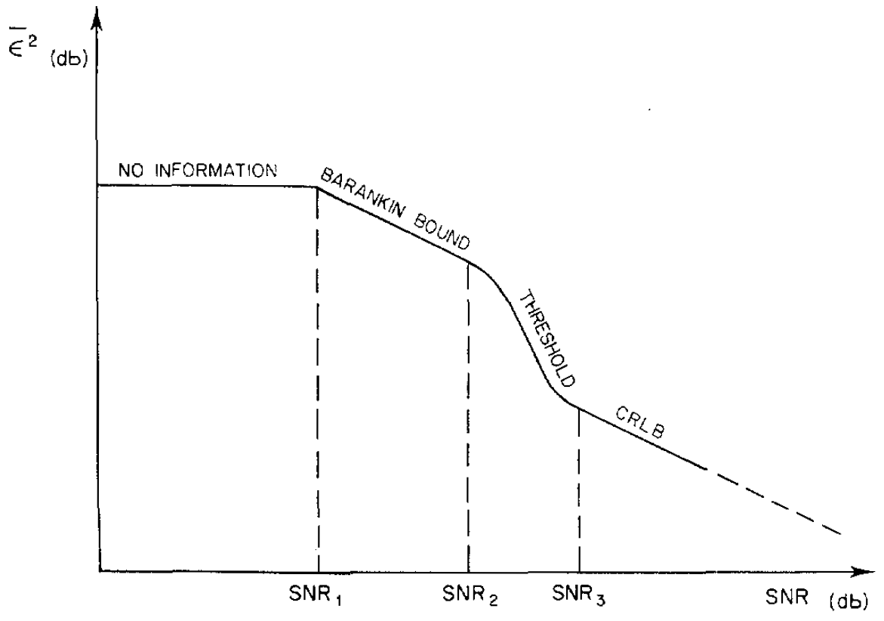
Example 1 – Weiss-Weinstein Bound
A priori info. dominated
Ambiguity dominated
Transition
Ambiguity free
WWB for passive time delay estimation.

Slide 14
Example 2 – Averaged ZZB for TDE under Random Convolutional Channel
Xu & Sadler
JSTSP, 2007

Slide 15
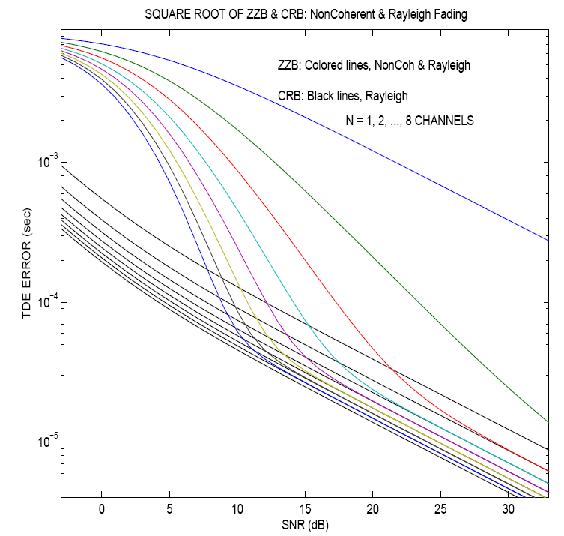
Example 3 – TDE w/ FH signals under Rayleigh Fading
Kozick & Sadler
TR, 2007

Slide 16
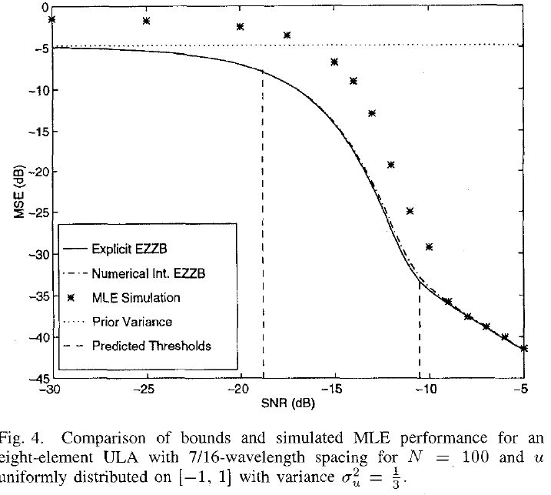
Example 4 – Bearing Estimation
Bell, Ephiraim, Van Trees, 1996

Slide 17
Conclusions
ZZB provides an approach to build a tighter bound for the uniformly distributed random parameter estimation.
ZZB has no restriction on estimators, and exploit the a priori parameter interval.
ZZB may incur high computation complex.
ZZB can be extended to multivariate with arbitrary distribution.

Slide 18
References
[1] J. Ziv and M. Zakai, “Some Lower Bounds on Signal Parameter Estimation,” IEEE Trans. IT, vol. IT-15, pp. 386-391, May 1969.
[2] L. P. Seidman, “Performance limitation and error calculation for parameter estimation,” Proc. IEEE, vol. 58, pp. 644-652, May 1970.
[3] D. Chazan, M. Zakai and J. Ziv, “Improved Lower Bounds on Signal Parameter Estimation,” IEEE Trans. IT, vol. 21, pp. 90-93, Jan. 1975.
[4] S. Bellini and G. Tartara, “Bounds on error in signal parameter estimation,” IEEE Trans. Commun., vol. COM-22, pp.340-342, Mar. 1974.
[5] D. L. Duttweiler and T. Kailath, “RKHS approach to detection and estimation – Part V: Parameter estimation,” IEEE Trans. IT, vol. IT-19, pp. 29-37, Jan. 1973.
[6] A. Weiss and E. Weinstein, “Fundamental limitations in passive time delay estimation – Part I: Narrow-band systems,” IEEE Trans. ASSP., vol. 31, pp. 472-486, Apr. 1983.
[7] A. Weiss and E. Weinstein, “Fundamental limitations in passive time delay estimation – Part II: Wide-band systems,” IEEE Trans. ASSP., vol. 32, pp. 1064-1078, Oct. 1984.
[8] K. L. Bell, Y. Steinberg, Y. Ephraim, and H. L. Van Trees, “Extended Ziv-Zakai lower bound for vector parameter estimation”, IEEE Trans. IT, vol. 43, pp. 624-637, Mar. 1997.

Slide 19
Thank you!

