Slide 1
Performance of Time Delay Estimation and Range-Based Localization in Wireless Channels
Ning Liu
Wireless Information Technology Lab
Department of Electrical Engineering
University of California, Riverside
September 3, 2010
Notes:
Good morning, every one. It’s my pleasure to have all of you here. Before the defense, firstly I’d like to thank my advisor, Dr. Xu, for his continuous support and advising on my thesis research in the past years. I’d also like to give my special thanks to Dr. Hua and Dr. Farrell to be my committee members. Without my committee I cannot arrive at the final defense. Thank you very much.
My thesis research is about transceiver localization in wireless systems. As we know, wireless positioning has been widely used in practice for a long time, but in the more and more complicated wireless environments, the localization techniques and the fundamental measurements are still facing great challenges. In this presentation, I’ll talk about my research on the performance of the time delay estimation and the range-based localization in typical wideband wireless channels.

Slide 2
Outline
Motivation
Challenges in multipath channels
Part I: Ziv-Zakai bounds for TDE in unknown random multipath channels
Pulsed signal
Frequency hopping waveforms
Part II: ToA localization performance in multipath channels
Deterministic and random bias
WLS and ML estimators
Conclusions
Notes:
This is the agenda. Firstly I’ll review my research motivations. They are mostly from the great challenges on range measurement and localization in multipath channels. After that, I will present my research in two parts. In Part 1, I developed the Ziv-Zakai performance bounds for TDE in unknown random multipath channels, including the ZZB for both pulsed signals and frequency hopping waveforms. The second part is about the performance of ToA localization in multipath channels. In this part I study the performance of typical location estimators with biased range measurement. And finally I’ll make conclusions.

Slide 3
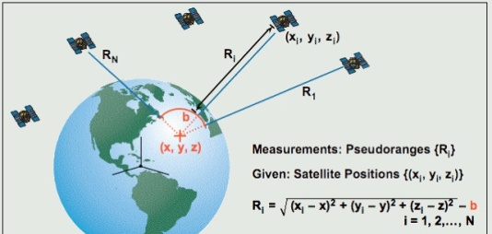
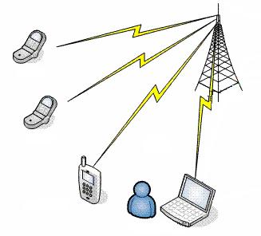
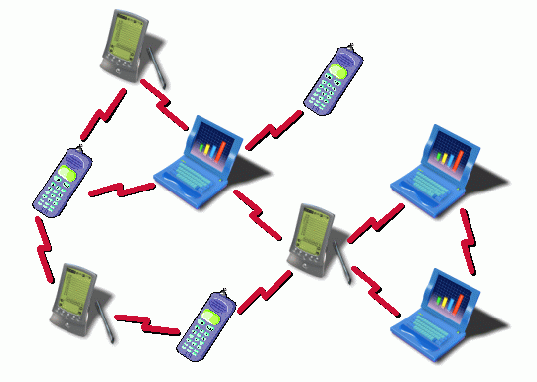
Transceiver Localization in Wireless Systems
GPS/GNSS:
Sky infrastructure-based
At least 4 accurate references always available
Cellular/WLAN:
Terrestrial infrastructure-based
Reference available in coverage
Ad-Hoc/Sensor networks: Infrastructure-less
Reference nodes are sparse
Possibly no direct radio link to references
Cooperative localization applicable
Notes:
Let’s firstly have an overview on wireless localization. There are many localization methods for different wireless systems. The system could be wide area or local area, the signal could be RF or ultrasound, and localization schemes, localization entity and estimators can all be different. But they all rely on some kinds of parameter measurements on the wireless signals, and they all rely on some reference points with known locations. For example, GPS is probably the mostly used localization system and it’s based on satellite networks. At any point on the earth, there are always at least 4 satellites available with their accurate positions, and the localization depends on the range measurements between satellites and GPS receivers. In terrestrial wireless networks, the infrastructure-based systems like celluar network or wireless LAN use the reference signal from base-stations to estimate the signal strength or ranges between BSs and mobile devices, and the availability depends on the network coverage. For the infrastructure-less ad hoc networks, the reference points are sparse, so localization has to depend on the measurements between neighboring unknown-location nodes. This method is called network or cooperative localization. From these examples we can see the localization methods could be quite different in wireless systems.

Slide 4

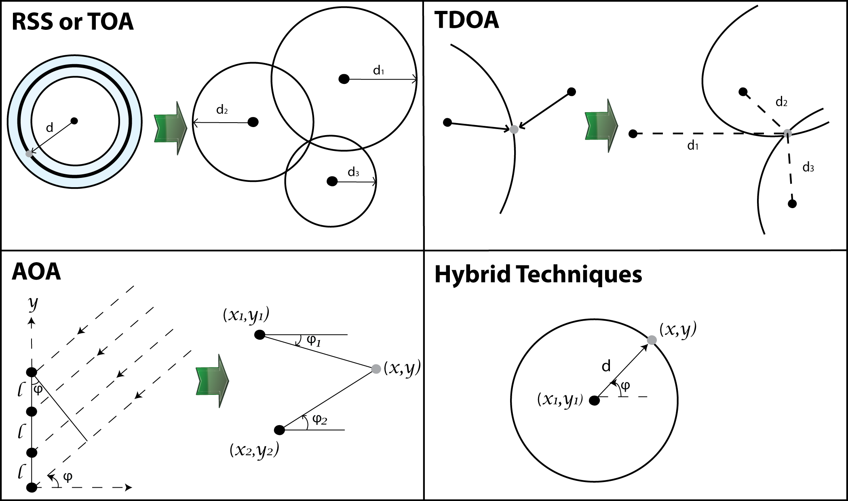
Two-Stage Localization Schemes
Notes:
Above all kinds of localization systems, we can summarize a two-stage procedure. With the received signal as input, the first stage estimates some position related parameters. For example, ToA scheme measures the range by time delay estimation, RSS by signal strength, and each range estimate forms a circle. TDoA scheme estimates range differences formed as hyperbolas. AoA method estimates the angels from references to the unknown-location transceiver, and each angle estimation determines a straight line.
Based on these parameter estimates from several reference points, at the second stage, the position is estimated The ToA localizer determines the position by the intersection of circles, TDoA is by the intersection of hyperbolas, and AoA is by the cross-points of straight lines. We can also use hybrid measurements. For example, by both angle and range measurements. So, for these 2-stage localization schemes, the accuracy of parameter estimation at the first stage is fundamental and critical to the localization performance at the second stage. Because the ToA localization is mostly used in practice, in the first part of my research I focused on the performance study of ToA estimation, or time delay estimation.

Slide 5
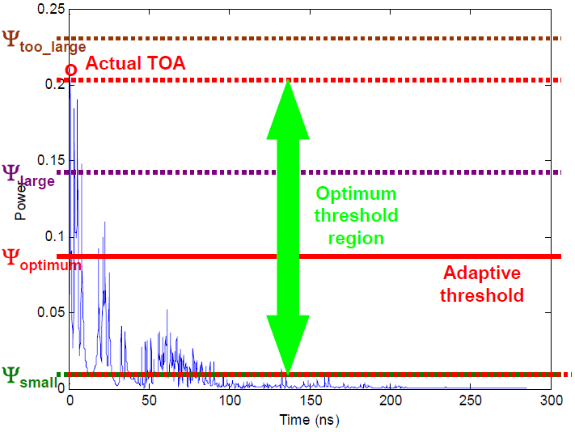
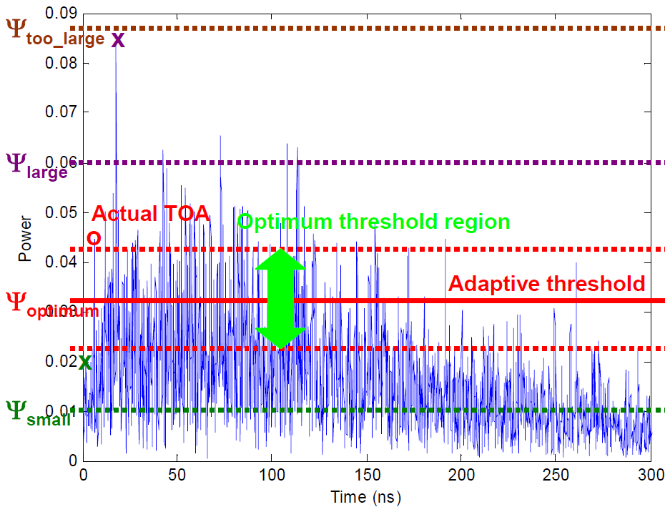
Time Delay Estimation
Challenge on TDE in multipath channels
t₀: generally random; Channel known/unknown to receivers.
LOS path detection (Patwari, 2005; Peterson, 1998; Lee, 2002)
NLOS identification and mitigation (Chen 1999; Tuchler, 2006)
LOS
NLOS
Notes:
If the signal clocks at the transmitter and receiver are exactly synchronized, then time delay estimation is quite straightforward by measuring the signal propagation time along the LOS path. However, in wideband wireless networks, such as cellular network, wireless LAN or UWB networks, wideband signal propagates over multipath channels and usually suffer from the dense reflectors and scatters. In the multipath environment, the LOS path could be weak, ambiguous or even totally blocked. These two figures show the examples of LOS and NLOS channels. On the left side the LOS path is the strongest among all the signal components, and the peak detection will find the actual ToA. But on the right, because of NLOS propagation, the actual LOS path is weak and the strongest NLOS signal path is mistakenly estimated as the ToA marked by the purple cross. So there will be NLOS error in the time delay estimation. NLOS error is defined as the excessive travelling distance with respect to the LOS path, and it is reported as the killer issue in the ToA estimation for range-based localization. In the literature, there are many methods proposed for weak LOS detection, NLOS identification and NLOS error mitigation, for example, some algorithms make use of the redundant measurements over time. But none of the algorithms can be universal for all the practical scenarios.

Slide 6
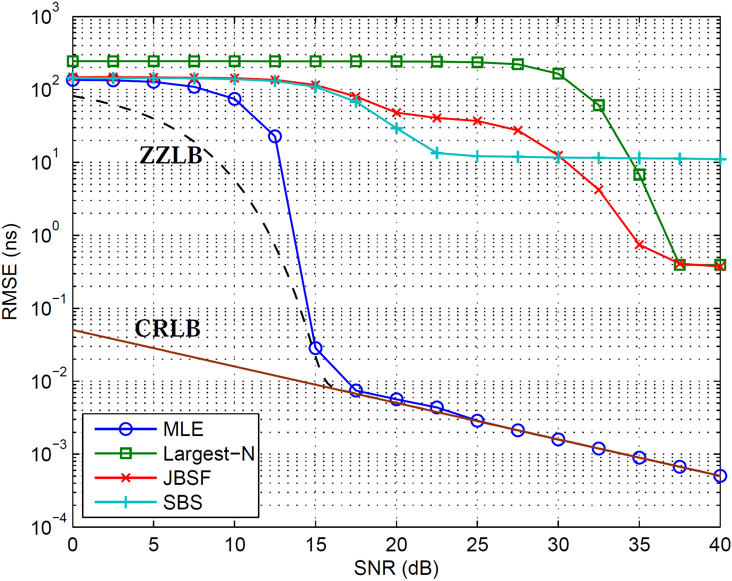
Motivation on Developing Realistic TDE Bounds
Practical Algorithms
Need better ranging algorithms in practice
Still a big gap between practical algorithms and fundamental bounds
Fundamental Bounds and MLE
Need tighter bounds in practical scenarios
Time delay estimation with UWB signal over deterministic multipath channels. (Guvenc et al, 2008)
Notes:
This figure shows an example of time delay estimation with UWB signal over deterministic multipath channels. The figure plots the performance curves of 3 practical algorithms, the ML estimation, and two performance bound, CRB and ZZB. The ZZB is plotted by pure monte-carlo simulation without an explicit expression. We can see there is a big gap between practical algorithms and fundamental bounds, and this deviation drives research efforts in two directions. One is to find better algorithms to approach the performance of optimum estimators and theoretical bounds. The other direction is to develop tighter bounds in practical scenarios. My research focused on the fundamental bounds development. Specifically, I develop the Ziv-Zakai bounds with explicit expressions for the practical scenario, that is, unknown random time delay is estimated over random multipath channels and the channel knowledge is unknown to receivers. With these assumptions, the bounds are realistic and tight for predicting the performance limits of time delay estimation.

Slide 7
Motivation: Two fundamental topics
Performance bounds for TDE
Tight bounds to predict performance limits
ZZB is tighter than CRB in low-to-mid SNR region
Bounds for practical scenario: unknown multipath channel
CRB for deterministic channels (Yau 1992, Saarnisaari 1996)
ZZB for AWGN and flat-fading channel (Sadler 2007, Kozick 2006)
Average ZZB for known multipath channel (Xu 2007)
Efficient evaluation method for ZZB
Performance of ToA localization with biased ranging
Error analysis for typical estimators
ML for Deterministic bias (Weiss 2008)
CRB of ToA localization
Uniformly distributed random bias (Jourdan 2008)
Notes:
Here I summarize the motivations of my research. I worked on the two fundamental topics about localization performance. The first is to develop tight performance bounds for TDE in practical scenarios. Such lower bounds provide useful tools for algorithm designers. We can easily know the best achievable performance without testing particular algorithms, and the bounds can be used as benchmarks for evaluating algorithms. Also the bounds can provide insights into the TDE behaviors. I follow the Ziv-Zakai approach on the bound development because it is tighter than CRB at low-to-mid SNRs. In the literature some bounds exist for deterministic channels or flat-fading channels, and an average ZZB has been developed for random multipath channels, assuming receivers know the channel realizations. But, my development of the ZZB assumes the channel knowledge is unknown to receivers, and receivers only know the channel statistics. So the ZZBs are more realistic. Also, ZZBs usually don’t have closed-form expressions, and fast evaluation methods are desired. That’s why I worked on the efficient computing method for ZZB.
By the two-stage localization model, we know the errors from the 1st-stage time delay estimation will propagate to the 2nd-stage position estimation. The 2nd part research is on the performance of ToA location estimators in multipath channels. The NLOS TDE errors are usually modeled as a bias in range measurement. In the literature some special cases have been discussed for deterministic or uniformly distributed random bias. In my development, the bias is generally modeled as either deterministic, or random following some common distributions. Based on these models I develop the error analysis for typical estimators, and also develop the CRBs.
In the following, I’ll go over these two parts separately, starting from the work on the TDE bounds development.

Slide 8
Part I
Ziv-Zakai Performance Bounds for TDE in Unknown Random Multipath Channels
Signal and channel models
ZZB development for pulsed signal
Evaluation of ZZB by MGF approach
Efficiently compute MGF with a compact form
Asymptotic analysis at low and high SNR regimes
ECRB, MAP/GML estimators.
ZZB for frequency hopping: frequency diversity
Numerical examples
Notes:
My first part research is on the Ziv-Zakai bounds for TDE in unknown random multipath channels. In this part, I’ll firstly introduce the signal and channel models, and then go over the bound development procedure for pulsed signal. I also propose the MGF approach for efficiently evaluating the ZZB. The asymptotic analysis is performed at both low and high SNR regimes. For comparison I develop the ECRB, MAP and Generalized ML estimators. The ZZB development for frequency hopping transmission is similar as the pulsed signal version, but it has the special feature of frequency diversity. And some numerical examples will show the ZZB behaviors.

Slide 9

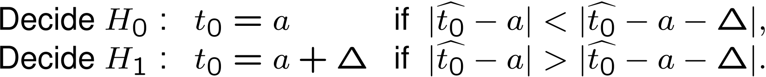

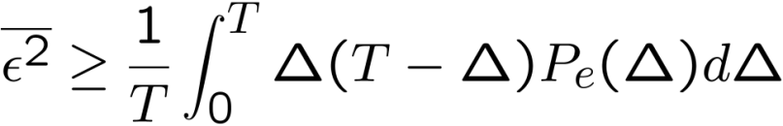

Review of ZZB: A Hypothesis Testing Approach
Two possible time delays for
Time delay estimate by an arbitrary estimator
Minimum error probability by an optimum detector
ZZB (Ziv, Zakai, ’69, ’75)
Question: How to find in case of interest?
: estimation error by an arbitrary estimator
Notes:
Let’s begin by the original development by Ziv and Zakai. They consider the received signal r(t) in this equation. The unknown time delay t0 is assumed uniformly distributed from 0 to T, and \alpha is the nuisance parameter such as channel gain and phase. In general, it’s impossible to calculate the minimal estimation error when the s function is a nonlinear with respect to t0. The ZZB approach is based on a binary detection problem. Suppose there are only two possible time delays in the duration from 0 to T, one delay is a, and the other is a+\delta. These two possible delays are known to both the transmitter and the receiver. The receiver estimates the time delay as t_hat by an arbitrary estimator, and make a decision from the two possible delays if the estimate is closer to one of them. If t_hat is closer to a, then the decision is made in favor of H_0; otherwise it decides on H_1. The error probability of this binary hypothesis testing can be expressed as the right side of this inequality, and it should be lower bounded by the minimum error probability Pe(a, a+\Delta) of an optimum detector. In most cases it’s independent of a, so it’s denoted as Pe(\Delta). This minimum error probability Pe is for the particular time delay \Delta. We integrate the both side from 0 to T plus some approximations, and we can find the classic expression of ZZB, that is \epsilon^2 the mean-square error by arbitrary estimator is bounded by this integration on Pe(\Delta). By this expression it’s obvious that the key step in developing the ZZB is to find the minimum error probability Pe. So, for a particular case of interest, how to find Pe(\Delta) becomes the critical question.

Slide 10

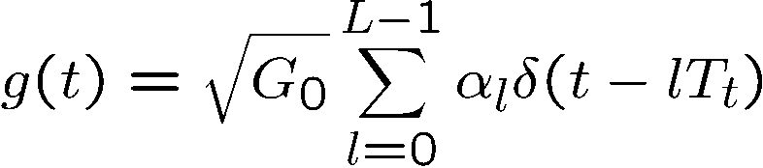

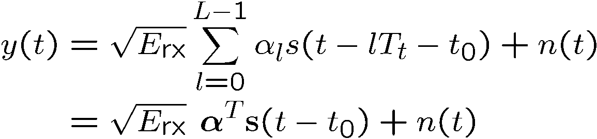
Pulsed Signal and Channel Models
Transmitted pulse
Multipath channel
Received signal
Notes:
My development of the ZZB starts from these signal and channel models. The transmitted pulse p(t) can be in any pulse shaping with the energy Etx. The multipath channel is modeled by a classic tap-delay-line model with L channel taps and channel gain G_0. \alpha_L is the normalized channel tap gain following Guassian distributions. The time spacing Tt is assumed equal between neighboring channel taps. So the received signal y(t) is the convolution of the transmitted p(t) with the channel impulse response g(t) delayed by t_0. We can pack the signal components of L channel taps into vectors \alpha and s as in the last equation. So the problem is to find the lower bound in estimating the time delay t_0.

Slide 11



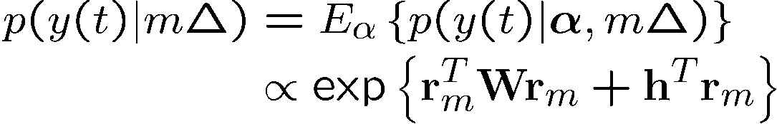
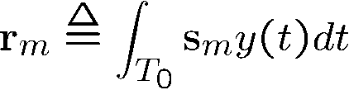
Distributions of Received Signal
Replace by for ZZB development:
pdf conditioned on one channel realization:
Unconditional pdf by averaging over channel:
: Gaussian vector, correlation at the receiver
W, h: depend on signal autocorrelation and channel statistics
Notes:
As we know, the ZZB development is based on binary HT. For a particular time delay \Delta, we have two possible hypotheses, that is, t0 is either 0 or Delta. So for ZZB development, we replace t_0 by m\Delta in the expression of y(t). Here m is 0 or 1, so m\Delta is 0 or \Delta. Then we can find the conditional distribution of y(t) from the Gaussian distribution of noise n(t), conditioned on a channel realization \alpha. Because we assume channel is random and unknown to the receiver, we average this conditional pdf over the distribution of channel, and the unconditional pdf is proportional to this quadratic form of the Gaussian vector r. r is the correlation between the received signal y and transmitted pulse s_m. Here we discard other terms independent of m\Delta because they don’t have effect on the hypothesis test. Then based on this unconditional pdf, we can form the likelihood ratio for the hypothesis test.

Slide 12
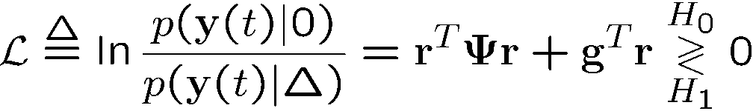
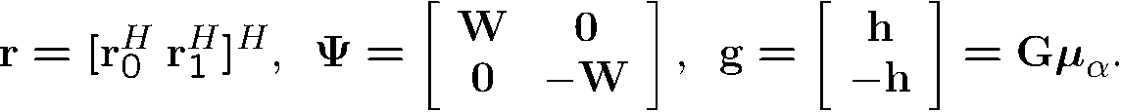



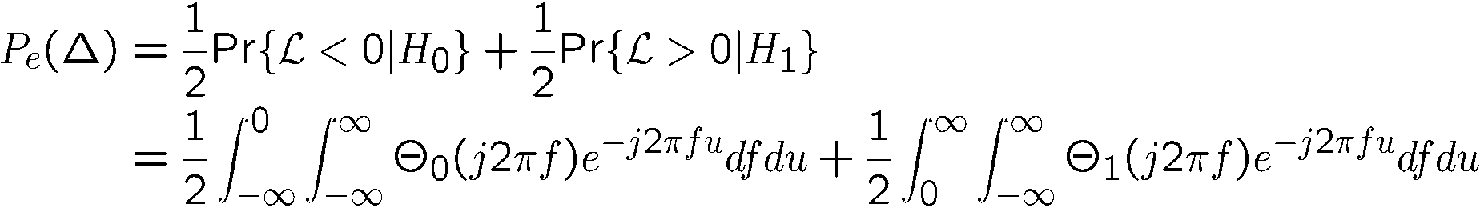
Log-likelihood Ratio Test
LLR to decide on H₀ and H₁
Find pdf of LLR: the MGF approach
pdf of r (Gaussian) MGF of (Quadratic Gaussian)
pdf of
and ZZB conditioned on actual delay
FT
Notes:
The log-likelihood ratio is expressed as the pdf of y conditioned on delay is 0, over the pdf conditioned on delay is \delta. We use this LLR to decide on H0 or H1. So the error probability of this test is the Pe(\Delta) for ZZB. We have to find the distribution of this LLR to compute Pe. Because the LLR is in the quadratic form of the Gaussian vector r, it’s hard to find its pdf directly. Here we use a detour approach. Firstly we start by find the Gaussian distribution of the vector r, which depends on the signal correlation and channel distribution. And then by some existing results about quadratic form of Gaussian vectors, we can find the MGF of the LLR. And the pdf is by Fourier transform from its characteristic function.
After finding the pdf, we can compute Pe by half-side integration on the LLR’s pdf, depending on the actual time delay 0 or \Delta. This is the same as the detection error probability of a binary modulation scheme in communications. In these double integrations, the inner integrations are the Fourier transforms from MGF \Theta_0 or \Theta_1 to the pdf, and the outer integration integrates the pdf. The final step is computing the ZZB. We can see there are triple integrations in the whole process. The inner integration is actually Fourier transform, and it can speed up by FFT. In practical implementations, most of the complexity actually comes from computing the MGF \Theta_0 and \Theta_1 because they have complicated expressions. Let’s see this in details.

Slide 13




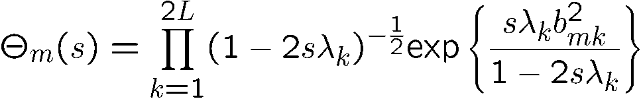



Efficiently Computing MGF
MGF of LLR: Direct Form
conditioned on actual delay
depend on LLR’s statistics, channel statistics, signal correlation.
MGF of LLR: Compact Form
: linear transform of
Each term is MGF of Chi-square variable
No matrix inverse and determinant. Only decomposition and scalar multiplication needed.
Notes:
This direct form of the MGF is quite complicated. Here rm tilde is the r vector depending on the actual time delay m\Delta, following a Gaussian distribution. The matrix Am, vector pm and constant Km are dependent on the distributions of LLR and channel, and signal autocorrelation. When computing the characteristic function, we have to compute the Am, pm, and km for each frequency f, and also compute the inverse and determinant of Am for each frequency. For digital implementations with a high sampling rate, this is a very time-consuming process. So I derived the compact form of the MGF. It’s based on this eigen-value decomposition on this symmetric matrix. The LLR can be transformed to the summation of these scalar quadratic terms. Here um follows the standard Gaussian distribution, and bm is constant, so these summation terms are actually independent chi-square random variables scaled by the eigen values \lambda_k. The MGF \theta is the product of the MGF for each chi-square random variable, and that is just computed by scalar operations with very low computation complexity. There is no need to compute matrix inverse and determinant. In numerical experiments, the compact form is about 20 times faster than the direct form. So it’s a very efficient way to evaluate the ZZB.

Slide 14

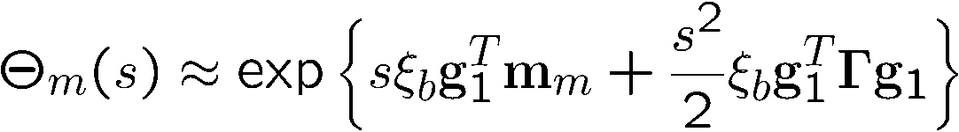
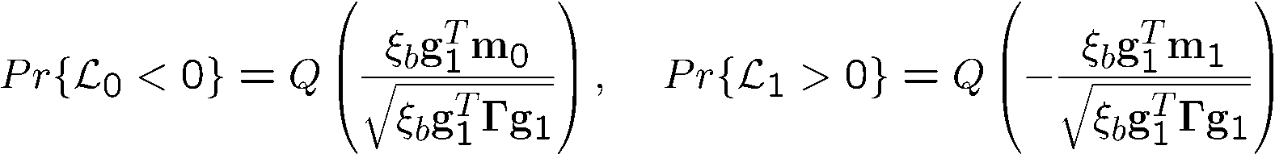

Asymptotic Analysis
Low SNR regime
High SNR regime
Notes:
Although the compact form is good for evaluation, the direct form of MGF has its advantage for asymptotic analysis. I did the asymptotic analysis at both low and high SNR regimes. The analysis is by expanding the MGF with perturbation analysis. When the SNR \xi_b goes to 0, the MGF has a very nice closed-form expression. It’s actually the MGF of a Guassian random variable. It means the LLR follows Gaussian distribution, and its mean and variance are determined by SNR, channel distributions and the signal correlation. So the error probability is in the form of Q-function. But in the high SNR regime, we are not so lucky to get a closed-form, while it still shows a linear relation with SNR in the coefficient, and a relation with the third-order SNR in the exponent. These two asymptotic analysis results are useful for determining the threshold behaviors of the ZZB. Let’s see a numerical example.

Slide 15
Numerical Result: Typical ZZB Behavior
Typical ZZB behavior for TDE. A prior distribution T=[0,30]. SRRC pulse with roll-off factor =0, pulse width Tp=2; channel taps L=5 with spacing Tt=1, Rician fading with exponential PDP.
Notes:
This figure shows the typical behaviors of the ZZB over unknown multipath channels. The root MSE is used as the performance metric. The time delay is assumed uniformly distributed from 0 to 30. The transmitted signal is a square-root raised cosine pulse and the pulse width $T_p=2$. We normalize all the time variables to the channel tap spacing, so the tap spacing is $T_t=1$, and the multipath is assumed with 5 independent taps. The multipath fading follows Rician fading with an exponential power delay profile.
The figure plots the ZZB in blue and the average ZZB in purple. The ZZB and average ZZB both converges to T/\sqrt{12} at low SNR, and the convergence level is plotted as the top dashed horizontal line. The low SNR approximation is plot using the Q-function approximation and it is valid up to 0 dB. We shift down the convergence level for 3dB, and the cross point with the low-SNR approximation curve is the low-SNR breakdown point \delta_1, that is about -4dB. When the SNR is increasing beyond $\delta_1$, the ZZB and the average ZZB separate for about 3 dB. This separation is because the ZZB reflect the lack of channel knowledge at the receiver, so it is tighter than the average ZZB. The high SNR threshold \delta_2 is determined by shifting up the high-SNR approximation curve by 3dB, and the cross point with the blue ZZB curve is \delta_2, about 17 dB. After SNR increases above \delta_2, the ZZB and average ZZB both linearly decrease with the increasing SNR. The decreasing slope is about negative 0.5. It’s consistent with the case of bandwidth limited signal in the original ZZB papers. So this figure shows the performance degradation when channel knowledge is unknown at receivers, and the developed ZZB is a more realistic and tighter bound than the average ZZB.

Slide 16
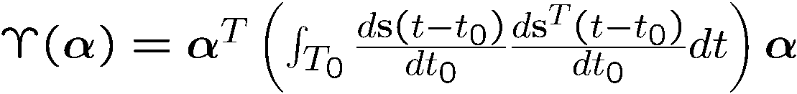

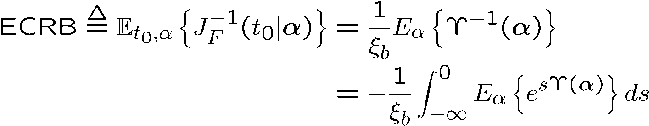
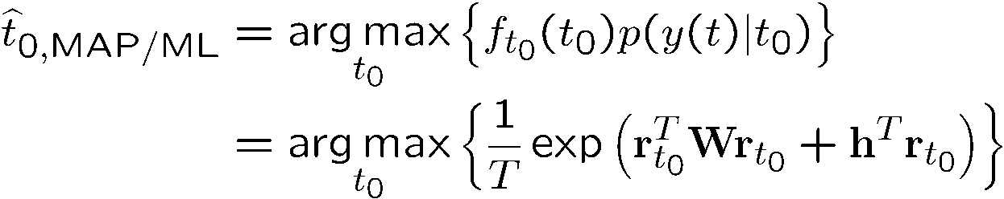
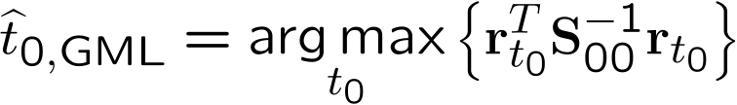
ECRB and MAP
ECRB: Expected conditional CRB
MAP and GML estimators
(Win & Scholtz 2002)
Notes:
Next we compare the developed ZZB with the commonly used CRB and the estimators. The unknown time delay is random, so we should use Bayesian CRB for comparison, but the regularity condition does not hold for the Bayesian CRB. So we turn to develop the ECRB, the expectation of the conditional CRB. The conditional CRB means the Fisher information is conditioned on a channel realization, and then averaging the inverse of Fisher information over channel distributions. Because this upsilon function in the Fisher information happens to be a quadratic form of the Gaussian vector \alpha, we can use the similar MGF approach to evaluate this expectation. So ECRB is easily obtained.
The MAP estimator is usually for estimating a random parameter, but in our case, the priori distribution for t_0 is uniform, so this prior distribution 1/T can be taken out, and the MAP estimator reverts back to the Maximum-Likelihood estimator. This likelihood metric is the same as the LLR used for ZZB, the difference is we need to compare this metric over the whole interval of t0 from 0 to T, but in ZZB we only need to compare 0 and \delta and make a binary decision. So the MAP estimator has a much higher complexity than ZZB.
The generalized ML estimator uses a different likelihood metric. Here r_t0 is the correlation between the received signal and the transmitted signal at all possible time delays. This estimator does not use the channel distributions, so it has a worse performance than the MAP estimator, but keeps a similar complexity level because it also searches over the whole a priori interval. Let's see an example for the CRB and estimators.

Slide 17
Numerical Result: Compare ZZB, CRB, Estimators
ZZB compared to ECRB, MAP and GMLE. A prior distribution T=[0,30]. SRRC pulse with roll-off factor =0, pulse width Tp=2; channel taps L=5 with spacing Tt=1, Rician fading with exponential PDP.
Notes:
This numerical example compares the estimators and the bounds. The MAP estimator converges to the ZZB at high SNR as expected, and there are a few dB gap between the ZZB and MAP estimator at mid-SNR. At low SNR the ZZB and MAP do not converge and the ZZB is 3-dB lower than the MAP estimator. This 3dB gap is because of the approximations by the inequalities during the original ZZB development, and there is a section explaining the details of this gap in my thesis. The ECRB is slightly looser than the ZZB because it is an average bound instead of a Bayesian bound. At low to mid SNRs, the CRB does not track the ZZB or MAP threshold behavior because it is a local bound, so it's not as tight as ZZB. The GML estimator has a general weak performance. It only tracks the MAP estimator at low SNR. At high SNR regime, the noise doesn't matter, and only the channel distribution has effect on the performance. But the GML estimator does not use the channel distribution information, so it pays the price under the random fading channels. From this comparison, we can see the developed ZZB is a realistic and tight Bayesian bound. This result validates the ZZB development.

Slide 18
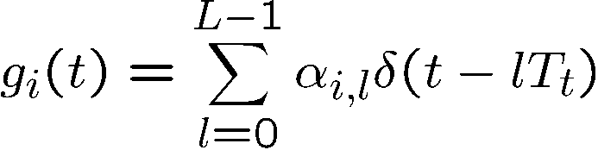
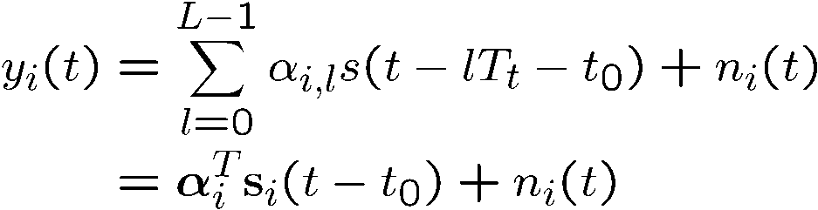
Case of Frequency Hopping Transmission
Transmitted waveform
Multipath channel
Received signal
Notes:
The ZZB is not only applicable for pulsed signal, but can also be used for frequency hopping waveforms. Suppose we have N hops in a transmission cycle, and the transmitted waveform for each hop is composed by M pulses modulated by the training symbols a_i,k. Similarly, the channel model is the same as the pulsed signal, and g_i for each hop is independent. At the receiver, for each hop, the received signal is the convolution of s_i and g_i. If we stack the channel gains, noise, and received signal for all the hops into long vectors, we can follow the same procedure of ZZB development as the pulsed signal case. But there is a difference. If no guard period between hops, the received signal of neighboring hops may overlap due to the multipath channel. The development in the thesis considered these possible overlaps, and I omit these tedious derivation here.

Slide 19
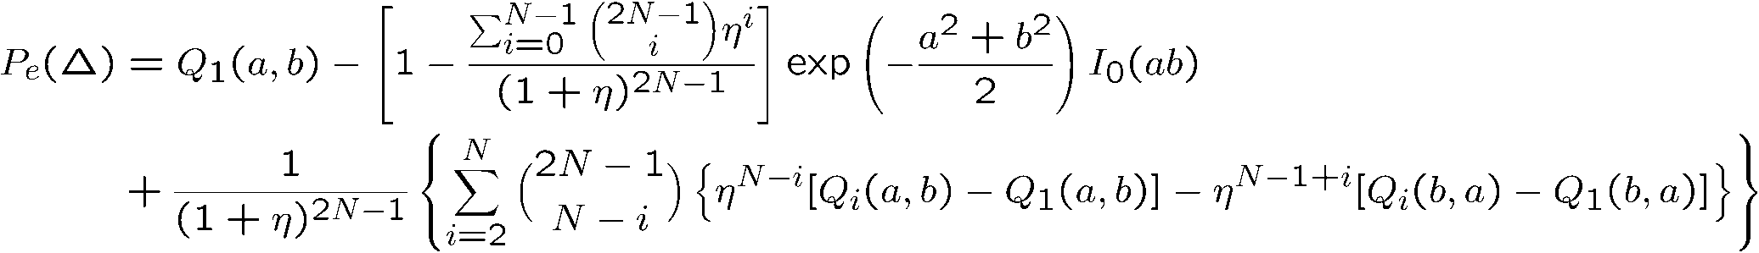

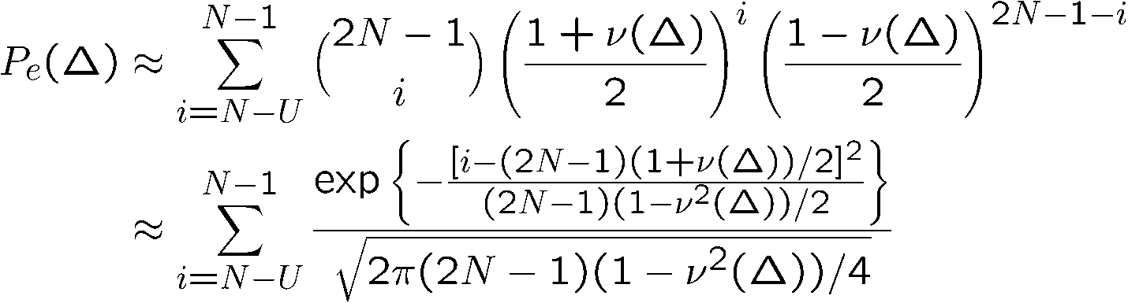

Closed-Forms under Independent Flat-Fading
Rician fading
depend on channel statistics and signal correlation.
Rayleigh fading
is a function of SNR, channel statistics and signal correlation.
Applicable for pulsed signal with N=1
Notes:
Let's see some special cases of the ZZB for frequency hopping. In the independent flat-fading channels, we can have some nice close-form expression of Pe(\Delta) in the ZZB. Suppose the fading follows Rician distribution, Pe(\Delta) can be express in the close-form by some special functions, including the Q-function, zero-order modified Bessell function, exponential function, and binomial coefficients. Here, the coefficients a,b,\eta are determined by channel statistics and signal correlation. Although this expression looks long, it actually has a much lower complexity than the MGF, and we don't need to do the inverse Fourier transform.
In Rayleigh fading channels, the closed-form for Pe\Delta is even simpler. It's actually a summation of binomial distribution, and if N is large each pmf can be further approximated by a Gaussian distribution. And the function nu(\Delta) is close to 1 in the high SNR region, so Pe is dominated by the last several summation terms with large i, so it's approximated further by selecting only the last U summation terms. And for large N, we only need to choose a small U. So the evaluation of ZZB is quite simple. From this approximated expression we can see each summation term in the error probability is exponentially decreasing with N, so it actually reflects the effect of frequency hopping diversity for time delay estimation. And these closed-forms are also applicable for the pulsed signal when N=1.

Slide 20
Numerical Results - Frequency Diversity
N=1, U=1
N=2, U=2
N>2, U=3
ZZB for FH shows frequency diversity gain. N = 1, 2, 4, 8 and 16. Number of symbols per hop M=80/N. Independent flat-fading Rayleigh channels. A prior distribution T=[0,30]. FH waveforms formed by SRRC pulses.
Notes:
These numerical results plot the ZZB for frequency hopping waveforms in the flat-fading Rayleigh channels. These solid curves are the ZZB by direct evaluation without approximation, and these dashed curves approximate the Pe by only U summation terms of Gaussian approximation. As the number of hops N increases, these approximations are getting closer to the non-approximated versions. We can also see the RMSE curves decrease a lot when the number of hops increases from 1 to 16. This clearly shows the frequency diversity of TDE by frequency hopping. Here we study the TDE performance behavior purely by ZZB without evaluating any algorithm, and this is a big advantage of studying the fundamental bounds.

Slide 21
Performance Summary on the ZZBs
ZZB: Bayesian MSE bound for random parameter, for unbiased or biased estimator, and tighter than CRB at low to mid SNRs.
ZZB for unknown random multipath channels:
Both LOS and NLOS channels
Rayleigh / Ricean
Different power delay profiles (PDPs)
Different tap correlation profiles (TCPs)
Known arbitrary finite duration pulse or frequency hopping waveforms.
Notes:
Now let's make a brief summary for the first part work on the TDE performance bounds. This work developed Ziv-Zakai bounds for time delay estimation in unknown random multipath channels. It's a Bayesian MSE bound applicable for estimating the random time delay, and for either unbiased or biased estimators. It's tighter than CRB at low to mid SNRs. The assumed multipath channel models make the ZZB valid for both LOS and NLOS channels with different power delay profiles and tap correlation profiles. The signal model can incorporate pulse signal with arbitrary pulse shaping and also frequency hopping waveforms. So the developed ZZBs are general, realistic and tight fundamental bounds for time delay estimation in practical scenarios.
Next, let's move to the second part.

Slide 22
Part II
ToA Localization Performance Analysis
With Biased Range/Time-Delay Measurements
in Multipath Channels
Modeling for biased time-delay measurement
Unknown deterministic
Random bias: convolved distributions
CRB of ToA localization with random biased ranging
WLS estimator error analysis
MLE error analysis and discussions on an extreme case
Numerical examples
Notes:
In ToA localization, the NLOS errors at the 1st stage time delay estimation will propagate to the location estimator at the 2nd stage. In the 2nd part, I study the performance of ToA localization in multipath channels. The biased time delay measurement is modeled for the NLOS errors. The bias could be either deterministic or random, and for the case of random bias, we need the convolved distributions of the summation of bias and additive noise.
The performance study starts from the CRB development for random bias cases, and then move to the error analysis for the WLS and ML estimators. And I’ll also discuss some extreme cases based on the error analysis results, and at the end are some numerical examples.

Slide 23
Assumptions on the Bias in Time Delay Estimation
Bias is known
Directly subtracted from time delay measurement
Bias is unknown deterministic, embedded in measurement error
WLS estimator
Bias is unknown deterministic, jointly estimated with unknown location
Identical for all measurements: Weiss & Picard, 2008
Bias is random, following certain distributions
CRB for uniform distribution: Jourdan, Dardari & Win, 2008
Notes:
The research on localization performance can be classified into several cases based on the assumptions on the ranging bias. The first case is straightforward. It assumes the bias is known to the localizer, and then it can be directly subtracted from time delay measurement. The second one assumes the bias is unknown and deterministic. It's embedded in the measurement errors with the noise. For this deterministic bias case, a typical estimator is by WLS. Case 3 also assumes deterministic bias, but it's jointly estimated with the location. This kind of research has been done by Weiss and Picard. In their paper the bias is assumed identical for all measurements. The last one is the random bias with certain distributions. In the literature a CRB has been found for the uniformly distributed bias. In my thesis I focused on case 2 and case 4. So the bias could be either deterministic or random embedded in the measurement error.

Slide 24
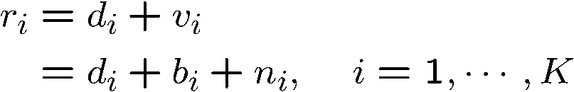

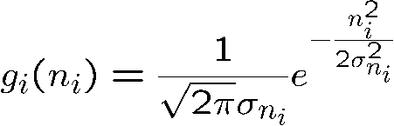

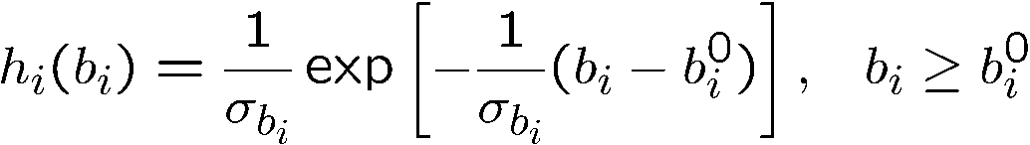
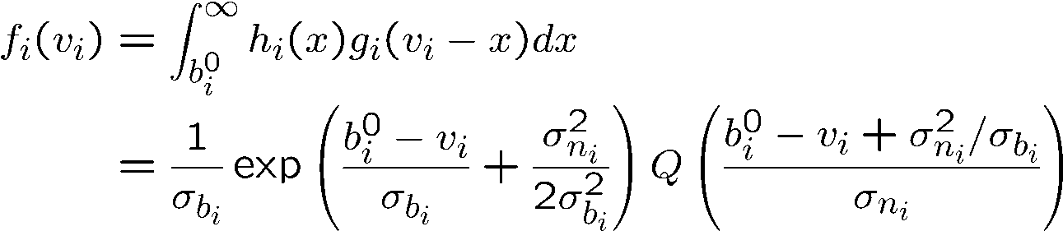
Model
Biased range measurement
Non-negative bias
White Gaussian noise
Random bias following exponential distribution
pdf
Convolved distribution
Notes:
The range measurement at the i-th reference point is simply modeled as the true distance d_i plus the bias b_i and white Gaussian noise n_i. The bias b_i should be positive regardless it's deterministic, or random. For random bias case, I analyzed on several distributions, including exponential, uniform, Maxwell and Bernoulli distributions. By practical experiments in the literature an exponential distribution is a good model in typical multipath channels. Here b_i0 in the pdf denotes a starting point and it is known to the localizer. The total error in range measurement v_i is the bias plus the noise, and its distribution is the convolution of the bias distribution h_i with the noise distribution g_i, expressed by an exponential function and a Q-function. For other bias models besides exponential distribution, we can get the convolved pdf in the similar way.

Slide 25
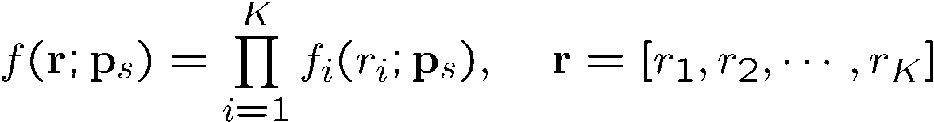

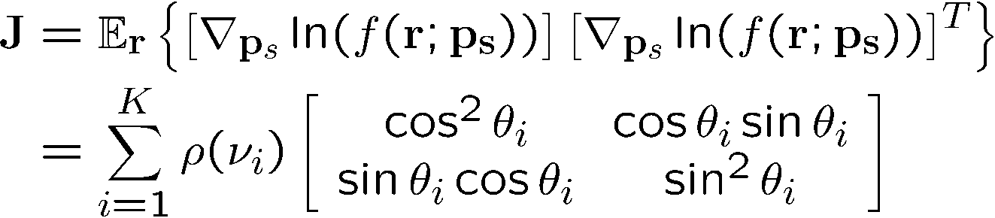

CRB
Joint distribution
Fisher information matrix (FIM)
CRB
Notes:
Based on the convolved pdf, it's easy to find the CRB. Firstly the joint distribution of the range vector r is just the production of the convolved distribution for each measurement r_i, because they are assumed independent.
The Fisher information matrix is the expectation of the gradients on the joint pdf. Here each summation term has two parts: this matrix means the performance depends on the geometry of the reference points, and this function \rho depends on the true distances d_i as well as the error distributions. So the CRB for estimating the unknown vector ps is just the inverse of the Fisher information matrix, and the total localization MSE is bounded by the trace of the CRB.

Slide 26
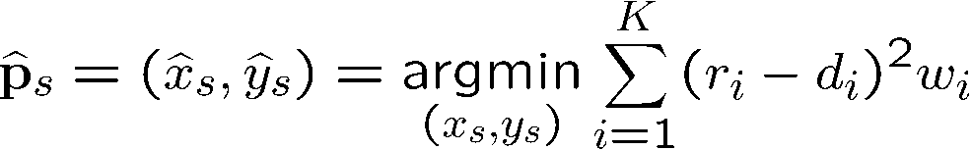
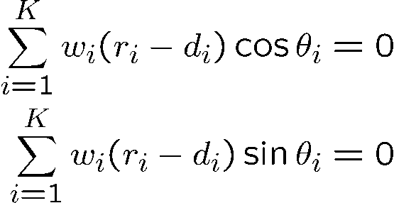
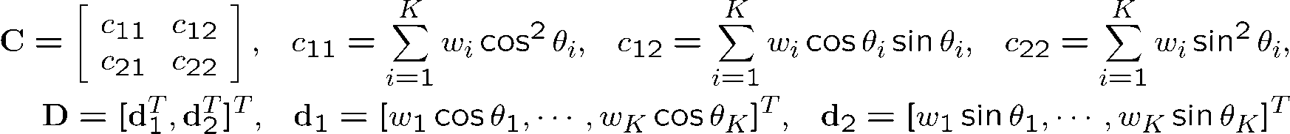
Weighted Least-Square (WLS)
Estimator
Constraints:
Error Analysis
Notes:
We want to compare CRB with estimators’ performance. A typical estimator is by the WLS criterion. It finds the position minimizing the summation of the squared range measurement errors. The derivative with respect to x_s and y_s gives the two constraint equations. Each one is a summation of linear terms, so the solution is very simple. The error analysis by perturbation shows the estimation error \delta P is a linear transform of the range measurement error \delta r.
We can see the transform matrices C and D only depend on the geometry of reference points by \theta_i and d_i, as well as the weights w_i. So if we use the WLS estimator for the case of random bias, it does not use the error distributions, so it has performance penalty.
The estimation MSE and bias can be easily found by these equations, and the results show the relation with the bias correlation matrix Rb and the noise covarinces.

Slide 27
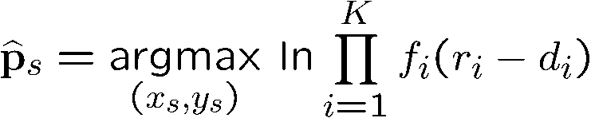
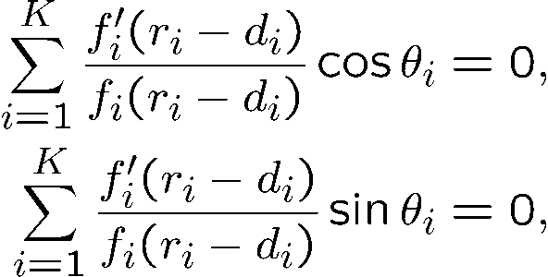
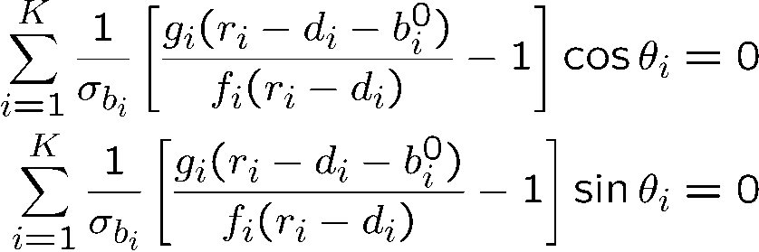
Maximum-Likelihood (MLE)
General
Constraints:
Case of exponential distribution
Notes:
The other estimator of interest is the maximum-likelihood estimator. It finds the ps that maximizes the joint convolved posteriori distribution. Similarly as LS estimator, we can find the constraint equations by taking derivatives. In the case of exponential distribution, these derivatives has a closed-form expression and the constraints are determined by the pdf fi and the Gaussian distribution g_i. For other bias distributions, the closed-form does not always exist.

Slide 28
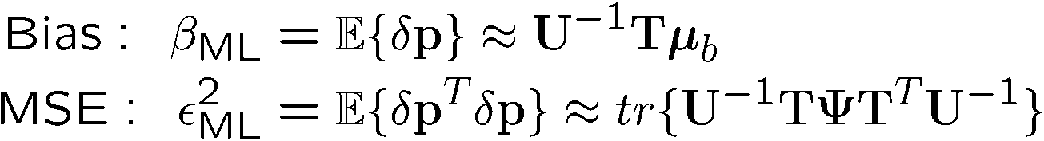


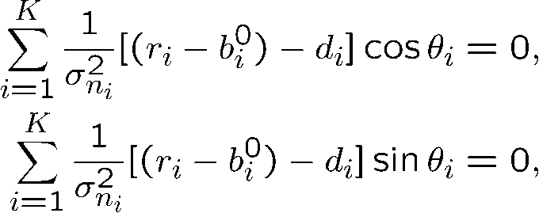
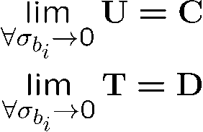
Error Analysis for MLE
Estimation MSE and bias
Extreme case: for exponential bias
pdf -> Gaussian:
MLE ->WLS:
Notes:
Here the error analysis on ML estimator is derived for the case of exponential distributed bias. By the first-order analysis, the location error \delta p is approximated by a linear transform of the ranging error \delta r. And then we can get the expressions for MSE and bias. The difference with the LS estimator is that the transform matrices U and T depend not only on d_i and theta_i, but also on the error distributions f_i and g_i. That means the ML estimator makes use of the statistical information in range measurement, so it should have better performance in random bias cases.
An interesting case here is when the standard deviation of the bias goes to 0. That means in the total measurement error, the bias diminishes and the Gaussian noise dominates. In such case, the convolved pdf becomes just Gaussian distribution, and the ML estimator reverts back to the WLS estimator. The matrices U and T also go back to the matrices C and D in the error analysis for WLS. So this extreme case shows the WLS estimator is optimum for deterministic bias and it also verifies the error analysis on the ML estimator.

Slide 29
Numerical Results: Typical
Localization by biased range measurement with non-uniform circular array of 10 references. Two groups of 5 sensors placed at 0 and 90 degrees, respectively. The exponential distributed bias and Gaussian noise at each sensor are assumed i.i.d.
Notes:
Next let's see some numerical results. In this figure the 10 reference points form non-uniform circular array, and they are split into two groups. The first group of 5 sensors is placed around 0 degree, and the second group is around 90 degree. The unknown location sensor is placed at the center. The distance from reference points to the center is normalized to 1 distance unit. The exponential distributed bias and noise at each sensor are assumed independent and with identical distribution, iid. We can see the bias of WLS estimation increases linearly with the measurement bias and contributes the most part of RMSE. But the RMSE and bias of ML estimation have much smaller increasing rates with \sigma_b, and the RMSE is close to CRB. So the ML estimator has obvious suppression effect to the bias in the range measurement.

Slide 30
Numerical Results: Non-i.i.d Bias
WLS
Group 3
MLE
Non-uniform circular array of 10 references. The case of non-iid measurement bias. The standard deviation of the exponential bias at five sensor groups (2 sensors per group) keep the constant ratio of 1:2:4:2:0.5, starting from the sensor at 0 degree.
Notes:
This is another setup similar to the last one. The reference array is still circular, but the reference sensors are uniformly distributed around the circle. We separate the 10 references into 5 groups, with 2 in each group starting from 0 degree in the counter-clockwise direction. The bias at each sensor group is no longer iid. The standard deviation \sigma_b keeps a constant ratio 1:2:4:2:0.5 between the five groups. We can see the bias and RMSE of WLS increase about twice faster than the \sigma_b. The ML estimation increases RMSE and bias only at rates of ½ and 1/8 of \sigma_b, and the RMSE has a very small gap with CRB. The scatter plots show the WLS estimates mostly fall in the fourth quadrant, that is the direction opposite to beacon group 3 with the largest bias standard deviation. On the other hand, the ML estimates mostly fall in the second quadrant close to beacon group 3, because the ML compensates the measurement bias by using the error distributions.

Slide 31
Numerical Results: Scatter Plots
WLS
MLE
Scatter plots with uniform and three non-uniform circular arrays. The exponential distributed bias and Gaussian noise at each sensor are assumed i.i.d.
Notes:
These scatter figures show the estimated locations are significantly affected by the reference array geometry. The uniform array is compared with three non-uniform configurations for both LS and ML estimators. In the three non-uniform cases, the beacons are split into two groups of five beacons. In configuration 1, both groups
are placed around 0 degree. Configuration 2 places them around 0 and 90 degrees, and Configuration 3 centers around 0 and 180 degrees. The ranging bias are assumed iid.
For the uniform array both LS and ML estimations are unbiased. The ML estimations have less variance. With non-uniform config 1 and 2, the LS estimates are pushed away from the beacons, and the ML estimates approach the beacons. For example, in config 2, WLS estimated points are mostly in the third quadrature, but the ML estimated points are mostly in the first quadrature. Config 3 is different because it has horizontal symmetric placement. It helps to mitigate the estimation bias along x-axis, and the ML estimation along y-axis is spread. The scatter plots provide us intuitive insight into the location estimators’ behavior.

Slide 32
Conclusions and Contributions
Developed Bayesian MSE bounds by Ziv-Zakai approach for random time delay estimation in unknown random multipath channels.
Valid for both pulsed signal and frequency hopping waveforms.
valid for both wideband and narrow band channels, both LOS and NLOS channels, different power delay profiles (PDP), and different channel tap correlation profiles (TCP).
The ZZBs represent more realistic and tighter performance limits, and provide good performance prediction for the MAP estimation.
The ZZB for FH waveforms reveals achievable performance with frequency diversity in wideband frequency-selective fading channels.
A MGF approach is proposed to compute the pdf of the LLR.
The compact form of MGF is developed, which greatly lowers the computation complexity, and is very efficient for evaluating ZZBs.
Closed-form expressions of the ZZB are developed for special cases of multipath channels: independent Rician/Rayleigh flat-fading channels.

Slide 33
Conclusions and Contributions of Thesis
Asymptotic analysis on the ZZBs at low and high SNR regimes are performed. The results are useful for studying ZZB SNR thresholds behavior. At low SNR a closed-form expression is obtained.
ECRB, MAP, and GML estimators for TDE in multipath channels are developed for comparative study with the ZZBs.
The 3dB gap between ZZB and MAP at low SNR is accounted for by studying the inequality approximations during ZZB development.
Developed random bias models and the convolved distributions are developed for ToA localization performance analysis.
Derived the CRB for ToA localization with random biased range measurements for several distribution cases.
Error analysis for WLS and ML location estimators:
Analytical estimation bias and MSE depend on bias and noise statistics, reference array geometry and estimator type.
The ML estimation has an obvious suppression effect on the estimation bias in typical cases, and is closer to the CRB.

Slide 34
Thank you!

Slide 35
Questions

