Slide 1
DIP-750 Course Presentation
Stu. Name: Fengdi Huang
Stu. ID: 231AHG003

Slide 2

ABOUT THE PRODUCT
It is a web crawler for Zhihu.com (Chinese Quora). It has three different packages
The helpers.py is responsible for getting user’s input of Question ID, file additional names and directory
The spider.py is responsible for scrapping.
The utils.py is responsible for changing the format of time, gender and etc.

Slide 3
ABOUT THE PRODUCT
Send Request Mimicking an Actual User: The script sends HTTP requests to the Zhihu API with headers that mimic a real user's browser to avoid being blocked.
Fetch JSON Data: It retrieves answer data in JSON format from the API.
Extract Details: The script parses the JSON data to extract relevant details such as author names, genders, follower counts, answer contents, and timestamps.
Append Data to CSV File: It organizes this data into a pandas Data Frame and appends it to a CSV file.
Handle Pagination: The process repeats, requesting additional pages of data until all answers are retrieved, with random delays between requests to simulate human behavior and avoid rate limiting.

Slide 4
01
The main

Slide 5
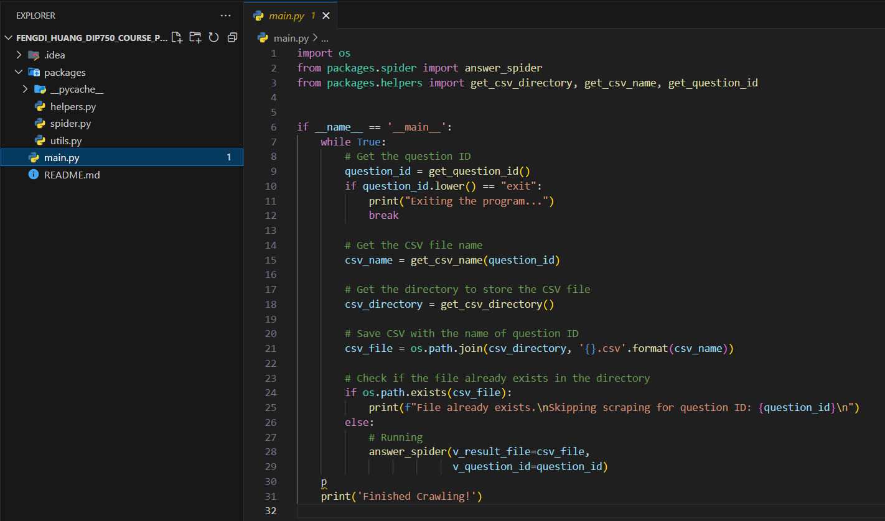

Slide 6
02
The helper

Slide 7
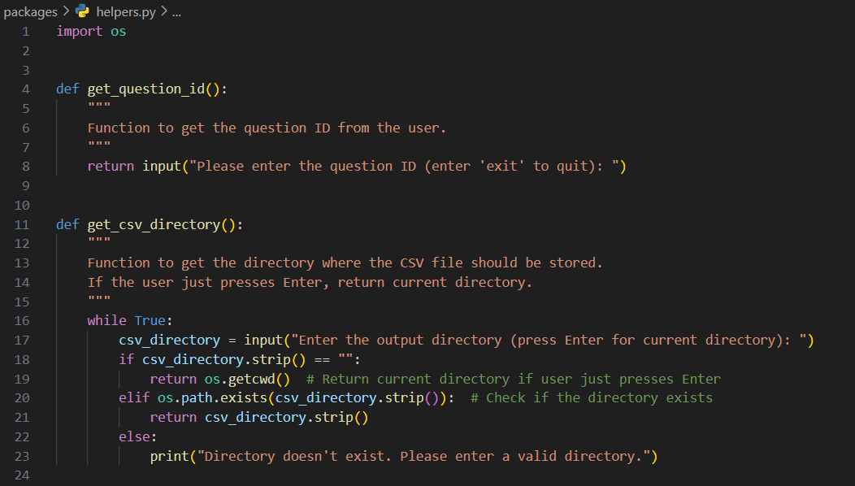

Slide 8
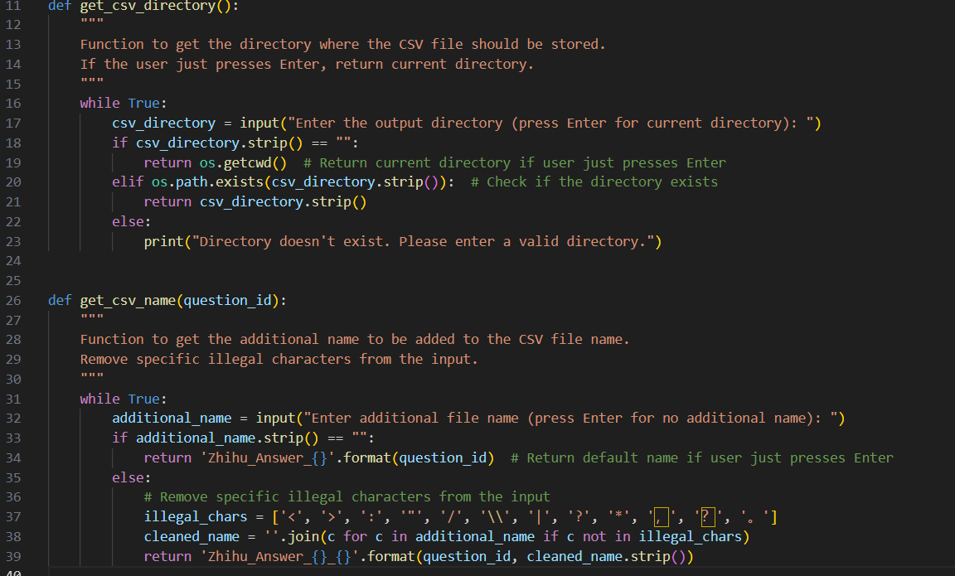

Slide 9
03
The utils

Slide 10
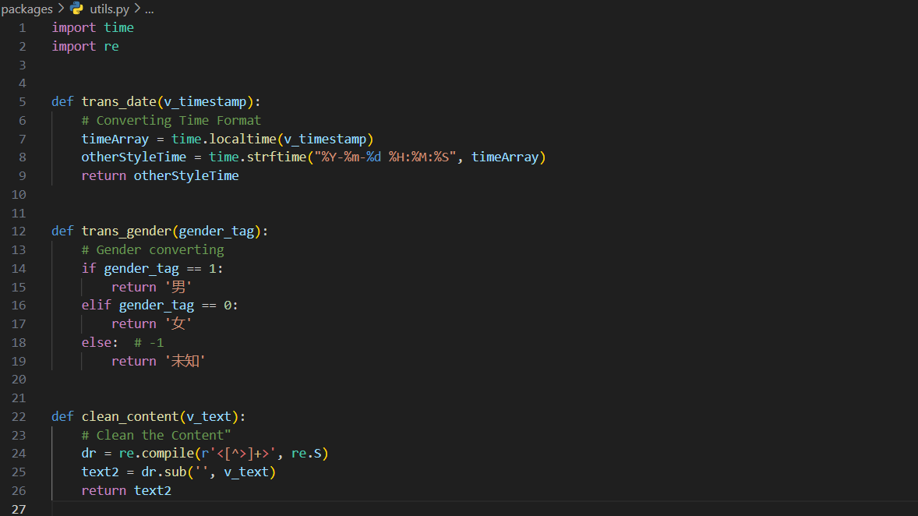

Slide 11
04
The spider

Slide 12
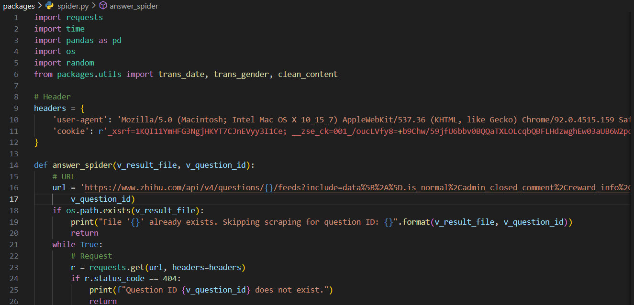

Slide 13
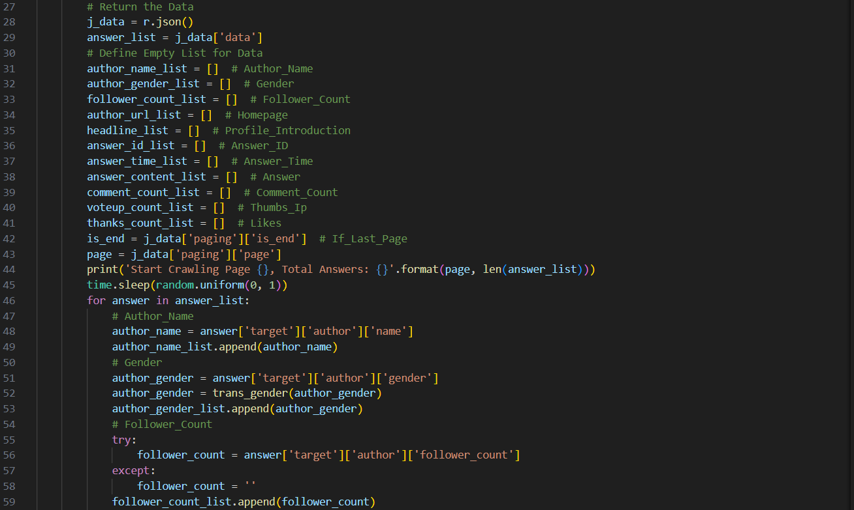

Slide 14
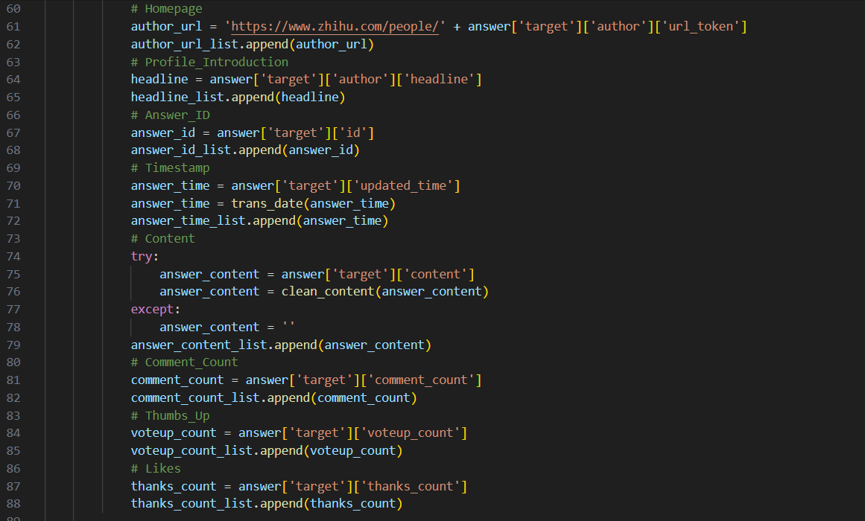

Slide 15
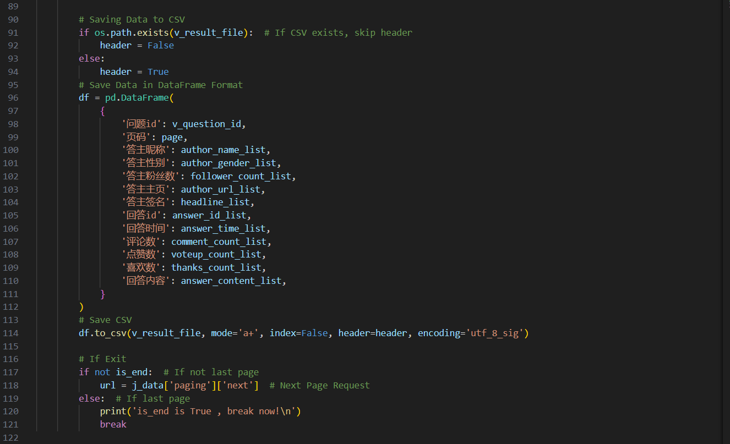

Slide 16
THANKS!
Do you have any questions?
https://github.com/JesseLovesGrace/Fengdi_Huang_DIP750_Course_Project

