Slide 1


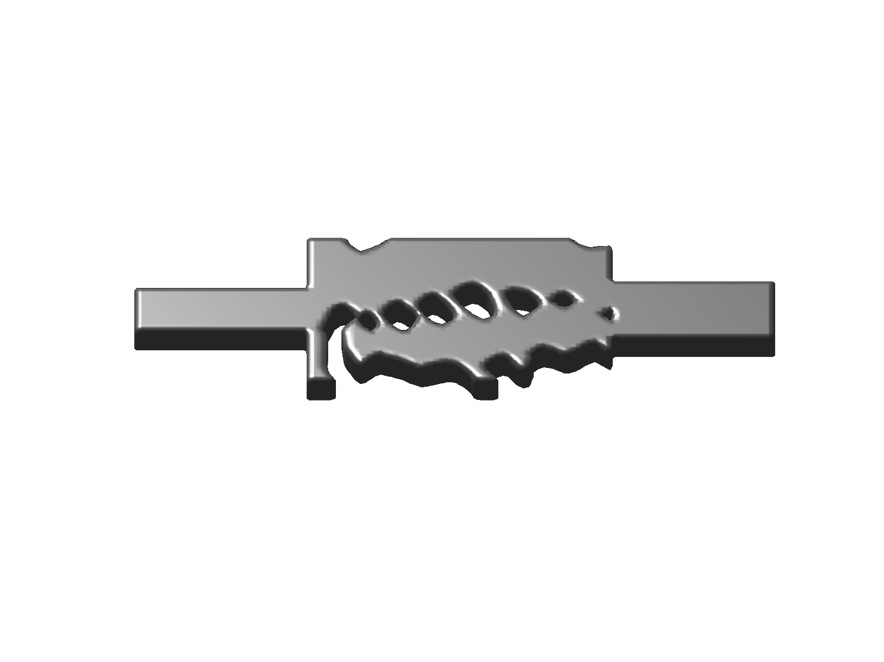
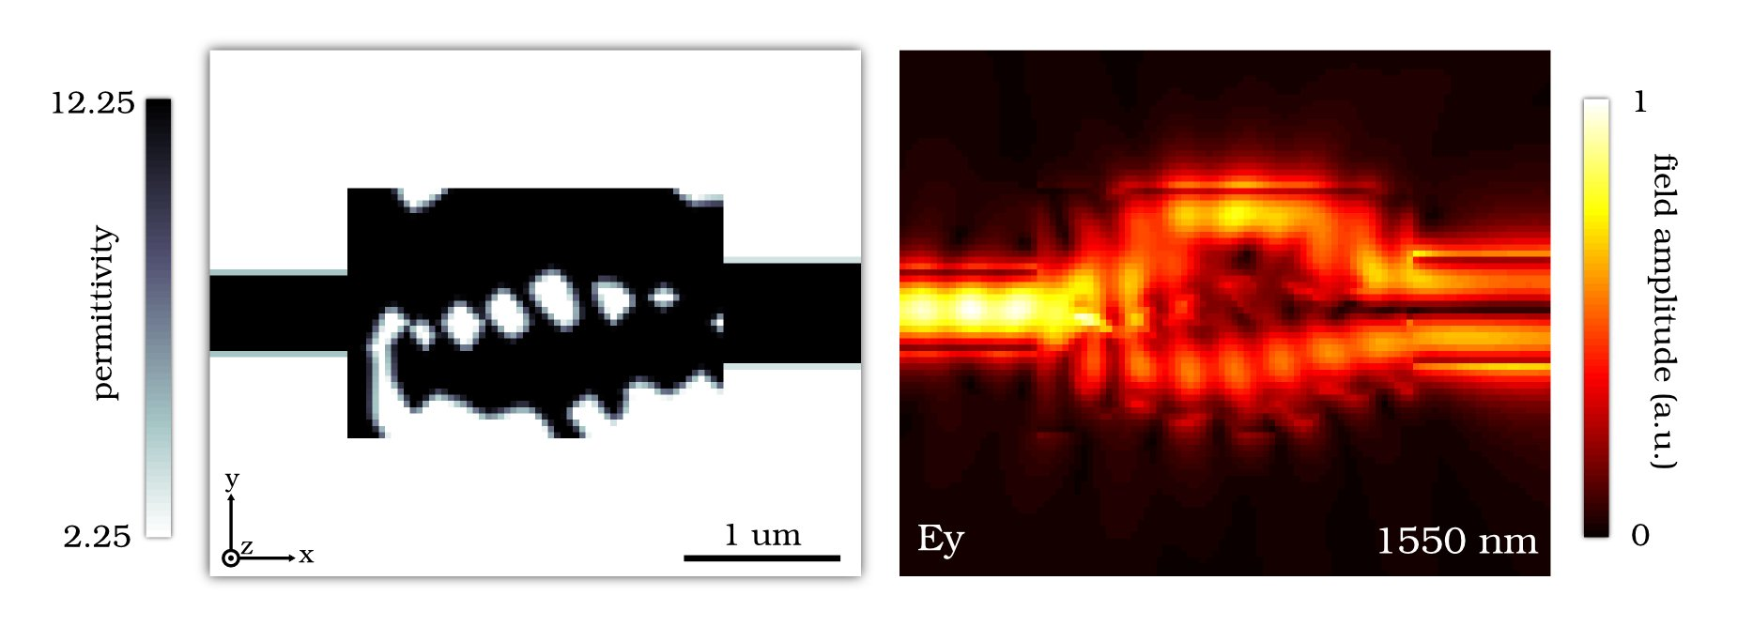
Nanophotonic Computational Design
Jesse Lu, Jelena Vuckovic, and Stephen Boyd, Stanford University
Result: Developed a design method for any 3D linear nanophotonic device
Design methodology:
Fully 3D (no approx.)‏
Utilizes full parameter space
No manual tuning
No nanophotonic expertise
Just specify desired performance
Design results:
High efficiency
Novel functionality
Multi-modal
Ultra-compact footprints
Manufacturable
Broadband
Robust to thermal shift
Robust to fabrication error
Design of 3D Nanophotonic Mode Converter

Slide 2
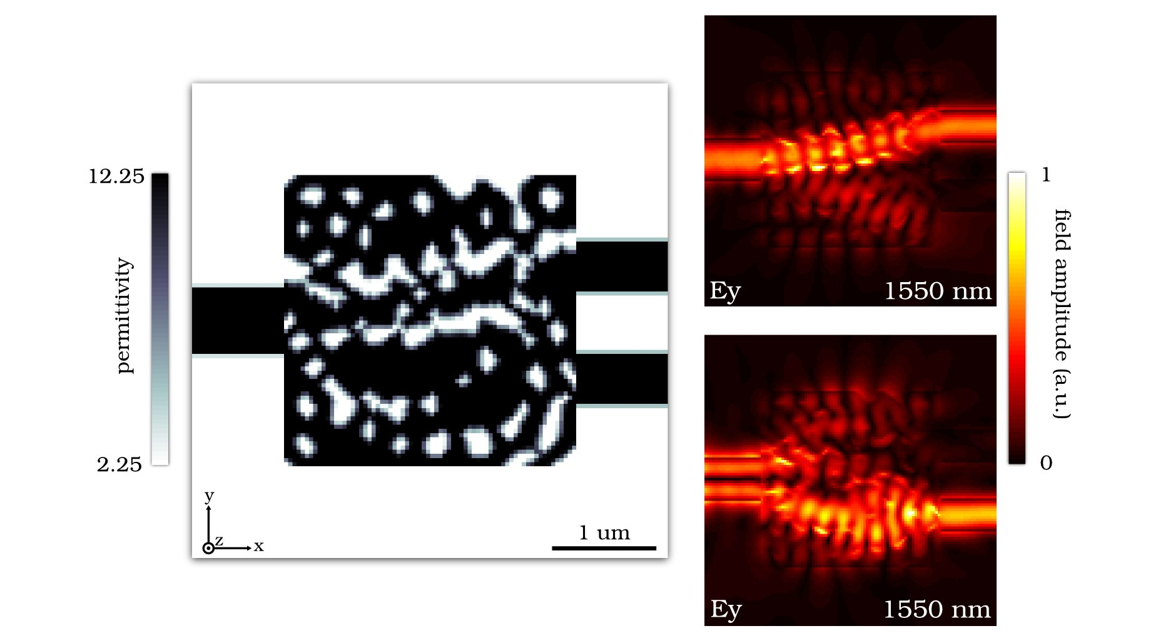
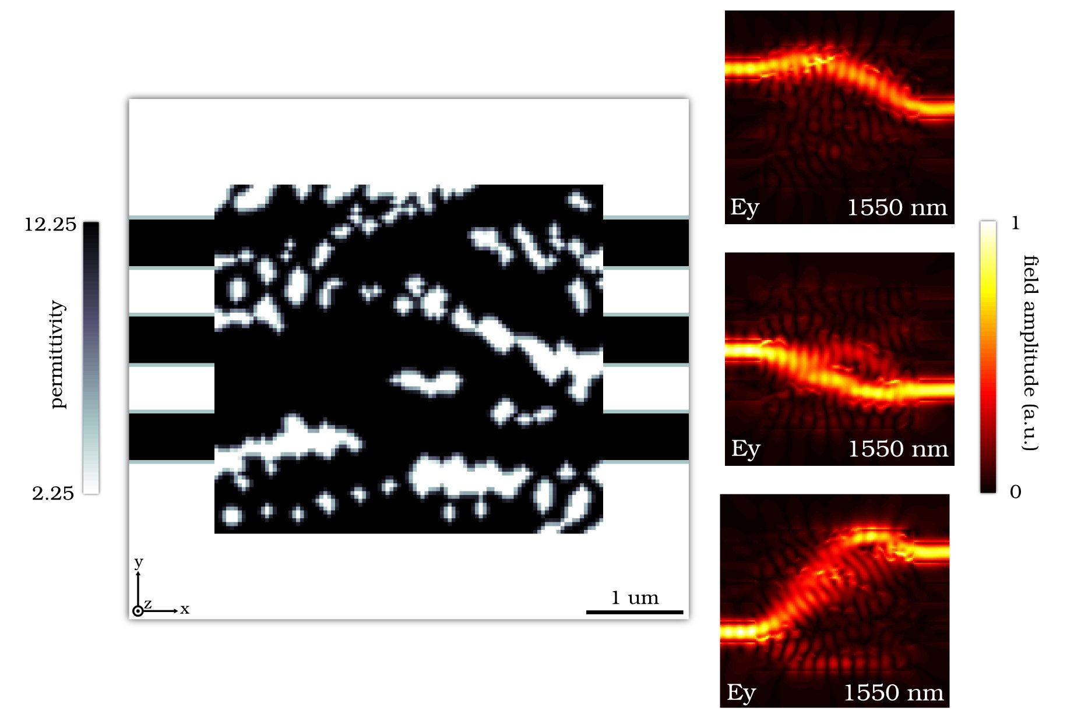
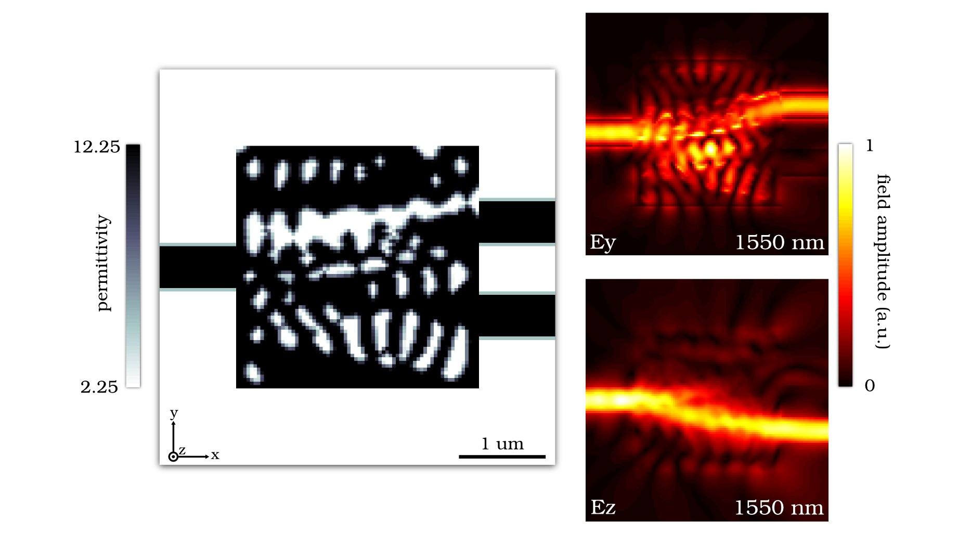
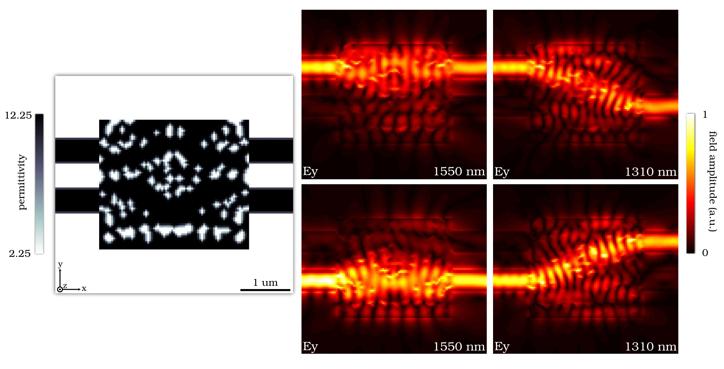
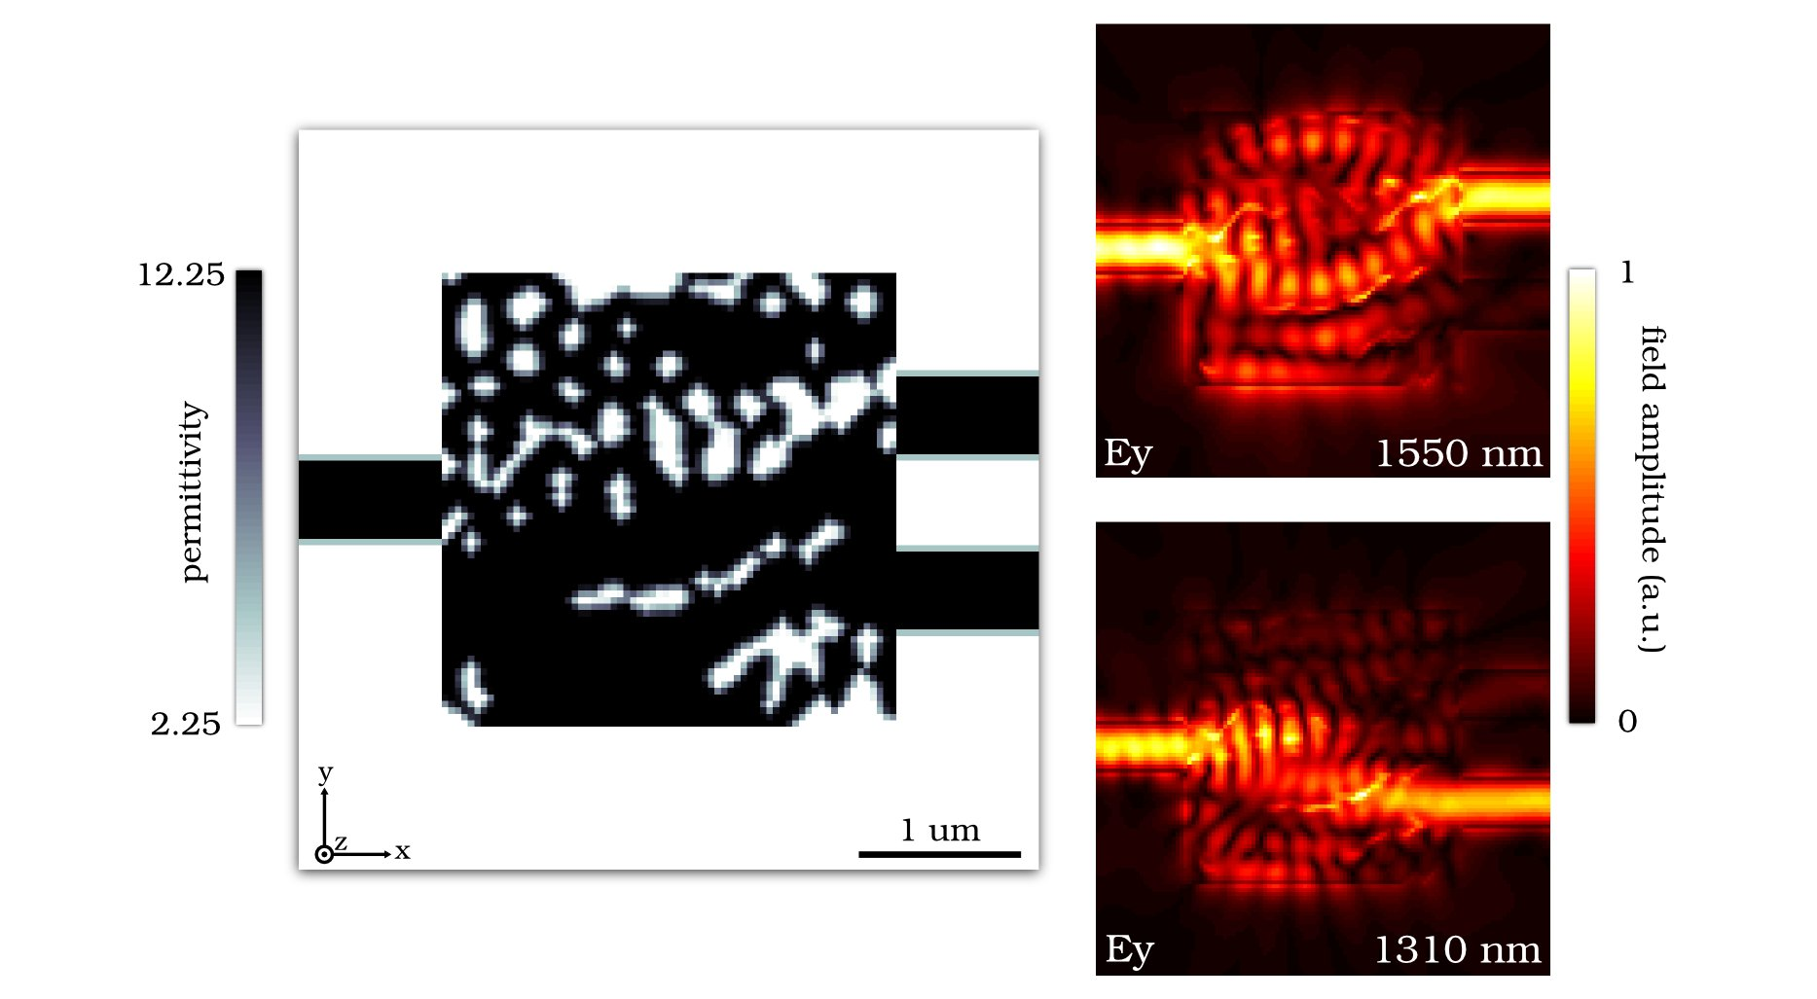
Splitter and Hub designs demonstrate
Multi-mode
Multi-input and multi-output
Modes can be split with respect to
profile, polarization, and wavelength
Spatial Mode Splitter
3x3 hub
TE/TM Splitter
2x2x2 hub
Wavelength Splitter

Slide 3
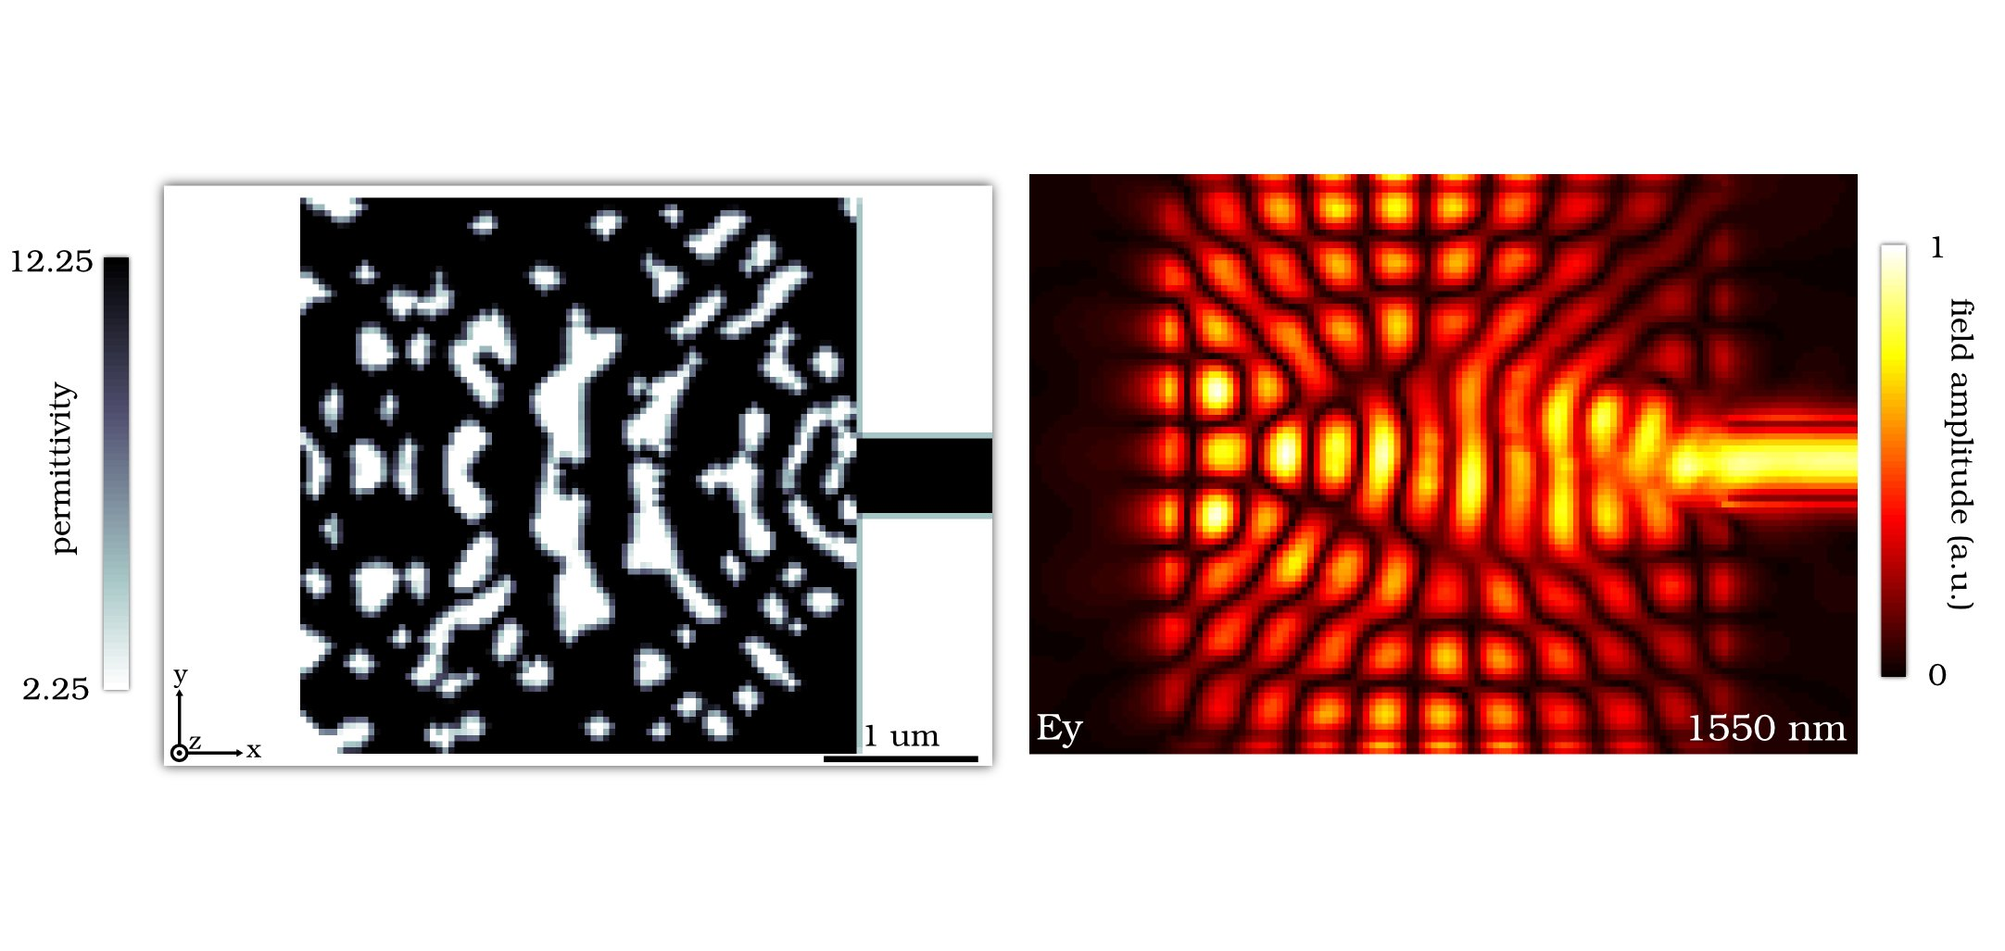
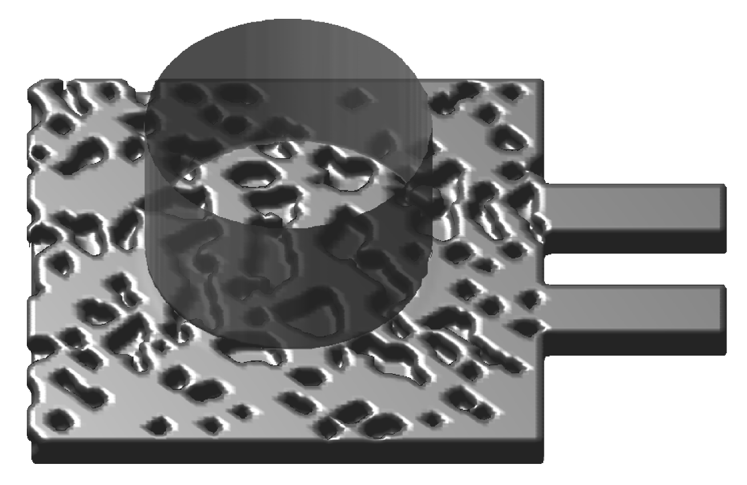
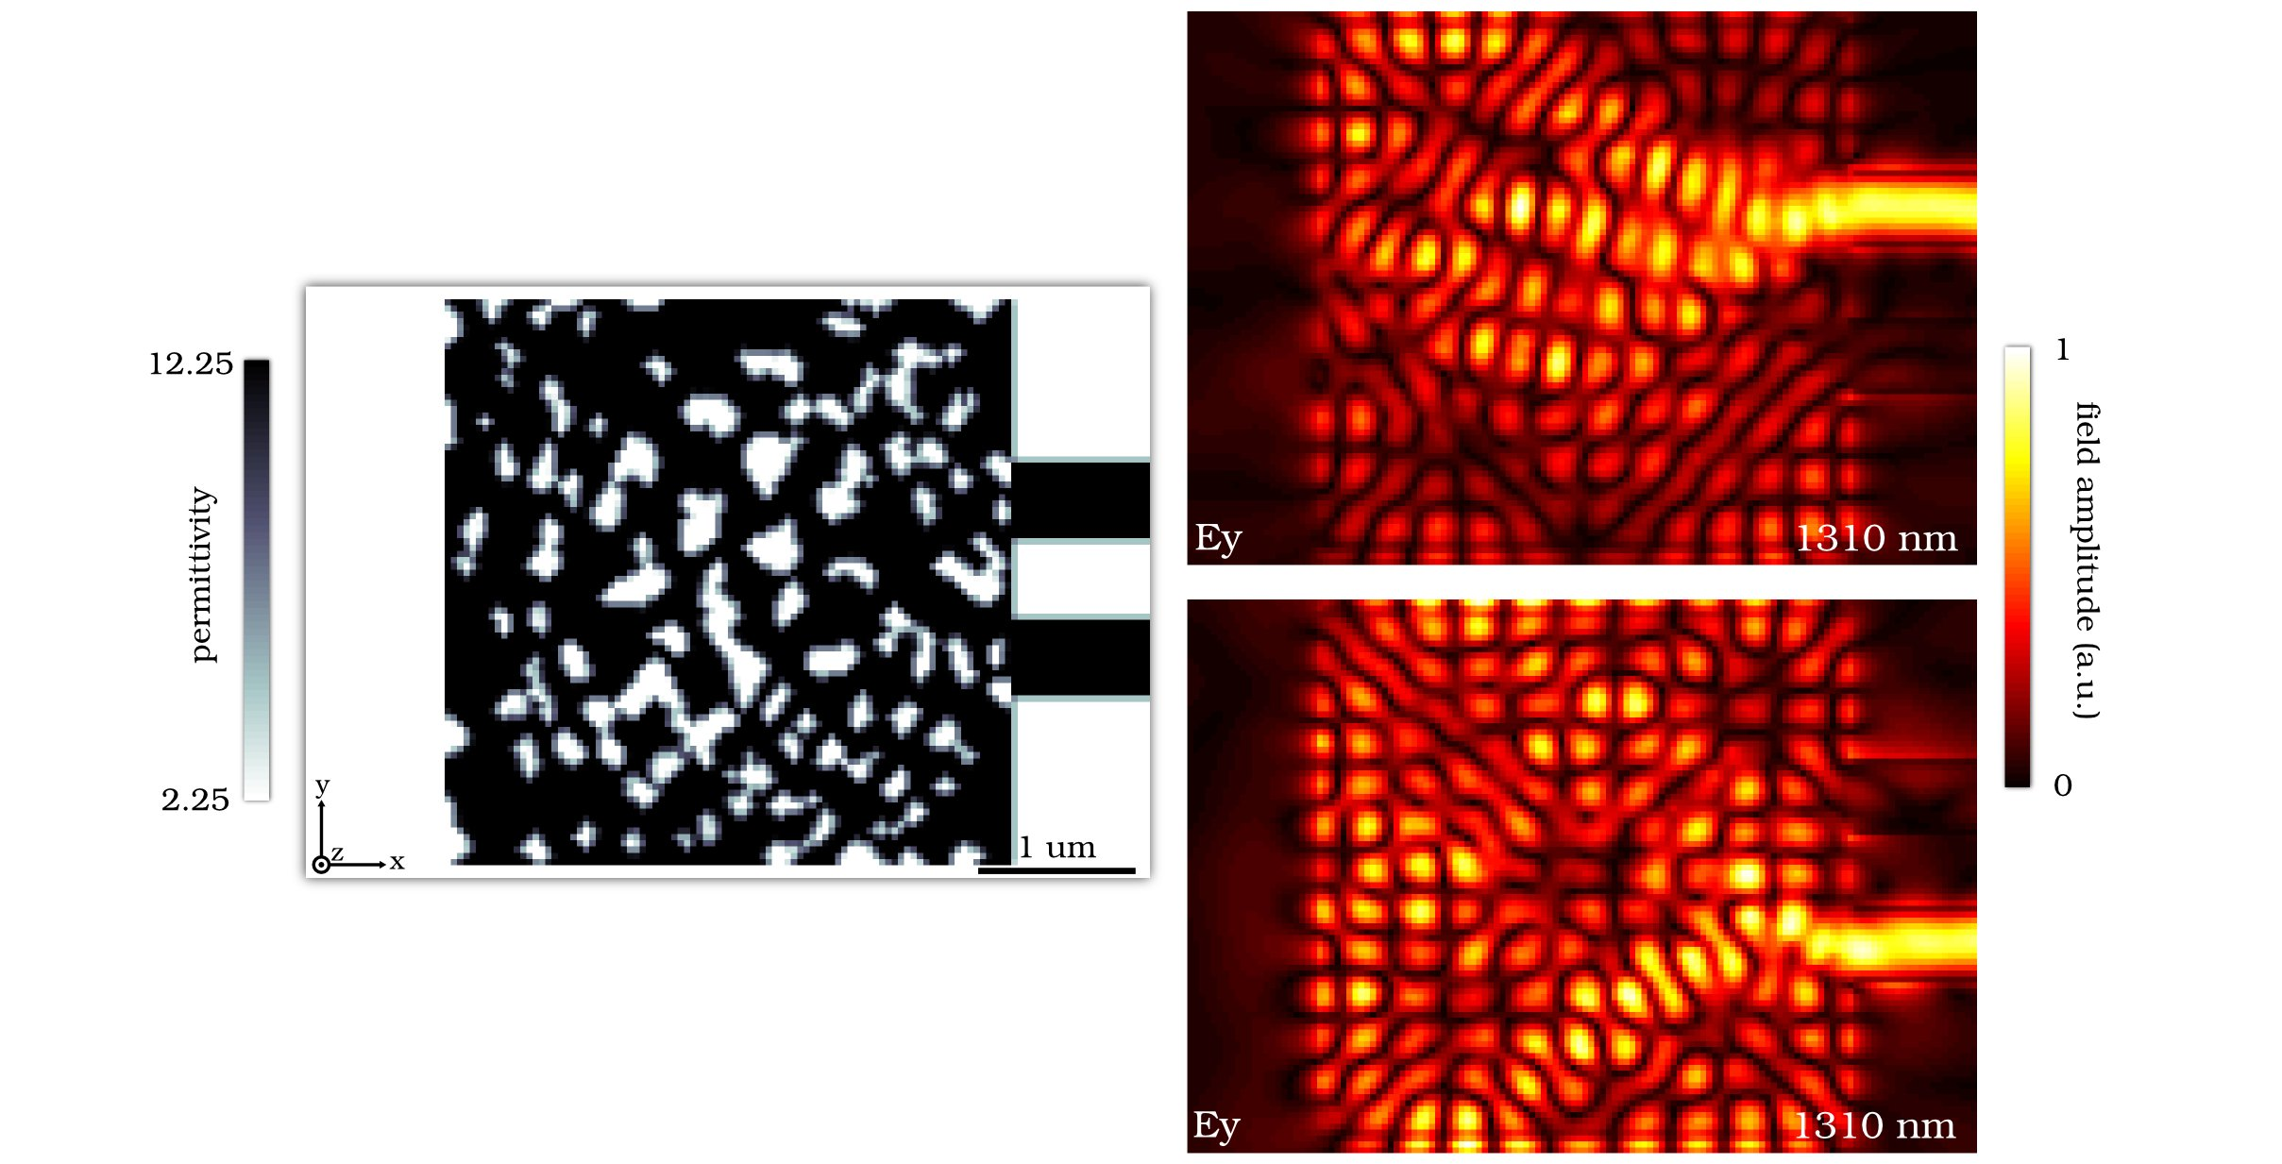
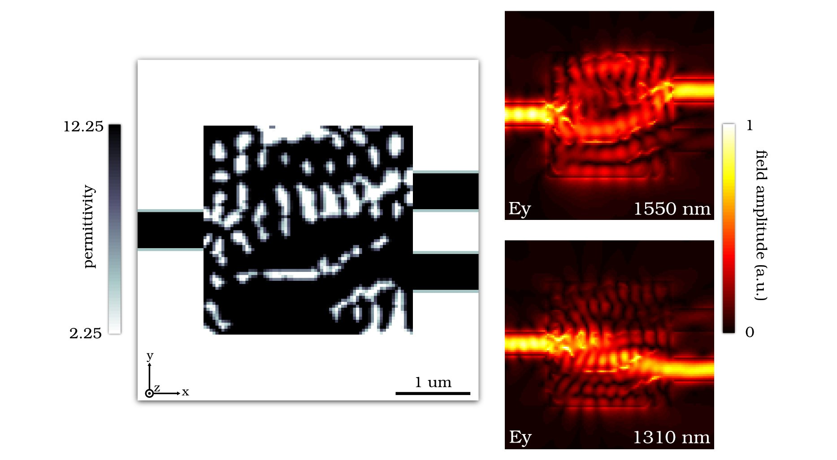
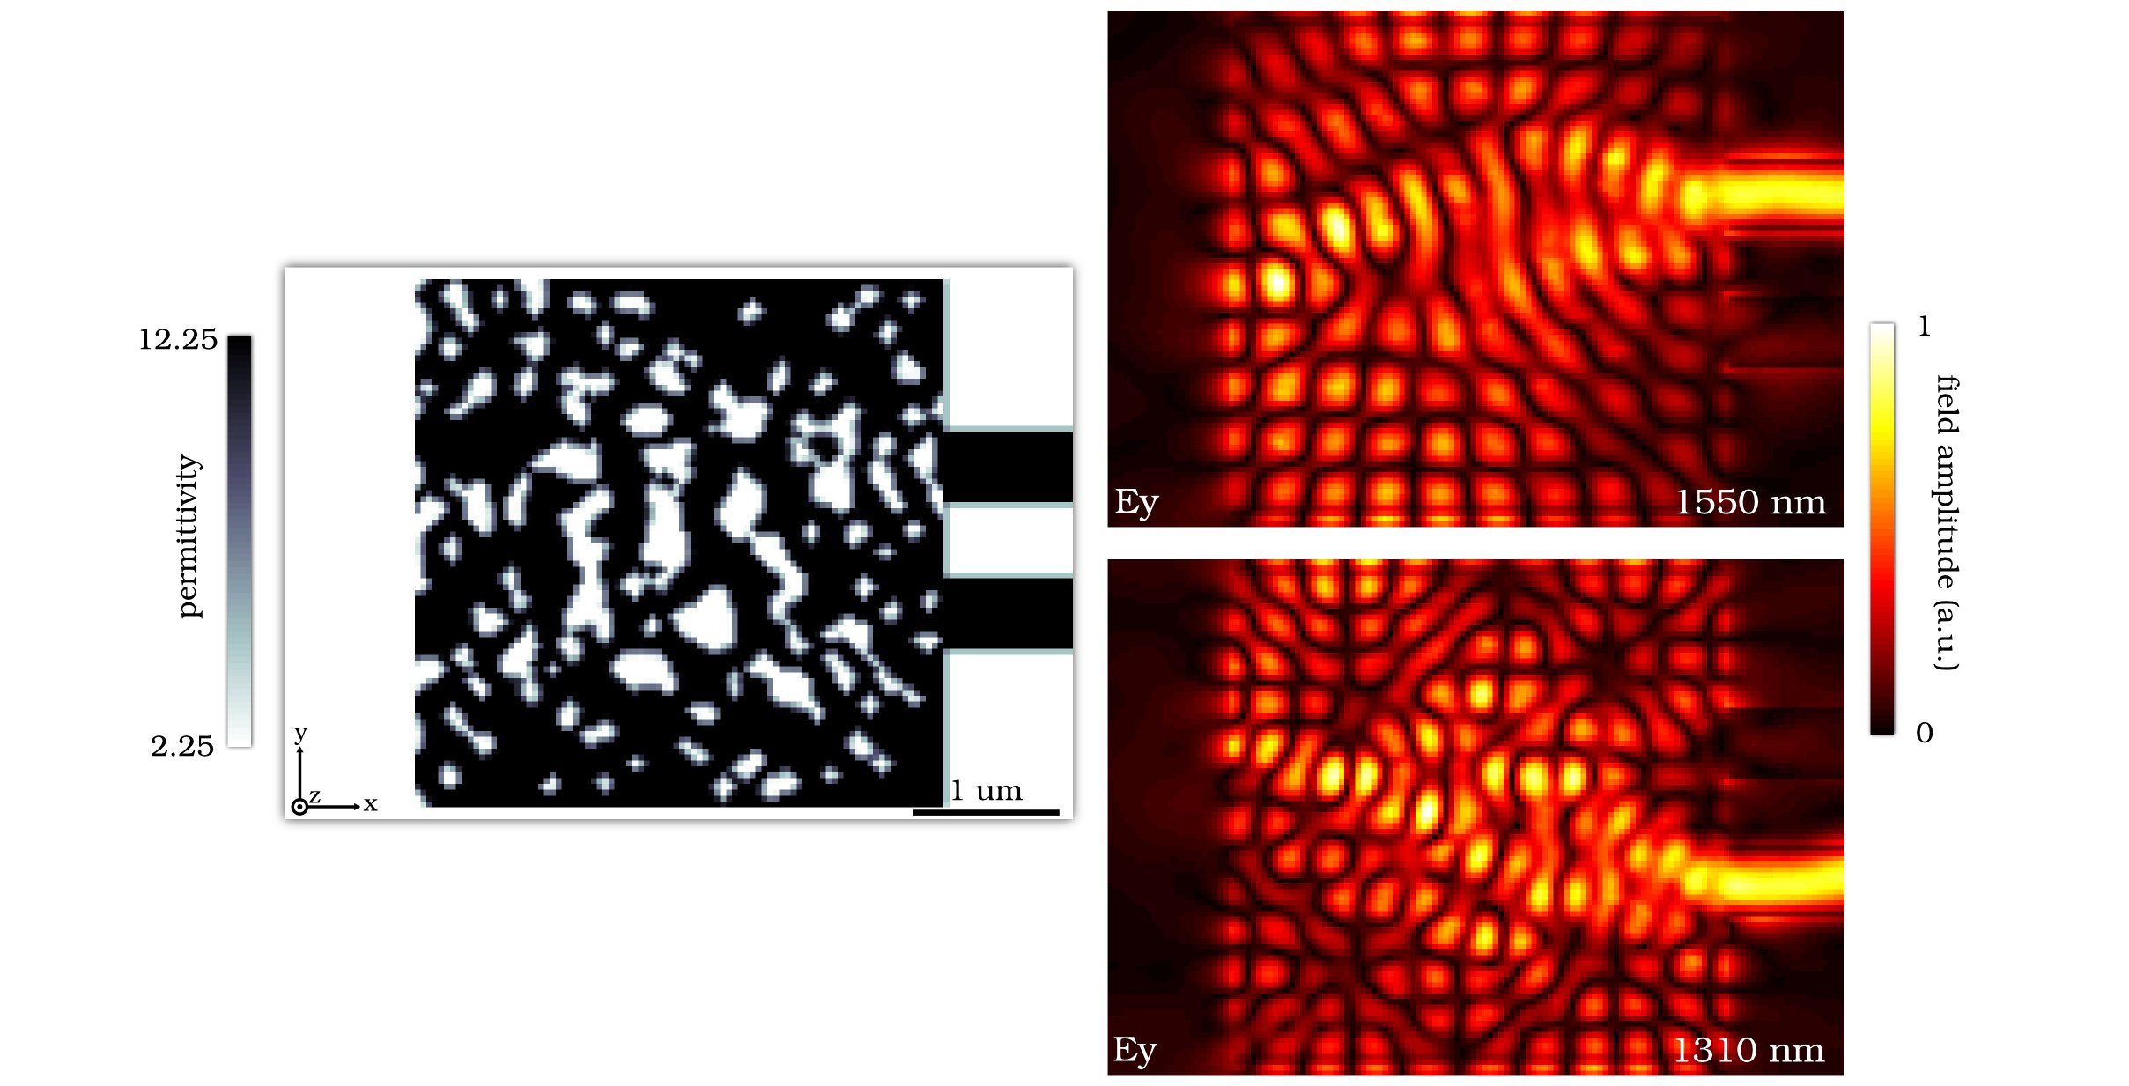
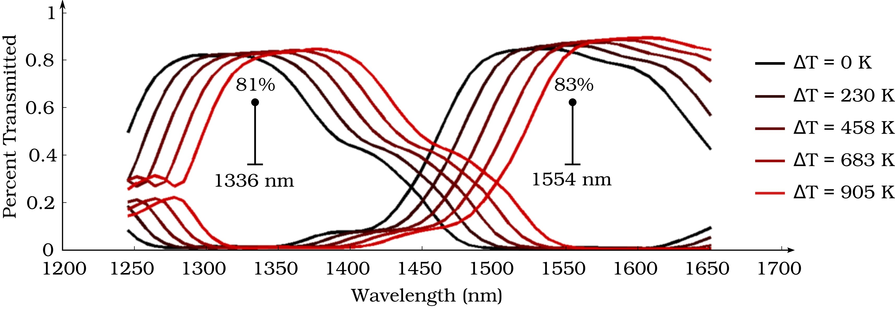
Fiber coupler
structure
Fiber coupler designs show:
Out-of-plane coupling
Multi-functional devices (coupling+splitting)‏
Broadband splitter demonstrates thermal stability for > 900K thermal shifts!
Compact Fiber Coupler
Mode-splitting
Fiber Coupler
Broadband
Wavelength Splitter
Wavelength-splitting
Fiber Coupler

