Slide 1
Typically,
minimize f(E,H)
subject to ▽×ε⁻¹▽×H-μω²H = 0
f(E,H), is the design objective
  reduce leakage
  eliminate back-reflections
Slow: requires full simulation to satisfy physics.
Starting point: Need to start in vicinty of an optimum.

Slide 2
Our approach,
minimize ▽×ε⁻¹▽×H-μω²H
subject to f(E,H) = 0
Allow non-physical fields
Strictly enforce the desired performance
Fast: Constraint can now be trivial to enforce.
Starting point: Works even for completely non-functional starting points.

Slide 3
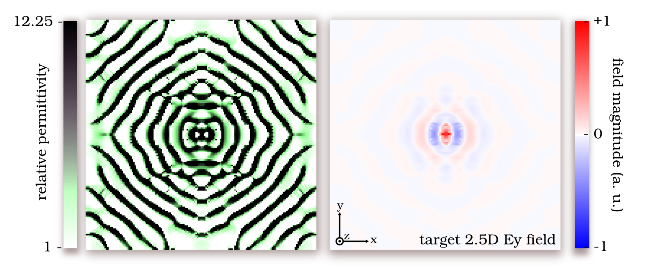
Previously,
Design of a 3D nanophotonic resonator.
Design is as fast as simulation (10 min.)!
Virtually any starting point works.
Q = 7000, Vmode = 0.32(λ/n)³
Optics Express, vol. 19 (2011).

Slide 4
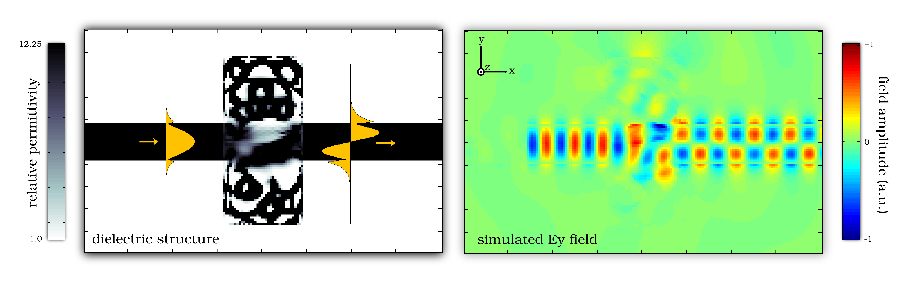
Today,
Design of arbitrary 2D mode couplers.
Still very fast (15 min),
Couples arbitrary waveguide modes,
Small footprint (~1 square vacuum wavelength),
High coupling efficiency (~95%).
Optics Express (submitted).

Slide 5
Algorithm outline
Update both ε and H to solve
minimize ▽×ε⁻¹▽×H-μω²H
subject to
f(E,H) = 0
1 < ε < 12.25
Implemented in Matlab on standard personal computer.
All designs were run for 200 iterations (15 min).

Slide 6
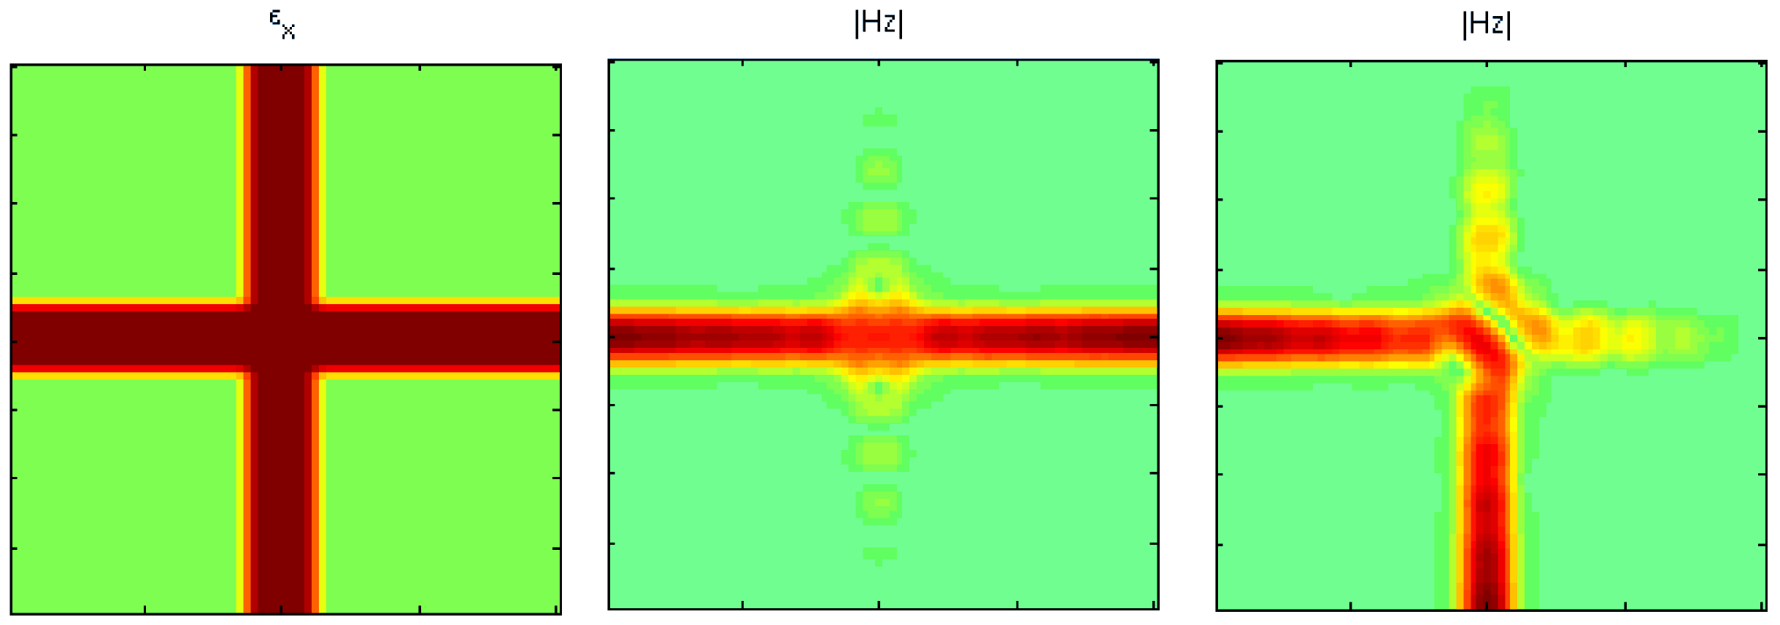
Choosing f(E,H)
Enforce boundary conditions required for perfect conversion.
Results in a “soft physics” solve.
These fields are not solutions to Maxwell’s equations!
However, they do help in designing structures.

Slide 7
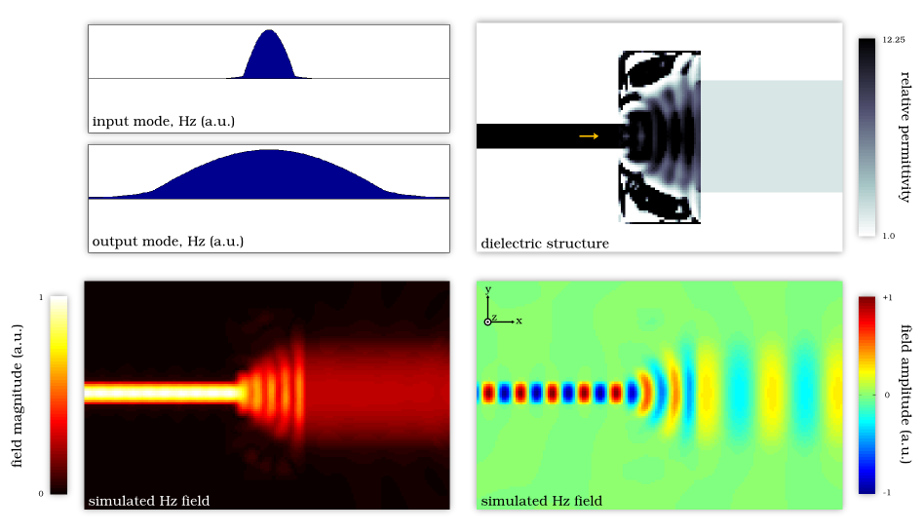
Result #1, fiber coupler
Coupler to a wide, low-index waveguide.
98.2% efficiency, ~1 λ₀², 15 minutes.

Slide 8
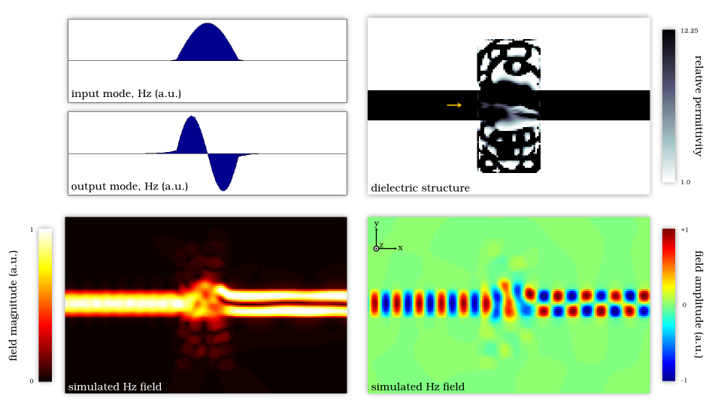
Result #2, mode converter
Starts with completely non-functional structure.
97.0% efficiency, ~1 λ₀², 15 minutes.

Slide 9
Movie of result #2

Slide 10
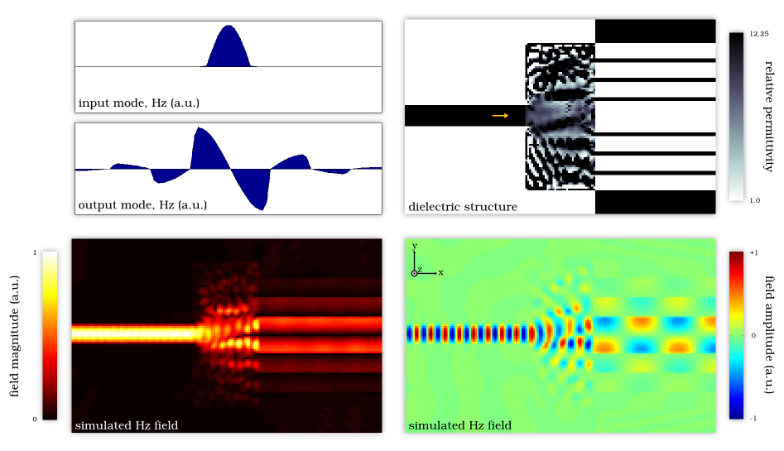
Result #3, to air-core
Output waveguide guides via distributed Bragg reflection.
85.1% efficiency, ~4 λ₀², 15 minutes.

Slide 11
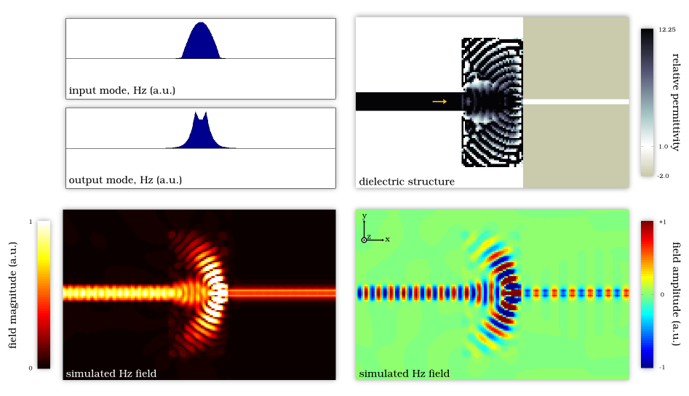
Result #4, to plasmonic MIM
Coupler between different material systems.
92.9% efficiency, ~4 λ₀², 15 minutes.

Slide 12
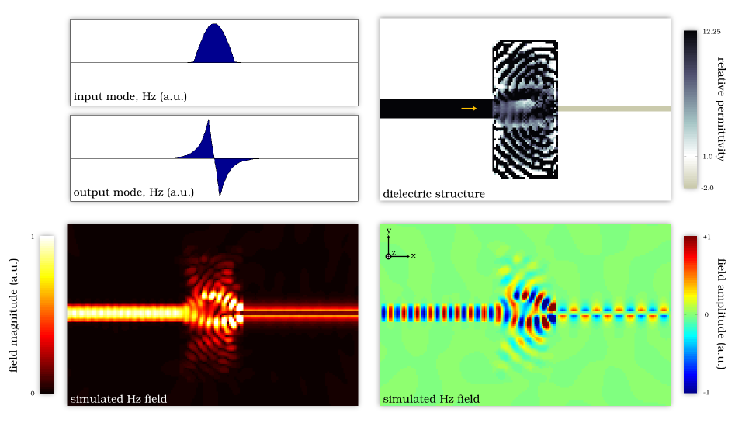
Result #5, to plasmonic wire
Non-functional starting structure (opposite symmetries).
93.2% efficiency, ~4 λ₀², 15 minutes.

Slide 13
Next steps,
Develop structure binarization step
Design multi-mode structures (e.g. MUX)
Implement in 3D

