Slide 1
Nigerian Cell/internet connectivity
Jesse Johnson

Slide 2
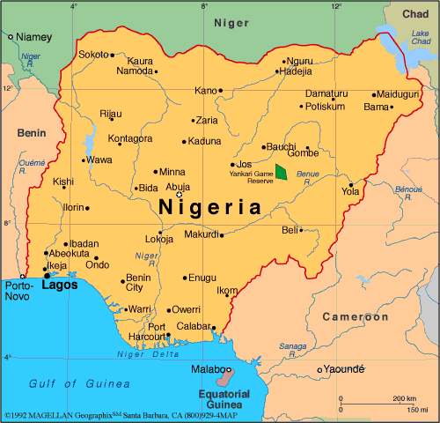
Map of Nigeria’s major cities

Slide 3
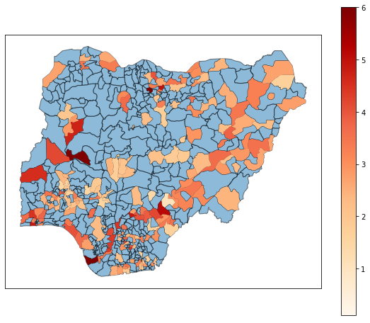
Map of Nigeria by self styled “connectivity score”

Slide 4
Conclusion
Firstly, there is a large discrepancy between number of Local Government Areas (LGAs) and the number represented on the colormap due to inconsistencies in spelling and geographical designations in more rural areas and villages, the blue zones were not able to be represented in this project without manually parsing the list of LGAs and standardizing spelling/reconciling geographic disputes
However, the data available shows that, as expected, connectivity is centered around the major cities: Kano, Lagos, Ibadan, and Port Harcourt, with some hubs in a few more surprising locations.
Hopefully I can work on filling out this map after class is over

