Slide 1
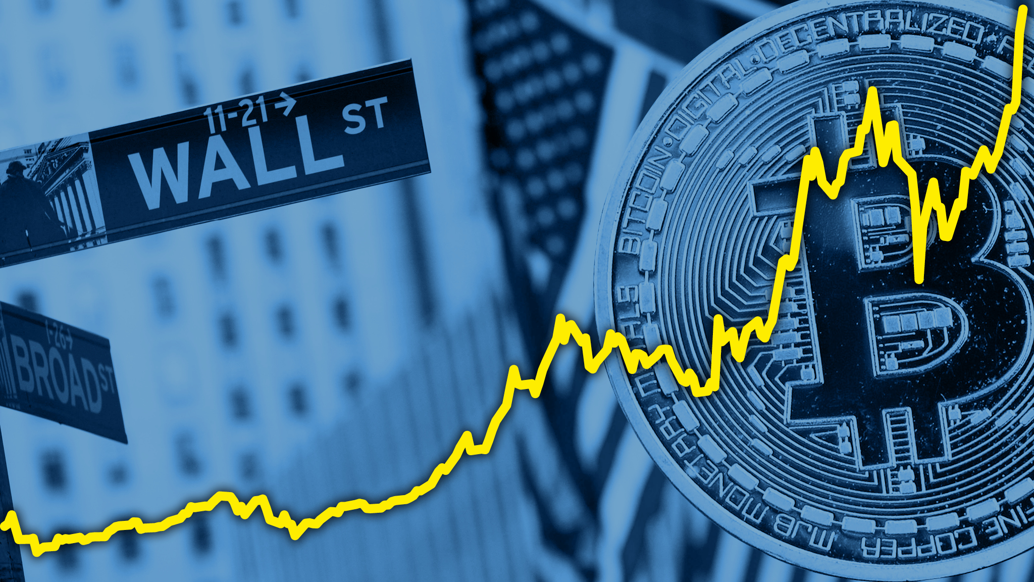
Mango python and theholyflask
A Deep dive into the world of Finance.
Wall Street vs Cryptocurrency
Jesse Perez, Yi Huang, Drew
Williams, Nashra Khan

Slide 2
Our Data

Slide 3
Technical Developments

