Slide 1
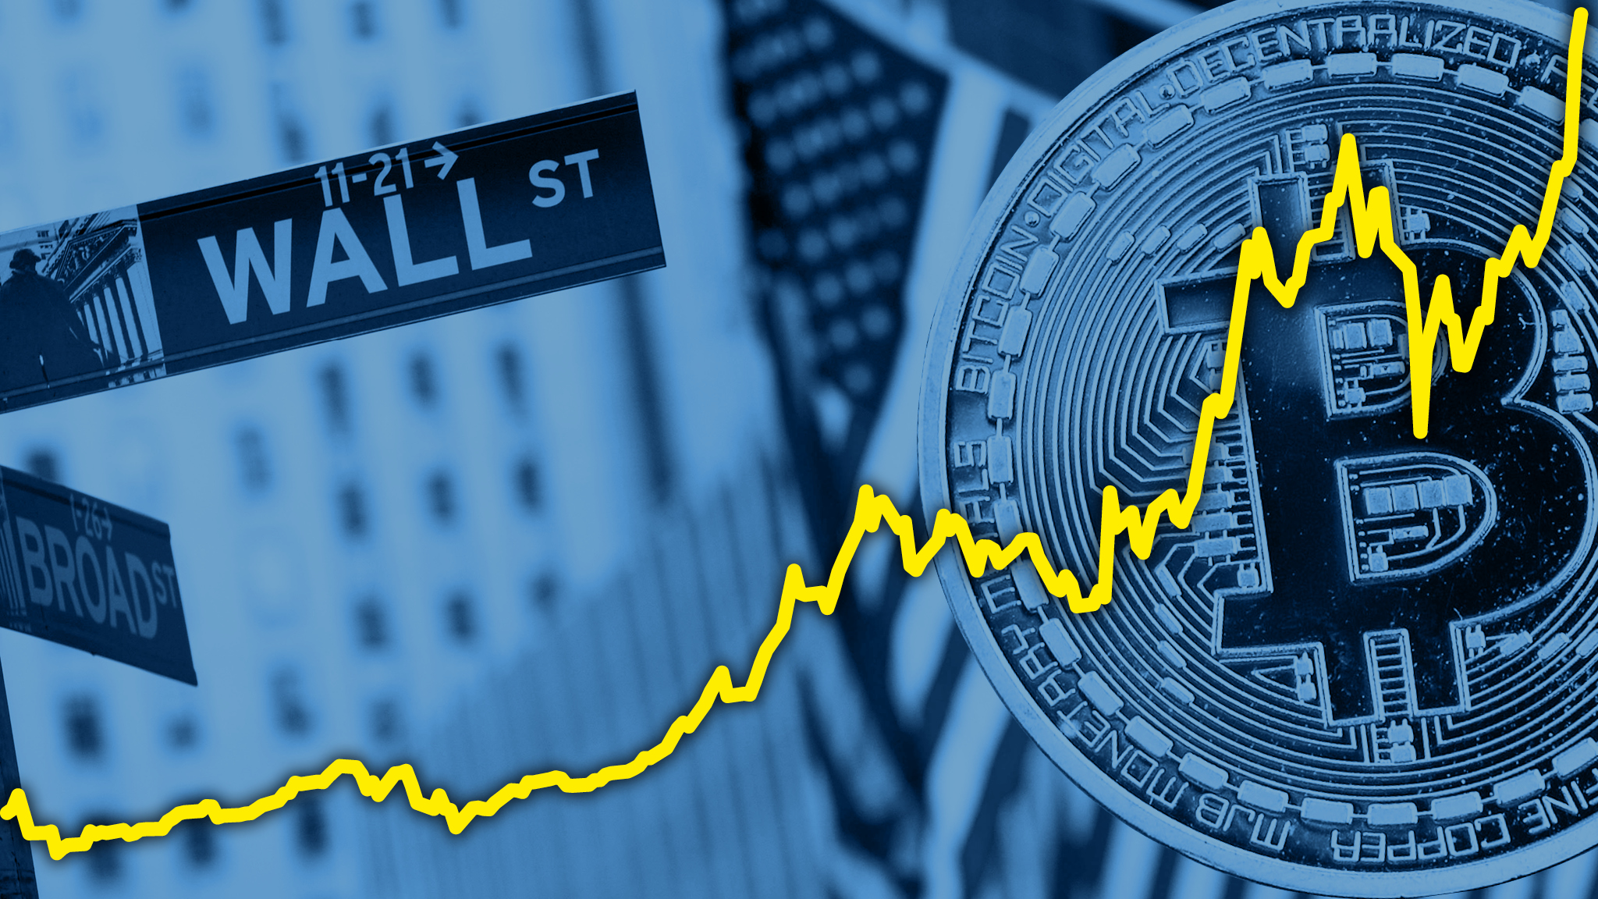
Mango python and theholyflask
A Deep dive into the world of Finance.
Wall Street vs Cryptocurrency
Jesse Perez, Yi Huang, Drew
Williams, Nashra Khan

Slide 2
Our Data
Stocks
S&P 500
Crypto
Top 100 cryptos on Yahoo Finance
Data of Interest
2 year span
Closing Price
Date

Slide 3
Technical Developments
Backend
sqlite database, cleaned and developed using Jupyter notebook, SQLAlchemy, SQLite3
Flask app serves our data via several routes allowing devs to access tickers by Sector (Category), Date, or Name
Frontend
Bootstrap, D3, ObservableHQ add-ons (D3), Plotly
ObservableHQ add-ons: Multiline chart, Tree map, Bubble chart

