Slide 1
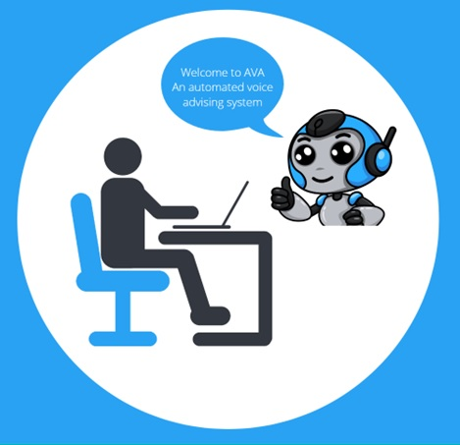
FALL 2022 PROFESSOR JOHNSON SOFTWARE ENGINEERING 515
AVA AN AUTOMATED VOICE ACTIVATED ADVISEMENT SYSTEM
BY THE SOFTWARE GURUS
19 December 2022
Team Members: Omar Obidat Jesse Parron Allen Asencio Dan Ferdetta Sumit Mistry

Slide 2


Slide 3
AGENDA
Introduction
Project Scope
Technology implementation
Demo
Team Organization & Teamwork
Q&A

Slide 4
INTRODUCTION
AVA AN AUTOMATED VOICE ACTIVATED ADVISEMENT SYSTEM
Student advisement tool for Computer Science Undergraduate students at Montclair State University.
Pros:
Reduce advisor’s workload
Cost efficient system
Quick support to students (24/7)

Slide 5
PROJECT SCOPE
AVA AN AUTOMATED VOICE ACTIVATED ADVISEMENT SYSTEM
Language Recognition
Academic advisement
GPA
Course catalog
Transcript
Login / Logout module

Slide 6
TECHNOLOGY USED
AVA AN AUTOMATED VOICE ACTIVATED ADVISEMENT SYSTEM
Backend:
Python Flask
Frontend:
HTML CSS
Database:
SQL

Slide 7
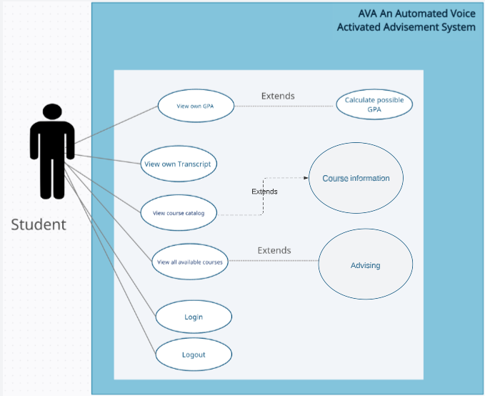
AVA AN AUTOMATED VOICE ACTIVATED ADVISEMENT SYSTEM

Slide 8
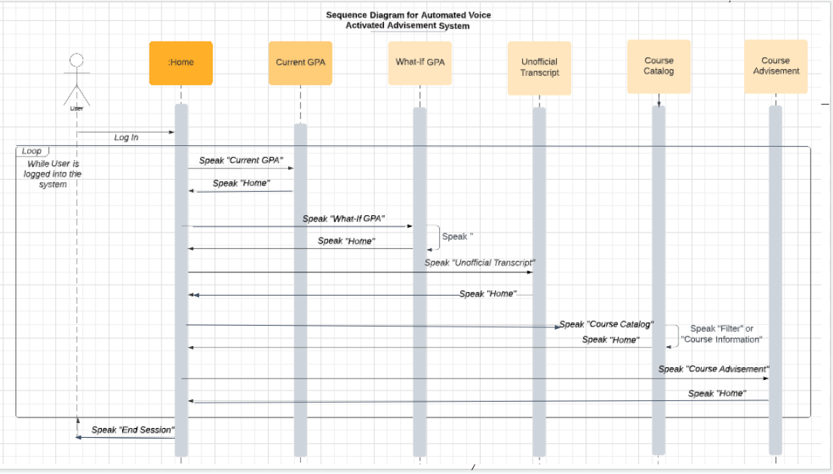

Slide 9
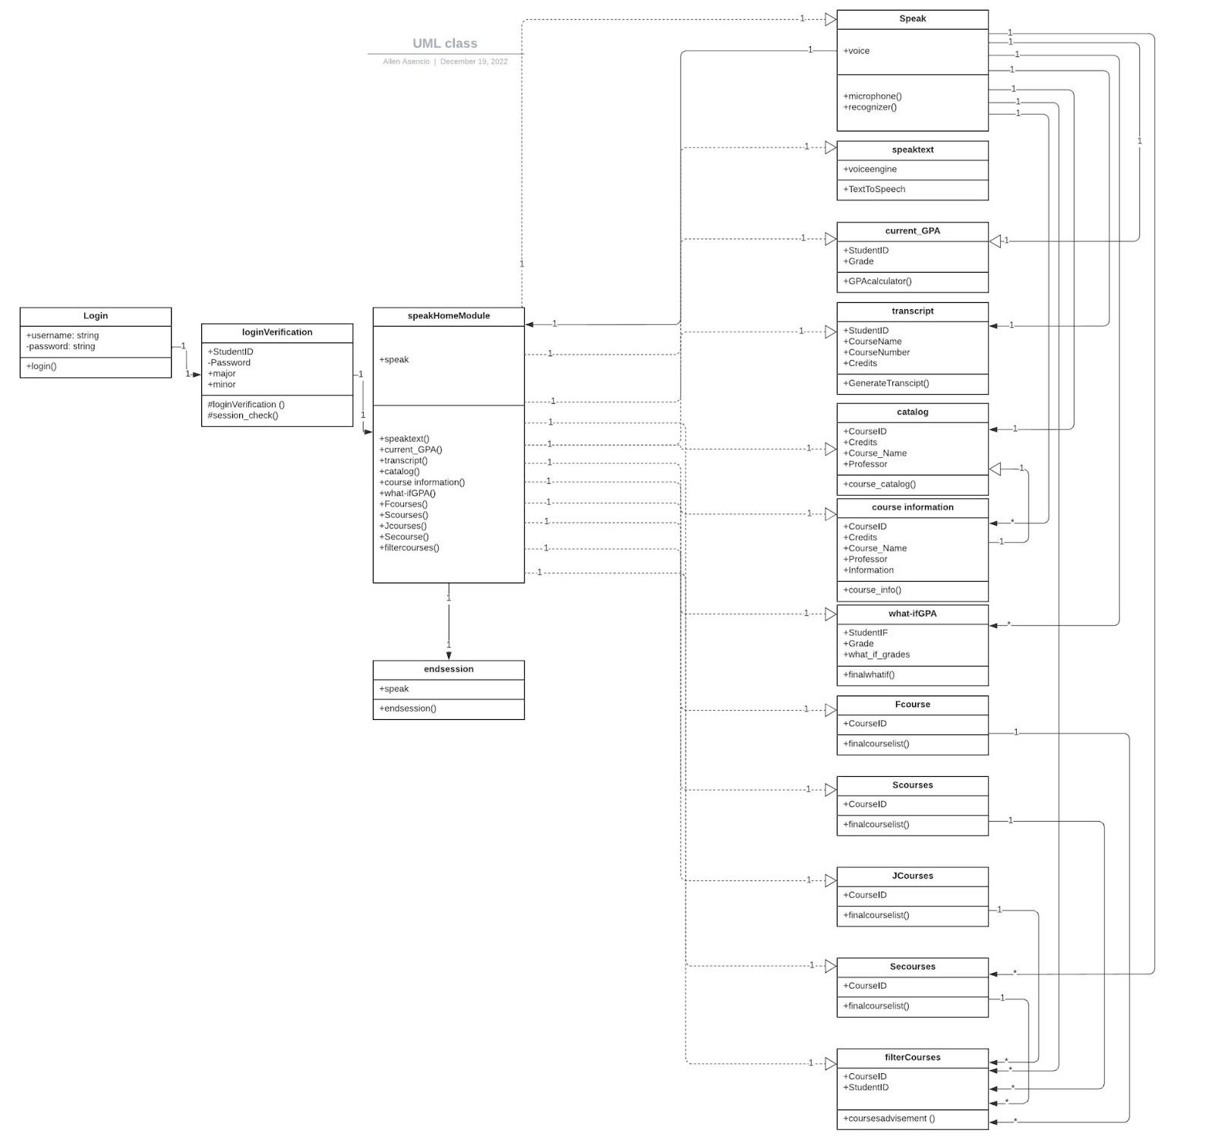
AVA AN AUTOMATED VOICE ACTIVATED ADVISEMENT SYSTEM

Slide 10

AVA AN AUTOMATED VOICE ACTIVATED ADVISEMENT SYSTEM

Slide 11
TEAM ORGANIZATION & TEAMWORK
Weekly meetings
Discord

Slide 12


