Slide 1
Suicide Risk and rate by demographic
Linet Osoro
Jesse Reed
Madeline Riley

Slide 2
Questions to Answer
What gender is more likely to attempt suicide
What gender is more likely to commit suicide
Why is that
What methods are most commonly used
Is there a difference between genders
Generation most likely to attempt suicide
How influential is the economy to suicide? Is there a strong correlation between income and suicide attempts?
What is the difference in perspective on suicide from a culturally perspective

Slide 3
Risk factors of suicide
Financial Stability
Drug Abuse
Genetics/Family History
LGBTQIA Community

Slide 4
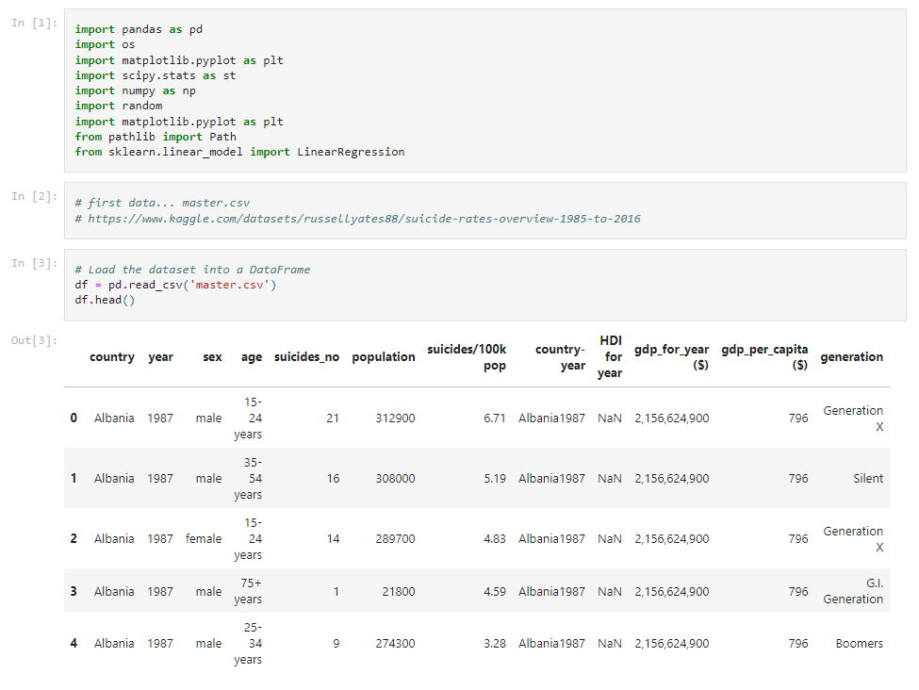
Dataset Code

Slide 5
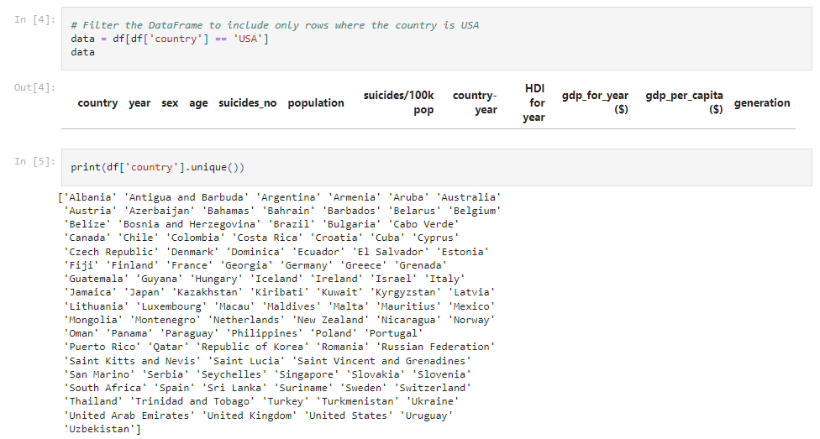
Dataset Code

Slide 6
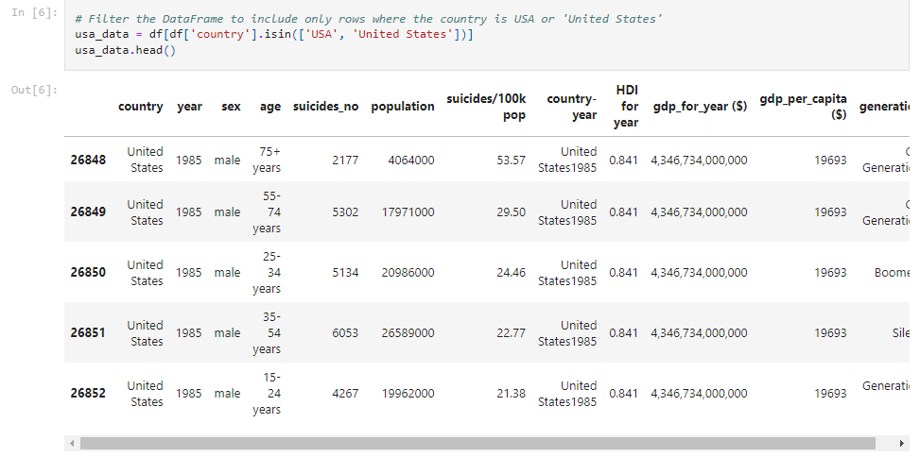
Dataset Code

Slide 7
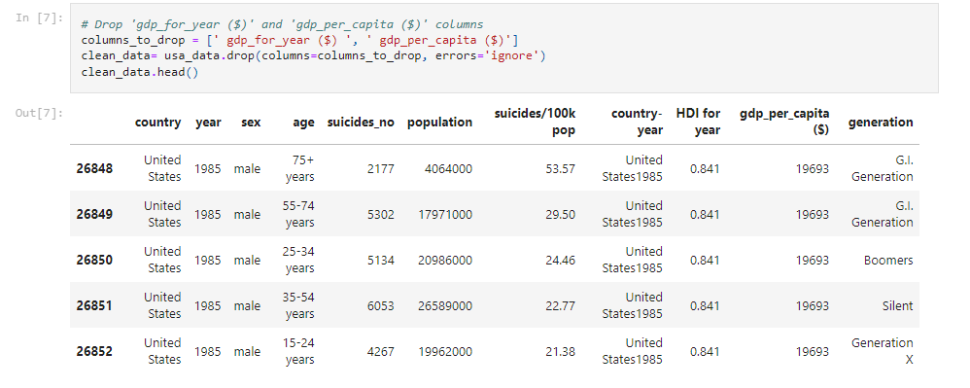
Dataset Code

Slide 8
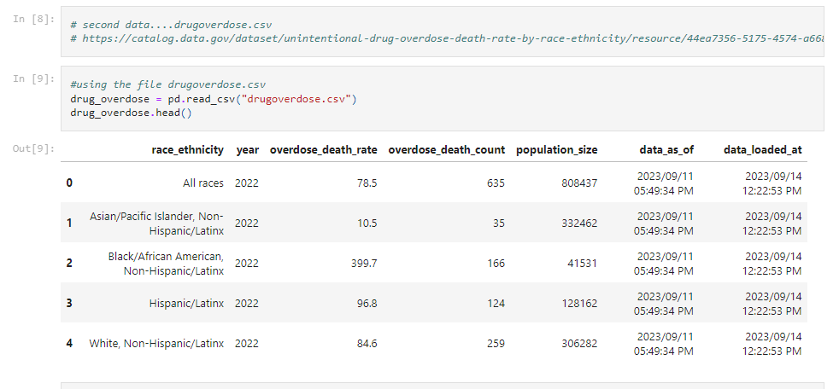
Dataset Code

Slide 9
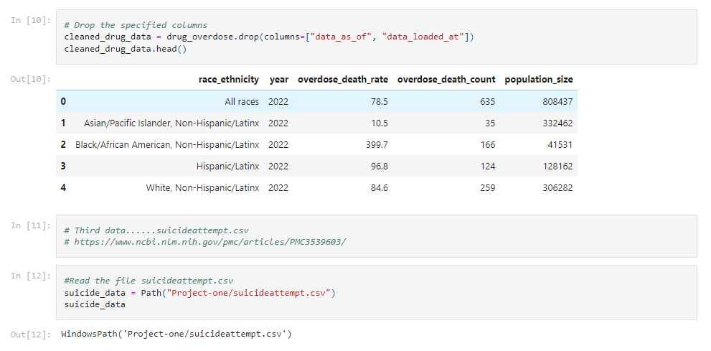
Dataset Code

Slide 10
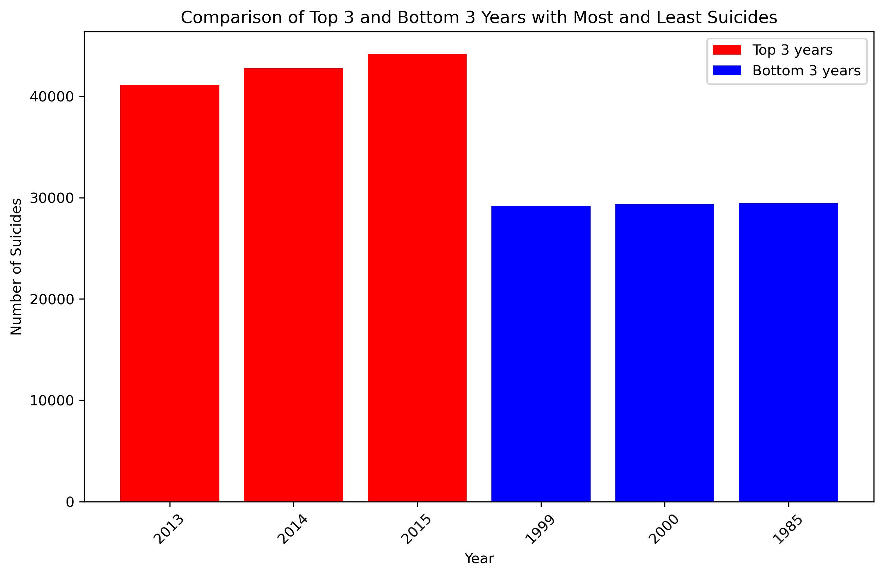
Top and Bottom Years for Suicide 1985-2015
Notes:
Social media and cyber bullying increased.
Few years after the market crashed in 2008/2009
Strong correlation between opioid usage and mood disorders amongst adolescent girls
Implementation of the cyber bullying act 2013-15
Increases in suicide amongst young men partially for the easier access to firearms within the United States
Job stability went down due to the crash, economic decline at the country level such as unemployment had a strong correlation to predict suicide.

Slide 11
Analysis
High Years
Low Years
Increase in cyberbullying
Access to firearms led to increase in male suicide
Job stability went down due to the crash
Rise in median income by 15%
Low unemployment; 4% in 1999

Slide 12
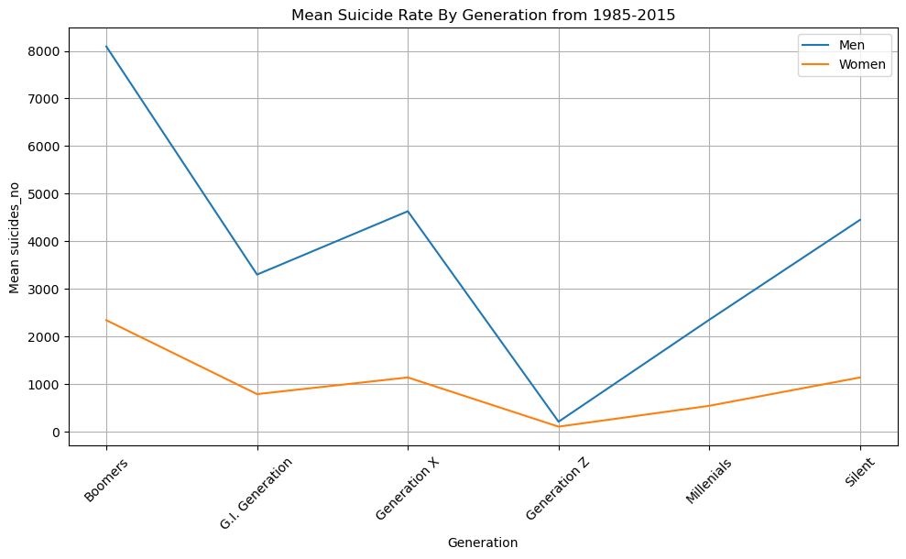
Mean Suicide Rate by Generation
Difference in generations due to length of time they’ve been alive
i.e. Gen Z has only been around since 1997

Slide 13
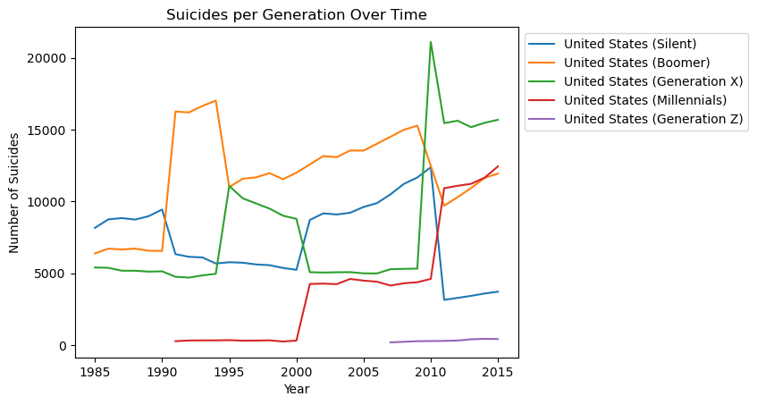
Generation with Highest Suicide Rate
Boomers are most likely due to
Feeling like a burden on family
Loneliness and lack of social life
Health issues

Slide 14
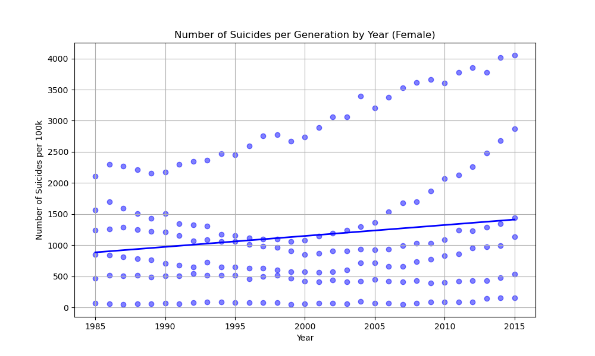
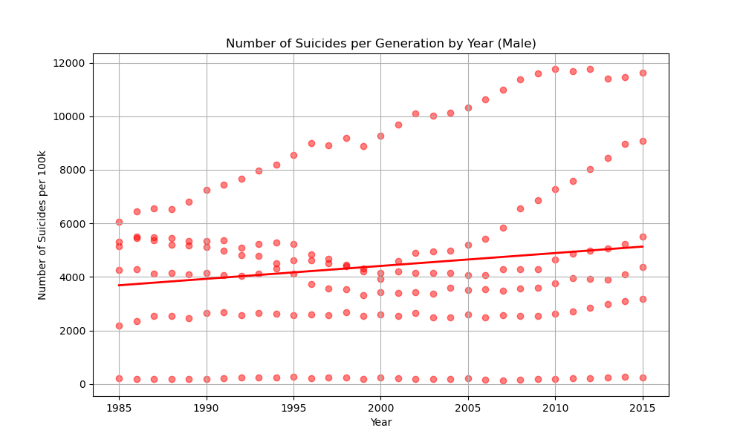
Number of Suicides by Generation

Slide 15
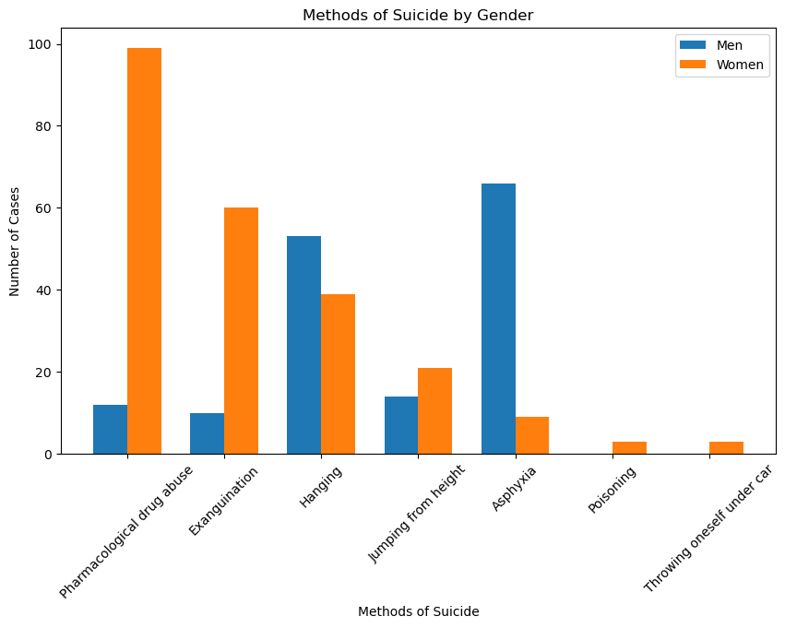
Suicide Methods

Slide 16
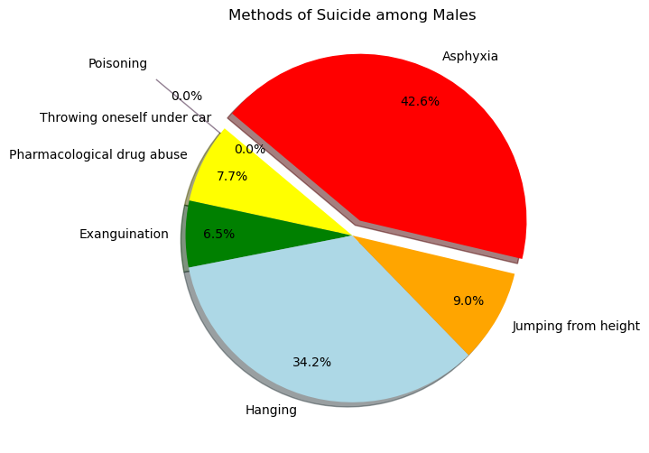
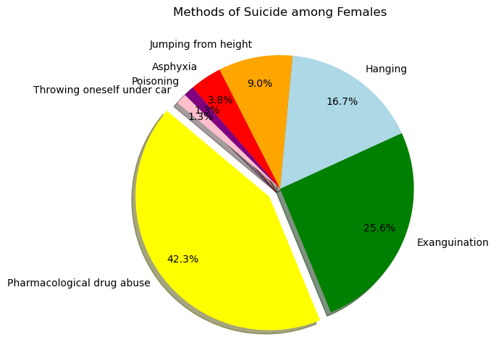
Methods By Gender

Slide 17
Difference In Methods by Gender
Men
Women
Men use more final methods
More men own firearms than women
Women anticipate the cleanup of their body
A theory is women care how their body looks post-mortem
Women potentially attempt as a cry for help

Slide 18
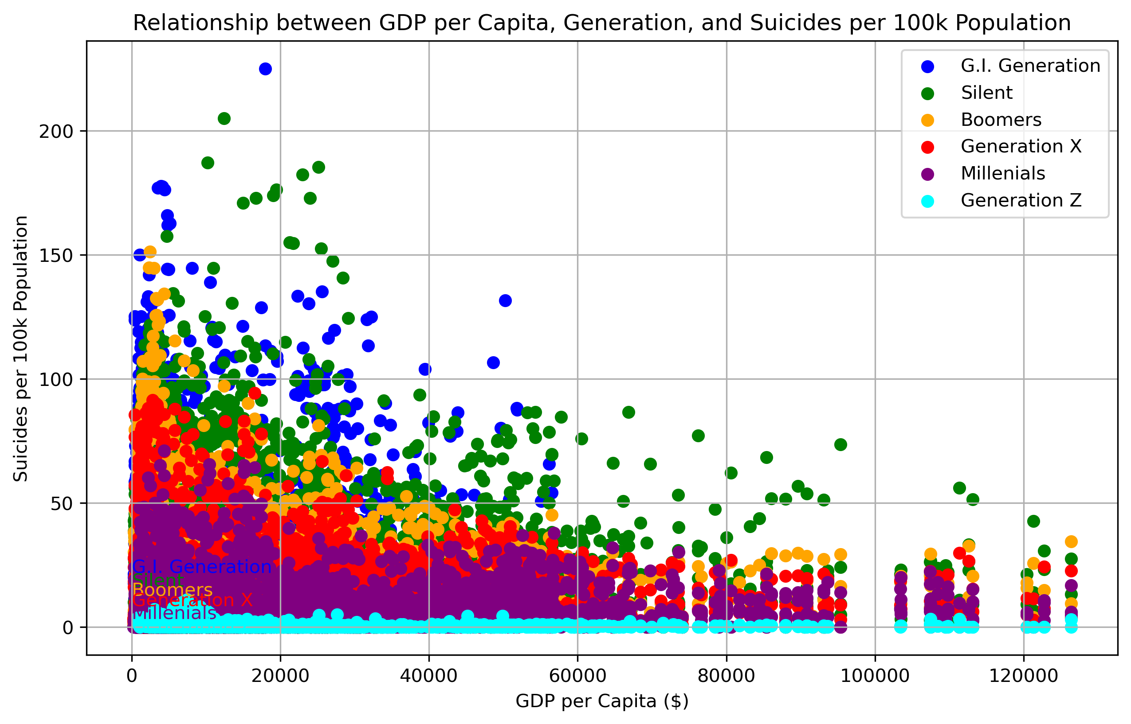
GDP And Suicide Rate by Generation
Notes:
A lower income rate is a predictor of a higher suicide rate.
Males who have lost their jobs in adulthood are those at higher risk of suicide and to whom financial support measures should be delivered in a timely manner.
Every 1% increase in global unemployment rates is associated with a 1% upsurge in male deaths by suicide.
Lower income and unemployment is strongly correlated with an increase in suicide
Strong correlation between increase in inflation and suicide rate

Slide 19
GDP And Suicide Rate by Generation
Lower income = higher suicide rate
Men without jobs are more likely to attempt suicide
For every 1% increase in unemployment rate there’s a 1% increase in male suicides

Slide 20
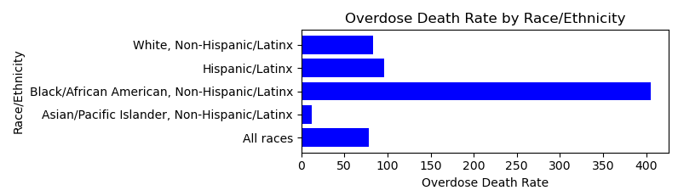
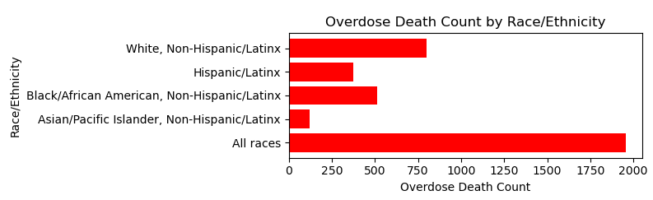
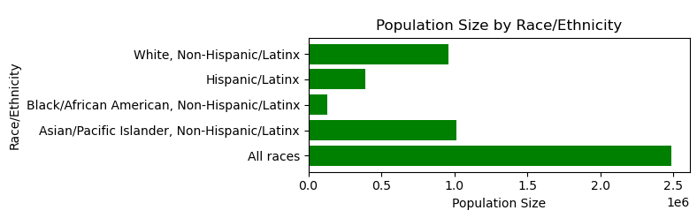

Slide 21
Overdose Among Different Races/Cultures
Common reason for suicide is access to drugs
African American risk factors
Racism
Stress
Fewer opportunities for advancement
Increased threats to well-being
Limited education/employment/income

Slide 22
Overdose Among Different Races/Cultures
Caucasian Americans
Make up 1/3 the suicide rate
Highest rate amongst uneducated middle-aged group
Higher suicide rates in rural America
According to the CDC- two times more likely that rates in larger metropolitan counties.
Hispanic Americans
Low suicide rate
Higher sense of community

Slide 23
References
https://www.aei.org/economics/1999-might-have-been-americas-last-good-year-and-not-because-of-the-phantom-menace/
https://ourfuture.org/20160422/an-economy-like-its-1999#:~:text=During%201999%2C%20the%20economy%20was,or%20%2469%2C405%20in%202014%20dollars
https://www.kaggle.com/datasets/russellyates88/suicide-rates-overview-1985-to-2016
https://www.ncbi.nlm.nih.gov/pmc/articles/PMC9292781/#:~:text=At%20the%20income%20class%20level,%2C%20RR%20%3D%200.95%20%5B0.94%E2%80%93
https://blogs.scientificamerican.com/bering-in-mind/sex-and-suicide-why-do-more-men-than-women-kill-themselves/
https://pubmed.ncbi.nlm.nih.gov/9675500/
https://www.ncbi.nlm.nih.gov/pmc/articles/PMC8699163/
https://www.prb.org/resources/in-u-s-who-is-at-greatest-risk-for-suicides/

Slide 24
References Cont.
https://www.nytimes.com/2020/12/30/upshot/suicide-demographic-differences.html
https://stackoverflow.com/questions/18039057/pandas-parser-cparsererror-error-tokenizing-data
https://github.com/matplotlib/matplotlib/issues/8998
https://www.programiz.com/python-programming/methods/built-in/zip
https://pandas.pydata.org/docs/reference/api/pandas.unique.html
https://pandas.pydata.org/docs/reference/api/pandas.DataFrame.aggregate.html
https://pandas.pydata.org/docs/reference/api/pandas.DataFrame.plot.bar.html
https://pandas.pydata.org/docs/user_guide/groupby.html
https://stackoverflow.com/questions/34087382/matplotlib-center-text-in-its-bbox
https://docs.scipy.org/doc/scipy/reference/generated/scipy.stats.linregress.html
https://pandas.pydata.org/docs/reference/api/pandas.DataFrame.isin.html

Slide 25
References Cont.
https://stackoverflow.com/questions/13018115/matplotlib-savefig-image-size-with-bbox-inches-tight
https://www.w3schools.com/python/ref_dictionary_items.asp
https://stackoverflow.com/questions/40908983/arguments-of-bbox-to-anchor-function
https://matplotlib.org/stable/api/_as_gen/matplotlib.pyplot.plot.html
https://catalog.data.gov/dataset/death-rates-for-suicide-by-sex-race-hispanic-origin-and-age-united-states-020c1/resource/e1d8e368-2a1b-488a-a7cc-6953439fc3af
https://www.enterpriseappstoday.com/stats/suicide-statistics.html#Causes_of_Suicide
Gender differentiation in methods of suicide attempts - PMC (nih.gov)
https://www.ncbi.nlm.nih.gov/books/NBK441982/#article-34532.s15
https://data.world/samhsa/serious-thoughts-of-suicide
https://www.statista.com/statistics/1053024/lgbtq-youth-in-us-attempted-suicide-conversion-therapy-experience/

Slide 26
References Cont.
https://catalog.data.gov/dataset/monthly-counts-of-deaths-by-select-causes-2014-2019-da9df
https://www.ajpmonline.org/article/S0749-3797(18)31677-5/fulltext
https://catalog.data.gov/dataset/unintentional-drug-overdose-death-rate-by-race-ethnicity
https://ourworldindata.org/suicide
https://catalog.data.gov/dataset/intimate-partner-homicide-suicide-in-new-york-city-2010-2018
https://catalog.data.gov/dataset/early-model-based-provisional-estimates-of-drug-overdose-suicide-and-transportation-relate-b35b2
https://www.cdc.gov/suicide/facts/disparities-in-suicide.html
https://catalog.data.gov/dataset/unintentional-drug-overdose-death-rate-by-race-ethnicity/resource/44ea7356-5175-4574-a668-3bca76c192c3
https://www.ncbi.nlm.nih.gov/pmc/articles/PMC3539603/

Slide 27
References Cont.
https://www.nytimes.com/2020/12/30/upshot/suicide-demographic-differences.html
https://www.prb.org/resources/in-u-s-who-is-at-greatest-risk-for-suicides/
https://www.ncbi.nlm.nih.gov/pmc/articles/PMC8699163/
https://pubmed.ncbi.nlm.nih.gov/9675500/
https://blogs.scientificamerican.com/bering-in-mind/sex-and-suicide-why-do-more-men-than-women-kill-themselves/
https://www.ncbi.nlm.nih.gov/pmc/articles/PMC9292781/#:~:text=At%20the%20income%20class%20level,%2C%20RR%20%3D%200.95%20%5B0.94%E2%80%93

