Slide 1



Final Project:
Credit Scoring with
Machine Learning
Data Analytics Project 4
Jesse Reed & Damon Robinson
June 10, 2024

Slide 2
Our machine learning problems worth analysis and visualizing:
Objective: Develop a categorical and linear regression machine learning model to analyze credit scores and
predict consumer loan eligibility based on historical
lending data, with the goal of assisting financial
institutions in making informed decisions on loan
approvals and minimizing credit risk.
Notes:
Objective: Develop a categorical and linear regression machine learning model to analyze credit scores and predict consumer loan eligibility based on historical lending data, with the goal of assisting financial institutions in making informed decisions on loan approvals and minimizing credit risk.

Slide 3

Calculating Credit Factors
Notes:
FICO Scores are calculated using many different pieces of credit data in your credit report. This data is grouped into five categories: payment history (35%), amounts owed (30%), length of credit history (15%), new credit (10%) and credit mix (10%).

Slide 4
Imported Dependencies
import pandas as pd
from sklearn.metrics
import confusion_matrix, classification_report
from pandas import DataFrame
from scipy.stats import linregress
import seaborn as sns
import matplotlib.pyplot as plt
import plotly.graph_objects as go
import warnings
#from xgboost import XGBClassifier
from sklearn.metrics import classification_report import joblib
#Packages options sns.set(rc={'figure.figsize': [14, 7]}, font_scale=1.2) # Standard figure size for all np.seterr(divide='ignore', invalid='ignore', over='ignore’) ;
import warnings warnings.filterwarnings("ignore")
Notes:
import numpy as np
import pandas as pd
from pathlib import Path
from sklearn.metrics import confusion_matrix, classification_report
from pandas import DataFrame
from pandas import Series
from scipy.stats import linregress
import seaborn as sns
import matplotlib.pyplot as plt
import plotly.express as px
import plotly.graph_objects as go
import warnings
import csv
import os
from collections import Counter
from sklearn.model_selection import train_test_split
from sklearn.preprocessing import PowerTransformer
#from datasist.structdata import detect_outliers
from sklearn.metrics import mean_squared_error
from imblearn.over_sampling import SMOTE
from sklearn.impute import SimpleImputer
#import category_encoders as ce
import re
from sklearn.experimental import enable_hist_gradient_boosting
from sklearn.ensemble import (
BaggingClassifier,
ExtraTreesClassifier,
RandomForestClassifier,
StackingClassifier,
HistGradientBoostingClassifier
)
#from xgboost import XGBClassifier
from sklearn.metrics import classification_report
import joblib
# Packages options
sns.set(rc={'figure.figsize': [14, 7]}, font_scale=1.2) # Standard figure size for all
np.seterr(divide='ignore', invalid='ignore', over='ignore') ;
import warnings
w

Slide 5
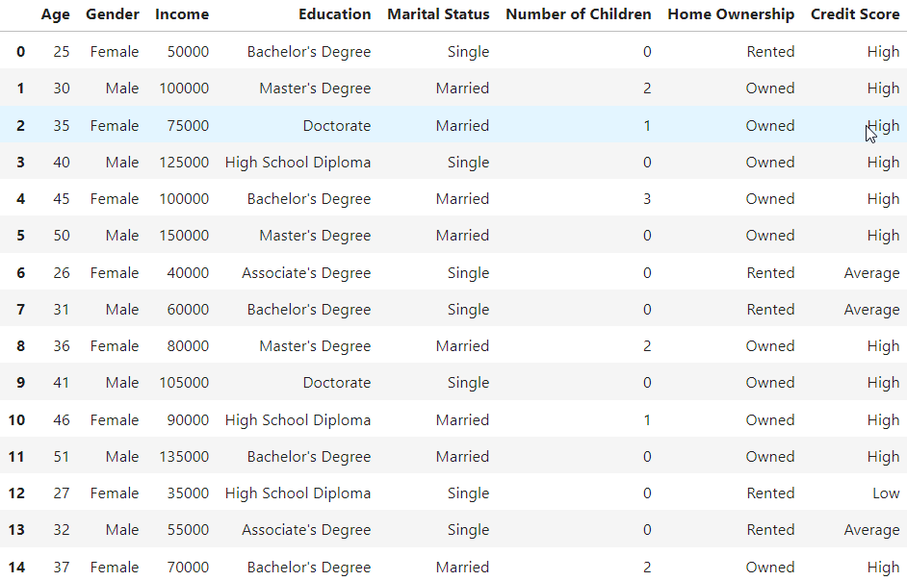
Credit Score Classification Dataset powered with at least 100 records.
Categorical Machine Learning Dataset
Credit Score Classification Dataset
Credit Risk Dataset
Credit Scoring
Notes:
Credit Score Classification Dataset 164 data rows
Credit Risk Dataset 32k data rows
Credit Scoring 1k data rows
When working with data that contains categorical variables or features, it is essential to use a categorical machine learning model or technique.

Slide 6
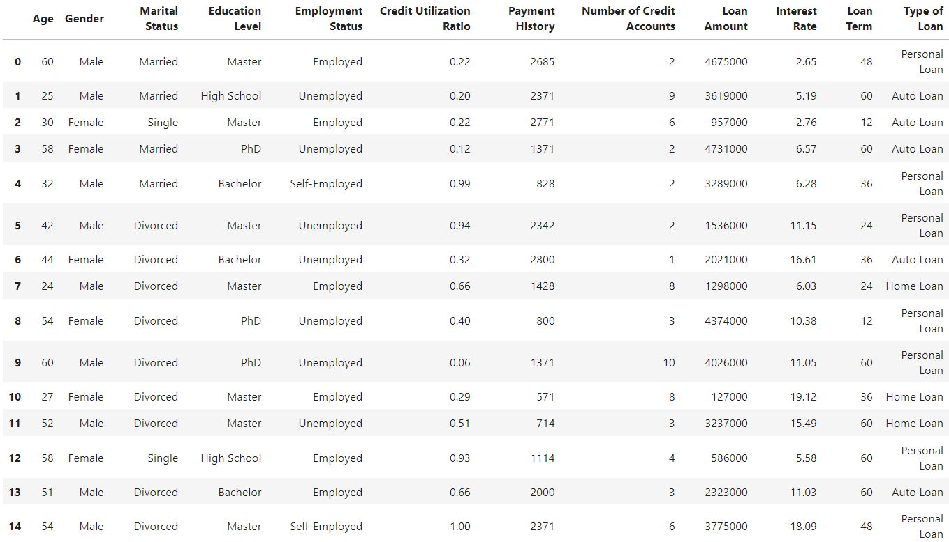
Credit Score Classification Dataset powered with at least 100 records.
Credit Score Classification Dataset
Credit Risk Dataset (32,000)
Credit Scoring
Notes:
Credit Score Classification Dataset 164 data rows
Credit Risk Dataset 32k data rows
Credit Scoring 1k data rows
When working with data that contains categorical variables or features, it is essential to use a categorical machine learning model or technique.

Slide 7
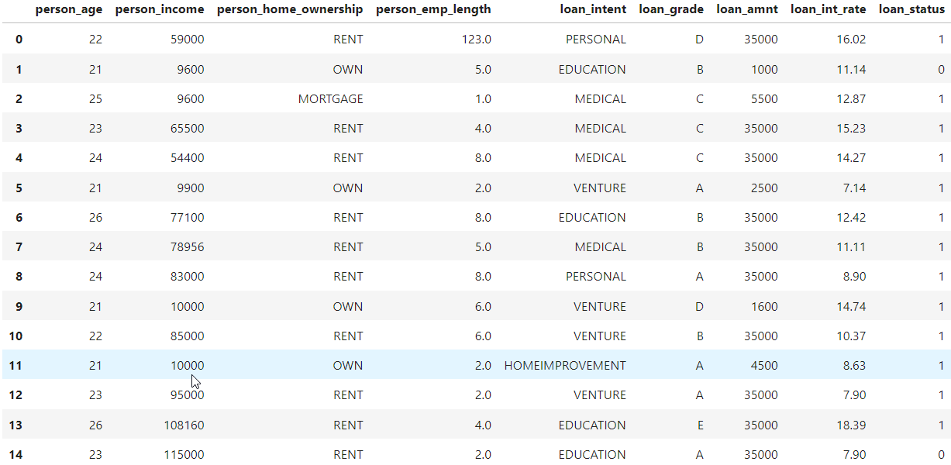
Credit Score Classification Dataset powered with at least 100 records.
Credit Score Classification Dataset
Credit Risk Dataset
Credit Scoring (1000)
Notes:
Credit Score Classification Dataset 164 data rows
Credit Risk Dataset 32k data rows
Credit Scoring 1k data rows
When working with data that contains categorical variables or features, it is essential to use a categorical machine learning model or technique.

Slide 8
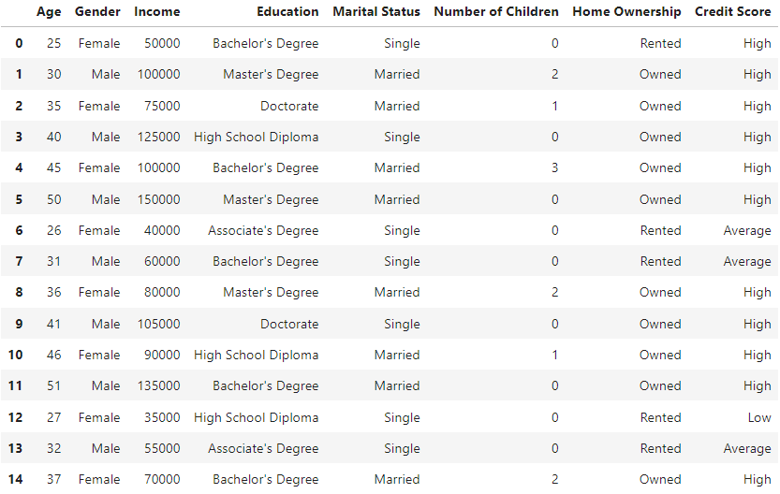
credit_class_df['Credit Score'] = credit_class_df['Credit Score'].apply( lambda x: 2 if x in ['High'] else (1 if x in ['Average'] else 0) )
Data Model Implementation
Notes:
Data Model Implementation
In data analysis, when you have categorical variables (such as "red," "blue," "green" for a color variable), you can't directly use them in many machine learning algorithms because these algorithms require numerical input.
Dummy variables are binary (0 or 1) variables that represent the categories of a categorical variable. Each category is converted into a separate binary column, where 1 indicates the presence of that category and 0 indicates the absence.

Slide 9
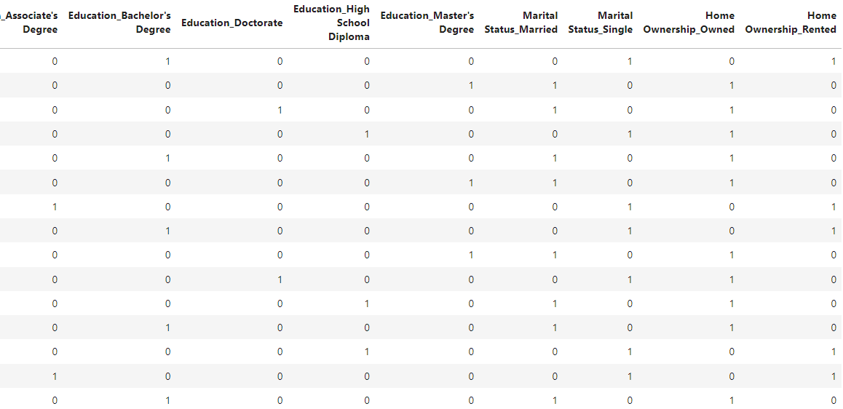
credit_dummies = pd.get_dummies(credit_class_df) credit_dummies.head(15)
Data Model Implementation
Notes:
Data Model Implementation
Data Model Implementation
In data analysis, when you have categorical variables (such as "red," "blue," "green" for a color variable), you can't directly use them in many machine learning algorithms because these algorithms require numerical input.
Dummy variables are binary (0 or 1) variables that represent the categories of a categorical variable. Each category is converted into a separate binary column, where 1 indicates the presence of that category and 0 indicates the absence.

Slide 10
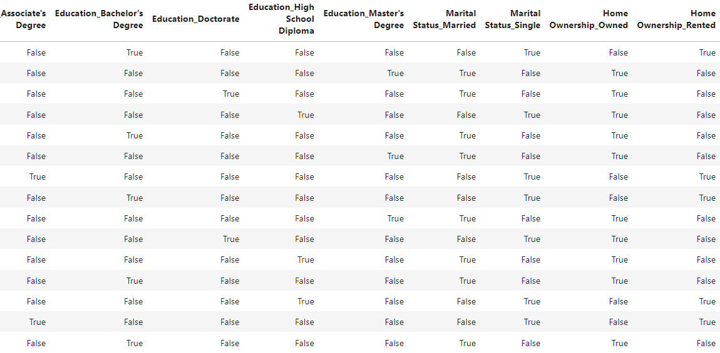
credit_dummies = pd.get_dummies(credit_class_df) credit_dummies.head(15)
Data Model Implementation
Notes:
Data Model Implementation
In data analysis, when you have categorical variables (such as "red," "blue," "green" for a color variable), you can't directly use them in many machine learning algorithms because these algorithms require numerical input.
Dummy variables are binary (0 or 1) variables that represent the categories of a categorical variable. Each category is converted into a separate binary column, where 1 indicates the presence of that category and 0 indicates the absence.

Slide 11
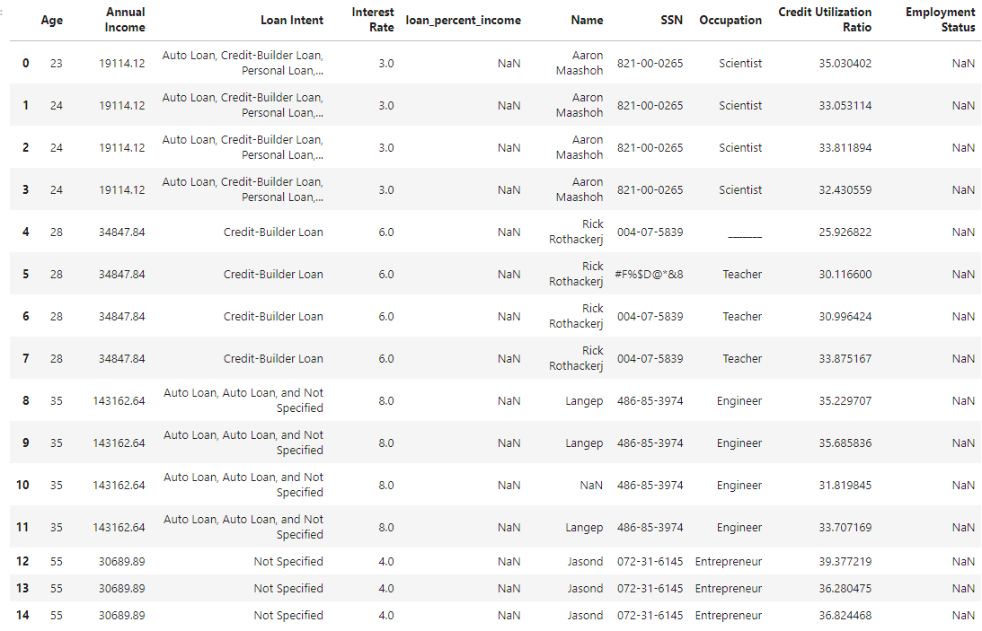
Cleaning data columns and dropping values

Slide 12
Cleaning data columns and dropping values
test_dfc = test_df.drop(columns=['ID','Customer_ID', 'Month','Loan Accounts','Monthly_Inhand_Salary', 'Num_Bank_Accounts', 'Num_Credit_Card', 'Delay_from_due_date','Num_of_Delayed_Payment', 'Changed_Credit_Limit', 'Num_Credit_Inquiries', 'Credit_Mix', 'Outstanding_Debt', 'Credit_History_Age', 'Payment_of_Min_Amount', 'Total_EMI_per_month', 'Amount_invested_monthly', 'Payment_Behaviour', 'Monthly_Balance'])
credit_dfc = credit_df.drop(columns=['person_home_ownership','person_emp_length','loan_grade','loan_amnt','loan_status','cb_person_default_on_file','cb_person_cred_hist_length'])
credit_scoring_dfc = credit_scoring_df.drop(columns=['Gender','Marital Status','Payment History','Number of Credit Accounts','Loan Amount','Loan Term'])

Slide 13
Cleaning data columns and dropping values

Slide 14
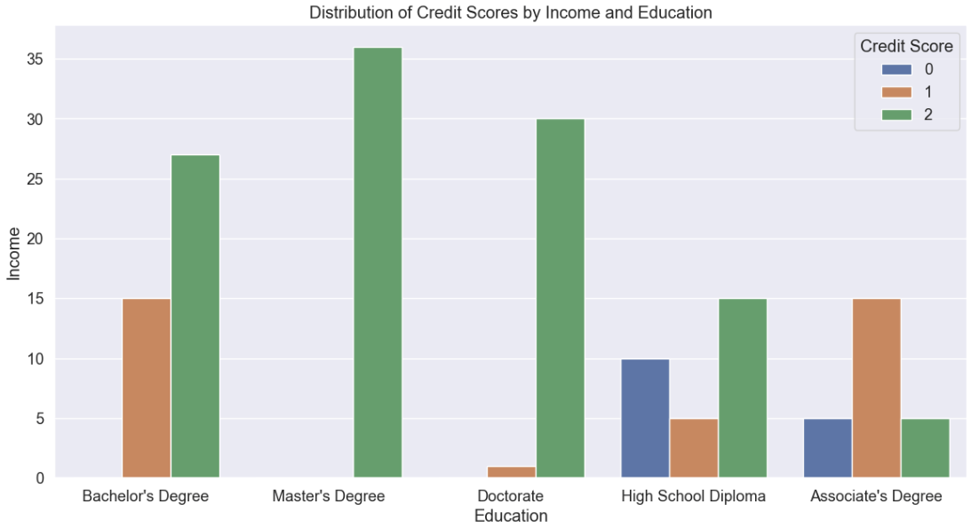
Influence of education on credit scores

Slide 15
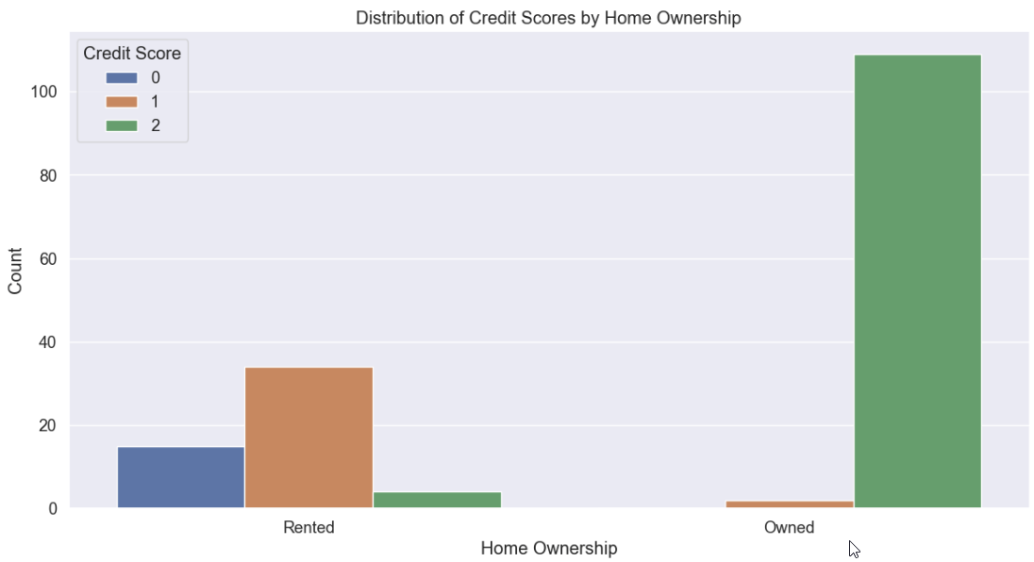
Home ownership influence on credit scores

Slide 16
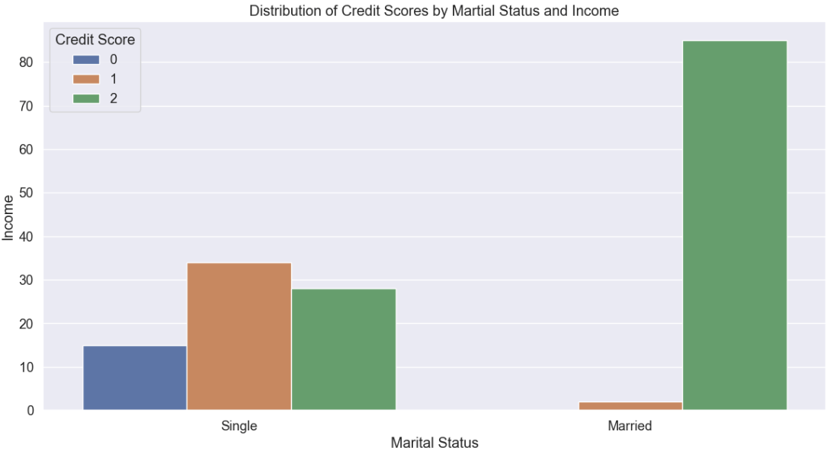
Influence of marital status on credit scores

Slide 17
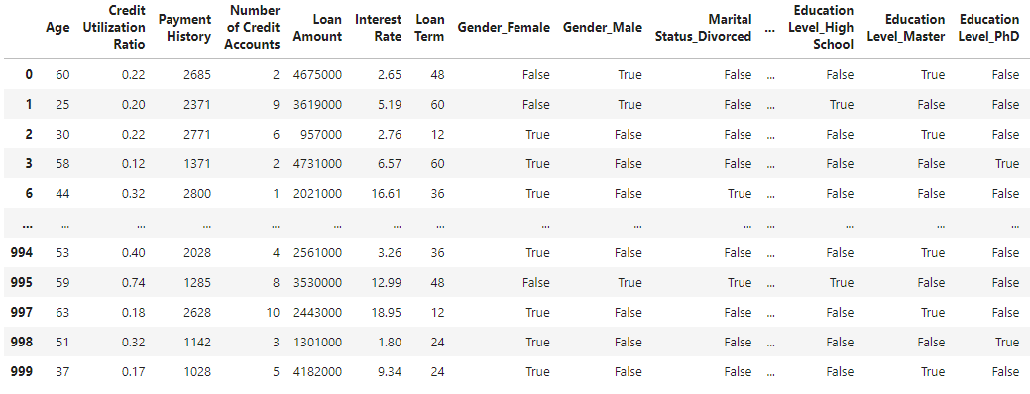
inearRegression()
LinearRegression()
from sklearn.linear_model import LinearRegression
model = LinearRegression()
model.fit(X, y)
LinearRegression()
y_predict = model.predict(X)
df_predicted = filtered_dummies.copy()df_predicted["Ratio predicted"] = y_predictdf_predicted
The r2 is 0.8823944130726918. The mean squared error is 0.04956296825888349.
The root mean squared error is 0.22262742027630714.
y = 0.22262742027630714x + 0.04956296825888349
Notes:
This formula represents a linear relationship between the input variable ( x ) and the predicted output ( y ) based on the given MSE and RMSE values.

Slide 18
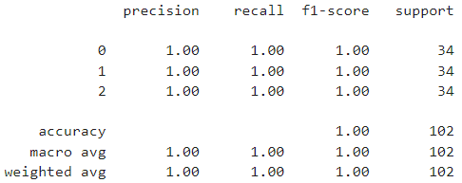

Machine Learning Predictions
cf_test_matrix = confusion_matrix(y_test, y_pred)cf_test_matrix
(classification_report(y_pred,y_test))
Notes:
# An accuracy rate of 1.0 (or 100%) in a confusion matrix means that the model has predicted all instances correctly. In other words, the model has made no mistakes in its predictions when compared to the actual values in the test dataset.
Here's a breakdown of the components of a confusion matrix in the context of accuracy:
True Positives (TP): The number of correct positive predictions.
True Negatives (TN): The number of correct negative predictions.
False Positives (FP): The number of incorrect positive predictions.
False Negatives (FN): The number of incorrect negative predictions.
When the accuracy rate is 1.0, it means that the sum of true positives and true negatives is equal to the total number of instances, indicating that the model has made no errors in its predictions.
Confusion Matrix Explanation:
Confusion Matrix explanation: first row and third row 34 wrongs and none wrong, second row: 33 guesses and predicted 1 wrong

Slide 19
Struggles with Data Conversion
&
Conclusions

