Slide 1
STaTE: Spacecraft-Control-Center Training and Testing Environment
Inc. 2 Sprint 2
Juliana Altamira, Carly Bosma, Jeff Cevallos, Kyle Garber, Jeremy Mog, Jesse Slager, Annamaria Summer
Notes:
Jesse

Slide 2
PROJECT UPDATES
UI Designs were approved by Professor Laskey
Instead of inputs via buttons, the user enters inputs through a command console
Outputs are displayed on an output console and on display panels
EPS Subsystem Complete
TC UI is mostly done, focusing more on FO UI
On track to finish project this semester
Notes:
Jesse

Slide 3
Finalized Subsystem Attributes
ACS: CMG Roll, Pitch, and Yaw (angle range), telemetry transfer (toggle), verify signal status (toggle)
EPS: Standby mode for ACS, EPS, TCS, payload power systems (toggle), solar panel level (charge/dissipate; toggle), telemetry transfer (toggle)
TCS: Cooling and heating functions for Comms: transceiver, antenna, and amplifiers, ACS: CMGs and sensors, Payload camera, and EPS: solar panels and battery temps, telemetry transfer (toggle)
Comms: (TBD)
Payload: Camera Zoom range (0, 50%, 100%), photo capture (toggle)
Notes:
Summer

Slide 4
Subsystem Updates
Notes:
Jeff

Slide 5
EPS Subsystem
EPS stores a dictionary with keys of subsystem names and values of the max power / power used by the corresponding subsystem
EPS distributes and manages power to other subsystems and itself
EPS generate power based on the incident angle of the simcraft and the sun
EPS initializes charging and battery capabilities based on desired simcraft maximum power draw
Notes:
Jeff

Slide 6
Subsystem UI Designs Changes
Notes:
Jules

Slide 7
Communications UI
FO will have panels displaying frequency of the SimCraft Ku-Band antenna and the ground station antenna
Users have the ability to change:
Gain
Frequency
Users will have to verify signal lock with ground station & other subsystems
Users will need to transmit photo to ground (ends simulation if done correctly)
Notes:
Jules

Slide 8
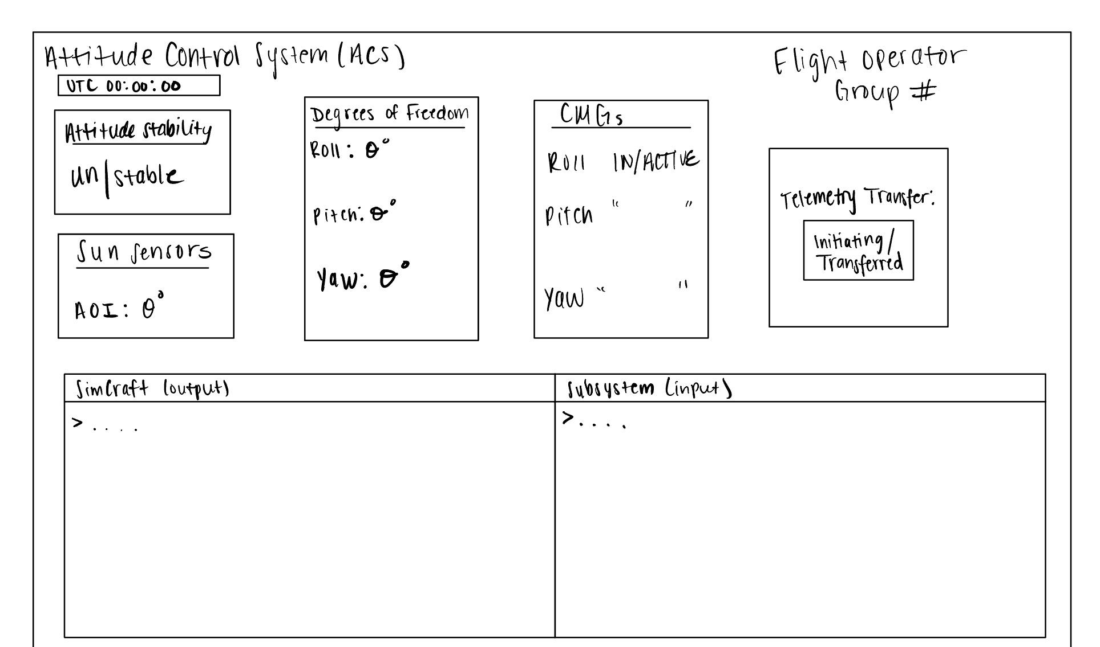
Attitude Control System UI
Notes:
Jules

Slide 9
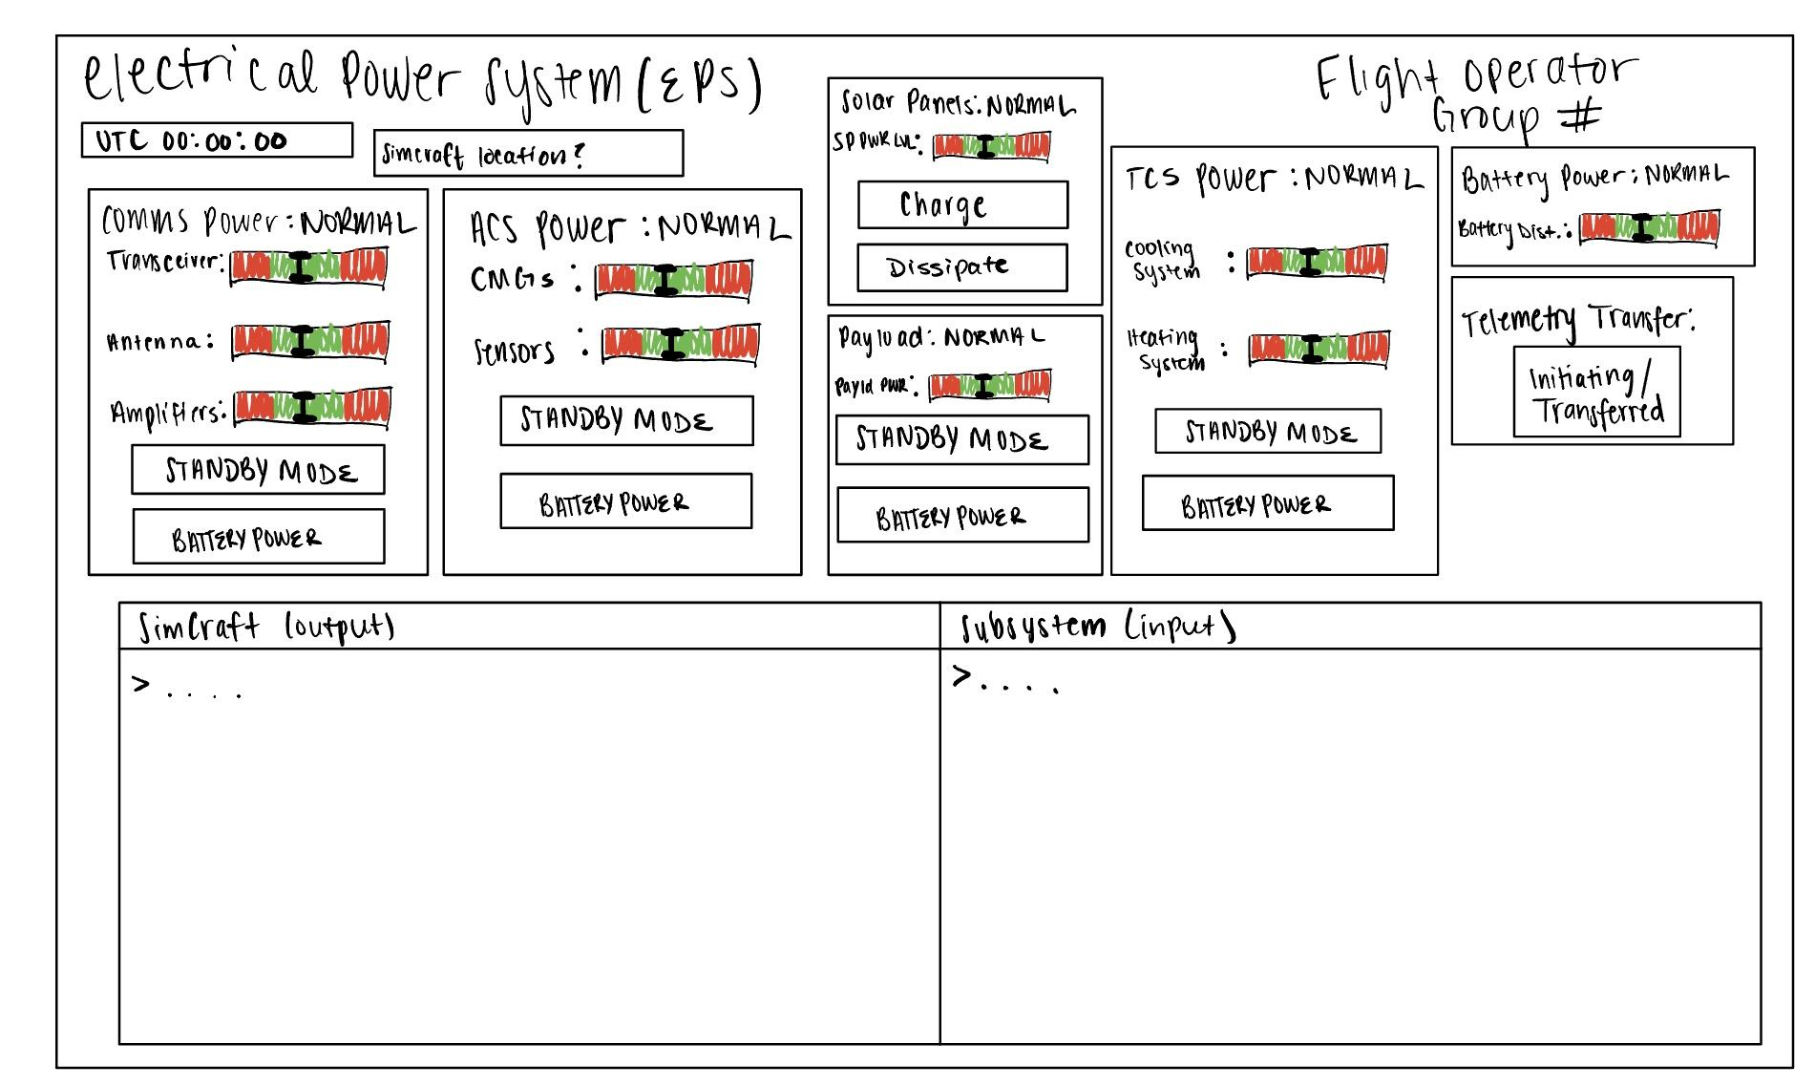
Electrical Power System UI
Notes:
Jules

Slide 10
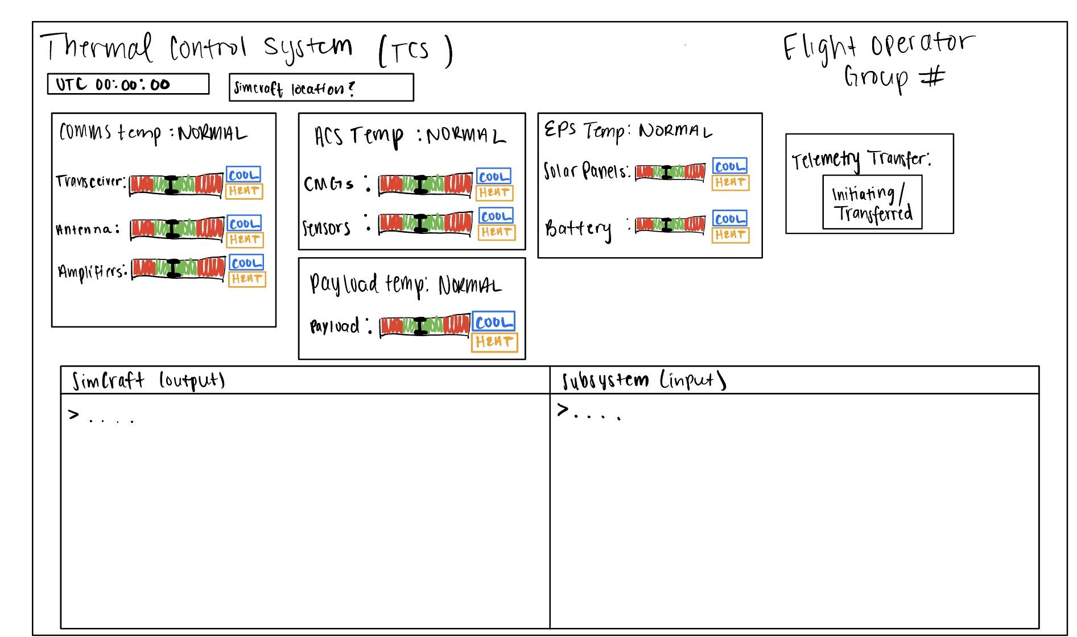
Thermal Control System UI
Notes:
Jules

Slide 11
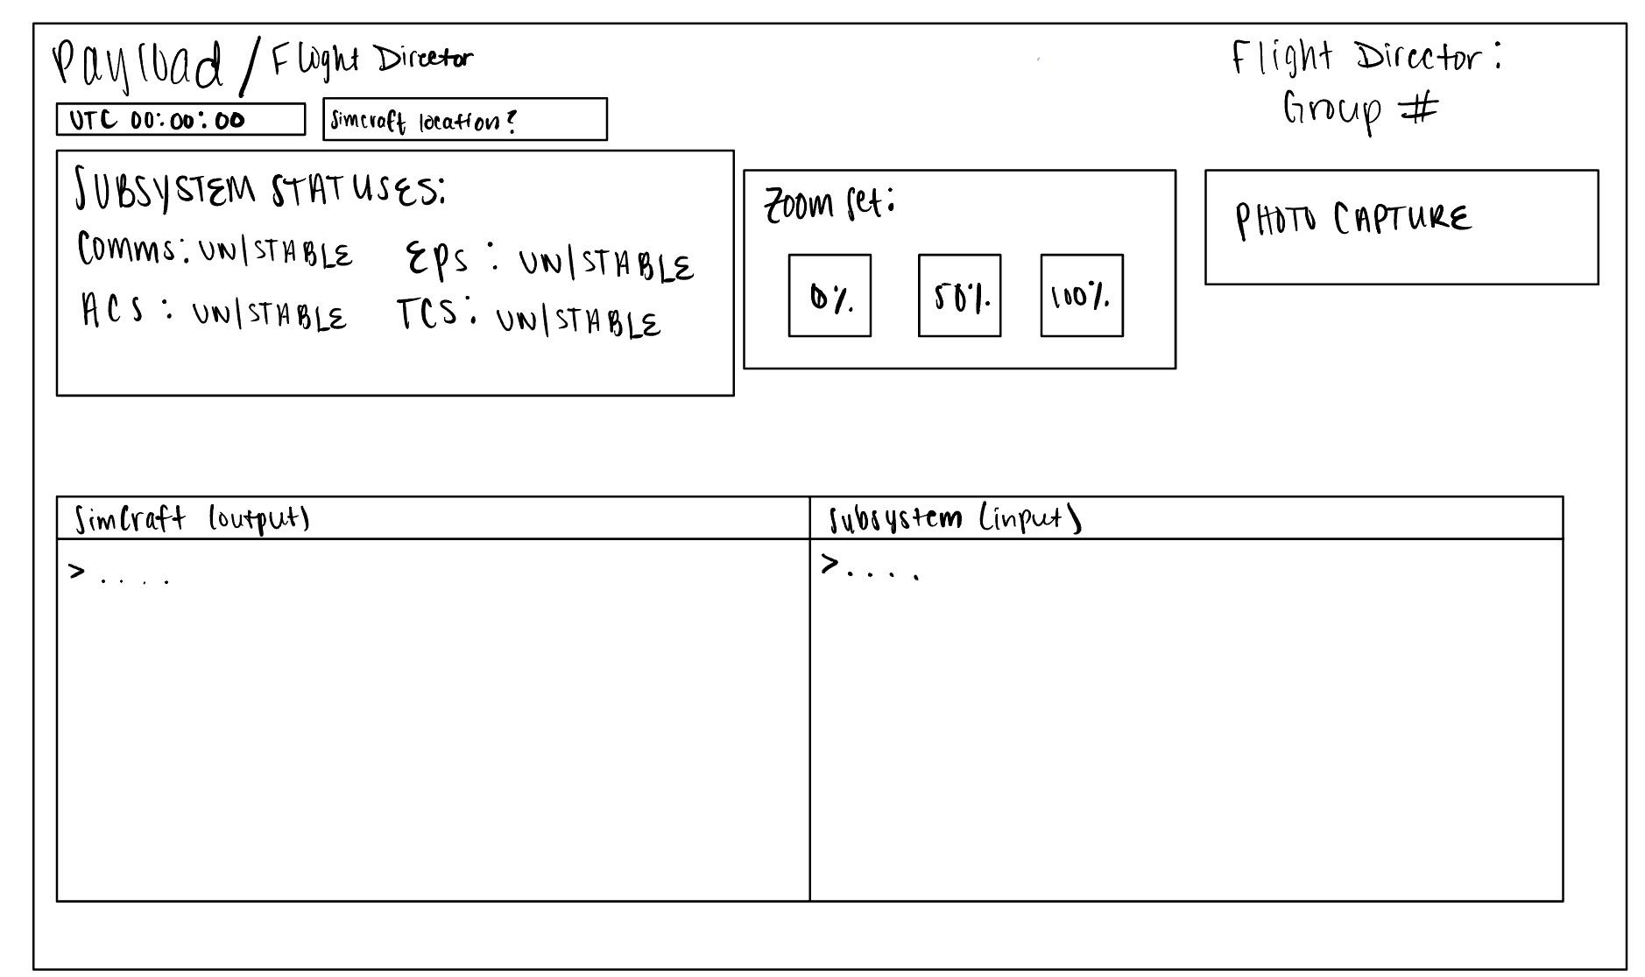
Payload UI
Notes:
Jules

Slide 12
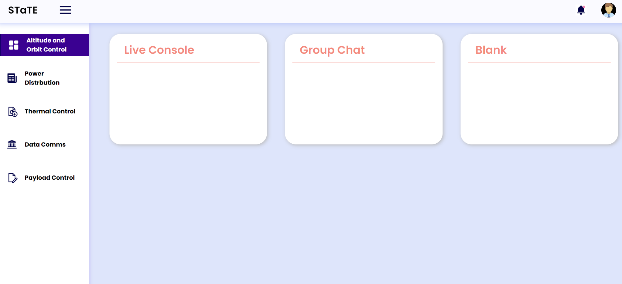
General Design
Notes:
Jules

Slide 13
Web Application Demo
Notes:
Kyle

Slide 14
Looking Forward…to being done
Splitting sprint 3 into two stages
Finishing the project (~4 weeks)
Testing Phase (~2 weeks)
Notes:
Jeremy

Slide 15
ISSUES/EXPECTATIONS
Time Constraints: Verification from customer took longer than expected, just on a strict timeline to complete the project as much as possible
Making the UI design look pretty
Notes:
Jeremy

Slide 16
Questions?
Notes:
Jesse

