Slide 1
Spacecraft-Control-Center
Testing and Training Environment
Team: Juliana Altamira, Carly Bosma, Jeff Cevallos, Kyle Garber, Jeremy Mog, Jesse Slager, Annamaria Summer

Slide 2
STaTE Project Summary
This Project intends to assist in training Flight Operations students on how to operate spacecraft control consoles and participate as an effective member on a spacecraft control team
The project consists of two applications:
A web-based application that allows test conductors and console operators to interface with a spacecraft simulation
A simulation application which creates a continuous spacecraft simulation that can be manipulated by a test conductor and managed by a flight operations team
Throughout the simulation, Flight Operators are presented with off-nominal spacecraft behavior by the Test Conductor and are tasked with correcting it. Their corrective actions are recorded and scored
Notes:
jeff

Slide 3
Benefit to Society
Importance
Help students solve complex issues that may be assigned from a professor
Portable platform that can be used by other universities
Expandable as training or retraining framework for flight operators
Opportunity for global collaboration on spacecraft simulations
Accessible team building activity with no stakes
Closes the gap between classroom lecture and technical field experience
Provides platform that is modifiable and can be updated with current spacecraft control console designs
Notes:
jeef

Slide 4
Design Considerations
Notes:
juuls

Slide 5
Assumptions
Dependencies
Students are knowledgeable regarding the functions of the consoles they are presented with for making adjustments to the simulated spacecraft
Student/instructor has access to a PC (on or off campus)
Student/instructor has access to some sort of internet source (ex. home wifi or campus wifi)
Information regarding possible anomalies and their solutions, which will be provided by the customer
Notes:
jules

Slide 6
General Constraints
Industry Standards Followed
Looking into limitations on webpage
Looking into coding languages that can be embedded/integrated easily with HTML5
Looking into server provided by ERAU IT
Included with a server provided by ERAU is all the constraints and regulations set in place by the IT department
No standard to strictly follow as of right now
Although, the UI is modeled after the real-life equivalents found at NASA command center stations
Notes:
jules

Slide 7
Security Constraints
Security Considerations
Must have account logins
Only allow certain data to be accessed by certain accounts
Protect server access
Protect codes associated with accessing simulations and consoles
Student’s personal information such as names and emails must be protected
Simulation logs should only be accessible by Test Conductor until shared with Flight Operators
Test Conductor Console access must be restricted to only the Test Conductor
Notes:
jules

Slide 8
System Architecture

Slide 9
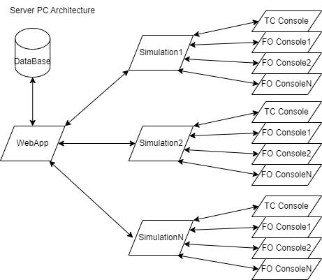
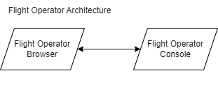
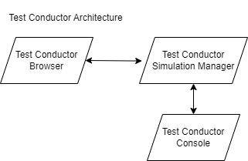
Architectural Diagrams
Notes:
carly

Slide 10
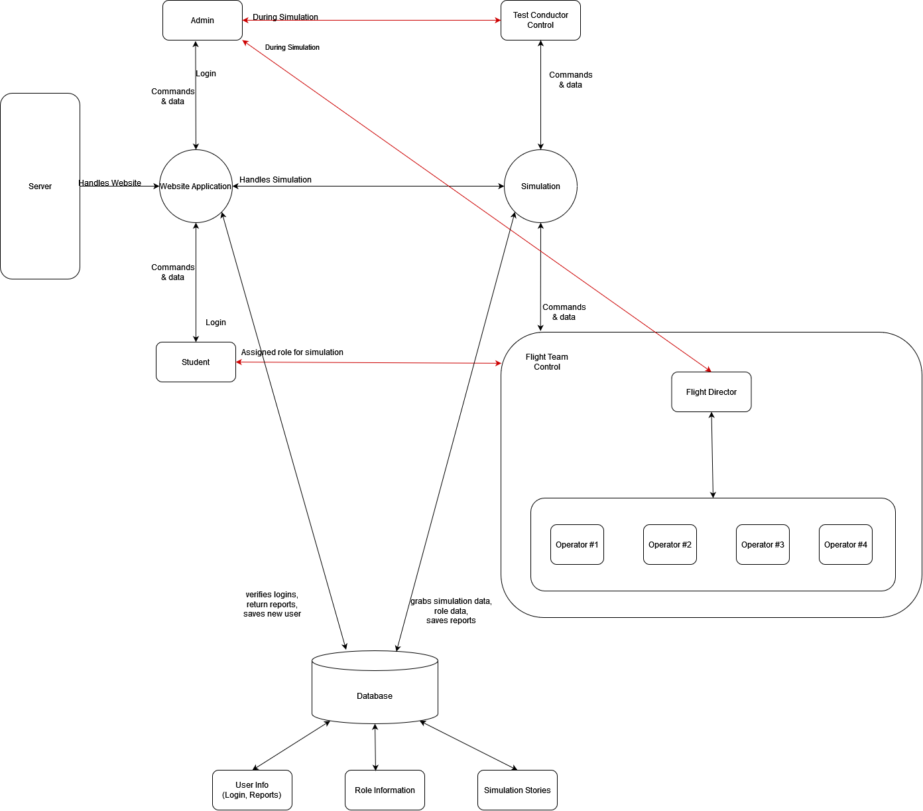
Data-Flow Diagram
Notes:
corky

Slide 11
Software Class Diagrams
Notes:
byle

Slide 12
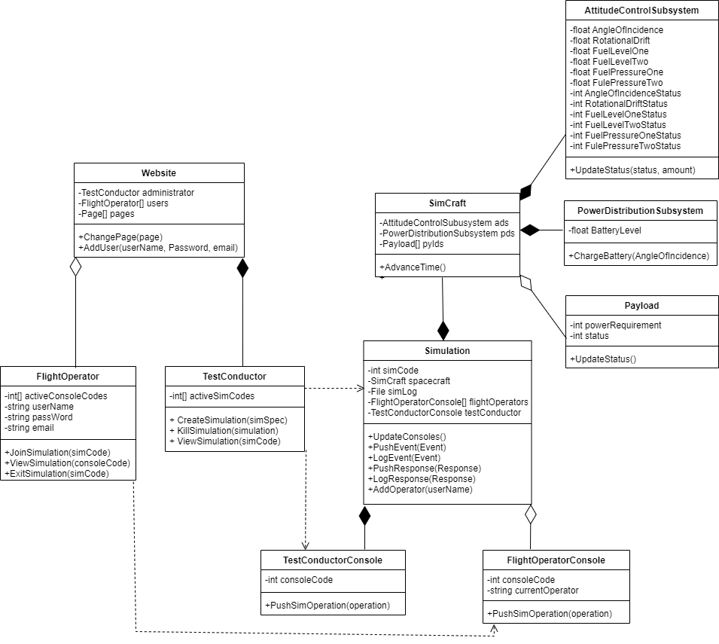
High-Level UML
Notes:
tyle

Slide 13
Hardware Diagrams
Notes:
myle

Slide 14
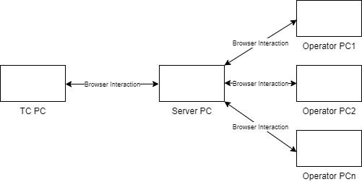
Hardware
Notes:
hyle

Slide 15
Interfaces
A Test Conductor interfaces with a spacecraft simulation through a web-hosted test conductor console
A Test Conductor interfaces with a spacecraft simulation through a web-hosted flight operator console
The web application interfaces with spacecraft simulations locally on the server PC
The web application and spacecraft simulations both interface with a shared database locally on the server PC
Exports
For use in after action reviews:
A spacecraft simulation regularly exports graded logs of test conductor activity
A spacecraft simulation exports logged inter-console communication data
Notes:
jerm

Slide 16
Parts Budget
Server PC candidates at ERAU are readily available once granted by IT and require no additional costs
Web hosting will be done on the server PC
Database hosting will also be done on the server PC
A domain name will need to be purchased before deployment and will require an investment of $2-$10 a year
Test Conductor and Flight Operator PCs will be supplied by users at no additional cost
Notes:
jerm

Slide 17
Accomplishments
Determined purpose and scope of project
Created test project with
User structure
Linked database
Browser-to-browser communications
Created preliminary relationship design
Team on Website
Team on Simulation
http://108.227.182.205:4004/
Sprint 1
Notes:
thumer

Slide 18
Project Timeline
Looking forward for the project:
Sprint 2
Obtain fully defined requirements from product owner & customer
This is the most important item to acquire first before we can continue on with the project
Have some kind of a demo for simulation
Simulation should be able to show continuous updates between the simulated spacecraft and what displays to the user
Fully operational website
Begin integration of website & simulation
Sprint 3
Fully integrated simulation in website
Be able to run multiple users and multiple simulations all running simultaneously
Notes:
thumer

Slide 19
Lesson Learned (so far)
Importance of communication
Taking initiative given vague project requirements and descriptions
High-emphasis on pre-planning and making early system requests
Necessity of having requirements
Notes:
Hessie jussie

Slide 20
Questions?

