Slide 1

Analysis of a bedtime procrastination study
28-06-2018
Students:
Yannick Hogebrug (2626424) Jesse Schouten (2621562)
Business Analytics Course: Project Big data (X_400645)

Slide 2
Today
Introduction
Data description
Results & conclusions
Discussion & questions

Slide 3
Introduction
Bedtime procastination
Delay time
Experimental and control group
Experimental → Lights dim automatically at intended bedtime.

Slide 4
Research questions
“Can bedtime procrastination be significantly influenced by experiment?” “How well can bedtime procrastination be predicted?”

Slide 5
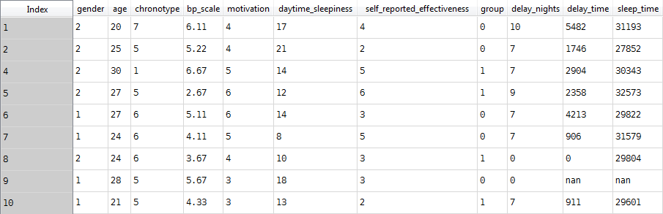
Data description
42 participants described by 11 variables

Slide 6
Some explanation
delay_time: time spent delaying bedtime (bedtime procrastination)
bp_scale: scale to measure level of bedtime procastination
chronotype: morning or evening person (7-point scale)

Slide 7
Results

Slide 8
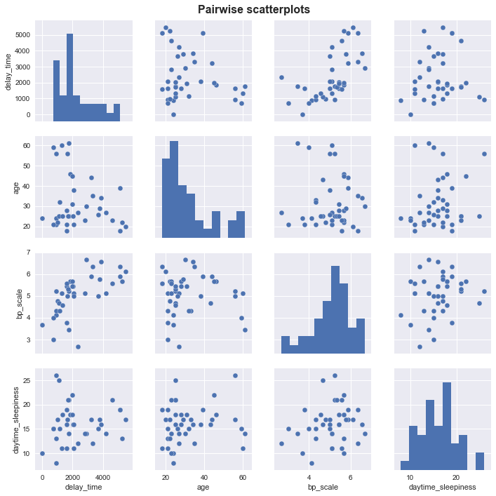
Correlation

Slide 9
Participant groups
Differences tested in:
Delay nights → None
Delay time → Possibly
Sleeptime → None

Slide 10
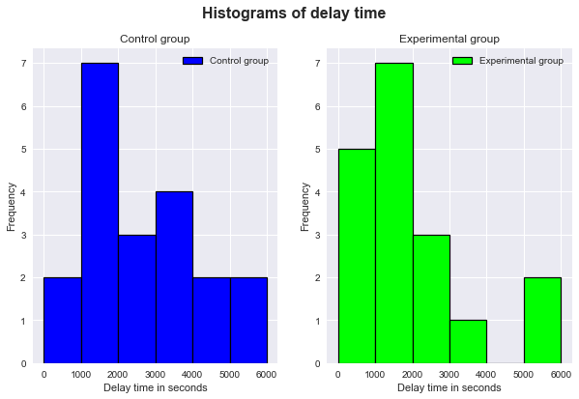
Participant groups

Slide 11
Predicting delay time
High correlation with bp_scale
Possible difference in participant group.
By context: chronotype

Slide 12
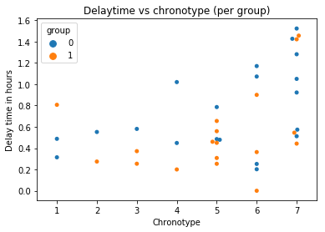

Slide 13
Final model
R-squared: 0.475
Not significantly better to include chronotype and group

Slide 14
Discussion
Small dataset
Missing data
Variables in model chosen based on intuition

Slide 15
Conclusion
No clear difference between participant groups in delay time
No good model for predicting bedtime procrastination was found

Slide 16

Questions

