Slide 1

Analysis of a bedtime procrastination study
28-06-2018
Students:
Yannick Hogebrug (2626424) Jesse Schouten (2621562)
Business Analytics Course: Project Big data (X_400645)

Slide 2
Today
Introduction
Data description
Data exploration
Results/conclusions
Discussion/questions

Slide 3
Introduction
Bedtime procastination
Experimental and control group

Slide 4
Research questions
“Can bedtime procrastination be significantly influenced by experiment?” “How well can bedtime procrastination be predicted?”

Slide 5
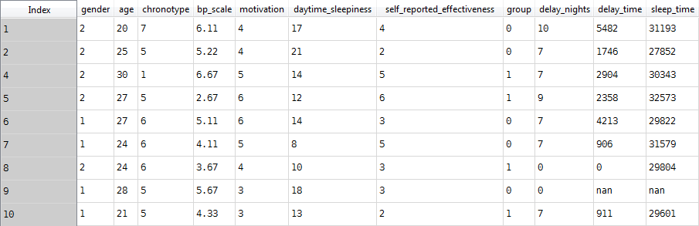
Data description
42 participants described by 11 variables

Slide 7
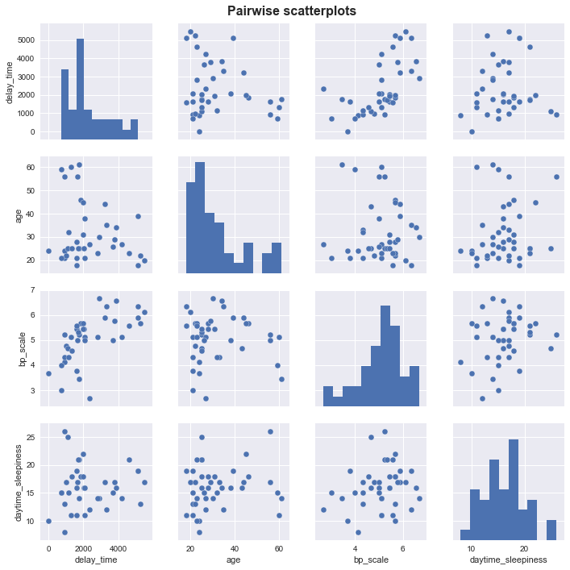
Correlation
Strong correlation between bp_scale and delay time (0.61)

Slide 8
Students:
Yannick Hogebrug (2626424) Jesse Schouten (2621562)
Business Analytics Course: Project Big data (X_400645).

Slide 9
Analysis of a HUE bedtime procastination study
Students:
Yannick Hogebrug (2626424) Jesse Schouten (2621562)
Business Analytics Course: Project Big data (X_400645).

Slide 10
Analysis of a HUE bedtime procastination study
Students:
Yannick Hogebrug (2626424) Jesse Schouten (2621562)
Business Analytics Course: Project Big data (X_400645).

Slide 11
Conclusion
Students:
Yannick Hogebrug (2626424) Jesse Schouten (2621562)
Business Analytics Course: Project Big data (X_400645).

Slide 12

Questions

