Slide 1

Analysis of a bedtime procrastination study
28-06-2018
Students:
Yannick Hogebrug (2626424) Jesse Schouten (2621562)
Business Analytics Course: Project Big data (X_400645)

Slide 2
Today
Introduction
Data description
Results
Discussion & conclusion
Questions

Slide 3
Introduction
Bedtime procrastination study
Many negative consequences of delaying bedtime
Experimental and control group
Experimental → Lights dim automatically at intended bedtime.

Slide 4
Research questions
“Can bedtime procrastination be significantly influenced by experiment?” “How well can bedtime procrastination be predicted?”

Slide 5
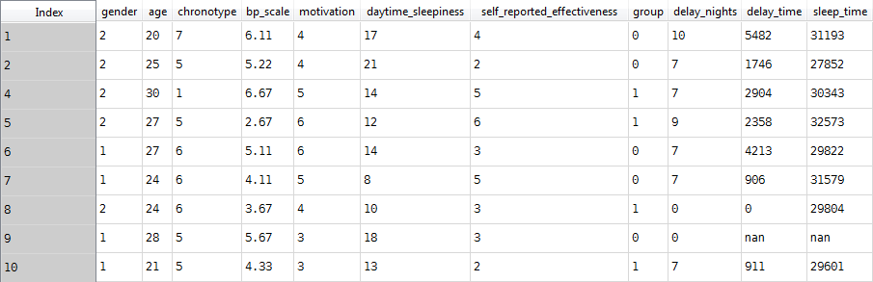
Data description
42 participants described by 11 variables

Slide 6
Some explanation
delay_time: time spent delaying bedtime (bedtime procrastination)
bp_scale: scale to measure level of bedtime procastination
chronotype: morning or evening person (7-point scale)
daytime_sleepiness: extent of sleepiness during the day

Slide 7
Results

Slide 8
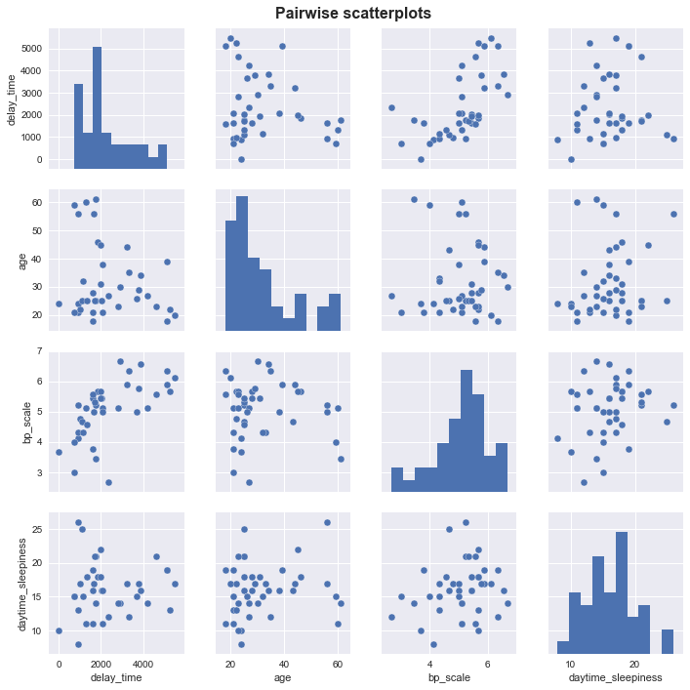
Correlation
0.61

Slide 9
Participant groups
Differences tested in:
Delay nights → No significance (p= 0.74)
Delay time → No significance (p= 0.053), but on verge!
Sleeptime → No significance (p= 0.88)
Wilcoxon rank-sum test was used

Slide 10
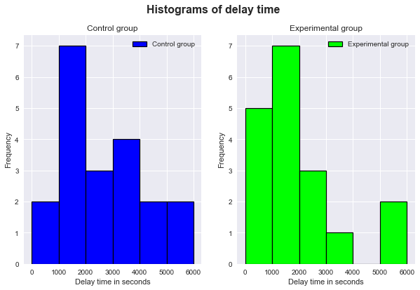
Participant groups

Slide 11
Predicting delay time
Multiple linear regression
High correlation with bp_scale
Possible difference in participant group.
By context: chronotype

Slide 12
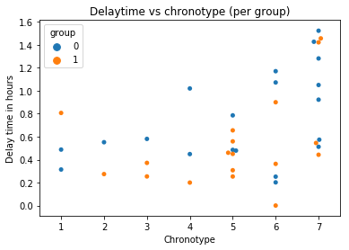

Slide 13
Final model
R-squared: 0.475
Not significantly better to include chronotype and group

Slide 14
Discussion
Small dataset
Variables in prediction model chosen based on intuition

Slide 15
Conclusion
No significant difference between participant groups in delay time
A prediction model with an R-squared of 0.475 was found

Slide 16

Questions

