Slide 1
Coast Guard Challenge
By Fernando Benavidez, Quan Nguyen, Jesse Slaten

Slide 2
Problem Outline
Develop a method to create a randomly generated route for a given circular area.
Every iteration must continue to be random and cover as much of the given area as possible.
Restrictions:
Routes are limited by the distance and fuel capacity of vessels used.

Slide 3
Our Solution Method
Through research, identify areas of math and computer science pertinent to problem.
Investigate said areas for applications, models, and algorithms relating to a possible solution.
Test and manipulate findings in a technical computing environment.
Develop and model a solution based on the knowledge and experienced gained.

Slide 4
Why we investigated Small-world models
Random Graph
Lattice Graph (grid graph)
Random node placement
Characteristically small path lengths
Low clustering
Fixed node position
Highly clustered
Typically long path lengths
- Small-world model provides the best attributes of both graph styles.

Slide 5
Small-World Model
A graph or network which aims to satisfy two properties:
Small average shortest path length
Shortest Path Length - least number of edges traversed between any two random selected nodes
Typical distance log n, n = number of nodes
High Global Clustering Coefficient
Clustering coefficient (C) is between 0 – 1.
C = 1; when graph is a complete graph.
C = 0; when no node has connected neighbors (sort of a linear graph)

Slide 6
Shortest-Path Algorithms
Breadth-First-Search –
Finds shortest path based on purely on distance (edge count).
Algorithm we are currently using
Dijkstra's Algorithm –
Takes edge weight into consideration when computing shortest path.
Otherwise similar to BFS

Slide 7
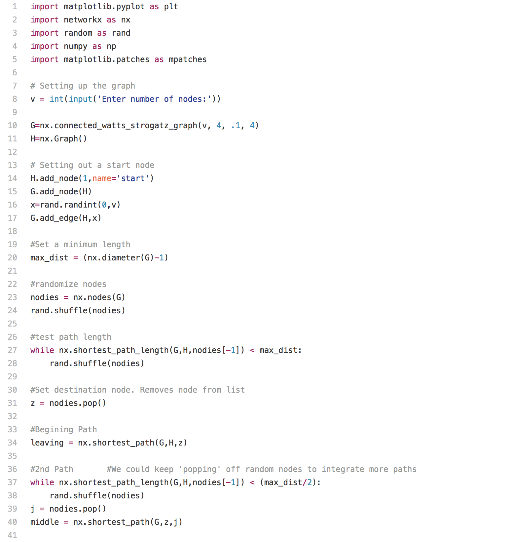
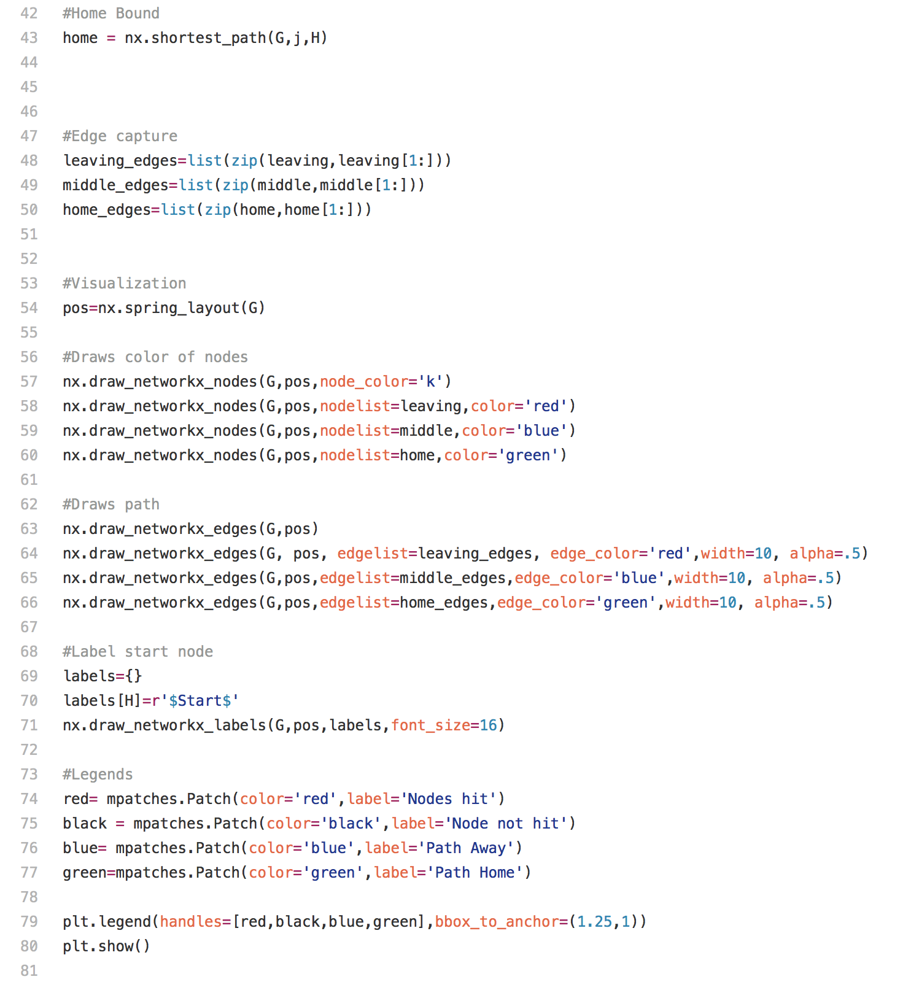

Slide 8
