Slide 1


MAINTAINER TRACK
Volcano for the
Agentic AI Era:
Unified Scheduling Across Training,
Inference, and Agents
Ricardo Aravena · Rainie Li
KubeCon + CloudNativeCon North America 2026
Salt Lake City · November 9–12
Volcano | KubeCon + CloudNativeCon North America 2026
01 / 22
Notes:
0:20。标题保持不变。Agentic AI 作为基础设施背景，不把每次 agent 调用等同于一个 Pod。讲者姓名以用户指示为准。

Slide 2


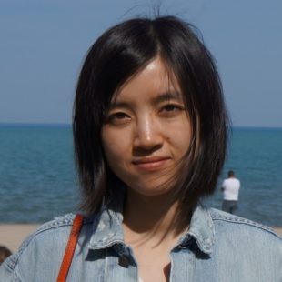
MAINTAINER TRACK
Speakers
Ricardo Aravena
Rainie Li
Cloud Native & AI Infrastructure
Pinterest
Open-source infrastructure
Kubernetes and AI/ML platforms
Data processing infrastructure
Apache YuniKorn PMC member
serverbooter.com
Apache YuniKorn · rainieli
Volcano | KubeCon + CloudNativeCon North America 2026
02 / 22
Notes:
0:40。简介暂依据公开资料；Ricardo 当前公司和正式职务不确定，未填公司。收到讲者偏好后更新文字与头像。照片来自 Linux Foundation 公开讲者页。
https://events.linuxfoundation.org/archive/2026/open-source-summit-north-america/program/program-committee/
https://events.linuxfoundation.org/spinnaker-live/program/featured-speakers/
https://yunikorn.apache.org/community/people/
https://www.linkedin.com/in/rainie-li-71b2b146

Slide 3
UNIFIED SCHEDULING
01
01 Unified scheduling
Unified scheduling
02 Multi-level gang & network topology
03 Ecosystem
04 Benchmark framework & progress
Different paths. Shared infrastructure.
How do schedulers coordinate node access?
Volcano | KubeCon + CloudNativeCon North America 2026
03 / 22
Notes:
0:10。从统一调度框架切入，后面落到工作负载、生态和验证。

Slide 4
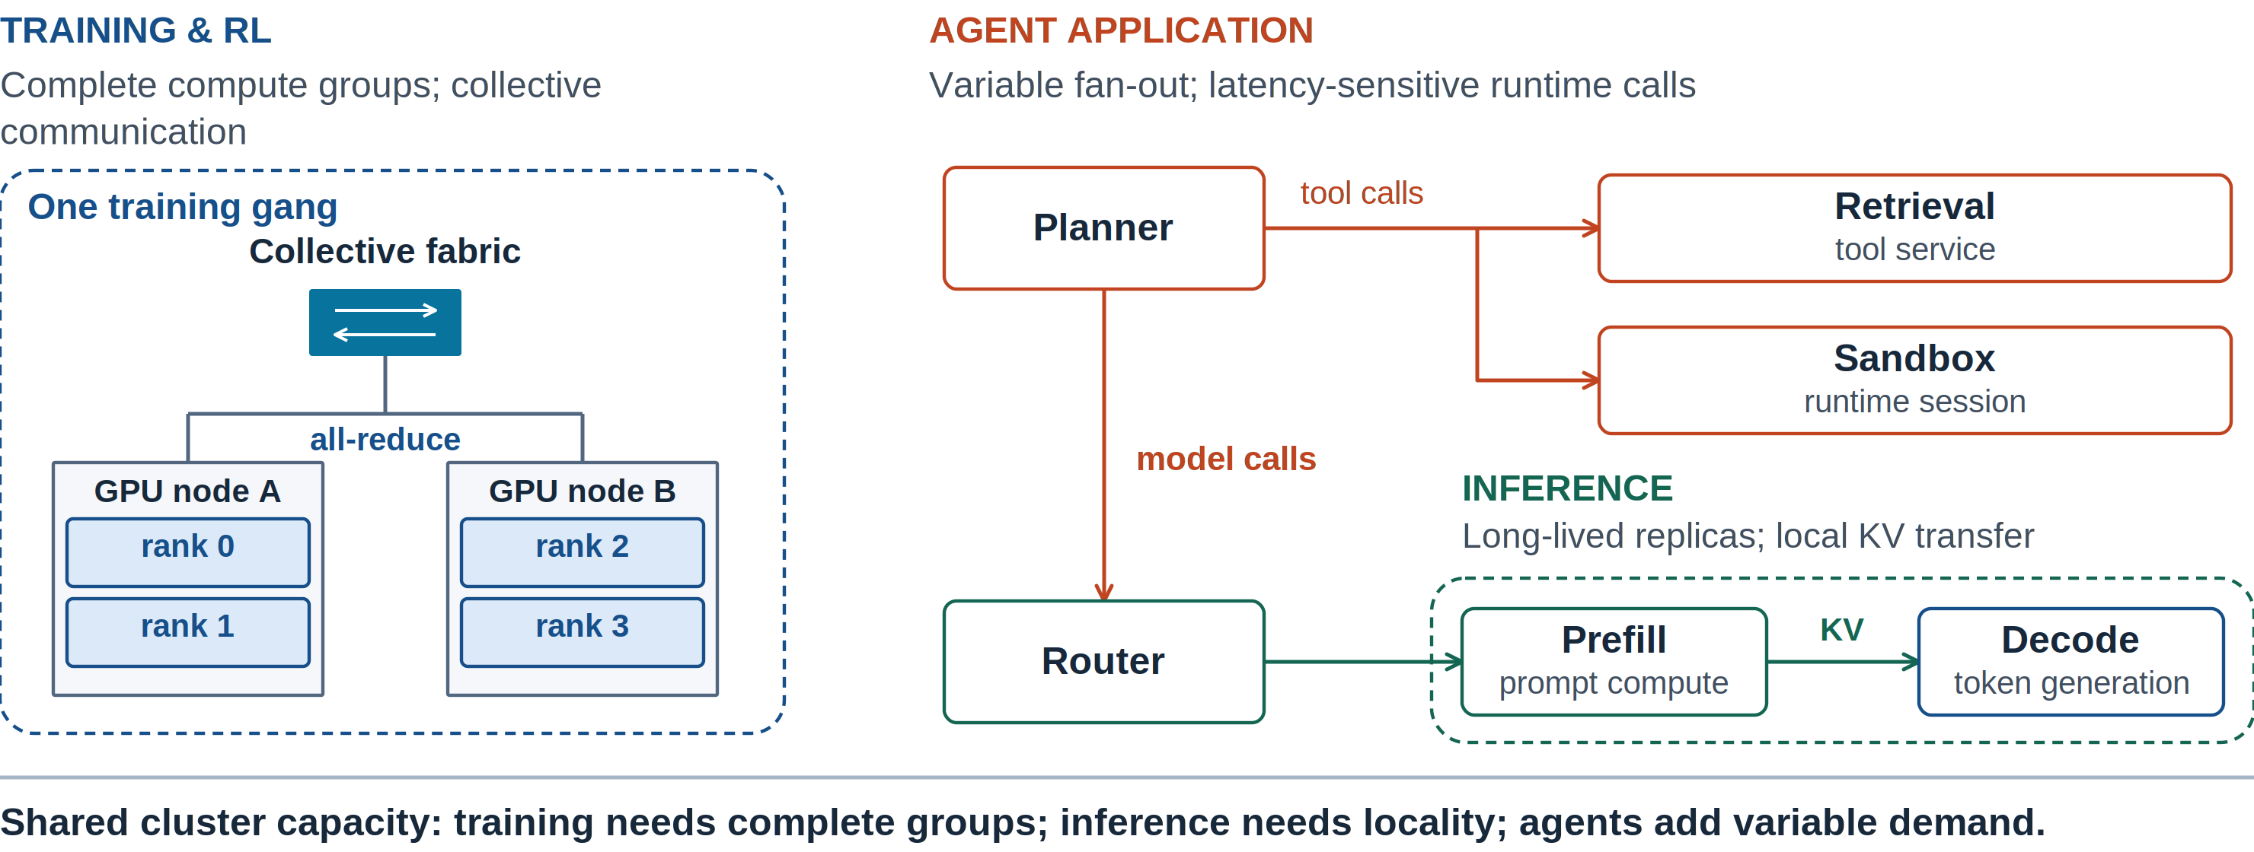
UNIFIED SCHEDULING
Different Workloads, Shared Infrastructure
Training, inference, and agent applications put different demands on the same cluster.
Volcano | KubeCon + CloudNativeCon North America 2026
04 / 22
Notes:
1:00。先讲共同的基础设施需求：训练/RL 更强调协同计算，推理有角色与副本结构，agent 业务带来突发和延迟压力。并非每次 agent 调用都要创建一个 Pod。
技术来源：
本页新版素材与说明：
Visual: na2026/svg/04-workload-demands.svg。PNG 固定几何；复用的旧图原本为位图，新增 YAML 和注释为 SVG 文本。

Slide 5
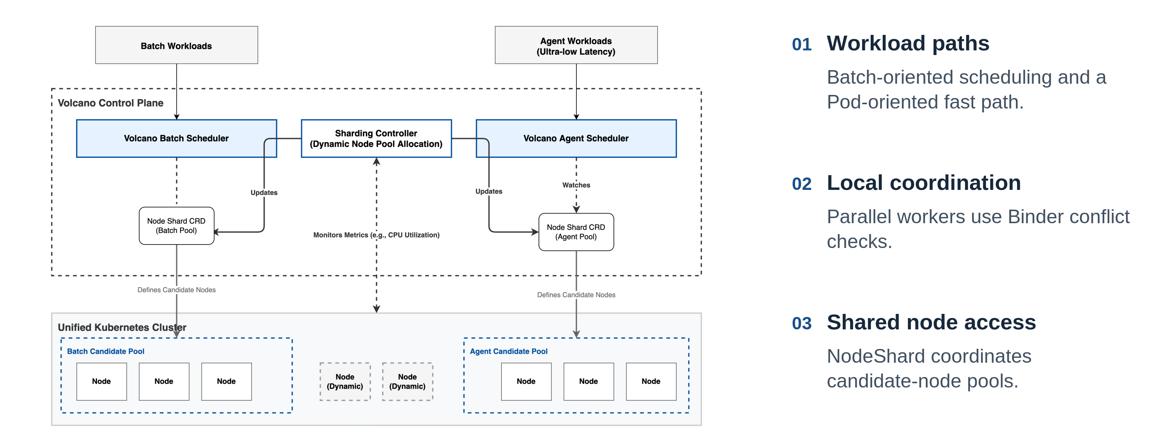
UNIFIED SCHEDULING
A Coordinated Scheduling Framework
Specialized scheduling paths coordinate through NodeShard.
Volcano | KubeCon + CloudNativeCon North America 2026
05 / 22
Notes:
1:30。复用 China 架构图，从左右两条路径讲到中间 NodeShard。worker/Binder 的冲突检查是局部机制；不宣称并行一定带来性能提升。
技术来源：
https://github.com/volcano-sh/volcano/blob/v1.16.0/docs/design/agent-scheduler.md
本页新版素材与说明：China 2026 slide 7; same architecture family as EU 2026.
Visual: na2026/svg/05-unified-architecture.svg。PNG 固定几何；复用的旧图原本为位图，新增 YAML 和注释为 SVG 文本。

Slide 6
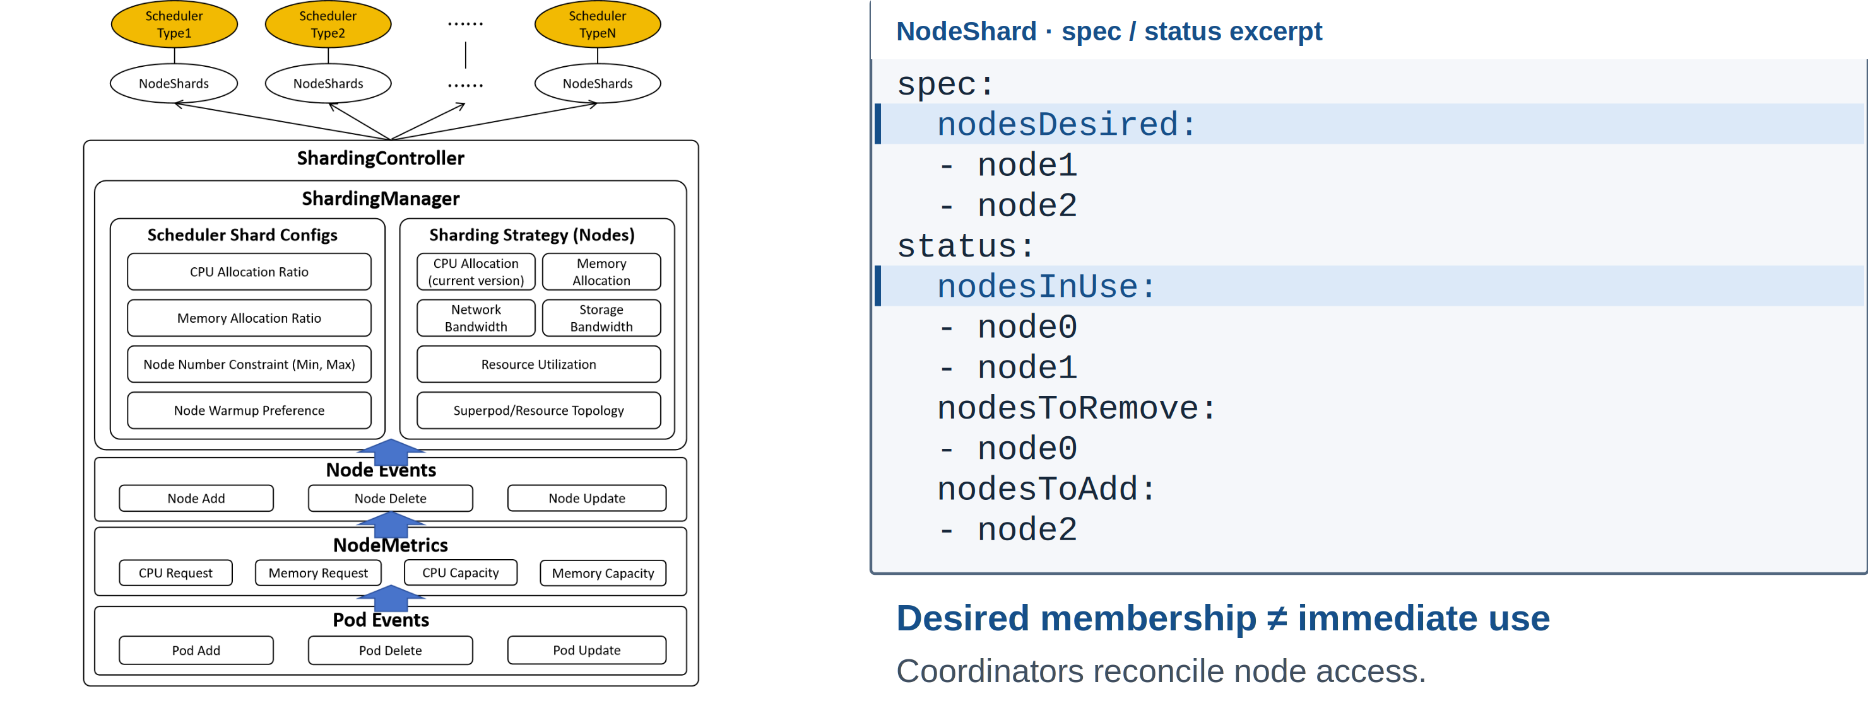
UNIFIED SCHEDULING
NodeShard: Desired Nodes and Current Use
Changing a shard coordinates future placement; it does not migrate running Pods.
Volcano | KubeCon + CloudNativeCon North America 2026
06 / 22
Notes:
1:40。重点对照 nodesDesired 和 nodesInUse。期望集合变化后需等待协调器交接，不迁移运行中的 Pod。旧图中的资源策略是架构扩展点，不表示所有策略都已完成。
技术来源：
https://github.com/volcano-sh/volcano/blob/v1.16.0/docs/design/agent-scheduler.md
本页新版素材与说明：China 2026 slide 9; docs/design/agent-scheduler.md; shard API types.
Visual: na2026/svg/06-nodeshard.svg。PNG 固定几何；复用的旧图原本为位图，新增 YAML 和注释为 SVG 文本。

Slide 7
MULTI-LEVEL GANG & NETWORK TOPOLOGY
02
01 Unified scheduling
Multi-level gang
& network topology
02 Multi-level gang & network topology
03 Ecosystem
04 Benchmark framework & progress
From available nodes to runnable workloads.
What must run together, and where should it fit?
Volcano | KubeCon + CloudNativeCon North America 2026
07 / 22
Notes:
0:15。转场：拿到可用节点之后，还要保留完整副本以及它们的通信局部性。

Slide 8
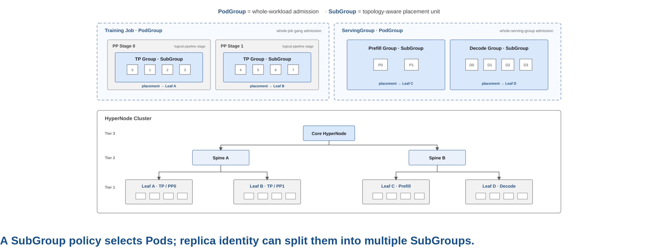
MULTI-LEVEL GANG & NETWORK TOPOLOGY
PodGroup and SubGroup: Preserve Workload Structure
Gang requirements apply to the workload and to its complete subgroups.
Volcano | KubeCon + CloudNativeCon North America 2026
08 / 22
Notes:
2:00。用左边训练和右边 serving 两种结构解释 PodGroup 与 SubGroup，先看完整计算组，再看下面的放置域。一个 policy 可以按 replica label 分出多个实际 SubGroup。
技术来源：
https://github.com/volcano-sh/kthena/blob/main/docs/kthena/versioned_docs/version-v1.0.0/user-guide/gang-scheduling.md
本页新版素材与说明：China 2026 slide 14. Figure reused unchanged.
Visual: na2026/svg/08-group-structure.svg。PNG 固定几何；复用的旧图原本为位图，新增 YAML 和注释为 SVG 文本。

Slide 9
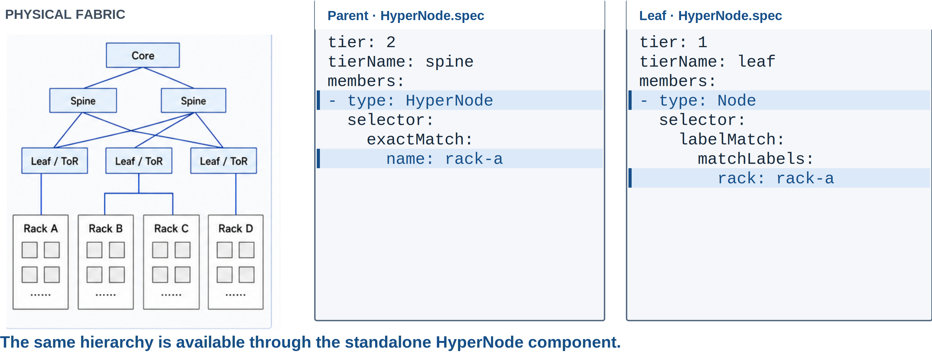
MULTI-LEVEL GANG & NETWORK TOPOLOGY
HyperNode: From Physical Fabric to Scheduling Domains
A parent HyperNode groups child HyperNodes; a leaf groups Kubernetes Nodes.
Volcano | KubeCon + CloudNativeCon North America 2026
09 / 22
Notes:
1:30。从物理网络映射到 HyperNode：非叶节点的成员是 HyperNode，叶节点的成员是 Node。standalone HyperNode 已交付；其他调度器 adapter 是独立的集成工作。
技术来源：
https://github.com/volcano-sh/kthena/blob/main/docs/kthena/versioned_docs/version-v1.0.0/user-guide/network-topology.md
https://github.com/volcano-sh/volcano/releases/tag/v1.16.0
本页新版素材与说明：China 2026 slide 16 (physical fabric); benchmark/scripts/create-hypernodes.sh.
Visual: na2026/svg/09-hypernode-api.svg。PNG 固定几何；复用的旧图原本为位图，新增 YAML 和注释为 SVG 文本。

Slide 10
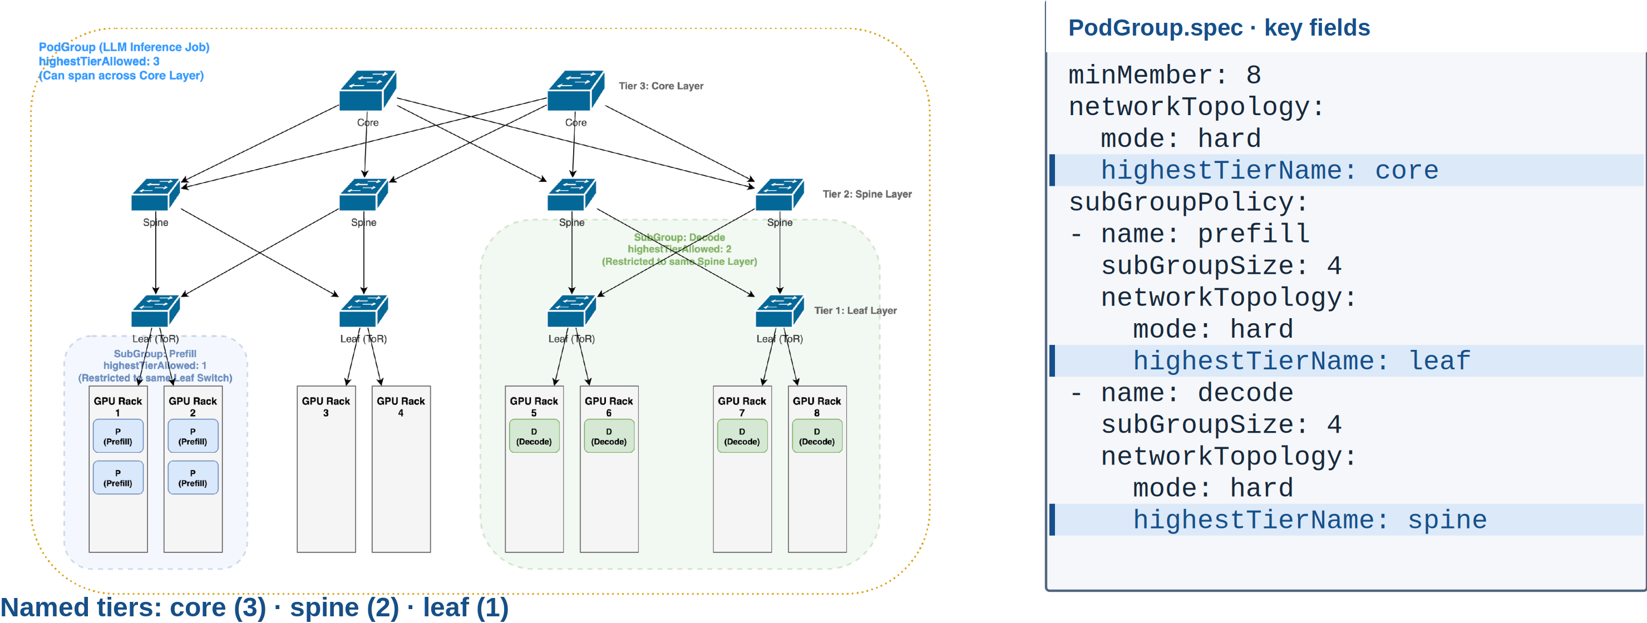
MULTI-LEVEL GANG & NETWORK TOPOLOGY
Place Groups at Different Topology Levels
An eight-Pod instance spans a larger domain; Prefill and Decode use different locality constraints.
Volcano | KubeCon + CloudNativeCon North America 2026
10 / 22
Notes:
2:00。PodGroup 是较大的实例边界，prefill 和 decode 的 locality 约束可以不同。两层约束都显式填写，不假设子组继承 PodGroup 的 topology。
技术来源：
https://github.com/volcano-sh/kthena/blob/main/docs/kthena/versioned_docs/version-v1.0.0/user-guide/network-topology.md
本页新版素材与说明：EU 2026 slide 16 / China 2026 slide 17; PodGroup API. Selector and Decode fragment below are explanatory excerpts.
图例使用两个固定角色组，各4 Pods。spec 片段省略 labelSelector；实际使用时给两个 policy 配置匹配各自角色的 Pod selector。不是可直接 apply 的完整 manifest。
Visual: na2026/svg/10-multilevel-placement.svg。PNG 固定几何；复用的旧图原本为位图，新增 YAML 和注释为 SVG 文本。

Slide 11
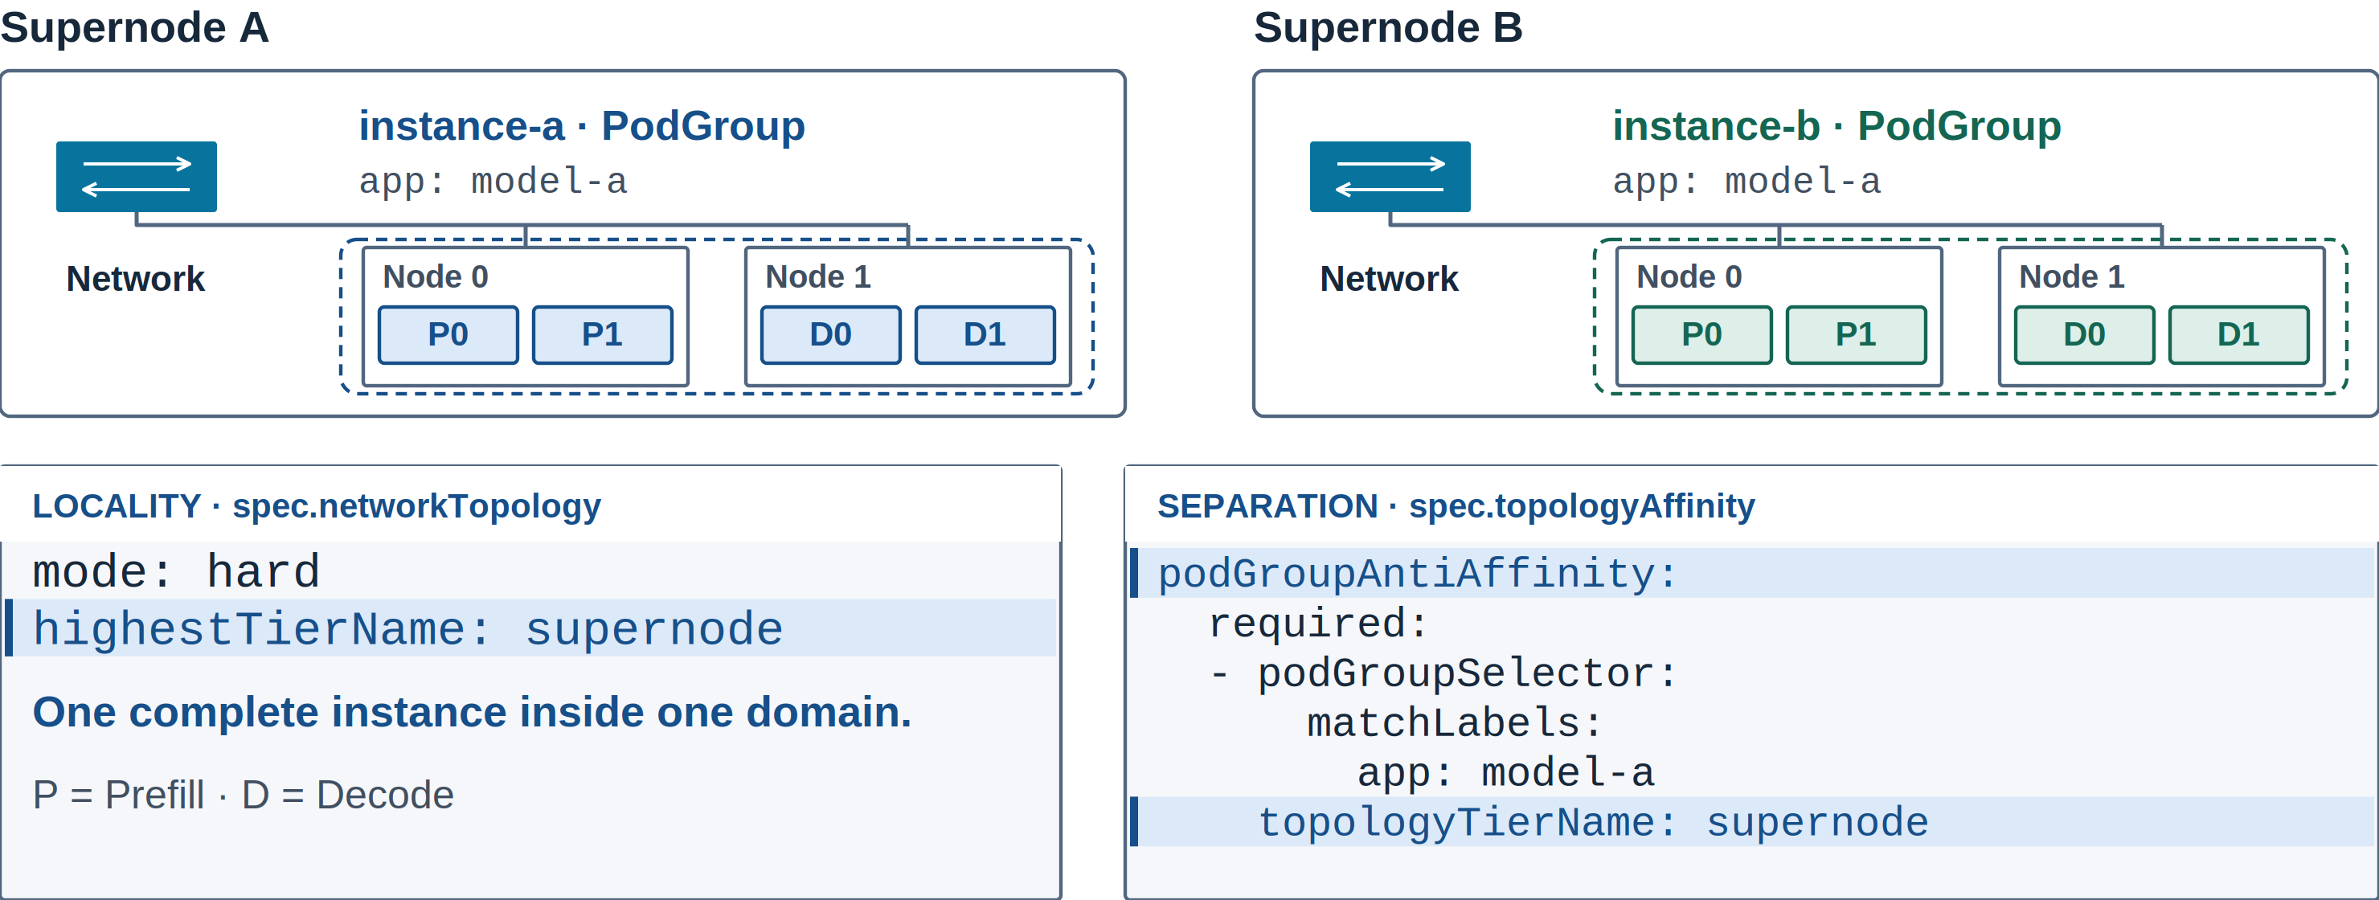
MULTI-LEVEL GANG & NETWORK TOPOLOGY
Keep Each Instance Together, Place Instances Apart
PodGroup anti-affinity separates service instances across HyperNode domains.
Volcano | KubeCon + CloudNativeCon North America 2026
11 / 22
Notes:
1:40。先让每个实例聚拢，再用 PodGroup anti-affinity 将两个实例分开。required 和 preferred 的差别是没有理想域时是否允许回退。
技术来源：
https://github.com/volcano-sh/volcano/blob/v1.16.0/docs/user-guide/how_to_use_podgroup_anti_affinity.md
https://github.com/volcano-sh/volcano/pull/5349
本页新版素材与说明：docs/user-guide/how_to_use_podgroup_anti_affinity.md; group-topology-affinity plugin, v1.16.
启用 group-topology-affinity 与 network-topology-aware；每个 PodGroup 配置相同分离规则。selector 匹配 PodGroup 标签，默认同 namespace。
Visual: na2026/svg/11-instance-isolation.svg。PNG 固定几何；复用的旧图原本为位图，新增 YAML 和注释为 SVG 文本。

Slide 12
ECOSYSTEM
03
01 Unified scheduling
Ecosystem
02 Multi-level gang & network topology
03 Ecosystem
04 Benchmark framework & progress
Workload controllers carry scheduling intent.
How do roles and replicas reach the scheduler?
Volcano | KubeCon + CloudNativeCon North America 2026
12 / 22
Notes:
0:10。转场：这些分组和拓扑语义，最终要由用户真正使用的 controller 传进来。

Slide 13
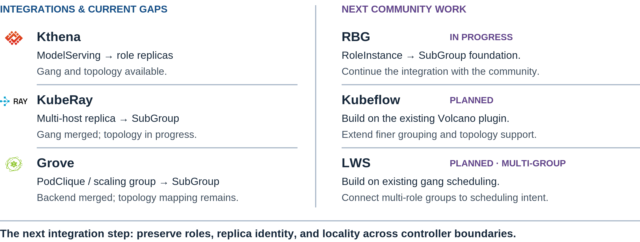
ECOSYSTEM
Controllers Bring Workload Structure to Scheduling
Existing integrations and the next steps in role, replica, and topology support.
Volcano | KubeCon + CloudNativeCon North America 2026
13 / 22
Notes:
1:15。左侧讲 Kthena、KubeRay、Grove 的已交付能力及拓扑差距。右侧讲社区后续工作：RBG 正在推进，Kubeflow 计划深化，LWS 推进 multi-group 调度支持。RBG 已有 gang/SubGroup 映射文档，Kubeflow 与 LWS 已有基础接入，不从零开始。后续方向来自 maintainer 计划，不表示已交付。
技术来源：
https://github.com/volcano-sh/kthena/blob/main/docs/kthena/versioned_docs/version-v1.0.0/user-guide/gang-scheduling.md
https://github.com/volcano-sh/kthena/blob/main/docs/kthena/versioned_docs/version-v1.0.0/user-guide/network-topology.md
https://github.com/kuberay-project/kuberay/pull/5249
https://github.com/kuberay-project/kuberay/pull/5369
https://github.com/ai-dynamo/grove/pull/516
https://trainer.kubeflow.org/en/latest/operator-guides/job-scheduling/volcano.html
https://github.com/kubernetes-sigs/lws/pull/498
https://github.com/sgl-project/rbg/blob/main/doc/features/gang-scheduling.md
https://github.com/kubernetes-sigs/lws/blob/main/README.md
本页新版素材与说明：Kthena docs; KubeRay #5249 / #5369; Grove #516; RBG gang-scheduling docs; Kubeflow Trainer Volcano plugin; LWS README / DisaggregatedSet. Roadmap intent supplied by maintainers.
https://github.com/sgl-project/rbg/blob/main/doc/features/gang-scheduling.md
https://github.com/kubernetes-sigs/lws/blob/main/README.md
右侧为 maintainer 提供的推进方向；RBG 公开文档已有 RoleInstance→SubGroup 基础。LWS 已有副本组，下一步是跨角色 multi-group 调度集成。
Visual: na2026/svg/13-ecosystem.svg。PNG 固定几何；复用的旧图原本为位图，新增 YAML 和注释为 SVG 文本。

Slide 14
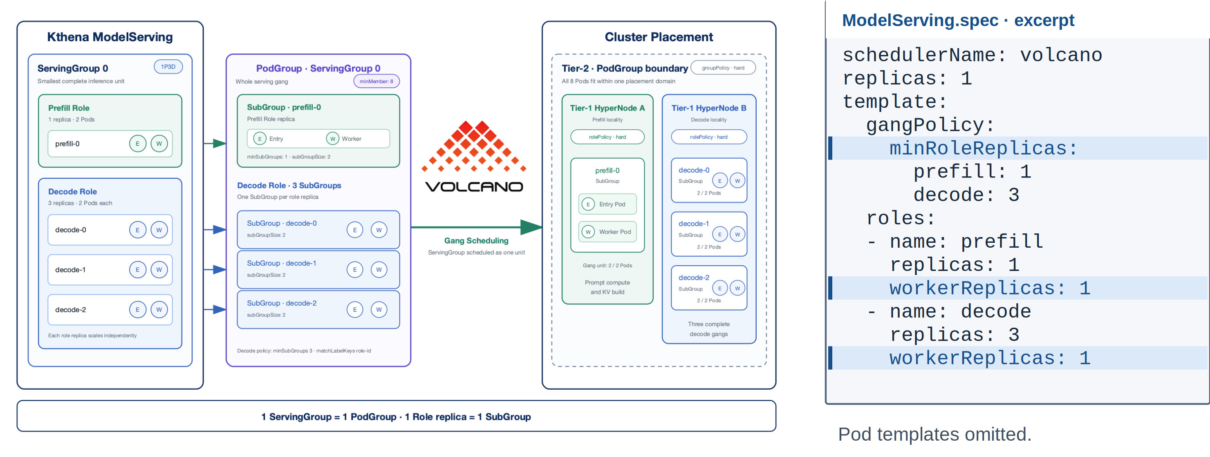
ECOSYSTEM
Kthena: From Serving Roles to Scheduling Groups
One ServingGroup maps to one PodGroup; each role replica forms a SubGroup.
Volcano | KubeCon + CloudNativeCon North America 2026
14 / 22
Notes:
1:40。沿用 China Kthena 图及关键 YAML，按 ServingGroup→PodGroup、role replica→SubGroup 的顺序讲。一个 Entry 加一个 Worker 组成两 Pod 副本。
技术来源：
https://github.com/volcano-sh/kthena/blob/main/docs/kthena/versioned_docs/version-v1.0.0/user-guide/gang-scheduling.md
本页新版素材与说明：China 2026 slide 22; Kthena ModelServing gang scheduling guide.
图中每个 role replica 有一个 Entry 和一个 Worker Pod；YAML 保留 gangPolicy、role 副本数与 workerReplicas，省略 entryTemplate、workerTemplate 与 networkTopology。Gang 不表示所有 Pod 原子绑定或同时启动。
Visual: na2026/svg/14-kthena-mapping.svg。PNG 固定几何；复用的旧图原本为位图，新增 YAML 和注释为 SVG 文本。

Slide 15
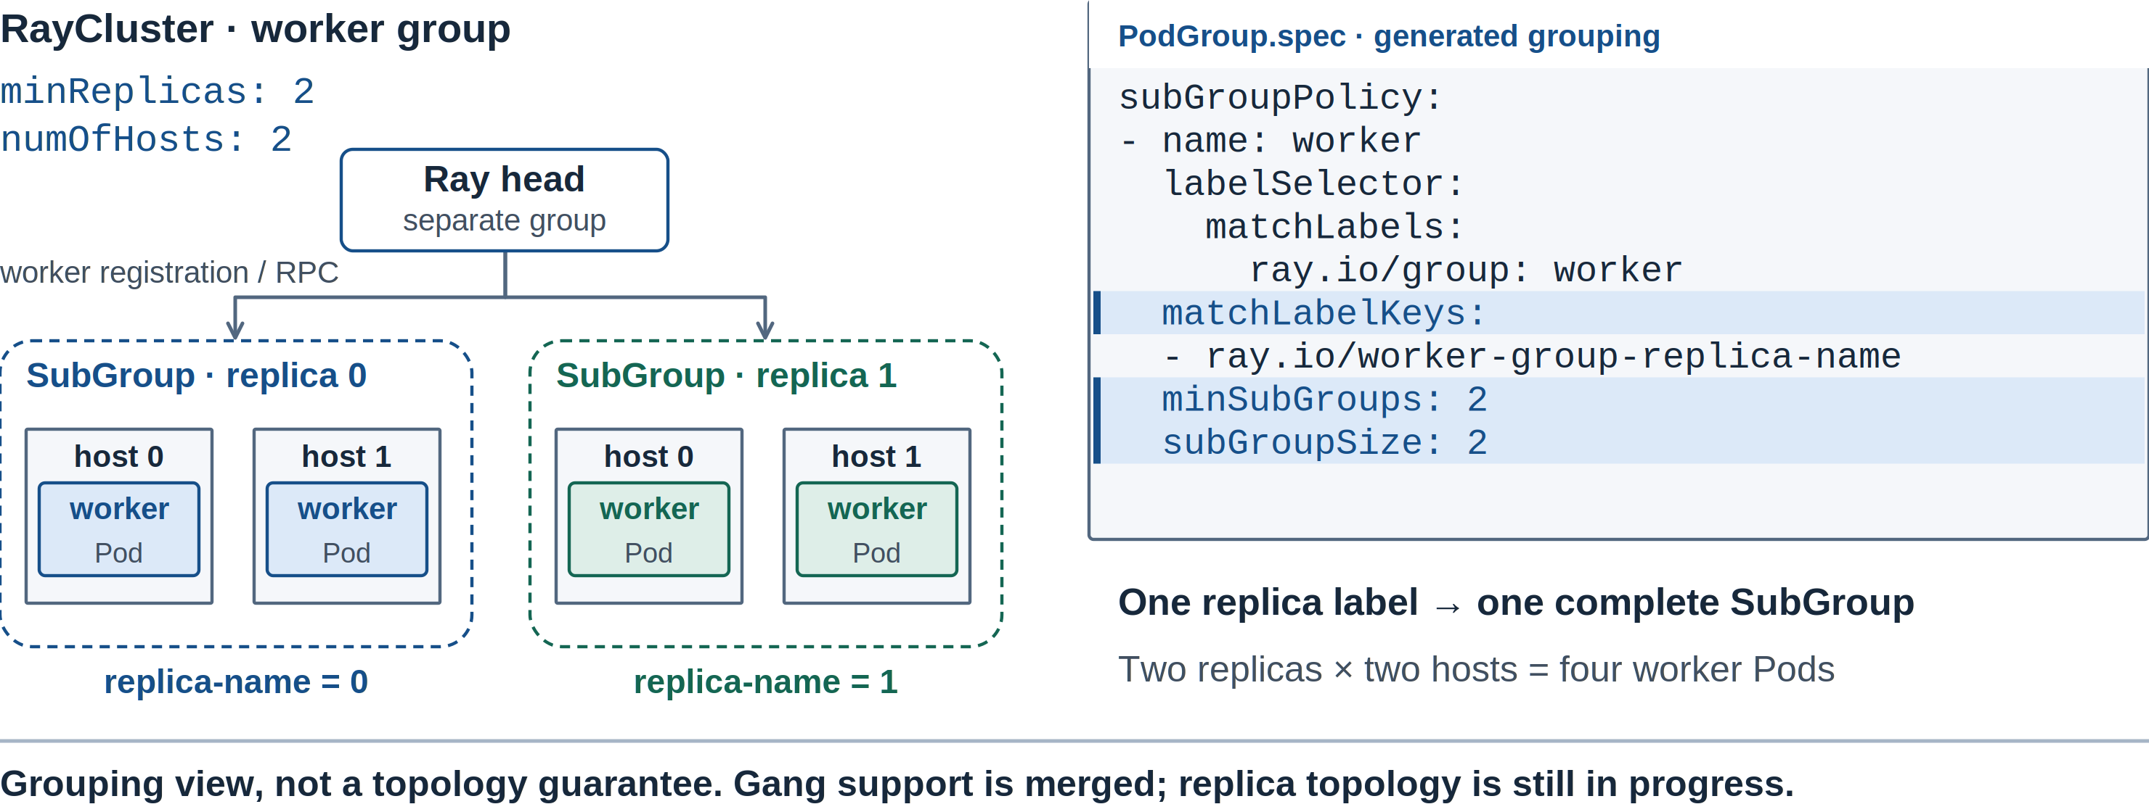
ECOSYSTEM
KubeRay: A Replica Can Span Multiple Pods
The replica label separates complete groups inside one WorkerGroup.
Volcano | KubeCon + CloudNativeCon North America 2026
15 / 22
Notes:
1:30。两个 replica，每个两个 hosts；用 matchLabelKeys 保持副本身份。head 另有分组。本页不把尚在推进的 KubeRay topology PR 当作已合入能力。
技术来源：
https://github.com/kuberay-project/kuberay/pull/5249
https://github.com/kuberay-project/kuberay/pull/5369
本页新版素材与说明：KubeRay #5249; #5369 open as of 2026-10-29. Volcano SubGroup API.
Visual: na2026/svg/15-ray-replicas.svg。PNG 固定几何；复用的旧图原本为位图，新增 YAML 和注释为 SVG 文本。

Slide 16
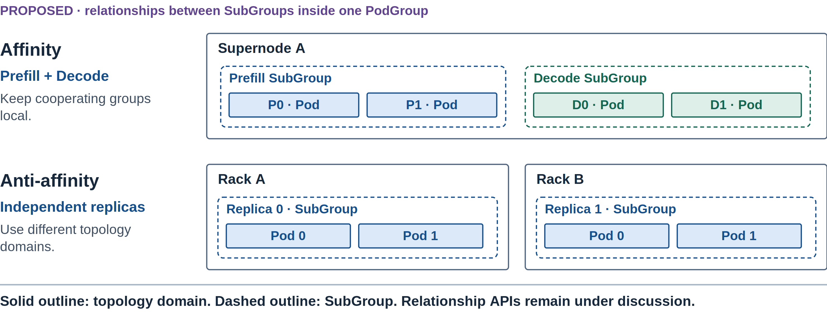
ECOSYSTEM
Next: Relationships Between SubGroups
Extend the placement model as controllers expose richer workload structure.
Volcano | KubeCon + CloudNativeCon North America 2026
16 / 22
Notes:
1:10。说明后续在同一个 PodGroup 内表达 SubGroup affinity/anti-affinity 的方向。图是意图示例，不提供假装已可执行的未来 YAML。
技术来源：
https://github.com/volcano-sh/volcano/releases/tag/v1.16.0
https://github.com/volcano-sh/volcano/issues/6166
https://github.com/volcano-sh/volcano/blob/v1.16.0/docs/design/group-topology-affinity.md
本页新版素材与说明：docs/design/group-topology-affinity.md (proposed SubGroup relationships); roadmap #6166.
本页为未来方向，不能当作已交付 API。示意同一 PodGroup 内将协作组放近、将副本分开；具体 selector 与亲和关系设计仍需社区讨论。
Visual: na2026/svg/16-subgroup-next.svg。PNG 固定几何；复用的旧图原本为位图，新增 YAML 和注释为 SVG 文本。

Slide 17
BENCHMARK FRAMEWORK & PROGRESS
04
01 Unified scheduling
Benchmark
framework & progress
02 Multi-level gang & network topology
03 Ecosystem
04 Benchmark framework & progress
Measure behavior across workload shapes.
What can we reproduce, compare, and improve?
Volcano | KubeCon + CloudNativeCon North America 2026
17 / 22
Notes:
0:10。转场：接入的控制器和约束越多，就越需要可重复的 benchmark。

Slide 18
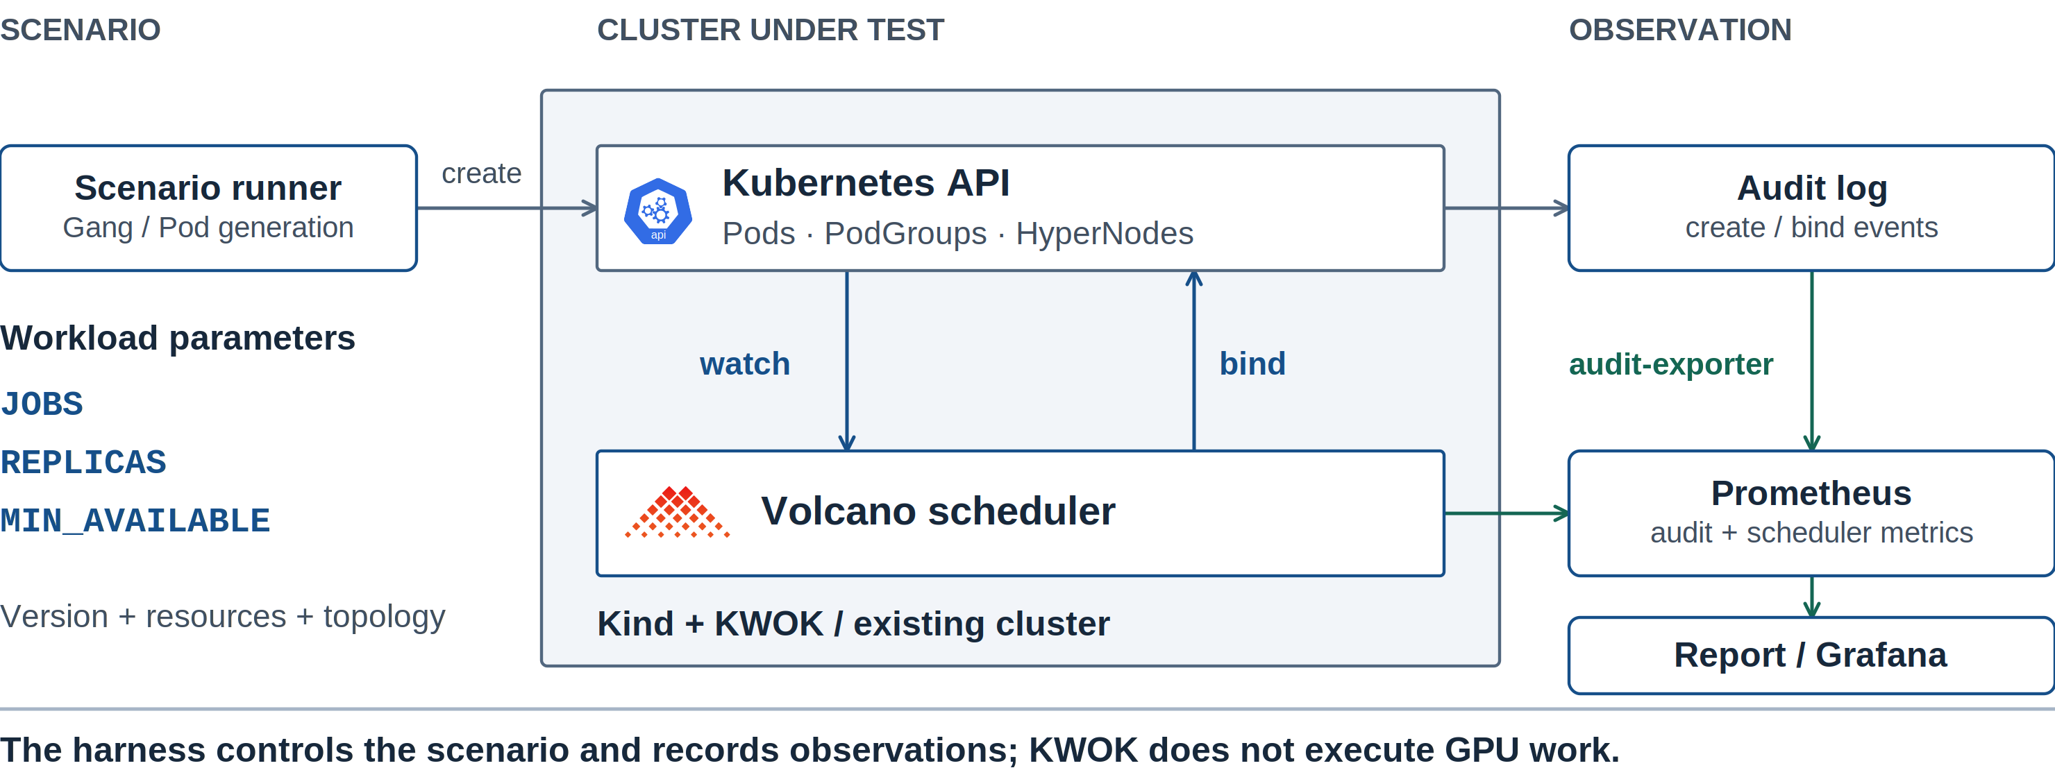
BENCHMARK FRAMEWORK & PROGRESS
A Repeatable Scheduling Benchmark Framework
Generate scenarios, observe API events, and retain comparable measurements.
Volcano | KubeCon + CloudNativeCon North America 2026
18 / 22
Notes:
1:30。沿数据路径解释 benchmark：场景输入→API/调度器→audit-exporter 与 Prometheus→报告。KWOK 只验证调度行为，不代表真实 GPU 执行吞吐。
技术来源：
https://github.com/volcano-sh/volcano/blob/a3d50b503/benchmark/README.md
https://github.com/volcano-sh/volcano/blob/a3d50b503/benchmark/scripts/README.md
本页新版素材与说明：benchmark/README.md; benchmark/scripts; benchmark/config; benchmark/testcases.
Visual: na2026/svg/18-benchmark-architecture.svg。PNG 固定几何；复用的旧图原本为位图，新增 YAML 和注释为 SVG 文本。

Slide 19
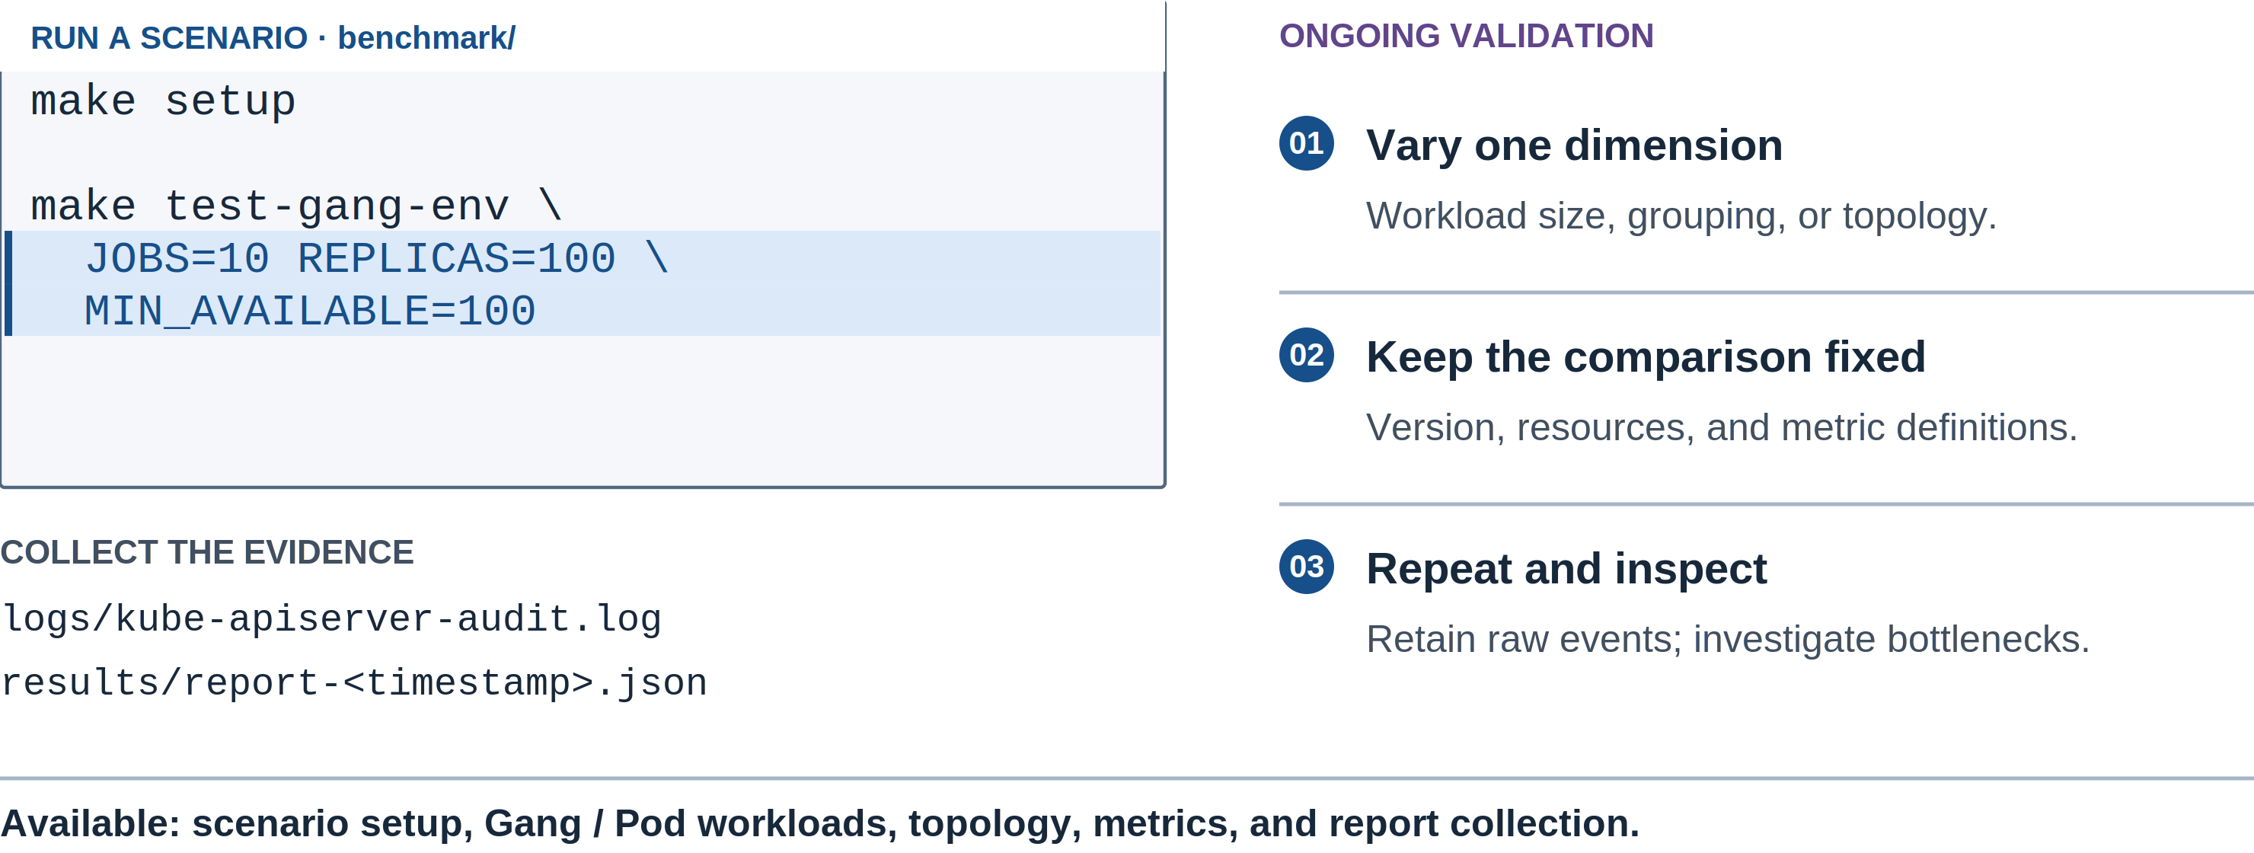
BENCHMARK FRAMEWORK & PROGRESS
Benchmark Progress and Ongoing Validation
The harness is available; testing and optimization continue across workload scenarios.
Volcano | KubeCon + CloudNativeCon North America 2026
19 / 22
Notes:
1:20。已有框架、场景和观察能力是本章可以确定展示的进展。继续验证规模、约束和优化，不为了演讲单独制造漂亮结果。命令仅展示框架用法，本次没有运行集群测试。
技术来源：
https://github.com/volcano-sh/volcano/blob/a3d50b503/benchmark/scripts/collect-report.sh
https://github.com/volcano-sh/volcano/blob/a3d50b503/benchmark/manifests/monitoring/grafana-dashboard.json
https://github.com/volcano-sh/volcano/issues/6166
本页新版素材与说明：benchmark/README.md; benchmark/Makefile; benchmark/scripts/collect-report.sh.
Visual: na2026/svg/19-benchmark-progress.svg。PNG 固定几何；复用的旧图原本为位图，新增 YAML 和注释为 SVG 文本。

Slide 20
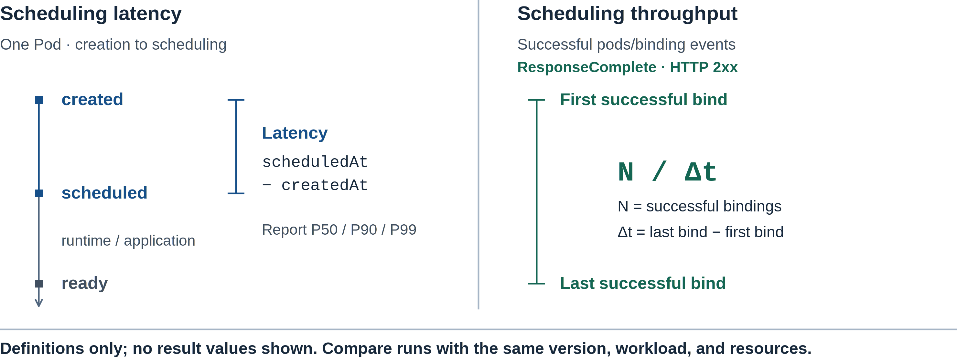
BENCHMARK FRAMEWORK & PROGRESS
Benchmark Metrics: Latency and Throughput
Separate scheduling delay, runtime readiness, and successful binding throughput.
Volcano | KubeCon + CloudNativeCon North America 2026
20 / 22
Notes:
1:20。讲清 created→scheduled 的统计口径、吞吐窗口和对照条件。仍待选定一项代表性结果，可以后续原位替换本页。
技术来源：
https://github.com/volcano-sh/volcano/blob/a3d50b503/benchmark/README.md
https://github.com/volcano-sh/volcano/blob/a3d50b503/benchmark/scripts/collect-report.sh
本页新版素材与说明：benchmark/scripts/collect-report.sh and audit-exporter event definitions. No performance results selected.
尚未选定代表性 benchmark 结果，本页只讲测量口径，不呈现虚构性能曲线或提升比例。
Visual: na2026/svg/20-benchmark-measurement.svg。PNG 固定几何；复用的旧图原本为位图，新增 YAML 和注释为 SVG 文本。

Slide 21
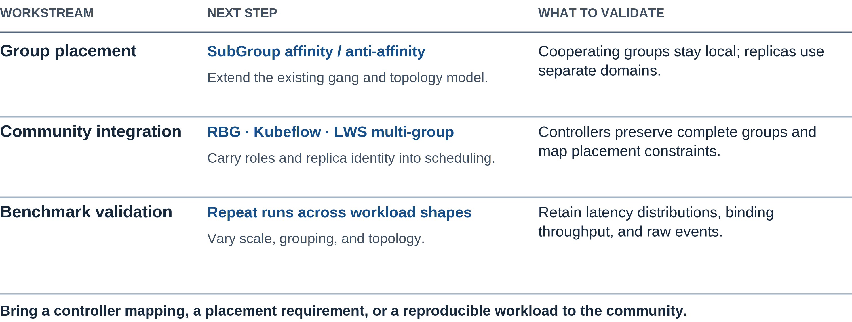
BENCHMARK FRAMEWORK & PROGRESS
What We Will Work On Next
Next steps in group placement, controller integration, and benchmarking.
Volcano | KubeCon + CloudNativeCon North America 2026
21 / 22
Notes:
1:10。按后续工作收尾：SubGroup 关系；RBG、Kubeflow 与 LWS multi-group 集成；扩展规模、分组与拓扑约束场景的重复测试。每项都明确需要验证的行为，不承诺未经验证的性能提升。
技术来源：
https://github.com/volcano-sh/volcano/issues/6166
https://github.com/volcano-sh/volcano/blob/a3d50b503/benchmark/README.md
本页新版素材与说明：
Visual: na2026/svg/21-takeaways.svg。PNG 固定几何；复用的旧图原本为位图，新增 YAML 和注释为 SVG 文本。

Slide 22
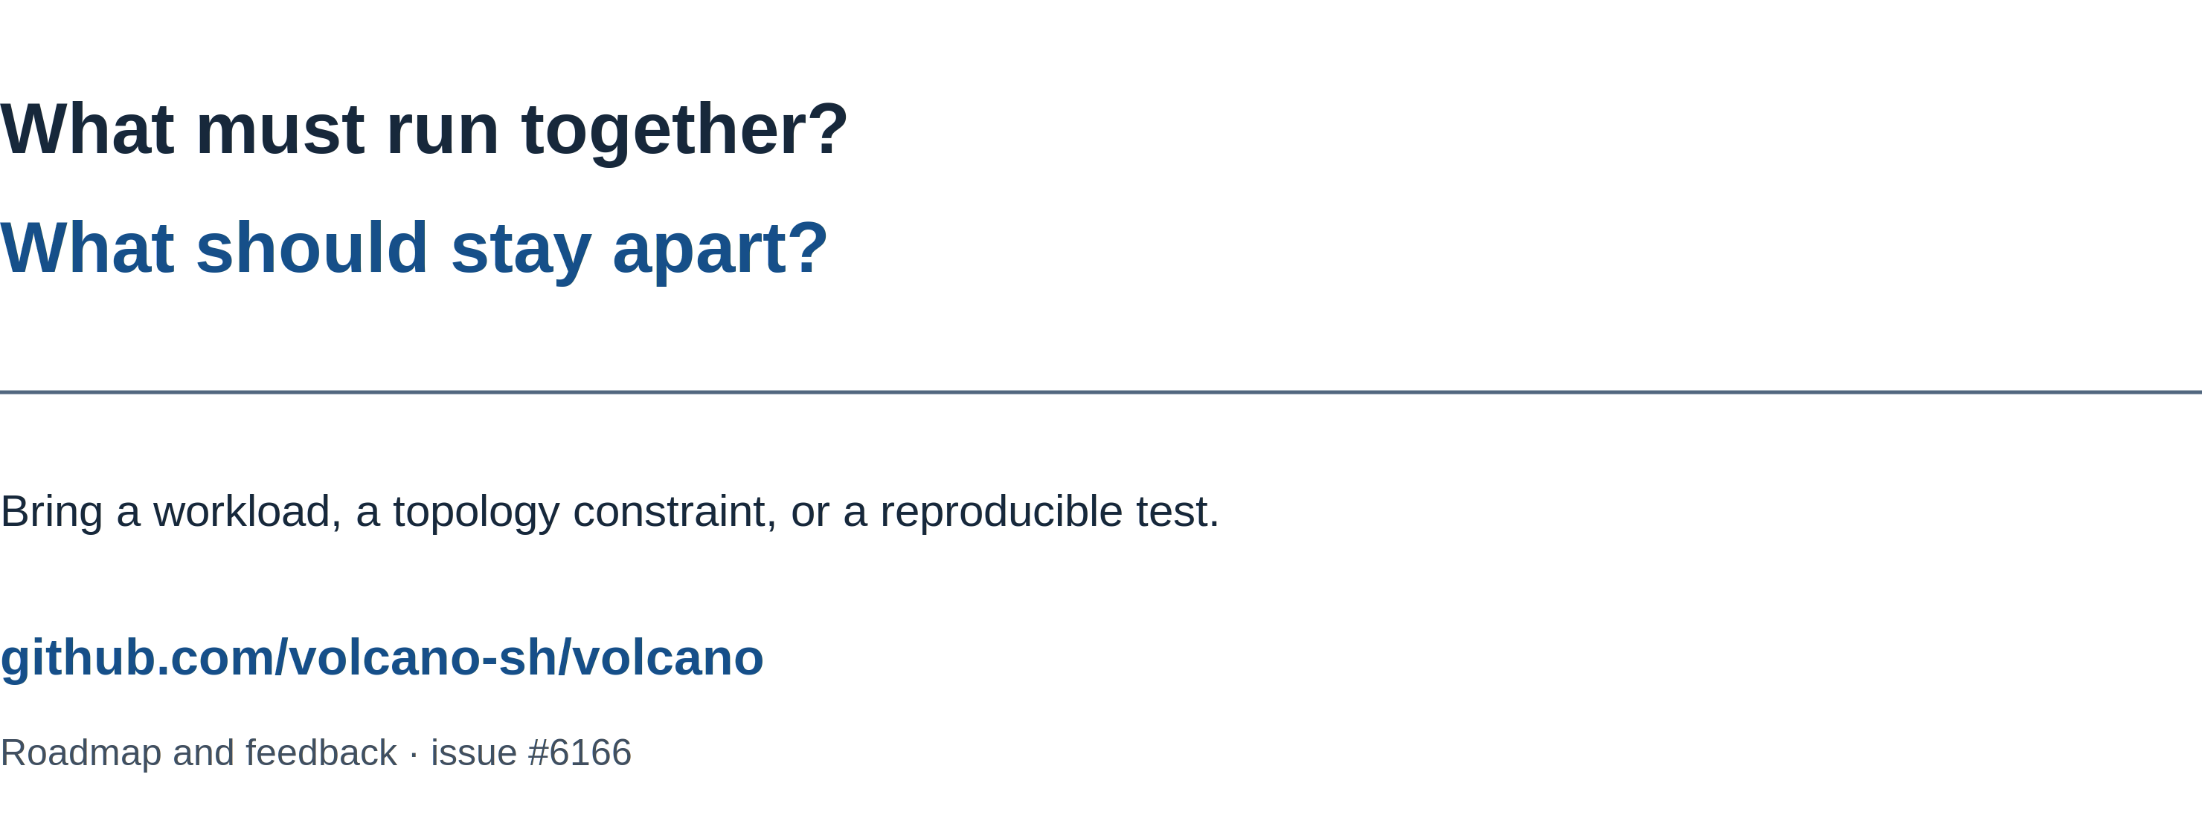
MAINTAINER TRACK
Questions & Discussion
Workload shapes, integration feedback, and reproducible observations are welcome.
Volcano | KubeCon + CloudNativeCon North America 2026
22 / 22
Notes:
5:00。问答。优先收集工作负载如何分组、需要哪些拓扑关系，以及可重复的测试场景。
技术来源：
https://github.com/volcano-sh/volcano/blob/v1.16.0/docs/design/agent-scheduler.md
https://github.com/volcano-sh/volcano/blob/v1.16.0/docs/user-guide/how_to_use_podgroup_anti_affinity.md
https://github.com/volcano-sh/volcano/issues/6166
本页新版素材与说明：
Visual: na2026/svg/22-questions.svg。PNG 固定几何；复用的旧图原本为位图，新增 YAML 和注释为 SVG 文本。

