Slide 1
Volcano: A Unified
Scheduling Platform for
Cloud Native AI
Zicong Chen · Huawei Technologies
DongYang Wang · SenseTime
Maintainer Track · Sep 9 · 16:15–16:45 · 5B + C
Notes:
[Sources]
- User-provided China template
[/Sources]

Slide 2


Speakers
Zicong Chen R&D Engineer, Volcano Maintainer Huawei Technologies Co., Ltd
https://github.com/JesseStutler
DongYang Wang Cloud-Native AI Infrastructure Engineer at SenseTime
https://github.com/kingeasternsun
Notes:
[Sources]
- User-provided user-edited English deck, slide 2
[/Sources]

Slide 3
Agenda
One story, from cluster resources to inference requests
01
02
03
WORKLOADS
SCHEDULER
SERVING
Unified Scheduling
Volcano Core
Kthena Serving
Different workload semantics
on one Kubernetes cluster
Fast scheduling with coordinated resource placement
Serving lifecycle, routing and P/D operations
Notes:
[Sources]
- User-provided KubeCon China 2026 template and English source deck
[/Sources]

Slide 4
AI Workloads Are Diverging
AI workloads are diverging fast.
Batch training dominated cluster design
Massive LLM
Distributed Training
LLM serving introduced disaggregated runtime patterns
Agent workloads
Bursty, short-lived, ultra-low latency scheduling
~ 2018
~ 2023
~ 2025
~ 2025
New requirement: one control plane, multiple execution patterns
One platform shall optimize for throughput and latency together
Notes:
[Sources]
- User-provided KubeCon EU maintainer deck, slide 6
[/Sources]

Slide 5




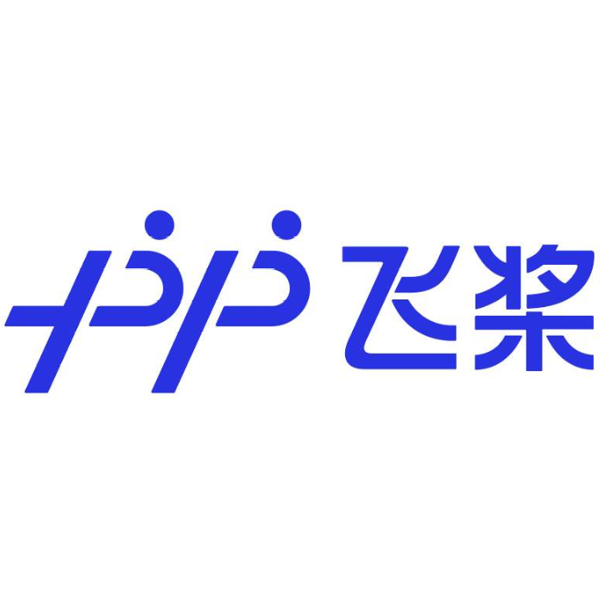














Volcano Overview
AI
MicroService
Unified Scheduling
Supports integrated job scheduling for both Kubernetes native workloads and mainstream computing frameworks (such as TensorFlow, Spark, PyTorch, Ray, Flink, etc.).
Queue Management
Provides multi-level queue management capabilities, enabling fine-grained resource quota control and task priority scheduling.
Big Data
HPC
Transcoding
AI
AI
AI
B
B
B
H
H
H
T
T
T
M
M
M
Batch Computing
MicroService
Workloads Colocation
Enables online and offline workloads colocation, improving cluster resource utilization through intelligent scheduling strategies.
Multi-cluster Scheduling
Supports cross cluster job scheduling, improving resource pool management capabilities and achieving large scale load balancing.
Volcano Global
Cluster A
Cluster B
Heterogeneous Device Support
Efficiently schedules heterogeneous devices like GPU and NPU, fully unleashing hardware computing potential.
Multiple Scheduling Policies
Supports various scheduling strategies such as Gang scheduling, Network Topology Aware Scheduling, Fair-Share, Binpack, DeviceShare, NUMA-aware scheduling, Task Topology, etc.
Node
AI
AI
T
Node
AI
B
M
T
M
H
H
kubelet
Volcano Agent
Kubelet
Volcano Agent
Notes:
[Sources]
- User-provided KubeCon EU maintainer deck, slide 5
[/Sources]

Slide 6
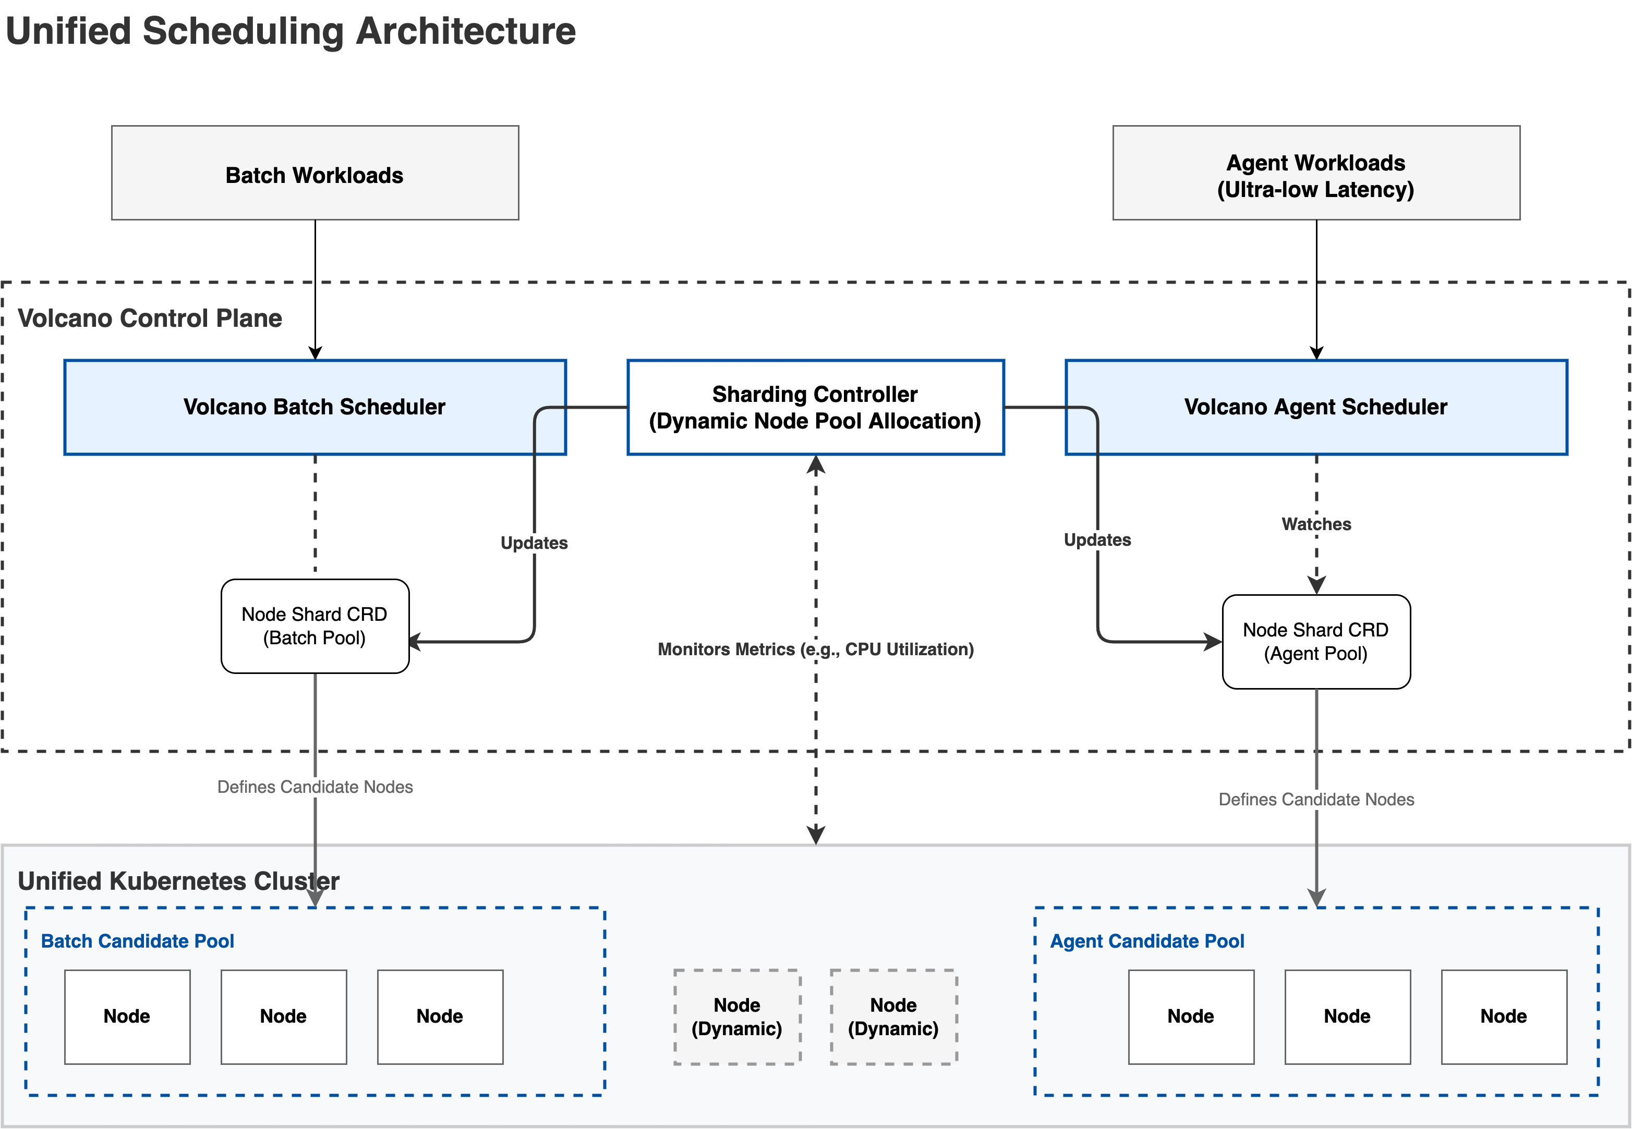
Unified Scheduling Architecture
Scheduling inputs
Workload intent
SLA and priority
Workload structure and topology
Node runtime state
Object type / schedulerName
Latency / throughput / criticality
Gang / role groups / network boundary
Capacity / utilization / availability
One control plane
Specialized scheduling paths
Dynamic NodeShard boundaries
Notes:
[Sources]
- User-provided Kubernetes unified scheduling practice deck, slide 8
[/Sources]

Slide 7
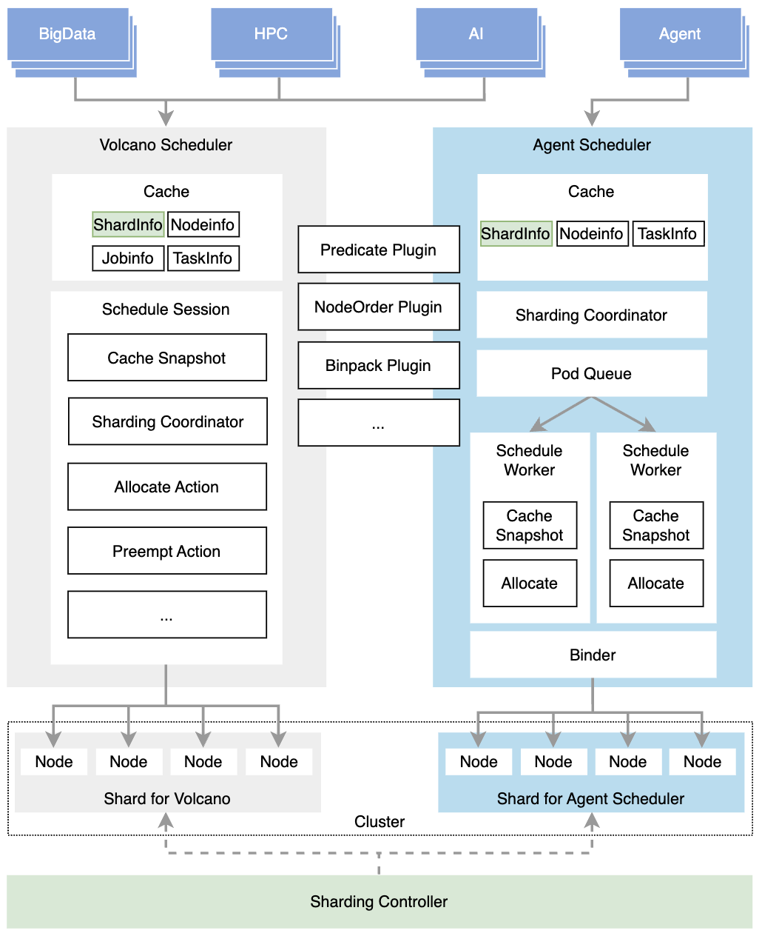
Fast-Path Agent Scheduling
Dedicated fast path
Bursty, short-lived agent tasks bypass the batch-oriented scheduling path.
Parallel scheduling
Multiple workers make placement decisions from shared cluster snapshots.
Conflict-aware binding
Optimistic scheduling reduces coordination overhead while preserving correctness.
Notes:
[Sources]
- User-provided KubeCon EU maintainer deck, slide 9
[/Sources]

Slide 8
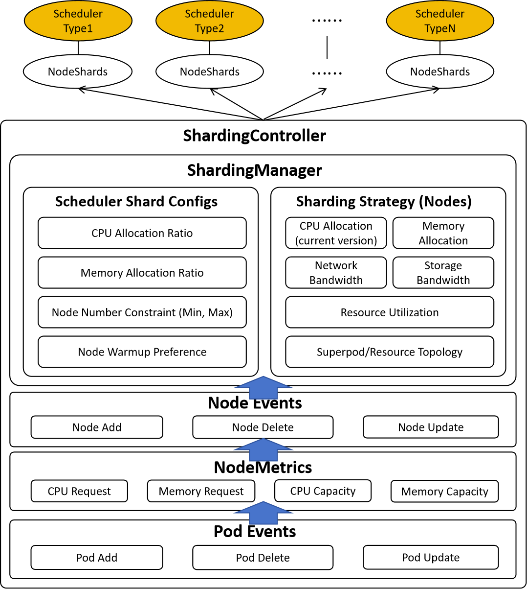
Dynamic Node Sharding
Specialized Scheduling, Resource Optimization
Scalability, Workload Isolation
Sharding Controller dynamically computes node pools based on extensible policies rather than inefficient static hard partitioning.
Enables flexible scheduler combinations (e.g., multiple Batch Schedulers, or Agent + Batch) coordinating via the NodeShard CRD.
Notes:
[Sources]
- User-provided KubeCon EU maintainer deck, slide 10
[/Sources]

Slide 9
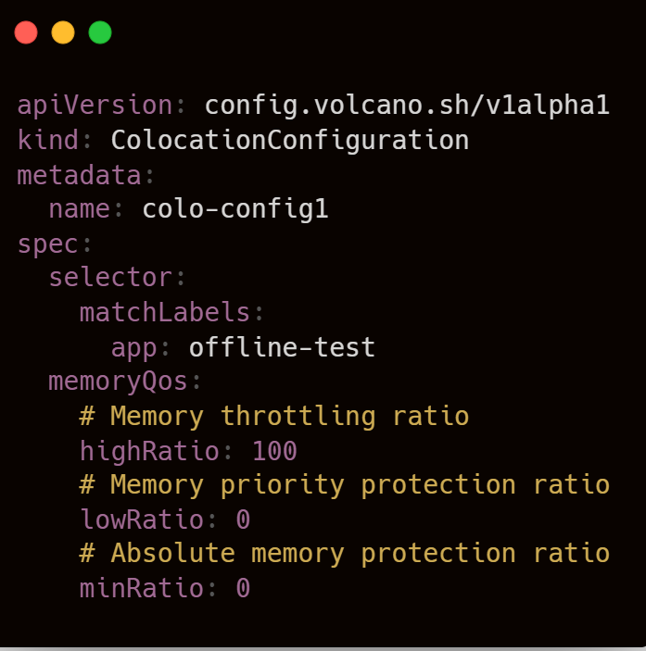
Colocation Foundations
Expanded OS Support: Fully decoupled from specific distros, now supporting generic operating systems (Ubuntu, CentOS, etc.).
Dynamic CPU Throttling & Burst: Adaptive CPU quota adjustment for offline pods to protect online workloads, plus CPU Burst for latency-sensitive tasks.
Full Cgroup v2 Integration: Auto-detects cgroup versions and natively implements v2 resource managers.
Fine-grained Memory QoS
Declarative Policy API: Introduced ColocationConfiguration CRD
Notes:
[Sources]
- User-provided KubeCon EU maintainer deck, slide 13
[/Sources]

Slide 10
Why Pod-Level Eviction Fails
A Serving PodGroup needs 4 GPUs. What happens if one Pod is evicted from each of four training jobs?
Training Job A
Training Job B
Training Job C
Training Job D
W1
W2
W3
W4
W1
W2
W3
W4
W1
W2
W3
W4
W1
W2
W3
W4
3 / 4 Worker → Blocked
3 / 4 Worker → Blocked
3 / 4 Worker → Blocked
3 / 4 Worker → Blocked
Evict one worker from each job to release 4 GPUs
Apparent result: the Serving Gang gets 4 GPUs and can start
Actual cost: four training jobs stall and 12 remaining workers stop making useful progress
Notes:
[Sources]
- User-provided Kubernetes unified scheduling practice deck, slide 14
[/Sources]

Slide 11
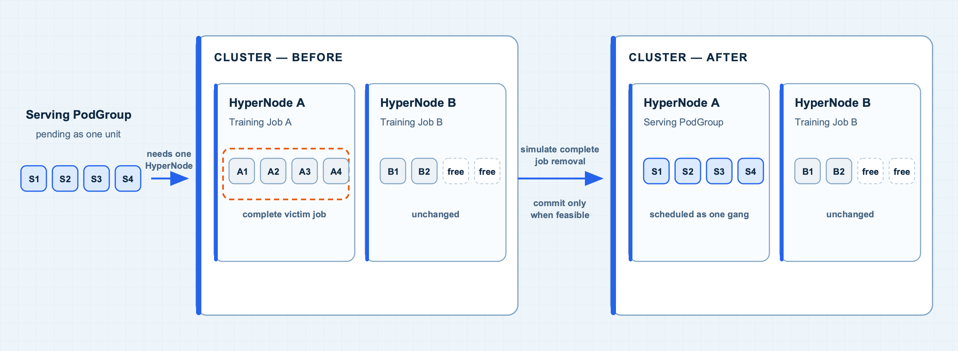
Gang-Aware Preempt / Reclaim
Volcano evicts Training Job A as a whole, freeing 4 GPUs in HyperNode A so the pending Serving PodGroup can start together, while HyperNode B remains untouched.
Notes:
[Sources]
- User-provided Kubernetes unified scheduling practice deck, slide 15
[/Sources]

Slide 12
Recoverable Handover
Checkpoint is not a queue reclaim action today; it is a foundation for reducing future victim-job training loss.
Resource return trigger
Queue: Training should return 4 GPUs
Serving PodGroup is short 4 GPUs
Gang-aware: select one complete victim job
Training victim job selected
CURRENT
UPSTREAM EXPLORATION
VOLCANO EVOLUTION
Current Volcano path
Kubernetes Pod C/R
Coordinated recovery for training jobs
Commit eviction
Checkpoint/Restore WG · KEP-5823
① ReclaimIntent
Delete the complete victim job
Return capacity as one Job / PodGroup
PodCheckpoint
restoreFrom
② Training Controller
Release 4 GPUs
Coordinate ranks and report checkpoint ready
Admit the Serving PodGroup
③ Commit & Restore
Evict after checkpoint; later restore the job
Near term: framework level
Long term: native Pod checkpoint / restore
Notes:
[Sources]
- User-provided Kubernetes unified scheduling practice deck, slide 17
[/Sources]

Slide 13
PodGroup and SubGroup
A single PodGroup tells the scheduler how many Pods are needed, but not which Pods belong together or where each group should land.
A flat PodGroup
Three scheduling levels
minMember / minResources
PodGroup → JobInfo
Complete training job / ServingGroup
Describes only the admission threshold for the whole job
Training SubGroup
Inference SubGroup
01
Training
TP / PP / DP groups
TP / PP / DP
Prefill / Decode
02
Inference
Prefill / Decode roles
size · minSubGroups
networkTopology · affinity
Pod
Pod
Pod
Pod
Pod
Pod
03
Placement
Different topology tiers
SubGroupPolicy：selector · size · minSubGroups · networkTopology
Notes:
[Sources]
- User-provided Kubernetes unified scheduling practice deck, slide 20
[/Sources]

Slide 14
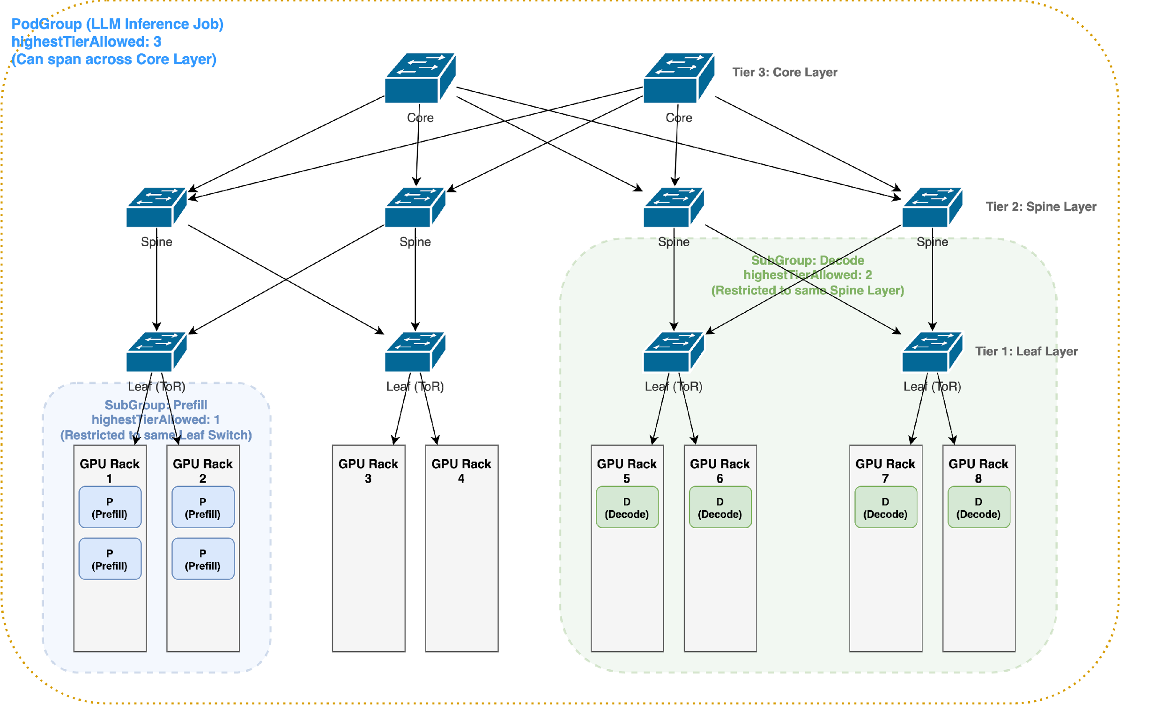
Topology Placement by Group
PodGroup limits the highest tier the complete job may span;
each SubGroup defines the local boundary for a role or parallel group.
Placement example
01
PodGroup
May span up to the Core tier
02
Prefill SubGroup
Must stay within one Leaf
02
Decode SubGroup
Prefer one Leaf; relax upward if needed
Gang readiness, role minimums and topology boundaries must all hold
Notes:
[Sources]
- User-provided Kubernetes unified scheduling practice deck, slide 21
[/Sources]

Slide 15
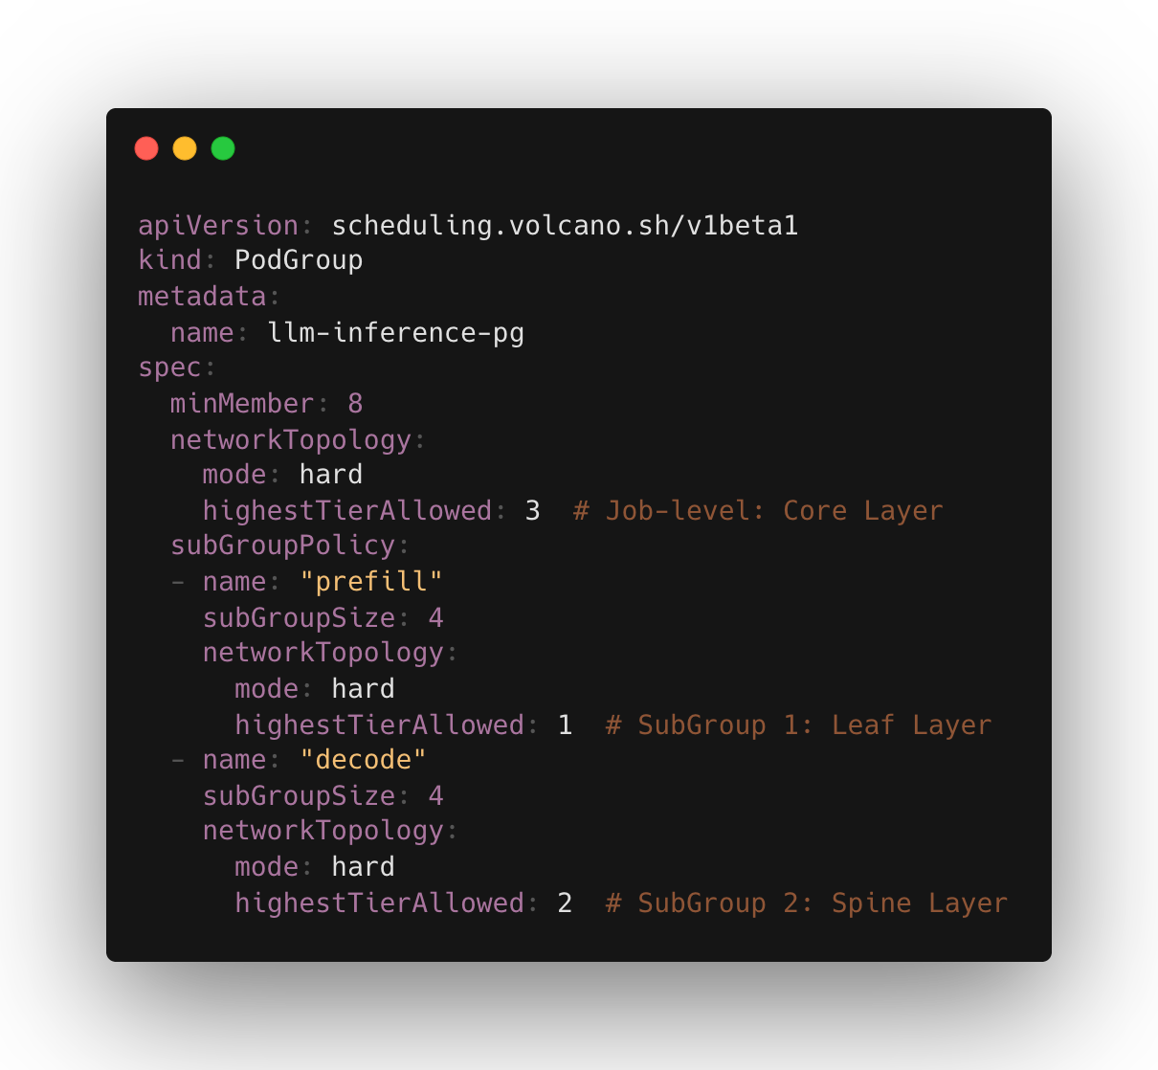
Multi-Level Network Topology
PodGroup(highestTierAllowed: 3 minMember:8)
SubGroup-prefill
(highestTierAllowed: 1 minMember:4)
SubGroup-Decode
(highestTierAllowed: 2 minMember:4)
Notes:
[Sources]
- User-provided KubeCon EU maintainer deck, slide 16
[/Sources]

Slide 16



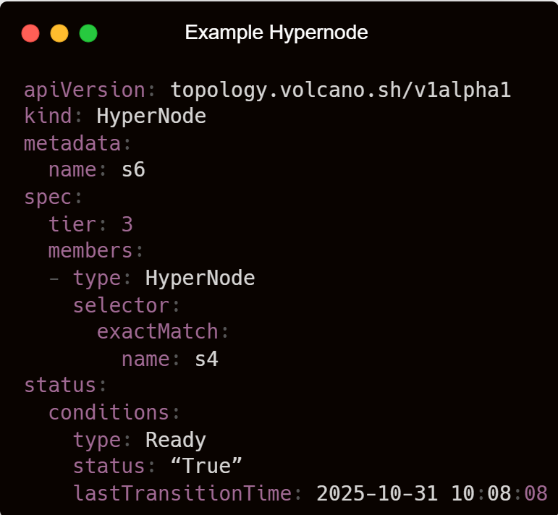

HyperNode Auto-Discovery
AI Cluster & Cloud Environment
HyerNode API Objects
Vocano Control Plane
Discovery Manager
On-Premise：
1. NVLink Fabric Manager API
2. IB Subnet Manager (OpenSM)
3. RoCE LLDP/CDP
UFM
Discoverer
Report Network Topology
Update HyperNode Hierarchy Tree
Create
/Update
HyperNode
NodeLabels
Discoverer
HyperNode Controller
RoCE
Discoverer
Cloud：
1. Cloud Provider APIs
2. DPU/SmartNIC Telemetry
other
Discoverers
Notes:
[Sources]
- User-provided KubeCon EU maintainer deck, slide 17
[/Sources]

Slide 17
Topology-Scoped Preemption
The target SubGroup needs 4 GPUs in one Leaf; fragmented capacity across domains still cannot start it.
Before
Scheduling decision
After
Target: Decode SubGroup × 4
Place all four in Leaf B
01
Choose domain
Leaf A
Leaf B
Leaf B
Leaf B · Selected Domain
T
T
T
T
Decode
Decode
Free
Free
Free
Free
02
Expand victims
Decode
Decode
Whole-job reclaim
Result
Four GPUs are free in total, but no Leaf can host the complete SubGroup
Commit condition
Validate Gang + SubGroup + topology
Target PodGroup / SubGroup is fully pipelined
Notes:
[Sources]
- User-provided Kubernetes unified scheduling practice deck, slide 24
[/Sources]

Slide 18
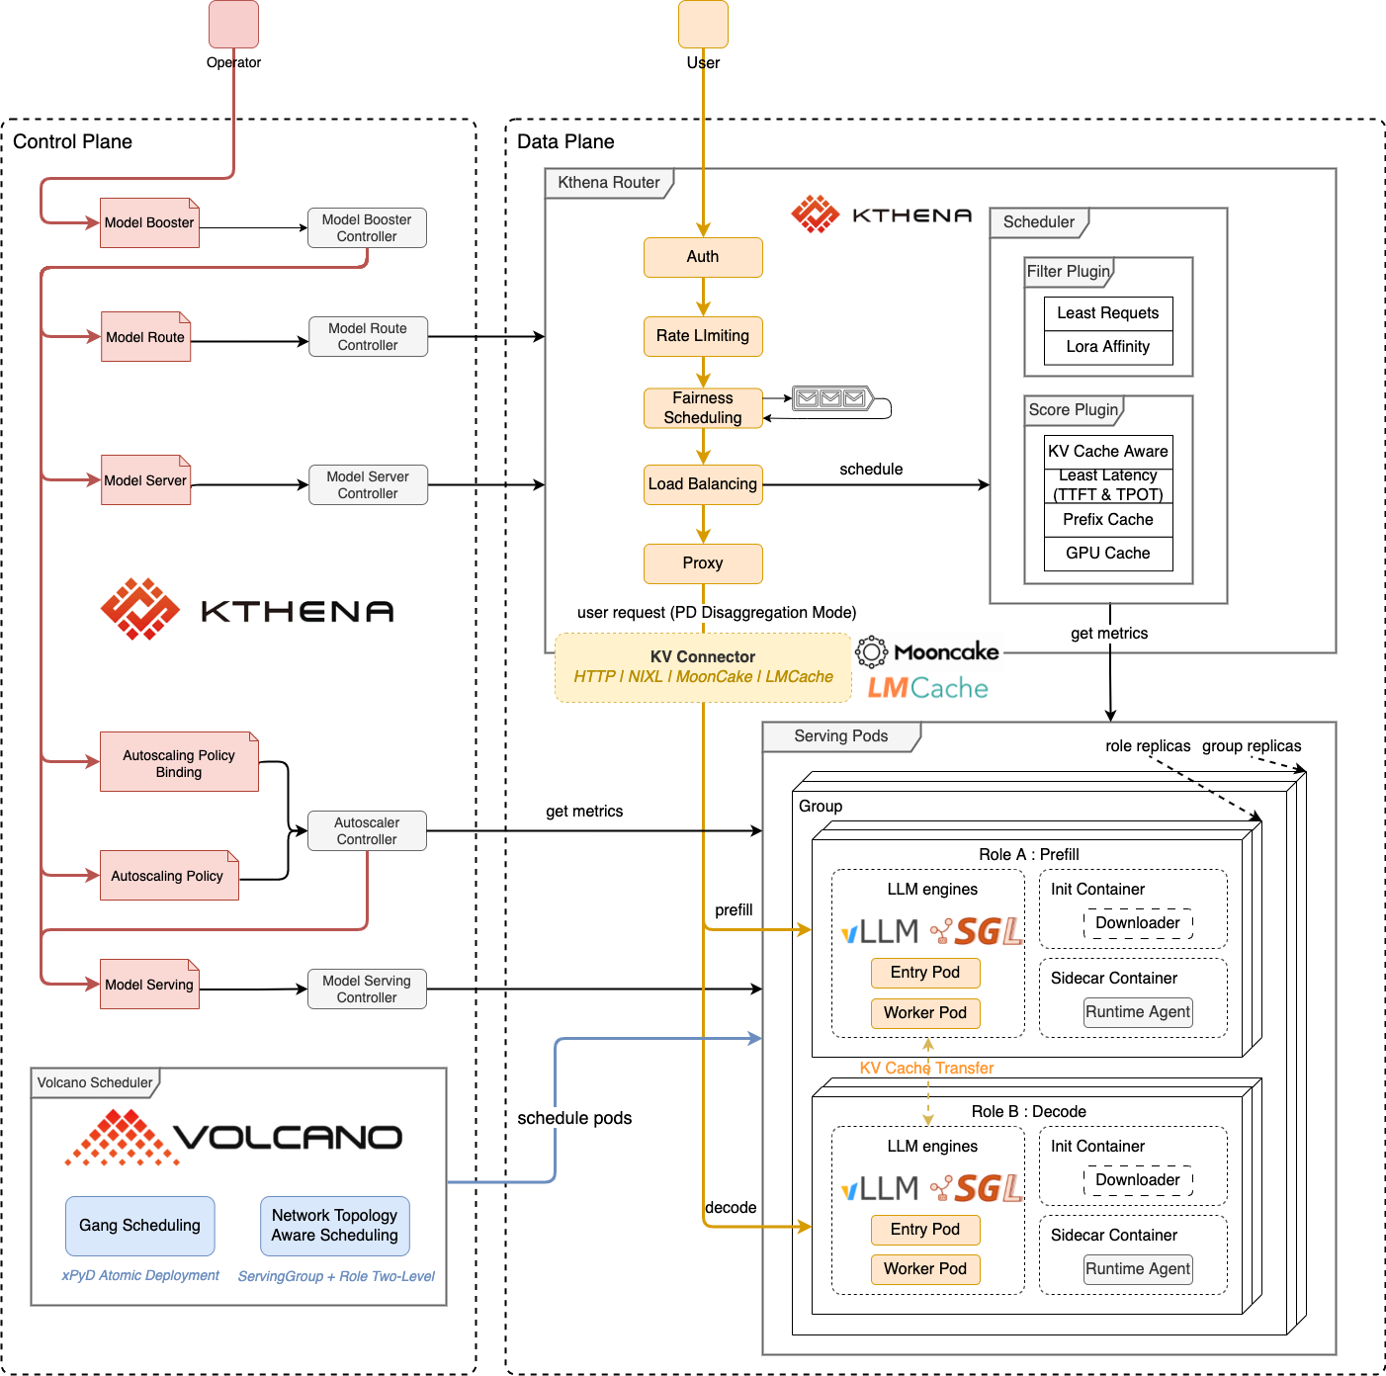
Kthena Serving Abstractions
Serving semantics project into PodGroup, SubGroup and Pod—not an unrelated set of Deployments.
Scheduling projection
ModelServing
Model, version and replica policy
Service
ServingGroup
Complete serving instance / PD group
PodGroup
Role / Instance
Prefill · Decode
SubGroup
Entry / Worker
Concrete runtime replicas
Pod
Notes:
[Sources]
- User-provided Kubernetes unified scheduling practice deck, slide 27
[/Sources]

Slide 19
Serving Scale-Out
Scale-out first creates real Serving PodGroup demand; queue fairness then reclaims capacity borrowed by training.
01 Kthena creates scale-out demand
02 Queue determines capacity return
03 Volcano reclaims and places as a whole
Traffic / latency signals
Serving Queue adds 4 pending GPUs
Select one complete victim job
AutoscalingPolicy computes role replicas
Real workload demand enters scheduling
Training returns 4 GPUs
Increase Prefill / Decode replicas
Serving 2 < Deserved 6
SubGroupPolicy + HyperNode
Update ModelServing and PodGroup
Training 10 > deserved 6: return 4 GPUs
Place by role group and network topology
Shared GPU pool state
T0 | Low serving load
T1 | Scale-out complete
On scale-in
Serving 2
Serving 6
Serving releases capacity Training / Batch may borrow again
Training 10
Training 6
Training borrows 4
Return 4 GPUs
Both return to deserved share
Release; borrow again
Notes:
[Sources]
- User-provided Kubernetes unified scheduling practice deck, slide 30
[/Sources]

Slide 20
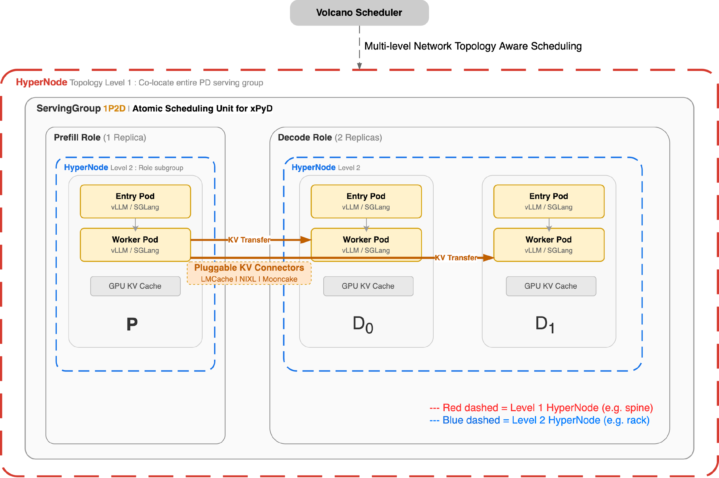
Prefill–Decode Disaggregation
ServingGroup as atomic scheduling unit for xPyD (1P1D, 1P3D, etc.)
Gang Scheduling: all pods in a PD group scheduled together or not at all
Multi-level network topology-aware scheduling:
ServingGroup level: co-locate entire PD
group in same HyperNode
Role level: co-locate Entry + Worker within
each Prefill/Decode role
Pluggable KV Connectors (LMCache, NIXL, Mooncake) for KV cache transfer between P and D
Notes:
[Sources]
- User-provided KubeCon EU maintainer deck, slide 23
[/Sources]

Slide 21
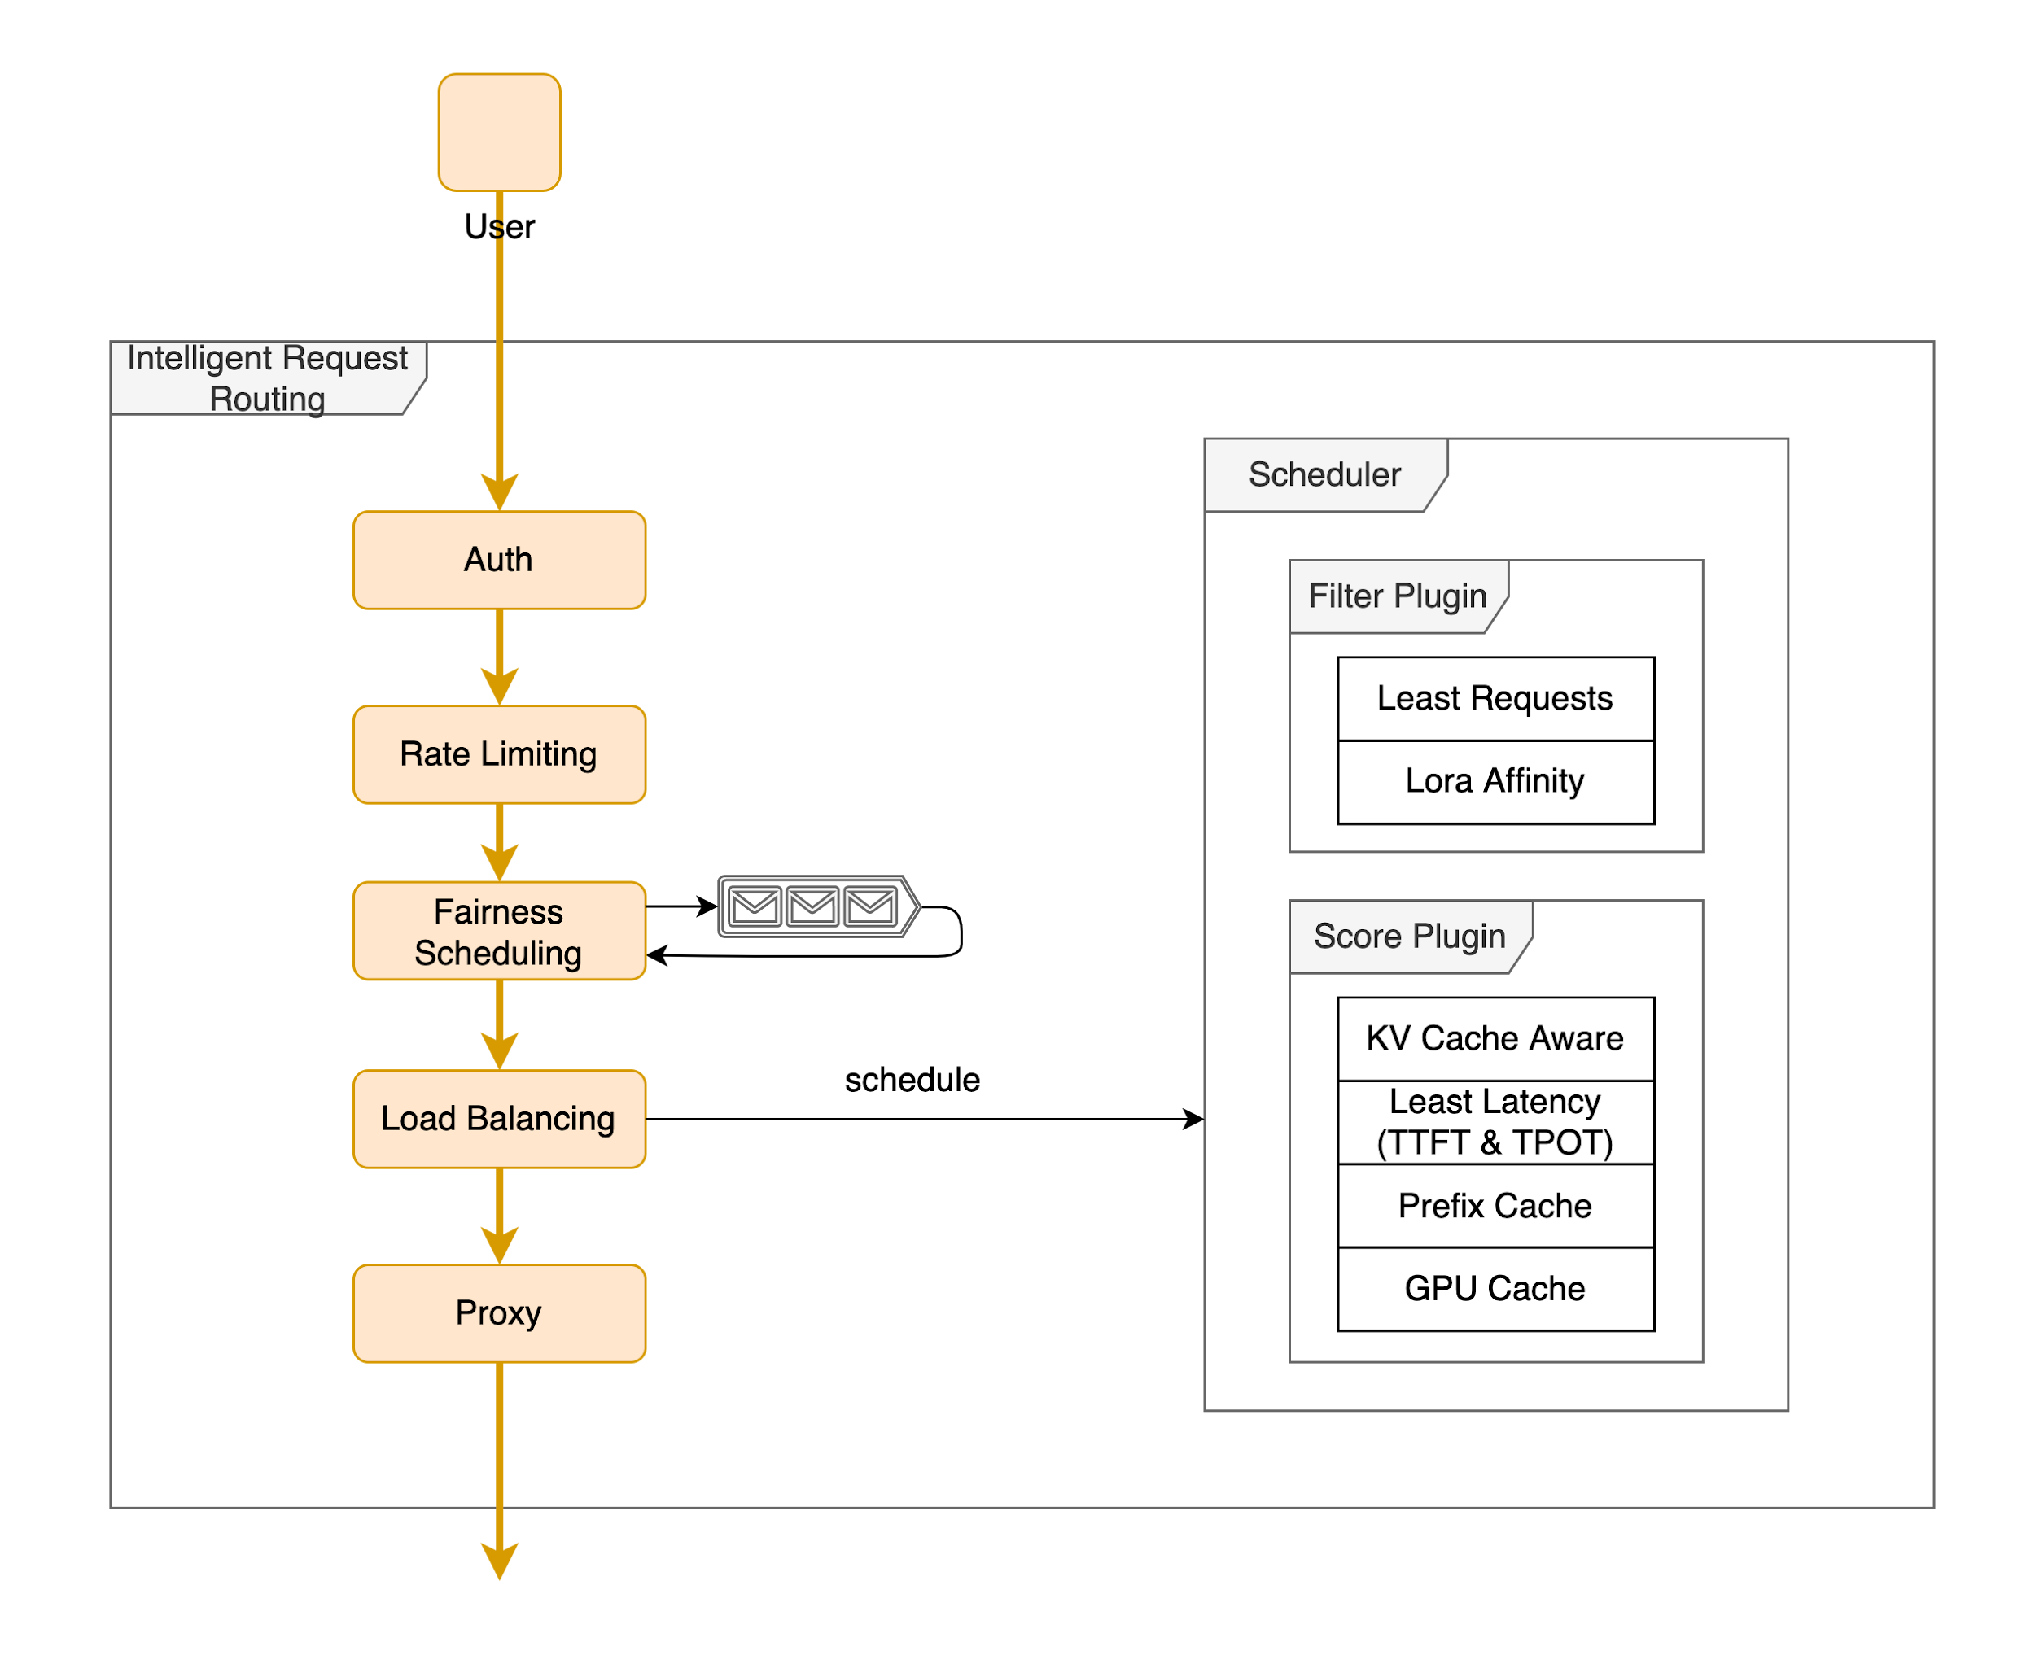
Kthena Intelligent Routing
Smart Pluggable Routing Engine
prefix-cache — route to pod with matching prompt prefix
kvcache-aware — Redis-based distributed KV block matching
least-request — avoid pods with long queues
least-latency — prefer lower TTFT / TPOT
lora-affinity — route to LoRA-loaded pod
gpu-usage — prefer free GPU KV cache
Token-Level Traffic Management
Token-based rate limiting (input + output, local + global Redis)
Per-user fairness on historical token usage
Weighted splitting for canary / A-B / multi-LoRA
Native PD Disaggregation Routing
Split Prefill and Decode by group; transfer KV through pluggable connectors.
Notes:
[Sources]
- User-provided KubeCon EU maintainer deck, slide 24
[/Sources]

Slide 22
Thank You
Questions?
Notes:
[Sources]
- User-provided China template
[/Sources]

