Slide 1


Volcano for the
Agentic AI Era:
Unified Scheduling Across Training,
Inference, and Agents
Ricardo Aravena · Rainie Li
KubeCon + CloudNativeCon North America 2026
Salt Lake City · November 9–12
Volcano | KubeCon + CloudNativeCon North America 2026
01 / 24
Notes:
0:20。标题保持不变。Agentic AI 作为基础设施背景，不把每次 agent 调用等同于一个 Pod。讲者姓名以用户指示为准。

Slide 2



Speakers
Ricardo Aravena
Rainie Li
AI Infrastructure Lead · Nunchux AI
Pinterest
CNCF TOC Alternate (GB)
Cloud native and AI infrastructure
Data processing infrastructure
Apache YuniKorn PMC member
nunchux.ai · CNCF TOC
Apache YuniKorn · rainieli
Volcano | KubeCon + CloudNativeCon North America 2026
02 / 24
Notes:
0:40。Ricardo：NA 2026 官方会议资料列为 Nunchux AI 的 AI Infrastructure Lead；CNCF TOC 页面列为 TOC Alternate (GB)，不是 Governing Board 成员，不写 Founder 或 CEO。2026-10-29 核查。照片来自 Linux Foundation 公开讲者页。
https://events.linuxfoundation.org/kubecon-cloudnativecon-north-america/program/schedule/?id=1289640
https://www.cncf.io/people/technical-oversight-committee/
https://events.linuxfoundation.org/archive/2026/open-source-summit-north-america/program/program-committee/
https://events.linuxfoundation.org/spinnaker-live/program/featured-speakers/
https://yunikorn.apache.org/community/people/
https://www.linkedin.com/in/rainie-li-71b2b146

Slide 3
01
01 Unified scheduling
Unified scheduling
02 Multi-level gang & network topology
03 Ecosystem
04 Benchmark framework & progress
Different paths. Shared infrastructure.
Volcano | KubeCon + CloudNativeCon North America 2026
03 / 24
Notes:
0:10。从统一调度框架切入，后面落到工作负载、生态和验证。

Slide 4
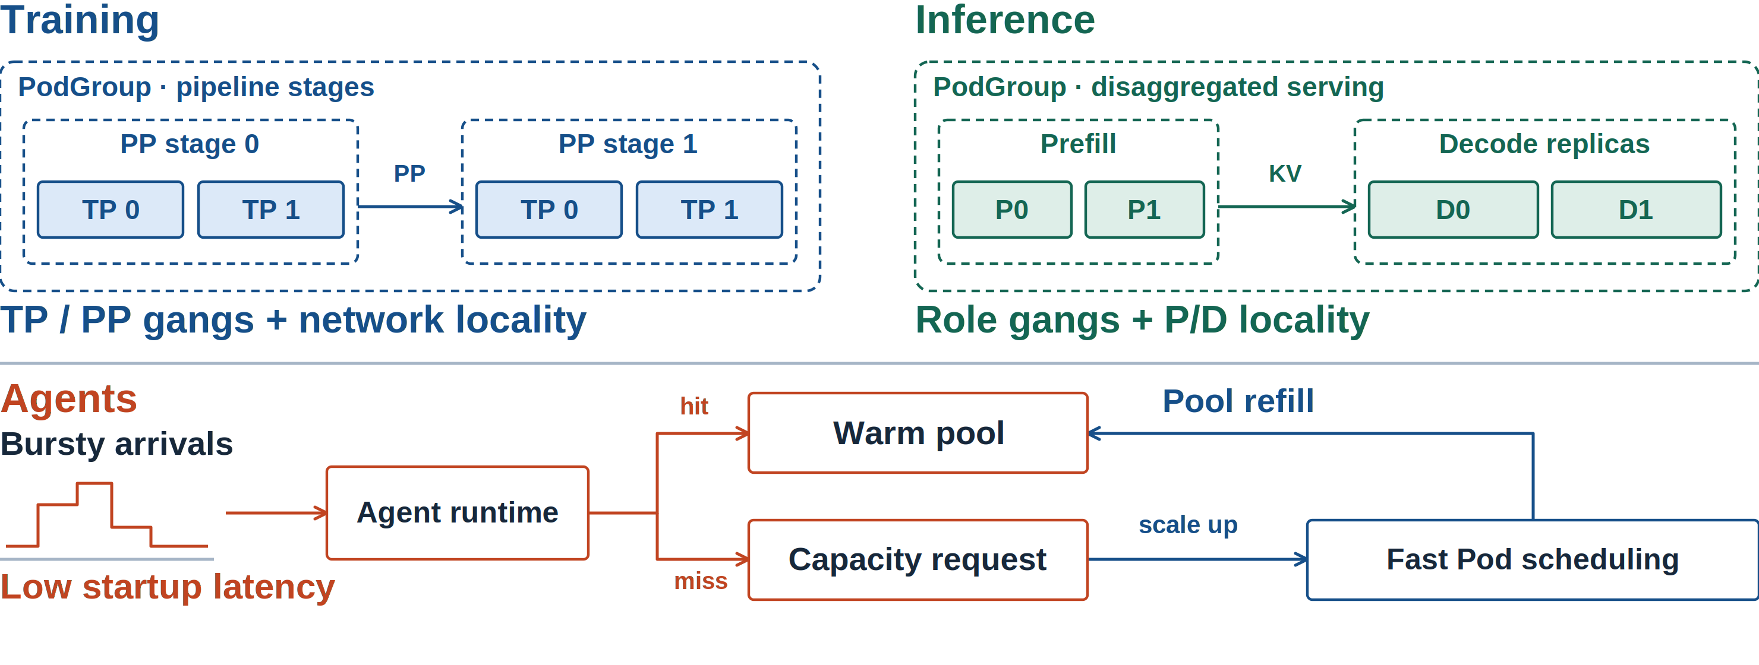
Different Workloads, Shared Infrastructure
Volcano | KubeCon + CloudNativeCon North America 2026
04 / 24
Notes:
1:20。训练图展示两个 PP stage，每个 stage 两个 TP ranks，需要完整子组及通信局部性。推理展示 P/D 分离，不同角色及副本的 gang 与 topology 约束。Agent 路径先命中预热池并复用 ready runtime；池子耗尽时由 runtime/pool controller 请求容量，经快速 Pod 调度补池。请求突发图是需求示意，没有测量值。池管理不是 Volcano 自带能力，也不是每次调用创建 Pod。
移入备注的外围说明：
Schedule complete groups and their locality; keep latency-sensitive capacity ready.
Training, inference, and agent applications put different demands on the same cluster.
Training
Inference
Complete TP / PP gangs + network locality
Role groups + topology-aware placement
Agents
Bursty arrivals
Low startup latency
reuse ready capacity
replenish the pool
Gang size · network locality · startup latency
TP / PP gangs · locality
P/D groups · locality
Warm pool
ready capacity
Capacity request
pool controller
Gang + locality
Gang + locality
技术来源：
本页新版素材与说明：
Visual: na2026/svg/04-workload-demands.svg。PNG 固定几何；复用的旧图原本为位图，新增 YAML 和注释为 SVG 文本。

Slide 5
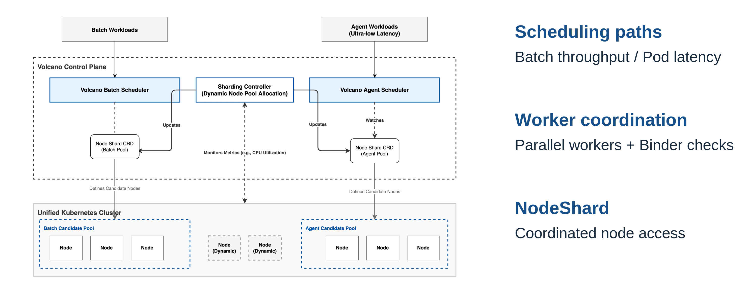
A Coordinated Scheduling Framework
Volcano | KubeCon + CloudNativeCon North America 2026
05 / 24
Notes:
1:30。复用 China 架构图，从左右两条路径讲到中间 NodeShard。worker/Binder 的冲突检查是局部机制；不宣称并行一定带来性能提升。
移入备注的外围说明：
Specialized scheduling paths coordinate through NodeShard.
01
Workload paths
Batch-oriented scheduling and a Pod-oriented fast path.
02
Local coordination
Parallel workers use Binder conflict checks.
03
Shared node access
NodeShard coordinates candidate-node pools.
Batch path · fast path · shared NodeShard
Workload paths
Batch · fast path
Worker coordination
Binder conflict checks
Shared node access
NodeShard
Batch / fast path
Binder checks
Shared node pools
技术来源：
https://github.com/volcano-sh/volcano/blob/v1.16.0/docs/design/agent-scheduler.md
本页新版素材与说明：China 2026 slide 7; same architecture family as EU 2026.
Visual: na2026/svg/05-unified-architecture.svg。PNG 固定几何；复用的旧图原本为位图，新增 YAML 和注释为 SVG 文本。

Slide 6
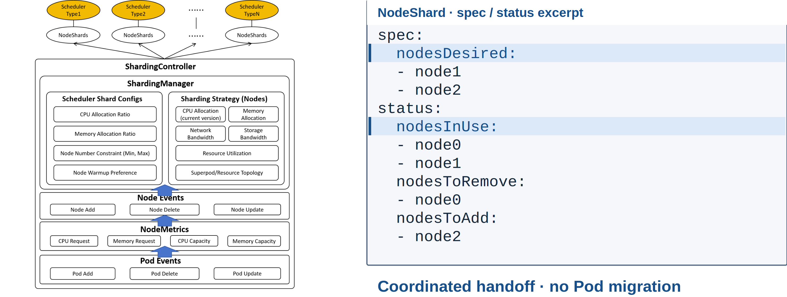
NodeShard: Desired Nodes and Current Use
Volcano | KubeCon + CloudNativeCon North America 2026
06 / 24
Notes:
1:40。重点对照 nodesDesired 和 nodesInUse。期望集合变化后需等待协调器交接，不迁移运行中的 Pod。旧图中的资源策略是架构扩展点，不表示所有策略都已完成。
移入备注的外围说明：
Changing a shard coordinates future placement. It does not migrate running Pods.
Desired membership ≠ immediate use
Coordinators reconcile node access.
Desired membership → coordinated handoff
Desired ≠ in use
技术来源：
https://github.com/volcano-sh/volcano/blob/v1.16.0/docs/design/agent-scheduler.md
本页新版素材与说明：China 2026 slide 9; docs/design/agent-scheduler.md; shard API types.
Visual: na2026/svg/06-nodeshard.svg。PNG 固定几何；复用的旧图原本为位图，新增 YAML 和注释为 SVG 文本。

Slide 7
02
01 Unified scheduling
Multi-level gang
& network topology
02 Multi-level gang & network topology
03 Ecosystem
04 Benchmark framework & progress
From available nodes to runnable workloads.
Volcano | KubeCon + CloudNativeCon North America 2026
07 / 24
Notes:
0:15。转场：拿到可用节点之后，还要保留完整副本以及它们的通信局部性。

Slide 8
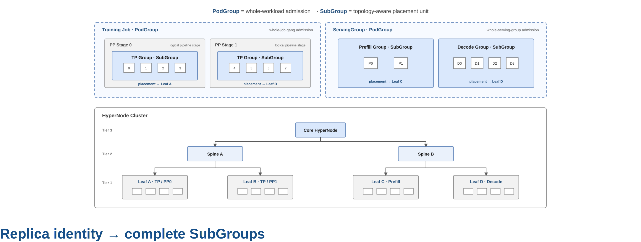
PodGroup and SubGroup: Preserve Workload Structure
Volcano | KubeCon + CloudNativeCon North America 2026
08 / 24
Notes:
2:00。用左边训练和右边 serving 两种结构解释 PodGroup 与 SubGroup，先看完整计算组，再看下面的放置域。一个 policy 可以按 replica label 分出多个实际 SubGroup。
移入备注的外围说明：
Gang requirements apply to the workload and to its complete subgroups.
A SubGroup policy selects Pods. Replica identity can split them into multiple SubGroups.
Workload gang · replica gang
Pod selection + replica identity
技术来源：
https://github.com/volcano-sh/kthena/blob/main/docs/kthena/versioned_docs/version-v1.0.0/user-guide/gang-scheduling.md
本页新版素材与说明：China 2026 slide 14. Figure reused unchanged.
Visual: na2026/svg/08-group-structure.svg。PNG 固定几何；复用的旧图原本为位图，新增 YAML 和注释为 SVG 文本。

Slide 9
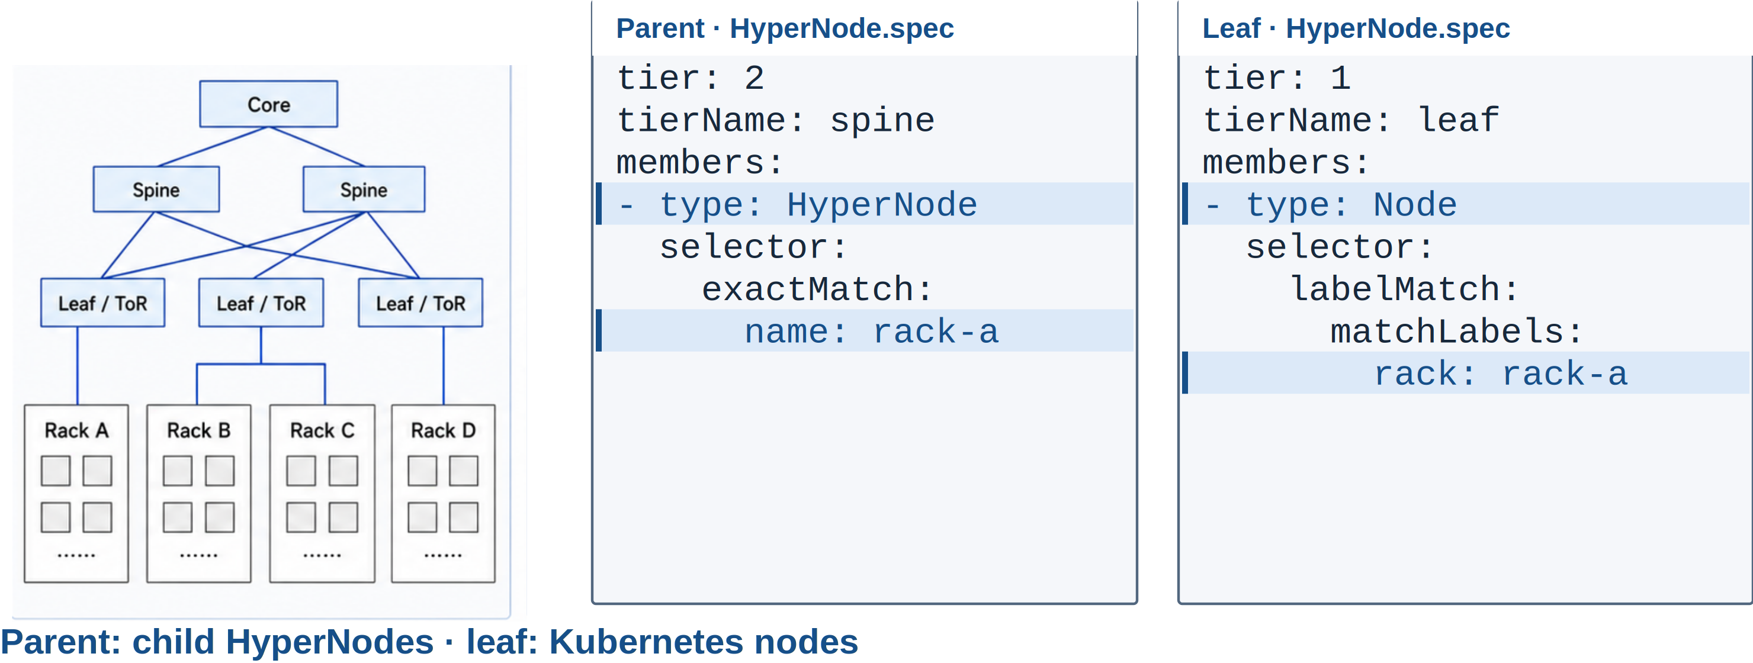
HyperNode: From Physical Fabric to Scheduling Domains
Volcano | KubeCon + CloudNativeCon North America 2026
09 / 24
Notes:
1:30。从物理网络映射到 HyperNode：非叶节点的成员是 HyperNode，叶节点的成员是 Node。standalone HyperNode 已交付；其他调度器 adapter 是独立的集成工作。
移入备注的外围说明：
A parent HyperNode groups child HyperNodes. A leaf groups Kubernetes Nodes.
Physical fabric
The same hierarchy is available through the standalone HyperNode component.
Physical network → scheduling domains
Physical fabric
Standalone HyperNode
技术来源：
https://github.com/volcano-sh/kthena/blob/main/docs/kthena/versioned_docs/version-v1.0.0/user-guide/network-topology.md
https://github.com/volcano-sh/volcano/releases/tag/v1.16.0
本页新版素材与说明：China 2026 slide 16 (physical fabric); benchmark/scripts/create-hypernodes.sh.
Visual: na2026/svg/09-hypernode-api.svg。PNG 固定几何；复用的旧图原本为位图，新增 YAML 和注释为 SVG 文本。

Slide 10
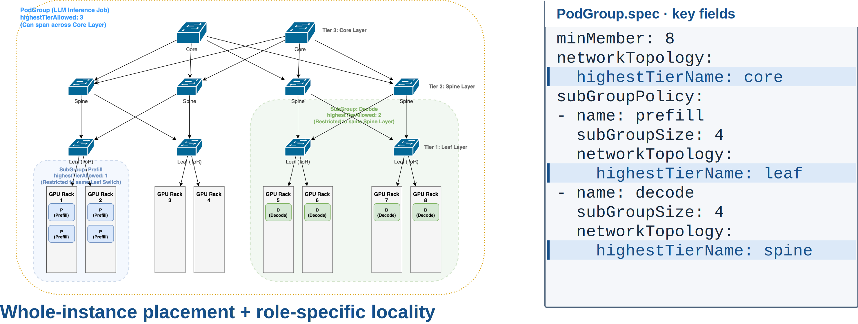
Place Groups at Different Topology Levels
Volcano | KubeCon + CloudNativeCon North America 2026
10 / 24
Notes:
2:00。PodGroup 是较大的实例边界，prefill 和 decode 的 locality 约束可以不同。两层约束都显式填写，不假设子组继承 PodGroup 的 topology。
移入备注的外围说明：
An eight-Pod instance spans a larger domain. Prefill and Decode use different locality constraints.
Named tiers: core (3) · spine (2) · leaf (1)
PodGroup: core · Prefill: leaf · Decode: spine
Core (3) / Spine (2) / Leaf (1)
技术来源：
https://github.com/volcano-sh/kthena/blob/main/docs/kthena/versioned_docs/version-v1.0.0/user-guide/network-topology.md
本页新版素材与说明：EU 2026 slide 16 / China 2026 slide 17; PodGroup API. Selector and Decode fragment below are explanatory excerpts.
本页三处 networkTopology 均按 mode: hard 讲解，展示片段省略重复字段。图例使用两个固定角色组，各4 Pods。spec 片段省略 labelSelector；实际使用时给两个 policy 配置匹配各自角色的 Pod selector。不是可直接 apply 的完整 manifest。
Visual: na2026/svg/10-multilevel-placement.svg。PNG 固定几何；复用的旧图原本为位图，新增 YAML 和注释为 SVG 文本。

Slide 11
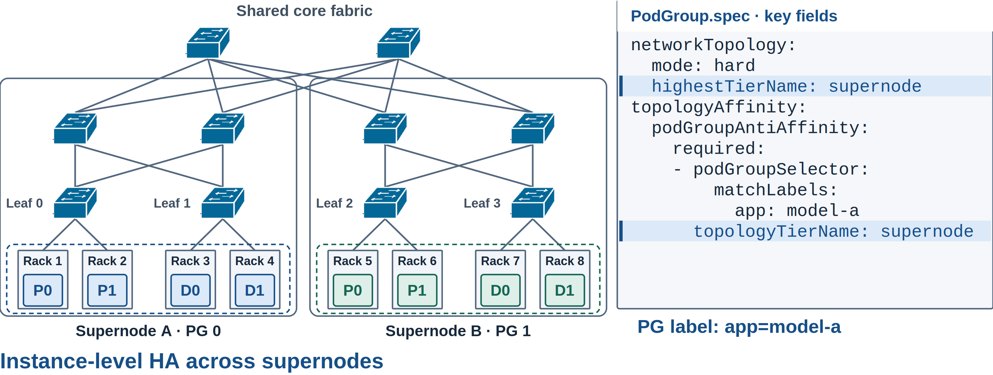
Keep Each Instance Together, Place Instances Apart
Same-label PodGroups → separate supernodes
Volcano | KubeCon + CloudNativeCon North America 2026
11 / 24
Notes:
1:40。复用第 10 页网络层级及交换机符号，两个 Supernode 共用上层 core fabric。两个完整服务实例各在一个域，避免一次域故障同时影响两份实例。P/D 是简化角色标记，不代表唯一模型结构。Kthena ServingGroup→PodGroup 可作为场景，但 topology affinity 接入截至 2026-10-29 仍是开放 proposal #1478 / issue #645，不能说 Kthena 已交付 anti-affinity。HA 的服务恢复还需 routing/health checks，scheduler 不提供应用故障切换。
移入备注的外围说明：
ServingGroup → PodGroup: a Kthena scenario. Anti-affinity integration in Kthena is proposed.
Each PodGroup: app=model-a
One domain can fail without taking both complete instances with it.
PodGroup anti-affinity · Kthena integration proposed
Separate failure domains
Kthena anti-affinity integration: proposed
技术来源：
https://github.com/volcano-sh/volcano/blob/v1.16.0/docs/user-guide/how_to_use_podgroup_anti_affinity.md
https://github.com/volcano-sh/volcano/pull/5349
本页新版素材与说明：docs/user-guide/how_to_use_podgroup_anti_affinity.md; group-topology-affinity plugin, v1.16.
https://github.com/volcano-sh/kthena/pull/1478
https://github.com/volcano-sh/kthena/issues/645
启用 group-topology-affinity 与 network-topology-aware；每个 PodGroup 配置相同分离规则。selector 匹配 PodGroup 标签，默认同 namespace。
Visual: na2026/svg/11-instance-isolation.svg。PNG 固定几何；复用的旧图原本为位图，新增 YAML 和注释为 SVG 文本。

Slide 12
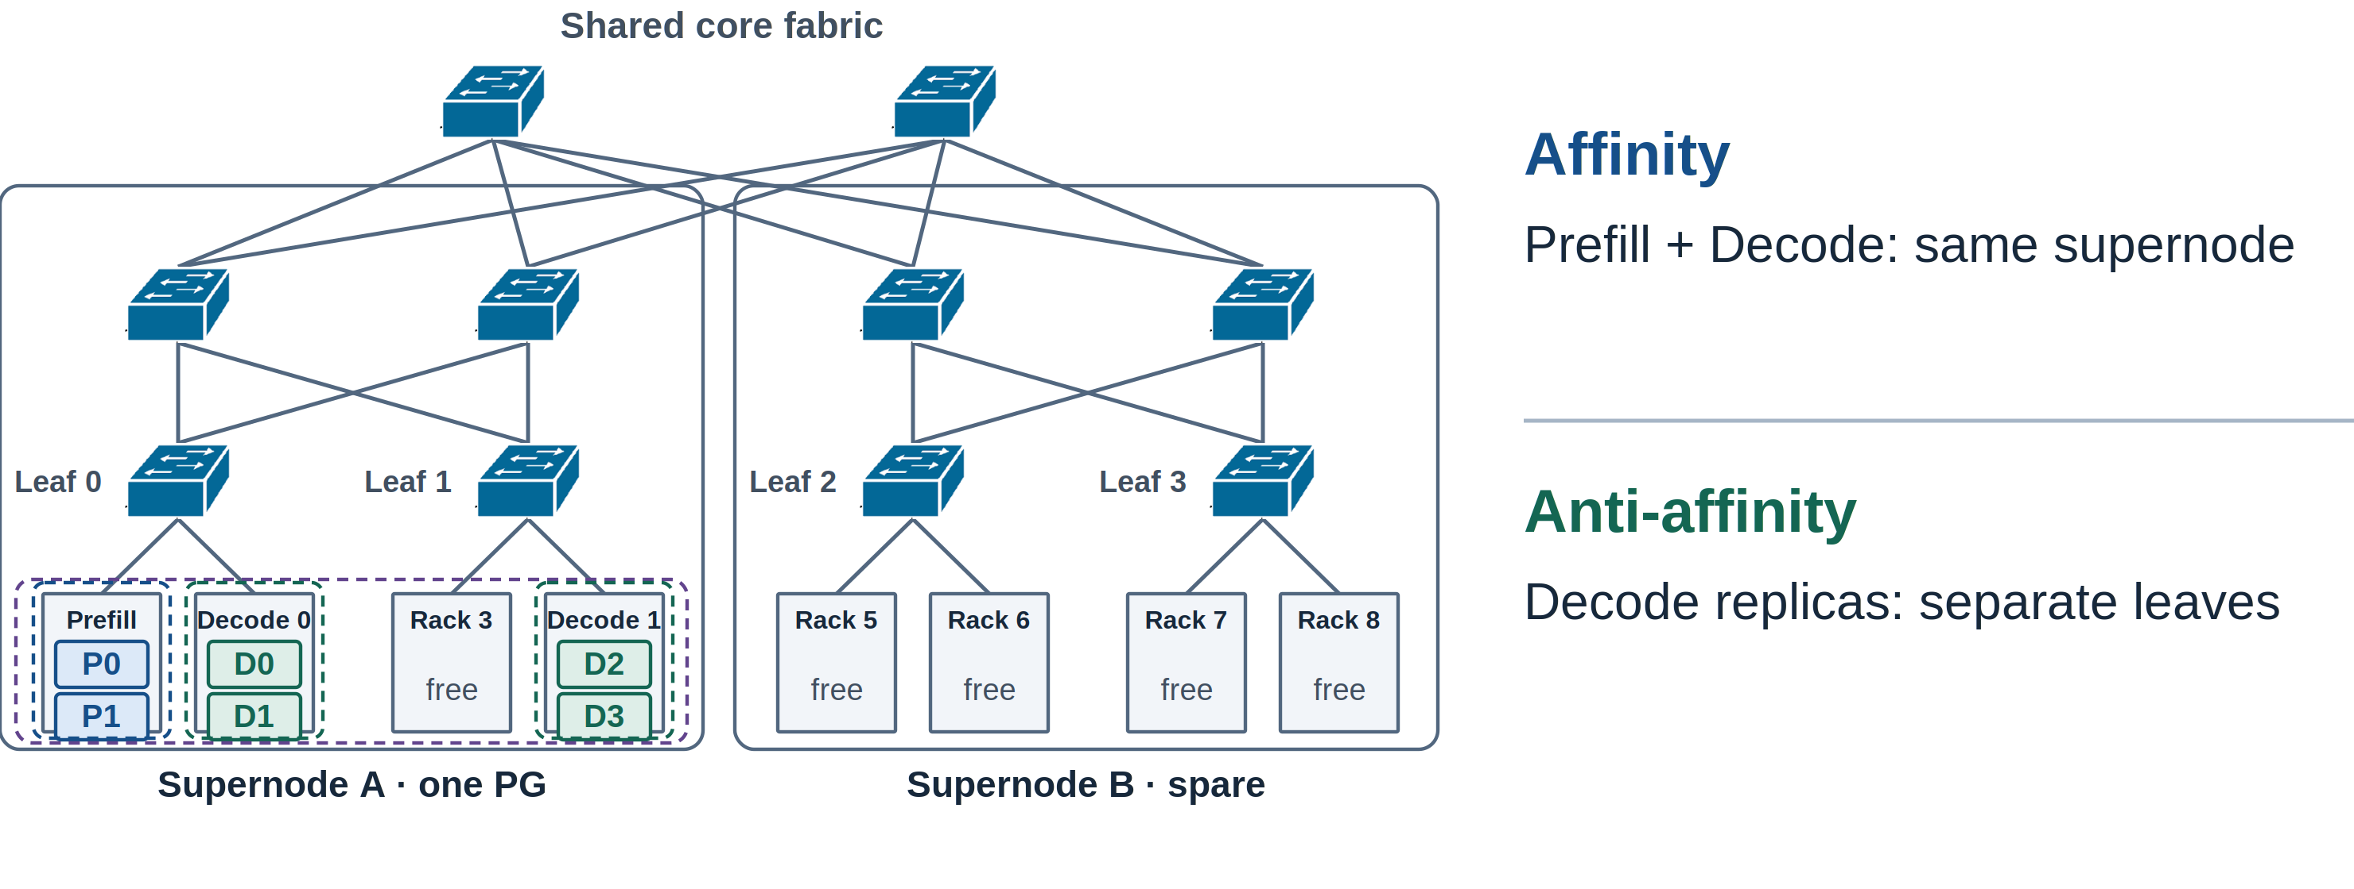
Next: Relationships Between SubGroups
Volcano | KubeCon + CloudNativeCon North America 2026
12 / 24
Notes:
1:20。放在第二章，以相同 fabric 演进关系语义。同一个 PodGroup 的 Prefill 与两个 Decode SubGroup 都位于 Supernode A，满足上层亲和；两个 Decode 副本分别位于 Leaf 0 与 Leaf 1，满足更细层级的反亲和。每个 SubGroup 都是完整两 Pod 组。Supernode B 和其他空闲 rack 表明这些约束是有选择的放置，而非资源只剩此处。关系 API 为 proposed，不提供伪造的可执行 YAML。
移入备注的外围说明：
Cooperate at one topology level; isolate replicas at a finer level.
Keep cooperating groups local while separating replicas inside the same PodGroup.
Proposed SubGroup relationships
Affinity · supernode
Prefill + Decode
Keep KV exchange inside the same supernode.
Anti-affinity · leaf
Decode replica 0 + replica 1
Keep complete replicas on separate leaf domains.
SubGroup affinity / anti-affinity · proposed
Affinity
Prefill + Decode
Same supernode · KV locality
Anti-affinity
Decode replicas
Separate leaves
Affinity
Supernode · KV locality
Anti-affinity
Leaf · replica isolation
Proposed
技术来源：
https://github.com/volcano-sh/volcano/releases/tag/v1.16.0
https://github.com/volcano-sh/volcano/issues/6166
https://github.com/volcano-sh/volcano/blob/v1.16.0/docs/design/group-topology-affinity.md
本页新版素材与说明：docs/design/group-topology-affinity.md (proposed SubGroup relationships); roadmap #6166.
本页为未来方向，不能当作已交付 API。示意同一 PodGroup 内将协作组放近、将副本分开；具体 selector 与亲和关系设计仍需社区讨论。
Visual: na2026/svg/12-subgroup-next.svg。PNG 固定几何；复用的旧图原本为位图，新增 YAML 和注释为 SVG 文本。

Slide 13
03
01 Unified scheduling
Ecosystem
02 Multi-level gang & network topology
03 Ecosystem
04 Benchmark framework & progress
Workload controllers carry scheduling intent.
Volcano | KubeCon + CloudNativeCon North America 2026
13 / 24
Notes:
0:10。转场：这些分组和拓扑语义，最终要由用户真正使用的 controller 传进来。

Slide 14
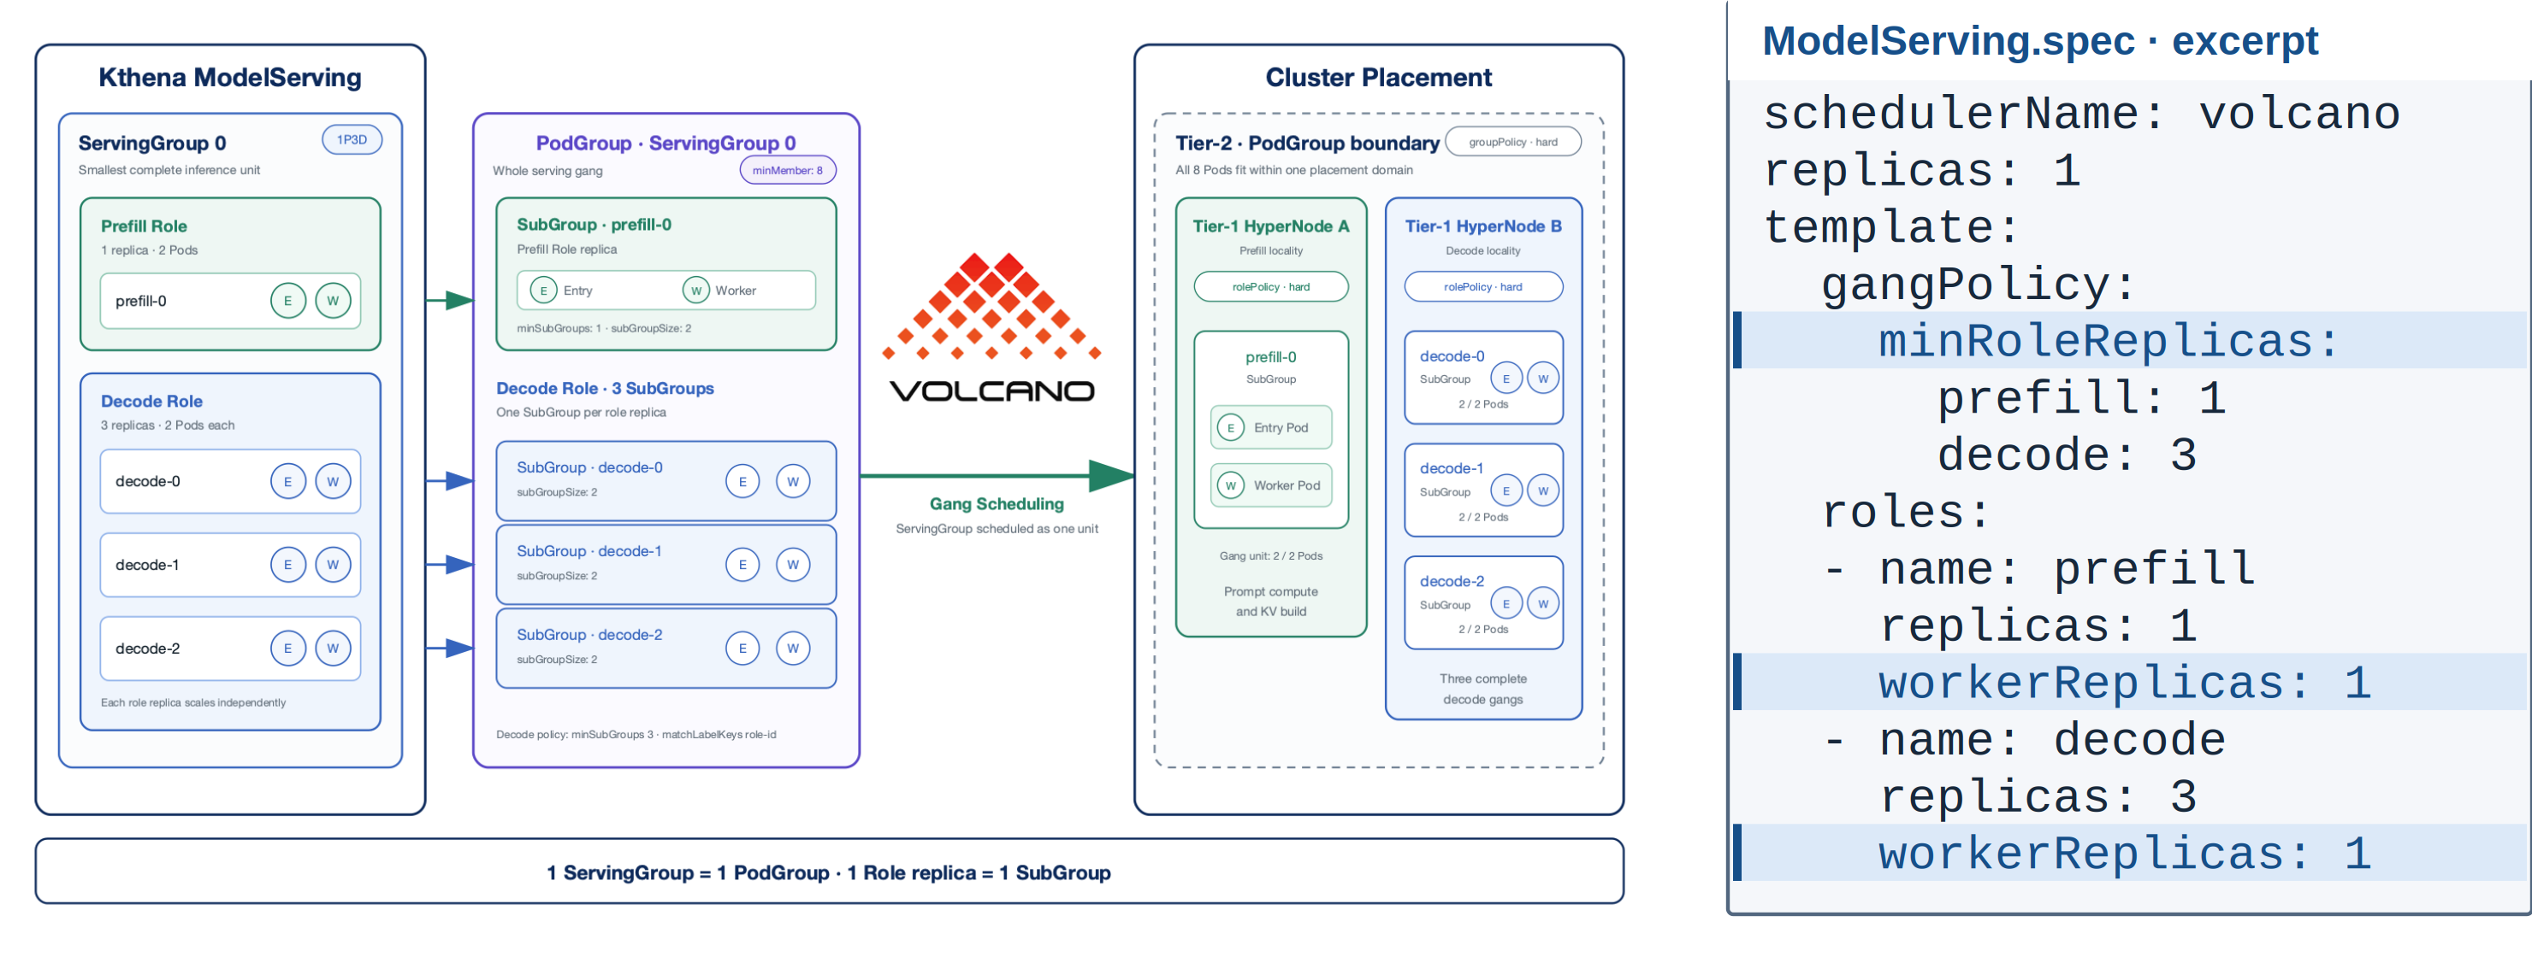
Kthena: From Serving Roles to Scheduling Groups
ServingGroup → PodGroup · role replica → SubGroup
Volcano | KubeCon + CloudNativeCon North America 2026
14 / 24
Notes:
1:40。沿用 China Kthena 图及关键 YAML，按 ServingGroup→PodGroup、role replica→SubGroup 的顺序讲。一个 Entry 加一个 Worker 组成两 Pod 副本。
移入备注的外围说明：
Pod templates omitted.
One ServingGroup maps to one PodGroup. Each role replica forms a SubGroup.
ServingGroup → PodGroup · Role replica → SubGroup
技术来源：
https://github.com/volcano-sh/kthena/blob/main/docs/kthena/versioned_docs/version-v1.0.0/user-guide/gang-scheduling.md
本页新版素材与说明：China 2026 slide 22; Kthena ModelServing gang scheduling guide.
图中每个 role replica 有一个 Entry 和一个 Worker Pod；YAML 保留 gangPolicy、role 副本数与 workerReplicas，省略 entryTemplate、workerTemplate 与 networkTopology。Gang 不表示所有 Pod 原子绑定或同时启动。
Visual: na2026/svg/14-kthena-mapping.svg。PNG 固定几何；复用的旧图原本为位图，新增 YAML 和注释为 SVG 文本。

Slide 15
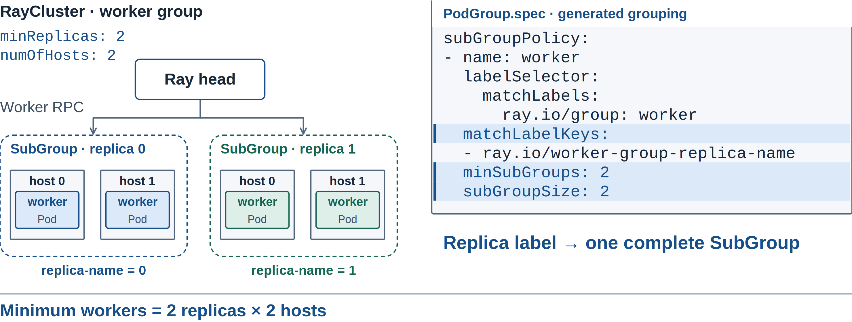
KubeRay: A Replica Can Span Multiple Pods
Volcano | KubeCon + CloudNativeCon North America 2026
15 / 24
Notes:
1:30。两个 replica，每个两个 hosts；用 matchLabelKeys 保持副本身份。head 另有分组。本页不把尚在推进的 KubeRay topology PR 当作已合入能力。
移入备注的外围说明：
The replica label separates complete groups inside one WorkerGroup.
worker registration / RPC
One replica label → one complete SubGroup
Two replicas × two hosts = four worker Pods
Gang support is merged. Replica topology is in progress.
Multi-host replicas · label-based grouping
Ray head
separate group
Replica label → SubGroup
Gang: merged · Topology: in progress
技术来源：
https://github.com/kuberay-project/kuberay/pull/5249
https://github.com/kuberay-project/kuberay/pull/5369
本页新版素材与说明：KubeRay #5249; #5369 open as of 2026-10-29. Volcano SubGroup API.
Visual: na2026/svg/15-ray-replicas.svg。PNG 固定几何；复用的旧图原本为位图，新增 YAML 和注释为 SVG 文本。

Slide 16
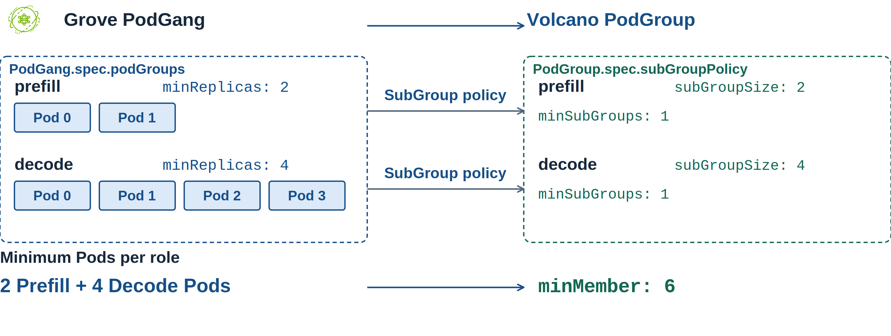
Grove: Carry PodGang Structure into Volcano
Volcano | KubeCon + CloudNativeCon North America 2026
16 / 24
Notes:
0:50。根据 Grove main 的实际 Volcano backend：一个 PodGang 生成一个 Volcano PodGroup；PodGang.spec.podGroups 中每一项生成 SubGroup policy，name 和 PodClique label 选中组，subGroupSize=max(minReplicas,1)，minSubGroups=1。图示两个组分别 2 和 4 Pods，总 minMember=6。当前 main 明确拒绝 PodCliqueSet / PodClique / PodCliqueScalingGroup 上的 topologyConstraint。区分已合入的 adapter 与发布版本支持；不要只依据 #516 初始 PR 描述判断后续 main。
https://github.com/NVIDIA/grove/blob/main/operator/internal/scheduler/volcano/backend.go
移入备注的外围说明：
The backend translates Grove PodGroups into Volcano SubGroup policies.
one policy
one policy
PodGang minimum = 2 + 4 = 6 Pods
Gang and SubGroup mapping are available. Topology support is pending.
Gang / SubGroup mapping available · topology unsupported
policy
policy
PodGang: 6 Pods
minMember: 6
Gang mapping available · topology unsupported
本页新版素材与说明：https://github.com/NVIDIA/grove/blob/1d8f83b38a3f54d9827bb579a68c0315ed54ce91/operator/internal/scheduler/volcano/backend.go (reviewed 2026-10-29); #516 merged. topologyConstraint is currently rejected.
Visual: na2026/svg/16-grove-mapping.svg。PNG 固定几何；复用的旧图原本为位图，新增 YAML 和注释为 SVG 文本。

Slide 17
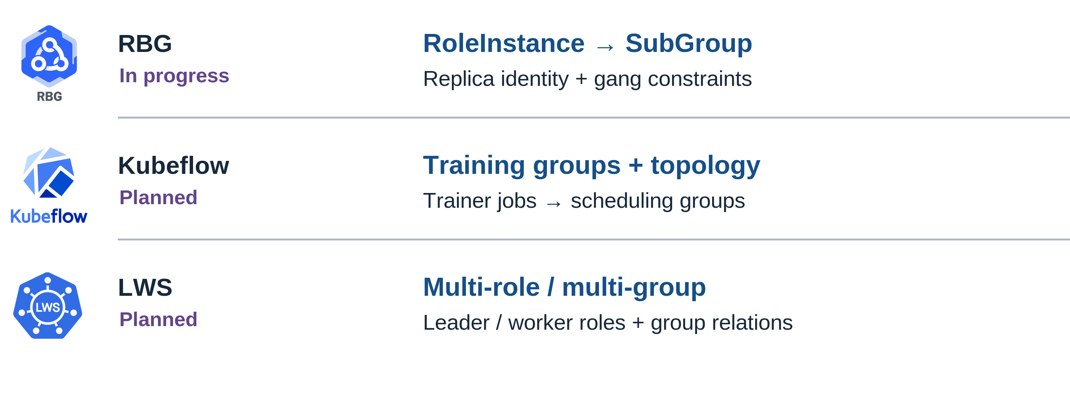
Next: RBG, Kubeflow, and LWS
Volcano | KubeCon + CloudNativeCon North America 2026
17 / 24
Notes:
0:50。具体 Kthena、KubeRay、Grove 案例之后再讲后续社区方向。RBG 推进中，已有 RoleInstance→SubGroup 基础；Kubeflow 计划在现有 Volcano 插件上深化分组及拓扑；LWS 计划 multi-role/multi-group 支持。状态来自 maintainer 的推进计划，不能写作全部已交付。
移入备注的外围说明：
Carry roles, replicas, and placement intent from the controller into Volcano.
Build on current integrations. Carry finer group structure and placement requirements.
In progress
RoleInstance → SubGroup
Extend the existing gang integration.
Planned
Training groups + topology
Build on the Volcano scheduler plugin.
Planned
Multi-role / multi-group support
Connect group relationships to scheduling.
RBG in progress · Kubeflow and LWS planned
Gang integration
Volcano plugin
Cross-group placement
技术来源：
https://github.com/volcano-sh/kthena/blob/main/docs/kthena/versioned_docs/version-v1.0.0/user-guide/gang-scheduling.md
https://github.com/volcano-sh/kthena/blob/main/docs/kthena/versioned_docs/version-v1.0.0/user-guide/network-topology.md
https://github.com/kuberay-project/kuberay/pull/5249
https://github.com/kuberay-project/kuberay/pull/5369
https://github.com/ai-dynamo/grove/pull/516
https://trainer.kubeflow.org/en/latest/operator-guides/job-scheduling/volcano.html
https://github.com/kubernetes-sigs/lws/pull/498
https://github.com/sgl-project/rbg/blob/main/doc/features/gang-scheduling.md
https://github.com/kubernetes-sigs/lws/blob/main/README.md
本页新版素材与说明：Kthena docs; KubeRay #5249 / #5369; Grove #516; RBG gang-scheduling docs; Kubeflow Trainer Volcano plugin; LWS README / DisaggregatedSet. Roadmap intent supplied by maintainers.
https://github.com/sgl-project/rbg/blob/main/doc/features/gang-scheduling.md
https://github.com/kubernetes-sigs/lws/blob/main/README.md
右侧为 maintainer 提供的推进方向；RBG 公开文档已有 RoleInstance→SubGroup 基础。LWS 已有副本组，下一步是跨角色 multi-group 调度集成。
Visual: na2026/svg/17-ecosystem.svg。PNG 固定几何；复用的旧图原本为位图，新增 YAML 和注释为 SVG 文本。

Slide 18
04
01 Unified scheduling
Benchmark
framework & progress
02 Multi-level gang & network topology
03 Ecosystem
04 Benchmark framework & progress
Measure behavior across workload shapes.
Volcano | KubeCon + CloudNativeCon North America 2026
18 / 24
Notes:
0:10。转场：接入的控制器和约束越多，就越需要可重复的 benchmark。

Slide 19
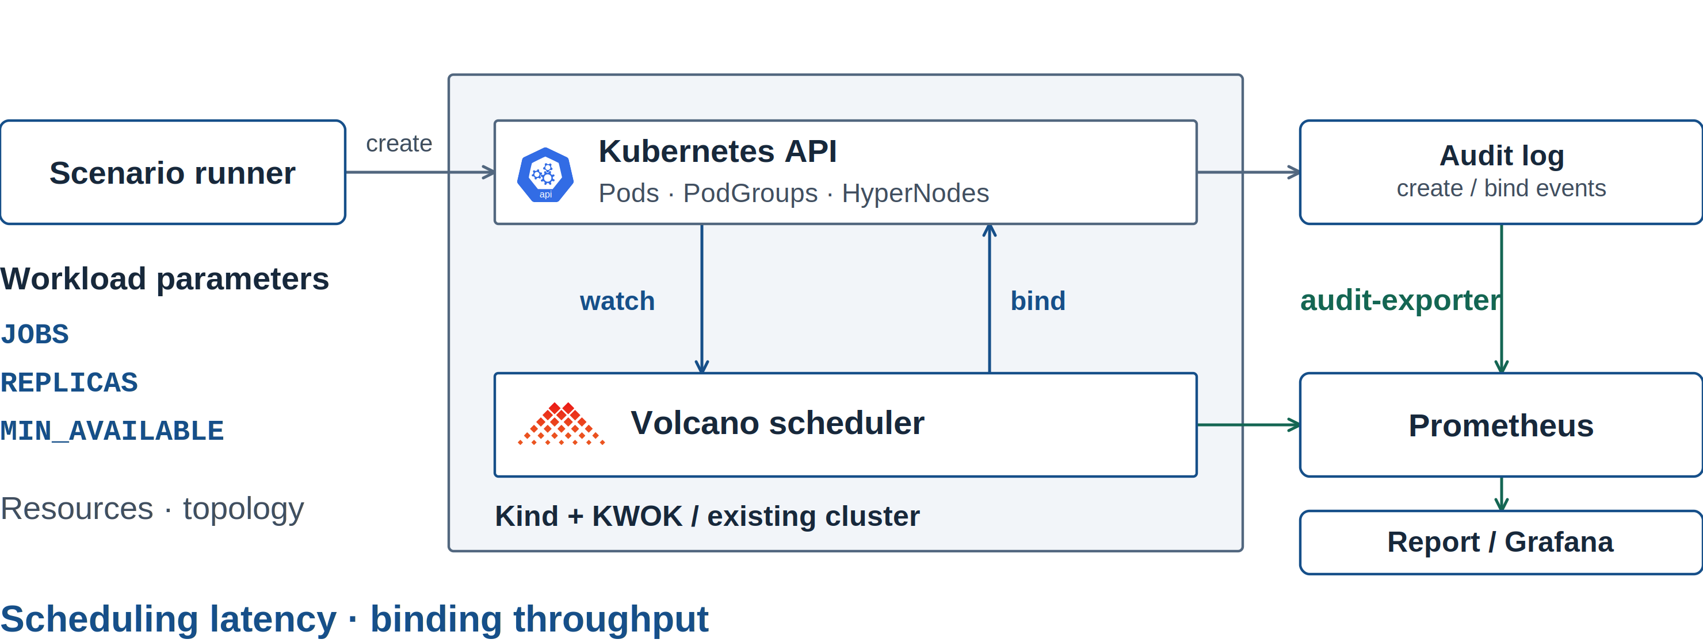
A Repeatable Scheduling Benchmark Framework
Volcano | KubeCon + CloudNativeCon North America 2026
19 / 24
Notes:
1:30。沿数据路径解释 benchmark：场景输入→API/调度器→audit-exporter 与 Prometheus→报告。KWOK 只验证调度行为，不代表真实 GPU 执行吞吐。
移入备注的外围说明：
The harness controls the scenario and records observations; KWOK does not execute GPU work.
Generate scenarios, observe API events, and retain comparable measurements.
Scenario
Cluster under test
Observation
Gang / Pod generation
Version + resources + topology
audit + scheduler metrics
audit-exporter
Scenario → cluster → measurements
Scenario
Cluster under test
Measurements
Scenario runner
Gangs / Pods
Workload parameters
Prometheus
Scheduler metrics
技术来源：
https://github.com/volcano-sh/volcano/blob/a3d50b503/benchmark/README.md
https://github.com/volcano-sh/volcano/blob/a3d50b503/benchmark/scripts/README.md
本页新版素材与说明：benchmark/README.md; benchmark/scripts; benchmark/config; benchmark/testcases.
Visual: na2026/svg/19-benchmark-architecture.svg。PNG 固定几何；复用的旧图原本为位图，新增 YAML 和注释为 SVG 文本。

Slide 20
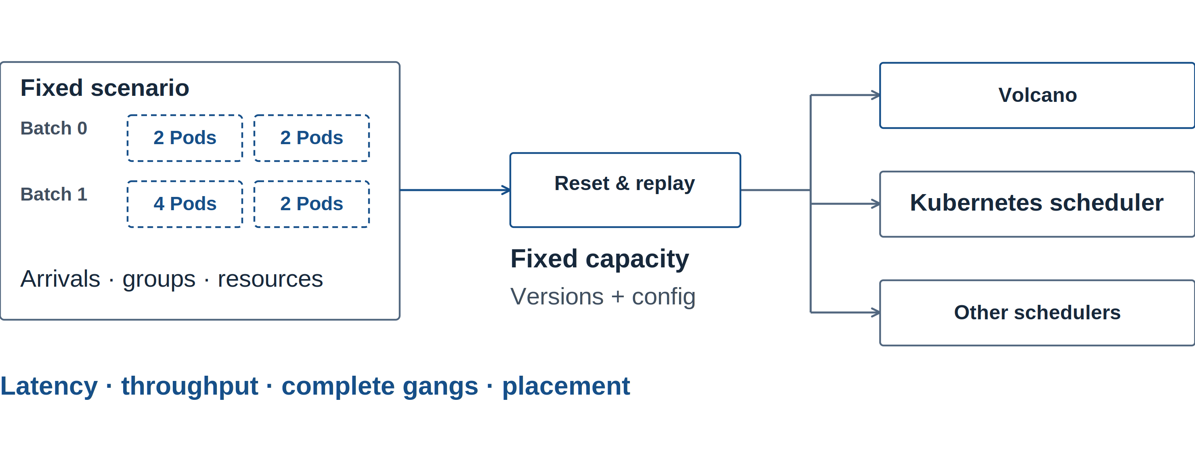
Next: Cross-Scheduler Comparisons
Volcano | KubeCon + CloudNativeCon North America 2026
20 / 24
Notes:
1:20。已有 harness 为重复场景和指标采集打底。后续在同样集群容量、相同 workload arrivals/grouping/resources 下逐个运行不同 scheduler；每次 reset，不能让调度器同时竞争资源。固定每个实现的版本、配置和指标口径；记录各自合理调参后的配置。Kubernetes scheduler 可作为支持场景的 baseline，其他调度器集合待确定。未支持 gang 或 topology 的调度器不强行比较相同语义，须标注差异。比较 tail latency、binding throughput、完整 gang 数及放置正确性，不展示虚构结果。
移入备注的外围说明：
¹ Planned comparison set; match workload semantics and record unsupported constraints.
Harness available. Next: cross-scheduler runs and representative scenarios.
Repeat controlled runs to understand throughput, latency, and placement tradeoffs.
One workload, replayed
Planned comparisons
Same arrivals · groups · resources
one scheduler per run
Same cluster capacity
Pin versions + config
Kubernetes scheduler
Compare latency · binding throughput · completed gangs · placement
Cross-scheduler comparisons · planned
Fixed workload
Schedulers
One per run
Latency · Throughput · Complete gangs · Placement
Planned comparisons
技术来源：
https://github.com/volcano-sh/volcano/blob/a3d50b503/benchmark/scripts/collect-report.sh
https://github.com/volcano-sh/volcano/blob/a3d50b503/benchmark/manifests/monitoring/grafana-dashboard.json
https://github.com/volcano-sh/volcano/issues/6166
本页新版素材与说明：benchmark/README.md; benchmark/Makefile; benchmark/scripts/collect-report.sh.
Visual: na2026/svg/20-benchmark-progress.svg。PNG 固定几何；复用的旧图原本为位图，新增 YAML 和注释为 SVG 文本。

Slide 21
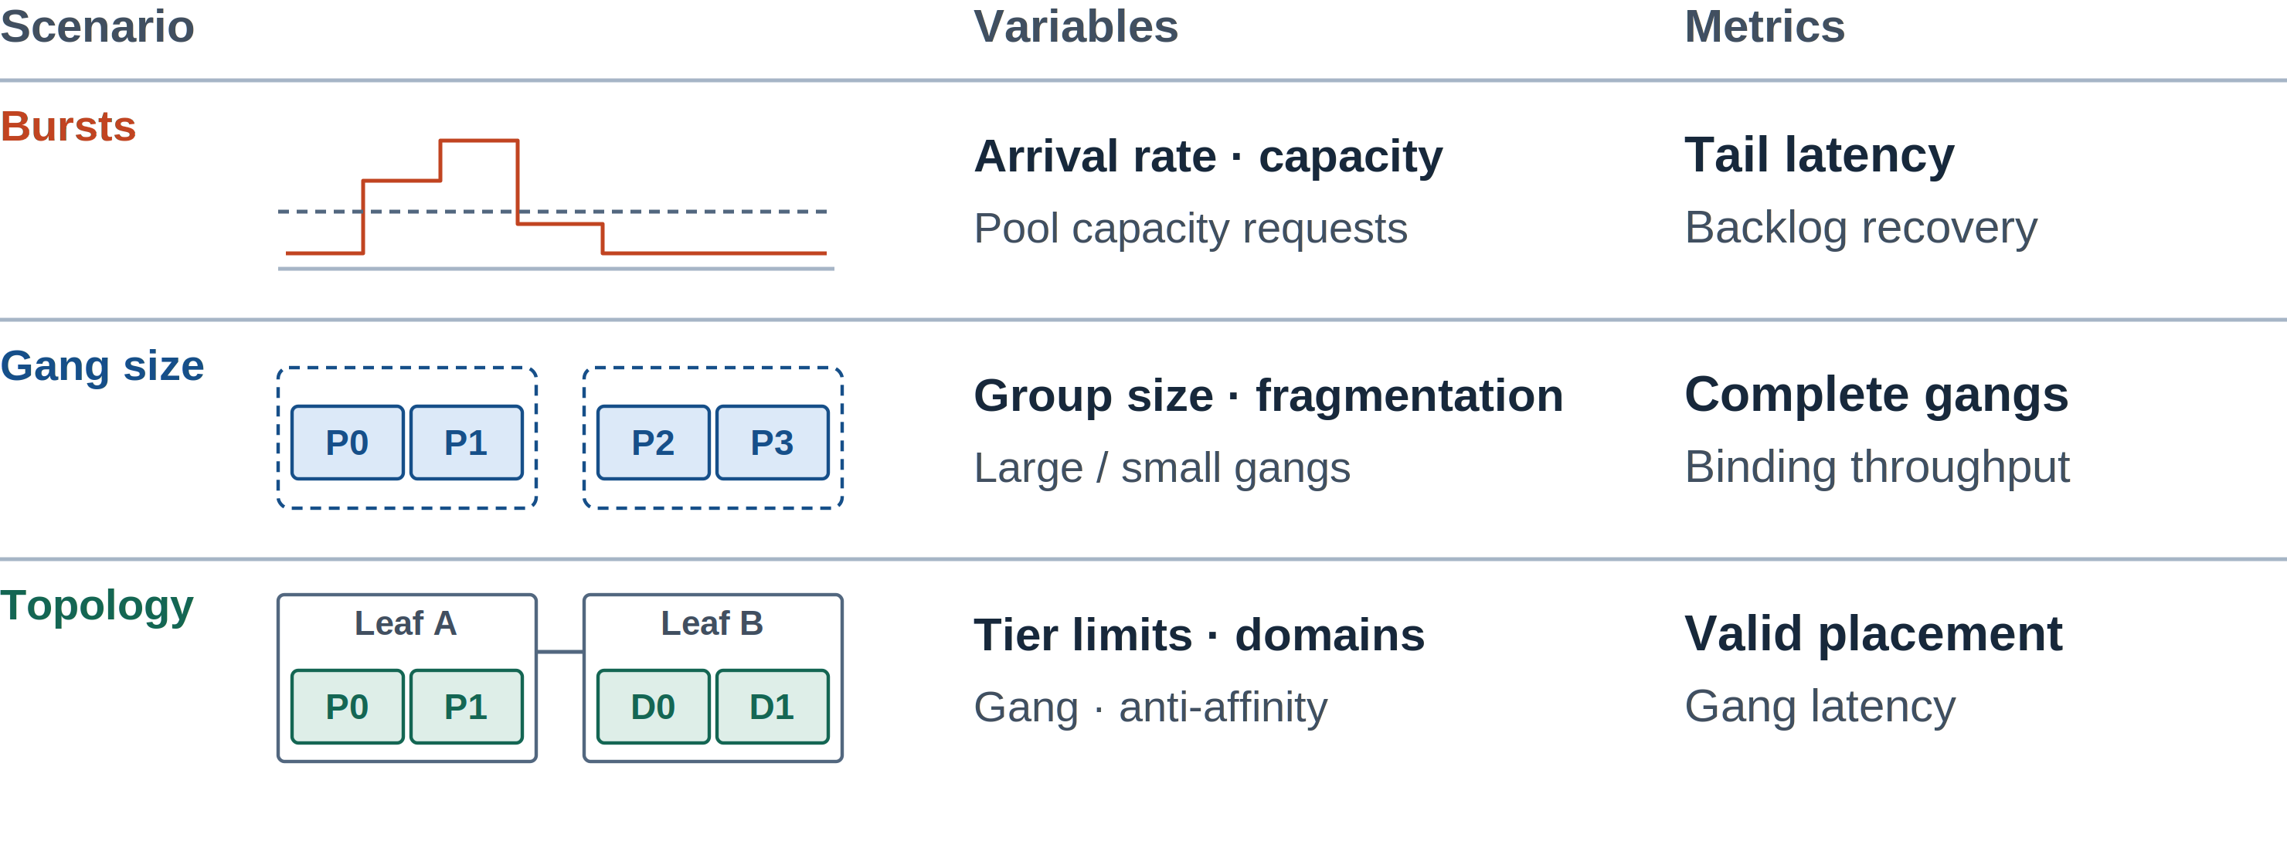
Next: Workload and Topology Test Matrix
Volcano | KubeCon + CloudNativeCon North America 2026
21 / 24
Notes:
1:20。选择代表性场景，寻找每种 scheduler 的适用边界，不只找有利 Volcano 的配置。第一类改变 arrival rate、预留容量，观察突发的尾延迟和积压恢复；只测试 pool 容量请求的调度，不用 KWOK 宣称完整 agent runtime 延迟。第二类改变 SubGroup 大小和可用资源碎片，观察完整 gangs 和 binding throughput。第三类组合 topology tier limits、可用域、gang/anti-affinity，检查 placement correctness 与完成延迟。KWOK 可以验证调度行为；NCCL/KV 带宽及实际模型吞吐需要真实硬件另测。本页是 ongoing/planned test matrix，没有 benchmark 数字。
移入备注的外围说明：
Expand tests across arrival patterns, group structure, and network topology.
Test shape
What to vary
What to observe
Arrival rate / spare capacity
Warm-pool capacity requests
Tail scheduling latency
Backlog recovery
SubGroup size / fragmentation
Few large vs. many small groups
Complete gangs placed
Binding throughput
Tier limits / available domains
Locality + gang + anti-affinity
Placement correctness
Gang completion + latency
Find the best-fit scenarios and test topology-aware gang placement.
Bursts · group size · topology
Planned test matrix
技术来源：
https://github.com/volcano-sh/volcano/blob/a3d50b503/benchmark/README.md
https://github.com/volcano-sh/volcano/blob/a3d50b503/benchmark/scripts/collect-report.sh
本页新版素材与说明：benchmark/scripts/collect-report.sh and audit-exporter event definitions. No performance results selected.
口径：scheduledAt−createdAt；binding throughput 为成功 bindings / 首尾成功 bind 时间差。对照时保留原始事件、重复次数与环境配置。命令与完整指标定义见 benchmark/README.md。
Visual: na2026/svg/21-benchmark-measurement.svg。PNG 固定几何；复用的旧图原本为位图，新增 YAML 和注释为 SVG 文本。

Slide 22
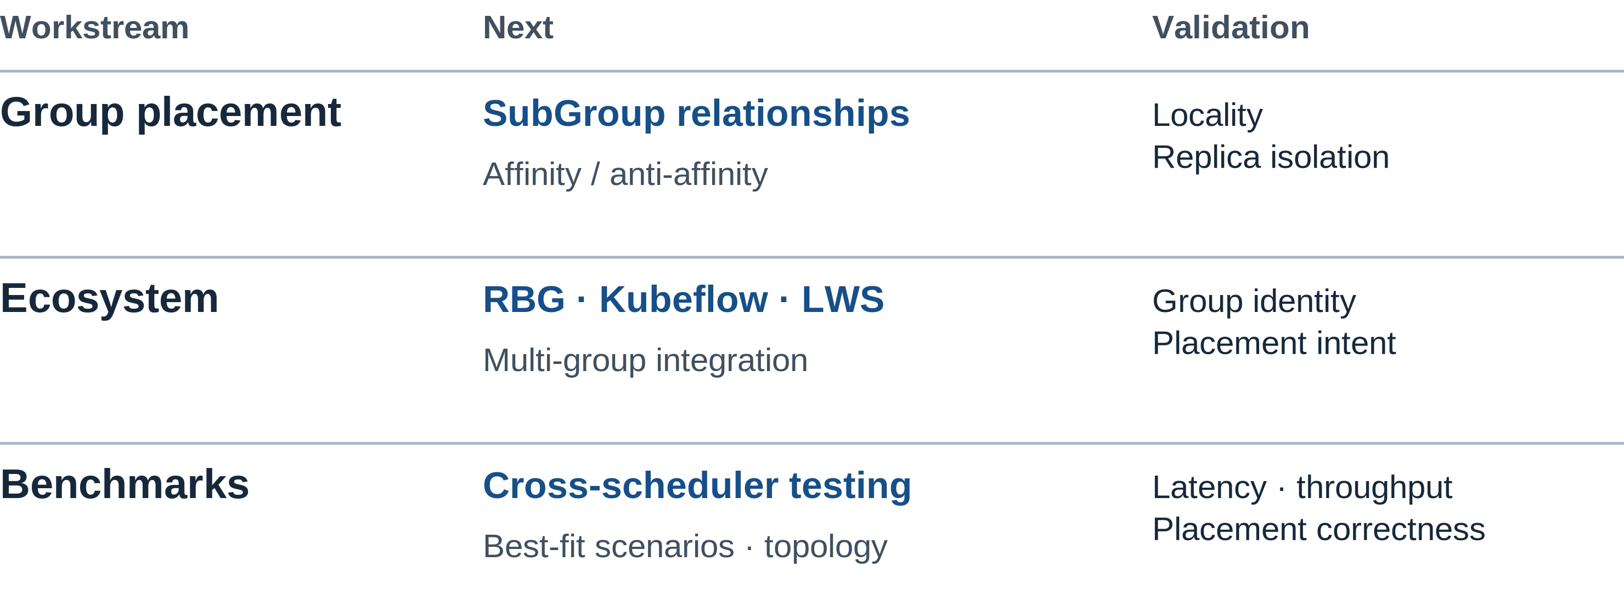
What We Will Work On Next
Volcano | KubeCon + CloudNativeCon North America 2026
22 / 24
Notes:
1:00。收尾强调下一步：SubGroup affinity/anti-affinity 的语义与实现；RBG/Kubeflow/LWS multi-group 的社区工作；多调度器横向对照、代表性场景及 topology-aware gang 测试。
移入备注的外围说明：
Bring a controller mapping, a placement requirement, or a reproducible workload to the community.
Next steps in group placement, controller integration, and benchmarking.
Workstream
Next step
What to validate
Group placement
SubGroup affinity / anti-affinity
Extend the existing gang and topology model.
Cooperating groups stay local. Replicas use separate domains.
Community integration
RBG · Kubeflow · LWS multi-group
Carry roles and replica identity into scheduling.
Controllers preserve complete groups and map placement constraints.
Benchmark validation
Compare schedulers across scenarios
Find best-fit cases. Test topology-aware gangs.
Retain latency distributions, binding throughput, and raw events.
Group placement · ecosystem · benchmarks
技术来源：
https://github.com/volcano-sh/volcano/issues/6166
https://github.com/volcano-sh/volcano/blob/a3d50b503/benchmark/README.md
本页新版素材与说明：
Visual: na2026/svg/22-takeaways.svg。PNG 固定几何；复用的旧图原本为位图，新增 YAML 和注释为 SVG 文本。

Slide 23
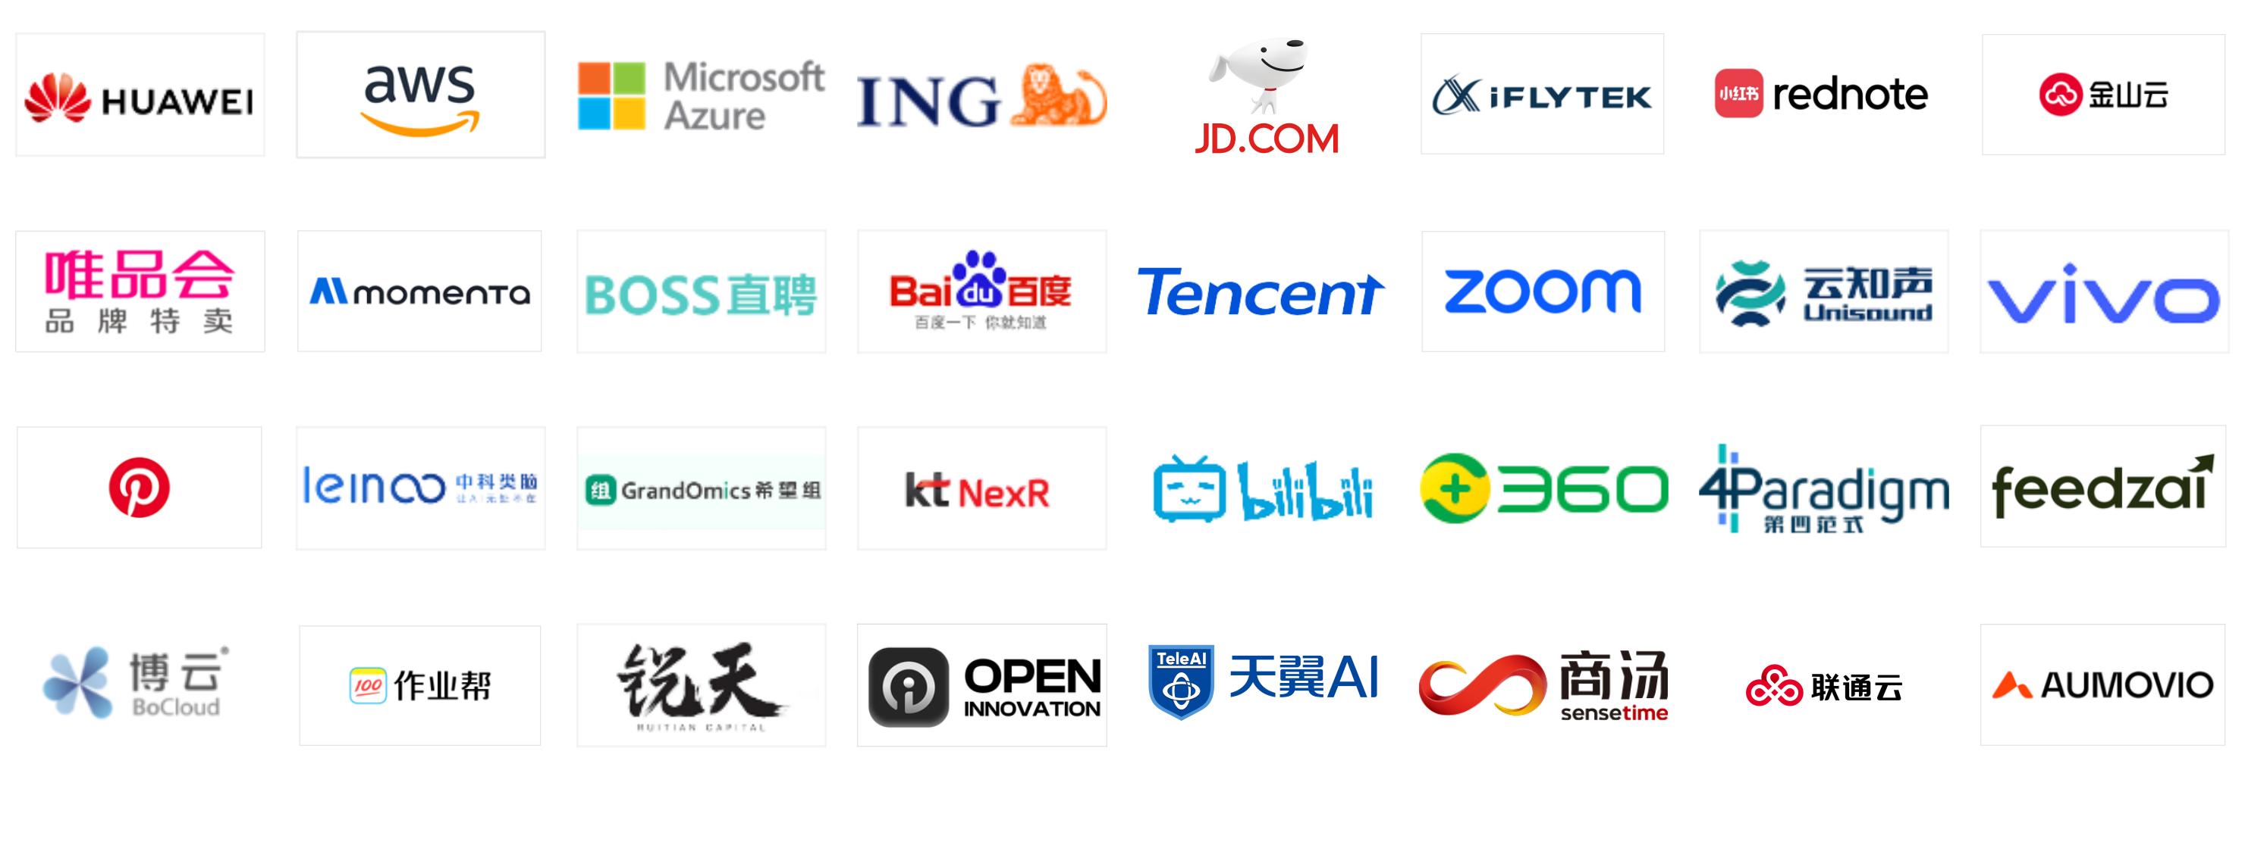
Volcano community
Volcano | KubeCon + CloudNativeCon North America 2026
23 / 24
Notes:
0:20。复用 China 第 25 页的 32 个社区用户 logo，保留素材来源，不新增商业伙伴关系或用户数量声明。
本页新版素材与说明：China 2026 slide 25. Original user logos, rearranged into eight columns; no new adopter count or partnership claims.
Visual: na2026/svg/23-community-users.svg。PNG 固定几何；复用的旧图原本为位图，新增 YAML 和注释为 SVG 文本。

Slide 24

Thank you
Volcano | KubeCon + CloudNativeCon North America 2026
24 / 24
Notes:
5:00。问答。优先收集工作负载如何分组、需要哪些拓扑关系，以及可重复的测试场景。
移入备注的外围说明：
Workload shapes, integration feedback, and reproducible observations are welcome.
二维码复用 China 第 25 页，分别指向 https://volcano.sh、https://github.com/volcano-sh/volcano、https://cloud-native.slack.com/archives/C011GJDQS0N。
技术来源：
https://github.com/volcano-sh/volcano/blob/v1.16.0/docs/design/agent-scheduler.md
https://github.com/volcano-sh/volcano/blob/v1.16.0/docs/user-guide/how_to_use_podgroup_anti_affinity.md
https://github.com/volcano-sh/volcano/issues/6166
本页新版素材与说明：
Visual: na2026/svg/24-questions.svg。PNG 固定几何；复用的旧图原本为位图，新增 YAML 和注释为 SVG 文本。

