Slide 1
Volcano for the Agentic AI Era:
Unified Scheduling Across Training, Inference, and Agents
Ricardo Aravena
Rainie Li
AI Infrastructure Lead at Nunchux AI
Engineering Manager at Pinterest
CNCF TOC Alternate (GB)
Apache YuniKorn PMC member
Notes:
Today we will look at how Volcano supports different AI workloads on shared Kubernetes clusters. We will move from scheduling paths to group placement, then show how ecosystem integrations and benchmarks bring these ideas into practice.

Slide 2

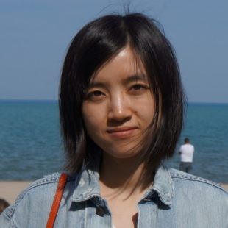
Speakers
Ricardo Aravena
Rainie Li
AI Infrastructure Lead, Nunchux AI
Engineering Manager, Pinterest
CNCF TOC Alternate (GB)
Cloud native and AI infrastructure
Data processing infrastructure
Apache YuniKorn PMC member
nunchux.ai
yunikorn.apache.org
Volcano at KubeCon + CloudNativeCon North America 2026
02 / 26
Notes:
Briefly introduce yourselves and your work in cloud native infrastructure. Connect that experience to the challenges of scheduling training, inference, and emerging agent workloads.

Slide 3
01
01 Unified scheduling
Unified scheduling
02 Multi-level gang & network topology
03 Ecosystem
Different paths. Shared infrastructure.
04 Benchmark framework & progress
Notes:
Different workloads have different scheduling needs. Start with how Volcano coordinates those needs across a shared cluster.

Slide 4
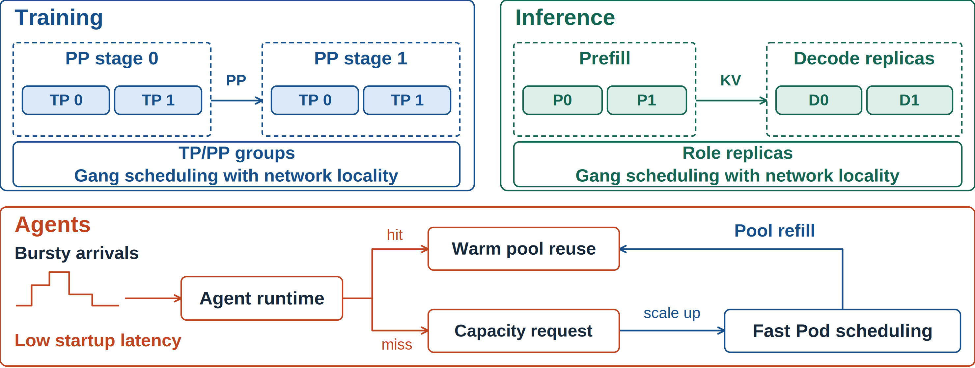
Different Workloads, Shared Infrastructure
Volcano at KubeCon + CloudNativeCon North America 2026
04 / 26
Notes:
Training and inference both need complete groups and good network locality. Training groups follow parallelism patterns such as TP and PP, while inference groups follow roles and replicas. Agent workloads add bursts and startup latency concerns. A runtime controller can reuse warm capacity, then request more Pods through a fast scheduling path when the pool needs to grow.

Slide 5
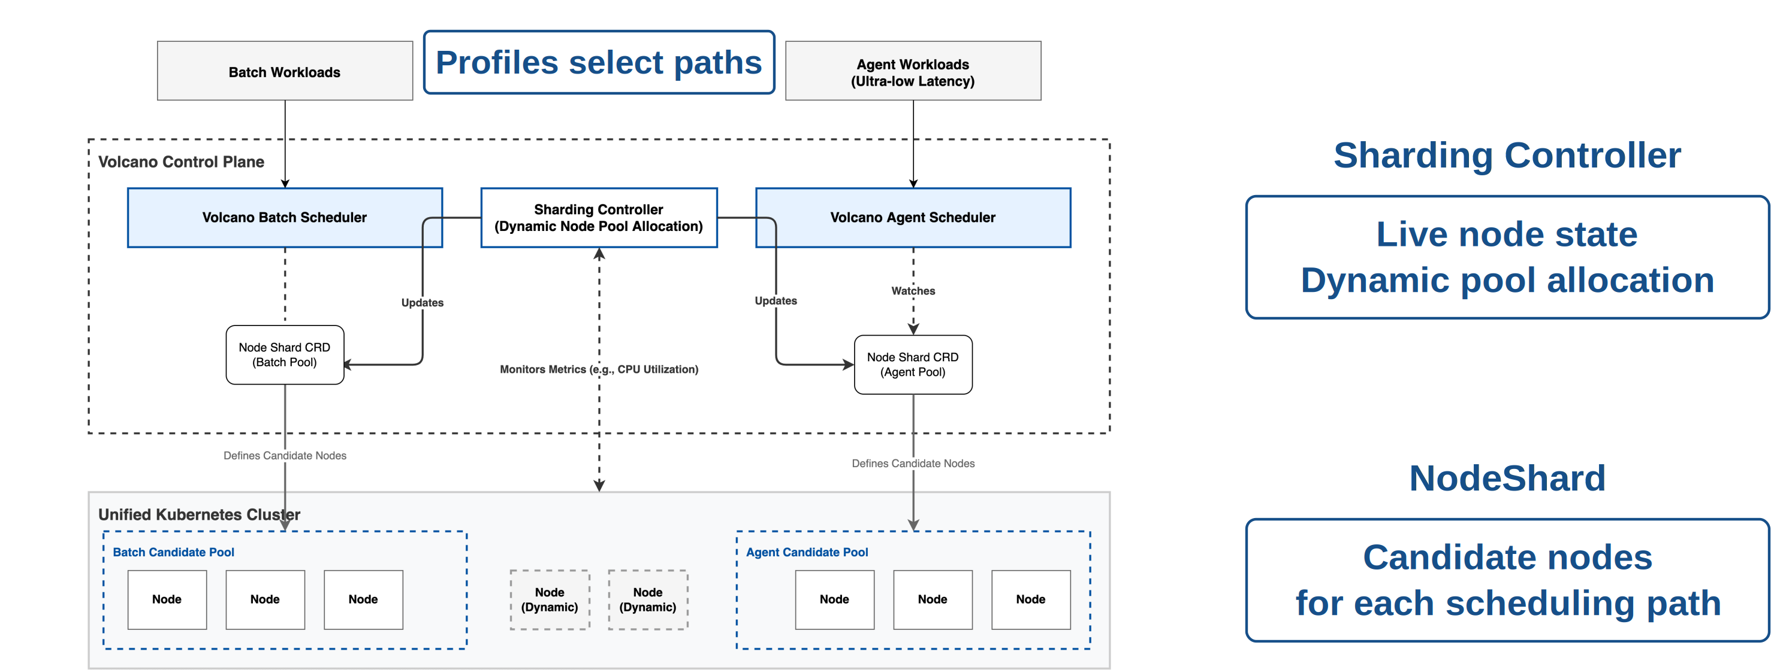
Unified Scheduling Framework
Volcano at KubeCon + CloudNativeCon North America 2026
05 / 26
Notes:
Different workloads can use different scheduling paths, while sharing the same cluster. The Sharding Controller uses node metrics and scheduling strategies to adjust the node pools. NodeShard carries the desired allocation, and the schedulers coordinate changes with the nodes already in use. This gives each path room to adapt as workload demands change.

Slide 6
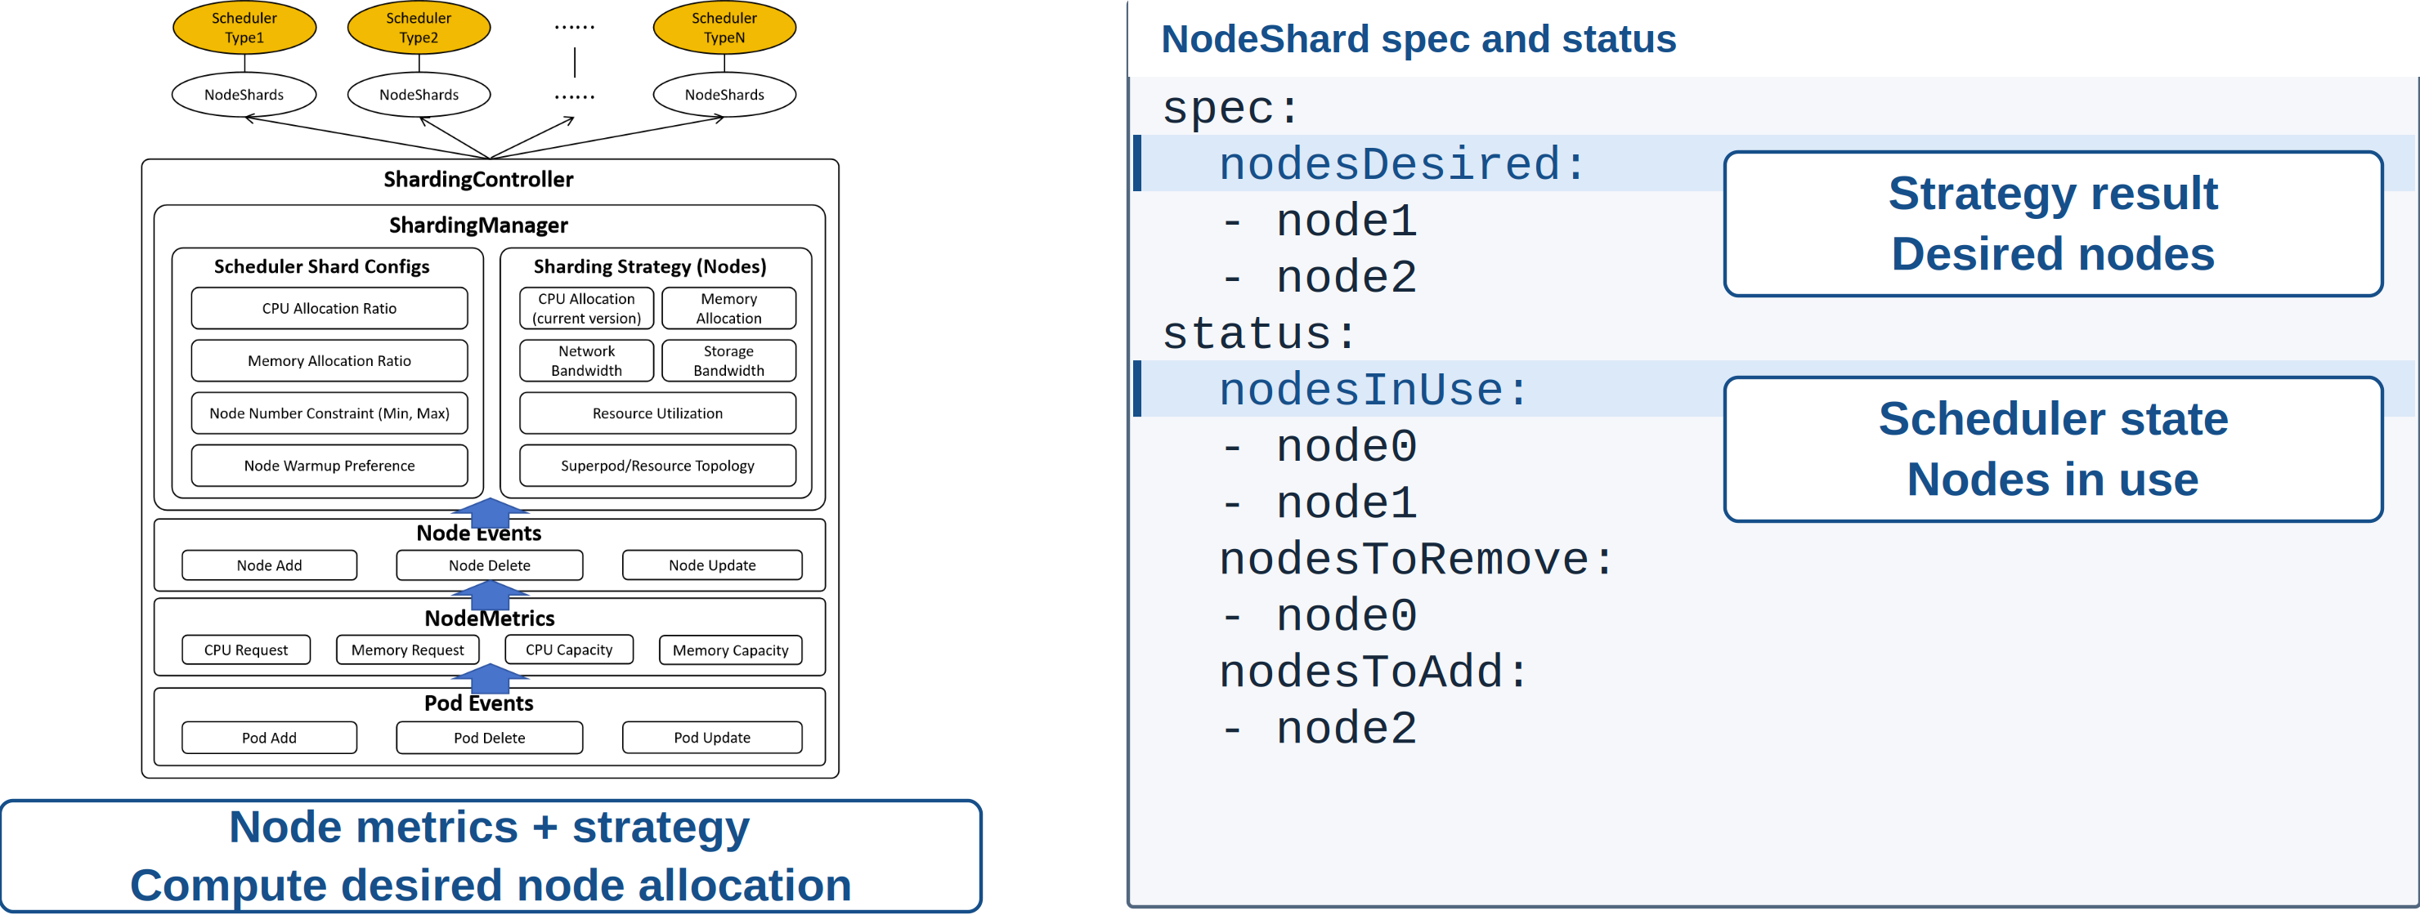
Dynamic Node Sharding
Volcano at KubeCon + CloudNativeCon North America 2026
06 / 26
Notes:
The controller combines node state with a sharding strategy to calculate the desired allocation. For example, it can filter nodes by CPU allocation, prefer nodes labeled for warmup, and cap how many nodes a scheduler receives. CPU allocation here comes from Pod resource requests, rather than measured CPU usage.
In the YAML, nodesDesired is the target set and nodesInUse is the current set. Their difference identifies nodes to add or release. The scheduler coordinates these changes as candidate pools evolve.

Slide 7
02
01 Unified scheduling
Multi-level gang
& network topology
02 Multi-level gang & network topology
03 Ecosystem
From available nodes to runnable workloads.
04 Benchmark framework & progress
Notes:
Having available nodes is only part of the problem. We also need to keep workload groups complete and place them within suitable network domains.

Slide 8
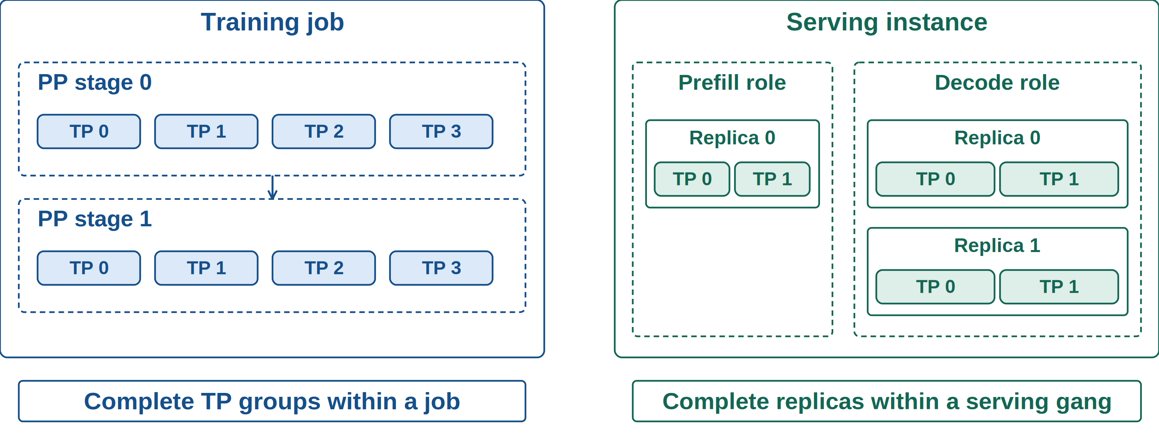
Training and Inference Groups
Volcano at KubeCon + CloudNativeCon North America 2026
08 / 26
Notes:
A training job can contain several pipeline stages, with tensor-parallel ranks inside each stage. A serving instance can contain Prefill and Decode roles, each with its own replicas. These structures create requirements at more than one level. We need to admit the overall workload while preserving complete compute groups inside it.

Slide 9
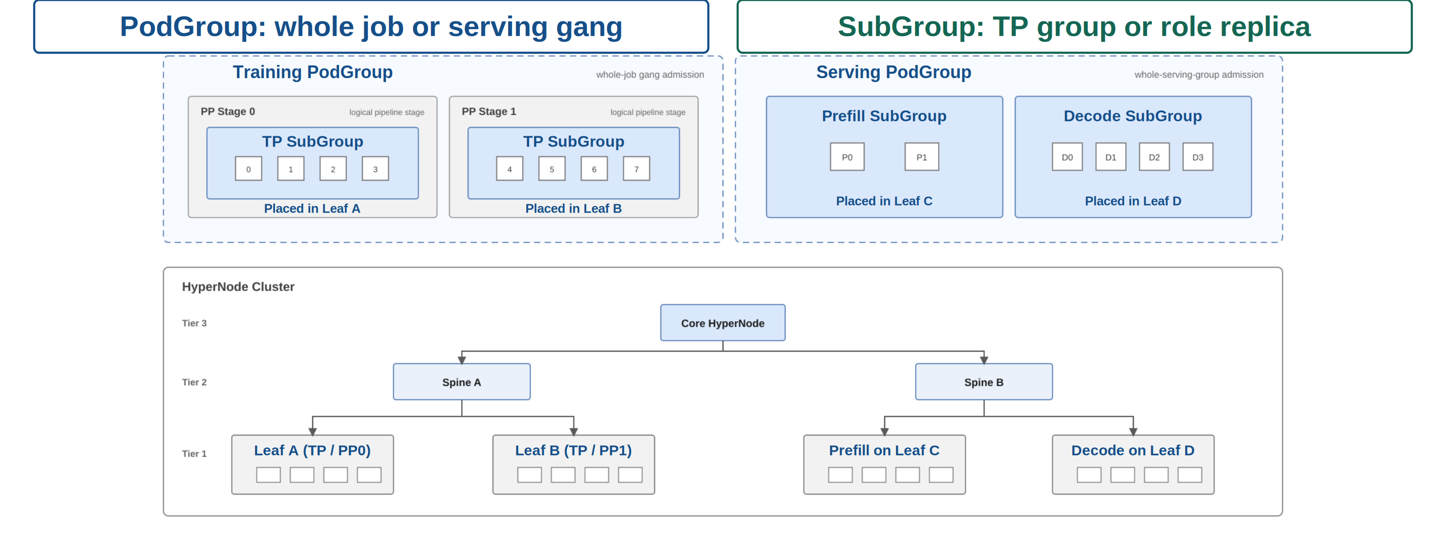
Multi-Level Gang Scheduling
Volcano at KubeCon + CloudNativeCon North America 2026
09 / 26
Notes:
PodGroup expresses admission requirements for the whole job or serving group. SubGroup preserves smaller units, such as a TP group or a role replica. One policy can use replica labels to identify multiple SubGroups. The network hierarchy below provides the domains where those complete groups can be placed.

Slide 10
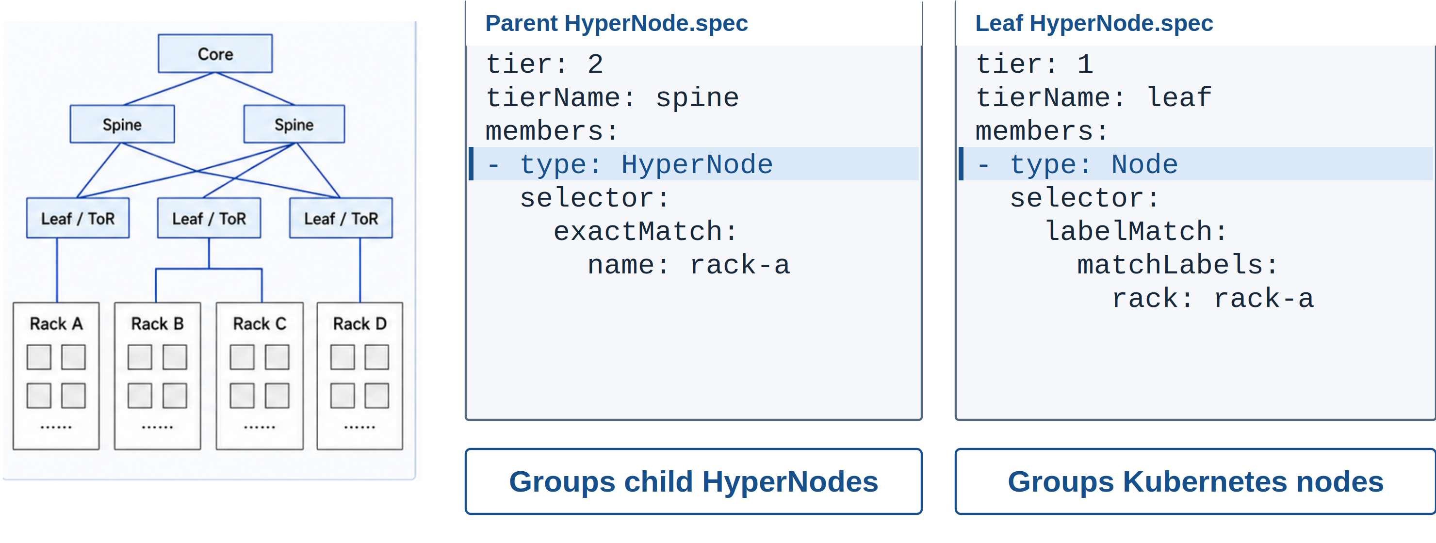
HyperNode: Network Topology
Volcano at KubeCon + CloudNativeCon North America 2026
10 / 26
Notes:
HyperNode turns the physical network hierarchy into scheduling domains. A parent HyperNode groups other HyperNodes, while a leaf HyperNode groups Kubernetes nodes. Named tiers such as spine and leaf let workloads express locality requirements. This gives the scheduler a common view of the network at several levels.

Slide 11
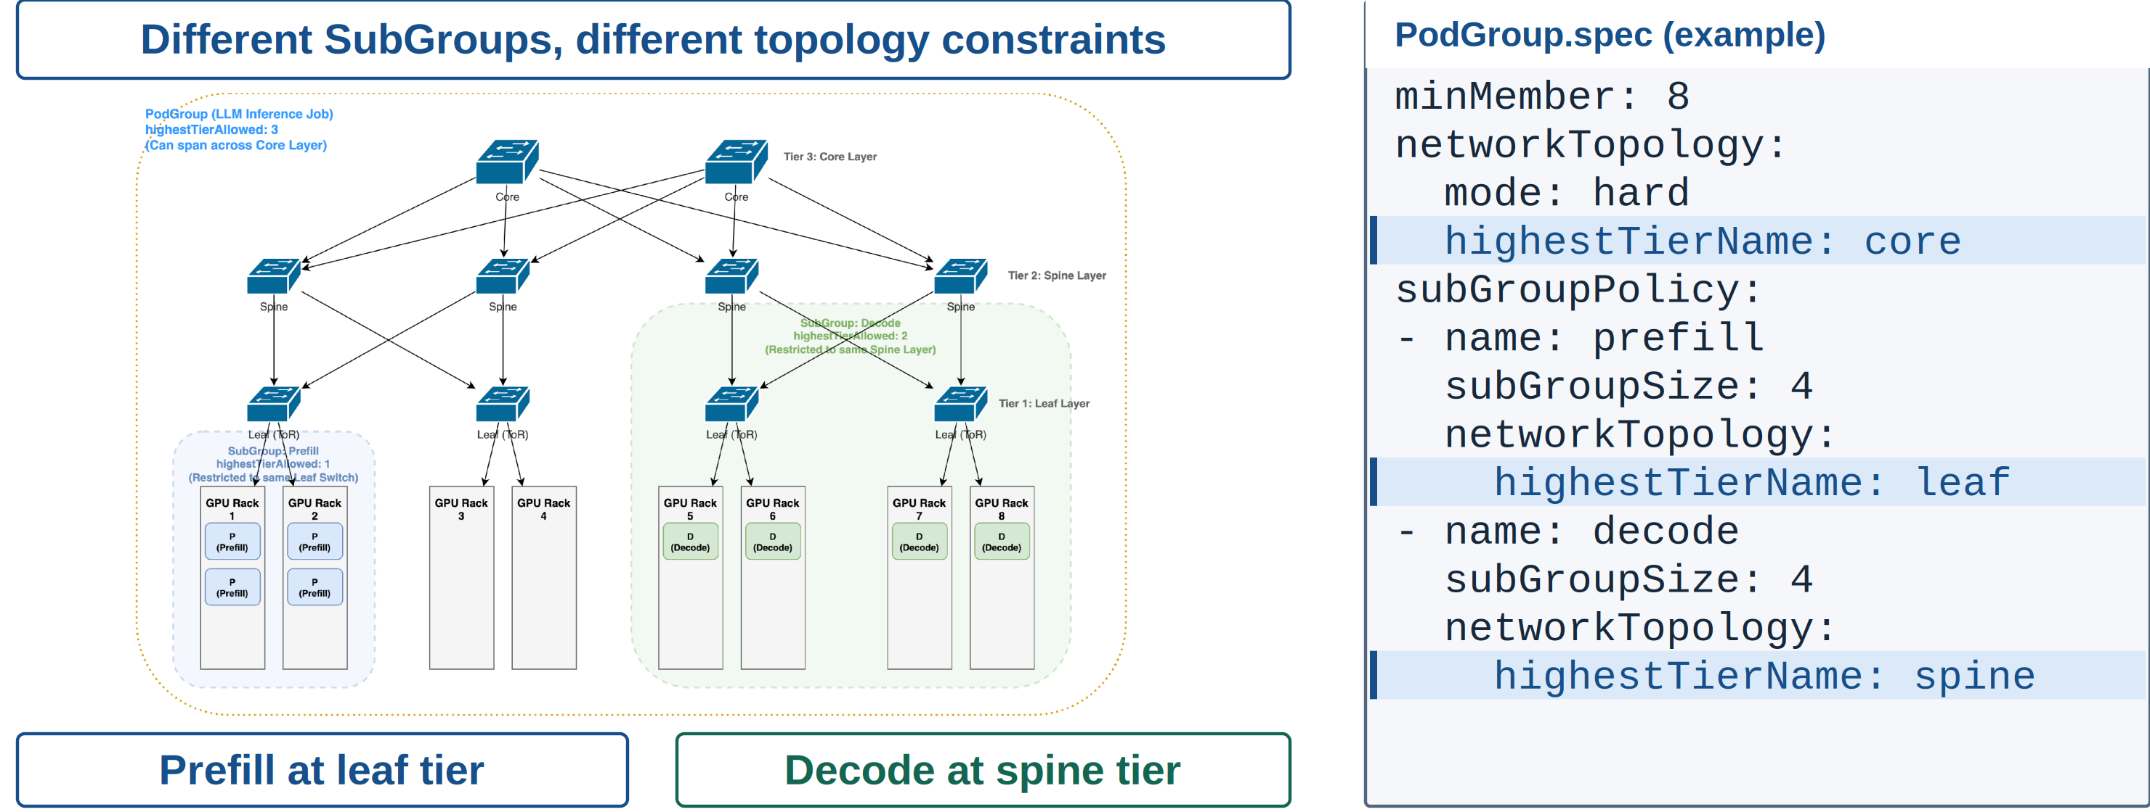
Place Groups at Different Topology Levels
Volcano at KubeCon + CloudNativeCon North America 2026
11 / 26
Notes:
This is one placement example, not a fixed layout for Prefill and Decode. The PodGroup uses the core tier, while its SubGroups request different topology domains. Each level can have its own network topology constraints.
For example, one SubGroup may need tight communication within a leaf, while another can span a spine. The actual choices depend on communication patterns and cluster topology. The role names do not dictate where they must run.

Slide 12
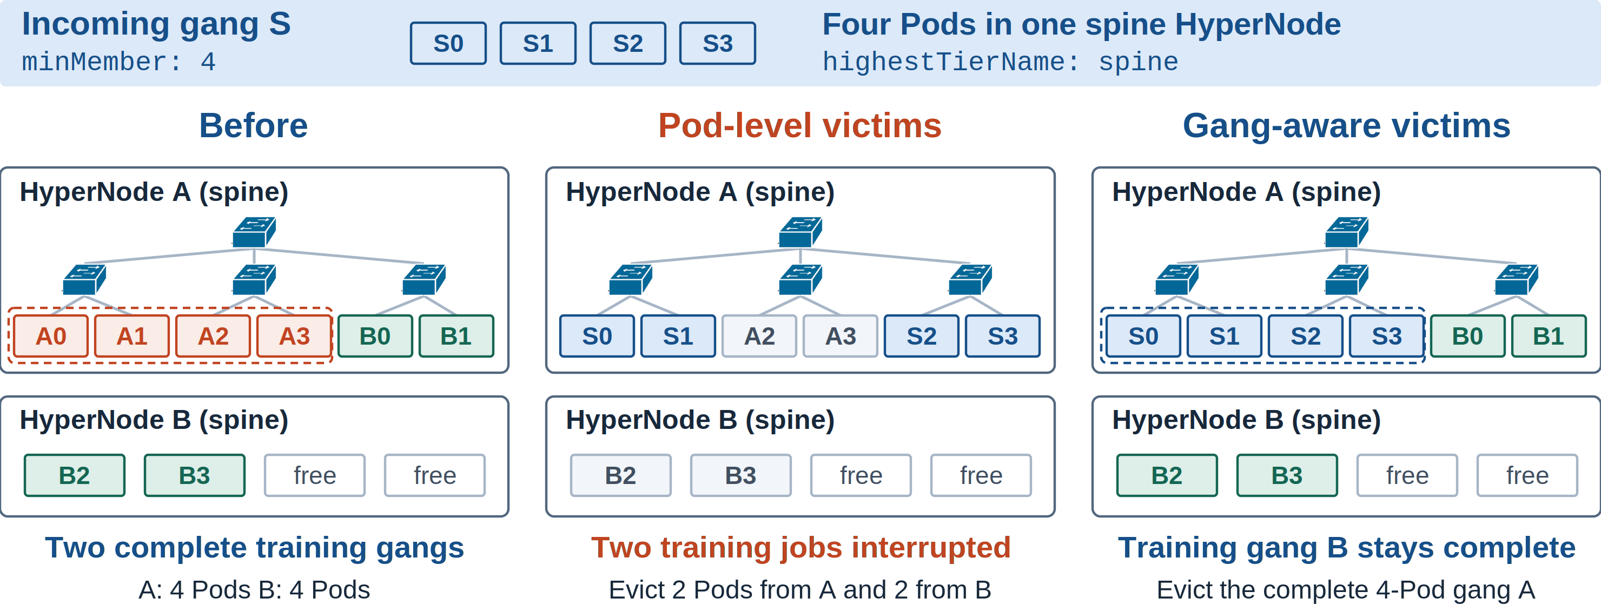
Gang-Aware Preemption
Volcano at KubeCon + CloudNativeCon North America 2026
12 / 26
Notes:
Start with two complete training gangs. A has four Pods in HyperNode A. B has two Pods in A and two in B. The incoming gang S needs four slots within one spine HyperNode.
Pod-level selection can take two Pods from each training job. S fits, but both training gangs become incomplete. They may need to restart from checkpoints and lose work since the last checkpoint. Gang-aware selection instead checks the complete victim gang A and the preemptor's topology constraints. In this example, evicting A admits S while B stays complete.

Slide 13
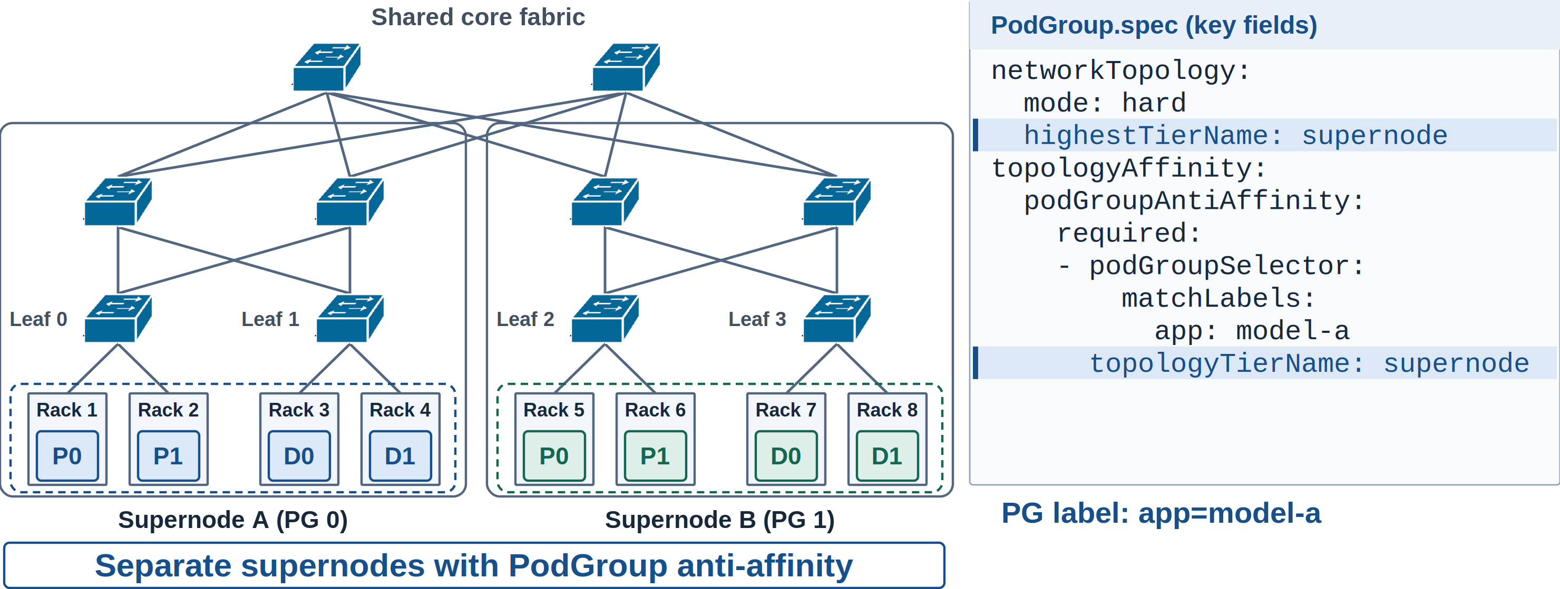
PodGroup Anti-Affinity
Separate matching PodGroups across supernodes
Volcano at KubeCon + CloudNativeCon North America 2026
13 / 26
Notes:
Each serving instance remains a complete PodGroup within its chosen domain. PodGroup anti-affinity places matching instances in separate supernodes, reducing their exposure to the same domain failure. The scheduler provides placement separation. Application health checks and routing still handle service recovery.

Slide 14
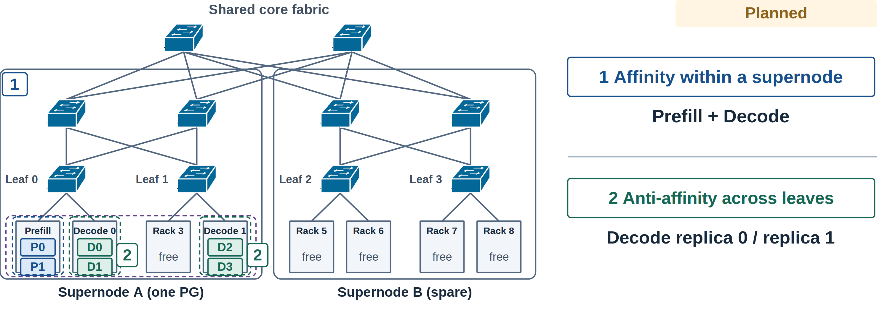
SubGroup Affinity and Anti-Affinity
Volcano at KubeCon + CloudNativeCon North America 2026
14 / 26
Notes:
The next step is to express relationships between SubGroups inside one PodGroup. Prefill and Decode groups may benefit from staying in the same supernode, while Decode replicas should use separate leaf domains. These affinity and anti-affinity rules are planned work. They would combine communication locality with replica isolation.

Slide 15
03
01 Unified scheduling
Ecosystem
02 Multi-level gang & network topology
03 Ecosystem
Workload controllers carry scheduling intent.
04 Benchmark framework & progress
Notes:
Workload controllers know the roles, replicas, and minimum group sizes. The next examples show how they pass that structure to Volcano.

Slide 16
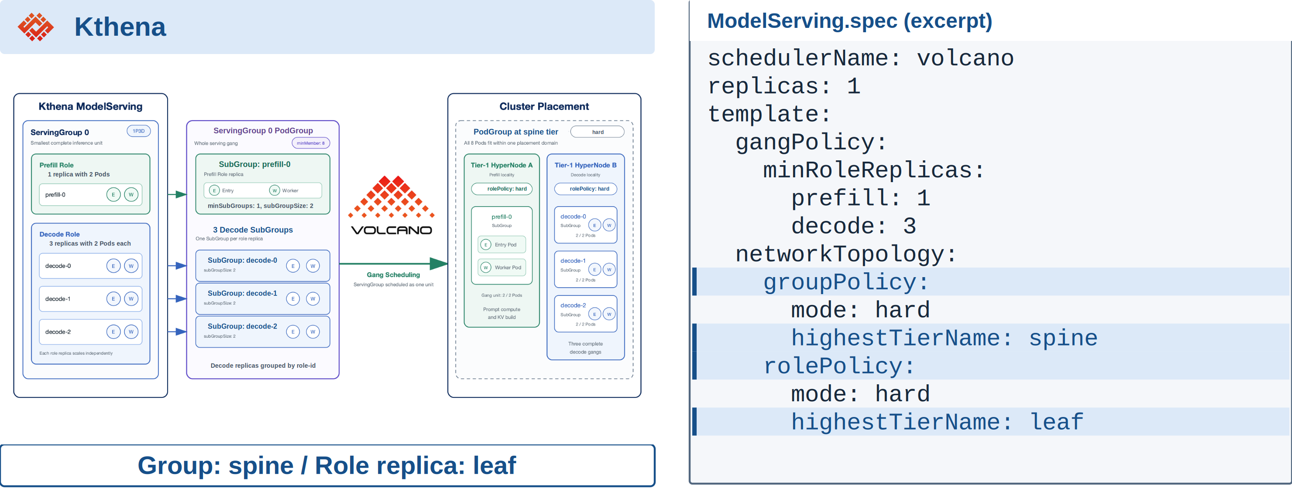
Kthena: Group and Role Topology
Volcano at KubeCon + CloudNativeCon North America 2026
16 / 26
Notes:
Kthena lets users describe scheduling intent in ModelServing. The groupPolicy applies to the whole ServingGroup, while rolePolicy applies to its role replicas. Here, the whole group stays within a spine domain and each role replica stays within a leaf. The next slide shows how these settings become Volcano PodGroup fields.

Slide 17
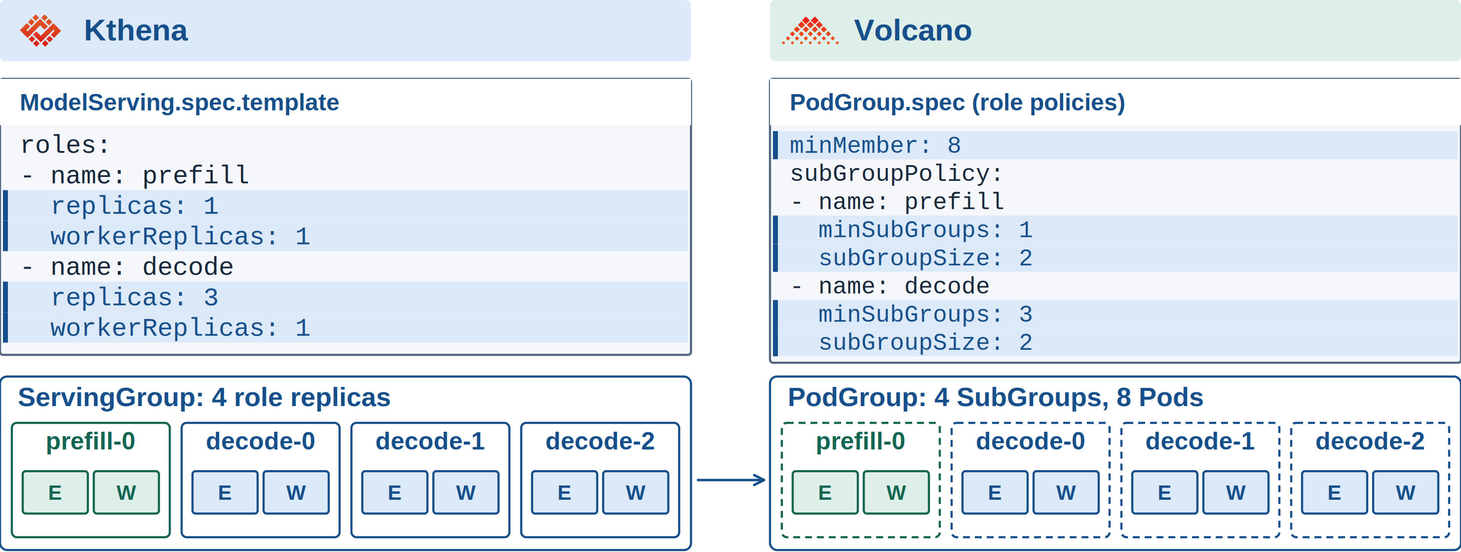
Kthena: Role Replica Mapping
Volcano at KubeCon + CloudNativeCon North America 2026
17 / 26
Notes:
Read the YAML and group diagrams together. E is the entry Pod and W is its worker. One Prefill replica and three Decode replicas make four two-Pod SubGroups, so the PodGroup minimum is eight.
There are two role policies but four SubGroups. Role identity labels distinguish the three Decode replicas. The groupPolicy and rolePolicy from the previous slide also carry into the generated PodGroup. The excerpts here focus on counts, while the companion YAML retains selectors and topology fields.

Slide 18
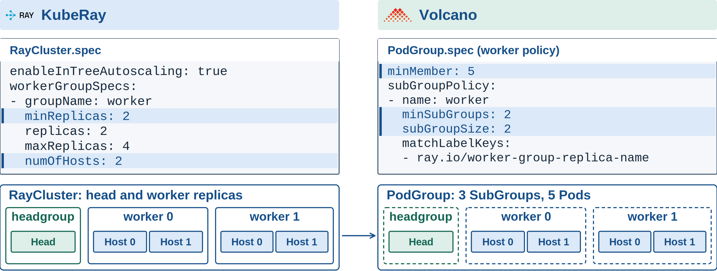
KubeRay: Multi-Host Replica Mapping
Volcano at KubeCon + CloudNativeCon North America 2026
18 / 26
Notes:
The left diagram has one Ray head and two worker replicas, with two hosts per replica. The right diagram shows three SubGroups: one for the head and one for each worker replica. That gives five minimum Pods.
With autoscaling enabled, minReplicas determines the minimum worker SubGroup count, and numOfHosts determines its size. The replica label keeps each pair of hosts together. Replica grouping must be enabled. The YAML focuses on workers; the head policy is included in the companion example. Worker-group topology support is still in progress.

Slide 19
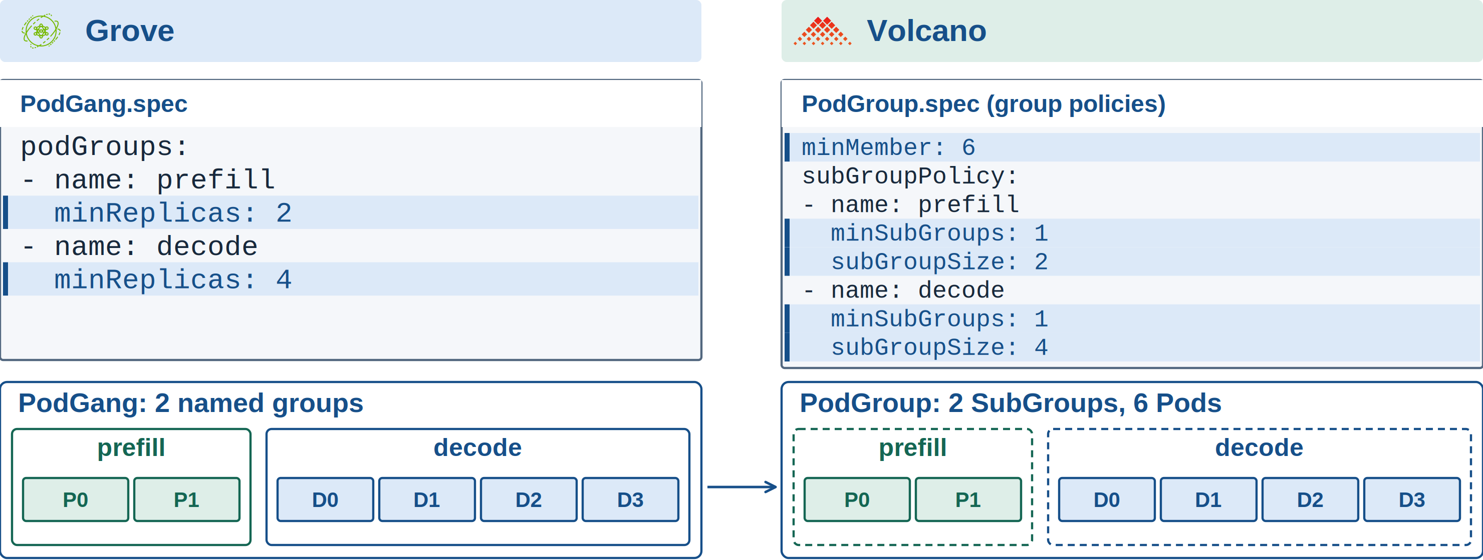
Grove: PodGang Mapping
Volcano at KubeCon + CloudNativeCon North America 2026
19 / 26
Notes:
Start with the two named groups in the PodGang: Prefill needs two Pods and Decode needs four. The same names and counts appear inside the Volcano PodGroup. Each group creates one SubGroup policy, giving two SubGroups and six minimum Pods.
The backend uses grove.io/podclique labels to select group members. The companion YAML includes those selectors. This mapping preserves gang structure, but this backend does not yet support topologyConstraint.

Slide 20
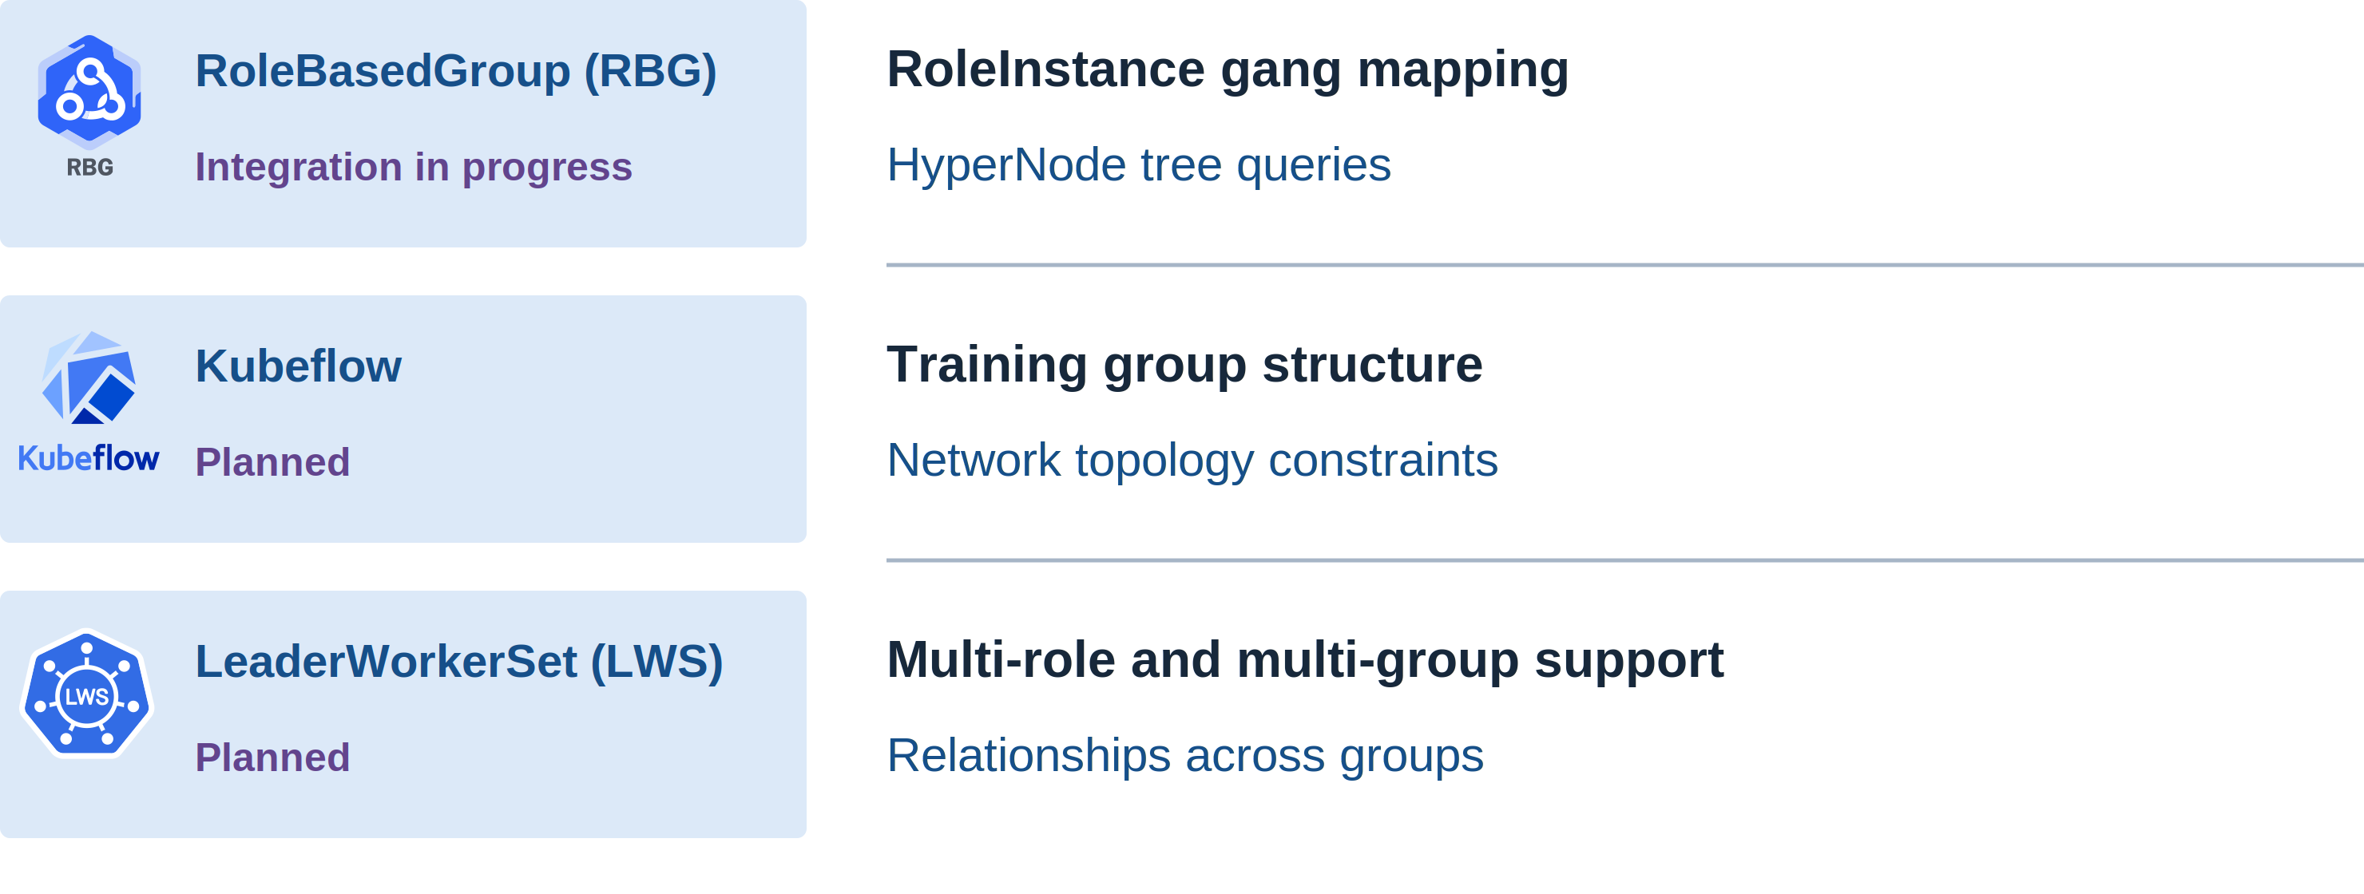
Ecosystem Roadmap
Volcano at KubeCon + CloudNativeCon North America 2026
20 / 26
Notes:
RBG integration is in progress, including RoleInstance grouping and support for querying the HyperNode tree. That gives the controller access to the topology hierarchy as the integration develops.
For Kubeflow, the planned work extends group structure and topology support. For LWS, it includes coordination across roles and multiple groups. These are integration directions, not a claim that all capabilities are available today.

Slide 21
04
01 Unified scheduling
Benchmark
framework & progress
02 Multi-level gang & network topology
03 Ecosystem
Measure behavior across workload shapes.
04 Benchmark framework & progress
Notes:
More workload shapes and placement rules also mean more behavior to validate. We need repeatable tests that help us compare schedulers and understand where each approach works well.

Slide 22
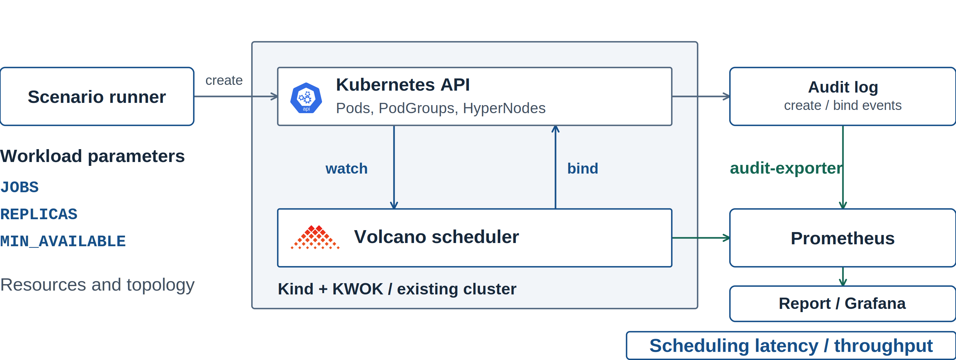
Scheduling Benchmark Framework
Volcano at KubeCon + CloudNativeCon North America 2026
22 / 26
Notes:
The framework generates workloads and records what happens through the API and scheduler. Audit events and Prometheus provide measurements for reports, including scheduling latency and binding throughput. Tests can use Kind with KWOK or an existing cluster. These measurements describe scheduling behavior, while GPU execution performance needs separate testing.

Slide 23
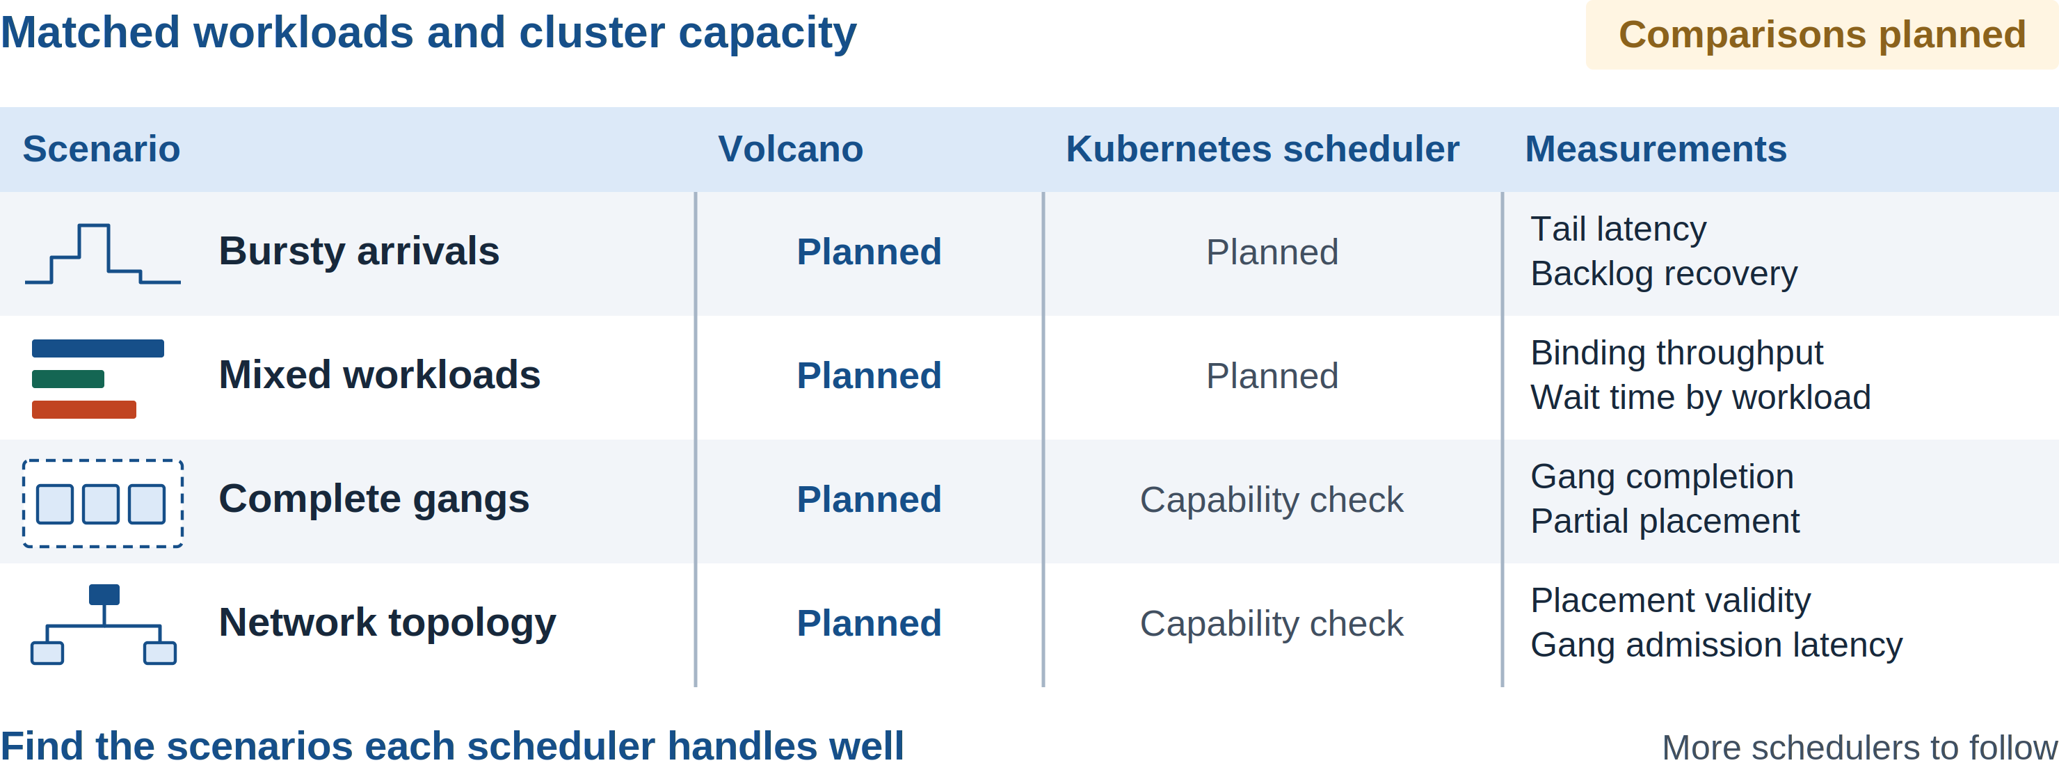
Cross-Scheduler Benchmarks
Volcano at KubeCon + CloudNativeCon North America 2026
23 / 26
Notes:
This is a comparison plan, not a results table. Replay the same workloads against Volcano and a Kubernetes scheduler baseline, with additional schedulers to follow. Reset cluster state between runs and record versions, settings, and resource requests.
Bursts and mixed workloads give us common starting points. For gang and topology cases, check feature support and match semantics before comparing results. We want to find each scheduler's best scenarios, not rank implementations using workloads they cannot represent.

Slide 24
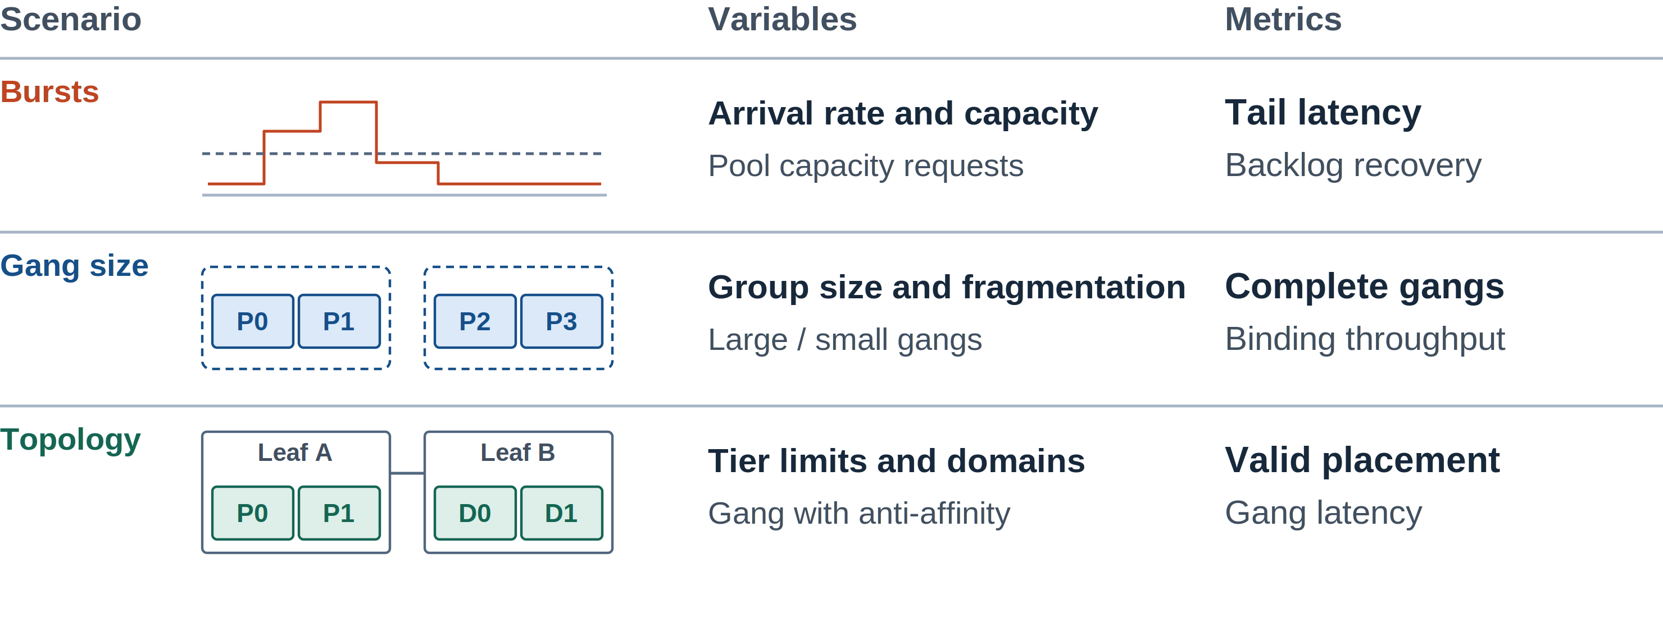
Workload and Topology Test Matrix
Volcano at KubeCon + CloudNativeCon North America 2026
24 / 26
Notes:
The test matrix should cover several kinds of pressure. Bursts test tail latency and backlog recovery, while larger gangs expose resource fragmentation. Topology cases check whether complete groups land in valid domains. The goal is to find the scenarios each scheduler handles well and understand the tradeoffs.

Slide 25
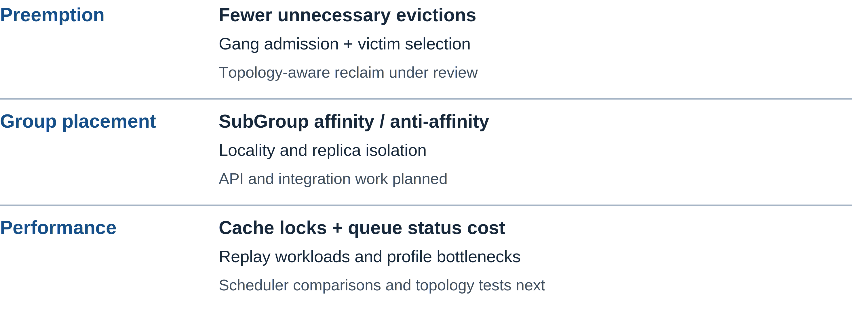
v1.17 Priorities
Volcano at KubeCon + CloudNativeCon North America 2026
25 / 26
Notes:
For v1.17, the related priorities are fewer unnecessary evictions, SubGroup relationships, and lower scheduling overhead. Topology-aware reclaim is under review, while SubGroup affinity and anti-affinity remain planned work. Benchmark replay and profiling will help evaluate performance changes. We also want broader scheduler comparisons and topology tests to guide that work.

Slide 26
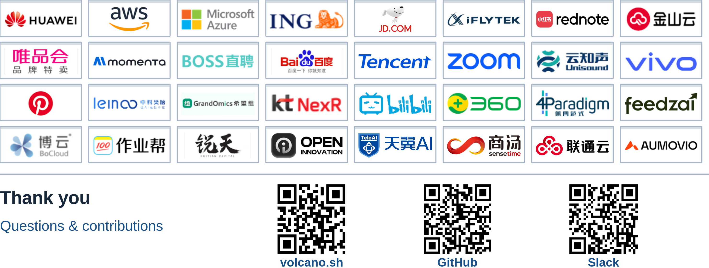
Volcano Users
Volcano at KubeCon + CloudNativeCon North America 2026
26 / 26
Notes:
These logos represent Volcano users and platforms that use or provide Volcano. Their usage and integration models differ. Thank them for their feedback and contributions, and invite the audience to share workload examples or integration needs.
The QR codes open the Volcano website, GitHub repository, and the Volcano channel in CNCF Slack. Slack requires workspace access. Open the floor for questions.

