Slide 1
AKI CDM* data collection
*CDM: PCORNET common data model
https://github.com/sxinger/AKI_CDM

Slide 2
PCORNET CDM
based on the FDA Sentinel Initiative Common Data Model (www.sentinelsystem.org)
leverages standard terminologies and coding systems for healthcare (including ICD, SNOMED, CPT, HCPSC, and LOINC) to enable interoperability with and responsiveness to evolving data standards
each PCORnet partner network maps data to the same consistent format (i.e., with the same variable name, attributes, and other metadata)
AKI data is based off current CDM version 4.1
specifications: https://pcornet.org/wp-content/uploads/2018/05/PCORnet-Common-Data-Model-v4-1-2018_05_15.pdf
DEMOGRAPHIC, VITAL, LAB_RESULT_CM, DIAGNOSIS, PROCEDURE, PRESCRIBING

Slide 3
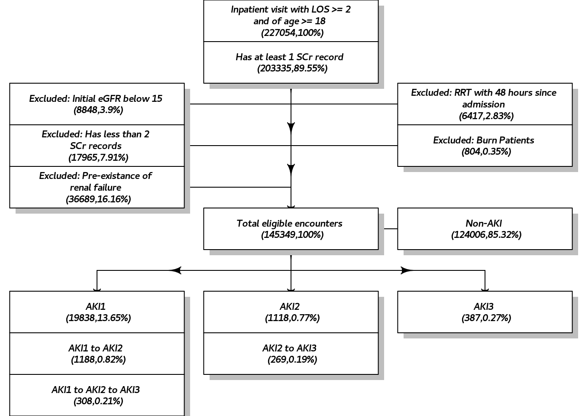
AKI Cohort

Slide 4
AKI Staging
AKI Stages are defined based on KDIGO:
AKI 1
Rolling base: increase in serum creatinine by >=0.3 mg/dL within 48 hours, OR
Fixed base: 1.5-1.9 times baseline within 7 days;
AKI 2
Fixed base: 2.0 to 2.9 times baseline within 7 days;
AKI 3
Rolling base: increase in serum creatinine to >= 4.0 mg/dL within 48 hours, OR
Fixed base: 3.0 times baseline within 7 days

Slide 5
Feature Collection and Compression
<demo>|<vital>|<lab>|<comorbidity>|<procedure>|<med>|<AKI_label>
Demographic (demo)
Age_Hispanic_Race_Sex
E.g.: 72_N_05_F can be decompressed as:
The patient at the encounter is of Age 72, who is Non-Hispanic, of Race “white” (05) and is Female
Age | Hispanic | Race | Sex
72 | N | 05 | F

Slide 6
Feature Collection and Compression (Con’t)
<demo>|<vital>|<lab>|<comorbidity>|<procedure>|<med>|<AKI_label>
Vital (vital)
Height_Weight_BMI_Smoking_Tabacco_TabaccoType_SBP_DBP
for each vital with multiple records:
val1,dd1;val2,dd2;val3,dd3;…
E.g.: 66,0.00_203,0.00_33,0.00_02,0.00_02,0.00_01,0.00_122,1.17;121,1.29; 119,1.33…_69,1.17;73,1.29;69,1.33… can be parsed as:
Note: 1. “dd” is decimal date format, which can be converted to day:hour:min
2. multiple entries is possible for all vital types.
Height | Weight | BMI | Smoking | Tabacco | TabaccoType | SBP | DBP
66, 0.00d | 203, 0.00d | 33, 0.00d | Current some day smoker (02), 0.00d | Never (02), 0.00d | Smoked tobacco only (01), 0.00d | 122, 1.17d; 121, 1.29d; 119, 1.33d; … | 69, 1.17d; 73, 1.29d; 69, 1.33d; …

Slide 7
Feature Collection and Compression (Con’t)
<demo>|<vital>|<lab>|<comorbidity>|<procedure>|<med>|<AKI_label>
Lab
Lab1_Lab2_Lab3_...
for each lab with multiple records:
labIndex1:val1,unit1,d1; val2,unit2,d2;…
E.g.: lab108:8.5,MG/DL,47;8.1,MG/DL,48;8.3,…_lab145:26,MMOL/L,47…
Remark: 1. labIndex# can be decrypted by looking up in the feature.csv file;
2. lengths of lab strings can be different from encounter to encounter;
Lab Index | Value | Unit | Days since Admission
108 | 8.5 | MG/DL | 47d
108 | 8.1 | MG/DL | 48d
… | … | … | …
145 | 26 | MMOL/L | 47d

Slide 8
Feature Collection and Compression (Con’t)
<demo>|<vital>|<lab>|<comorbidity>|<procedure>|<med>|<AKI_label>
CCS (comorbidity)
CCS1_CCS2_CCS3_...
for each historical CCS diagnosis with multiple records:
ccsIndex1:d1,d2,…_
E.g.: ccs10:-107_ccs49: -107,-112,-287_...
Remark: 1. ccsIndex# can be decrypted by looking up in the feature.csv file;
2. lengths of ccs strings can be different from encounter to encounter;
CCS Index | Days since Admission
10 | -107d (before admission)
49 | -107d (before admission)
49 | -112d (before admission)
49 | -287d (before admission)

Slide 9
Feature Collection and Compression (Con’t)
<demo>|<vital>|<lab>|<comorbidity>|<procedure>|<med>|<AKI_label>
PX (procedure)
PX1_PX2_PX3_...
for each procedure with multiple records:
pxIndex1:d1,d2,…_
E.g. px10895: 1_px11269: 2,3,4…_...
Remark: 1. pxIndex# can be decrypted by looking up in the feature.csv file;
2. lengths of px strings can be different from encounter to encounter;
PX Index | Days since Admission
10895 | 1d
11269 | 2d
11269 | 3d
11269 | 4d

Slide 10
Feature Collection and Compression (Con’t)
<demo>|<vital>|<lab>|<comorbidity>|<procedure>|<med>|<AKI_label>
Med (med)
Med1_Med2_Med3_...
for each medication with multiple records:
medIndex1:q1,d1; q2,d2,…
E.g. med10347: 1,9;1,10;1,11;1,12; 2,14;2,15…
Remark: 1. medIndex# can be decrypted by looking up in the feature.csv file;
2. lengths of med strings can be different from encounter to encounter;
med Index | Daily Exposure | Days since Admission
10347 | 1 | 9d
10347 | 1 | 10d
… | … | …
10347 | 2 | 14d
10347 | 2 | 15d

Slide 11
Feature Collection and Compression (Con’t)
<demo>|<vital>|<lab>|<comorbidity>|<procedure>|<med>|<AKI_label>
Label (AKI_label)
AKI1,d1_AKI2,d2_AKI3,d3, OR, AKI0,d0
Each label should only associated with one date and only valid discovered labels are reported:
Example: 1,2_2,5_3,9
Remark: 1. lengths of strings can be different from encounter to encounter;
AKI stage | Days since Admission
1 | 2
2 | 5
3 | 9

