Slide 1
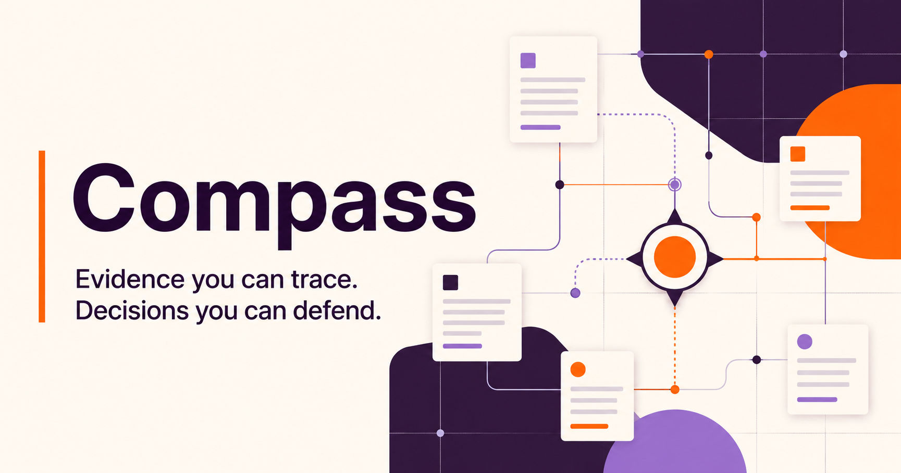
GITLAB FOUNDATION
CASE STUDY • SEPT 2026
Jessenia Cintron
Notes:
I designed Compass around one rule: if a program officer cannot open the evidence behind a sentence, Compass should not say it. I will show the decision problem, the product, the system behind it, and the boundaries that make the first release safe and useful.
Sources:

Slide 2
THE DECISION PROBLEM
Four systems hold different kinds of truth
A useful answer must connect the records without flattening their meaning.
Google Drive
GivingData
Airtable
Zoom Chat
Narrative evidence
Grant truth
Relationship context
Decisions in motion
Reports, proposals, memos, tables
Organizations, requests, payments, requirements
Partners, cohorts, projects, touchpoints
Discussion, rationale, informal observations
Design consequence
Preserve source authority, date, status, metric definition, and permissions in every answer.
02
Notes:
The four systems are not four copies of the same truth. GivingData should own grant transactions. Drive carries narrative evidence. Airtable carries flexible relationship context. Zoom captures decisions in motion. Before synthesizing, Compass has to preserve those roles.
Sources:
https://knowledgebase.givingdata.com/data-structure
https://developers.google.com/workspace/drive/api/guides/about-files
https://support.airtable.com/articles/6292134965-getting-started-with-airtable-s-web-api
https://support.zoom.com/hc/en/article?id=zm_kb&sysparm_article=KB0060329

Slide 3
DISCOVERY
The question comes before the architecture
Week one turns ambiguity into explicit product and data contracts.
USERS + DECISIONS
DATA + MEANING
ACCESS + GOVERNANCE
1
Which decisions recur?
1
What links a grant across systems?
1
Who may read each collection?
2
What makes an answer actionable?
2
Which source wins each field?
2
Which content is never indexed?
3
Where does context live only in someone’s head?
3
Estimated or observed impact?
3
Does Zoom retain five years?
4
Which wording could harm a grantee relationship?
4
Which metric definitions changed over time?
4
What must delete when the source deletes?
Output: gold question set • source-of-truth matrix • permission map • baseline task times
03
Notes:
I would not begin with the model. I would observe actual review and strategy workflows, then name the highest-value recurring questions. In parallel, I would map joins, definitions, owners, permissions, and exclusions. This creates the gold question set and data contracts that the build can be evaluated against.
Sources:

Slide 4
THE PRODUCT
Compass returns an evidence brief
The interface makes provenance, coverage, and uncertainty part of the answer.
What are we learning about AI-enabled career navigation?
Ask
MEDIUM EVIDENCE CONFIDENCE
EVIDENCE COVERAGE
Early signals are promising; outcome evidence still trails usage data
Drive
7
Across three active grants, participants use AI navigation most when recommendations connect to a live coach or an employer pathway. None yet isolates a sustained earnings effect.
GivingData
3
Airtable
5
Zoom Chat
4
3
2/3
0
relevant grants
early outcomes
causal studies
Evidence gap: 6- and 12-month earnings follow-up
LIVE PROTOTYPE • compass-gitlab-foundation.jesseniatriumph.chatgpt.site
04
Notes:
This is the user experience I would test. The answer leads with a plain-language synthesis, then shows exactly what supports it. Coverage says what Compass searched, not that the corpus is complete. The evidence-gap box matters most: the tool helps a program officer see what still requires judgment or a grantee conversation. I would click the prototype now and open one citation.
Sources:
https://compass-gitlab-foundation.jesseniatriumph.chatgpt.site

Slide 5
SYSTEM DESIGN
Evidence moves through six controlled stages
Structured data answers exact questions. Narrative evidence supplies context.
01
02
03
04
05
06
Connect
Preserve
Resolve
Retrieve
Answer
Improve
Approved scopes
+Data contracts
Raw objects
+Version + ACL
Canonical grant
+Entity crosswalk
Filters + keyword
+Semantic rerank
Strict schema
+Claim citations
Gold questions
+Feedback loop
Source ID
Version + time
Access principals
Metric status
Model version
Always
Always
Always
Estimated / actual
When derived
The raw source stays intact; the canonical layer links records without pretending they mean the same thing.
05
Notes:
Each connector begins with a contract for scope, owner, refresh, retention, and permissions. I preserve the raw object and lineage, then resolve only the minimum canonical entities. Retrieval combines exact structured filters with keyword and semantic search. The model receives permitted evidence and a strict answer contract. Feedback joins the evaluation set.
Sources:
https://developers.google.com/workspace/drive/api/guides/manage-sharing
https://knowledgebase.givingdata.com/custom-fields
https://support.airtable.com/articles/7735693959-managing-api-call-limits-in-airtable

Slide 6
TRUST AND PERMISSIONS
The access check happens before generation
A citation can open only when the user can open its source record.
1
2
3
4
5
Identity
Policy
Retrieval
Model
Citation
User + groups
Allowed principals
Permitted chunks
Evidence only
Access recheck
ZERO-TOLERANCE GATE
RETRIEVED TEXT IS UNTRUSTED
No permission leaks in the test suite
Reports and chat can contain prompt injection
No cache crosses an access boundary.
Scan, isolate tools, constrain output, and quarantine failures.
06
Notes:
Permissions cannot rely on a prompt such as “do not reveal confidential data.” Identity filters the retrieval candidates before any text enters the model context, and the product rechecks access before opening a citation. Retrieved reports and chat are also untrusted input. This addresses the prompt-injection and sensitive-disclosure risks that OWASP ranks among the most serious LLM application risks.
Sources:
https://cheatsheetseries.owasp.org/cheatsheets/RAG_Security_Cheat_Sheet.html
https://www.nist.gov/publications/artificial-intelligence-risk-management-framework-generative-artificial-intelligence

Slide 7
FAILURE MODES
The product should fail visibly
The safest response can be a conflict, a coverage gap, or an abstention.
FAILURE
PREVENTION
USER EXPERIENCE
Permission leak
Block before retrieval
Stop + security event
Estimated ≠ actual
Typed metrics + model version
Compare with labels
Conflicting records
Source-of-truth matrix
Show values, dates, owner
Wrong entity merge
Stable IDs + review queue
Keep separate
Missing Zoom history
Retention audit
Show date/channel gap
Weak evidence
Groundedness + citation gate
Abstain
Confidence describes evidence quality, never the model’s feelings.
07
Notes:
I designed the failure state as carefully as the happy path. A permission problem stops the answer. A data conflict appears with both values and an owner. Missing chat history appears as a coverage gap. Low evidence produces an abstention. The label “confidence” should describe coverage, source agreement, and evaluation results, not the model’s self-reported certainty.
Sources:

Slide 8
TRADEOFFS
V1 proves trust on a narrow corpus
The first release earns expansion through measured use.
INCLUDE
DEFER
✓
5–10 gold questions
×
Direct messages
✓
25–40 grants in one cohort
×
Autonomous grant scoring
✓
GivingData + approved Drive folder
×
Write-back to source systems
✓
Read-only evidence briefs
×
Organization-wide access
✓
3–5 Programs and Impact users
×
Real-time sync and full backfill
Prove: faster accepted answers • ≥90% cited claims • zero permission leaks • repeat weekly use
08
Notes:
I would rather prove ten consequential questions with excellent citations and zero permission leaks than index five years of content and create false confidence. I would start with GivingData and one controlled Drive folder. Chat direct messages, automated scoring, write-back, broad access, and real-time sync wait until the team has evidence that the core workflow works.
Sources:

Slide 9
IMPLEMENTATION
A 16-week path from pilot to reusable capability
Every phase ends with an explicit decision to continue, change, or stop.
1
2
3
4
DISCOVER
PROVE
HARDEN
EXPAND
WEEKS 1–3
WEEKS 3–6
WEEKS 6–10
WEEK 10+
Users, questions, data contracts, access
Drive + GivingData vertical slice
Airtable, backfill, monitoring
Governed chat and wider access
The strategic fit
Compass operationalizes CREDIT: transparent evidence, faster work, responsible iteration, and shared organizational learning.
The pilot also creates reusable data contracts, evaluation sets, permission controls, and operating practices for a future product and engineering function.
09
Notes:
The roadmap advances only when a phase meets its exit criteria. By week six, the team has a real vertical slice and evidence about usefulness and safety. By week ten, the operating system is documented and monitored. Governed chat and wider access come last. This fits the Foundation’s CREDIT values and creates the foundations for the small product and engineering function described in the role. Compass prepares the evidence. People interpret it and own the decision.
Sources:
https://www.gitlabfoundation.org/our-journey/transparency-in-action-understanding-gitlab-foundations-handbooknbsp
https://www.philanthropy.com/news/can-ai-make-grant-seeking-easier-and-grant-making-more-refined/
https://www.gitlabfoundation.org/team

