Slide 1
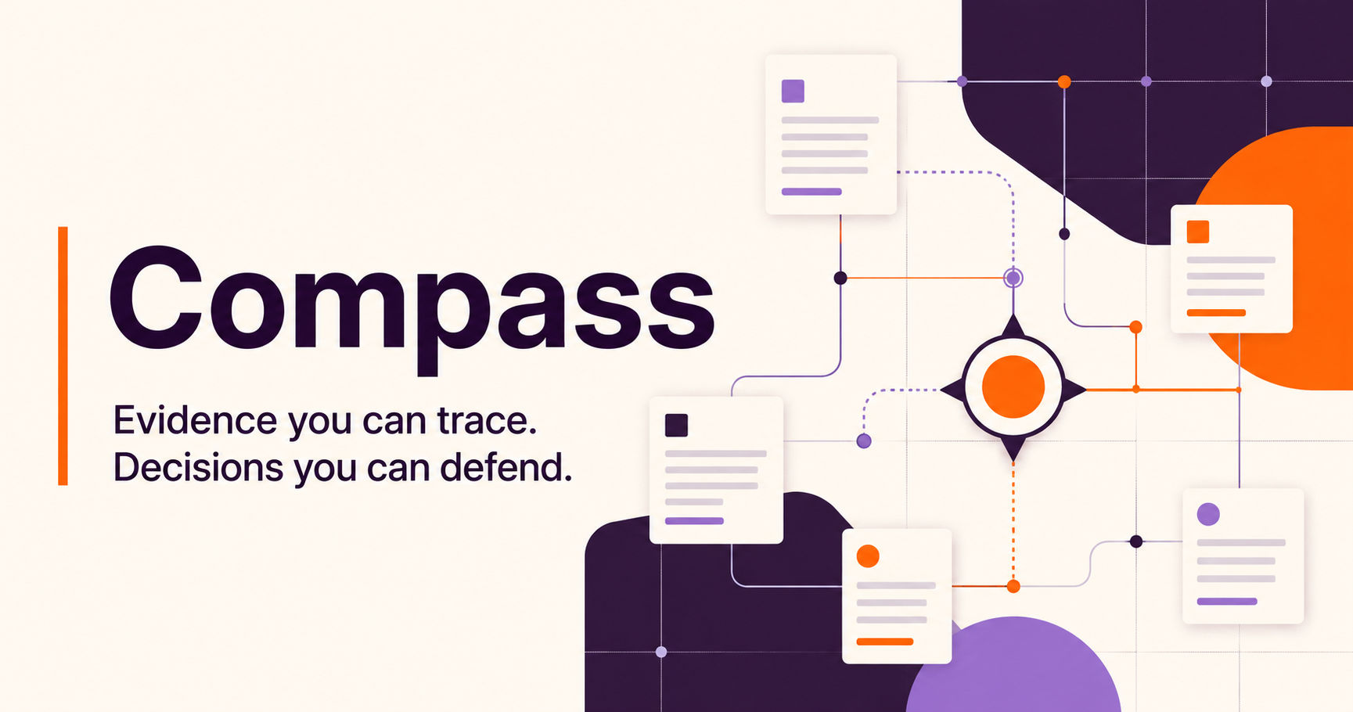
GITLAB FOUNDATION
CASE STUDY WITH OPTIONAL PROTOTYPE EVIDENCE SEPT 2026
Jessenia Cintron
Notes:
The assignment asked for scope and process, so that is the presentation. Compass is my proposed approach, not a product I expect the team to adopt. After completing the scope, I built a small prototype with fictional evidence to pressure-test a few assumptions. I will use it only as optional supporting evidence. The team can evaluate the case study without seeing the demo.
Sources:

Slide 2
THE DECISION PROBLEM
Four systems hold different kinds of truth
A useful answer must connect the records without flattening their meaning.
Google Drive
GivingData
Airtable
Zoom Chat
Narrative evidence
Grant truth
Relationship context
Decisions in motion
Reports, proposals, memos, tables
Organizations, requests, payments, requirements
Partners, cohorts, projects, touchpoints
Discussion, rationale, informal observations
Design consequence
Preserve source authority, date, status, metric definition, and permissions in every answer.
02
Notes:
The four systems are not four copies of the same truth. GivingData should own grant transactions. Drive carries narrative evidence. Airtable carries flexible relationship context. Zoom captures decisions in motion. Before synthesizing, Compass has to preserve those roles.
Sources:
https://knowledgebase.givingdata.com/data-structure
https://developers.google.com/workspace/drive/api/guides/about-files
https://support.airtable.com/articles/6292134965-getting-started-with-airtable-s-web-api
https://support.zoom.com/hc/en/article?id=zm_kb&sysparm_article=KB0060329

Slide 3
DISCOVERY
Discovery defines the solution
The first stage turns ambiguity into explicit user, data, and access agreements.
USERS + DECISIONS
DATA + MEANING
ACCESS + GOVERNANCE
1
Which decisions recur?
1
What links a grant across systems?
1
Who may read each collection?
2
What makes an answer actionable?
2
Which source wins each field?
2
Which content is never indexed?
3
Where does context live only in someone’s head?
3
Estimated or observed impact?
3
Does Zoom retain five years?
4
Which wording could harm a grantee relationship?
4
Which metric definitions changed over time?
4
What must delete when the source deletes?
Output: gold questions, source ownership, permission map, and baseline task times
03
Notes:
I would not begin with the model. I would observe actual review and strategy workflows, then name the highest-value recurring questions. In parallel, I would map joins, definitions, owners, permissions, and exclusions. This creates the gold question set and data contracts that the build can be evaluated against.
Sources:

Slide 4
OPTIONAL PROTOTYPE EVIDENCE
A small prototype pressure-tests the scoped design
It uses fictional records and no Foundation credentials, integrations, or data.
What did we decide about reporting for the AI opportunity cohort?
Ask
HIGH EVIDENCE CONFIDENCE
EVIDENCE COVERAGE
A lighter monthly signal was proposed, but the source of record is unchanged
Drive
1
A conversation and draft memo support the new cadence. GivingData still holds the prior requirement, so Compass labels the decision proposed rather than final.
GivingData
1
Airtable
0
Zoom Chat
1
3
3
1
cited records
systems
source conflict
Next check: confirm owner and effective date
SUPPLEMENTAL EVIDENCE The case study stands on its own
04
Notes:
I did not treat the prompt as permission to skip discovery or build around assumptions. I completed the scope first, then used a contained prototype to test one interaction: can the system show agreement, conflict, citations, and a next check without overstating certainty? The browser calls a local API and uses fictional records only. This is evidence about the design method, not a claim that the Foundation needs this interface or should adopt this code.
Sources:

Slide 5
THE SYSTEM
Proposed end-to-end system
The prototype validates selected contracts inside a broader design that still requires team input.
01
02
03
04
05
06
Admit
Filter
Retrieve
Answer
Persist
Evaluate
Hosted subject
+Exact email
Readable records
before ranking
Lexical baseline
+Bounded corpus
Typed brief
+Claim citations
D1 feedback
+Audit events
Security tests
+Gold questions
API routes
D1 tables
Automated checks
Corpus
Source writes
4
4
9
Fictional
None
The prototype tests answer, policy, and review contracts. Real connectors require team approval and source access.
05
Notes:
This slide describes the proposed system, not a completed Foundation deployment. The prototype implements a bounded browser, policy, answer, persistence, and test path so I could find weak assumptions early. The Foundation would still define source ownership, user groups, access rules, retention, and success measures before any real connector work. I kept retrieval deterministic because a model or vector index should earn its place against approved questions.
Sources:
https://developers.google.com/workspace/drive/api/guides/manage-sharing
https://developers.google.com/workspace/drive/api/guides/manage-changes

Slide 6
TRUST AND PERMISSIONS
Security gates in the proposed system
A citation should open only when the user can open its source record.
1
2
3
4
5
Identity
Admission
Candidates
Brief
Citation
Stable subject
Exact email
Policy filtered
Cited claims
Access recheck
PROTOTYPE TEST EVIDENCE
RETRIEVED TEXT IS UNTRUSTED
Nine automated checks pass
Reports and chat can contain prompt injection
Policy, citation, injection, conflict, and context invariants.
Scan, isolate tools, constrain output, and quarantine failures.
06
Notes:
The key design choice is where the constraints sit. A prompt cannot enforce access. The proposed server authenticates a stable subject, checks the approved account, and filters candidates before ranking or model context. The prototype has nine passing checks that exercise this pattern. Those tests support the proposal, but they do not replace Foundation security review, source revocation tests, or an incident exercise.
Sources:
https://cheatsheetseries.owasp.org/cheatsheets/LLM_Prompt_Injection_Prevention_Cheat_Sheet.html
https://www.nist.gov/itl/ai-risk-management-framework

Slide 7
FAILURE MODES
The system should fail visibly
The safest response can be a conflict, a coverage gap, or an abstention.
FAILURE
PREVENTION
USER EXPERIENCE
Permission leak
Block before retrieval
Stop + security event
Estimated ≠ actual
Typed metrics + model version
Compare with labels
Conflicting records
Source-of-truth matrix
Show values, dates, owner
Wrong entity merge
Stable IDs + review queue
Keep separate
Missing Zoom history
Retention audit
Show date/channel gap
Weak evidence
Groundedness + citation gate
Abstain
Confidence describes evidence quality, never the model’s feelings.
07
Notes:
I designed the failure state as carefully as the happy path. A permission problem stops the answer. A data conflict appears with both values and an owner. Missing chat history appears as a coverage gap. Low evidence produces an abstention. The label “confidence” should describe coverage, source agreement, and evaluation results, not the model’s self-reported certainty.
Sources:

Slide 8
TRADEOFFS
The first version stays deliberately narrow
The case-study scope remains primary. Prototype evidence is supplemental.
IN THE CASE STUDY
LEFT OUT OF THE FIRST VERSION
✓
Users, decisions, and discovery questions
×
Live Foundation connectors
✓
Source authority and access map
×
Production identity and deployment
✓
End-to-end system proposal
×
Automated scoring or grant decisions
✓
Visible failure and refusal states
×
Writeback actions into source systems
✓
Phased validation and implementation gates
×
A product for other foundations
The fictional prototype tests assumptions. It does not expand the requested scope or commit the team to this design.
08
Notes:
The prompt asked for scoping and process, not a working product. I honored that by making the case study complete without the demo. The prototype came afterward as a private validation exercise using fictional evidence. I would show it only briefly or when asked. I deliberately left out live connections, production deployment, automated decisions, source writeback, and productization because each requires discovery and separate authority.
Sources:

Slide 9
IMPLEMENTATION
A sequence for validating the proposal
Each phase begins only after the team confirms the prior assumptions.
1
2
3
4
DISCOVER
DESIGN
PILOT
DECIDE
TEAM CONFIRMS USE CASE
ACCESS MAP APPROVED
SYNTHETIC TESTS PASS
USERS REVIEW EVIDENCE
Observe decisions, name owners, define gold questions
Source contracts, permission model, deletion behavior
One source pair, cited answers, refusal behavior
Measure accuracy, time saved, and trust before the next scope
The collaboration model
Compass would support the team’s existing experiments and decisions. The people doing the work retain ownership of the workflow.
The team decides whether evidence supports a pilot, another design pass, or stopping the work.
09
Notes:
This sequence protects against building ahead of the people who will use and govern the system. Discovery defines the use case. The team approves the access map. A narrow pilot tests cited answers and refusal behavior. Users then decide whether the evidence supports further investment. My role would be to bring technical judgment and momentum while working with the people who already understand the Foundation’s programs and experiments.
Sources:
https://gitlabfoundation.notion.site/Values-313cf60acc3b47c4b1f64e8352ce1707
https://www.gitlabfoundation.org/

