Slide 1
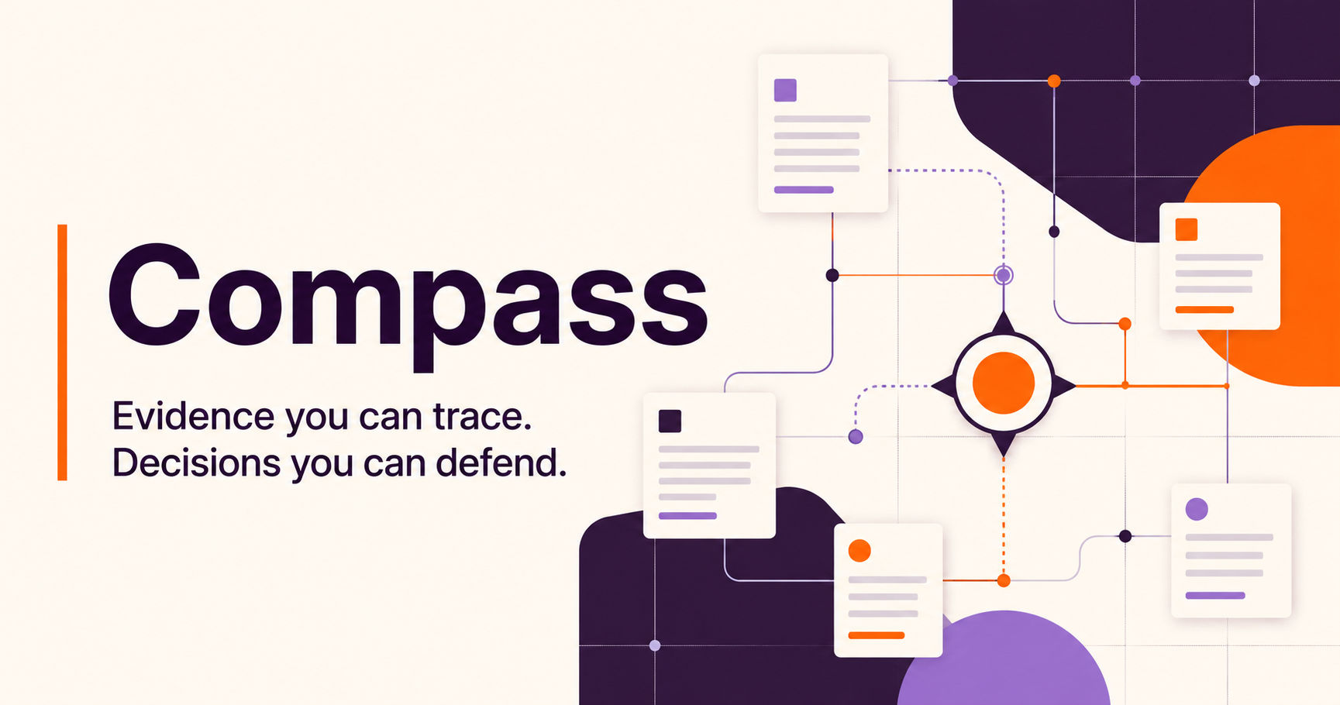
GITLAB FOUNDATION
WORKING MVP + CASE STUDY SEPT 2026
Jessenia Cintron
Notes:
I designed Compass around one rule: if a program officer cannot open the evidence behind a sentence, Compass should not say it. The assignment asked me to scope the problem. I also built a narrow working slice on fictional evidence so I could test whether the architecture and interaction actually hold together.
Sources:

Slide 2
THE DECISION PROBLEM
Four systems hold different kinds of truth
A useful answer must connect the records without flattening their meaning.
Google Drive
GivingData
Airtable
Zoom Chat
Narrative evidence
Grant truth
Relationship context
Decisions in motion
Reports, proposals, memos, tables
Organizations, requests, payments, requirements
Partners, cohorts, projects, touchpoints
Discussion, rationale, informal observations
Design consequence
Preserve source authority, date, status, metric definition, and permissions in every answer.
02
Notes:
The four systems are not four copies of the same truth. GivingData should own grant transactions. Drive carries narrative evidence. Airtable carries flexible relationship context. Zoom captures decisions in motion. Before synthesizing, Compass has to preserve those roles.
Sources:
https://knowledgebase.givingdata.com/data-structure
https://developers.google.com/workspace/drive/api/guides/about-files
https://support.airtable.com/articles/6292134965-getting-started-with-airtable-s-web-api
https://support.zoom.com/hc/en/article?id=zm_kb&sysparm_article=KB0060329

Slide 3
DISCOVERY
The question comes before the architecture
The first stage turns ambiguity into explicit product and data contracts.
USERS + DECISIONS
DATA + MEANING
ACCESS + GOVERNANCE
1
Which decisions recur?
1
What links a grant across systems?
1
Who may read each collection?
2
What makes an answer actionable?
2
Which source wins each field?
2
Which content is never indexed?
3
Where does context live only in someone’s head?
3
Estimated or observed impact?
3
Does Zoom retain five years?
4
Which wording could harm a grantee relationship?
4
Which metric definitions changed over time?
4
What must delete when the source deletes?
Output: gold questions, source ownership, permission map, and baseline task times
03
Notes:
I would not begin with the model. I would observe actual review and strategy workflows, then name the highest-value recurring questions. In parallel, I would map joins, definitions, owners, permissions, and exclusions. This creates the gold question set and data contracts that the build can be evaluated against.
Sources:

Slide 4
THE PRODUCT
Compass now returns a permission-filtered brief
The working synthetic slice calls a server API. Citations and gaps come from authorized evidence.
What did we decide about reporting for the AI opportunity cohort?
Ask
HIGH EVIDENCE CONFIDENCE
EVIDENCE COVERAGE
A lighter monthly signal was proposed, but the source of record is unchanged
Drive
1
A conversation and draft memo support the new cadence. GivingData still holds the prior requirement, so Compass labels the decision proposed rather than final.
GivingData
1
Airtable
0
Zoom Chat
1
3
3
1
cited records
systems
source conflict
Next check: confirm owner and effective date
VERIFIED LOCALLY Browser to API to D1 persistence
04
Notes:
This is no longer only a scripted interface. The browser calls the ask API, the server applies access policy before selecting evidence, and the response returns a typed brief. Here the system finds agreement in a conversation and draft memo, then catches that GivingData still contains the old requirement. In ordinary language, Compass says what we know, why we know it, and what someone still needs to confirm. All records shown here remain fictional.
Sources:

Slide 5
SYSTEM DESIGN
The working slice reaches from browser to D1
Each stage has a code contract, a failure behavior, and a testable handoff.
01
02
03
04
05
06
Admit
Filter
Retrieve
Answer
Persist
Evaluate
Hosted subject
+Exact email
Readable records
before ranking
Lexical baseline
+Bounded corpus
Typed brief
+Claim citations
D1 feedback
+Audit events
Security tests
+Gold questions
API routes
D1 tables
Automated checks
Corpus
Source writes
4
4
9
Fictional
None
Production connectors replace the fixtures without changing the answer, policy, or review contracts.
05
Notes:
The vertical slice now runs end to end. A hosted identity header and exact email allowlist admit the user. Authorization constrains the candidate set. The system builds a typed brief, persists review feedback and audit events in D1, and runs automated checks. I kept retrieval deterministic for this slice. A model or vector index should earn its place by improving the approved gold questions.
Sources:
https://developers.google.com/workspace/drive/api/guides/manage-sharing
https://developers.google.com/workspace/drive/api/guides/manage-changes

Slide 6
TRUST AND PERMISSIONS
The access check happens before generation
A citation can open only when the user can open its source record.
1
2
3
4
5
Identity
Admission
Candidates
Brief
Citation
Stable subject
Exact email
Policy filtered
Cited claims
Access recheck
INITIAL RELEASE EVIDENCE
RETRIEVED TEXT IS UNTRUSTED
Nine automated checks pass
Reports and chat can contain prompt injection
Policy, citation, injection, conflict, and context invariants.
Scan, isolate tools, constrain output, and quarantine failures.
06
Notes:
The technical edge is where the constraints sit. A prompt does not enforce access. The server authenticates a stable subject, checks the exact approved account, then filters the candidates before any ranking or future model context. The initial suite has nine passing checks, including restricted evidence, prompt injection, citations, conflict handling, and the rule that role context can never expand access. Production still needs source revocation tests and an incident exercise.
Sources:
https://cheatsheetseries.owasp.org/cheatsheets/LLM_Prompt_Injection_Prevention_Cheat_Sheet.html
https://www.nist.gov/itl/ai-risk-management-framework

Slide 7
FAILURE MODES
The product should fail visibly
The safest response can be a conflict, a coverage gap, or an abstention.
FAILURE
PREVENTION
USER EXPERIENCE
Permission leak
Block before retrieval
Stop + security event
Estimated ≠ actual
Typed metrics + model version
Compare with labels
Conflicting records
Source-of-truth matrix
Show values, dates, owner
Wrong entity merge
Stable IDs + review queue
Keep separate
Missing Zoom history
Retention audit
Show date/channel gap
Weak evidence
Groundedness + citation gate
Abstain
Confidence describes evidence quality, never the model’s feelings.
07
Notes:
I designed the failure state as carefully as the happy path. A permission problem stops the answer. A data conflict appears with both values and an owner. Missing chat history appears as a coverage gap. Low evidence produces an abstention. The label “confidence” should describe coverage, source agreement, and evaluation results, not the model’s self-reported certainty.
Sources:

Slide 8
BUILD STATUS
A working slice now supports the case study
The remaining gaps depend on Foundation access, ownership, and operating approval.
WORKING NOW
FOUNDATION-GATED NEXT
✓
Responsive app and four API routes
×
Tenant OAuth configuration
✓
Exact-account admission logic
×
Drive and GivingData connectors
✓
Pre-retrieval policy filtering
×
Revocation and deletion propagation
✓
D1 review queue and audit events
×
Real gold questions and baselines
✓
Nine security and evaluation checks
×
Approved model terms and incident drills
Working product slice on fictional evidence. No claim that Foundation systems or credentials are connected.
08
Notes:
This slide is the honest boundary. I built a real browser, API, policy, persistence, and test path. The evidence remains fictional. I cannot connect Foundation systems responsibly without tenant approval, exact user assignments, source contracts, and credentials. That is useful evidence of judgment, not unfinished thinking. The architecture is ready for those adapters.
Sources:

Slide 9
IMPLEMENTATION
Sequential gates with aggressive target windows
Work moves forward when an earlier dependency closes.
1
2
3
4
ALIGN
CONNECT
PROVE
HARDEN
1–2 SESSIONS
1–3 AFTER ACCESS
2–5 SESSIONS
2 DECISION CYCLES
Decision workflow, owner, gold questions
Source contracts, OAuth, controlled corpus
Real connector slice, policy, cited answer
Revocation, recovery, adoption, measured value
The strategic fit
Compass applies the Foundation’s CREDIT values through visible evidence, responsible iteration, and shared learning.
Each target window tracks planned, forecast, and actual progress. Security and evidence gates remain fixed even when the team moves faster.
09
Notes:
I use two synchronized plans. The dependency map protects correctness. The target windows create urgency. Teams can build fixtures, tests, interface states, and adapter contracts in parallel while credentials wait. They pull work forward when entry conditions close early. They never broaden access or skip a trust gate to appear ahead. Compass prepares the evidence. People interpret it and own the decision.
Sources:
https://gitlabfoundation.notion.site/Values-313cf60acc3b47c4b1f64e8352ce1707
https://www.gitlabfoundation.org/

