Slide 1
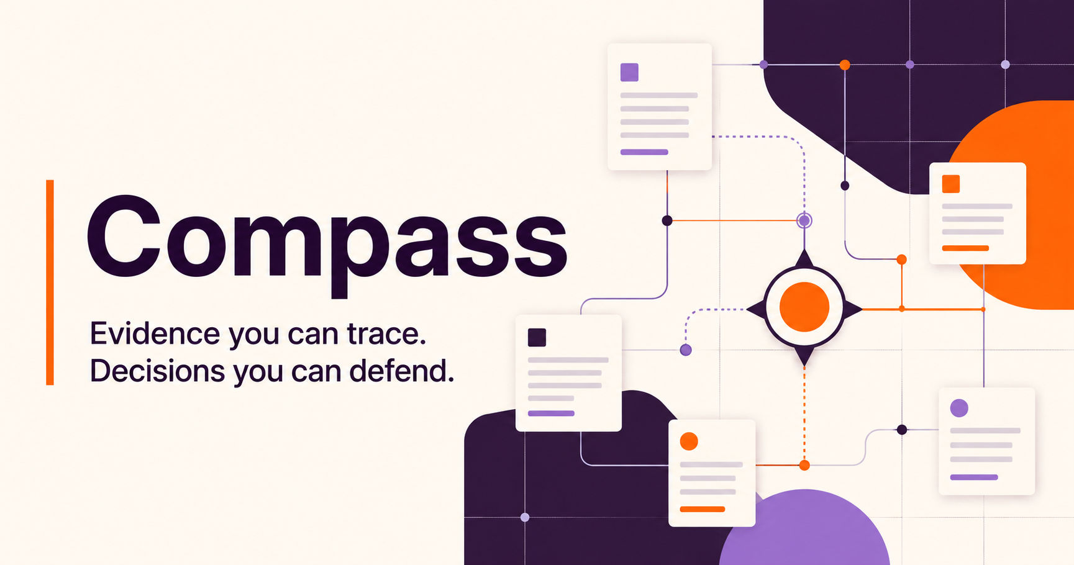
GITLAB FOUNDATION
CASE STUDY SEPT 2026
Jessenia Cintron
Notes:
I started with the assignment you gave me: scope the problem and explain the process. Compass is my proposed approach, not a product I expect you to adopt. After I finished the scope, I made a small demo with invented information to test whether the answer could stay honest when records disagree. The case study stands on its own.
Sources:

Slide 2
THE DECISION PROBLEM
What each system knows
The answer should connect the records without treating them as interchangeable.
Google Drive
GivingData
Airtable
Zoom Chat
Written evidence
Official grant record
Working relationship notes
Team decisions and context
Reports, proposals, memos, and tables
Amounts, payments, and requirements
Contacts, cohorts, and follow-up
Conversation, rationale, and observations
Design consequence
Every answer should show where the information came from, when it was recorded, whether it is final, and who may see it.
02
Notes:
I would first agree with the team on what each system is trusted to answer. GivingData may hold the official grant record. Drive may hold the fuller story. Airtable may capture relationship work, while Zoom explains why a decision changed. Compass should connect those pieces while keeping their original meaning and access rules.
Sources:
https://knowledgebase.givingdata.com/data-structure
https://developers.google.com/workspace/drive/api/guides/about-files
https://support.airtable.com/articles/6292134965-getting-started-with-airtable-s-web-api
https://support.zoom.com/hc/en/article?id=zm_kb&sysparm_article=KB0060329

Slide 3
CONTEXT
What I would learn before designing anything
I need to understand the decisions people make, the information they trust, and what each person may see.
PEOPLE + DECISIONS
INFORMATION
ACCESS
1
What questions keep coming up?
1
How do we match the same grant?
1
Who may see which records?
2
What decision follows the answer?
2
Which system owns each fact?
2
What should never enter search?
3
Who owns the final call?
3
What counts as expected versus achieved?
3
How much Zoom history exists?
4
What could damage trust with a grantee?
4
What changed during the five years?
4
When a source deletes something, how quickly must the copy disappear?
Output: priority questions, clear owners, access rules, and a way to measure time saved
03
Notes:
Before I choose technology, I want to watch how the team actually finds answers and what happens next. I would ask people to show me recent examples, including times when the systems disagreed. That gives us a short list of important questions, a clear owner for each kind of information, access rules, and a starting point for measuring whether the solution helps.
Sources:

Slide 4
OPTIONAL DEMO
I used a small demo to test the idea
The case study does not depend on it. The demo uses invented records and no Foundation information.
What did we decide about reporting for the AI opportunity cohort?
Ask
STRONG SUPPORT, WITH ONE OPEN QUESTION
EVIDENCE COVERAGE
A lighter monthly signal was proposed, but the official record has not changed
Drive
1
A meeting note and draft memo recommend monthly check-ins. GivingData still shows the older requirement, so the answer calls the change proposed and explains what to confirm.
GivingData
1
Airtable
0
Zoom Chat
1
3
3
1
sources linked
systems checked
conflict found
Next check: confirm owner and effective date
OPEN LIVE DEMO
VIEW SOURCE CODE ON GITHUB
Both links are clickable
04
Notes:
Once I finished the scope, I made this small demo to test one question: can the answer show what agrees, what conflicts, and what a person still needs to confirm? Everything in it is invented. I am not presenting it as a finished product or as a decision already made for the team. It simply helped me challenge my own design before presenting it.
Sources:

Slide 5
THE SYSTEM
How a question becomes an answer
The system checks the person and their access before it searches.
01
02
03
04
05
06
Sign in
Check access
Find evidence
Explain
Record review
Test
Confirm the person
+Approved account
Remove records
they cannot open
Search approved
sources only
Plain answer
+Source links
Save feedback
+Review history
Safety checks
+Answer quality
EVERY ANSWER SHOWS
IF RECORDS DISAGREE
IF EVIDENCE IS WEAK
WHO DECIDES
REAL FOUNDATION DATA
Source links
Both versions
No answer
A person
None
A real pilot starts only after the team agrees on access, ownership, and how success will be measured.
05
Notes:
Here is the process in plain language. First, confirm who is asking. Then remove anything that person cannot already open. Search only the remaining information, explain the answer with direct links, save feedback for review, and keep testing whether the system is safe and useful. A real pilot would begin only after the team agrees on ownership, access, and what success means.
Sources:
https://developers.google.com/workspace/drive/api/guides/manage-sharing
https://developers.google.com/workspace/drive/api/guides/manage-changes

Slide 6
TRUST AND PERMISSIONS
How I would protect people and information
The system must never reveal more than the original source already allows.
1
2
3
4
5
Confirm person
Confirm access
Search
Explain
Open source
Approved sign-in
What they may see
Allowed records only
Answer with links
Check access again
WHAT THE DEMO TESTS
REPORTS CAN CONTAIN BAD INSTRUCTIONS
Nine safety checks pass
Treat retrieved text as evidence, not commands
Access, source links, conflicting records, and unsafe instructions.
Keep actions separate, limit what tools can do, and stop when content looks unsafe.
06
Notes:
I would protect access in code, not rely on the AI to remember a rule. The system confirms the person, checks what they may see, and searches only those records. It checks access again when someone opens a source. Reports and chat may also contain text that tries to instruct the AI. The system should treat that text as evidence, never as permission to take an action.
Sources:
https://cheatsheetseries.owasp.org/cheatsheets/LLM_Prompt_Injection_Prevention_Cheat_Sheet.html
https://www.nist.gov/itl/ai-risk-management-framework

Slide 7
RISKS AND EDGE CASES
How the system can fail
A good answer can say that records conflict, information is missing, or the evidence is too weak.
FAILURE
PREVENTION
USER EXPERIENCE
Private information appears
Check access before searching
Stop the answer and alert security
Forecast shown as a result
Label forecast, result, and date
Compare them clearly
Records disagree
Decide which system owns each fact
Show both, with date and owner
Two organizations get merged
Use stable IDs and review uncertain matches
Keep them separate
Zoom history is missing
Check retention and coverage
Show missing dates and channels
There is too little evidence
Require enough support and source links
Say “I do not know”
Confidence should describe the evidence, not how certain the AI sounds.
07
Notes:
I want the system to be honest when it cannot answer. Private information stops the response. A forecast should never look like a result. When records disagree, the user should see both versions and who owns the answer. Missing history should stay visible. If the evidence is too weak, the system should simply say that it does not know.
Sources:

Slide 8
TRADEOFFS
What I would leave out at first
The first version should answer one important team question safely before taking on more.
IN THE CASE STUDY
LEFT OUT AT FIRST
✓
The most important questions and users
×
Connecting to live Foundation systems
✓
Which system owns each fact
×
Real employee sign-in and hosting
✓
Who may see which information
×
Scoring proposals or grants
✓
How answers show gaps and conflicts
×
Changing source records automatically
✓
Pilot steps and success checks
×
Selling a product to other foundations
The demo uses invented information to test assumptions. It does not commit the team to this design.
08
Notes:
The prompt asked me to scope the problem, and that remains the work I am presenting. I would keep the first version narrow. No live connections, automated decisions, or automatic changes to source records. Productizing for other foundations belongs much later, after this team proves that the approach solves a real problem safely.
Sources:

Slide 9
IMPLEMENTATION
How I would move from idea to pilot
Each step begins only after the team agrees that the previous one is sound.
1
2
3
4
LISTEN
AGREE
TEST
DECIDE
TEAM CONFIRMS PRIORITY
ACCESS RULES APPROVED
FICTIONAL TESTS PASS
USERS REVIEW RESULTS
Watch the real work, name the owner, define a good answer
Decide which system owns each fact and what never enters search
Try one small source pair and check sources, gaps, and refusals
Compare accuracy, time saved, and trust. Then continue, revise, or stop
Working with the team
The people closest to the work set the rules. I bring a clear process, build only what we agree to test, and show the evidence.
This adds momentum without replacing the team’s judgment or the work already underway.
09
Notes:
My job would be to make progress with the team, not arrive with a finished answer for them. The people closest to the work define the priority and access rules. I can turn those decisions into a small test, show what worked and what did not, and help the team decide whether to continue, revise, or stop.
Sources:
https://gitlabfoundation.notion.site/Values-313cf60acc3b47c4b1f64e8352ce1707
https://www.gitlabfoundation.org/

